Slide 1




3rd Forward Physics Facility Meeting (FPF3)
25 October 2021
Jonathan Feng, UC Irvine
FPF Logo Credit: Savannah Shively

Slide 2
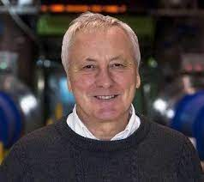
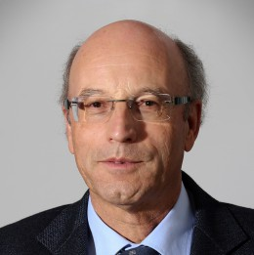

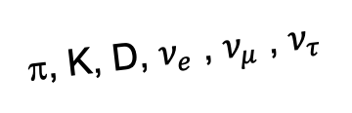
INTRODUCTION
On the 50th anniversary of hadron colliders, many have recounted the missed opportunities from an initial lack of coverage of high p_{T} physics at CERN’s ISR.
  “There was initially a broad belief that physics action would be in the forward directions at a hadron collider…. It is easy to say after the fact, still with regrets, that with an earlier availability of more complete… experiments at the ISR, CERN would not have been left as a spectator during the famous November revolution of 1974 with the J/ψ discoveries at Brookhaven and SLAC.” -- Lyn Evans and Peter Jenni, “Discovery Machines,” CERN Courier (2021).
In a similar (but opposite) way, what opportunities are we currently missing from a lack of coverage of far-forward physics at the LHC?
  By far the largest flux of energetic light particles (mesons, neutrinos, and maybe also dark photons, ALPs, mCPs, DM, …) is in the far-forward direction.
A’, a, mCPs, χ, …
π, K, D, $ν_{e}$ , $ν_{μ}$ , $ν_{τ}$

Slide 3
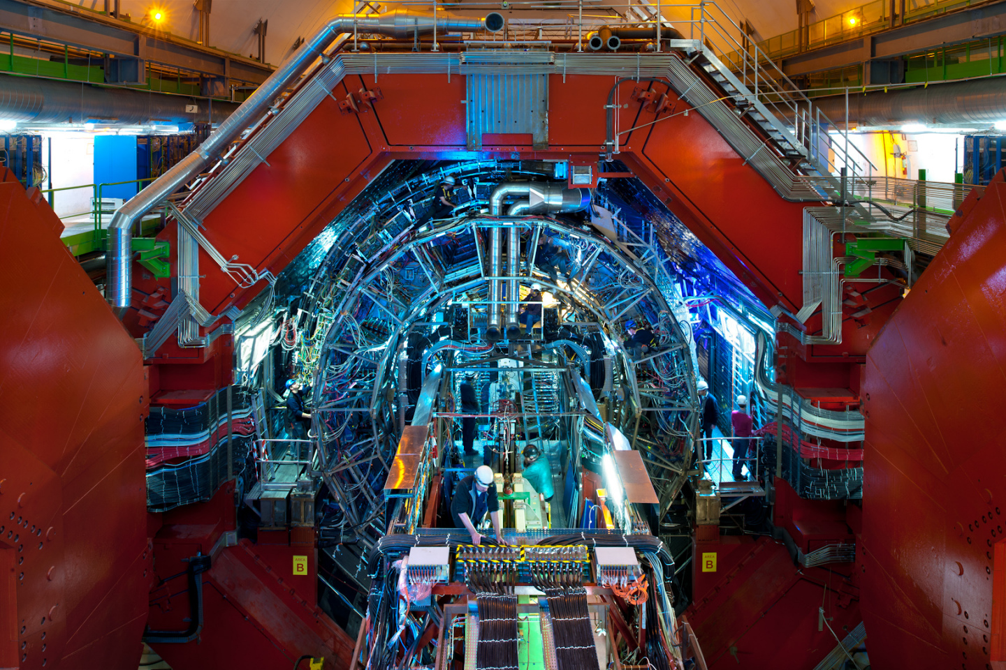
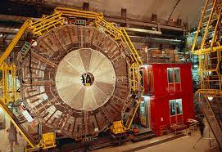
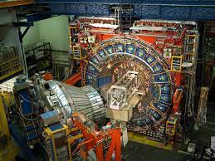
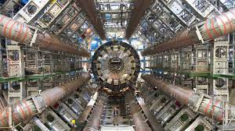
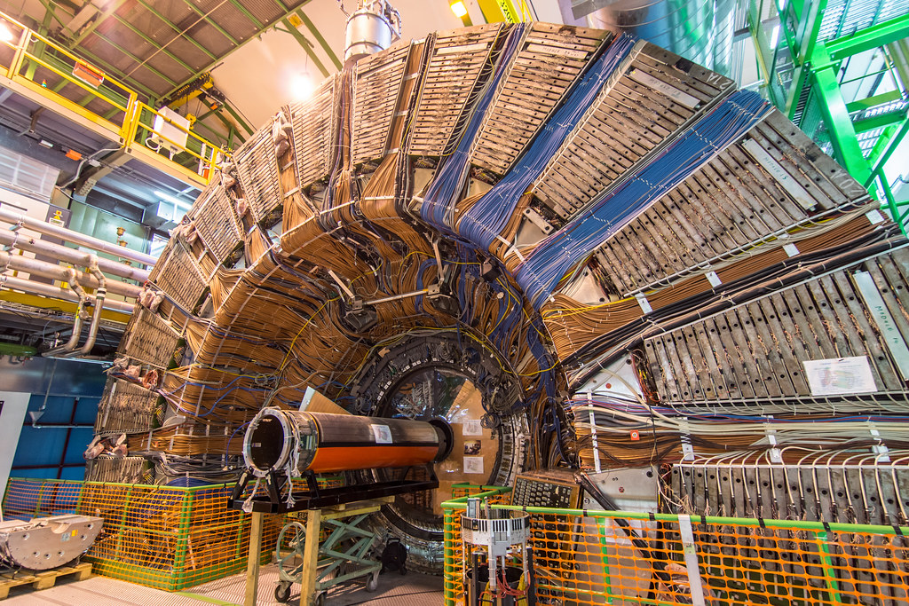
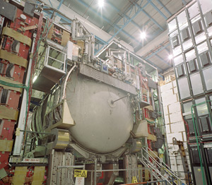
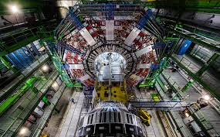
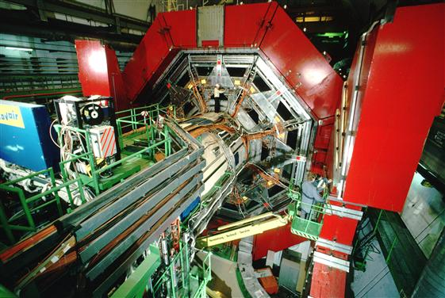

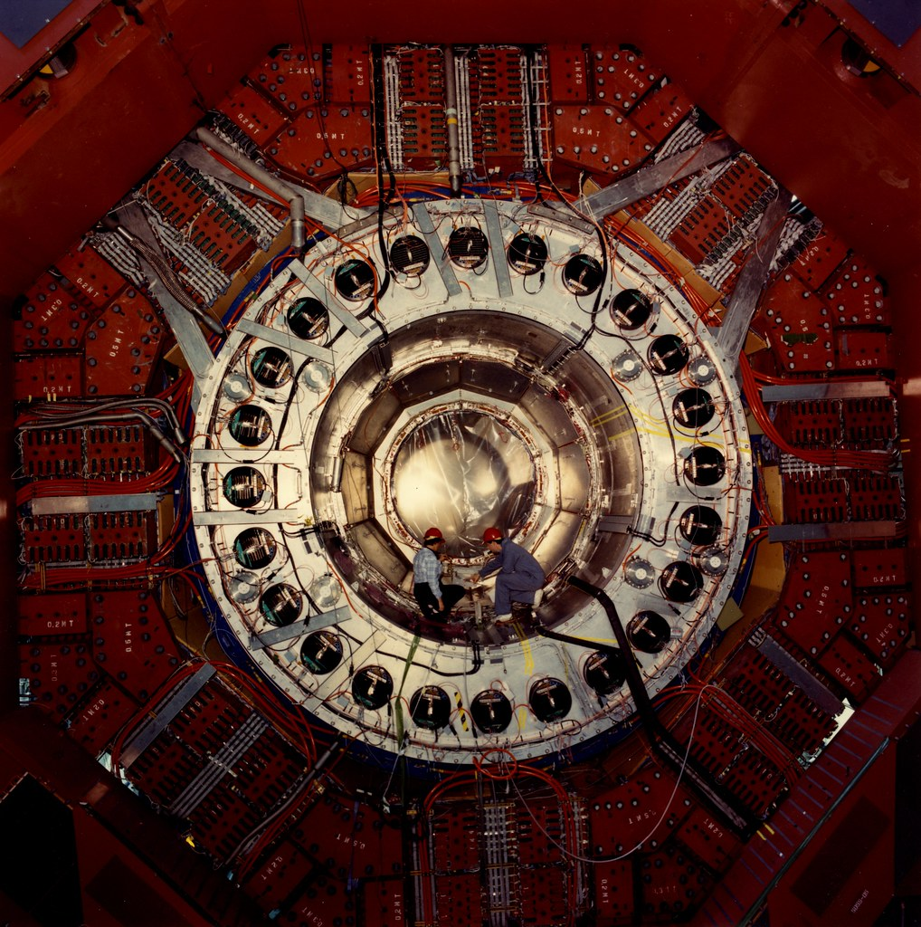
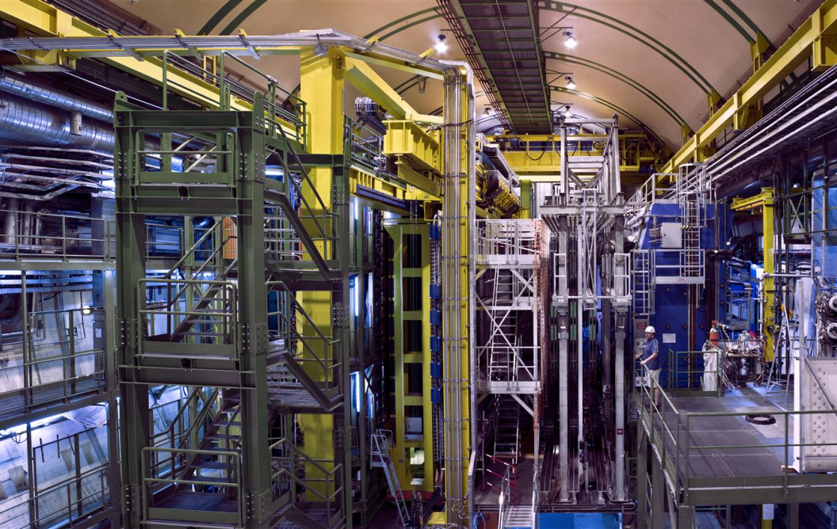
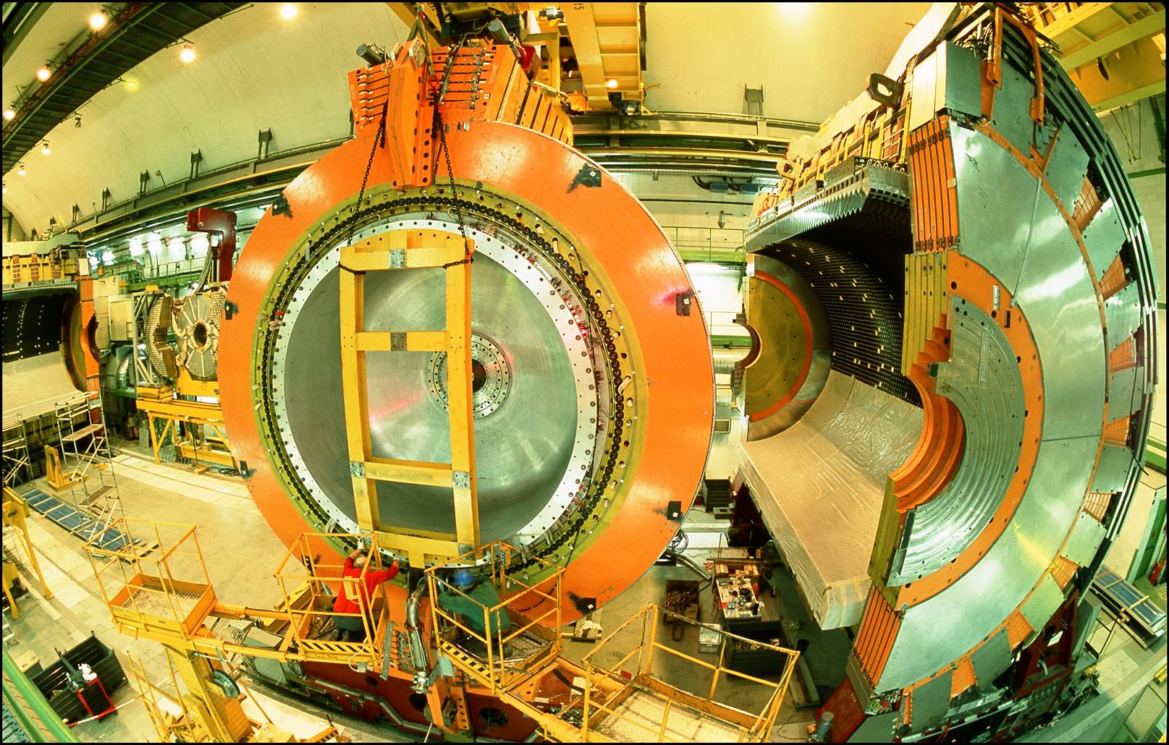
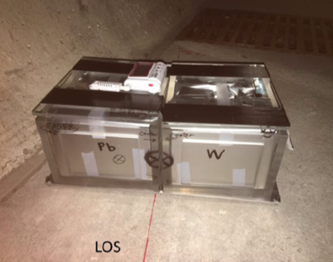
AN EXAMPLE: COLLIDER NEUTRINOS
…
ALICE
ALEPH
CDF
FASERν Pilot Detector
Suitcase-size, 4 weeks
$0 (recycled parts)
6 neutrino candidates
ATLAS
DELPHI
D0
CMS
L3
LHCb
SLD
OPAL
2105.06197
All previous
collider detectors
Building-size, decades
~$10⁹
0 neutrino candidates

Slide 4
AN EXAMPLE: COLLIDER NEUTRINOS
…
ALICE
ALEPH
CDF
FASERν Pilot Detector
Suitcase-size, 4 weeks
$0 (recycled parts)
6 neutrino candidates
ATLAS
DELPHI
D0
CMS
L3
LHCb
SLD
OPAL
2105.06197
All previous
collider detectors
Building-size, decades
~$10⁹
0 neutrino candidates
Not the 5σ discovery of collider neutrinos, but a sign of the latent potential of far-forward physics

Slide 5
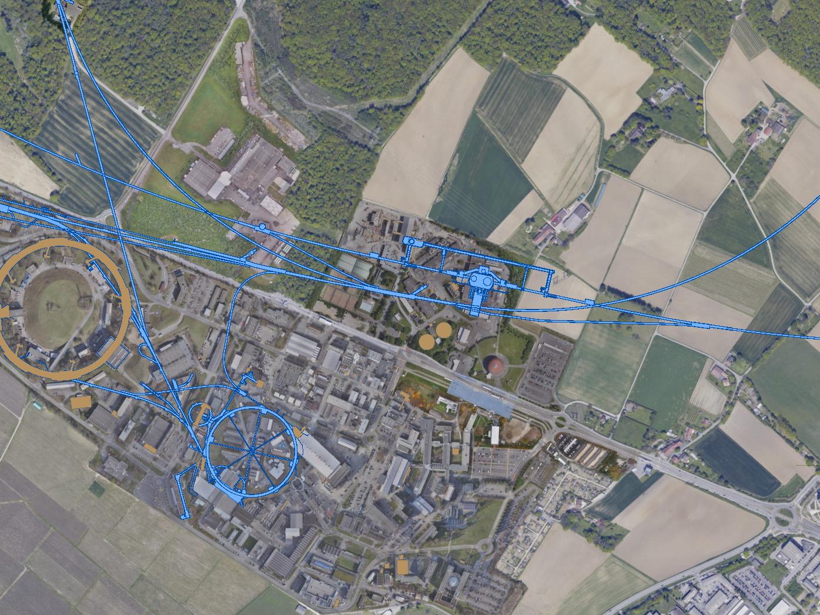
FAR FORWARD EXPERIMENTS AT LHC RUN 3
There are currently 3 detectors underway to exploit this potential in the upcoming LHC Run 3.
UJ18
ATLAS
SPS
SND@LHC: approved March 2021
UJ12
LHC
FASER: approved March 2019
LOS
FASERν: approved December 2019
CERN GIS

Slide 6
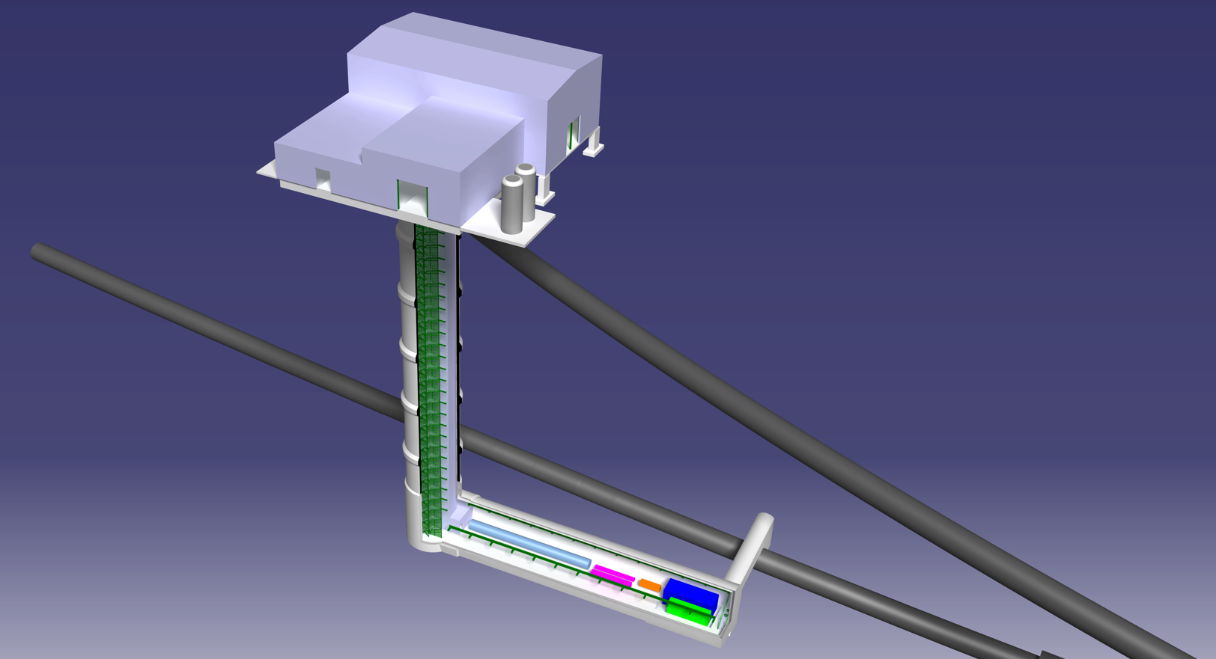
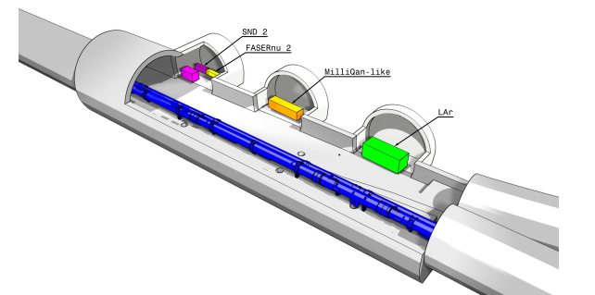
FORWARD PHYSICS FACILITY FOR HL-LHC
The FPF is proposed to extend this program into the HL-LHC era.
The goal of this meeting is to further our understanding of the FPF’s physics potential and the facility and experiments (FASER2, FASERν2, Advanced SND, FORMOSA, FLArE, …) required to realize this potential.
UJ18
ATLAS
SPS
UJ12
LHC
LOS
See talk of Kincso
Balazs at FPF2
CERN GIS

Slide 7
WELCOME
So, on behalf of my co-organizers, Maria Vittoria Garzelli and Felix Kling, welcome!
This meeting is the 3rd in the series:
  FPF Kickoff Meeting, 9-10 Nov 2020, https://indico.cern.ch/event/955956
  FPF2 Meeting, 27-28 May 2021, https://indico.cern.ch/event/1022352
  FPF3 Meeting, 25-26 Oct 2021, https://indico.cern.ch/event/1076733
These meetings take place within the framework of, and with the support of, two important community studies.
  Snowmass 2021: https://snowmass21.org
  Physics Beyond Colliders: https://pbc.web.cern.ch
Since FPF2, we have completed “The Forward Physics Facility: Sites, Experiments, and Physics Potential” (2109.10905), a significant effort by ~80 authors distilling key progress on the FPF so far.
This meeting kicks off preparation for the FPF White Paper, a ~200 page document to be submitted to Snowmass in February-March 2022.

Slide 8
STRUCTURE OF THE PROGRAM
Day 1
  Facilities and related topics
  Talks on FASER2, FORMOSA, FLArE
  Snowmass update and physics potential
  Parallel sessions: talks on Advanced SND and FASERν2 and on QCD, Neutrinos, and Dark Sectors
Day 2
  QCD and forward hadron production
  Panel on FPF and event generators for cosmic ray physics
  Neutrino interactions
  Panel on neutrino event generators
  Next steps and the Snowmass White Paper

Slide 9
NOTES ON THE PROGRAM
Zoom links have been sent to registrants and are also now posted on the indico site. Note the different links for the QCD and Neutrino parallel sessions (the Dark Sectors parallel link = the plenary link).
In each session, ~20-30 minutes are reserved for discussion, or the session is a panel discussion. Following the successful examples of FPF1 and FPF2, these are led by chairs/moderators/provocateurs and we hope for open and free-flowing discussions. This meeting is not recorded.
Speakers and chairs: please stay on time; there is no buffer between sessions.
At the end of Day 2, we will discuss future meetings (FPF4) and the organization of the Snowmass White Paper. We look forward to your advice and contributions.

