Slide 1



THEORETICAL INTRODUCTION TO
POSSIBLE INTERPRETATIONS
Shedding Light on X17
Centro Ricerche Enrico Fermi, Rome
Jonathan Feng, UC Irvine
7 September 2021

Slide 2
OUTLINE
Could this be new physics?
Essential features of the signal
Explanations that don’t work
  Scalars, dark photons
Possible solutions
  vectors, axial vectors, pseudoscalars
The protophobic gauge boson
Paths toward a resolution
  Implications for future experiments

Slide 3
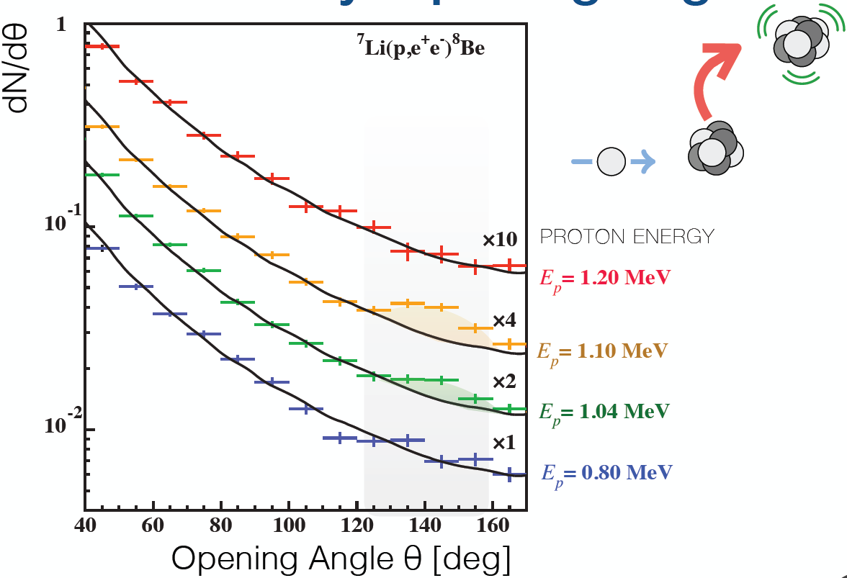
COULD THIS BE NEW PHYSICS?
The ATOMKI ⁸Be and ⁴He results are the most interesting anomalies to appear in the last several years.
Key considerations for a BSM theorist
  6.8σ statistical significance – not likely to disappear with more data
  It’s a bump, not a general excess
  Rises and falls as one goes through resonance
  Fit improves drastically with the introduction of a new particle
  No compelling SM explanation
  No experimental problem identified
  ⁸Be and ⁴He support each other
Zhang, Miller (2017); Viviani et al. (2021)
Krasznahorkay et al. (2015)
And last, in general terms, it fits beautifully with current ideas for BSM physics and cosmology that motivate weakly interacting, light particles.

Slide 4
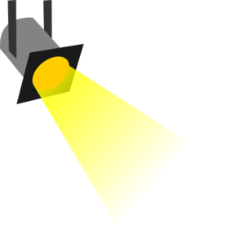
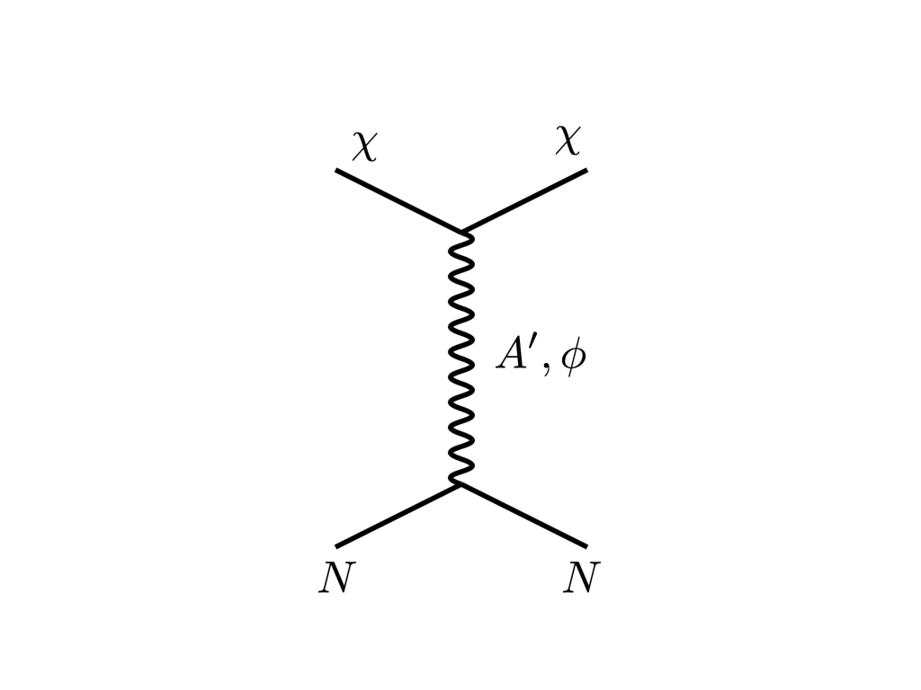






THE NEW PARTICLE LANDSCAPE
Particle
Colliders
Mass
MeV
GeV
TeV
1
Already
Discovered
Strongly Interacting
Heavy Particles
Too Little to be
Dark Matter
$$e$$
DM
$$ε$$
$$A’$$
$$ε$$
Interaction Strength
Just Right to
be Dark Matter
10⁻³
DM
$$e$$
<$σv$> ~ $\frac{ε^{2}}{m_{A′}^{2}}$
Weakly Interacting
Light Particles
Impossible to
Discover
10⁻⁶
Too Much to be
Dark Matter
Boehm, Fayet (2003)
Pospelov, Ritz, Voloshin (2007)
Feng, Kumar (2008)

Slide 5







REFERENCES
These motivations have led to many works on BSM interpretations. My viewpoint has been informed by these works and collaborators:
  Protophobic Fifth-Force Interpretation of the Observed Anomaly in ⁸Be Nuclear Transitions, J.L. Feng, B. Fornal, I. Galon, S. Gardner, J. Smolinsky, T. Tait, F. Tanedo, 1604.07411, Phys. Rev. Lett. 117, 071803 (2016)
  Particle Physics Models for the 17 MeV Anomaly in Beryllium Nuclear Decays, J.L. Feng, B. Fornal, I. Galon, S. Gardner, J. Smolinsky, T. Tait, F. Tanedo, 1608.03591, Phys. Rev. D 95, 035017 (2017)
  Dynamical Evidence for a Fifth Force Explanation of the ATOMKI Nuclear Anomalies, J.L. Feng, T. Tait, C. Verhaaren, 2006.01151, Phys. Rev. D 102, 036016 (2020)
Bart
Fornal
Iftah
Galon
Susan
Gardner
Jordan
Smolinsky
Tim
Tait
Flip
Tanedo
Chris
Verhaaren

Slide 6
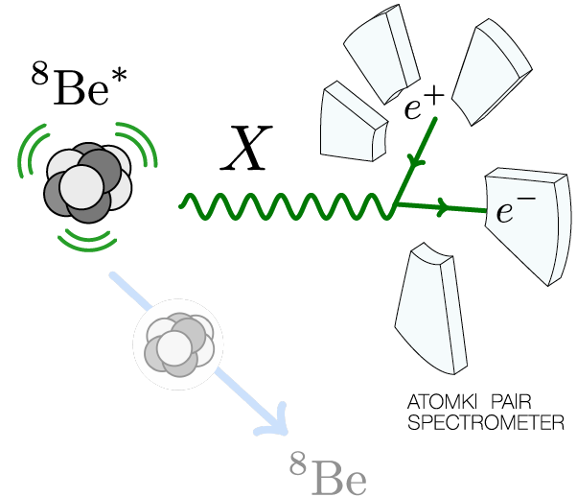
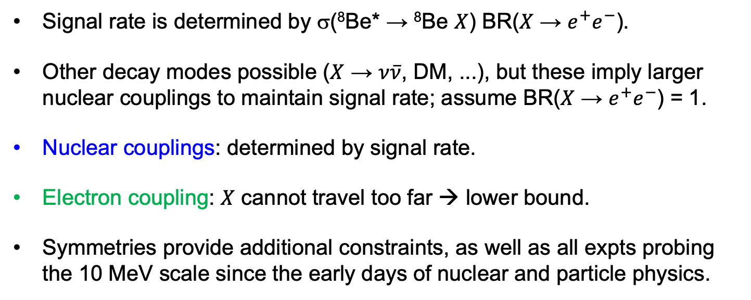
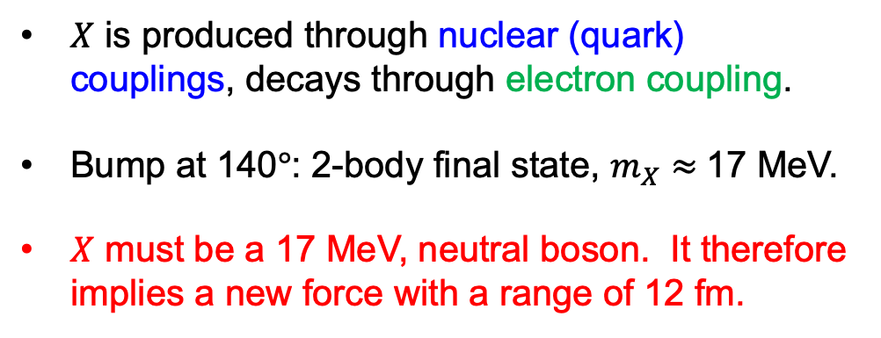
ESSENTIAL FEATURES OF THE SIGNAL
$X$ is produced through nuclear (quark) couplings, decays through electron coupling.
Bump at 140$°$: 2-body final state, $m_{X}≈$17 MeV.
$X$ must be a 17 MeV, neutral boson. It therefore implies a new force with a range of 12 fm.
Signal rate is determined by σ(⁸Be* → ⁸Be $X$) BR($X$ → $e^{+}e^{−}$).
Other decay modes possible ($X$ → $ν\overline{ν}$, DM, ...), but these imply larger nuclear couplings to maintain signal rate; assume BR($X$ → $e^{+}e^{−}$) = 1.
Nuclear couplings: determined by signal rate.
Electron coupling: $X$ cannot travel too far → lower bound.
Symmetries provide additional constraints, as well as all expts probing the 10 MeV scale since the early days of nuclear and particle physics.

Slide 7
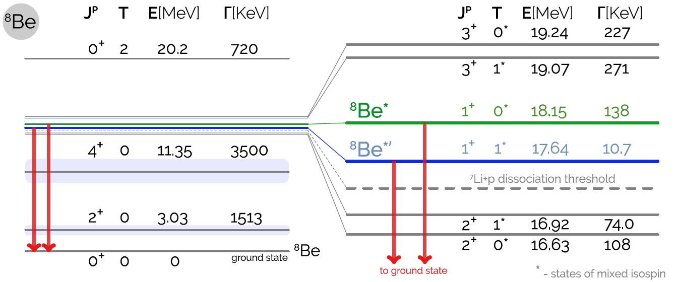
EXPLANATIONS THAT DON’T WORK: SCALARS
Can X be a spin-0 boson (dark Higgs boson) with J^{P} = 0⁺ ?
The decay would then have J^{P} assignments: 1⁺ → 0⁺ 0⁺.
L Conservation: L = 1, Parity Conservation: P = (-1)^{L} = 1, so this is forbidden in parity-conserving theories.
A scalar is not a viable explanation of the ⁸Be results.
Feng et al. (2016)
1608.03591; based on Tilley et al. (2004), http://www.nndc.bnl.gov/nudat2, Wiringa et al. (2013)

Slide 8
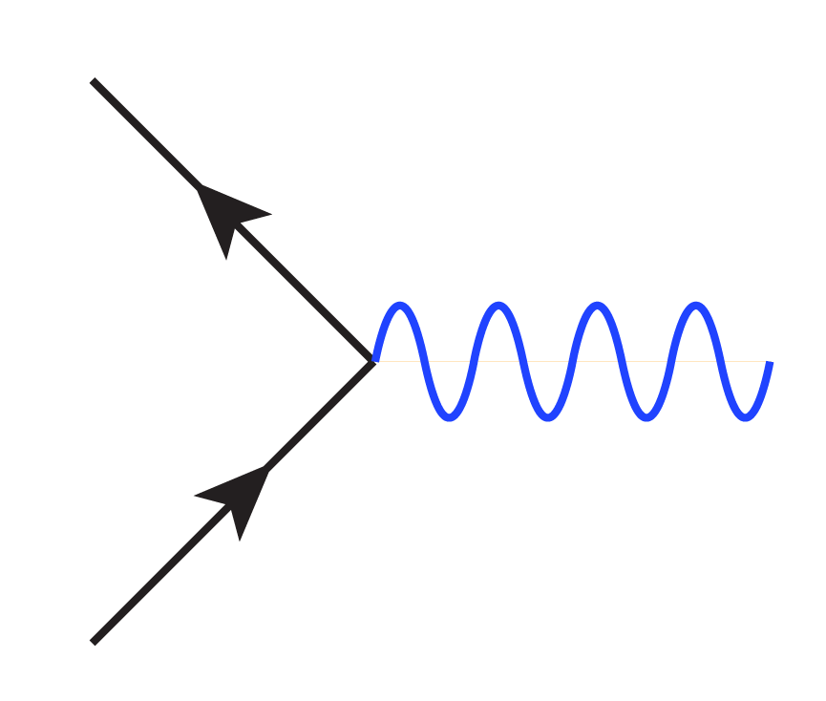
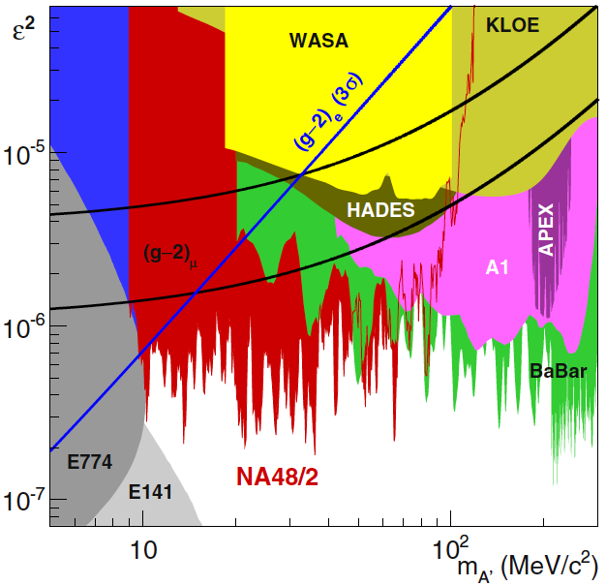
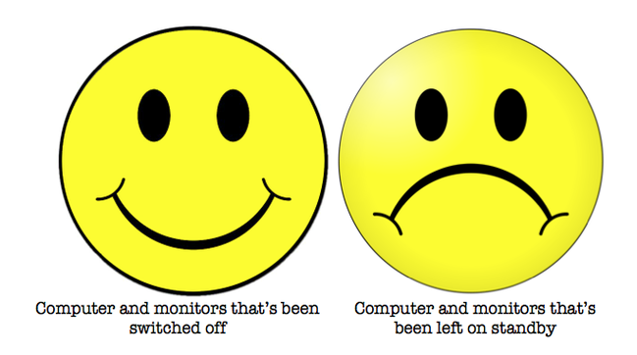



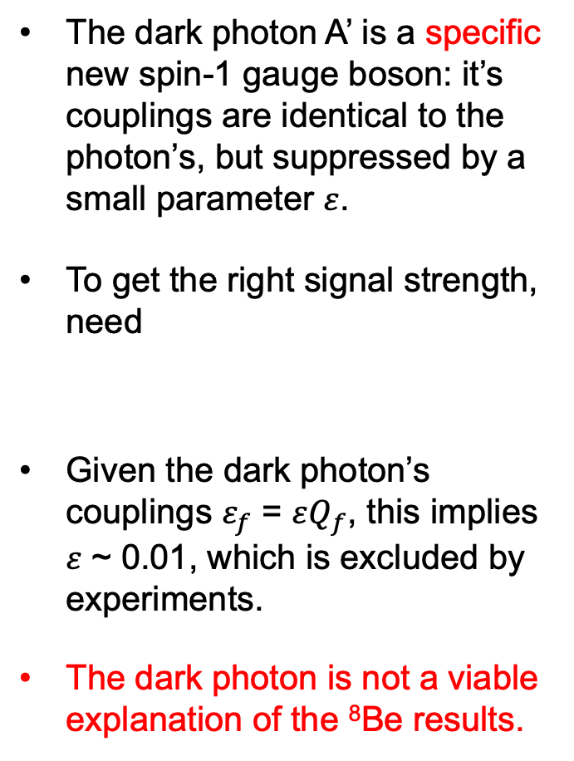





EXPL. THAT DON’T WORK: DARK PHOTONS
The dark photon A’ is a specific new spin-1 gauge boson: it’s couplings are identical to the photon’s, but suppressed by a small parameter $ε$.
To get the right signal strength, need
Given the dark photon’s couplings $ε_{f}$ = $εQ_{f}$, this implies $ε$ ~ 0.01, which is excluded by experiments.
The dark photon is not a viable explanation of the ⁸Be results.
$$f$$
$$f$$
$$Q_{f}$$
$$εQ_{f}$$
  $$γ$$
  A’
$$\overline{f}$$
$$\overline{f}$$
Feng et al. (2016)

Slide 9
POSSIBLE SOLUTIONS
One must then turn to other possible candidates.
Vectors (spin-1 gauge bosons) that are not dark photons
  Feng, Fornal, Galon, Gardner, Smolinsky, Tait, Tanedo (1604.07411, 1608.03591); Gu, He (1606.05171); Jia, Li (1608.05443); Chen, Lin, Lin, Xu (1609.07198); Kitahara, Yamamoto (1609.01605); Delle Rose, Khalil, Moretti (1704.03436); …
Axial vectors
  Kahn, Krjaic, Mishra-Sharma, Tait (1609.09072); Kozaczuk, Morrissey, Stroberg (1612.01525); …
Pseudo-scalars
  Ellwanger, Moretti (1609.01669); Alves, Weiner (1710.03764); …
…and others. See the talks of Delle Rose, Tait, Zhang, Alves, and Wong at this meeting, and also the review of Fornal (1707.09749).

Slide 10
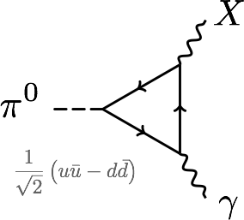
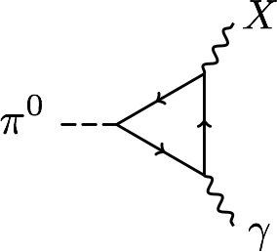





PROTOPHOBIA
Among the dominant constraints on 17 MeV particles are null results from searches for exotic pion decays π⁰ → X γ → e⁺ e⁻ γ.
This is eliminated if $Q_{u}X_{u}$– $Q_{d}X_{d}$ ≈ 0 or 2$X_{u}$+${ X}_{d}$≈ 0 or $X_{p}$ ≈ 0.
A protophobic gauge boson with couplings to neutrons, but suppressed couplings to protons, can explain the ⁸Be signal without violating other constraints.
$$X_{f}$$
$$X_{f}$$
u, d
p, n
$$Q_{f}$$
$$Q_{f}$$

Slide 11
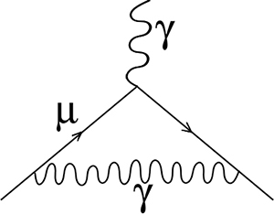
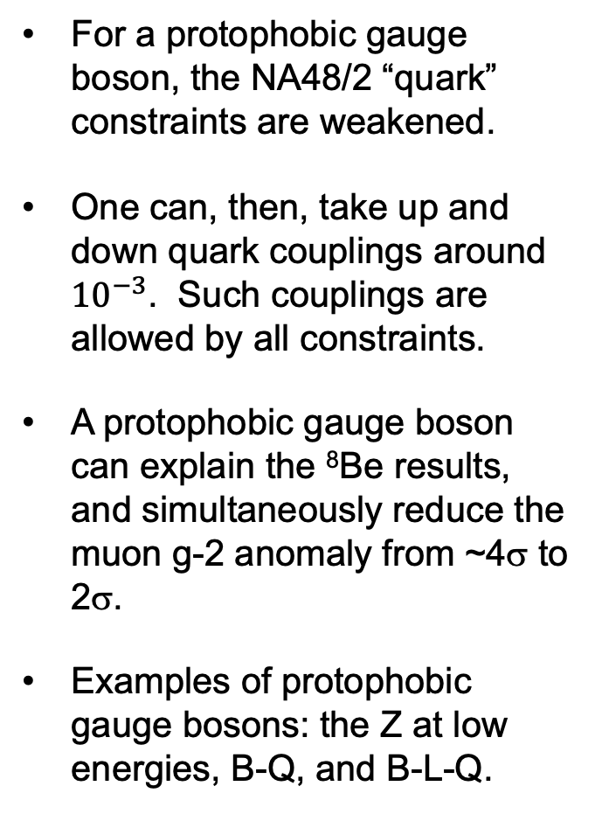
PROTOPHOBIC GAUGE BOSON
For a protophobic gauge boson, the NA48/2 “quark” constraints are weakened.
One can, then, take up and down quark couplings around ${10}^{−3}$. Such couplings are allowed by all constraints.
A protophobic gauge boson can explain the ⁸Be results, and simultaneously reduce the muon g-2 anomaly from ~4σ to 2σ.
Examples of protophobic gauge bosons: the Z at low energies, B-Q, and B-L-Q.
γ, X

Slide 12
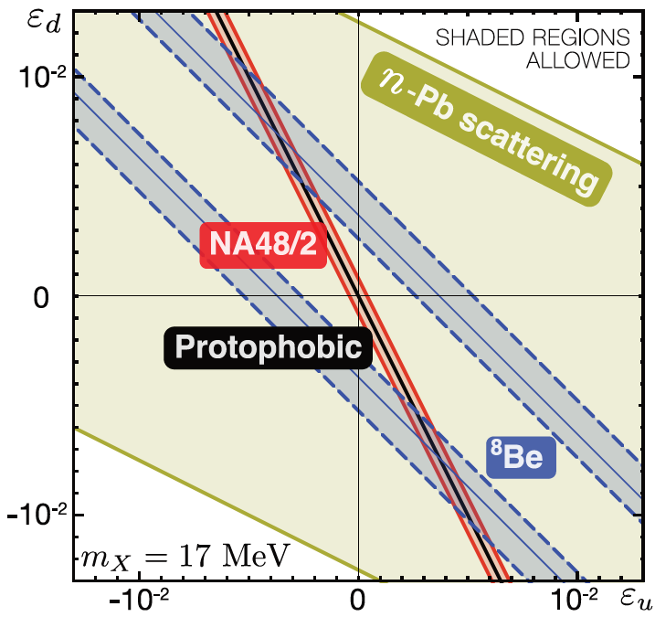
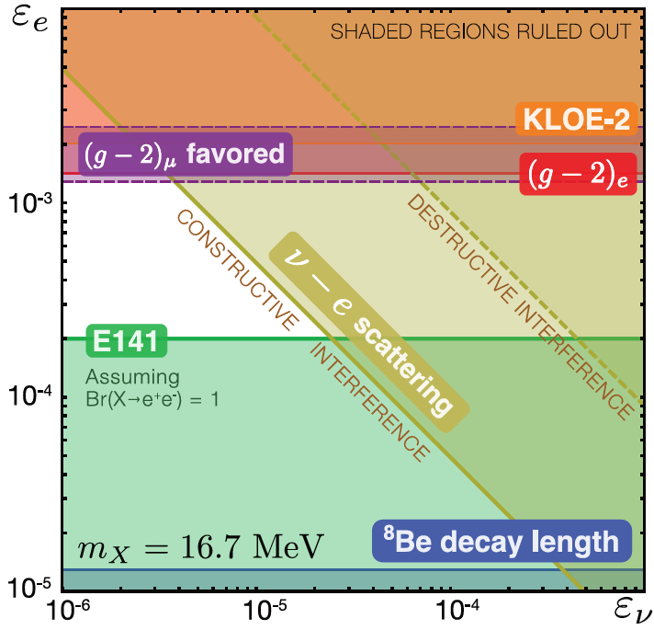

COUPLING CONSTRAINTS
Considering all constraints, the ⁸Be results can be explained with
  $ε_{u}$, $ε_{d}$ ~ few ${10}^{−3}$ with ~10% cancelation for protophobia (exact protophobia not needed).
  ${10}^{−5}$ < $ε_{e}$ from requiring X decay length < 1 cm. Other experiments require ${10}^{−4}$ $<$ $ε_{e}$ < ${10}^{−3}$, although the ${10}^{−4}$ $<$ $ε_{e}$ bound is very sensitive to $m_{X}$.
Feng, Fornal, Galon, Gardner, Smolinsky, Tait, Tanedo (2016)

Slide 13
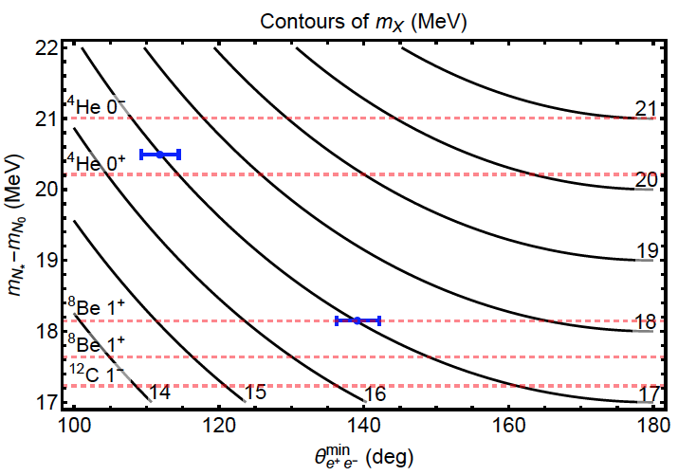
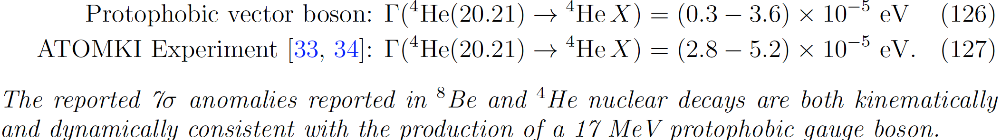
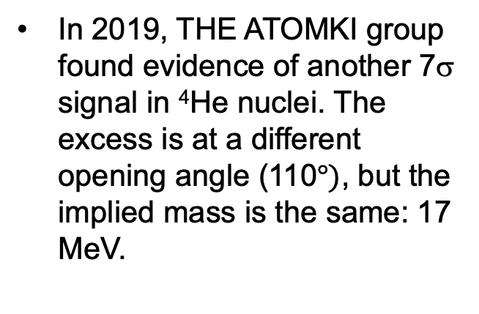
CONSISTENCY WITH THE ⁴HE ATOMKI RESULTS
In 2019, THE ATOMKI group found evidence of another 7σ signal in ⁴He nuclei. The excess is at a different opening angle (110$°)$, but the implied mass is the same: 17 MeV.
Feng, Tait, Verhaaren (2020)
In 2020, Tait, Verhaaren, and I showed that, for the protophobic gauge boson, the required couplings are also similar:
The ⁴He rate, as well as the kinematics, therefore supports the protophobic gauge boson; this is highly non-trivial and is not the case for other candidates. (But see upcoming talks.)

Slide 14

PATHS TOWARD A RESOLUTION
When the protophobic explanation was announced in April 2016, it and the ATOMKI anomaly itself elicited a large range of reactions.
The most interesting to me was from James Bjorken: “All this is to say that our scenario is a longshot, but it need not be demoted further by theoretical arguments.”
His point: what is needed is further experimental data. What are the other implications? How can it be tested?

Slide 15
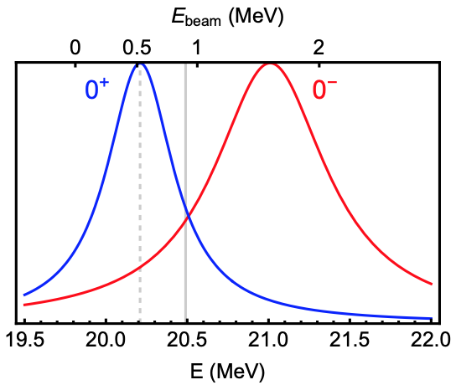
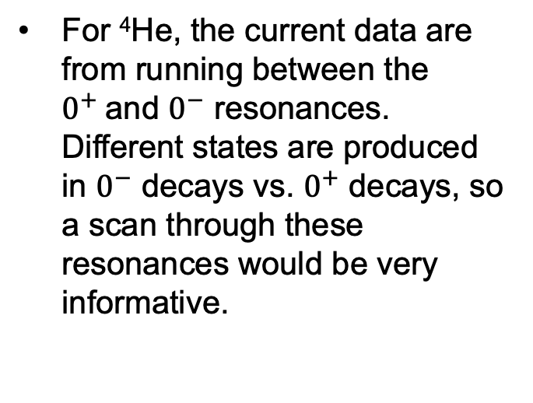
NUCLEAR EXPERIMENTS
Clearly it would be good for other groups to examine the decays of ⁸Be* (18.15) and ⁴He (20.49).
⁸Be*’ (17.64) decay to X17 is also generically present (although phase space suppressed). Given identical J^{P} and isospin mixing, this is typically there, although suppressed.
For ⁴He, the current data are from running between the $0^{+}$and $0^{−}$ resonances. Different states are produced in $0^{−}$ decays vs. $0^{+}$ decays, so a scan through these resonances would be very informative.
The decays of the J^{P} = 1⁻ state ¹²C (17.23) also help discriminate. For X17:

Slide 16
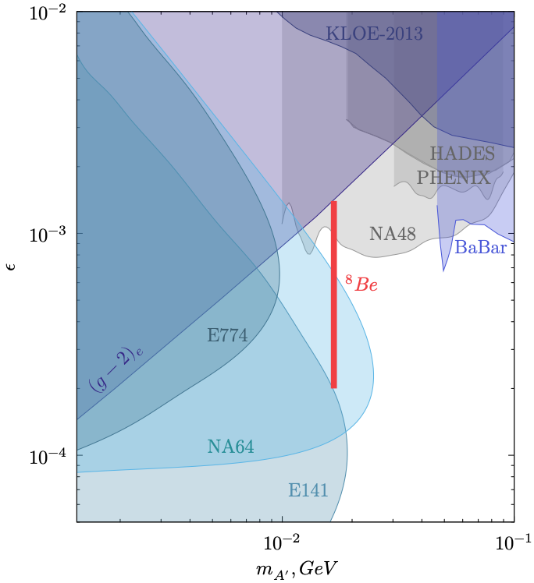

PARTICLE EXPERIMENTS
Particle experiments can test the ATOMKI anomalies by exploiting the fact that the new 17 MeV particle must couple to electrons and positrons.
In the next few years, NA64 and FASER will be able to discover or exclude an X(17) particle for the remaining electron couplings in the range$ε$ ~ ${10}^{−5}−{10}^{−3}$.
Also prospects for PADME, many other LLP experiments.
NA64 @ CERN, Current bounds
FASER @ CERN, Projected Sensitivity
1811.12522
⁸Be
1912.11389

Slide 17
SUMMARY
The ⁸Be results have been tantalizing for 6 years now, and are now supplemented by ⁴He results.
New physics explanations require a new weakly-interacting, light particle, with connections to beautiful ideas in particle physics, cosmology, and dark matter.
There are many interesting explanations, and these strongly motivate a diverse set of nuclear and particle experiments.

