Slide 1




AND THE
FORWARD PHYSICS FACILITY
Quarks 2021, XXI International Seminar on High-Energy Physics
8 June 2021
Jonathan Feng, UC Irvine

Slide 2
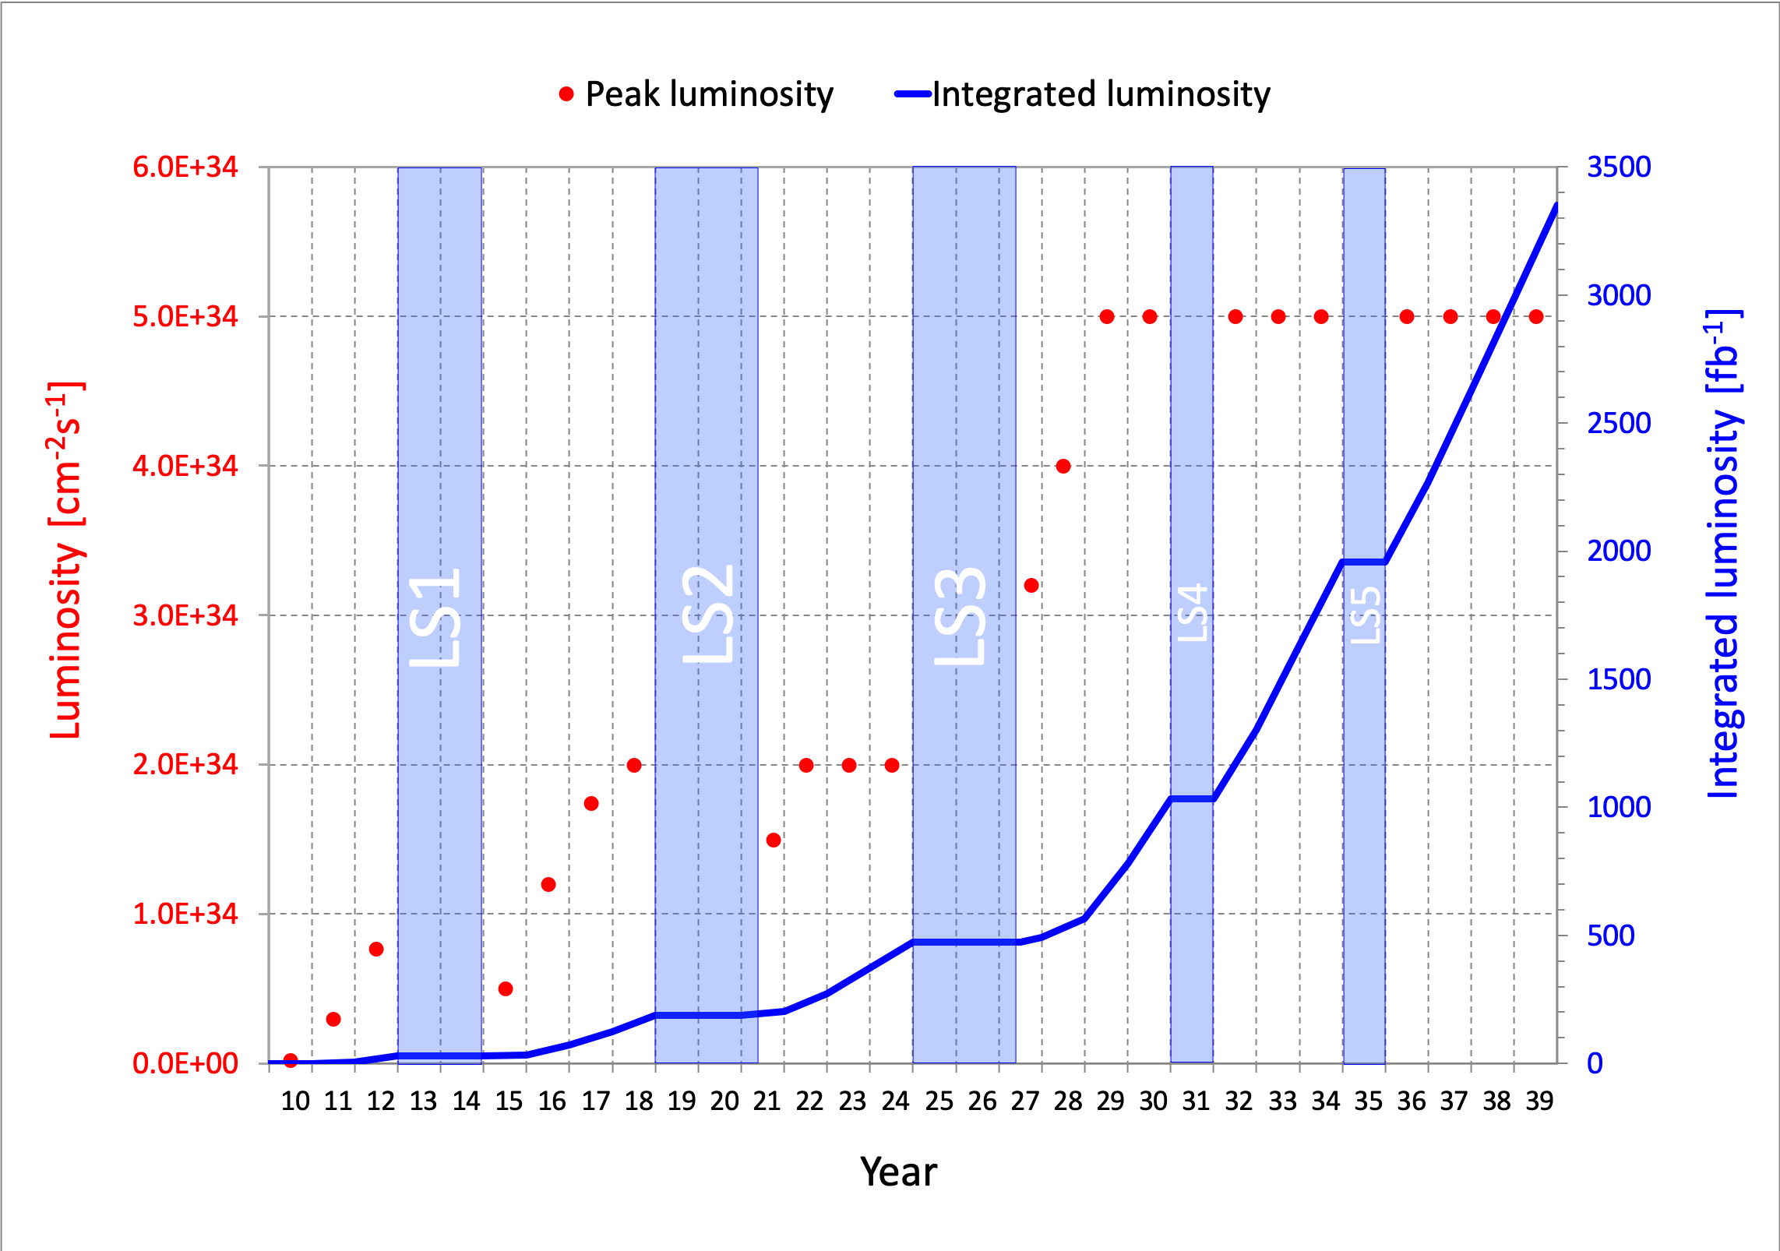
FUTURE OF PARTICLE PHYSICS
A fact that should be better appreciated: we are in a critical period.
In the next year or two, we will either make plans to exploit new opportunities at the HL-LHC, or lose them until 2045, 2060, 2075, …, long after many of us are (professionally) dead.
What should we do now? One answer: explore a rich BSM and SM physics program in the far forward region that greatly expands the LHC physics potential with relatively little additional investment.

Slide 3
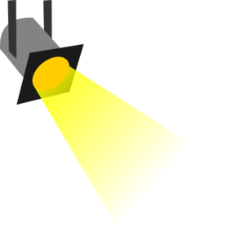
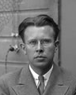
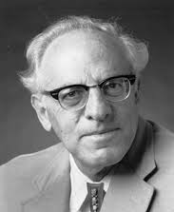
THE NEW PARTICLE LANDSCAPE
Particle
Colliders
Mass
MeV
GeV
TeV
1
Already
Discovered
Strongly Interacting
Heavy Particles
Interaction Strength
New Targets of Small Experiments
Traditional Targets
of Big Science
10⁻³
Weakly Interacting
Light Particles
Impossible to
Discover
10⁻⁶

Slide 4
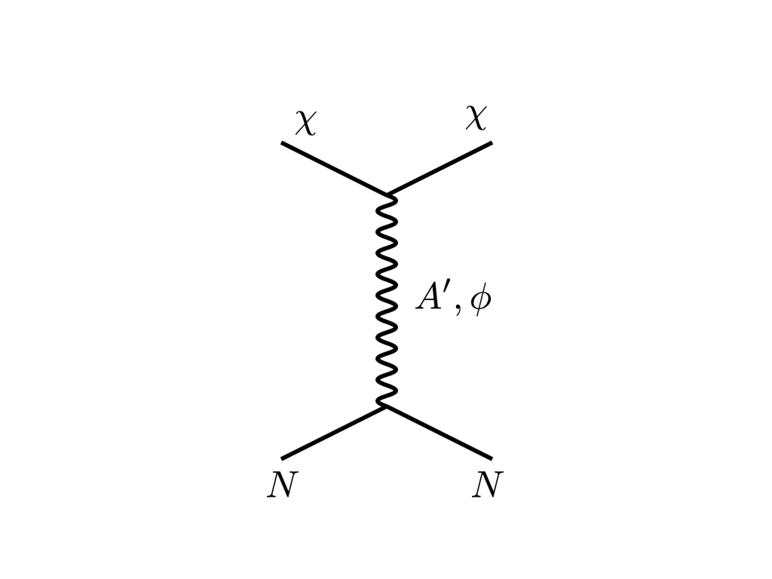





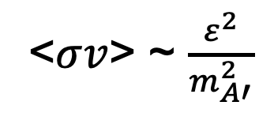
THE THERMAL RELIC LANDSCAPE
Particle
Colliders
Mass
MeV
GeV
TeV
1
Already
Discovered
Strongly Interacting
Heavy Particles
Too Little to be
Dark Matter
$$e$$
DM
$$ε$$
$$A’$$
$$ε$$
Interaction Strength
Just Right to
be Dark Matter
10⁻³
DM
$$e$$
<$σv$> ~ $\frac{ε^{2}}{m_{A′}^{2}}$
Weakly Interacting
Light Particles
Impossible to
Discover
10⁻⁶
Too Much to be
Dark Matter

Slide 5

SEARCHES FOR NEW LIGHT PARTICLES
If new particles are light and weakly interacting, existing LHC detectors are perfectly designed NOT to see them.
Existing detectors are designed to find new heavy particles. These particles are produced almost at rest and decay isotropically.
But new light particles are mainly produced in the decays of light particles: π, η, K, D and B mesons. These are mainly produced along the beamline, and so the new particles disappear through the holes that let the beams in.
Clearly we need a detector to exploit the “wasted” σ_{inel} ~ 100 mb and cover these “blind spots” in the forward region. If we go far enough away, the proton beams are bent by magnets (it’s a circular collider!), whereas the new light particles will go straight.

Slide 6
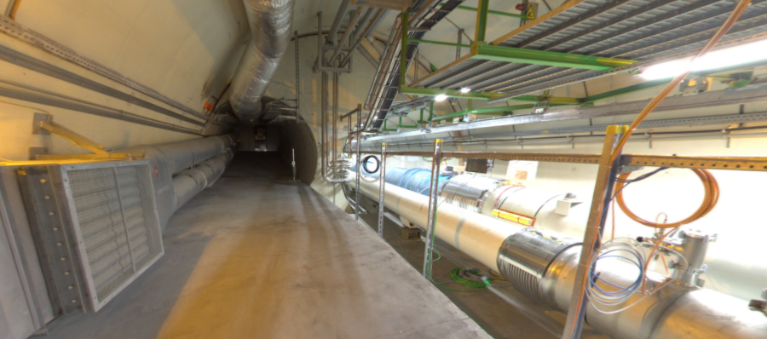
LOCATION, LOCATION, LOCATION
Beam collision axis passes
through 100 m of rock, emerges in tunnel TI12, 480 m from ATLAS
UJ12
TI12 near UJ12
The view in UJ12 looking west (2019)
TI12
Beam collision axis
LHC beamline

Slide 7
FASER TIMELINE
September 2017: Proposed by Feng, Galon, Kling, Trojanowski.
July 2018: Submitted LOI to CERN LHCC
October 2018: Approval from ATLAS SCT and LHCb Collaborations for use of spare detector modules
November 2018: Submitted Technical Proposal to LHCC
November 2018 – January 2019: Experiment funded by grants from the Heising-Simons and Simons Foundations
March 2019: FASER fully approved by CERN along with host lab costs
December 2019: FASERν fully approved by CERN along with host lab costs
March 2021: FASER fully installed, commissioning of the detector begins
April 2021: FASERν announces first collider neutrino candidates
Early 2022: FASER and FASERν begin collecting data in Run 3

Slide 8
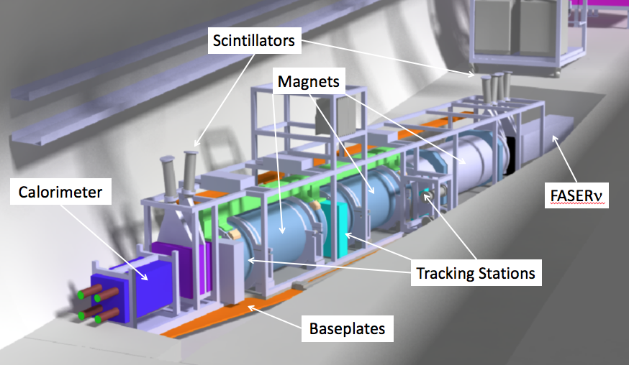
THE SIGNAL
Nothing incoming and 2 ~TeV, opposite-sign charged tracks pointing back to the ATLAS IP: a “light shining through (100 m-thick) wall” experiment.
Scintillators veto incoming charged tracks (muons), and permanent dipole magnets split the charged tracks, which are detected by 3 tracking stations and a calorimeter.
LLP
ν
e⁺
e⁻

Slide 9
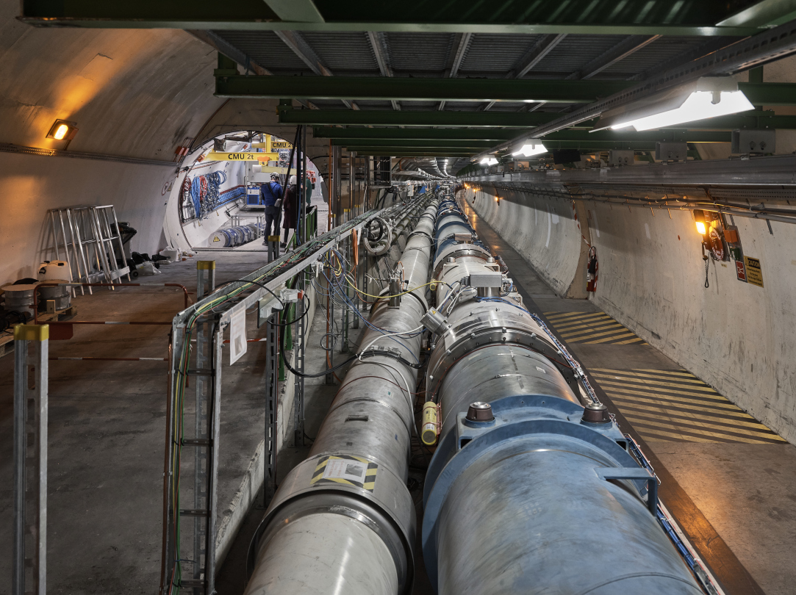
FASER INSTALLATION COMPLETED

Slide 10
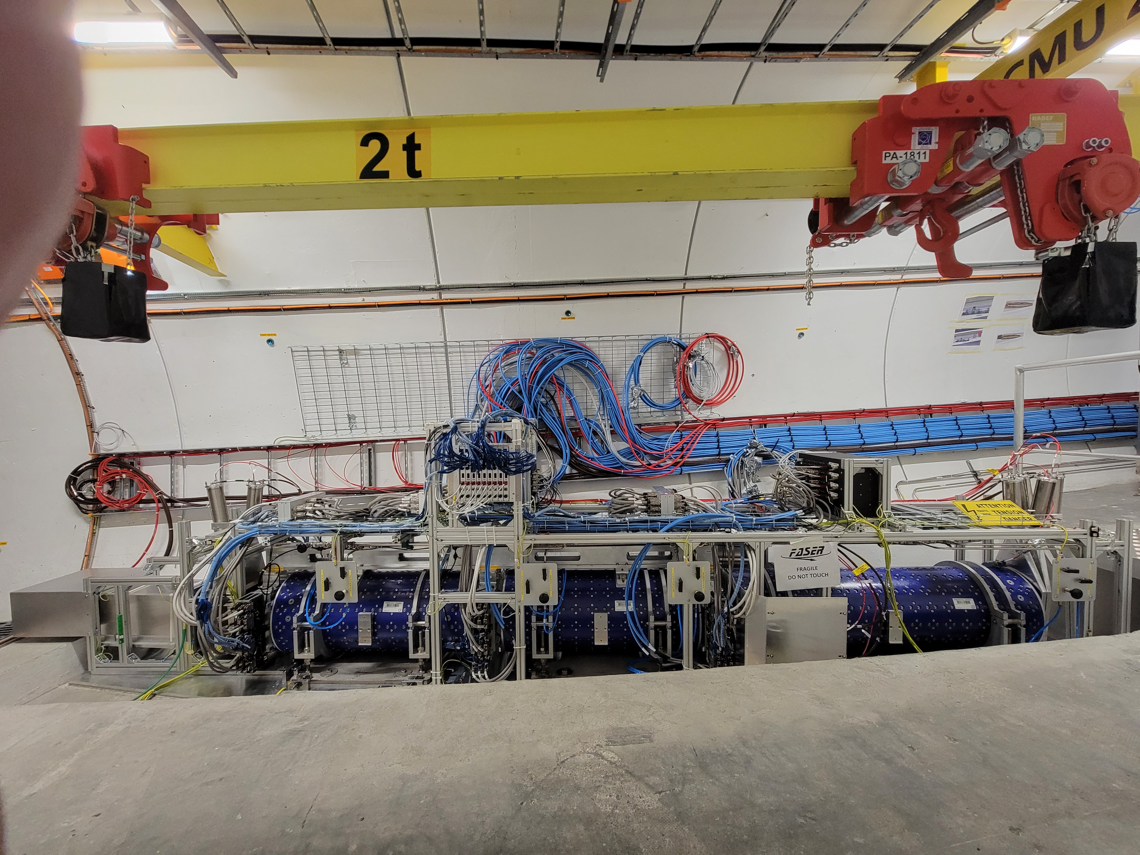
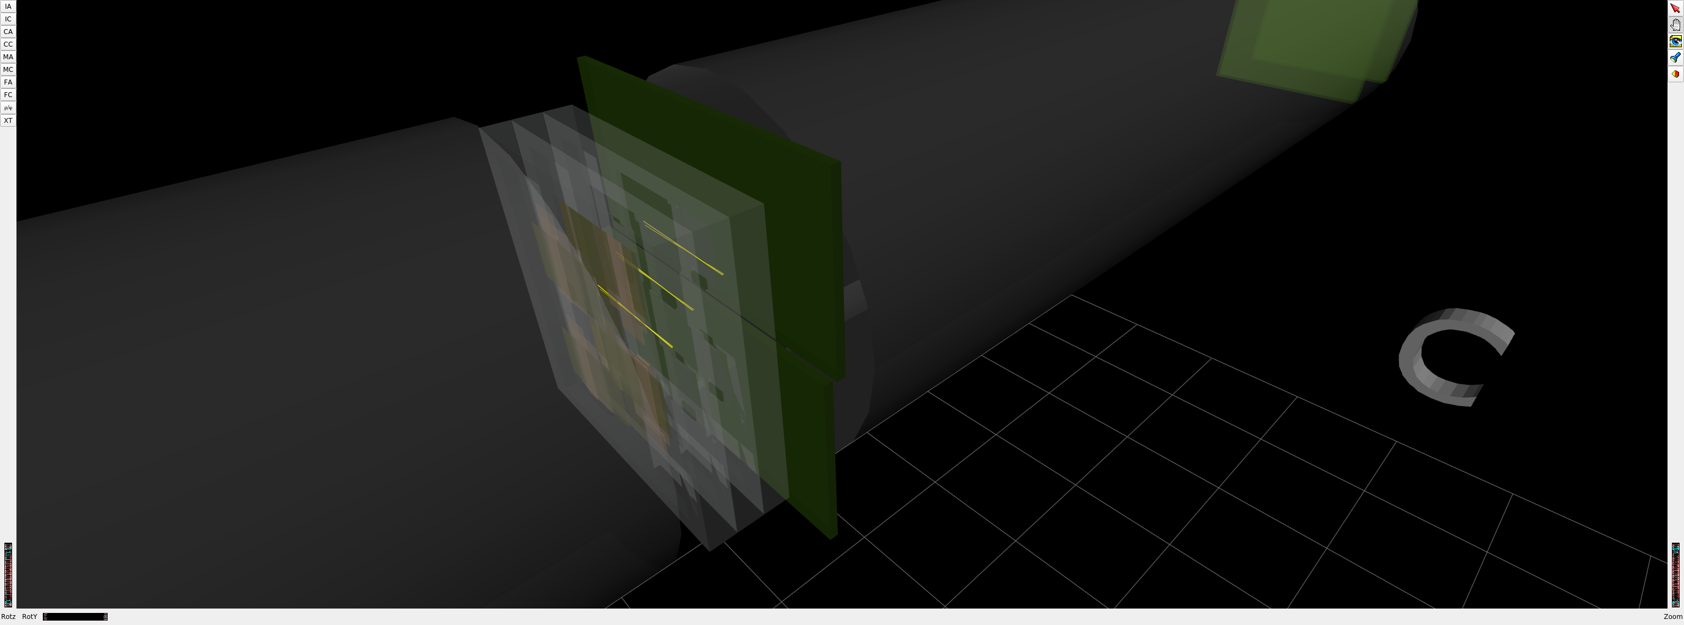
FASER COMMISSIONING UNDERWAY
1st Cosmic Ray
18 March 2021

Slide 11
DARK PHOTON SENSITIVITY REACH
FASER probes new parameter space with just 1 fb⁻¹ starting in 2022.
Without detector upgrade, HL-LHC extends (L*Volume) by factor of 3000; possible upgrade to FASER 2 (R = 1m, L = 10m) extends (L*Volume) by factor of ~10⁶.
FASER
_{FASER Collaboration (2018)}

Slide 12
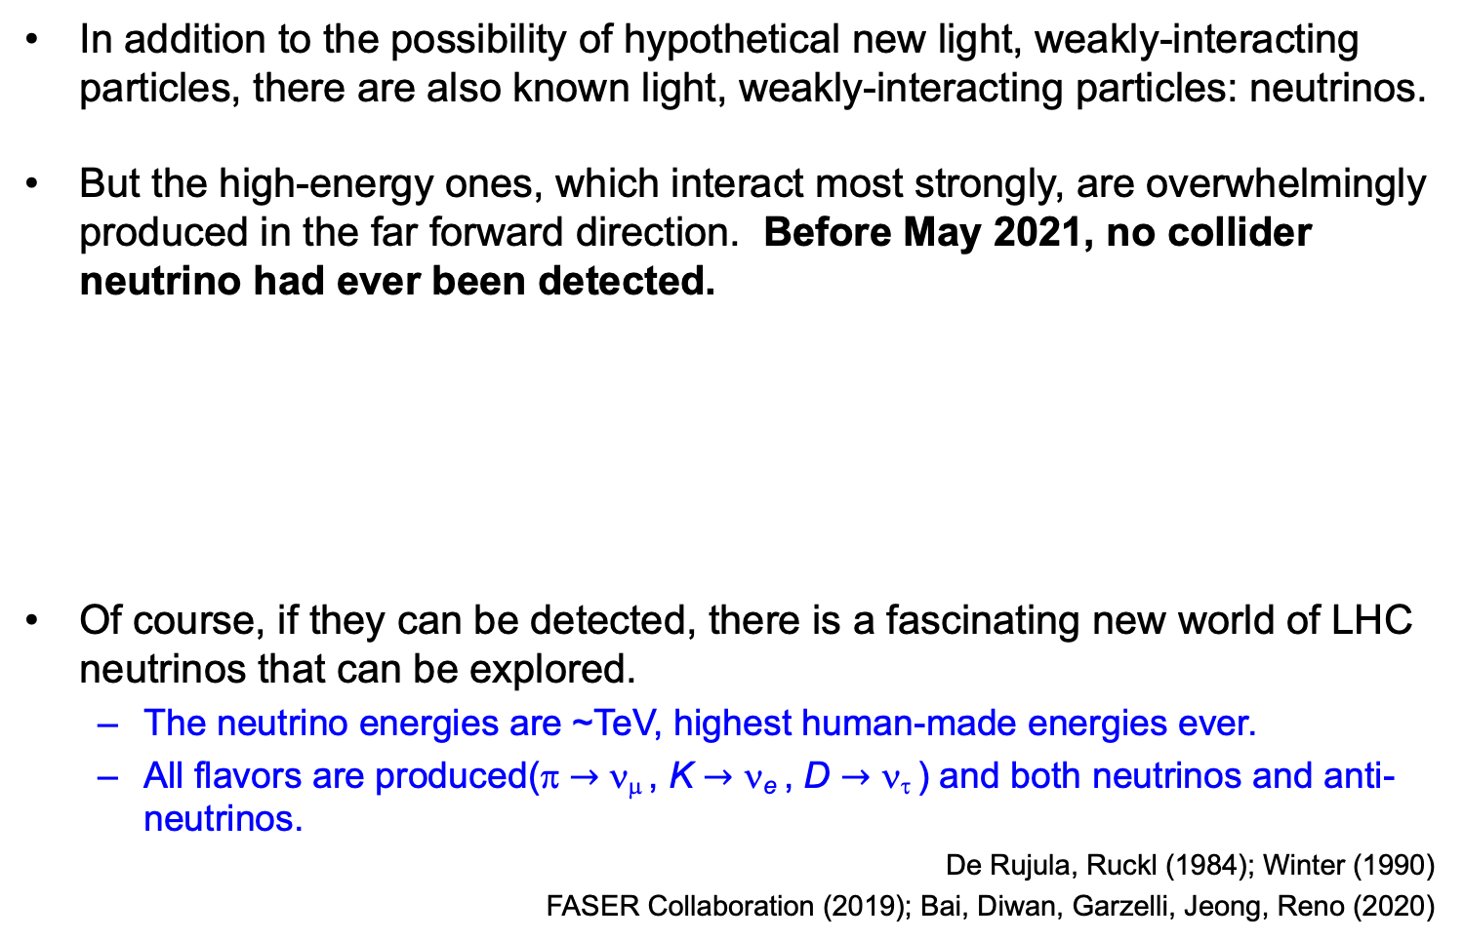
COLLIDER NEUTRINOS
In addition to the possibility of hypothetical new light, weakly-interacting particles, there are also known light, weakly-interacting particles: neutrinos.
But the high-energy ones, which interact most strongly, are overwhelmingly produced in the far forward direction. Before May 2021, no collider neutrino had ever been detected.
Of course, if they can be detected, there is a fascinating new world of LHC neutrinos that can be explored.
  The neutrino energies are ~TeV, highest human-made energies ever.
  All flavors are produced(π $→$ ν_{μ} , K $→$ ν_{e} , D $→$ ν_{τ} ) and both neutrinos and anti-neutrinos.
De Rujula, Ruckl (1984); Winter (1990)
FASER Collaboration (2019); Bai, Diwan, Garzelli, Jeong, Reno (2020)

Slide 13
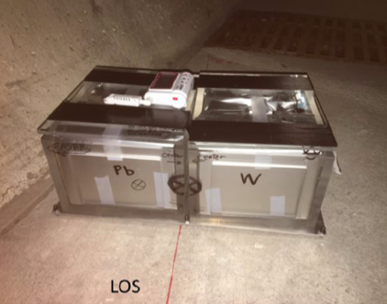
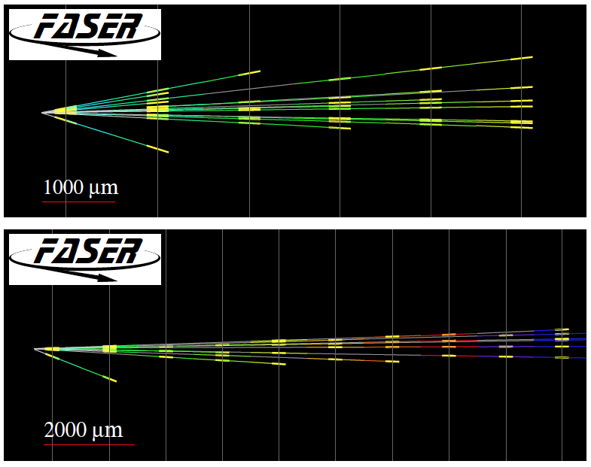
FIRST COLLIDER NEUTRINOS
In 2018 a 29 kg FASER pilot emulsion detector collected 12.2 fb⁻¹ on the beam collision axis (installed and removed during Technical Stops).
Based on 11 kg fidiucial mass, expect ~3.3 neutrino interactions. On 14 May 2021, we announced the first direct detection of 6 collider neutrino candidates above 12 expected neutral hadron background events (2.7σ).
Not the discovery of collider neutrinos, but a promising sign of things to come!

Slide 14
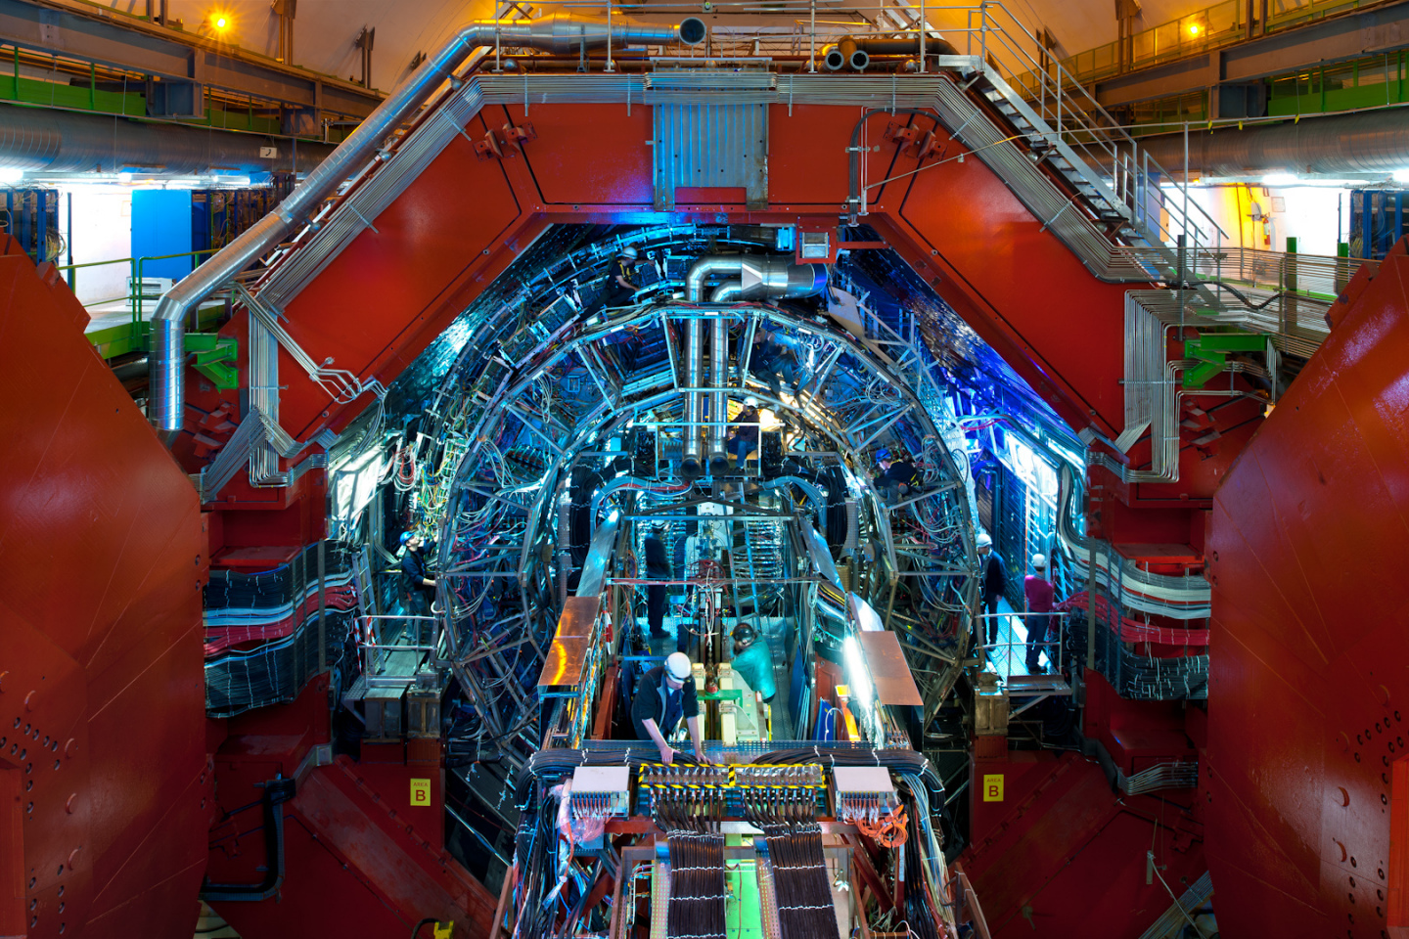
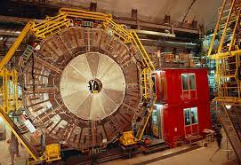
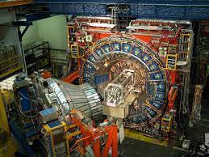
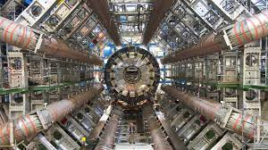
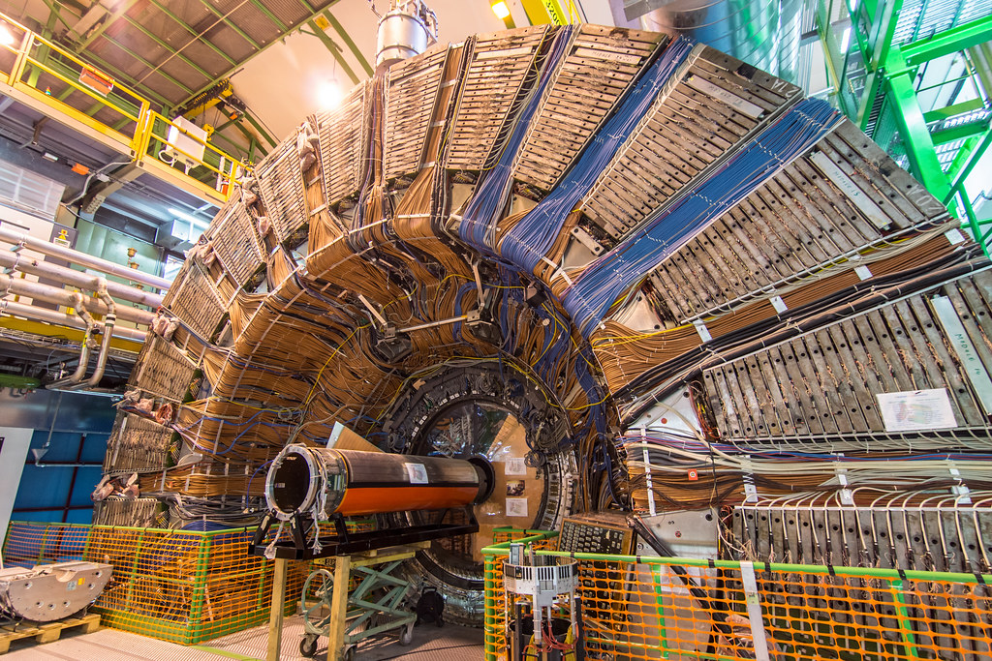
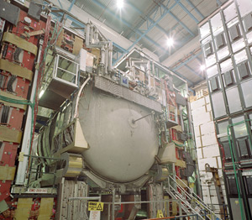
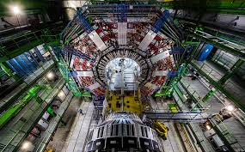
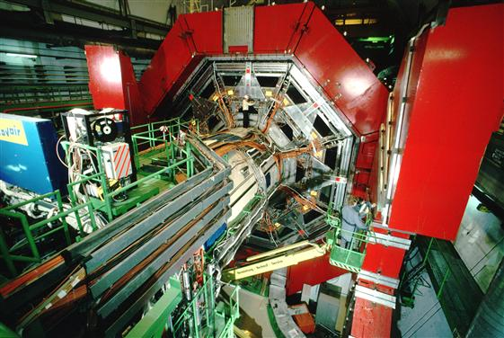

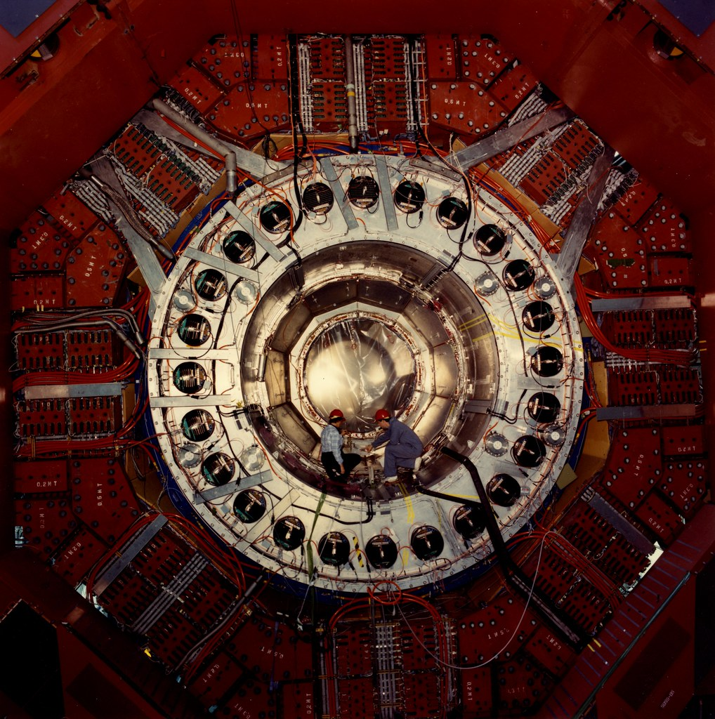
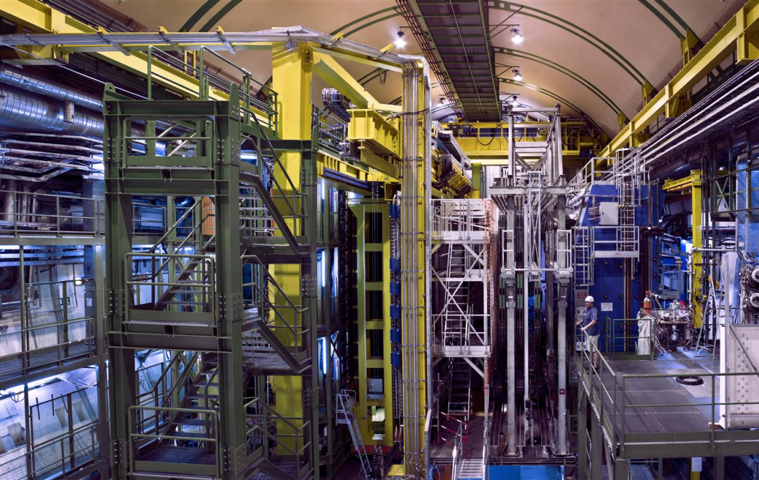
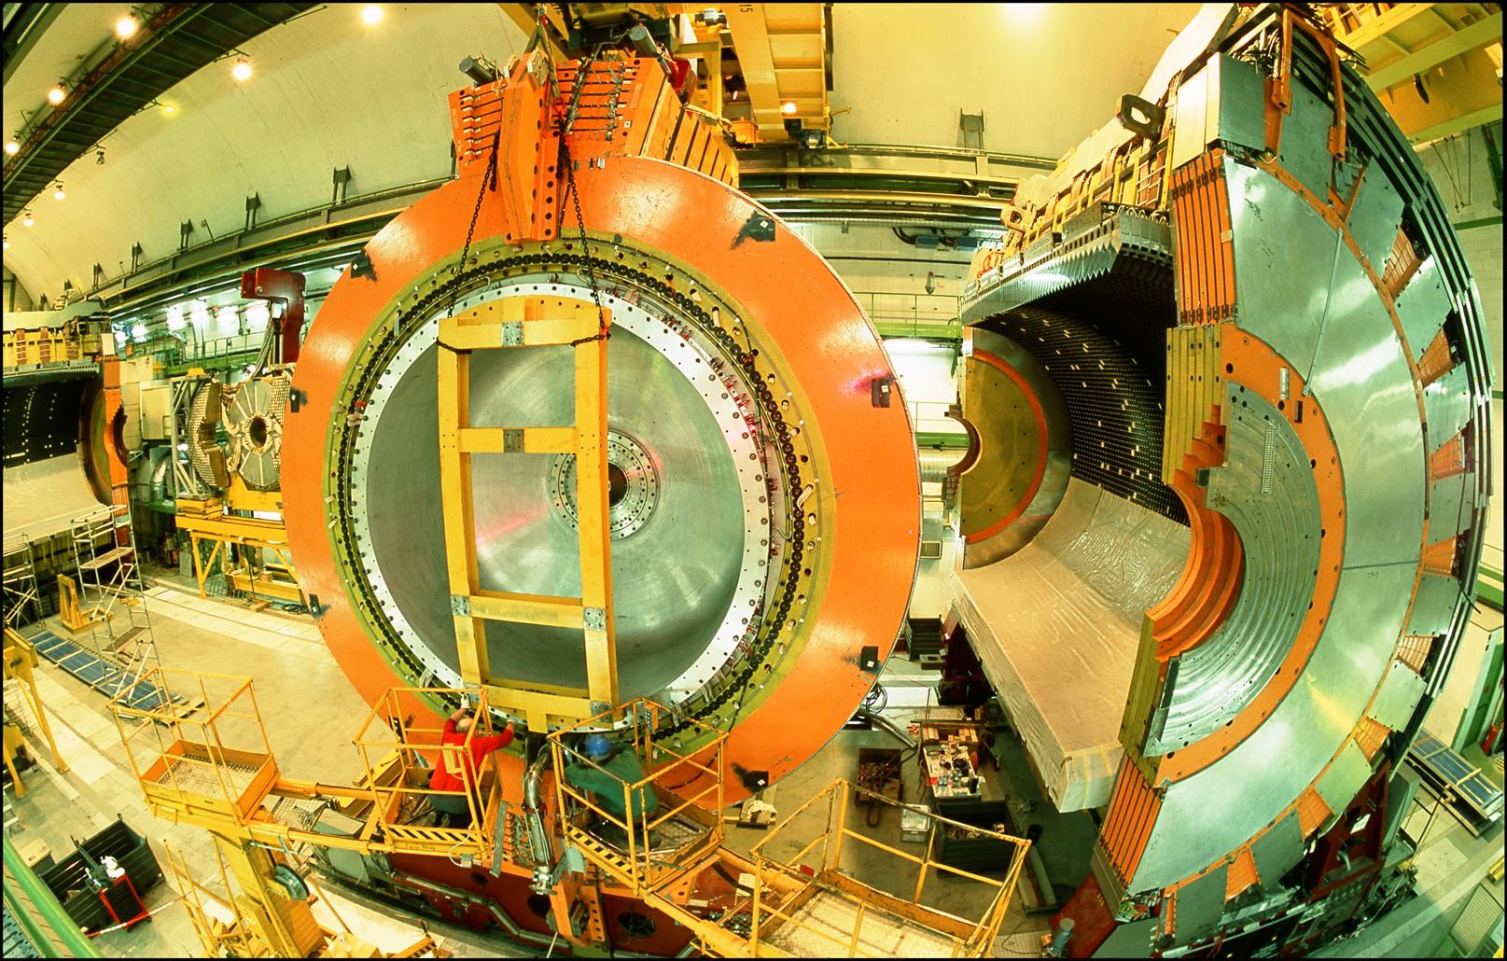
LOCATION, LOCATION, LOCATION
…
ALICE
ALEPH
CDF
FASER Pilot Detector
Suitcase-size, 4 weeks
$0 (recycled parts)
6 neutrino candidates
ATLAS
DELPHI
D0
CMS
L3
LHCb
SLD
OPAL
All previous
collider detectors
Building-size, decades
~$10⁹
0 neutrino candidates

Slide 15
THE FASERν DETECTOR
FASERν is designed to detect neutrinos of all flavors.
  25cm x 30cm x 1.1m detector consisting of 770 emulsion layers interleaved with 1mm-thick tungsten plates; target mass = 1.1 tonne.
  Emulsion swapped out every ~10-30 fb⁻¹, total 10 sets of emulsion for Run 3.
LLP
ν
e⁺
e⁻

Slide 16
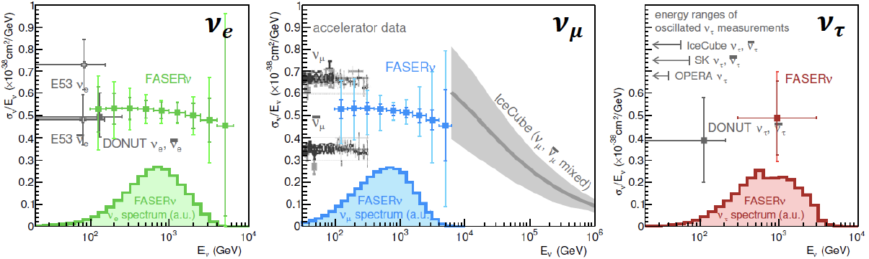
NEUTRINO PHYSICS
In Run 3 (2022-24), FASERν will
  Detect the first collider neutrino.
  Record ~1000 ν_{e} , ~10,000 ν_{μ} , and ~10 ν_{τ} interactions at TeV energies, the first direct exploration of this energy range for all 3 flavors.
  Double the world’s supply of tau neutrinos.
  Distinguish muon neutrinos from anti-neutrinos by combining FASER and FASERν data, and so measure their cross sections independently.
FASER Collaboration 1908.02310 (2019)

Slide 17
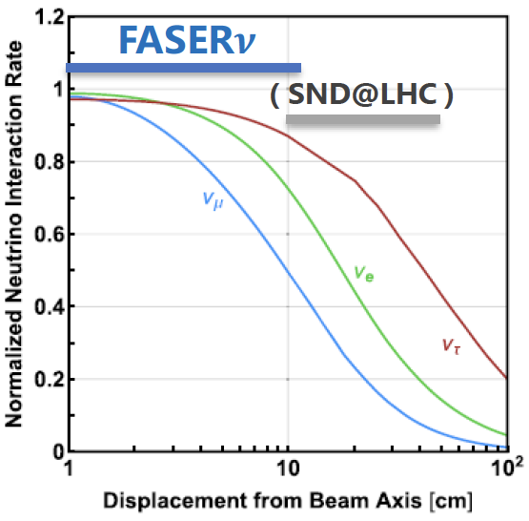
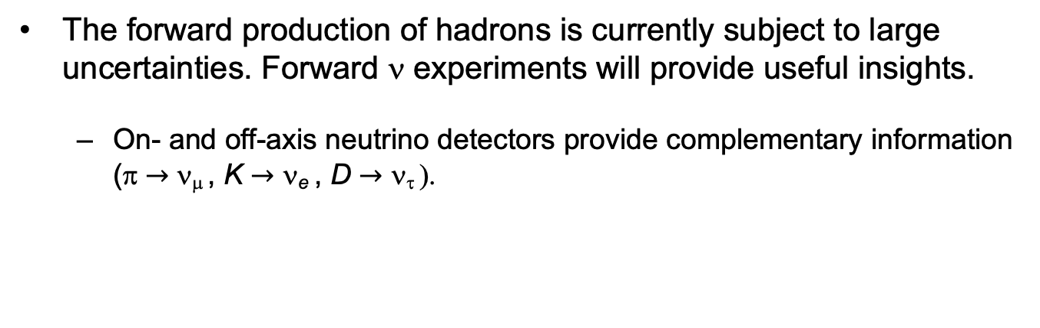
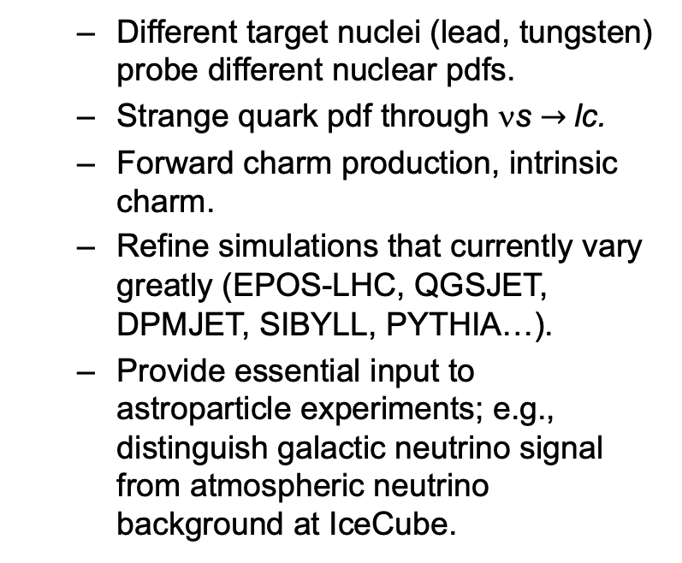
QCD PHYSICS
The forward production of hadrons is currently subject to large uncertainties. Forward ν experiments will provide useful insights.
  On- and off-axis neutrino detectors provide complementary information (π $→$ ν_{μ} , K $→$ ν_{e} , D $→$ ν_{τ} ).
  Different target nuclei (lead, tungsten) probe different nuclear pdfs.
  Strange quark pdf through νs $→$lc.
  Forward charm production, intrinsic charm.
  Refine simulations that currently vary greatly (EPOS-LHC, QGSJET, DPMJET, SIBYLL, PYTHIA…).
  Provide essential input to astroparticle experiments; e.g., distinguish galactic neutrino signal from atmospheric neutrino background at IceCube.

Slide 18
FORWARD PHYSICS FACILITY
FASER, FASERν, and other proposed far-forward detectors are currently highly constrained by 1980’s infrastructure that was never intended to support experiments.
At the same time, it is becoming clear that there is a rich physics program in the far-forward region.
  New particle searches, neutrinos, QCD, MC event generators, milli-charged particles, dark matter, dark sector, cosmic neutrinos, …
Strongly motivates creating a dedicated facility to house far-forward experiments for the HL-LHC era from 2027-37.
  Snowmass LOI: 240 authors from many different communities
  FPF Kickoff Meeting: 9-10 Nov 2020, https://indico.cern.ch/event/955956, 2nd FPF Workshop: 27-28 May 2021, https://indico.cern.ch/event/1022352.
  1st paper on the physics potential of the FPF will be completed July 2021, Snowmass white paper to be completed February 2022.

Slide 19
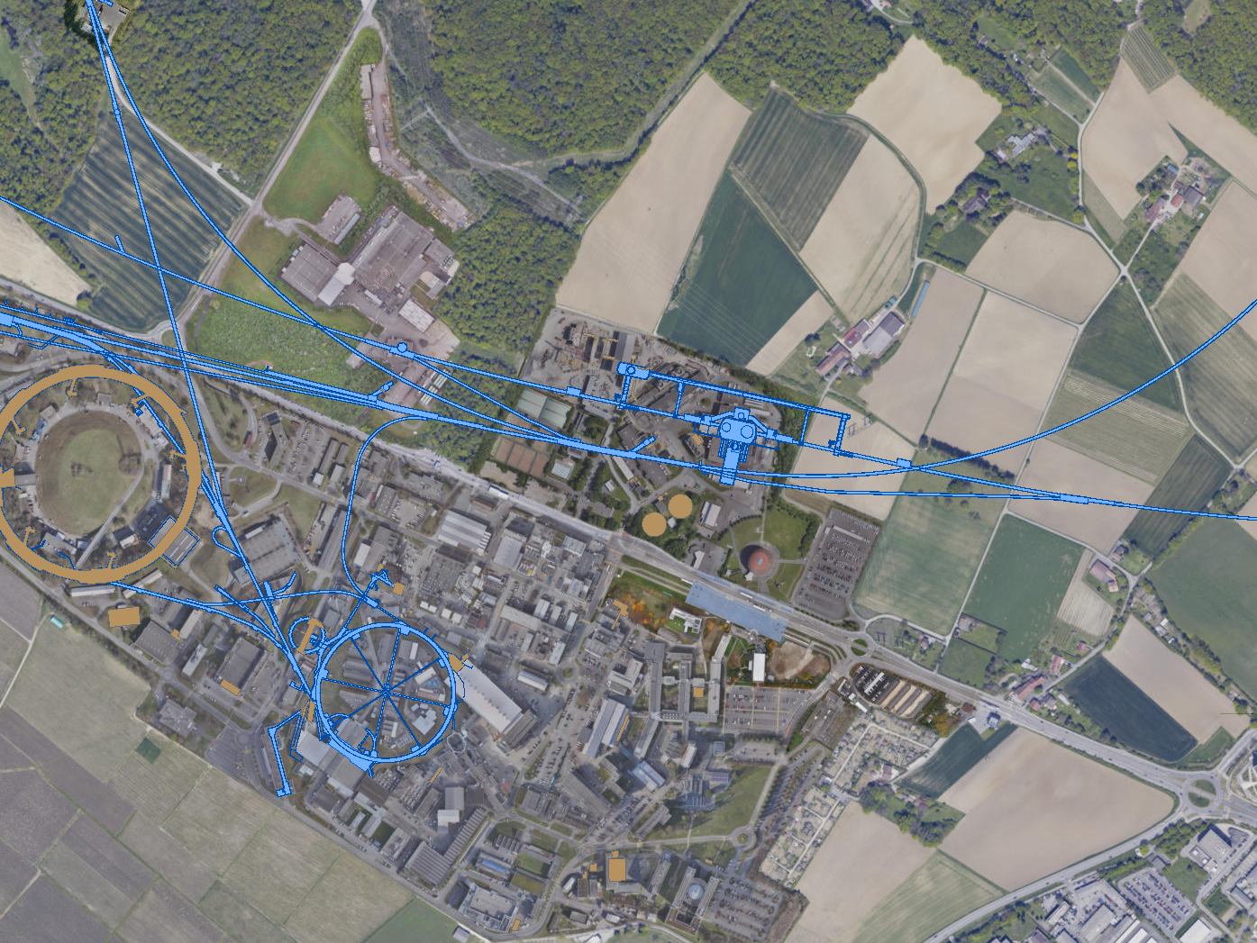
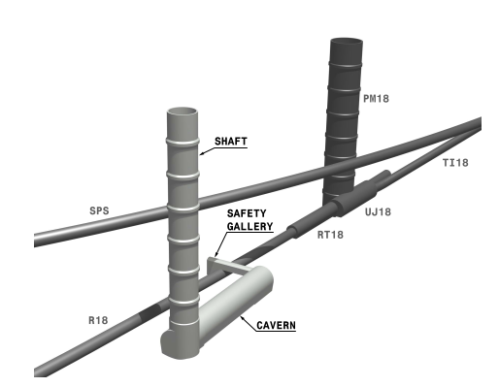
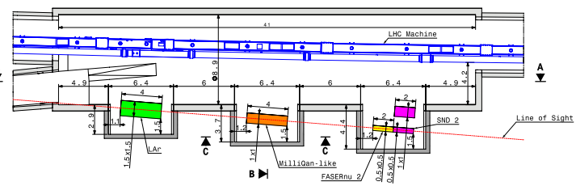
FPF LOCATION
Possibilities under active investigation: enlarge existing cavern UJ12, 480 m from ATLAS and shielded from the ATLAS IP by ~100 m of rock; or create a new shaft and cavern ~612 m from ATLAS past UJ18.
UJ18
ATLAS
SPS
UJ12
LHC
LOS
See Kincso Balazs talk, FPF2 Meeting
CERN GIS

Slide 20
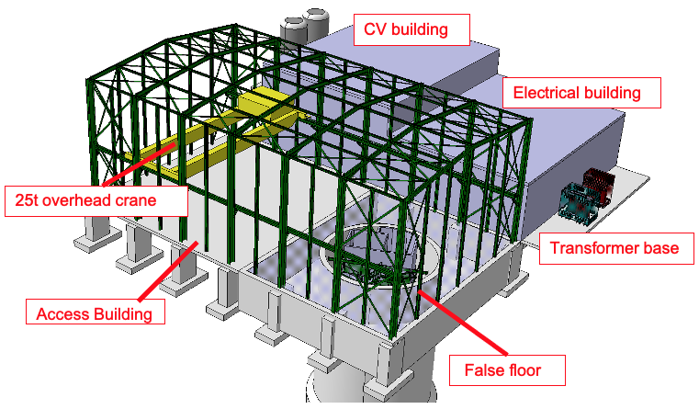
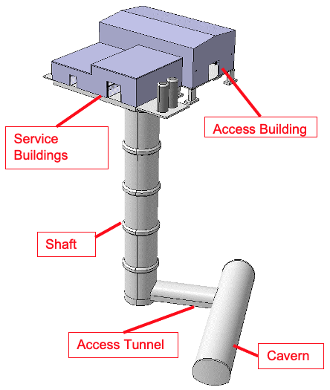
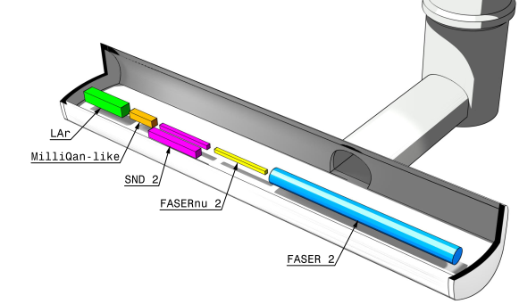
Jonathan Gall, FPF Workshop
FPF: NEW SHAFT AND CAVERN
Many advantages
  Construction access far easier
  Access possible during LHC operations
  Designed around needs of experiments
  Very preliminary (Class 4) cost estimate: ~$23 MCHF.
Design by Liam Dougherty (EN-ACE-INT)

Slide 21
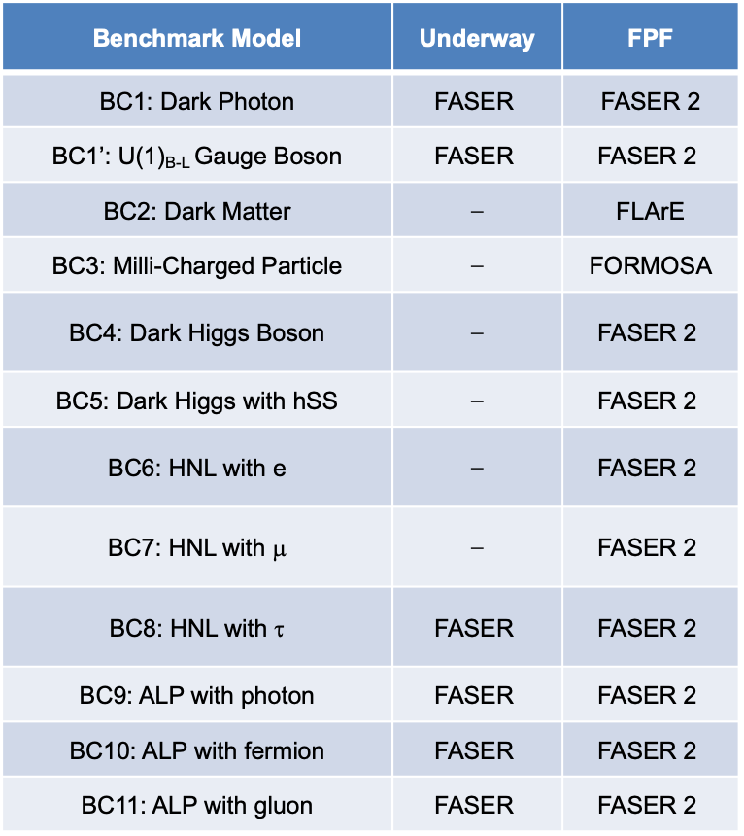
NEW PHYSICS SEARCHES AT THE FPF
The FPF will house a number of experiments
FASER 2, an upgraded FASER with R = 1 m, L = 10 m, can discover all candidates with renormalizable couplings (dark photon, dark Higgs, HNL); ALPs with all types of couplings (γ, f, g); and many other particles.
Other experiments can probe neutrinos and many other interesting ideas.
Benchmark Model | Underway | FPF
BC1: Dark Photon | $$\text{FASER}$$ | FASER 2
BC1’: U(1)_{B-L} Gauge Boson | $$\text{FASER}$$ | $$\text{FASER}\text{ 2}$$
BC2: Dark Matter | ⎼ | FLArE
BC3: Milli-Charged Particle | ⎼ | FORMOSA
BC4: Dark Higgs Boson | ⎼ | $$\text{FASER}\text{ 2}$$
BC5: Dark Higgs with hSS | ⎼ | $$\text{FASER}\text{ 2}$$
BC6: HNL with e | ⎼ | $$\text{FASER}\text{ 2}$$
BC7: HNL with μ | ⎼ | $$\text{FASER}\text{ 2}$$
BC8: HNL with τ | $$\text{FASER}$$ | $$\text{FASER}\text{ 2}$$
BC9: ALP with photon | $$\text{FASER}$$ | $$\text{FASER}\text{ 2}$$
BC10: ALP with fermion | $$\text{FASER}$$ | $$\text{FASER}\text{ 2}$$
BC11: ALP with gluon | $$\text{FASER}$$ | $$\text{FASER}\text{ 2}$$

Slide 22
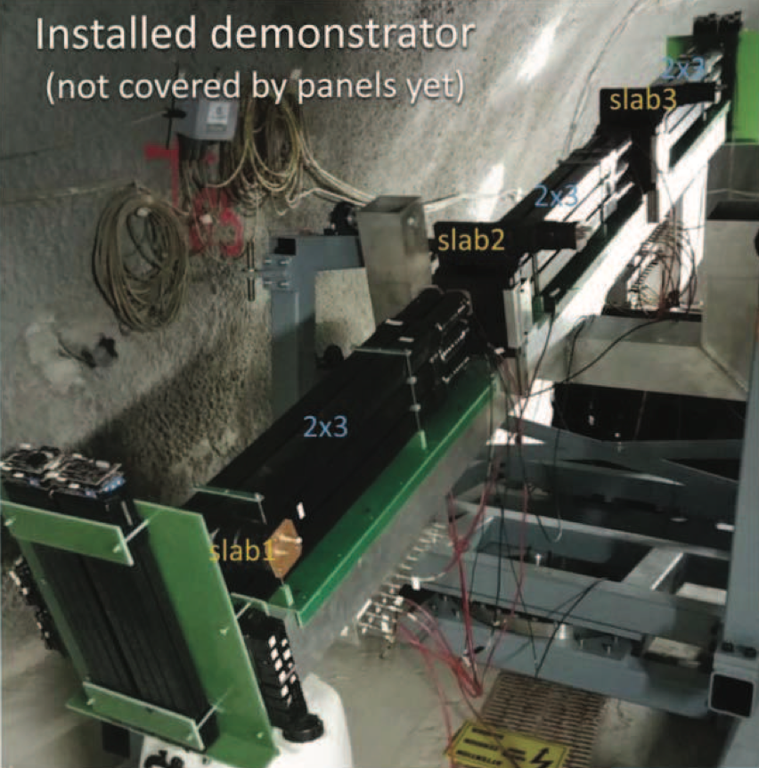
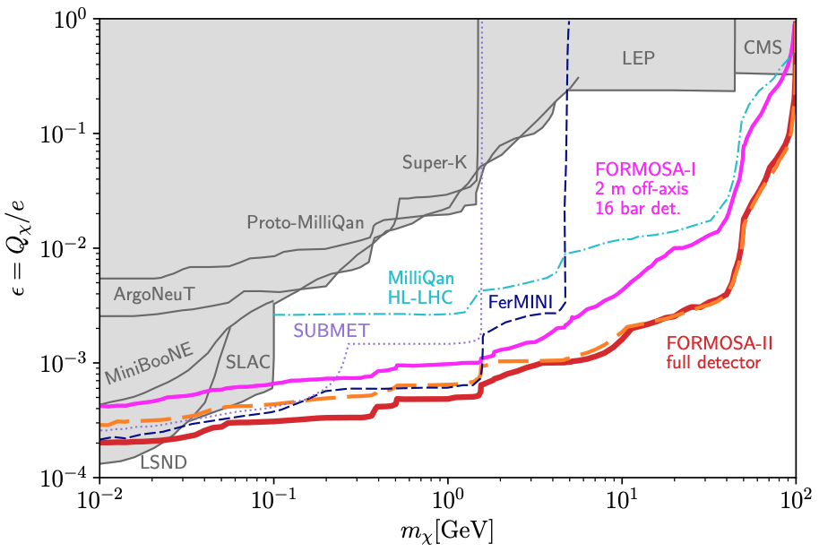
BC2: MILLI-CHARGED PARTICLES
Currently the target of the MilliQan experiment near the CMS IP.
MilliQan Demonstrator (Proto-MilliQan) already probes new region. Full MilliQan planned to run in this location at HL-LHC, but the sensitivity can be improved significantly by moving it to the FPF (FORMOSA).
Foroughi-Abari, Kling, Tsai (2020)

Slide 23
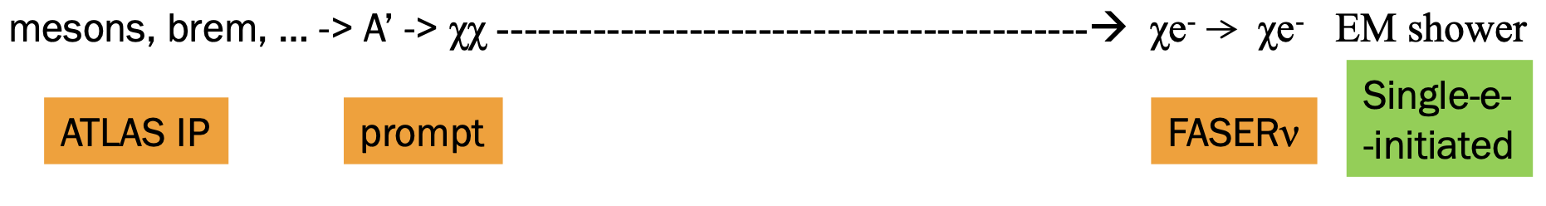
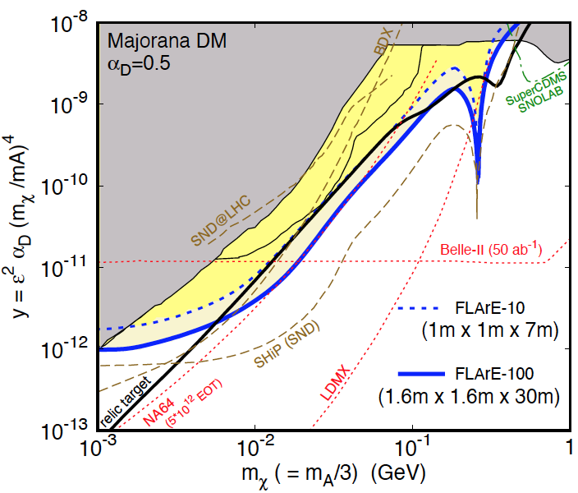
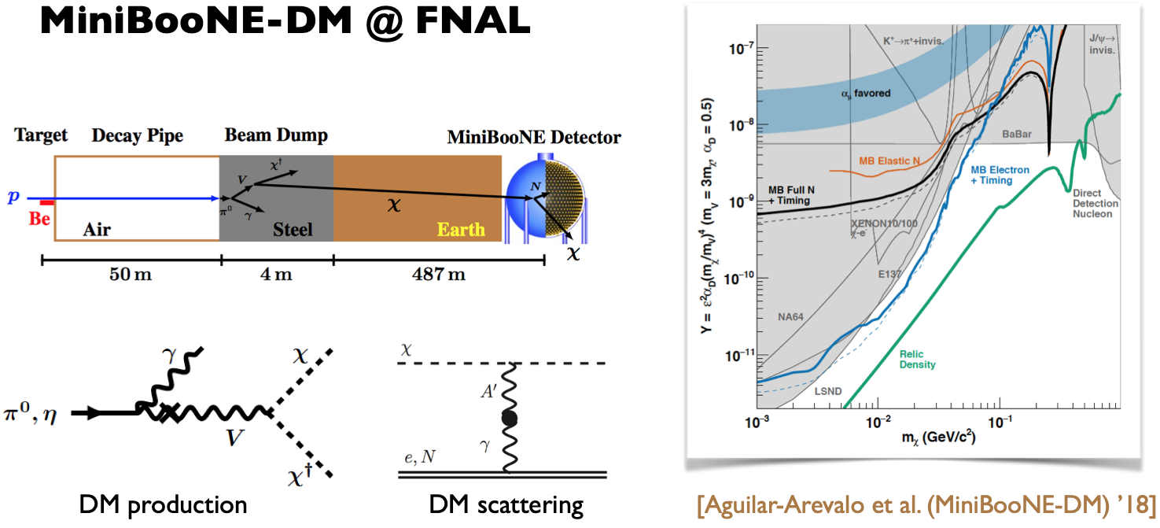
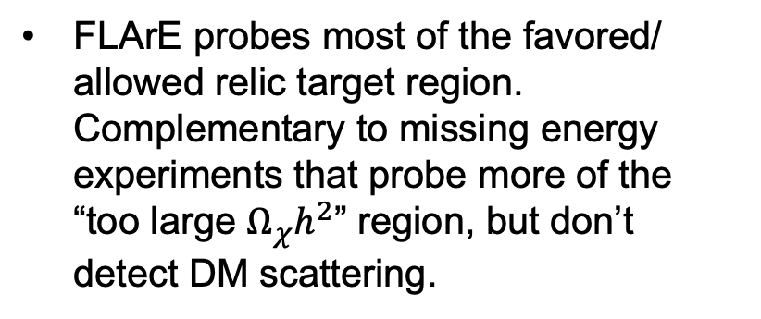
BC3: DARK MATTER
If m_{LLP} > 2m_{DM} , the LLP will typically decay to dark matter, leading to a highly collimated beam of dark matter particles.
Can look for the resulting DM to scatter off electrons at FLArE, Forward Liquid Argon Experiment, a proposed 10 to 100 tonne LArTPC.
FLArE probes most of the favored/ allowed relic target region. Complementary to missing energy experiments that probe more of the “too large $Ω_{χ}h^{2}$” region, but don’t detect DM scattering.
Batell, Feng, Trojanowski (2021)

Slide 24
SUMMARY
New target for discovery: neutrinos and light and weakly-interacting particles probed by fast, small, cheap experiments in the far-forward region of the LHC.
FASER and FASERν: 3.5 years from theory proposal to completion, 5 m long, ~$2M. Data-taking starts in 2022 with a rich physics program.
  BSM: searches for dark photons, HNLs, ALPs, new forces.
  SM: opens the new field of LHC neutrino physics. ~1000 ν_{e}, ~10,000 ν_{μ}, ~10 ν_{τ} at TeV energies. Implications for neutrino properties, forward hadron production, cosmic ray and cosmic neutrino physics.
Forward Physics Facility: Proposed facility to house a suite of far-forward experiments for the HL-LHC era from 2027-37.
FLArE: Forward Liquid Argon Experiment, proposed 10-100 tonne LArTPC for dark matter searches, neutrino physics.

