Slide 1
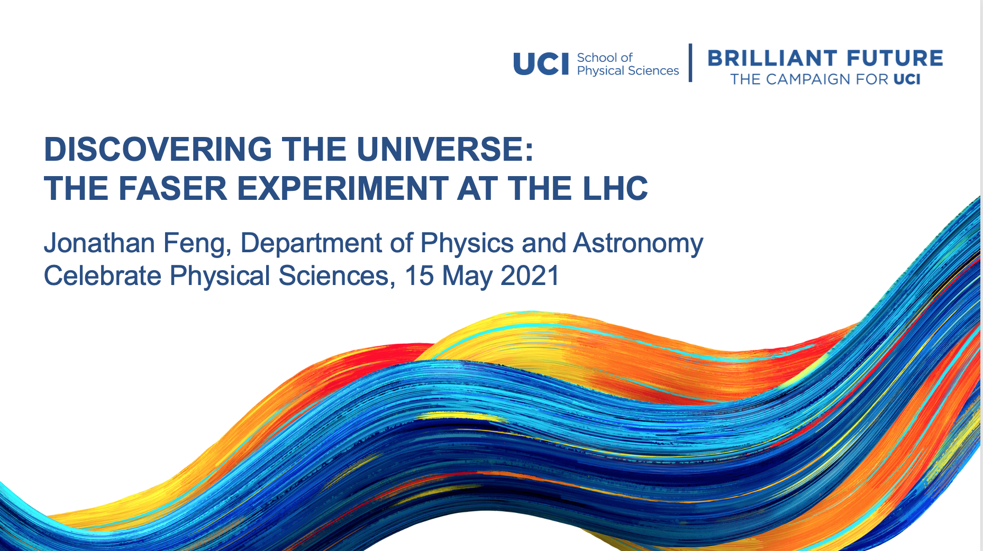

Slide 2
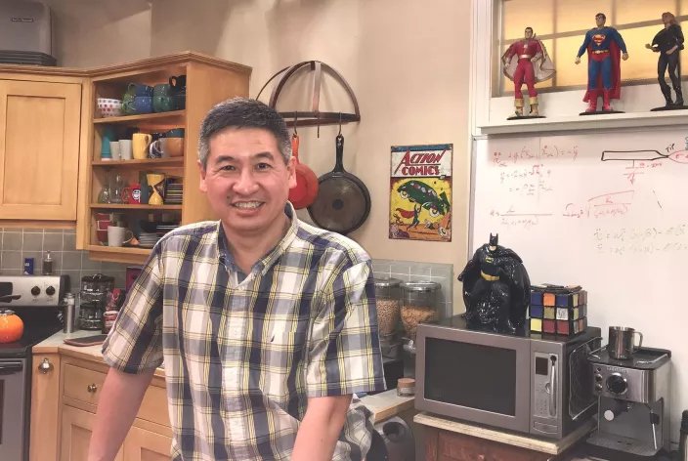
WELCOME!
I’ve been at UCI since 2002
P&A Courses Taught
  7D: Electricity and Magnetism
  7E: Oscillations, Waves, and Optics
  60: Thermal Physics
  H90: The Physics of Sound and Light
  116: Relativity and Black Holes
  136: Introduction to Particle Physics
  234AB: Elementary Particle Physics
  235AB: Quantum Field Theory
Please jump in with questions, despite the webinar format.

Slide 3
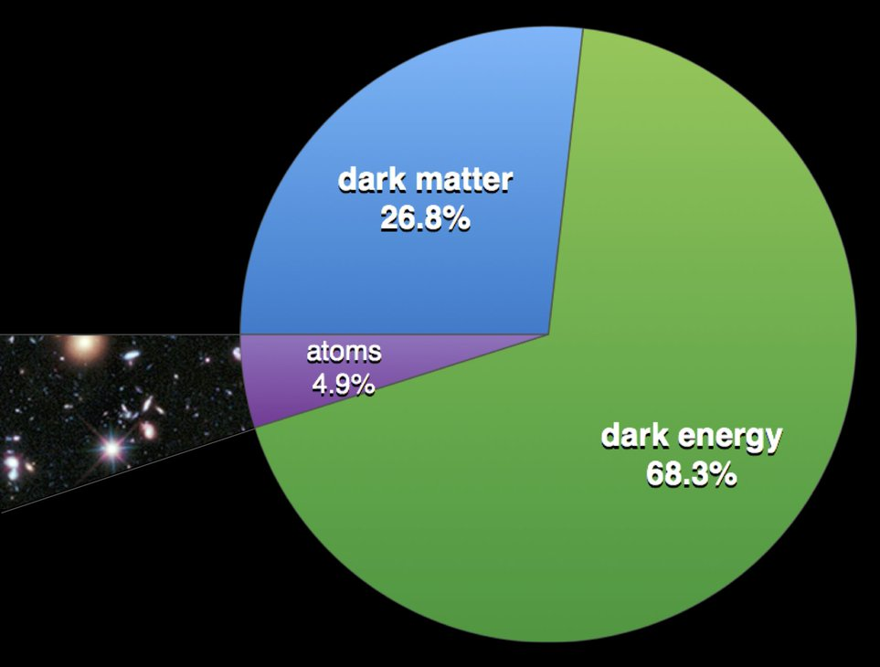
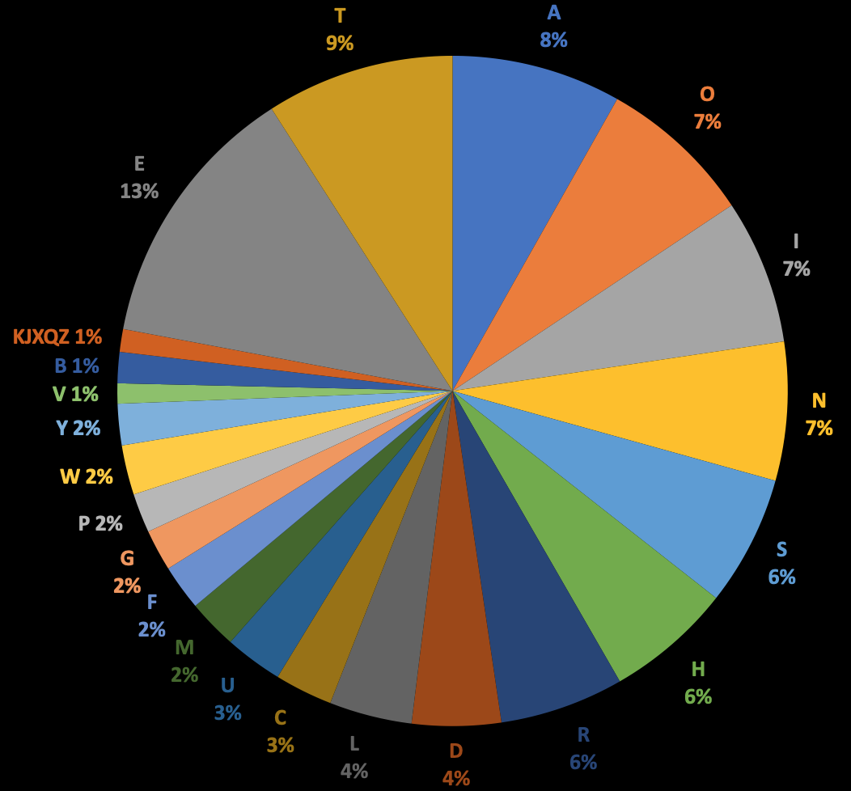
THE UNIVERSE TODAY
Trying to understand the universe knowing only what we know today is like trying to understand the English language knowing only the letters V, Y, and W.
We need to discover the rest of the alphabet!

Slide 4
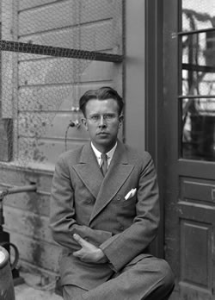
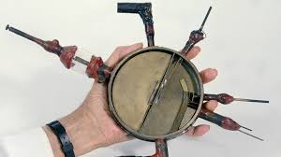
PARTICLE ACCELERATORS AND COLLIDERS
To discover new forms of matter, the workhorse tool has been particle colliders: we accelerate electrons and protons, smash them together, and see what comes out.
The first accelerator: Ernest Lawrence in the 1930’s
Bigger accelerators: higher energies, heavier particles

Slide 5

THE LATEST REALIZATION OF LAWRENCE’S VISION
The Large Hadron Collider at CERN in Geneva
.
FASER
Now colliding protons at 99.999999% the speed of light
Notes:
5

Slide 6
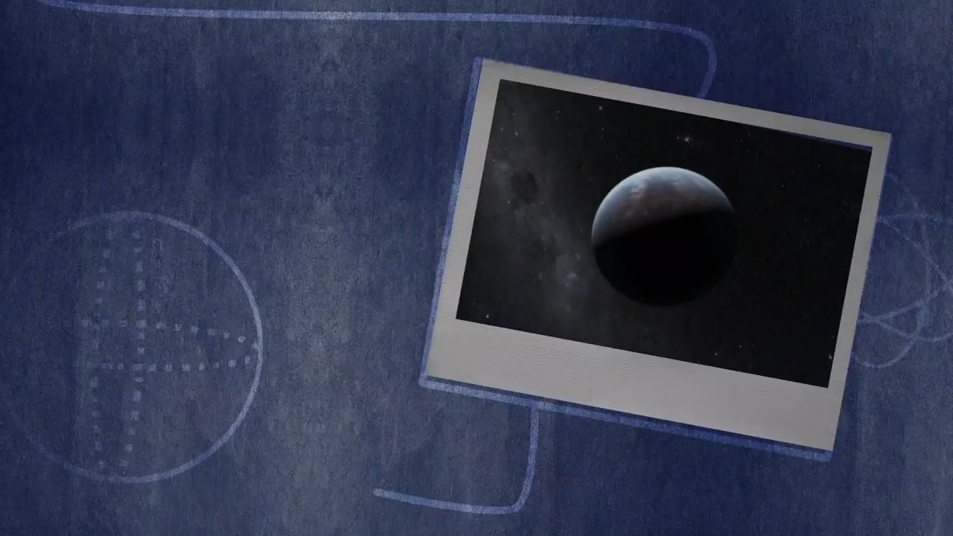

Slide 7
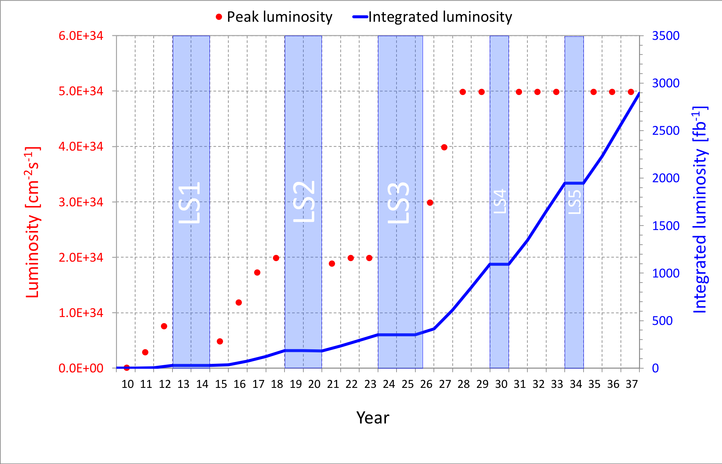
LARGE HADRON COLLIDER: CURRENT STATUS
The discovery of the Higgs boson in 2012 completed the standard model of particle physics, but so far there is no evidence for other new particles.
The LHC is currently shut down for upgrades. COVID has delayed the re-opening by a year, but the LHC will start again in 2022 and run until 2037.

Slide 8
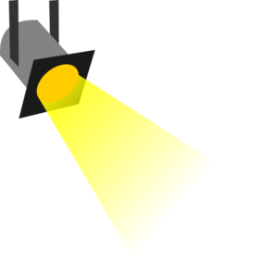

THE NEW PARTICLE LANDSCAPE
Particle
Colliders
Mass
In 2017, our group at UCI noticed that weakly interacting, light particles are dominantly produced along the beamline:
But existing detectors have holes along the beamline, and so are almost perfectly designed not to discover these particles.
MeV
GeV
TeV
1
Already
Discovered
Strongly Interacting
Heavy Particles
New Targets
(long-lived particles, like neutrinos)
Traditional Targets (supersymmetry, extra dimensions)
Interaction Strength
10⁻³
Weakly Interacting
Light Particles
Impossible to
Discover
10⁻⁶

Slide 9
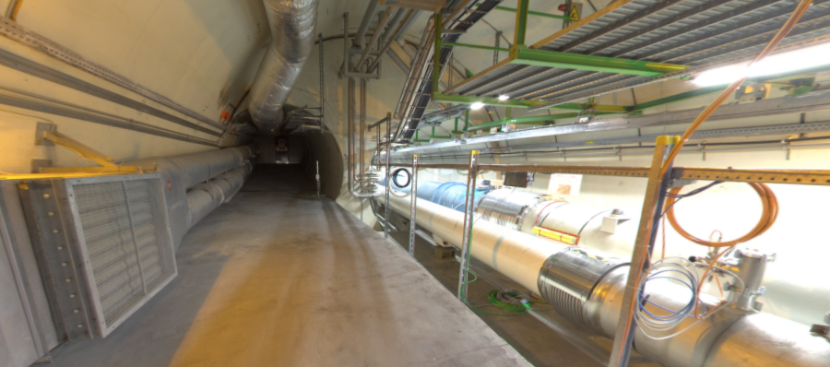
A SOLUTION
We can’t put a detector on the beamline – it will stop the protons.
But if we go far down the beamline, the LHC beam will curve away, while the new weakly interacting particles which go straight.
We can discover new particles in this far-forward region – and there is an existing tunnel there, 480 m downstream!
The view looking west
New Particles
(Dark Particles)
LHC Beamline
(Protons)
Feng, Galon, Kling, Trojanowski (2017)

Slide 10
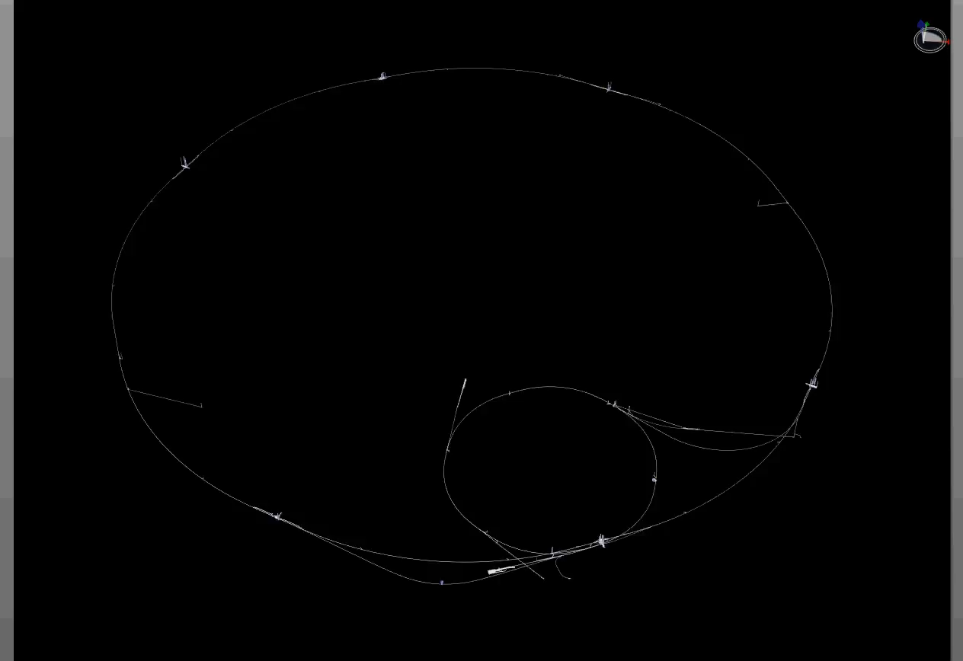
PATH OF DARK PARTICLES FROM ATLAS TO FASER
Dougherty, CERN Integration (2019)

Slide 11

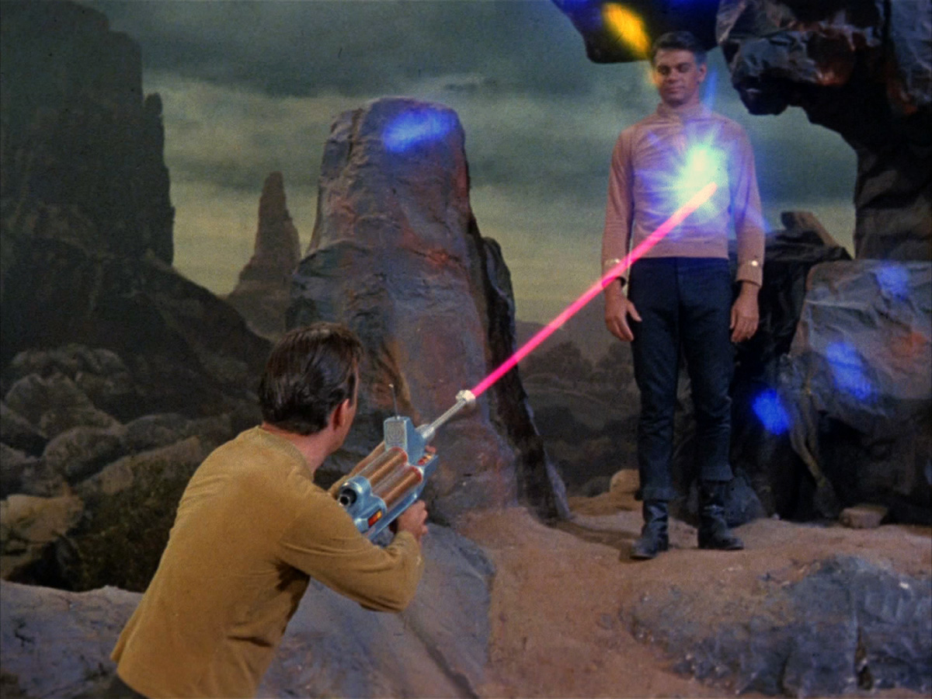
FORWARD SEARCH EXPERIMENT
It turns out that a relatively cheap, small, and fast experiment placed in the existing tunnel can provide the most sensitive searches to date for many kinds of new particles.
FASER: “The acronym recalls another marvelous instrument that harnessed highly collimated particles and was used to explore strange new worlds.”
Feng, Galon, Kling, Trojanowski (2017)

Slide 12










THE FASER COLLABORATION NOW
71 collaborators, 20 institutions, 8 countries
Henso Abreu (Technion), Yoav Afik (Technion), Claire Antel (Geneva), Akitaka Ariga (Chiba/Bern), Tomoko Ariga (Kyushu/Bern), Florian Bernlochner (Bonn), Tobias Boeckh (Bonn), Jamie Boyd (CERN), Lydia Brenner (CERN), Franck Cadoux (Geneva), Dave Casper (UC Irvine), Charlotte Cavanagh (Liverpool), Xin Chen (Tsinghua), Andrea Coccaro (INFN), Monica D’Onofrio (Liverpool), Candan Dozen (Tsinghua), Yannick Favre (Geneva), Deion Fellers (Oregon), Jonathan Feng (UC Irvine), Didier Ferrere (Geneva), Stephen Gibson (Royal Holloway), Sergio Gonzalez-Sevilla (Geneva), Carl Gwilliam (Liverpool), Shih-Chieh Hsu (Washington), Zhen Hu (Tsinghua), Peppe Iacobucci (Geneva), Tomohiro Inada (Tsinghua), Sune Jakobsen (CERN), Enrique Kajomovitz (Technion), Felix Kling (SLAC), Umut Kose (CERN), Susanne Kuehn (CERN), Helena Lefebvre (Royal Holloway), Lorne Levinson (Weizmann), Ke Li (Washington), Jinfeng Liu (Tsinghua), Chiara Magliocca (Geneva), Josh McFayden (CERN), Dimitar Mladenov (CERN), Mitsuhiro Nakamura (Nagoya), Toshiyuki Nakano (Nagoya), Marzio Nessi (CERN), Friedemann Neuhaus (Mainz), Laurie Nevay (Royal Holloway), Hidetoshi Otono (Kyushu), Lorenzo Paolozzi (Geneva), Carlo Pandini (Geneva), Hao Pang (Tsinghua), Brian Petersen (CERN), Francesco Pietropaolo (CERN), Johanna Price (UC Irvine), Markus Prim (Bonn), Michaela Queitsch-Maitland (CERN), Filippo Resnati (CERN), Chiara Rizzi (Geneva), Hiroki Rokujo (Nagoya), Jakob Salfeld-Nebgen (CERN), Osamu Sato (Nagoya), Paola Scampoli (Bern), Kristof Schmieden (Mainz), Matthias Schott (Mainz), Anna Sfyrla (Geneva), Savannah Shively (UC Irvine), John Spencer (Washington), Yosuke Takubo (KEK), Ondrej Theiner (Geneva), Eric Torrence (Oregon), Serhan Tufanli (CERN), Benedikt Vormvald (CERN), Di Wang (Tsinghua), Gang Zhang (Tsinghua)

Slide 13
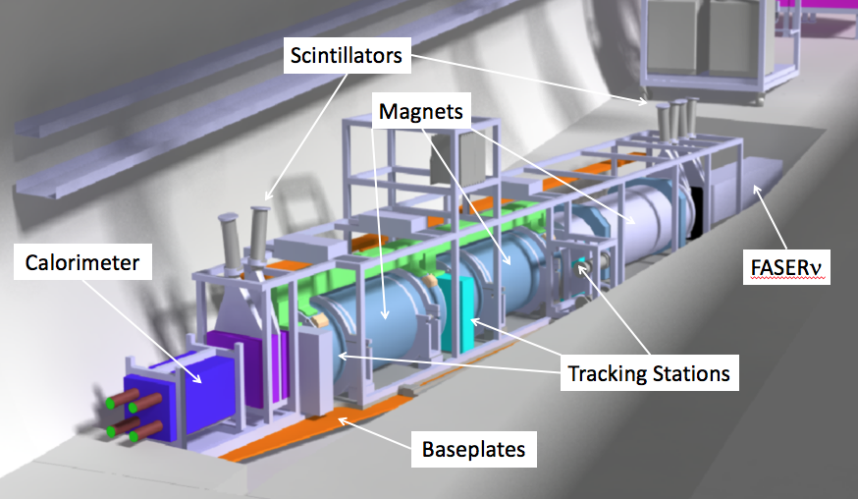
THE SIGNAL – WHAT WE ARE LOOKING FOR
Nothing comes in, but 2 ~TeV, opposite-charged tracks are created, which point back to the ATLAS interaction point: a “light shining through (100 m-thick) wall,” background-free experiment.
Scintillators veto incoming charged tracks (muons), and permanent dipole magnets split the charged tracks, which are detected by 3 tracking stations and a calorimeter.
LLP
ν
e⁺
e⁻

Slide 14
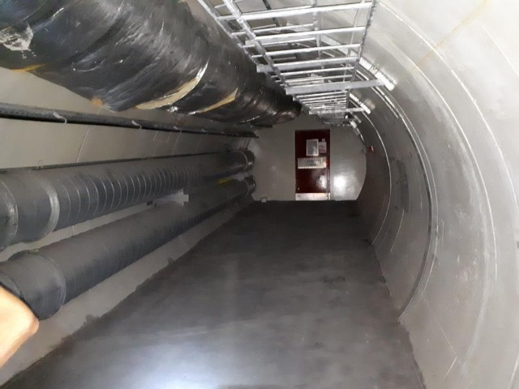
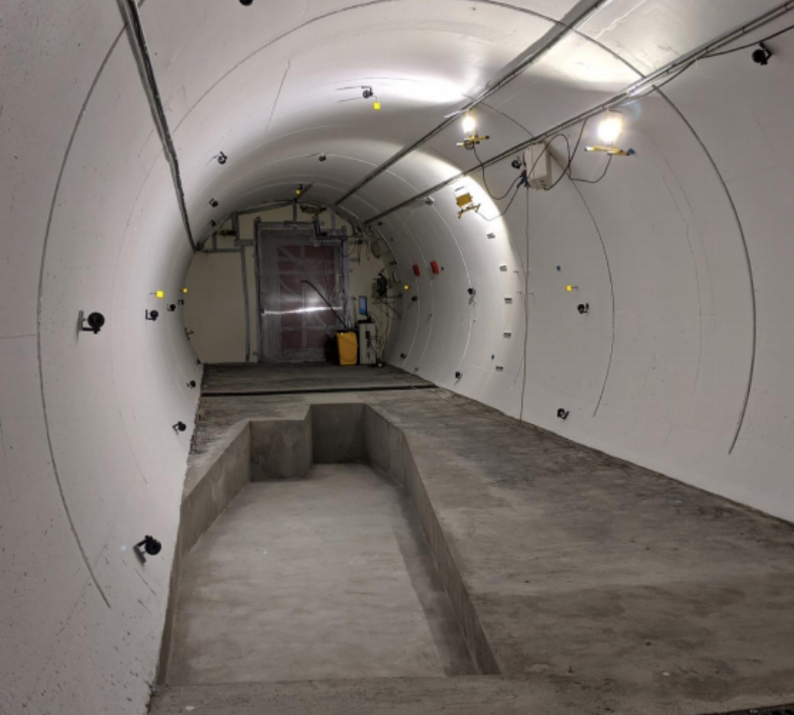
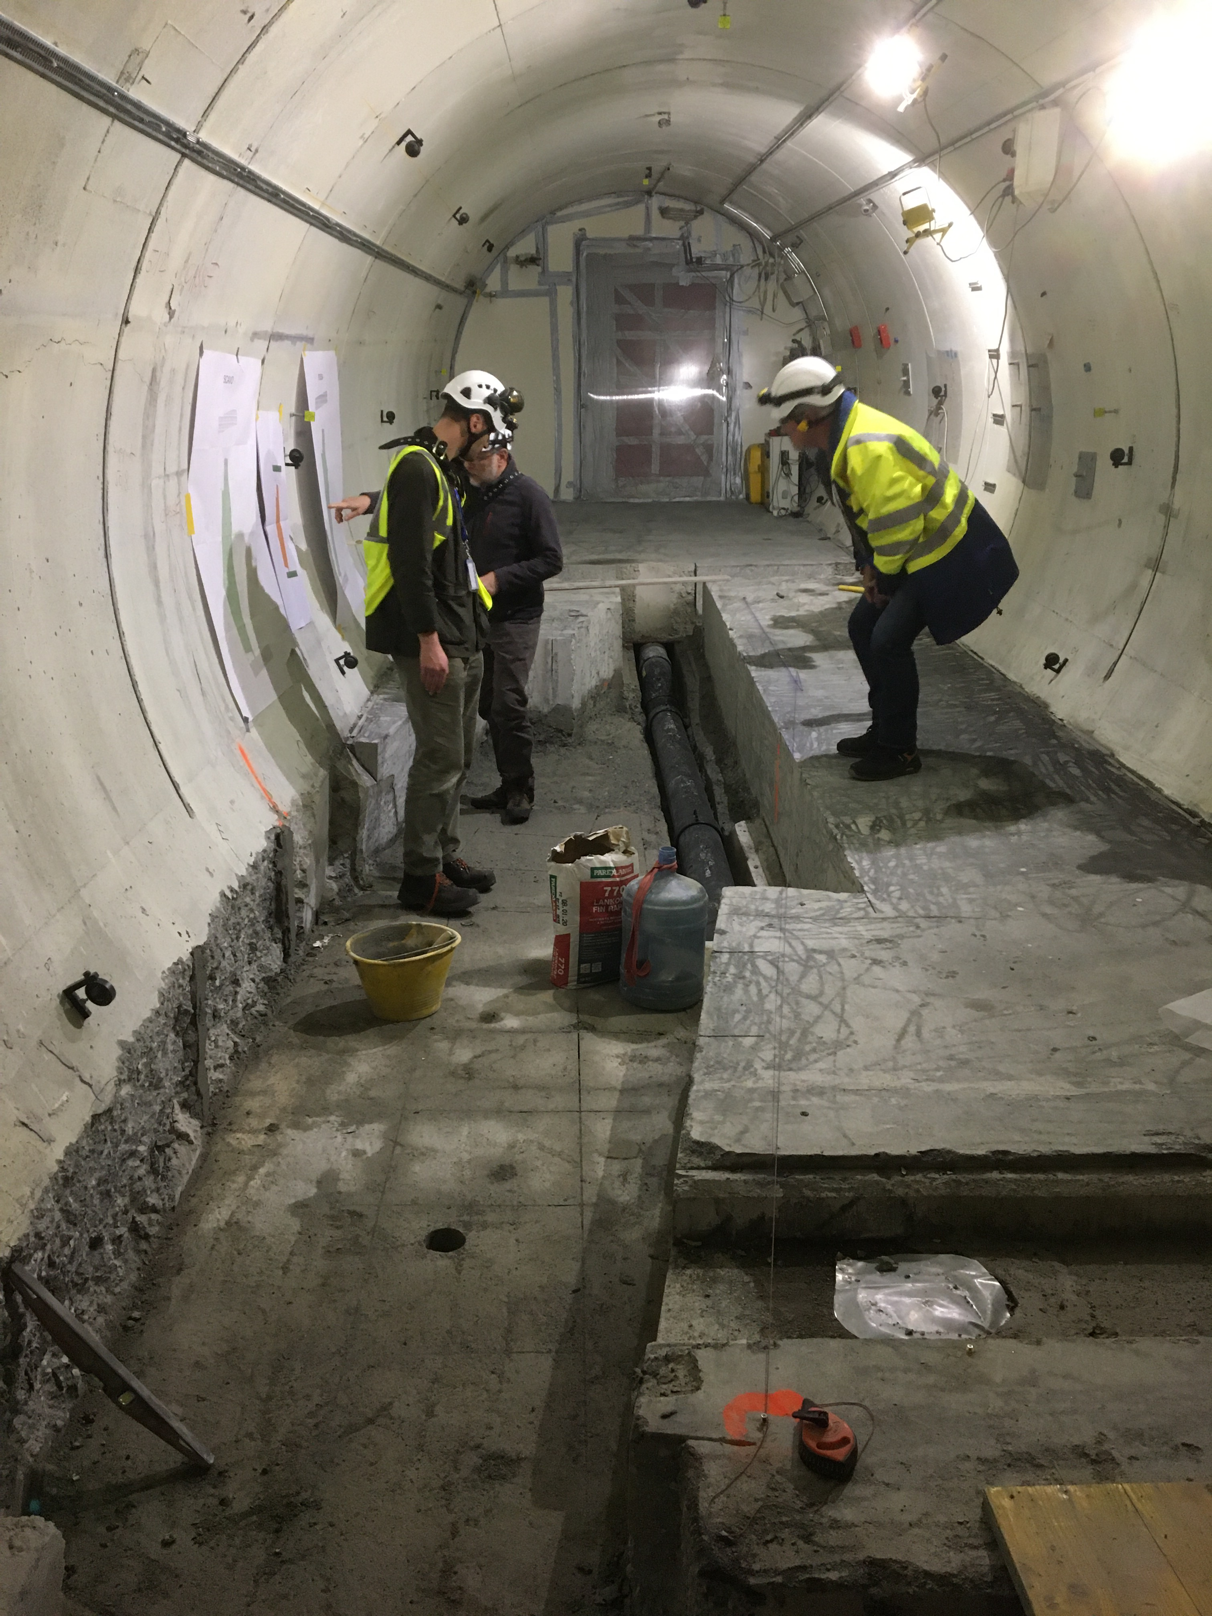
PREPARING THE TUNNEL FOR FASER
The beam collision axis has been located to mm accuracy by the CERN survey department. To place FASER on this axis, a trench was required to lower the floor by 46 cm.
The trench was completed by an Italian firm just hours before COVID shut down CERN in March 2020.
2019
Spring 2020
Summer 2020

Slide 15
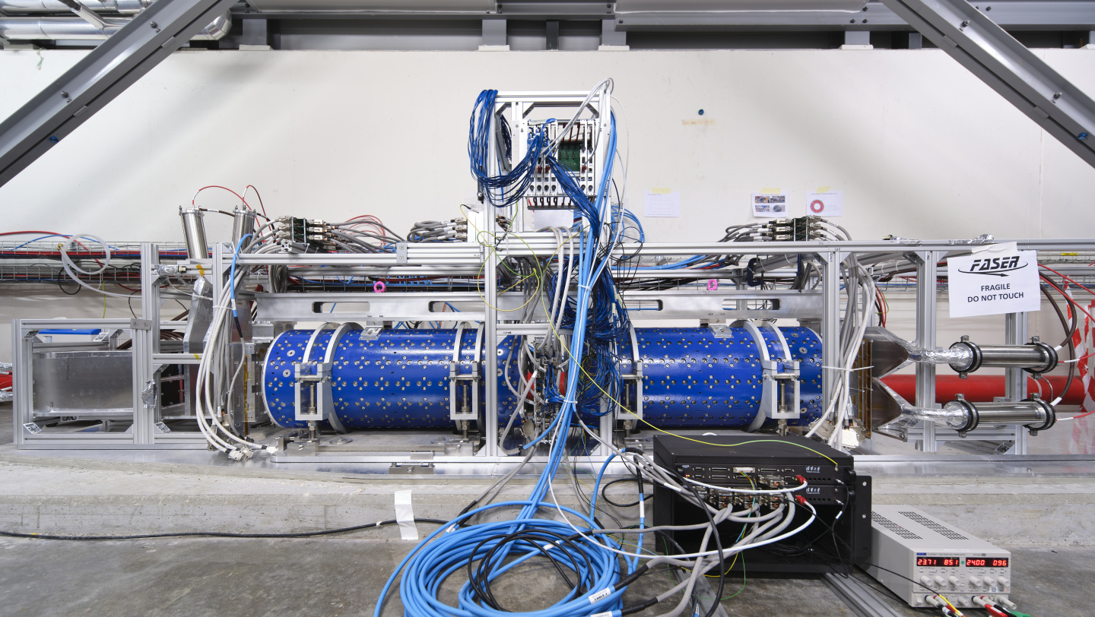
DETECTOR ASSEMBLY ON THE SURFACE
CONSTRUCTION AND COMMISSIONING ON THE SURFACE

Slide 16
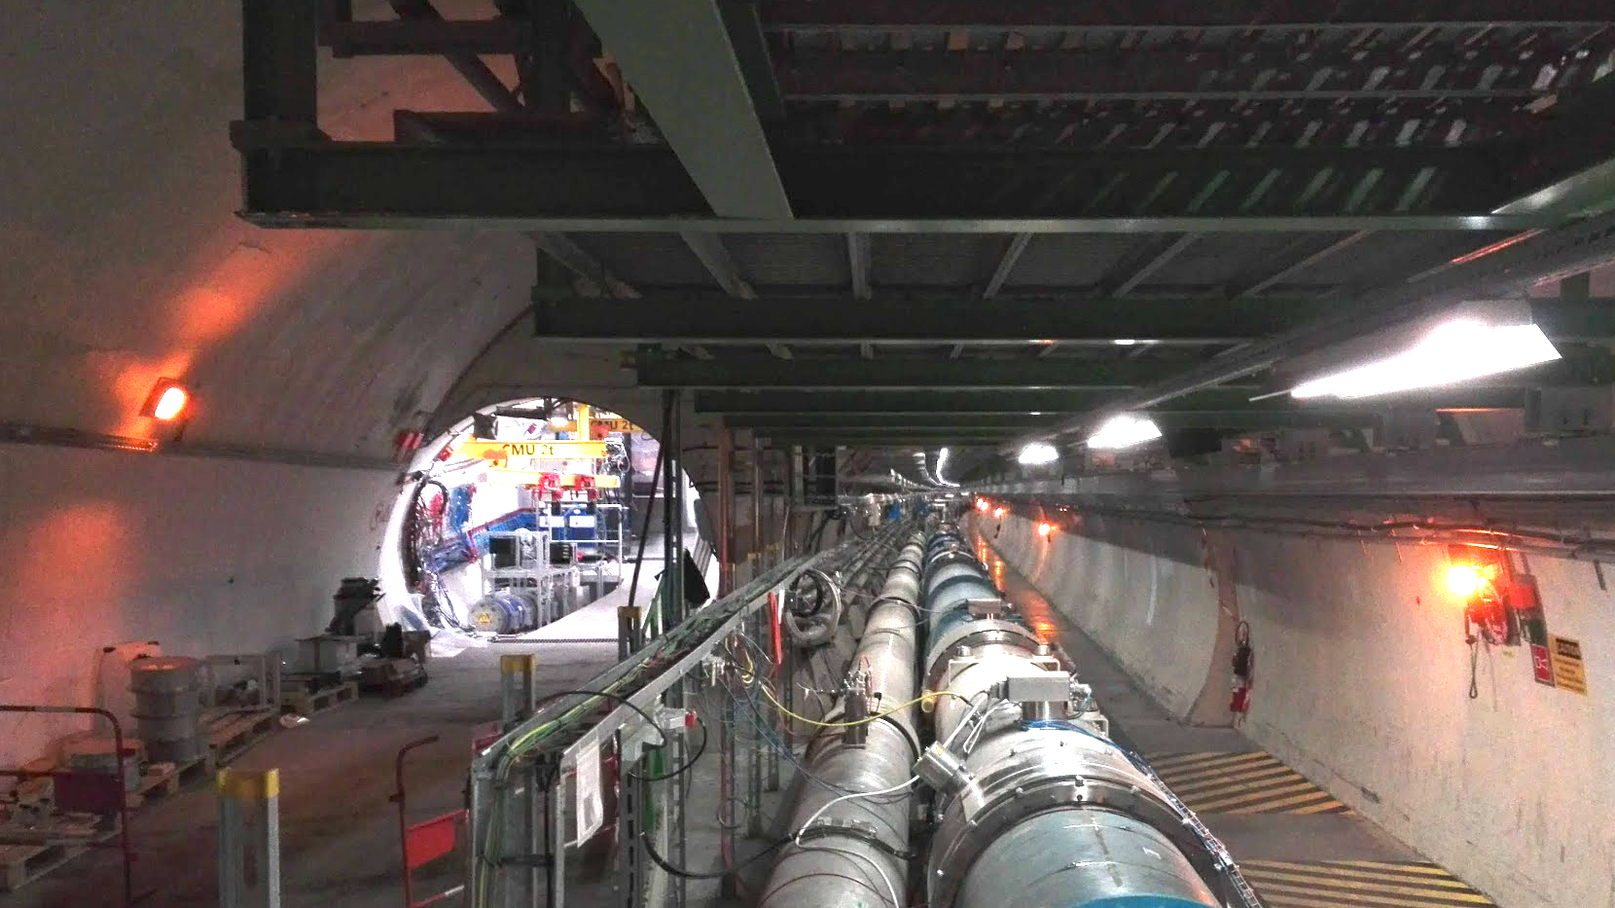
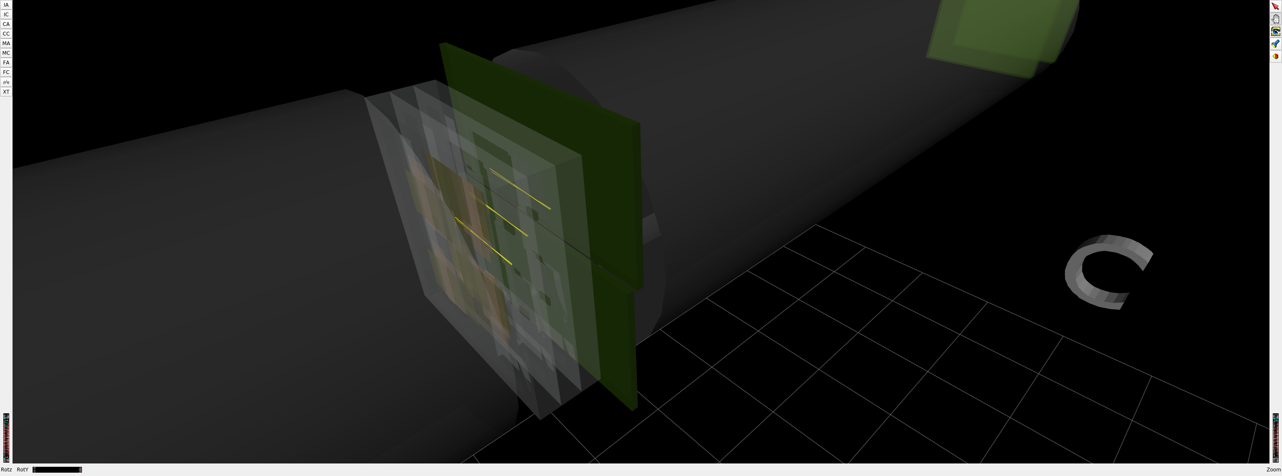
FASER INSTALLATION IN THE LHC TUNNEL
Installation completed in March 2021
Commissioning with cosmic rays ongoing
Data taking begins in April 2022 when the LHC turns on
1st Cosmic Ray
18 March 2021

Slide 17
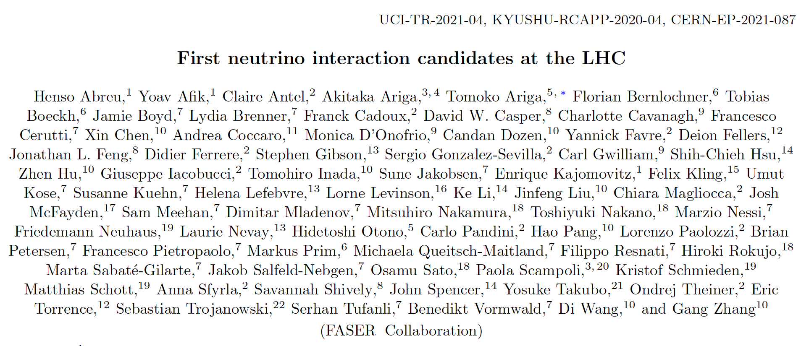
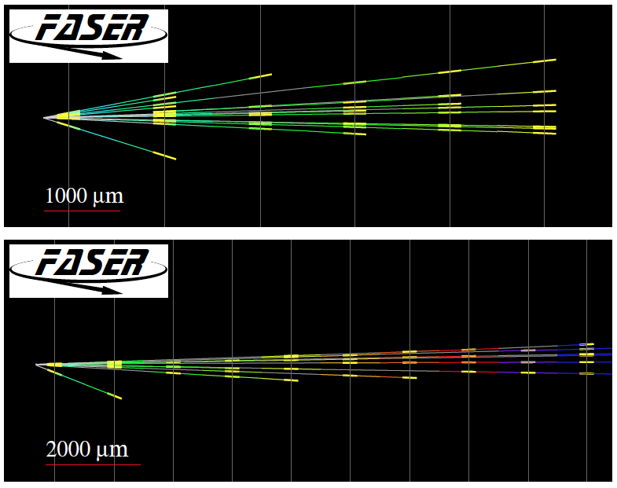
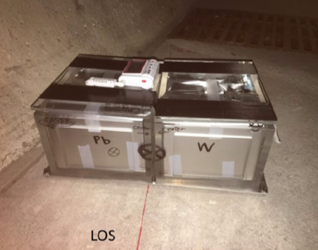
FIRST COLLIDER NEUTRINOS
We are looking for new light and weakly interacting particles, but there are also known light and weakly-interacting particles: neutrinos.
No collider neutrino has ever been detected, because the highest-energy, most-detectable ones are produced along the beamline in the far forward direction.
In 2018, we placed a 29 kg pilot detector in the far forward region for 4 weeks.
On 14 May 2021, we announced the first direct detection of neutrino candidates produced at a collider. A promising sign of things to come!

Slide 18
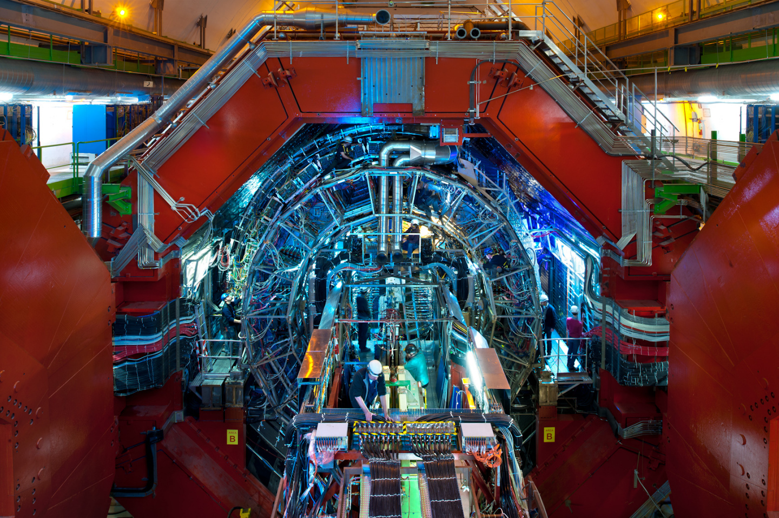
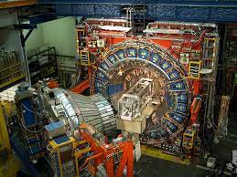
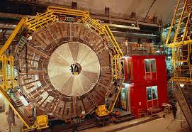
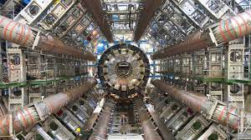
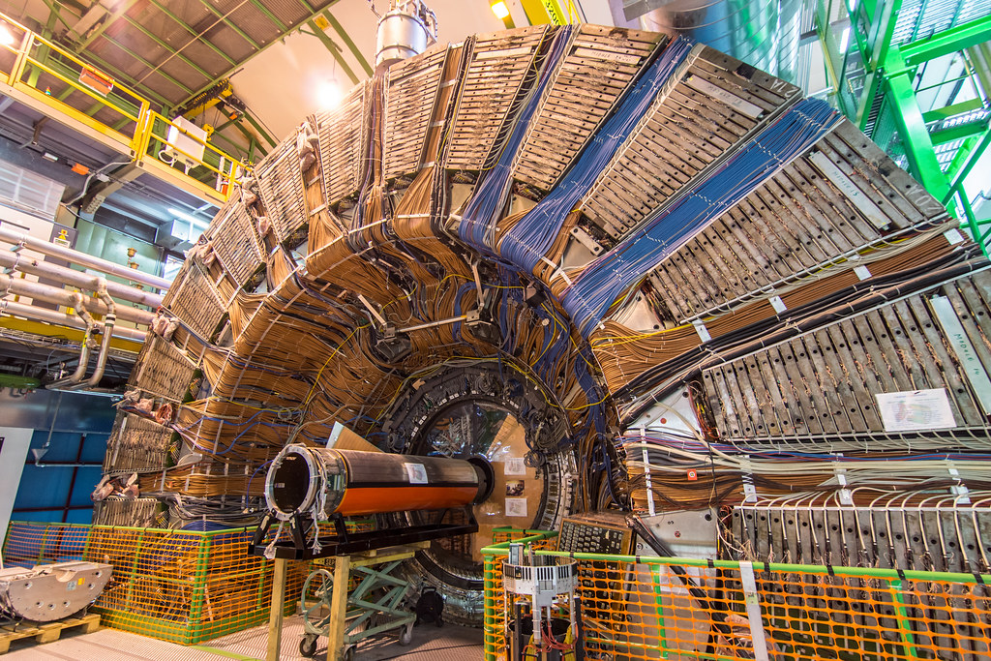
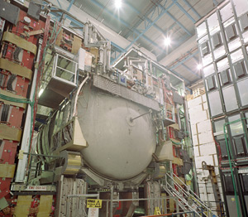
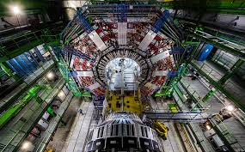
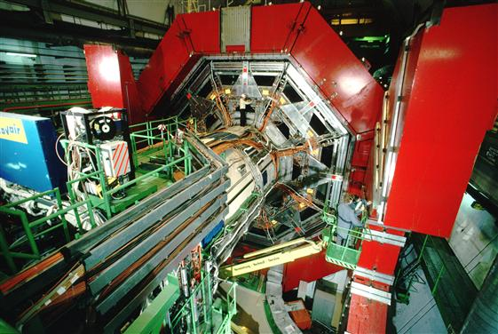
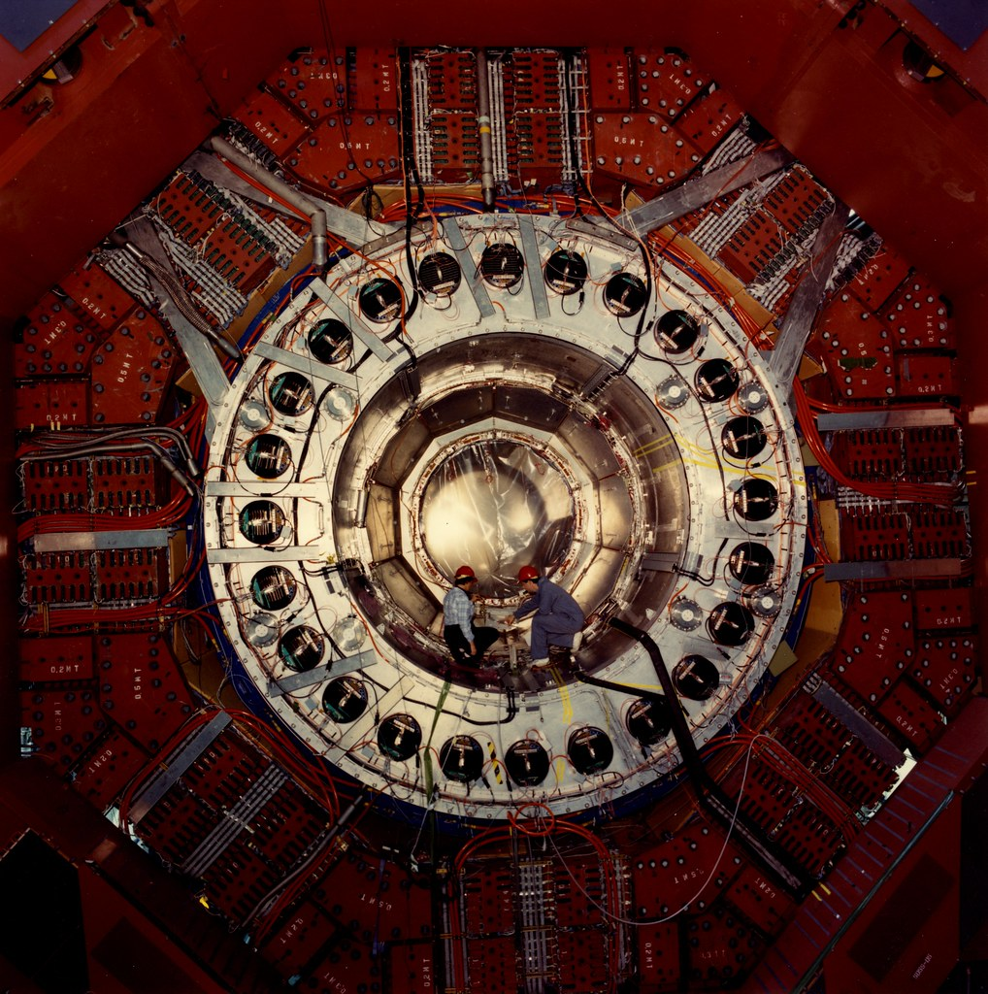
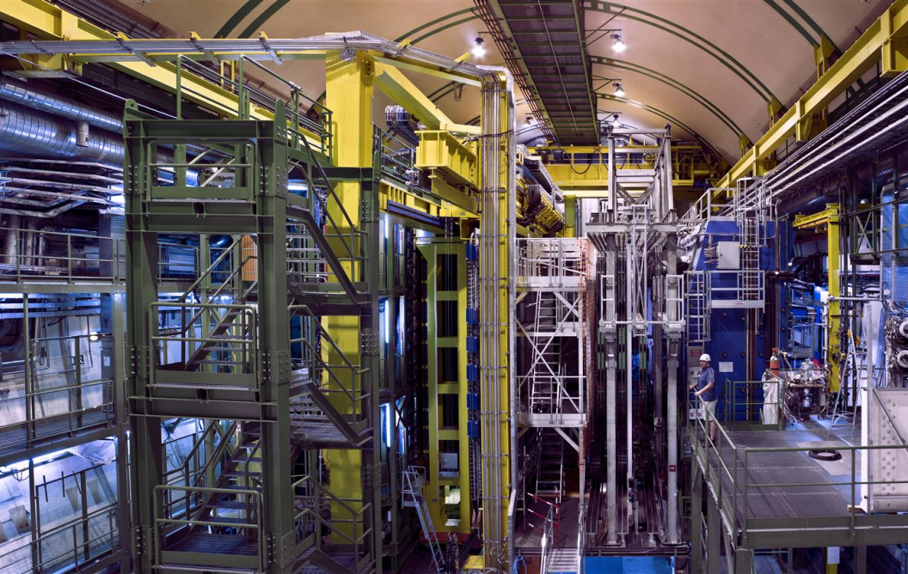
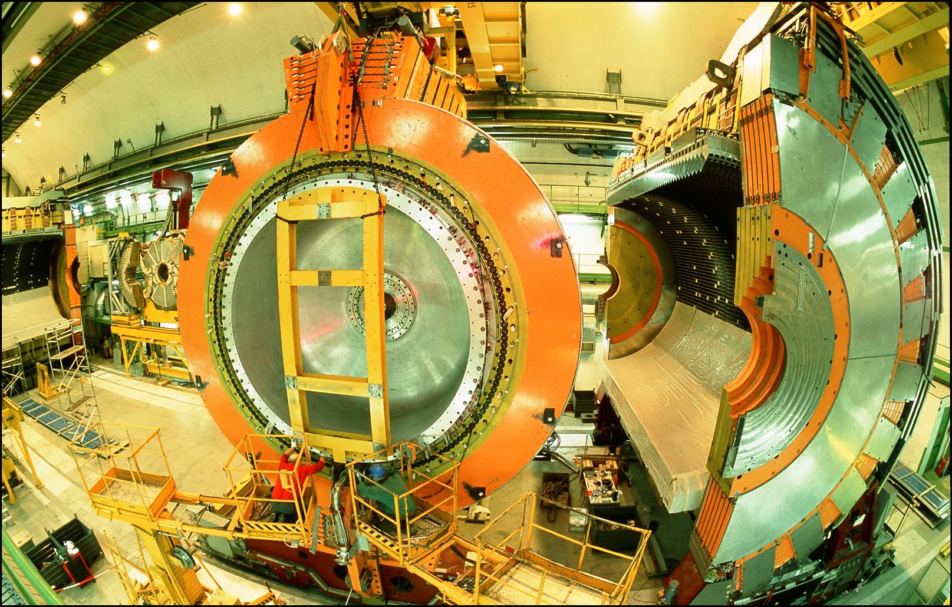
LOCATION, LOCATION, LOCATION
ALICE
CDF
ALEPH
FASER
Pilot Detector
Suitcase-size
4 Weeks
$0 (recycled parts)
6 ν candidates
ATLAS
All Previous
Collider Detectors
Building-size
Decades
$billions
0 ν candidates
>>
DELPHI
D0
CMS
L3
SLD
LHCb
OPAL
…

Slide 19
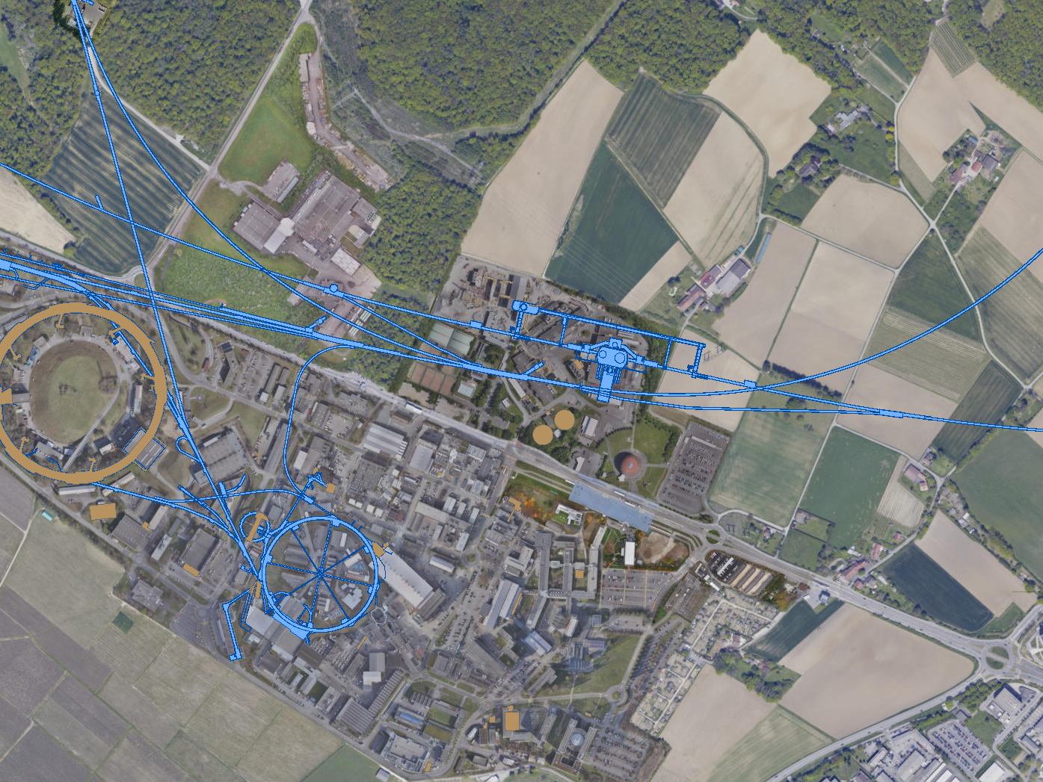
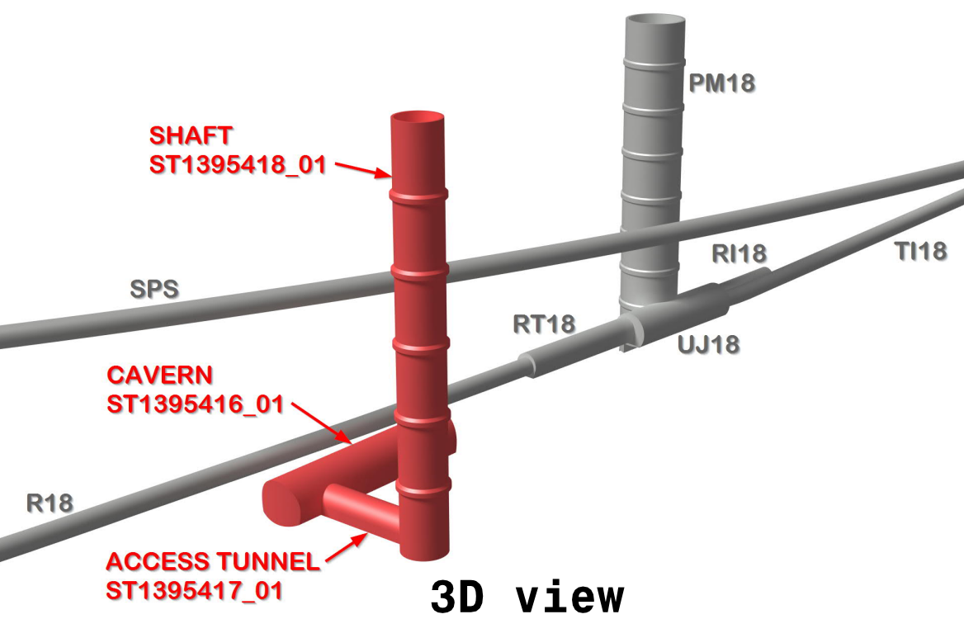
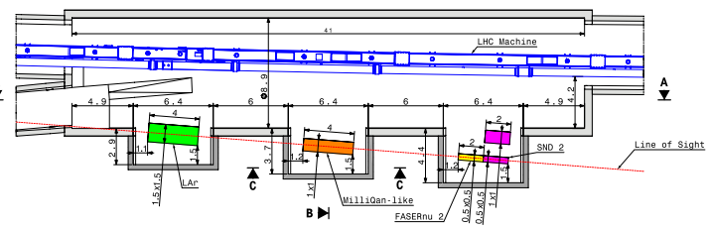
FORWARD PHYSICS FACIILITY
Possibilities under active investigation:
enlarge existing cavern UJ12 with alcoves for each experiment
create a new shaft and cavern ~612 m from ATLAS past UJ18
UJ18
ATLAS
SPS
UJ12
LHC
LOS
John Osborne, Kincso Balazs, Jonathan Gall
see John Osborne’s talk, PBC Workshop 3/3/21
CERN GIS

Slide 20
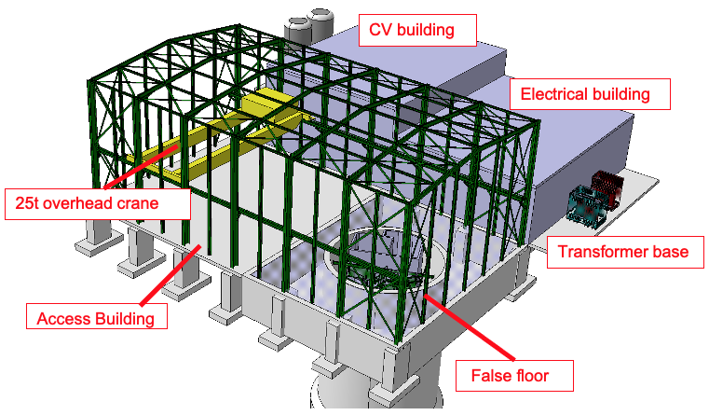
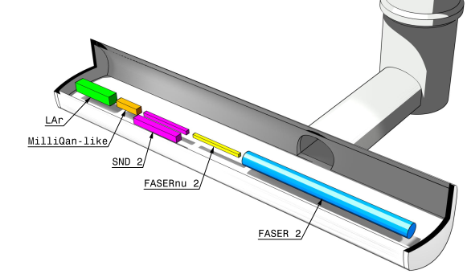
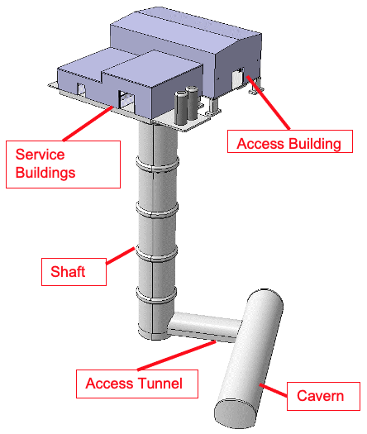
NEW SHAFT AND CAVERN
Many advantages
  Construction access far easier
  Access possible during LHC operations
  Flexible size and length of cavern (> 60 m)
  Designed around needs of the experiments
Design by Liam Dougherty (EN-ACE-INT)

Slide 21


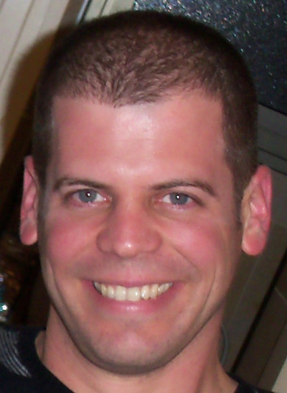
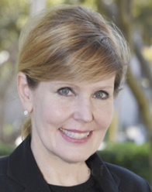
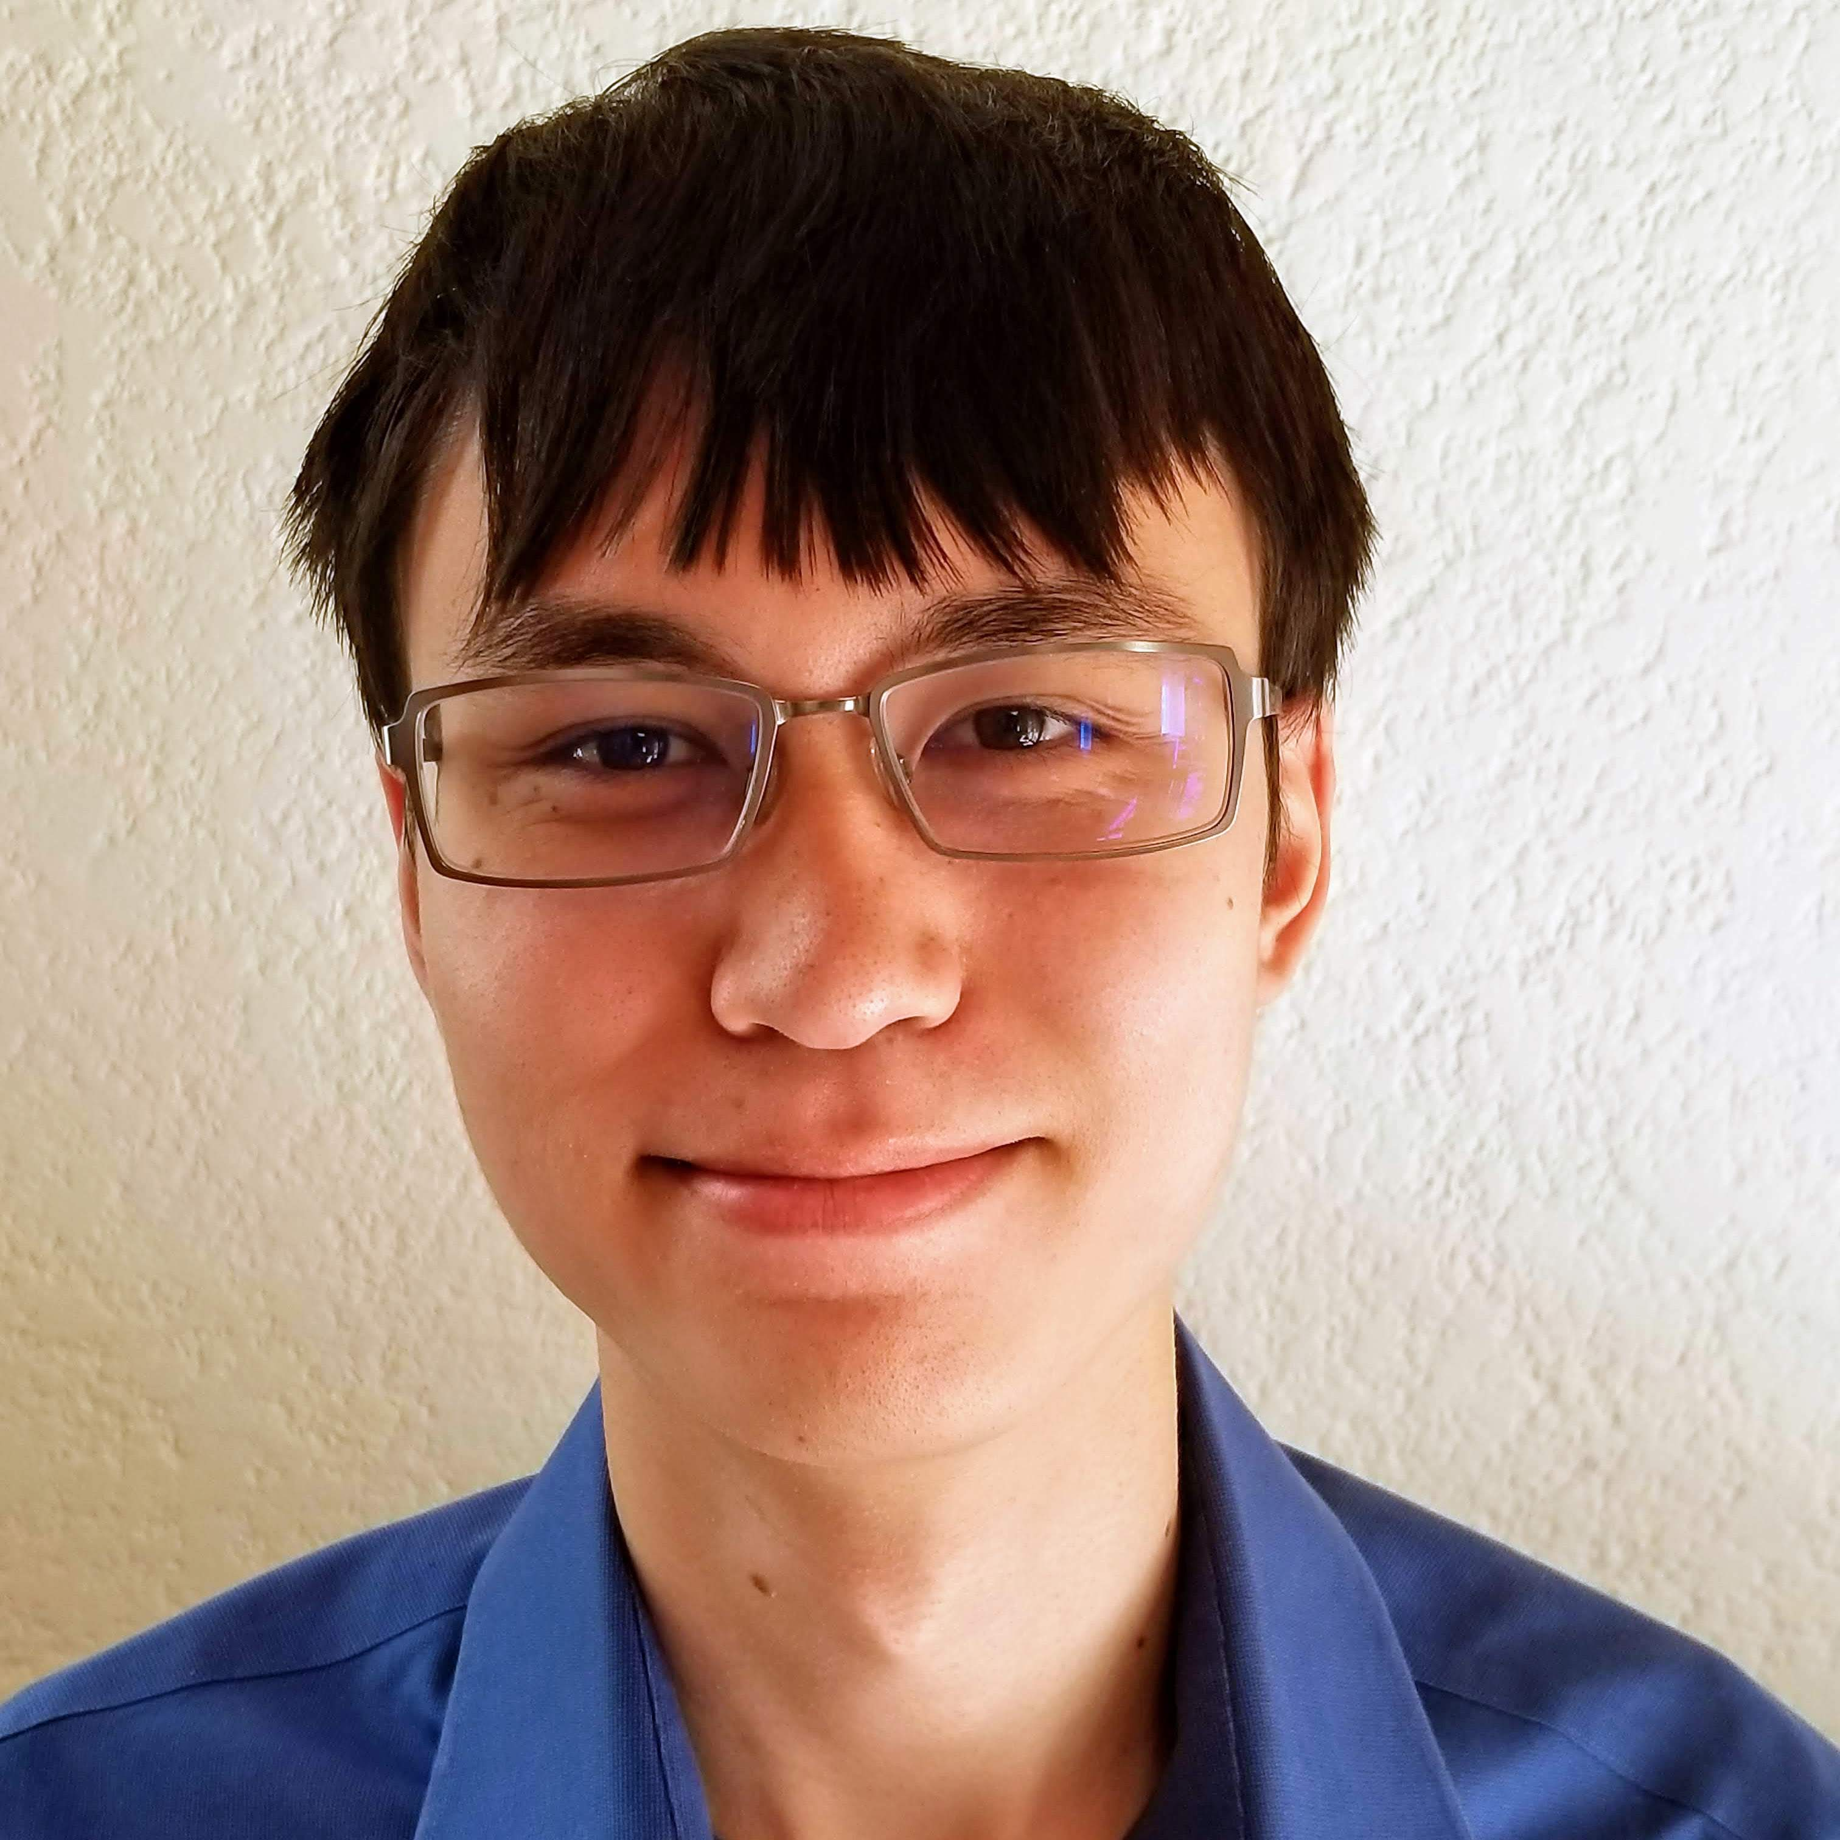
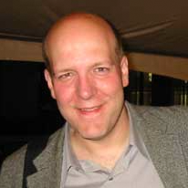

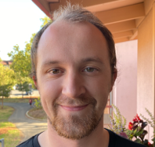
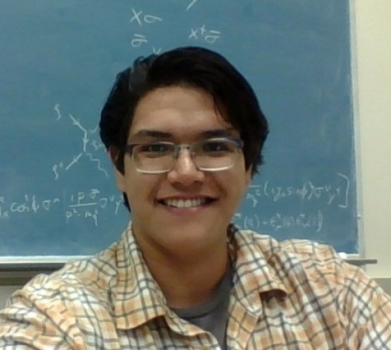
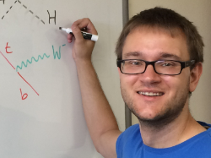

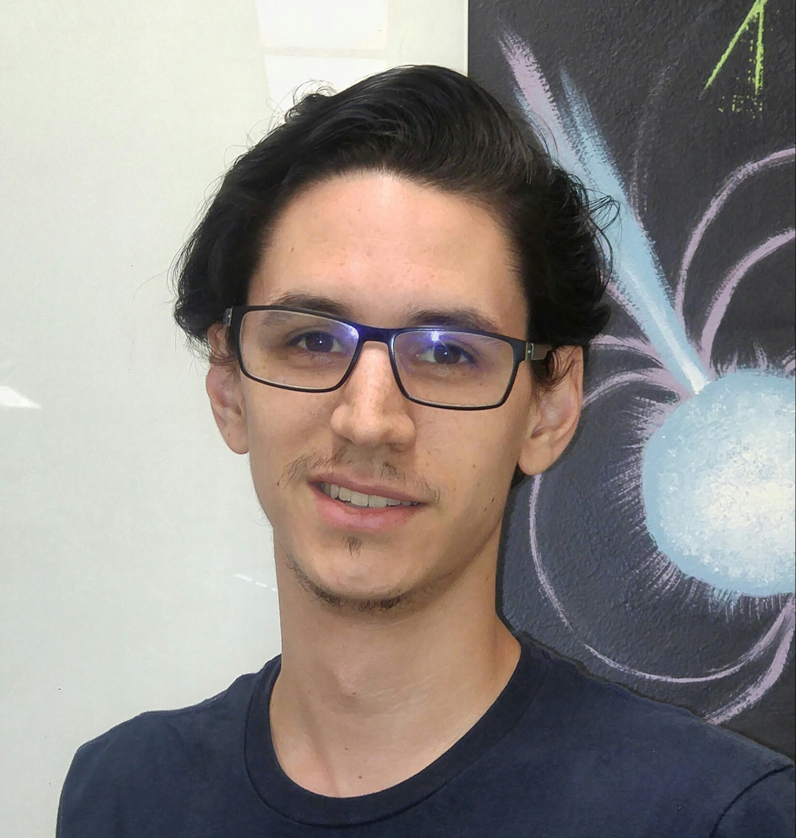
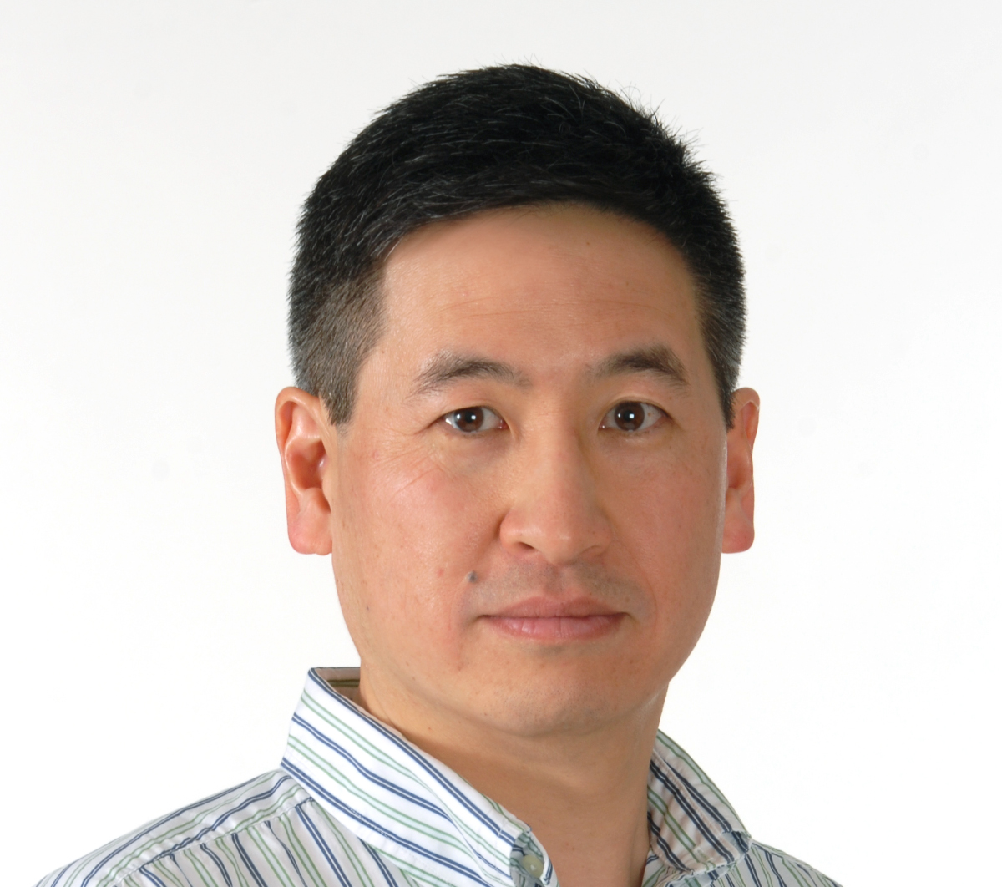

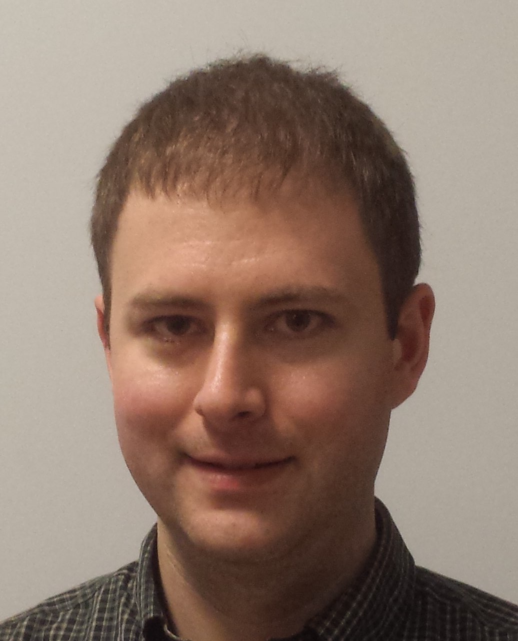
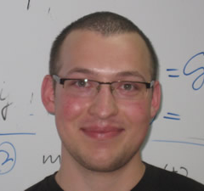









FASER AND FORWARD PHYSICS AT UCI
UNDERGRADS
GRADUATE STUDENTS
POSTDOCS
STAFF
FACULTY
SUPPORTERS
Jason Arakawa
Tyler Smith
Iftah Galon
Alison Lara
Alan Barkley-Yeung
Dave Casper
Max Fieg
Jordan Smolinsky
Felix Kling
Grace Park
Ryan Rice-Smith
Jonathan Feng
Johanna Paine
Aaron Soffa
Sebastian Trojanowski
Shelley Scallan
Kyungseop Yoon
Tim Tait
Corwin and Nancy Evans
Savannah Shively
Michael Waterbury
Mauro Valli
Chris Sepulveda

Slide 22



CONCLUSIONS
95% of the universe is waiting to be discovered.
Relatively small, fast, and cheap experiments can provide world-leading searches.
FASER was proposed in 2017, funded in 2018, approved in 2019, constructed in 2020, installed in 2021. In 2022, when the LHC turns on again, we will detect ~10,000 collider neutrinos, and, perhaps, get our first glimpse of the dark universe.
https://faser.web.cern.ch
Branigan, Symmetry Magazine (2019)

