Slide 1



UPDATES ON THE
FORWARD PHYSICS FACILITY
FOR THE HL-LHC
Snowmass EF09 (BSM General) Informal Gathering
30 April 2021
Jonathan Feng, UC Irvine

Slide 2
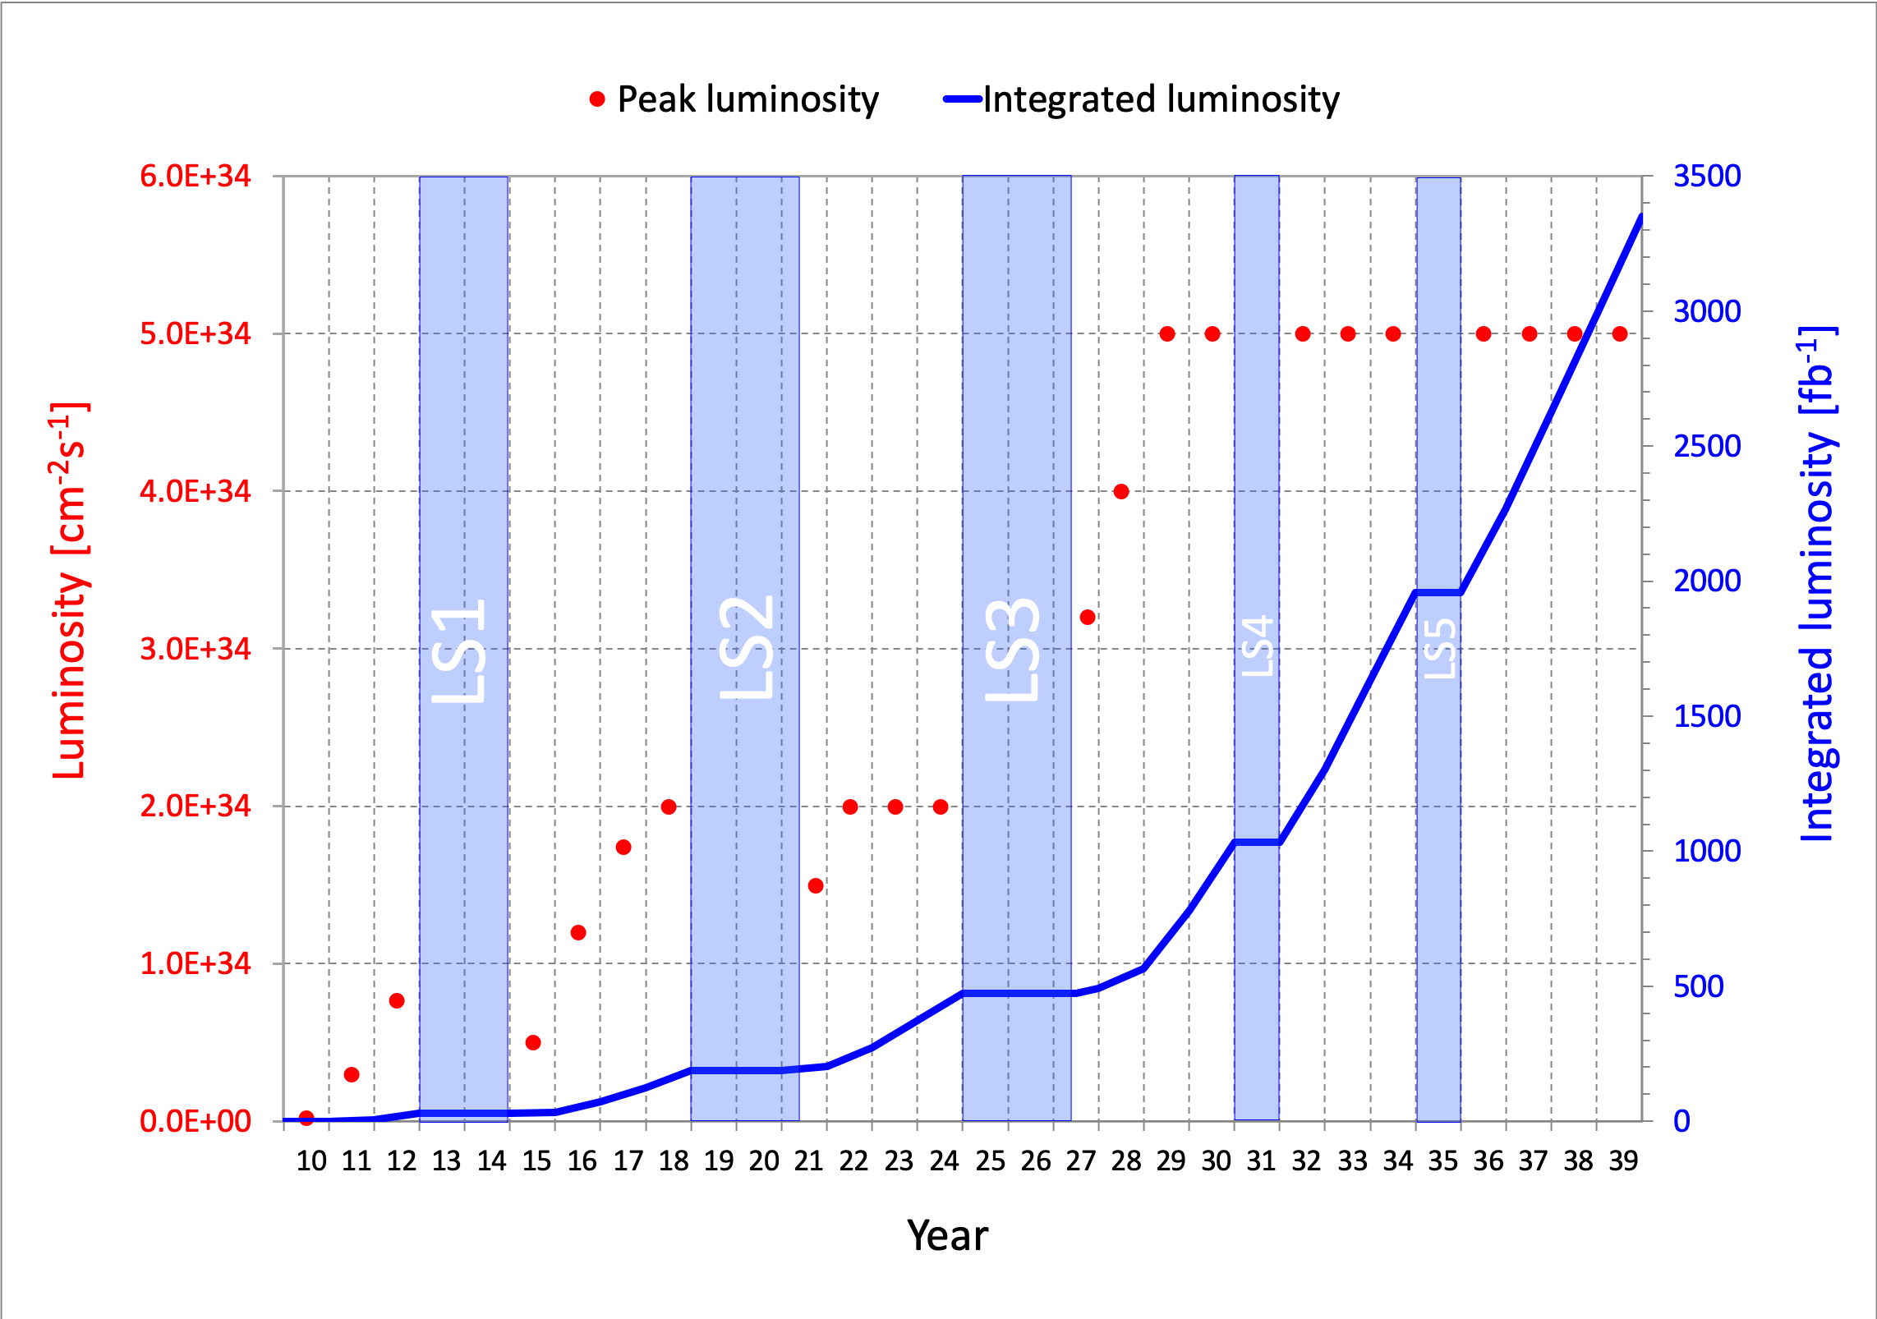
FORWARD PHYSICS FACILITY
A fact that should be better appreciated: we are in a critical period.
In the next year or two, we will either make plans to exploit new opportunities at the HL-LHC, or lose them until 2045, 2060, 2075, …, long after many of us are (professionally) dead.
The Forward Physics Facility is such an opportunity: an opportunity to explore a rich BSM and SM physics program in the far forward region with relatively little additional investment.

Slide 3
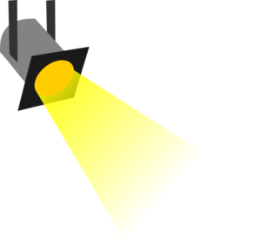

THE PARTICLE LANDSCAPE
Particle
Colliders
Mass
MeV
GeV
TeV
1
Already
Discovered
Strongly Interacting
Heavy Particles
New Targets of Small Experiments at the FPF: ν, LLPs, DM, …
Traditional Targets of Large Experiments at the LHC: SUSY, …
Interaction Strength
10⁻³
Weakly Interacting
Light Particles
Impossible to
Discover
10⁻⁶
100 mb
fb, pb, nb

Slide 4
UPDATES:
CIVIL ENGINEERING
BSM PHYSICS
SM PHYSICS
NEXT STEPS

Slide 5
CIVIL ENGINEERING

Slide 6
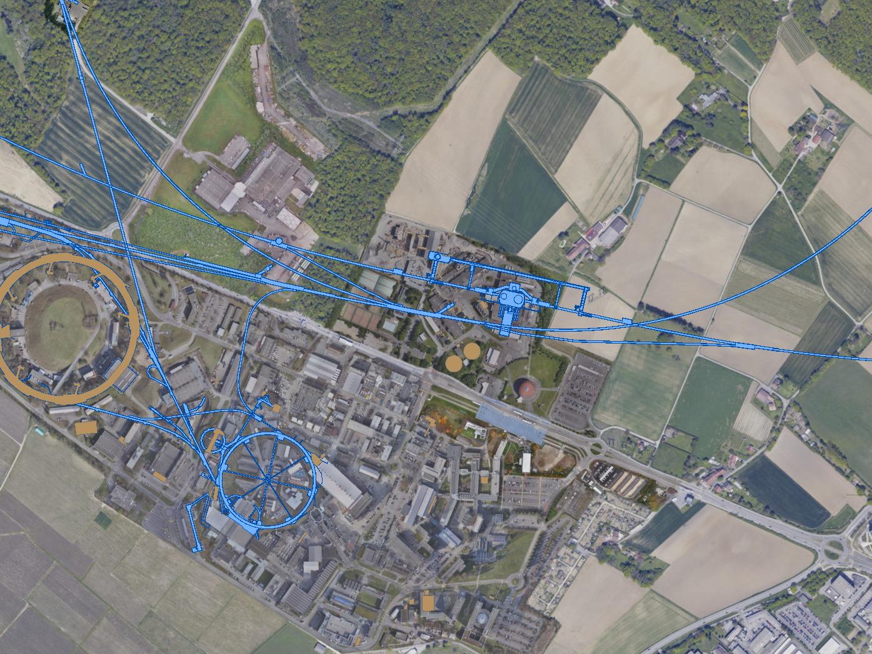
FAR FORWARD LHC EXPERIMENTS
The existing caverns UJ12 and UJ18 and adjacent tunnels are good locations for experiments along the LOS: 480 m from ATLAS and shielded from the ATLAS IP by ~100 m of rock.
UJ18
ATLAS
SPS
SND: approved March 2021
UJ12
LHC
FASER: approved March 2019
LOS
FASERν: approved December 2019
CERN GIS

Slide 7
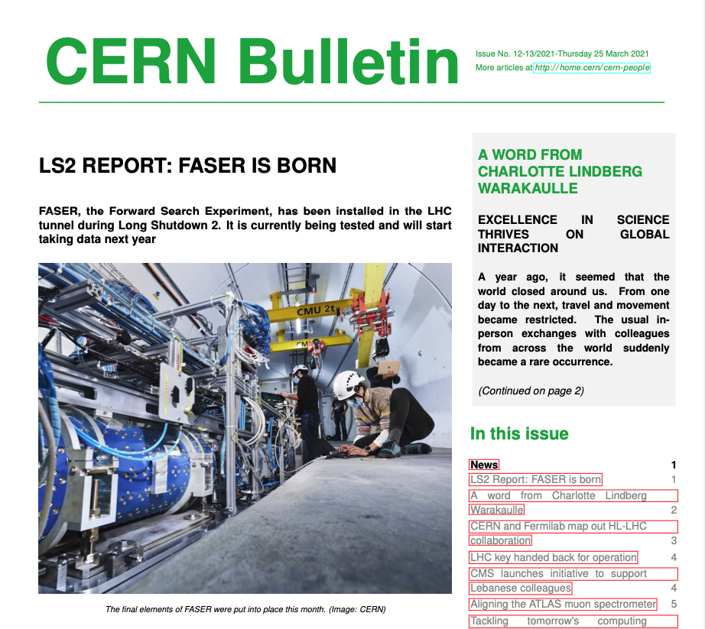
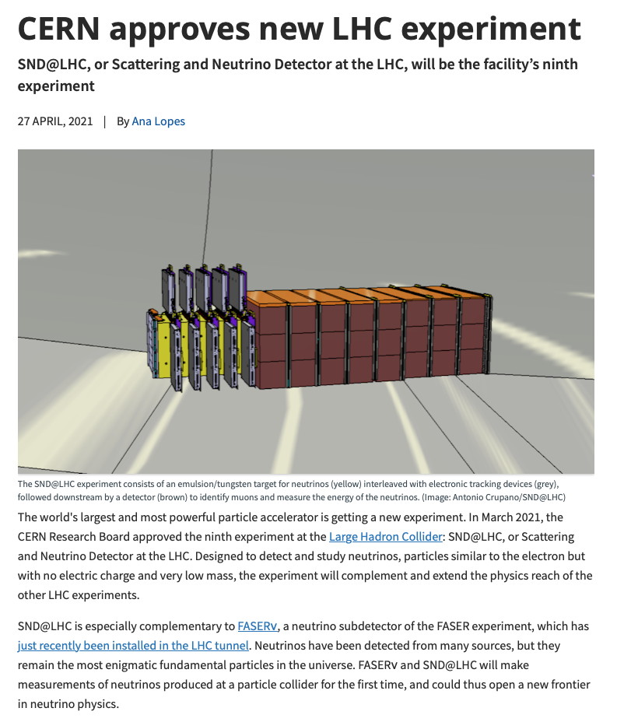
RECENT NEWS
25 March 2021
27 April 2021

Slide 8
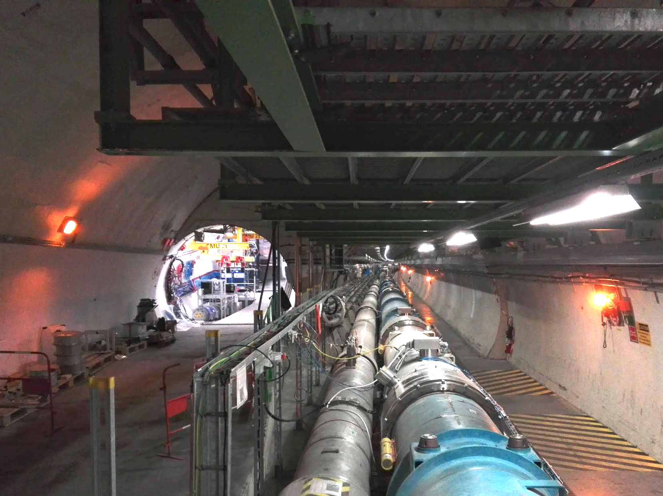
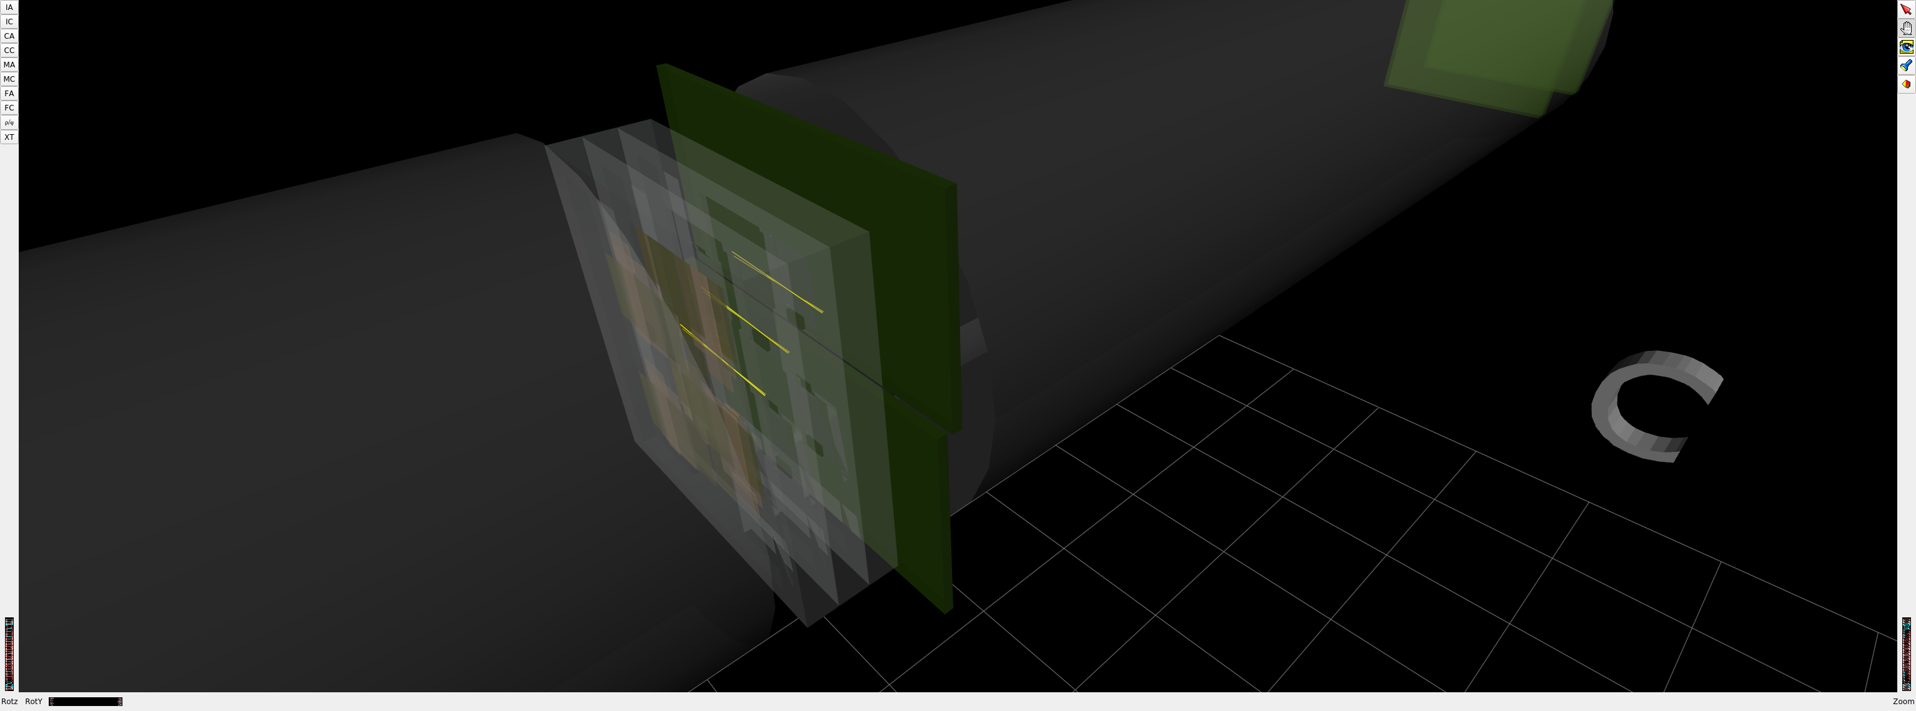
FASER CURRENT STATUS
Installation completed in March 2021
Commissioning with cosmics ongoing
No room for more experiments along the LOS in the existing tunnel
1st Cosmic Ray
18 March 2021

Slide 9
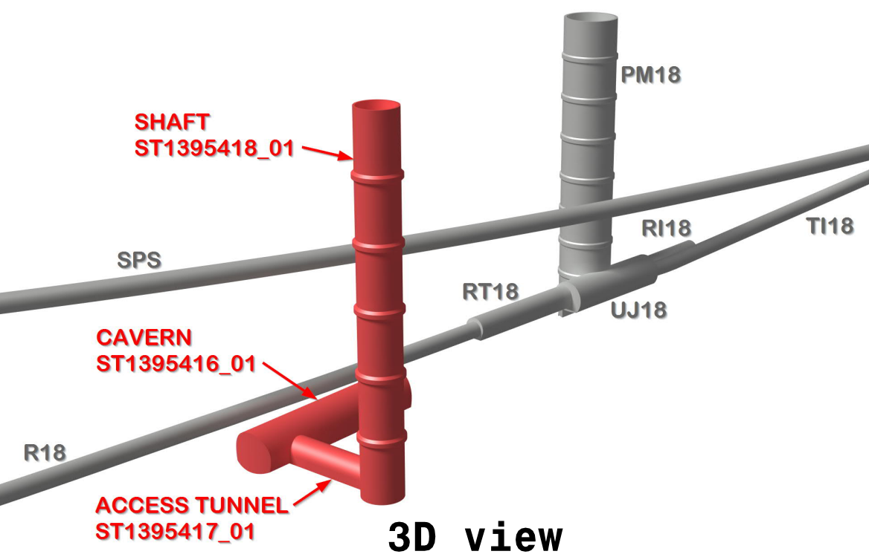
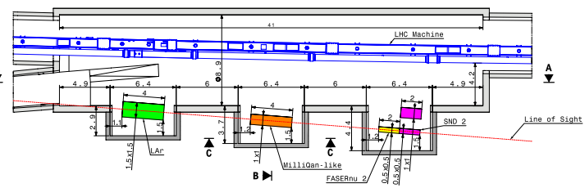
FPF LOCATION
Possibilities under active investigation:
enlarge existing cavern UJ12 with alcoves for each experiment
create a new shaft and cavern ~612 m from ATLAS past UJ18
UJ18
ATLAS
SPS
UJ12
LHC
LOS
John Osborne, Kincso Balazs, Jonathan Gall
see John Osborne’s talk, PBC Workshop 3/3/21
CERN GIS

Slide 10
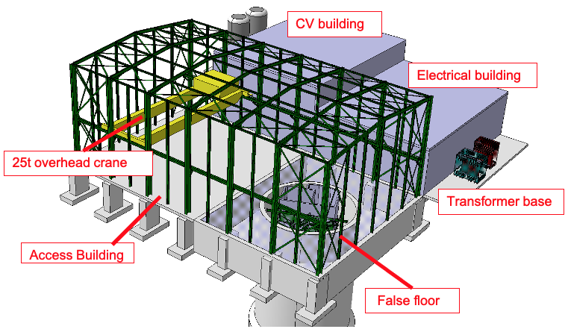
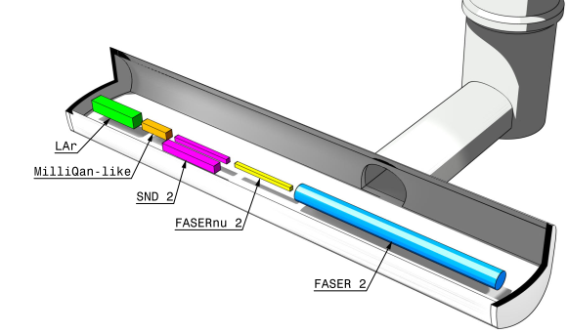
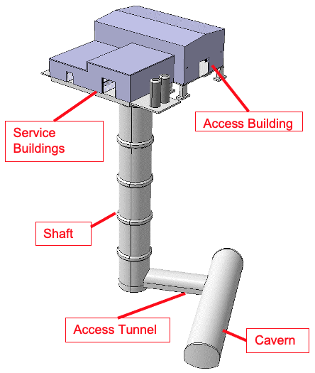
NEW SHAFT AND CAVERN
Many advantages
  Construction access far easier
  Access possible during LHC operations
  Flexible size and length of cavern (> 60 m)
  Designed around needs of the experiments
Design by Liam Dougherty (EN-ACE-INT)

Slide 11
BSM PHYSICS

Slide 12
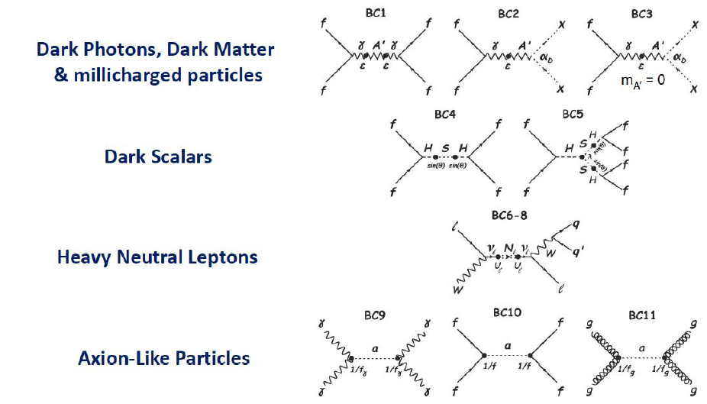
PBC BSM BENCHMARK CASES
11 models of light, weakly-interacting particles (LLPs, FIPs)

Slide 13
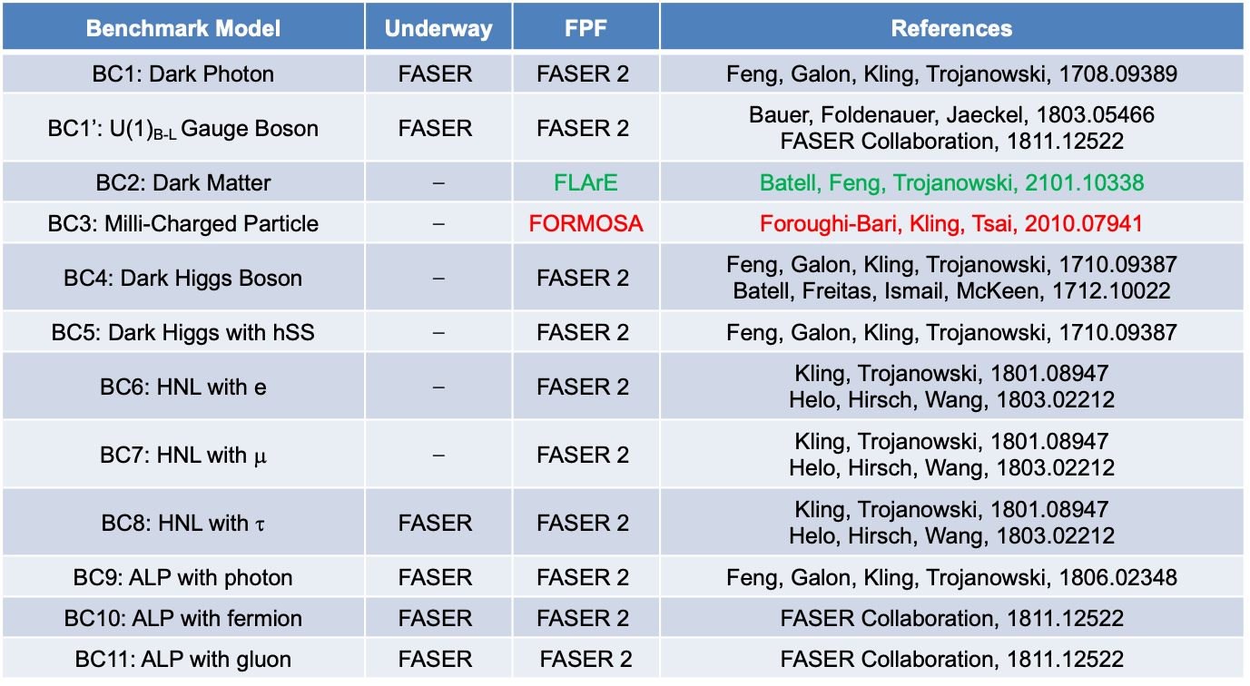
BSM SUMMARY
FASER and FASER2 are well-known to cover many, but not all, of the benchmarks.
Recent studies have shown that FPF experiments can discover new physics in the remaining two PBC benchmark cases (BC2 and BC3).
Benchmark Model | Underway | FPF | References
BC1: Dark Photon | $$\text{FASER}$$ | $$\text{FASER}\text{ 2}$$ | Feng, Galon, Kling, Trojanowski, 1708.09389
BC1’: U(1)_{B-L} Gauge Boson | $$\text{FASER}$$ | $$\text{FASER}\text{ 2}$$ | Bauer, Foldenauer, Jaeckel, 1803.05466 FASER Collaboration, 1811.12522
BC2: Dark Matter | ⎼ | FLArE | Batell, Feng, Trojanowski, 2101.10338
BC3: Milli-Charged Particle | ⎼ | FORMOSA | Foroughi-Bari, Kling, Tsai, 2010.07941
BC4: Dark Higgs Boson | ⎼ | $$\text{FASER}\text{ 2}$$ | Feng, Galon, Kling, Trojanowski, 1710.09387 Batell, Freitas, Ismail, McKeen, 1712.10022
BC5: Dark Higgs with hSS | ⎼ | $$\text{FASER}\text{ 2}$$ | Feng, Galon, Kling, Trojanowski, 1710.09387
BC6: HNL with e | ⎼ | $$\text{FASER}\text{ 2}$$ | Kling, Trojanowski, 1801.08947 Helo, Hirsch, Wang, 1803.02212
BC7: HNL with μ | ⎼ | $$\text{FASER}\text{ 2}$$ | Kling, Trojanowski, 1801.08947 Helo, Hirsch, Wang, 1803.02212
BC8: HNL with τ | $$\text{FASER}$$ | $$\text{FASER}\text{ 2}$$ | Kling, Trojanowski, 1801.08947 Helo, Hirsch, Wang, 1803.02212
BC9: ALP with photon | $$\text{FASER}$$ | $$\text{FASER}\text{ 2}$$ | Feng, Galon, Kling, Trojanowski, 1806.02348
BC10: ALP with fermion | $$\text{FASER}$$ | $$\text{FASER}\text{ 2}$$ | FASER Collaboration, 1811.12522
BC11: ALP with gluon | $$\text{FASER}$$ | $\text{FASER}$ 2 | FASER Collaboration, 1811.12522

Slide 14
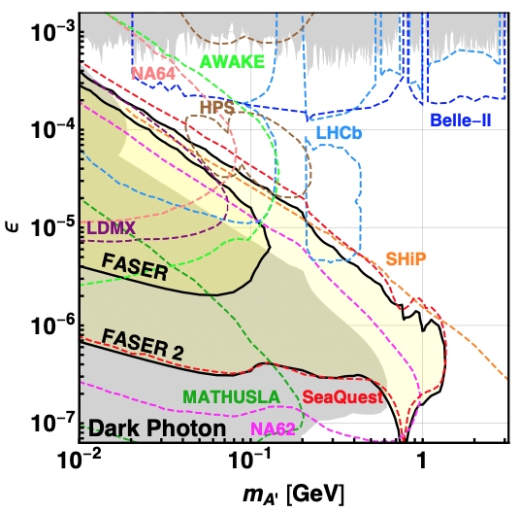
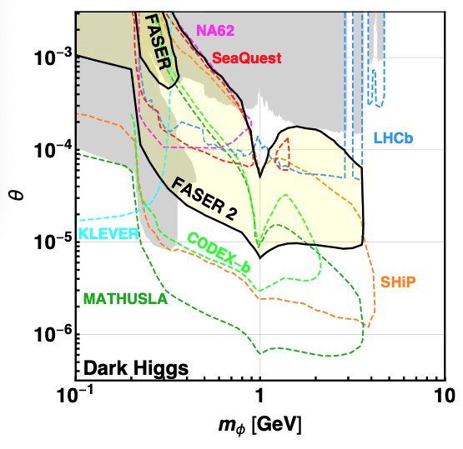
BCs 1, 4-11: LLPS AT FASER AND FASER 2
FASER can discover new physics in some of these models with 1 fb⁻¹.
The Forward Physics Facility will provide space to upgrade
  FASER (R=10cm, L=1.5m, Run 3) → FASER 2 (R=1m, L=5m, HL-LHC), either extending sensitivity greatly (e.g., dark photon), or providing new discovery prospects (e.g., dark Higgs) complementary to other expts.
FASER Collaboration, 1811.12522 (2018)

Slide 15
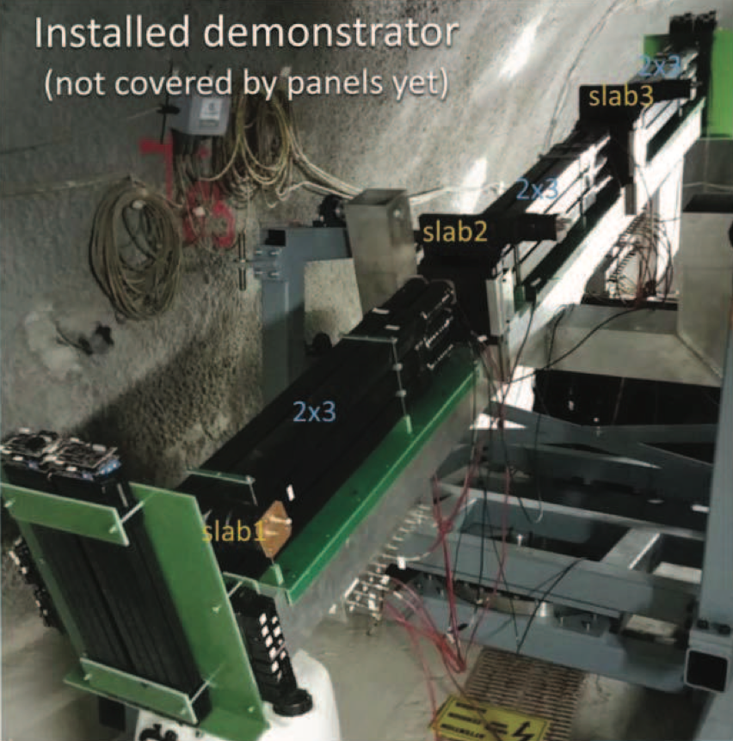
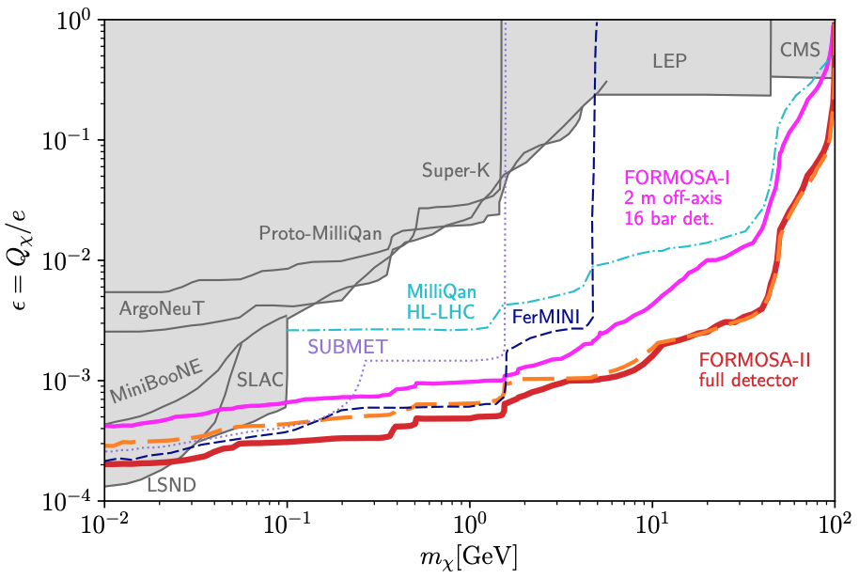
BC2: MILLI-CHARGED PARTICLES
Currently the target of the MilliQan experiment near the CMS IP.
MilliQan Demonstrator (Proto-MilliQan) already probes new region. Full MilliQan planned to run in this location at HL-LHC, but the sensitivity can be improved significantly by moving it to the FPF (FORMOSA).
Foroughi-Abari, Kling, Tsai (2020)

Slide 16
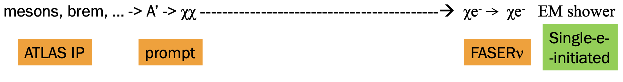
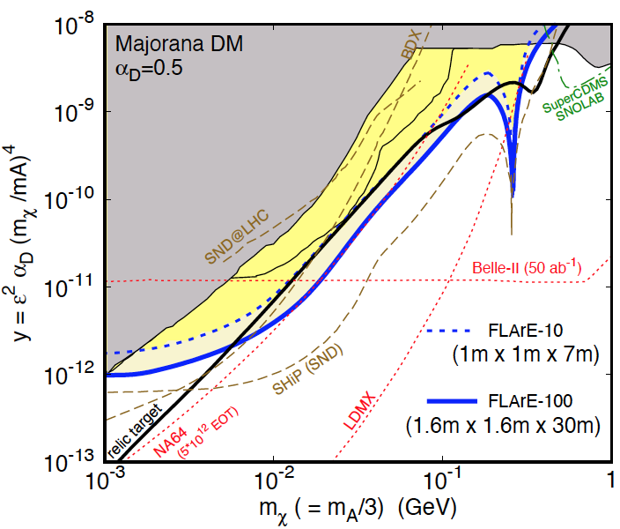
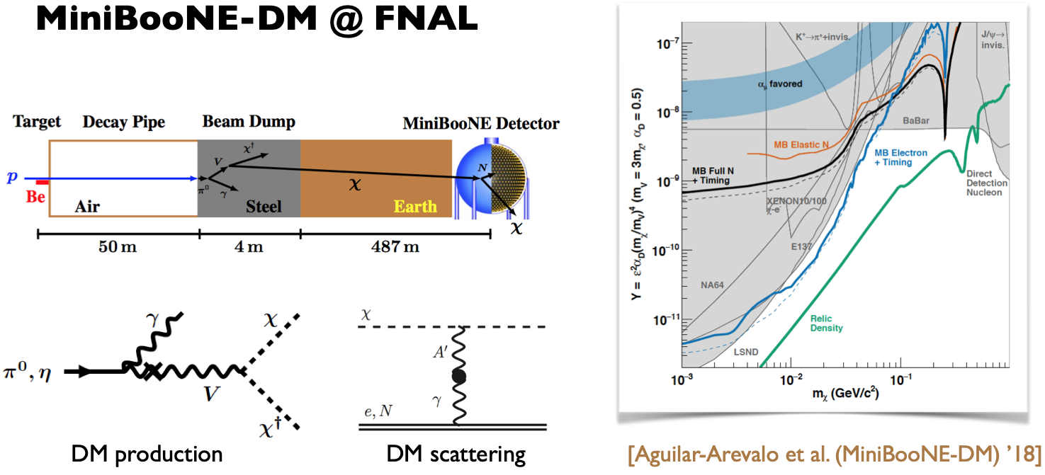

BC3: DARK MATTER
If m_{LLP} > 2m_{DM} , the LLP will typically decay to dark matter, leading to a highly collimated beam of dark matter particles.
Can look for the resulting DM to scatter off electrons at FLArE, Forward Liquid Argon Experiment, a proposed 10 to 100 tonne LArTPC.
FLArE probes most of the favored/ allowed relic target region. Complementary to missing energy experiments that probe more of the “too large $Ω_{χ}h^{2}$” region, but don’t detect DM scattering.
Batell, Feng, Trojanowski (2021)

Slide 17
SM PHYSICS

Slide 18
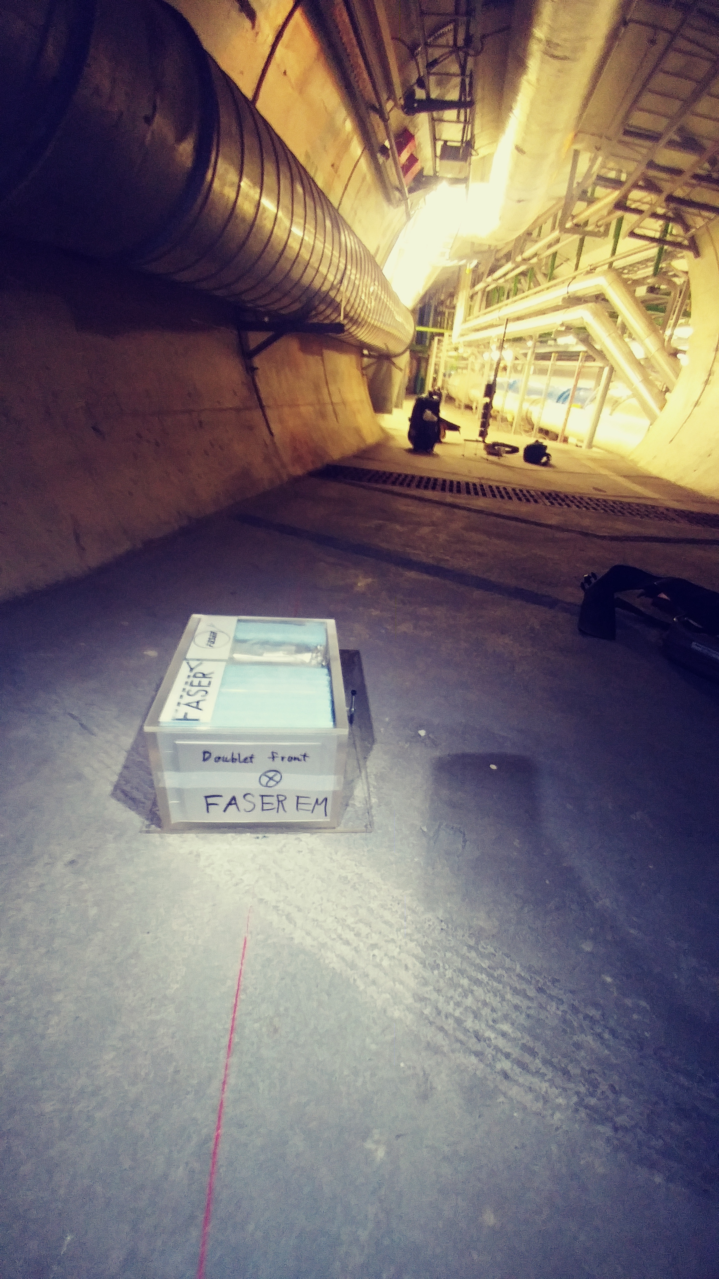
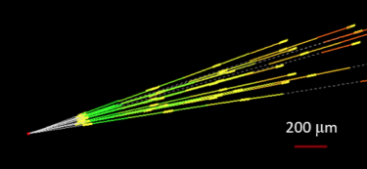
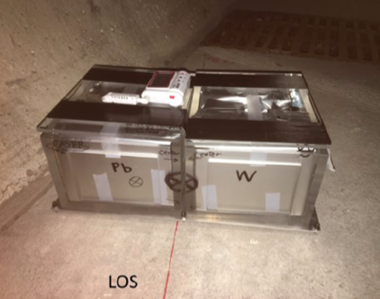
FIRST COLLIDER NEUTRINOS
No collider neutrino has ever been detected.
But there is a huge flux of TeV neutrinos in the far forward direction.
De Rujula, Ruckl (1984); Winter (1990)
In 2018, the FASER Collaboration placed a 29 kg emulsion detector in the far forward region for 6 weeks (inserted and removed in TSs).
Expect ~few neutrino interactions. Several neutral vertices have been identified, likely to be neutrinos. Paper expected soon.

Slide 19
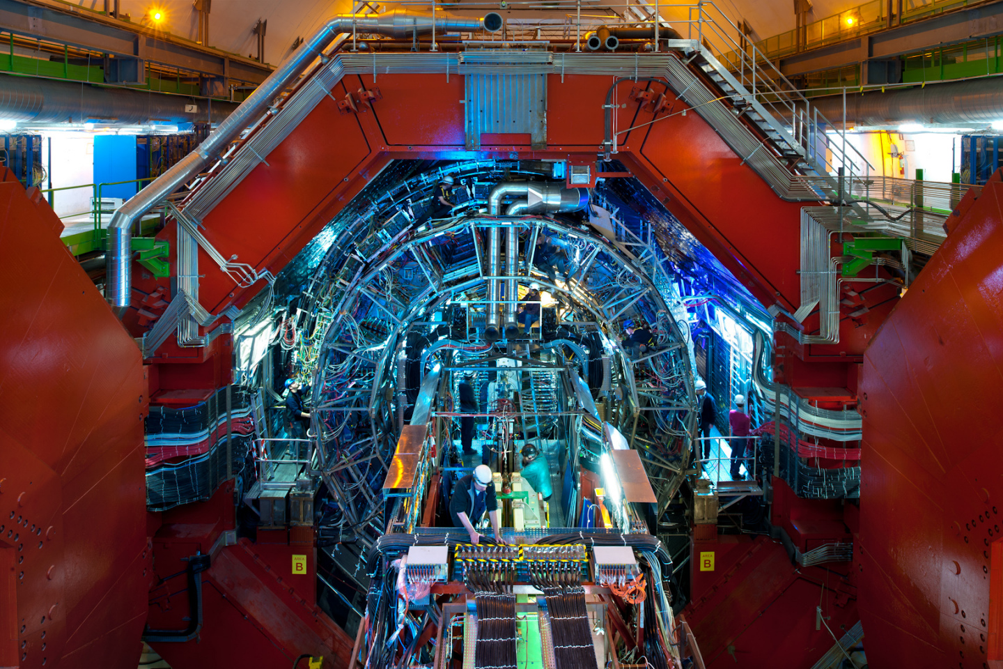
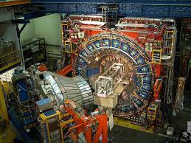
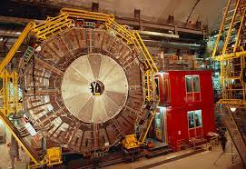
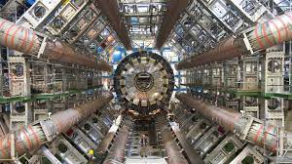
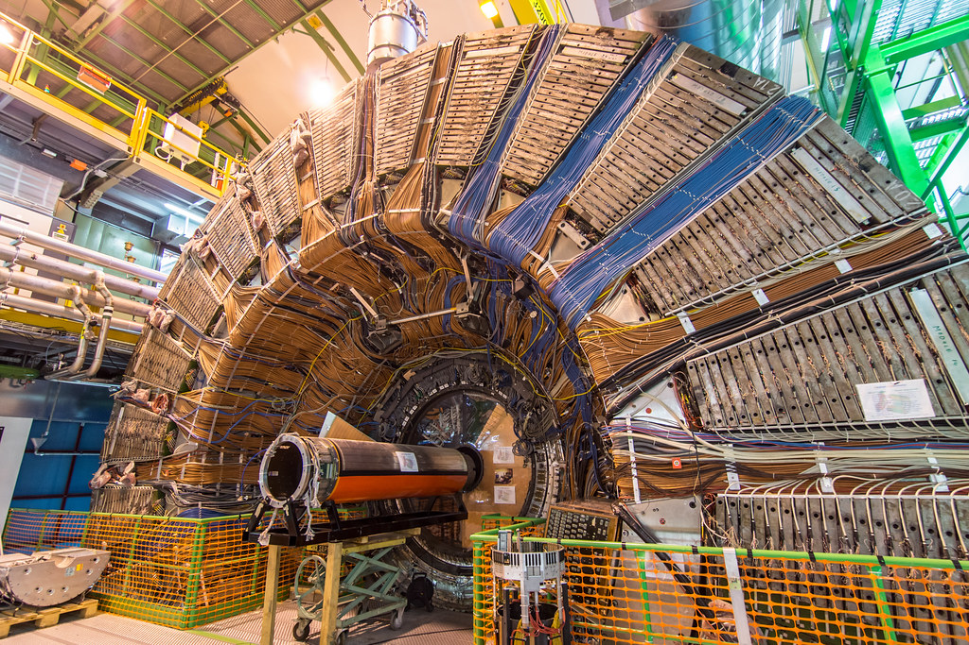
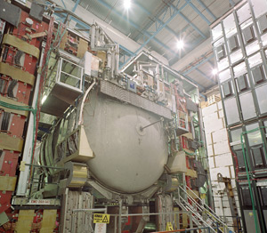
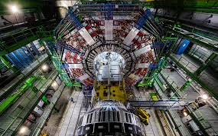
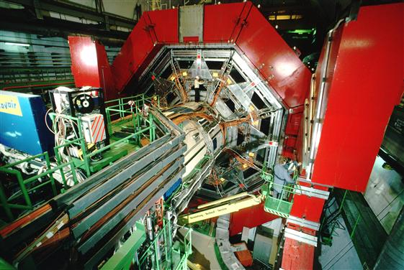
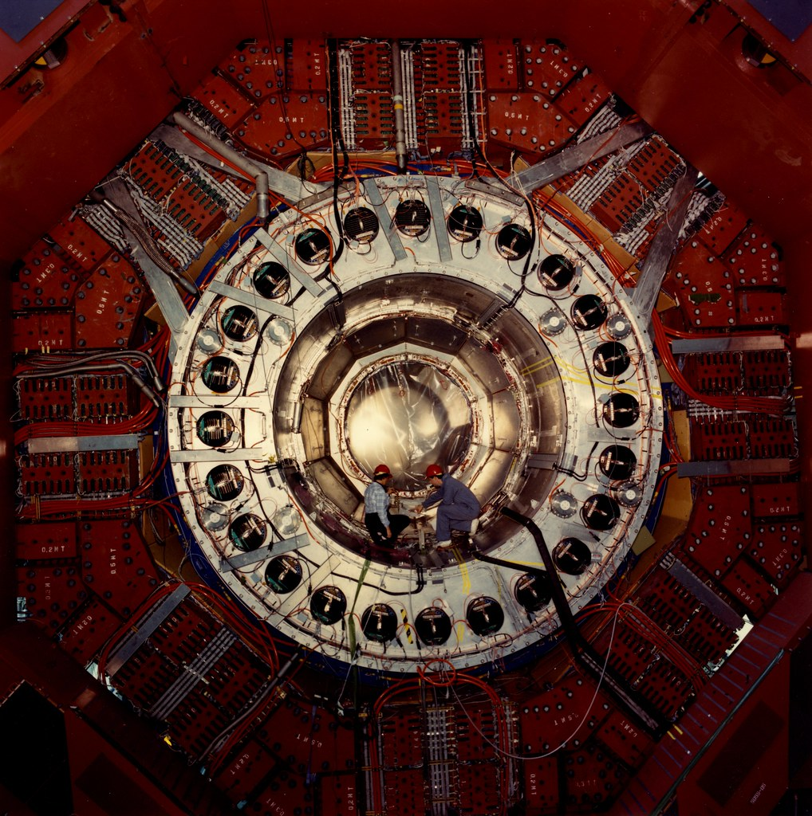
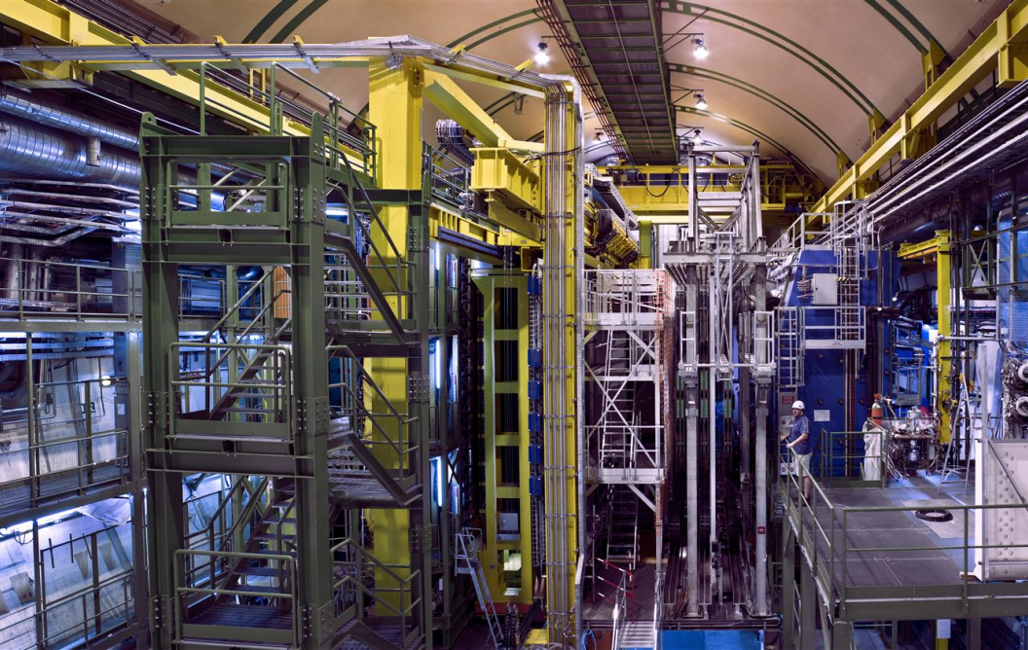
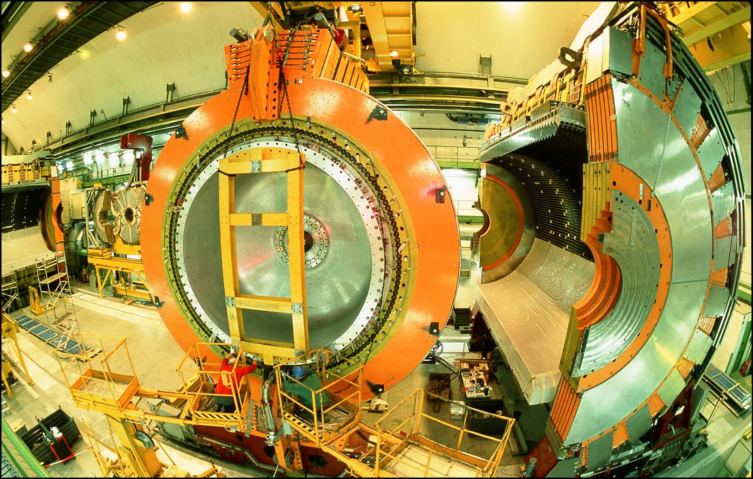
LOCATION, LOCATION, LOCATION
>>
…

Slide 20
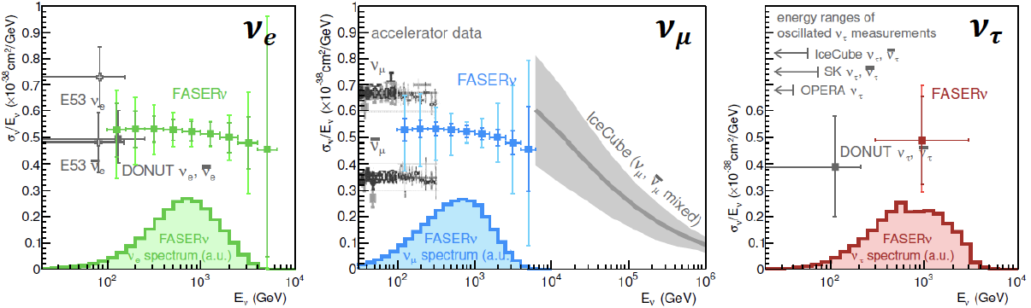
NEUTRINO PHYSICS
Run 3: FASERν (on-axis) and SND (off-axis), ~1-tonne emulsion/tungsten detectors, will open the new field of neutrino physics at the LHC
  Will record ~1000 ν_{e} , ~10,000 ν_{μ} , and ~10 ν_{τ} interactions at TeV energies, the first direct exploration of this energy range for all 3 flavors
HL-LHC: FPF will accommodate FASERν2 / SND2 (~10-tonne emulsion detectors), FLArE (10+ tonne LArTPC), FORMOSA, …
  Will record ~10⁵ ν_{e} , ~10⁶ ν_{μ} , and ~10³ ν_{τ} interactions at TeV energies.
  Identify 1st anti-ν_{τ} , probe neutrino properties (NSIs, ν_{τ} MDM), …
1908.02310

Slide 21
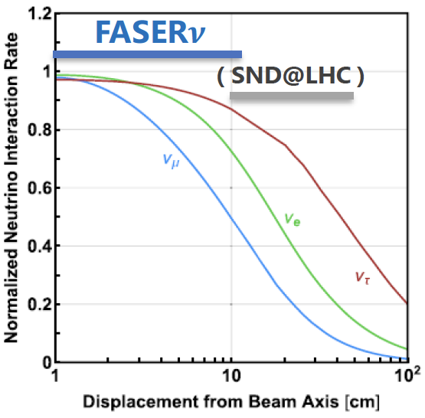


QCD PHYSICS
The forward production of hadrons is currently subject to large uncertainties. FPF experiments would provide useful insights.
  By accommodating both on-axis and off-axis neutrino detectors, could provide complementary information (π $→$ ν_{μ} , K $→$ ν_{e} , D $→$ ν_{τ} ).
  Different target nuclei (lead, tungsten) to probe different nuclear pdfs
  Strange quark pdf through νs $→$lc
  Forward charm production, intrinsic charm
  Refine simulations that currently vary greatly (EPOS-LHC, QGSJET, DPMJET, SIBYLL, PYTHIA…)
  Provide essential input to astroparticle experiments; e.g., distinguish galactic neutrino signal from atmospheric neutrino background at IceCube

Slide 22
NEXT STEPS

Slide 23
NEXT STEPS
Explore the full physics potential of the Forward Physics Facility
Identify the suite of experiments that will maximize the physics potential within the constraints of cost, schedule, safety, …. A fascinating and multi-faceted optimization problem!
The FPF Kickoff Workshop was held 9-10 November 2020
  40 talks, fascinating discussions across a broad range of topics
  For talk slides and recordings, see https://indico.cern.ch/event/955956
Snowmass EF06 meeting on SM physics at the FPF will be 5 May 2021
The 2nd FPF Workshop will be 27-28 May 2021
  https://indico.cern.ch/event/1022352
  Questions? Contact Jonathan Feng, Maria Vittoria Garzelli, Felix Kling

