Slide 1
FORWARD PHYSICS FACILITY
AT THE LHC
Physics Beyond Colliders Annual Workshop
1-4 March 2021
Jonathan Feng, UC Irvine

Slide 2
FORWARD PHYSICS FACILITY
As the LHC runs at much higher luminosities in the next 15+ years, how can its potential be maximally exploited?
Upgrades for the HL-LHC era have focused on high p_{T} / low cross section physics (~fb, pb, nb).
But the total cross section is ~100 mb, and most of these events (and most of the highest energy particles) are in the far forward region / low p_{T}.
In recent years, it has become clear that there is a rich physics program that remains to be explored in the far forward region, and this can be done with relatively little additional investment.
The proposal: create a Forward Physics Facility for the HL-LHC to house a suite of experiments that will greatly enhance the LHC’s potential for both BSM physics (LLPs, FIPs, milli-charged particles, dark matter, dark sectors) and SM physics (neutrinos, QCD, cosmic ray physics).

Slide 3
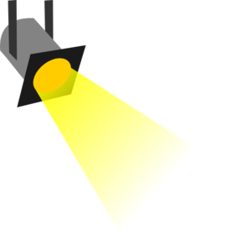
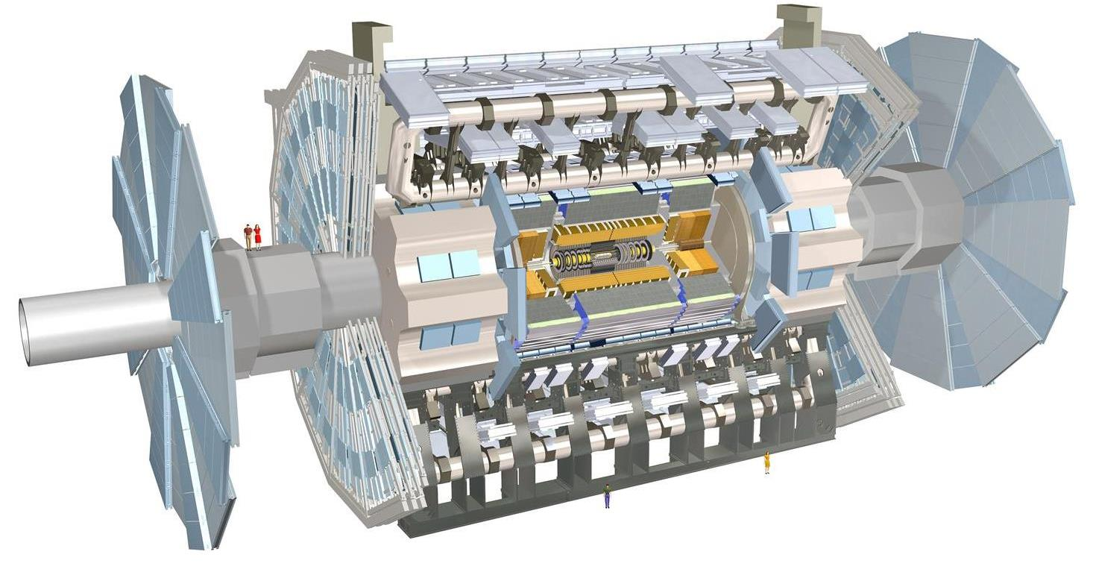
THE PARTICLE LANDSCAPE
Particle
Colliders
Mass
MeV
GeV
TeV
1
Already
Discovered
Strongly Interacting
Heavy Particles
New Targets of Small Experiments at the FPF: ν, LLPs, DM, …
Traditional Targets of Large Experiments at the LHC: SUSY, …
Interaction Strength
10⁻³
Weakly Interacting
Light Particles
Impossible to
Discover
10⁻⁶

Slide 4
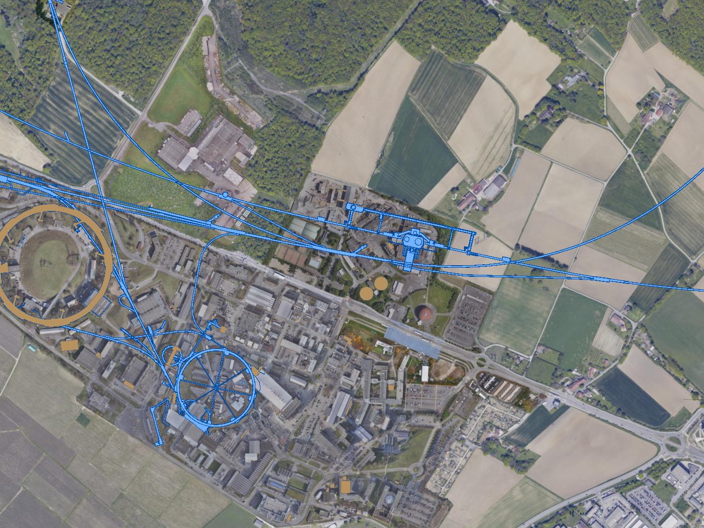
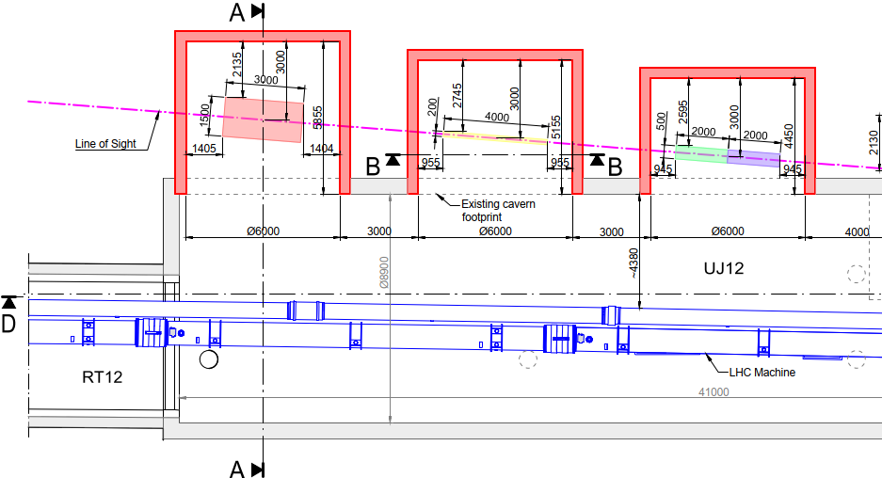
FPF LOCATION
See John Osborne’s talk
Possibilities under active investigation: enlarge existing cavern UJ12, 480 m from ATLAS and shielded from the ATLAS IP by ~100 m of rock; or create a new shaft and cavern ~612 m from ATLAS past UJ18.
UJ18
ATLAS
SPS
UJ12
LHC
LOS
CERN GIS

Slide 5
BSM PHYSICS

Slide 6
PBC BSM BENCHMARK CASES
11 models of light, weakly-interacting particles (LLPs, FIPs)

Slide 7
FPF DISCOVERY PROSPECTS
The discovery prospects for FASER and FASER 2 are well-studied by the PBC
Recent studies show the promise of the FPF for exploring all the BCs
Benchmark Model | Underway | FPF | References
BC1: Dark Photon | $$\text{FASER}$$ | $$\text{FASER}\text{ 2}$$ | Feng, Galon, Kling, Trojanowski, 1708.09389
BC1’: U(1)_{B-L} Gauge Boson | $$\text{FASER}$$ | $$\text{FASER}\text{ 2}$$ | Bauer, Foldenauer, Jaeckel, 1803.05466 FASER Collaboration, 1811.12522
BC2: Dark Matter | ⎼ | FLArE | Batell, Feng, Trojanowski, 2101.10338
BC3: Milli-Charged Particle | ⎼ | FORMOSA | Foroughi-Bari, Kling, Tsai, 2010.07941
BC4: Dark Higgs Boson | ⎼ | $$\text{FASER}\text{ 2}$$ | Feng, Galon, Kling, Trojanowski, 1710.09387 Batell, Freitas, Ismail, McKeen, 1712.10022
BC5: Dark Higgs with hSS | ⎼ | $$\text{FASER}\text{ 2}$$ | Feng, Galon, Kling, Trojanowski, 1710.09387
BC6: HNL with e | ⎼ | $$\text{FASER}\text{ 2}$$ | Kling, Trojanowski, 1801.08947 Helo, Hirsch, Wang, 1803.02212
BC7: HNL with μ | ⎼ | $$\text{FASER}\text{ 2}$$ | Kling, Trojanowski, 1801.08947 Helo, Hirsch, Wang, 1803.02212
BC8: HNL with τ | $$\text{FASER}$$ | $$\text{FASER}\text{ 2}$$ | Kling, Trojanowski, 1801.08947 Helo, Hirsch, Wang, 1803.02212
BC9: ALP with photon | $$\text{FASER}$$ | $$\text{FASER}\text{ 2}$$ | Feng, Galon, Kling, Trojanowski, 1806.02348
BC10: ALP with fermion | $$\text{FASER}$$ | $$\text{FASER}\text{ 2}$$ | FASER Collaboration, 1811.12522
BC11: ALP with gluon | $$\text{FASER}$$ | $\text{FASER}$ 2 | FASER Collaboration, 1811.12522

Slide 8
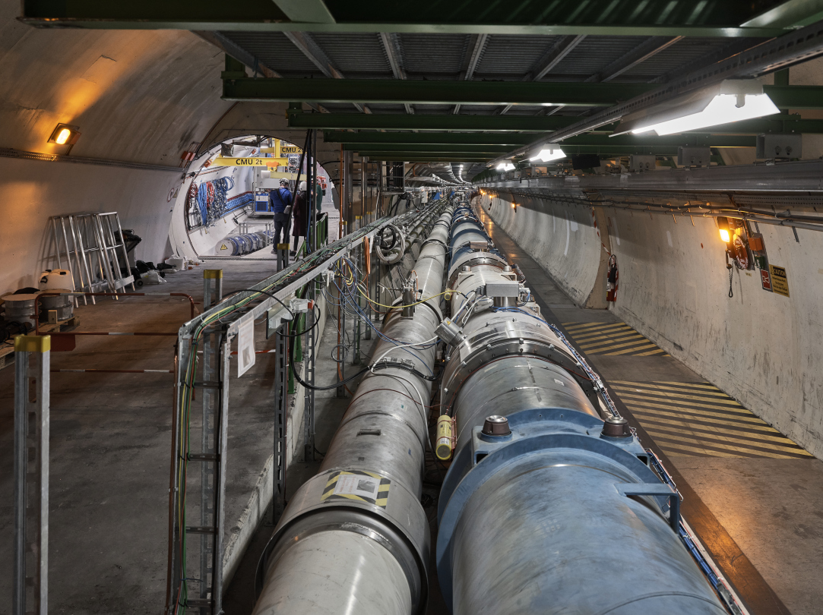
FASER CURRENT STATUS
FASER construction completed, partially installed in November 2020
Remaining FASER installation starts next week for 1 month
No room to upgrade FASER to FASER 2 in the existing, LEP-era tunnel

Slide 9
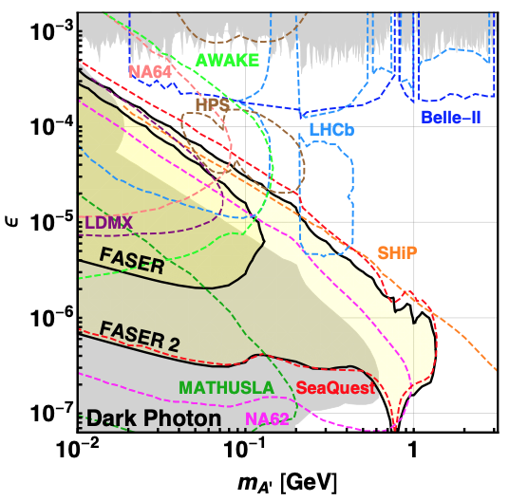
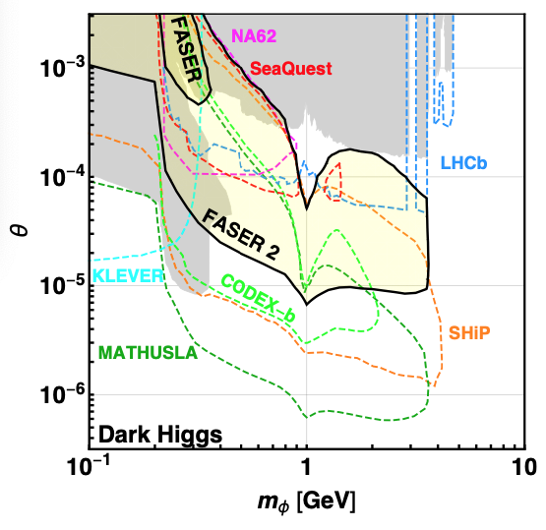
BC1, 4-11: LLPS AT FASER AND FASER 2
FASER probes new parameter space in some models with just 1 fb⁻¹.
The Forward Physics Facility will provide space to upgrade
FASER (R=10cm, L=1.5m, Run 3) → FASER 2 (R=1m, L=5m, HL-LHC), either extending sensitivity greatly (e.g., dark photon), or providing new discovery prospects (e.g., dark Higgs) complementary to other expts.
FASER Collaboration, 1811.12522 (2018)

Slide 10
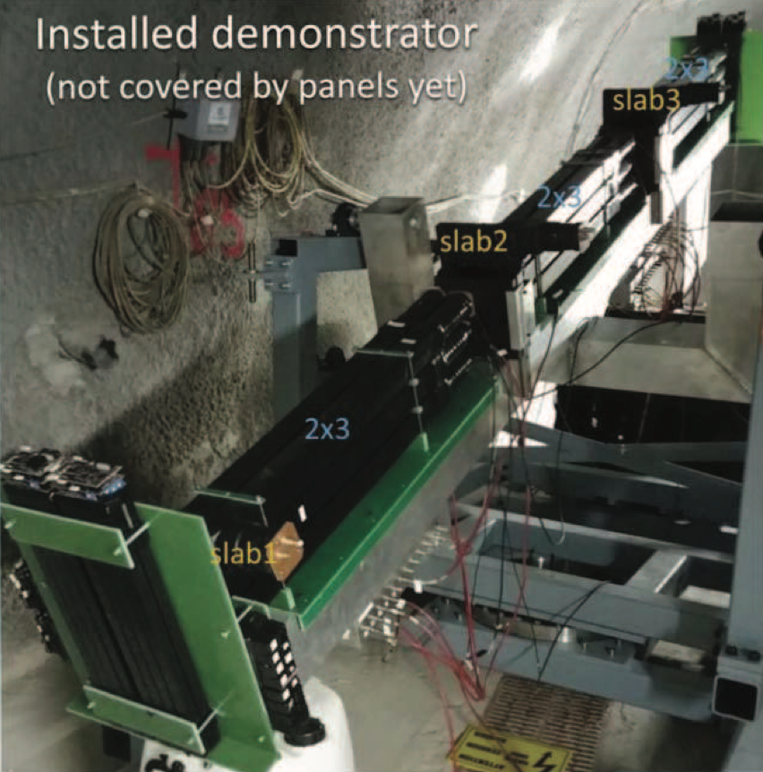
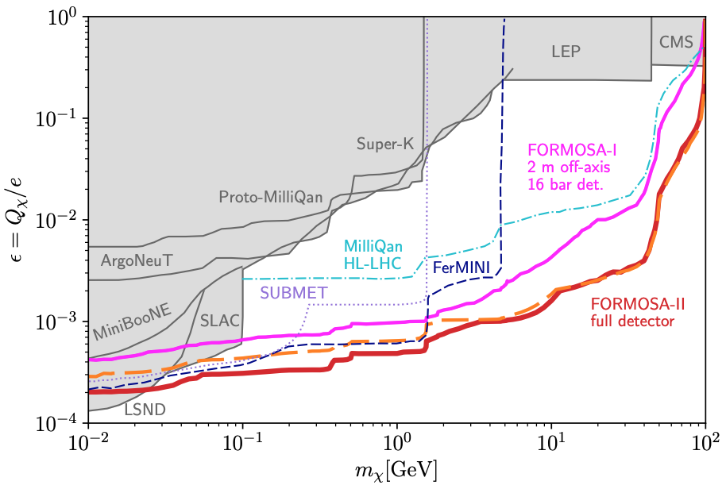
BC2: MILLI-CHARGED PARTICLES AT FORMOSA
Currently the target of the MilliQan experiment near the CMS IP.
MilliQan Demonstrator (Proto-MilliQan) already probes new region. Full MilliQan planned to run in this location at HL-LHC, but the sensitivity can be improved significantly by moving it to the FPF (FORMOSA).
Foroughi-Abari, Kling, Tsai (2020)

Slide 11
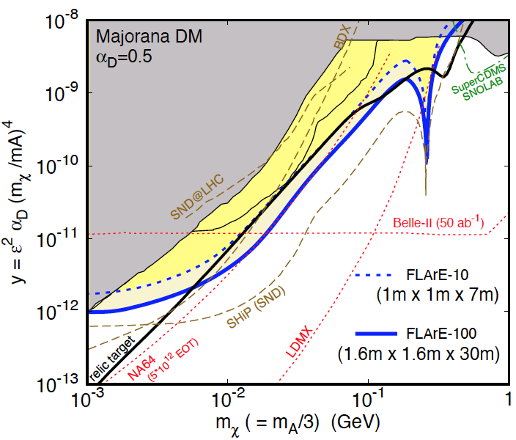
BC3: DARK MATTER DETECTION AT FLARE
If m_{LLP} > 2m_{DM} , the LLP will typically decay to dark matter, leading to a highly collimated beam of dark matter particles.
Can look for the resulting DM to scatter off electrons at FLArE, Forward Liquid Argon Experiment, a proposed 10 to 100 tonne LArTPC.
FLArE probes most of the favored/ allowed relic target region. Complementary to missing energy experiments that probe more of the “too large $Ω_{χ}h^{2}$” region, but don’t detect DM scattering.
Batell, Feng, Trojanowski (2021)

Slide 12
BSM SUMMARY
Benchmark Model | Underway | FPF
BC1: Dark Photon | $$\text{FASER}$$ | FASER 2
BC1’: U(1)_{B-L} Gauge Boson | $$\text{FASER}$$ | $$\text{FASER}\text{ 2}$$
BC2: Dark Matter | ⎼ | FLArE
BC3: Milli-Charged Particle | ⎼ | FORMOSA
BC4: Dark Higgs Boson | ⎼ | $$\text{FASER}\text{ 2}$$
BC5: Dark Higgs with hSS | ⎼ | $$\text{FASER}\text{ 2}$$
BC6: HNL with e | ⎼ | $$\text{FASER}\text{ 2}$$
BC7: HNL with μ | ⎼ | $$\text{FASER}\text{ 2}$$
BC8: HNL with τ | $$\text{FASER}$$ | $$\text{FASER}\text{ 2}$$
BC9: ALP with photon | $$\text{FASER}$$ | $$\text{FASER}\text{ 2}$$
BC10: ALP with fermion | $$\text{FASER}$$ | $$\text{FASER}\text{ 2}$$
BC11: ALP with gluon | $$\text{FASER}$$ | $$\text{FASER}\text{ 2}$$
The FPF will house a number of experiments.
These will have the potential to discover new physics in all of the PBC benchmark cases.
There are many other models worth consideration, and much further work required to realize these FPF detectors.

Slide 13
SM PHYSICS

Slide 14
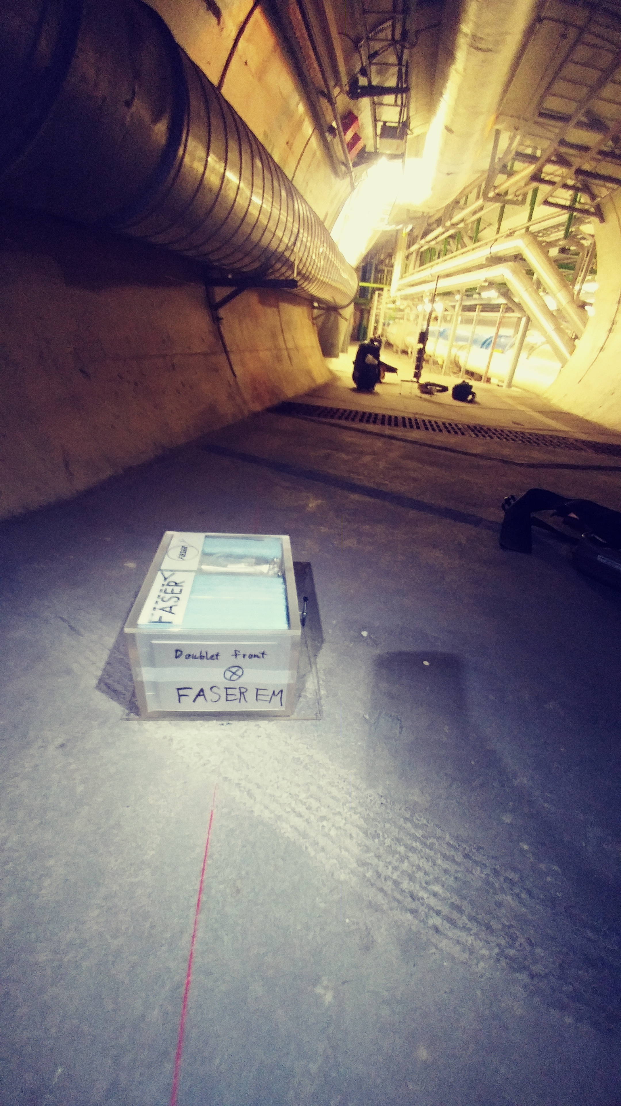
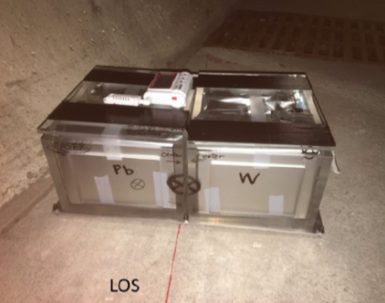
FIRST COLLIDER NEUTRINOS
No collider neutrino has ever been detected.
But there is a huge flux of TeV neutrinos in the far forward direction.
De Rujula, Ruckl (1984); Winter (1990)
In 2018, the FASER Collaboration placed ~30 kg emulsion detectors in the far forward region for 6 weeks (inserted and removed in TSs).
Expect ~few neutrino interactions. Several neutral vertices have been identified, likely to be neutrinos. Analysis ongoing.

Slide 15
NEUTRINO PHYSICS
Run 3: FASERν (on-axis) and SND (off-axis), ~1-tonne emulsion/tungsten detectors, will open a new field of neutrino physics at the LHC
Will record ~1000 ν_{e} , ~10,000 ν_{μ} , and ~10 ν_{τ} interactions at TeV energies, the first direct exploration of this energy range for all 3 flavors.
HL-LHC: FPF could accommodate FASERν2 and SND2 (~10-tonne emulsion detectors), FLArE (10+ tonne LArTPC), FORMOSA, …
Will record ~10⁵ ν_{e} , ~10⁶ ν_{μ} , and ~10³ ν_{τ} interactions at TeV energies.
Detect 1st anti-ν_{τ} , probe neutrino properties (NSIs, ν_{τ} MDM), …
1908.02310

Slide 16
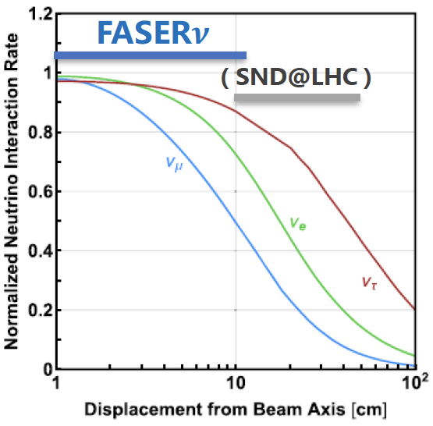
QCD PHYSICS
The forward production of hadrons is currently subject to large uncertainties. FPF experiments would provide useful insights.
By accommodating both on-axis and off-axis neutrino detectors, could provide complementary information (π $→$ ν_{μ} , K $→$ ν_{e} , D $→$ ν_{τ} ).
Different target nuclei (lead, tungsten) to probe different nuclear pdfs
Strange quark pdf through νs $→$lc
Forward charm production, intrinsic charm
Refine simulations that currently vary greatly (EPOS-LHC, QGSJET, DPMJET, SIBYLL, PYTHIA…)
Provide essential input to astroparticle experiments; e.g., distinguish galactic neutrino signal from atmospheric neutrino background at IceCube

Slide 17
SUMMARY AND PLANS
The FPF is well-aligned with
the European Strategy Update’s recommendations for a diverse experimental program, connections to astroparticle experiments, etc.
CERN’s updated Physics Beyond Colliders mandate
the American Snowmass community study and P5 prioritization exercise
There are already many experiments that would be excellent fits for the FPF. These build on current experiments, such as FASER, FASERν, SND@LHC, and MilliQan, but also new ideas, such as FLArE.
The physics topics addressed by these experiments are already astoundingly diverse: measurements of TeV neutrino properties, proton pdfs, nuclear pdfs, forward hadron production, implications for IceCube and other cosmic ray experiments, searches for dark portal particles, light gauge bosons, axion-like particles, other LLPs, dark matter scattering, milli-charged particles, …

Slide 18
SUMMARY AND PLANS
Clearly, now is the time to establish the FPF’s physics case and feasibility if it is to benefit from running in the HL-LHC era.
We would like to determine the optimal suite of experiments that will maximize the physics potential within the constraints of cost, schedule, safety, …. An interesting and multi-faceted optimization problem!
The FPF Kickoff Workshop was held 9-10 November 2020
40 talks, lots of fascinating discussions across the broad range of relevant topics
For talk slides and recordings, see https://indico.cern.ch/event/955956
Next meeting will be announced soon

Slide 19
BACKUP

Slide 20
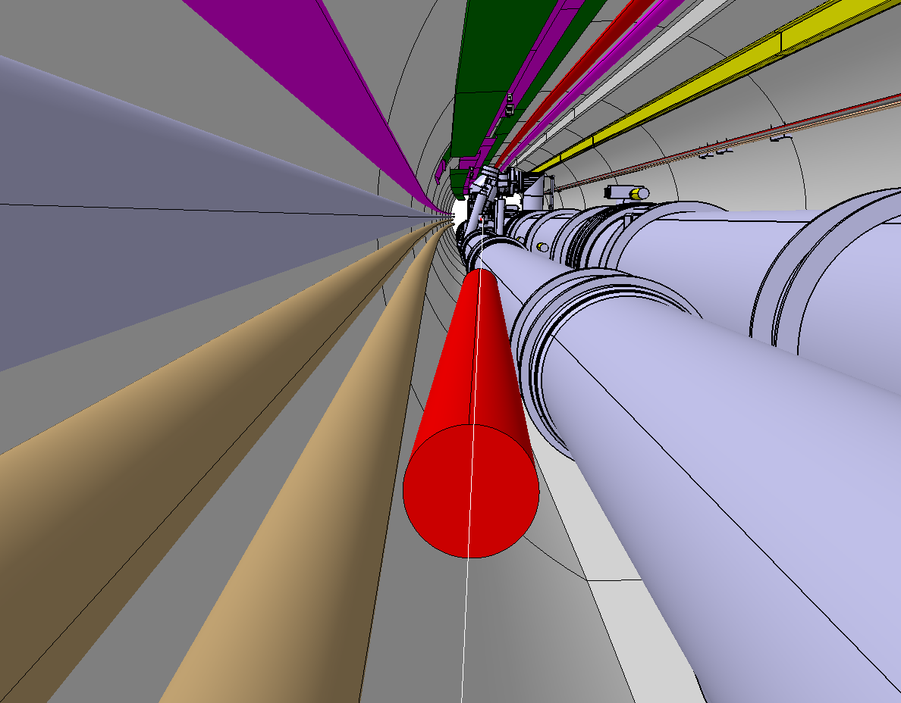
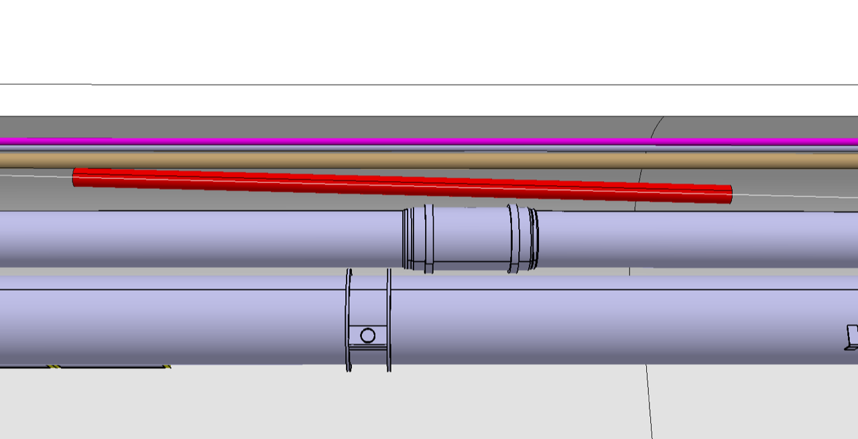
SWEEPER MAGNET
For the FPF, a magnet can sweep away muons, greatly reducing backgrounds.
A 7-m-long, 20-cm-diameter magnet along the LOS can fit in the LHC tunnel after muons leave the LHC beampipe.
Liam Dougherty (2021)

