Slide 1




AND
FORWARD PHYSICS AT THE LHC
Particle Physics Seminar, Brookhaven National Laboratory
Jonathan Feng, UC Irvine, 25 March 2021

Slide 2
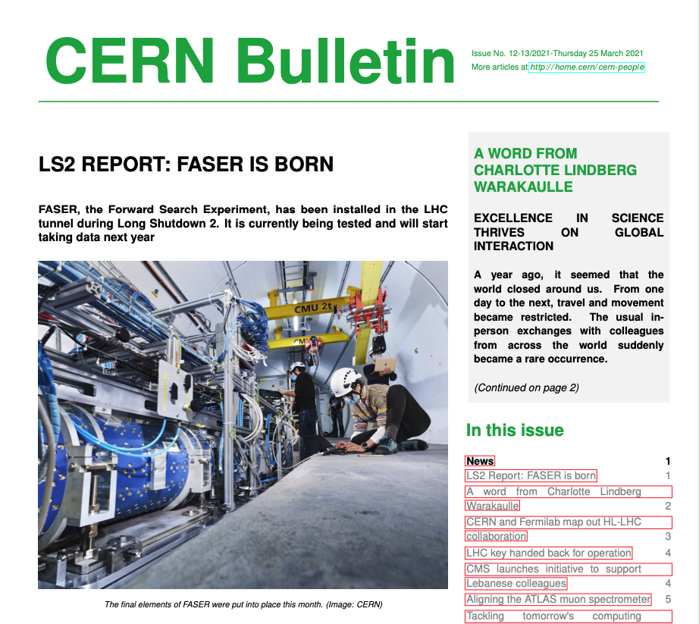
HOT OFF THE PRESS

Slide 3
OUTLINE
MOTIVATIONS
FORWARD PHYSICS
FASER
FASERν
FORWARD PHYSICS FACILITY
FLArE
SUMMARY

Slide 4
MOTIVATIONS

Slide 5
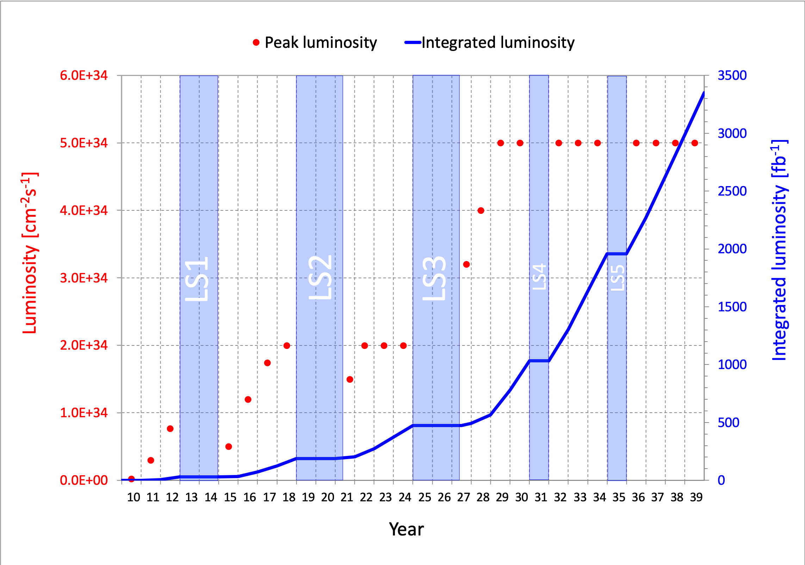
LHC: CURRENT STATUS
The discovery of the Higgs boson in 2012 completed the standard model of particle physics, but so far there has been no other direct evidence for new particles from the LHC.
The LHC is currently in Long Shutdown 2, but will start up again in 2022 and run till ~2037. Will we find new particles through conventional searches?
What other approaches can enhance the prospects for discovering new physics?

Slide 6
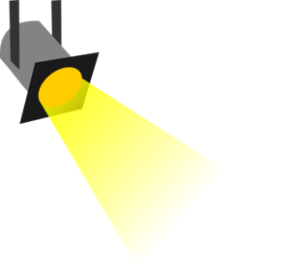
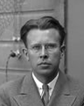
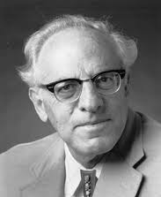
THE NEW PARTICLE LANDSCAPE
Particle
Colliders
Mass
MeV
GeV
TeV
1
Already
Discovered
Strongly Interacting
Heavy Particles
Interaction Strength
New Targets of Small Experiments
Traditional Targets
of Big Science
10⁻³
Weakly Interacting
Light Particles
Impossible to
Discover
10⁻⁶

Slide 7
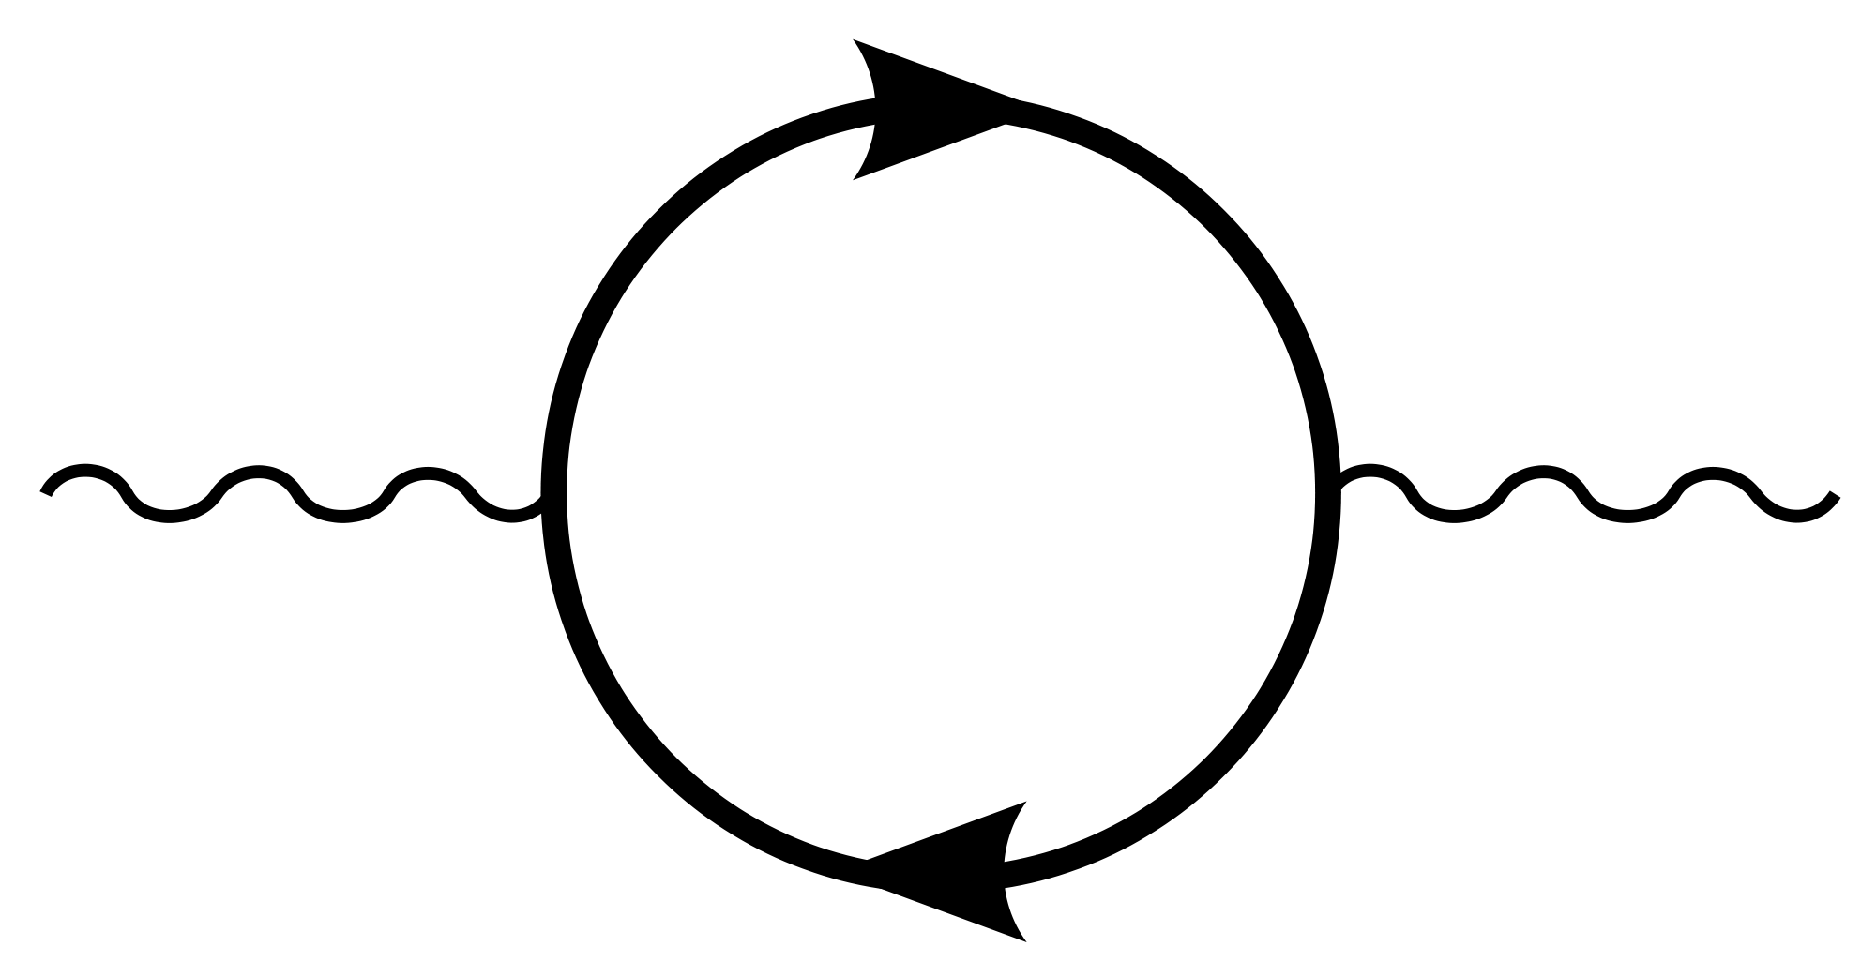
AN EXAMPLE: DARK PHOTONS
Suppose there is a dark sector that contains dark matter X and also a dark force: dark electromagnetism.
Generically, the force carriers of the SM and dark EM will mix
The resulting theory contains a new particle, the dark photon A’. It’s like a normal photon, except that it can have a small mass, m_{A’}, and its couplings to charged particles are suppressed by a small parameter ε: it is a weakly-interacting, light particle.
Finding a dark photon would imply the discovery of a new fundamental force and also our first “portal” through which to view the dark sector.
SM
EM
Dark Sector
EM, X
M
A
A_{D}
Holdom (1986)

Slide 8
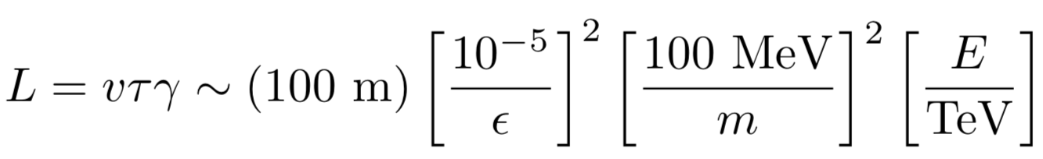


DARK PHOTON PROPERTIES
Consider mass m_{A’} ~ 1-100 MeV and coupling ε ~ 10⁻⁶ - 10⁻³.
Production: through meson decay, dark bremsstrahlung, ….
Propagation: they pass through matter without interacting, and they go straight, unaffected by E and B fields.
ε
A’
ε
π, η
A’
γ
Decay: they may decay to visible particles, but only after a long time:
They are generically long-lived particles (LLPs) !
ε
$$e^{+}$$
A’
$$e^{−}$$

Slide 9
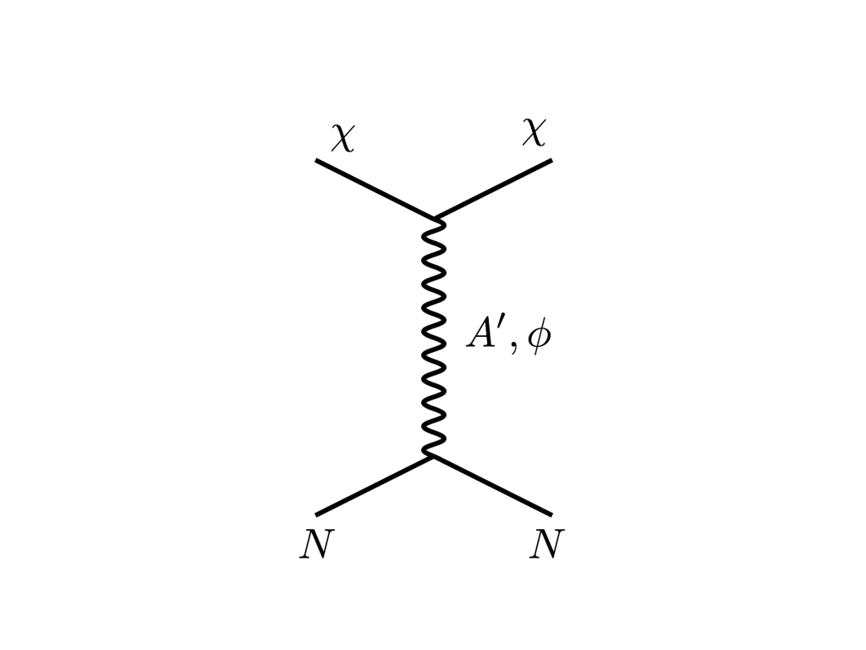





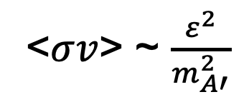
THE THERMAL RELIC LANDSCAPE
Particle
Colliders
Mass
MeV
GeV
TeV
1
Already
Discovered
Strongly Interacting
Heavy Particles
Too Little to be
Dark Matter
$$e$$
DM
$$ε$$
$$A’$$
$$ε$$
Interaction Strength
Just Right to
be Dark Matter
10⁻³
DM
$$e$$
<$σv$> ~ $\frac{ε^{2}}{m_{A′}^{2}}$
Weakly Interacting
Light Particles
Impossible to
Discover
10⁻⁶
Boehm, Fayet (2003)
Feng, Kumar (2008)
Too Much to be
Dark Matter

Slide 10
FORWARD PHYSICS

Slide 11

SEARCHES FOR NEW LIGHT PARTICLES
If new particles are light and weakly interacting, existing LHC detectors are perfectly designed NOT to see them.
Existing detectors are designed to find new heavy particles. These particles are produced almost at rest and decay isotropically.
But new light particles are mainly produced in the decays of light particles: π, η, K, D and B mesons. These are mainly produced along the beamline, and so the new particles disappear through the holes that let the beams in.
Clearly we need a detector to exploit the “wasted” σ_{inel} ~ 100 mb and cover these “blind spots” in the forward region. If we go far enough away, the proton beams are bent by magnets (it’s a circular collider!), whereas the new light particles will go straight.

Slide 12
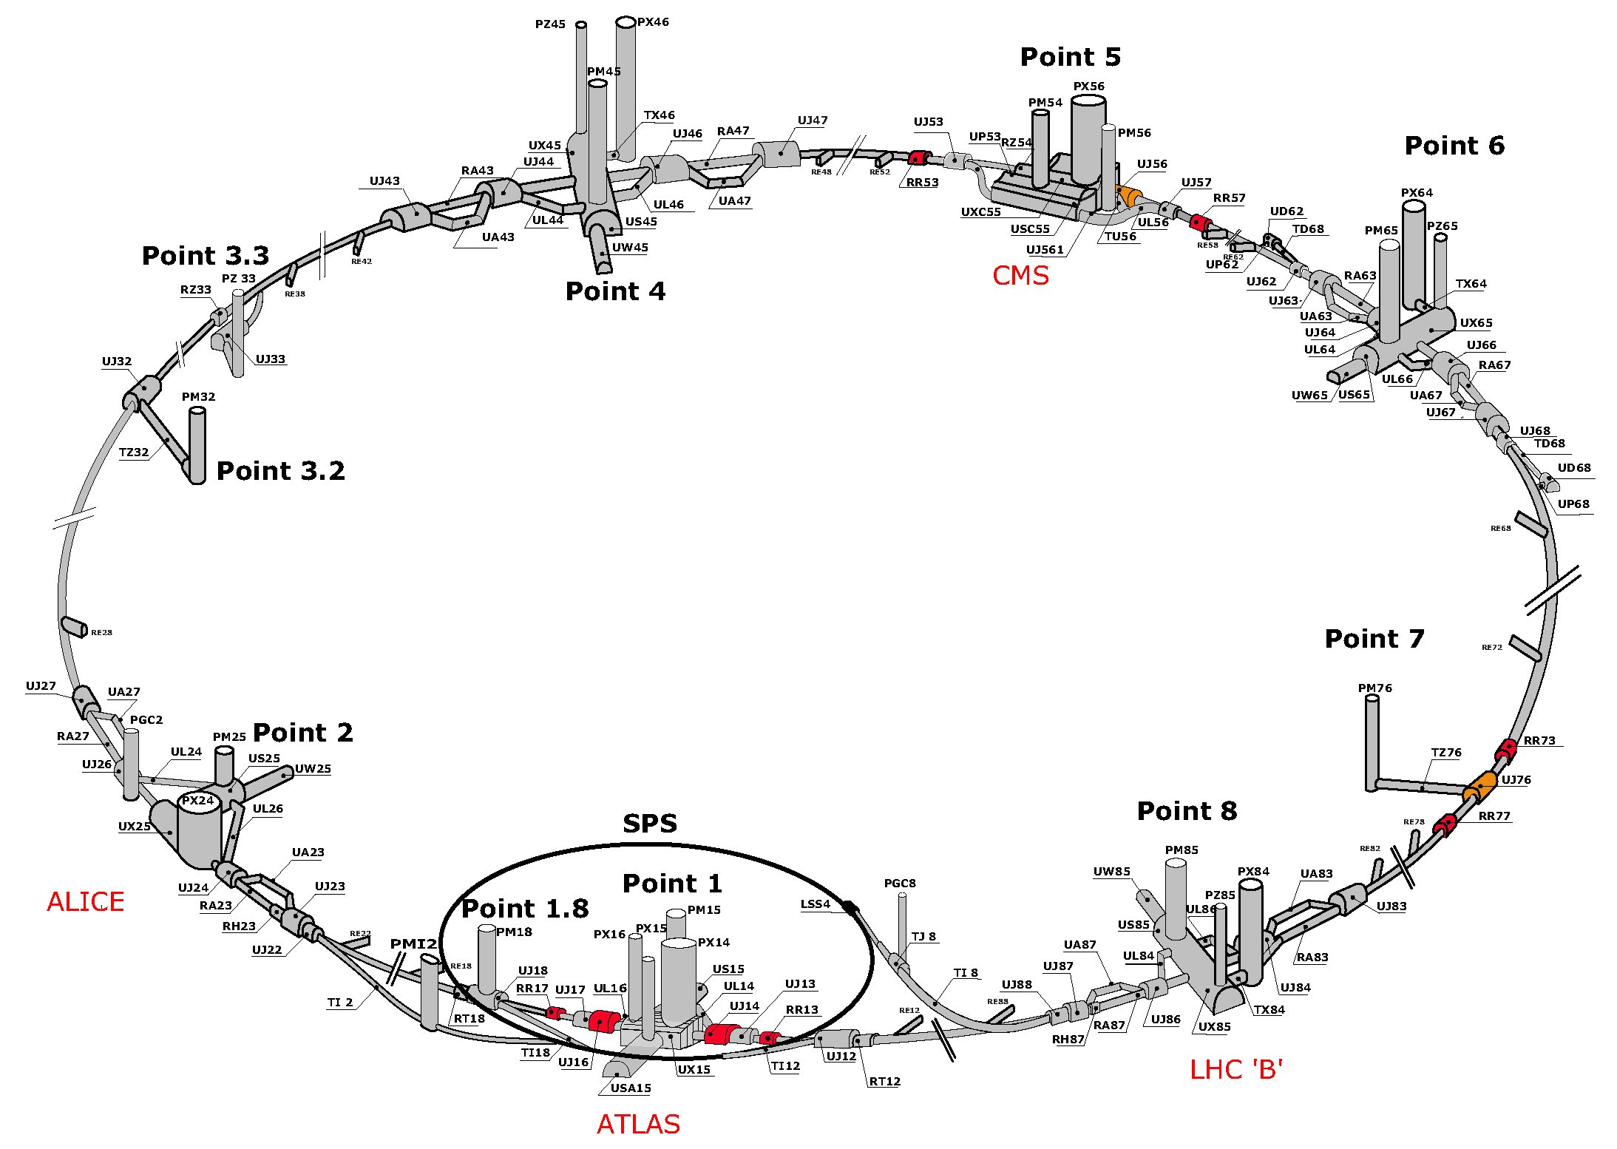
MAP OF LHC
!!!

Slide 13
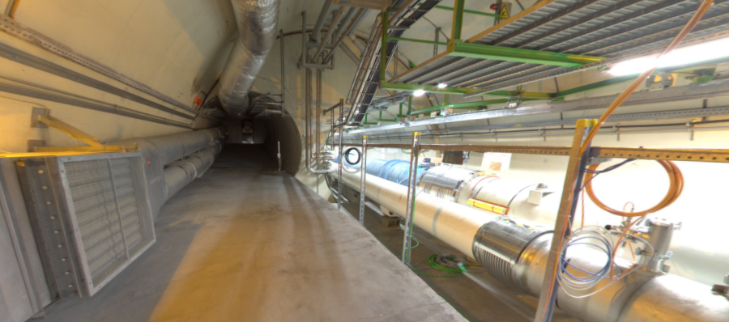
LOCATION, LOCATION, LOCATION
Beam collision axis passes
through 100 m of rock, emerges in tunnel TI12, 480 m from ATLAS
UJ12
TI12 near UJ12
The view in UJ12 looking west (2019)
TI12
Beam collision axis
LHC beamline

Slide 14
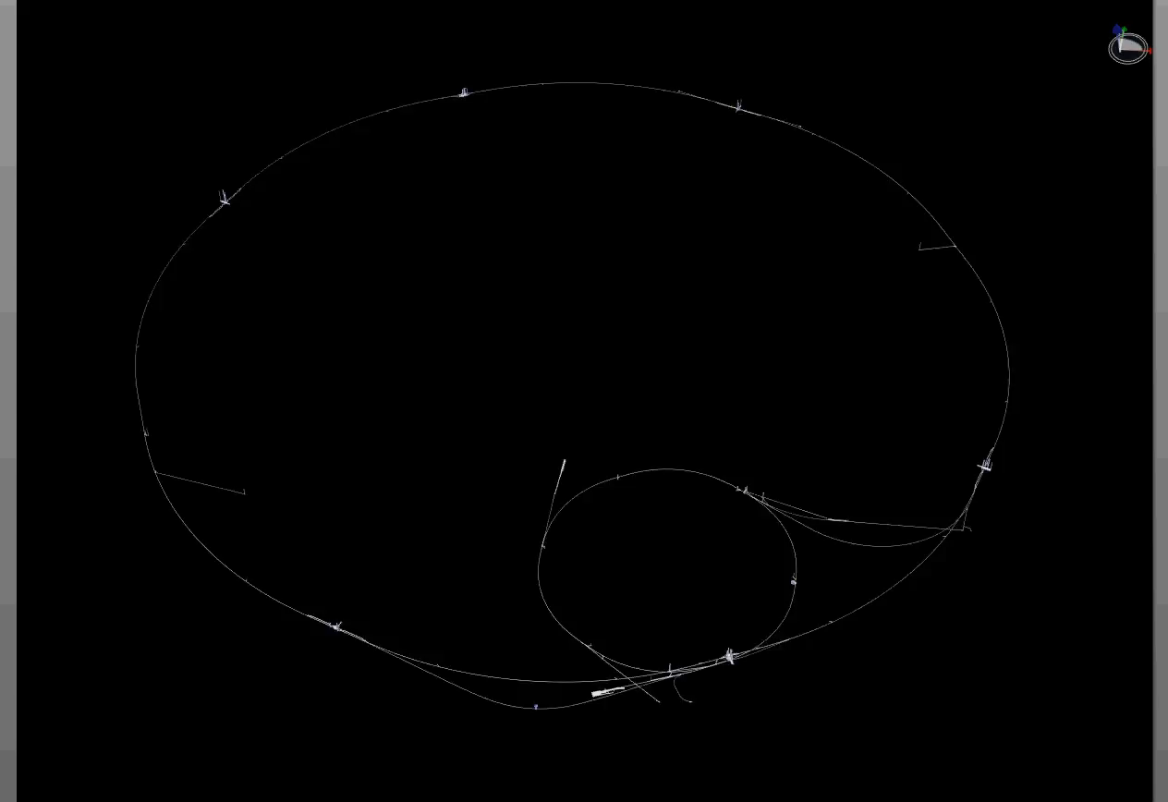
PARTICLE PATH FROM ATLAS TO TI12
Dougherty, CERN Integration (2019)

Slide 15
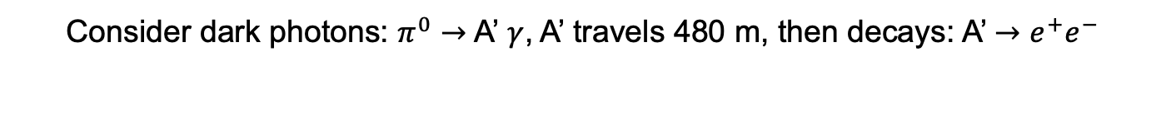
HOW BIG DOES THE DETECTOR HAVE TO BE?
Consider dark photons: $π^{0}→$ A’ $γ$, A’ travels 480 m, then decays: A’ $→$ $e^{+}e^{−}$
Pions at the IP
Production is peaked at p_{T} ~ m_{π},Λ_{QCD}~250 MeV
Enormous event rates: N_{π}~10¹⁵ per bin
A’s at the IP
Rates highly suppressed by ε² ~ 10⁻¹⁰
But still N_{A’} ~ 10⁵ per bin
A’s decay in [480m, 483m]
Only highly boosted ~TeV A’s decay in FASER
N_{A’} ~ 100 e⁺e⁻ events, within 20 cm of “on axis”
300 fb⁻¹
Feng, Galon, Kling, Trojanowski (2017)

Slide 16
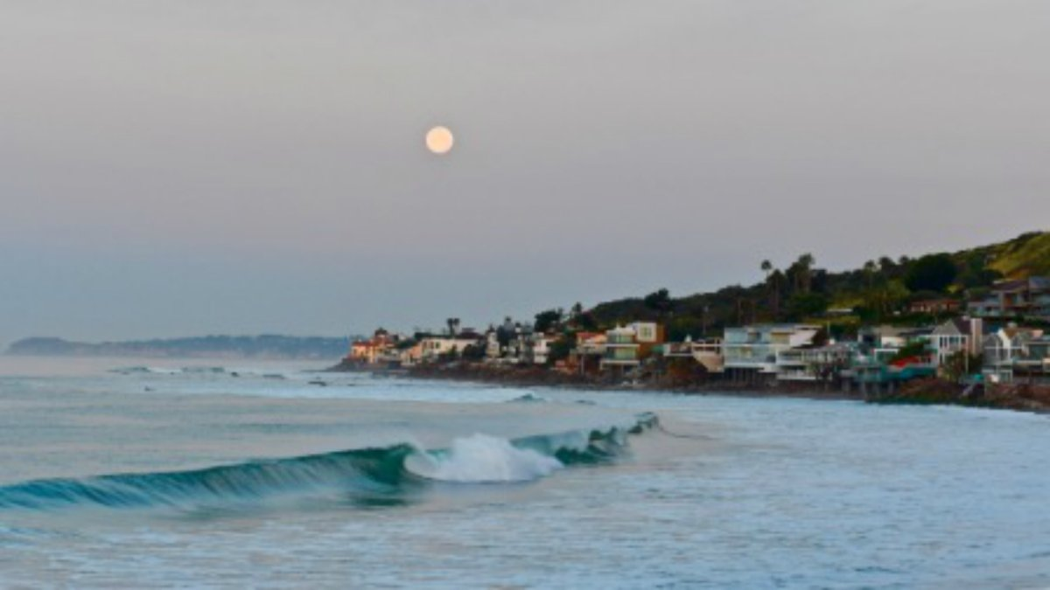
HOW BIG DOES THE DETECTOR HAVE TO BE?
Momentum:
Space:
200 MeV
1 TeV
10 cm
480 m
The opening angle is 0.2 mrad (η ~ 9); cf. the moon (7 mrad).
TeV dark photons (or any other new particles produced in π, η, K, D, B decay) are far more collimated than shown below, motivating a new, small, fast, cheap experiment at the LHC.

Slide 17
FASER

Slide 18
FASER TIMELINE
September 2017: Proposed by Feng, Galon, Kling, Trojanowski.
July 2018: Submitted LOI to CERN LHCC
October 2018: Approval from ATLAS SCT and LHCb Collaborations for use of spare detector modules
November 2018: Submitted Technical Proposal to LHCC
November 2018 – January 2019: Experiment funded by grants from the Heising-Simons and Simons Foundations
March 2019: FASER fully approved by CERN LHCC and Research Board along with support for infrastructure costs
April 2019: 1st FASER Collaboration Meeting
November 2020 – March 2021: Installation of FASER in tunnel during Long Shutdown 2, commissioning of the detector
Early 2022: Start collecting data in Run 3

Slide 19
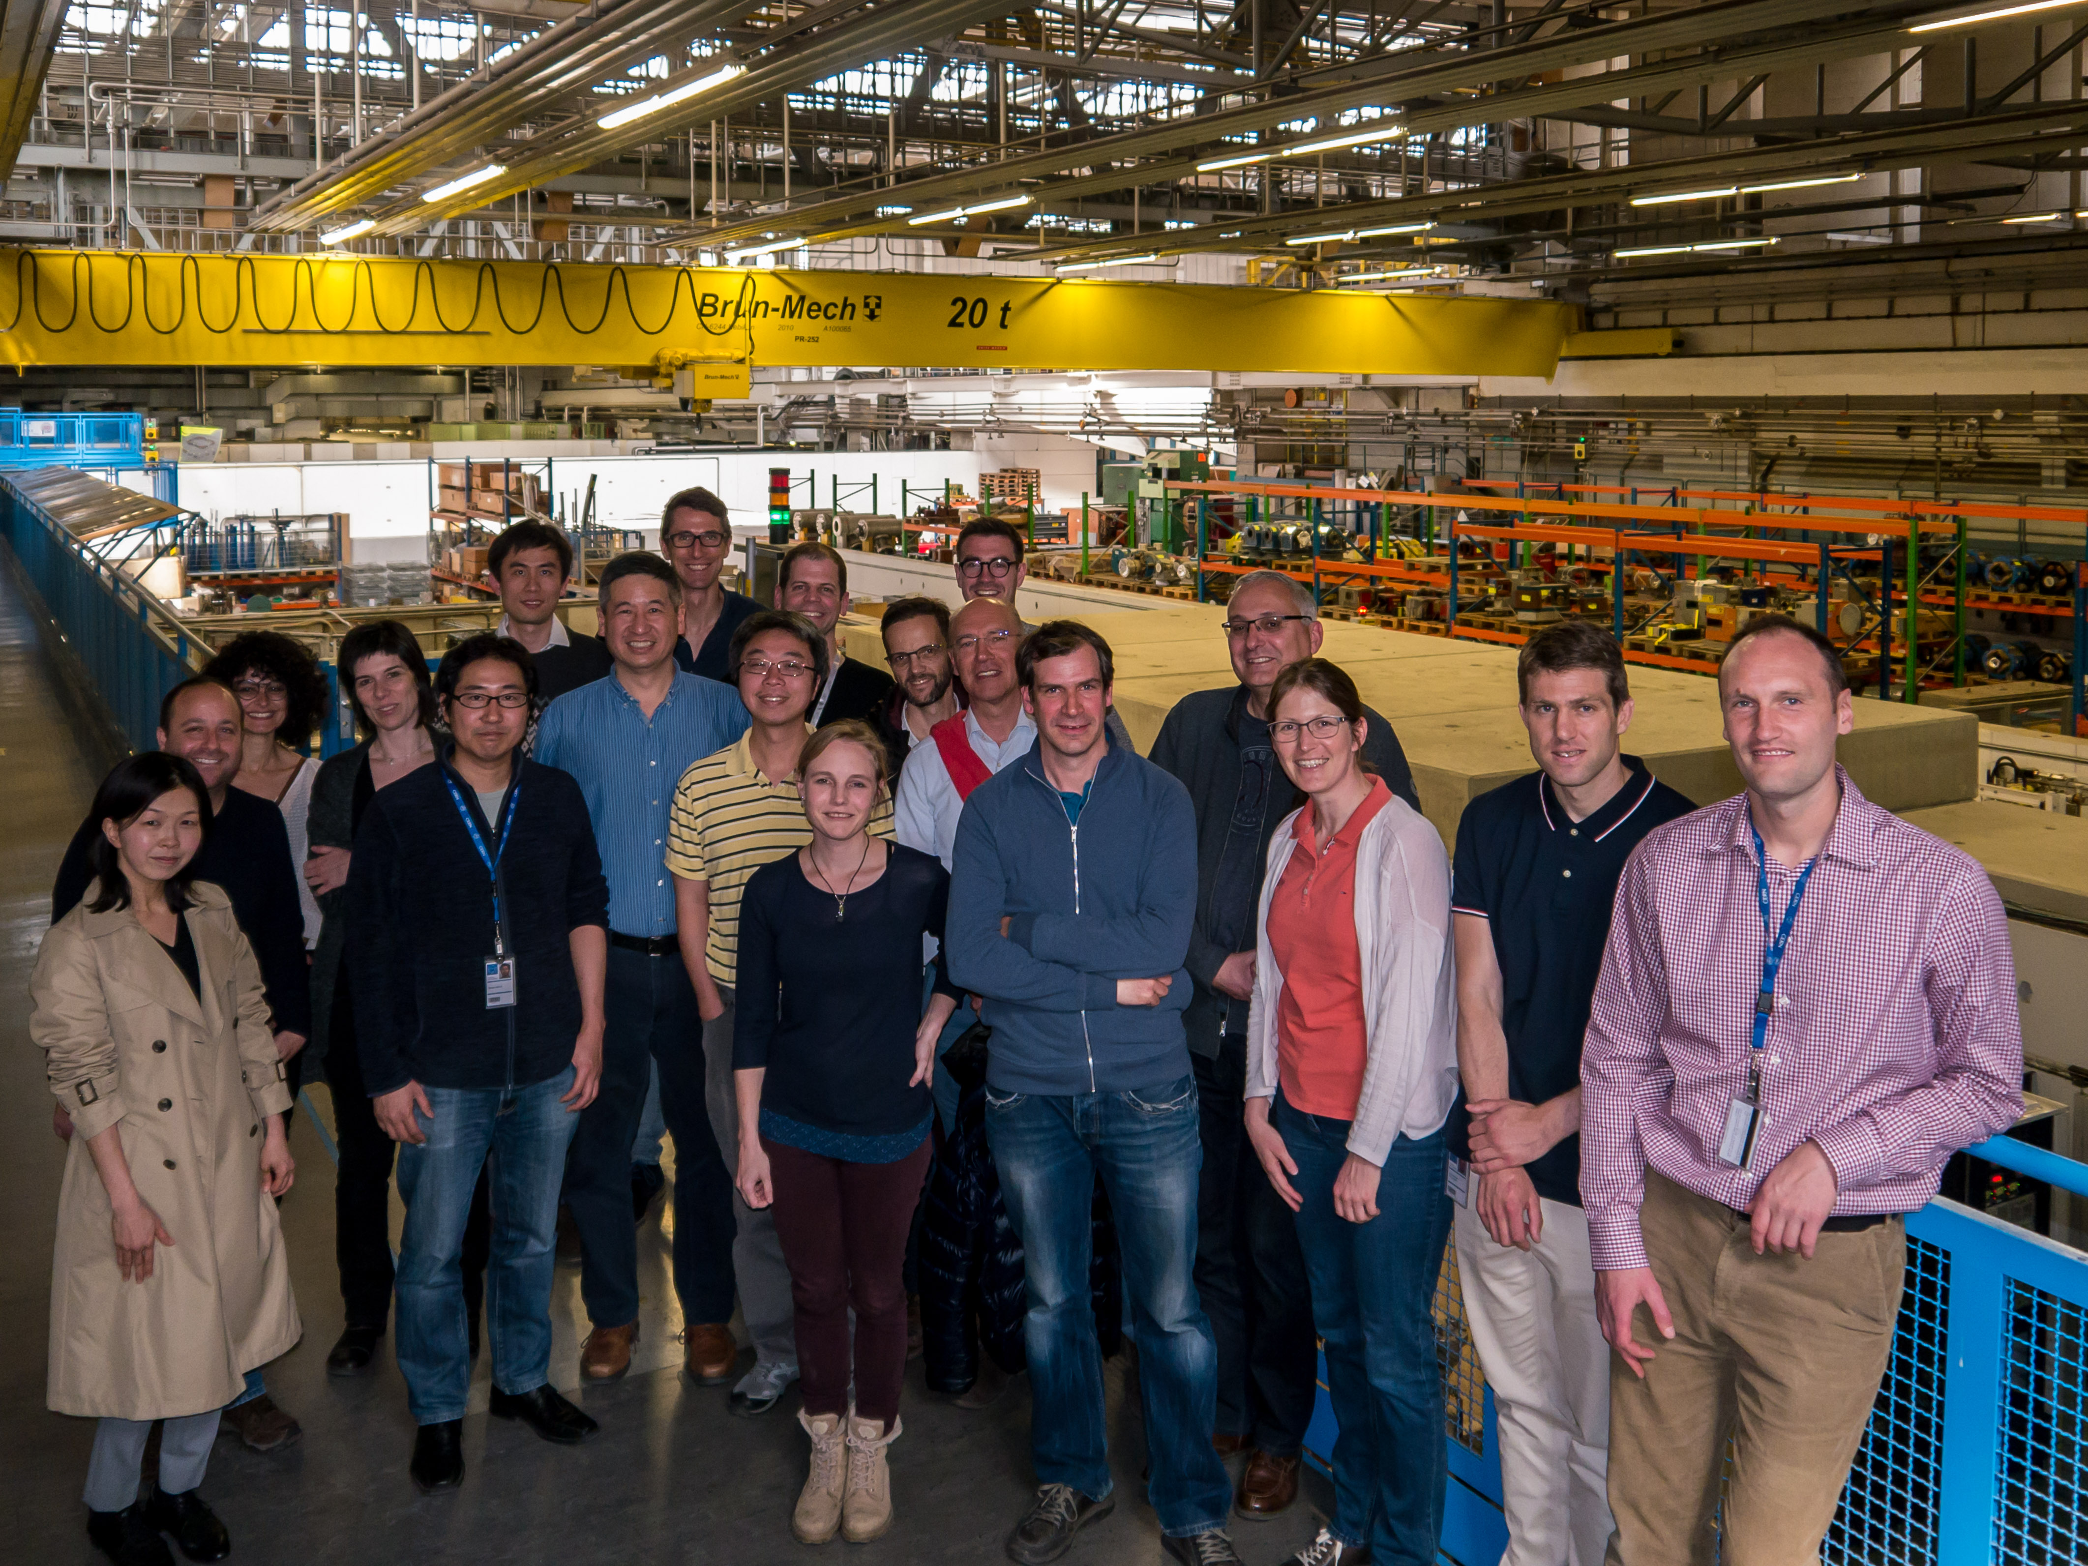
FIRST FASER COLLABORATION MEETING

Slide 20








THE FASER COLLABORATION TODAY
70 collaborators, 19 institutions, 8 countries
Henso Abreu (Technion), Yoav Afik (Technion), Claire Antel (Geneva), Akitaka Ariga (Bern), Tomoko Ariga (Kyushu/Bern), Florian Bernlochner (Bonn), Tobias Boeckh (Bonn), Jamie Boyd (CERN), Lydia Brenner (CERN), Franck Cadoux (Geneva), Dave Casper (UC Irvine), Charlotte Cavanagh (Liverpool), Xin Chen (Tsinghua), Andrea Coccaro (INFN), Monica D’Onofrio (Liverpool), Candan Dozen (Tsinghua), Yannick Favre (Geneva), Deion Fellers (Oregon), Jonathan Feng (UC Irvine), Didier Ferrere (Geneva), Stephen Gibson (Royal Holloway), Sergio Gonzalez-Sevilla (Geneva), Carl Gwilliam (Liverpool), Shih-Chieh Hsu (Washington), Zhen Hu (Tsinghua), Peppe Iacobucci (Geneva), Tomohiro Inada (Tsinghua), Sune Jakobsen (CERN), Enrique Kajomovitz (Technion), Felix Kling (SLAC), Umut Kose (CERN), Susanne Kuehn (CERN), Helena Lefebvre (Royal Holloway), Lorne Levinson (Weizmann), Ke Li (Washington), Jinfeng Liu (Tsinghua), Chiara Magliocca (Geneva), Josh McFayden (CERN), Sam Meehan (CERN), Dimitar Mladenov (CERN), Mitsuhiro Nakamura (Nagoya), Toshiyuki Nakano (Nagoya), Marzio Nessi (CERN), Friedemann Neuhaus (Mainz), Laurie Nevay (Royal Holloway), Hidetoshi Otono (Kyushu), Carlo Pandini (Geneva), Hao Pang (Tsinghua), Brian Petersen (CERN), Francesco Pietropaolo (CERN), Johanna Price (UC Irvine), Markus Prim (Bonn), Michaela Queitsch-Maitland (CERN), Filippo Resnati (CERN), Hiroki Rokujo (Nagoya), Jakob Salfeld-Nebgen (CERN), Osamu Sato (Nagoya), Paola Scampoli (Bern), Kristof Schmieden (Mainz), Matthias Schott (Mainz), Anna Sfyrla (Geneva), Savannah Shively (UC Irvine), John Spencer (Washington), Yosuke Takubo (KEK), Ondrej Theiner (Geneva), Eric Torrence (Oregon), Serhan Tufanli (CERN), Benedikt Vormvald (CERN), Di Wang (Tsinghua), Gang Zhang (Tsinghua)

Slide 21
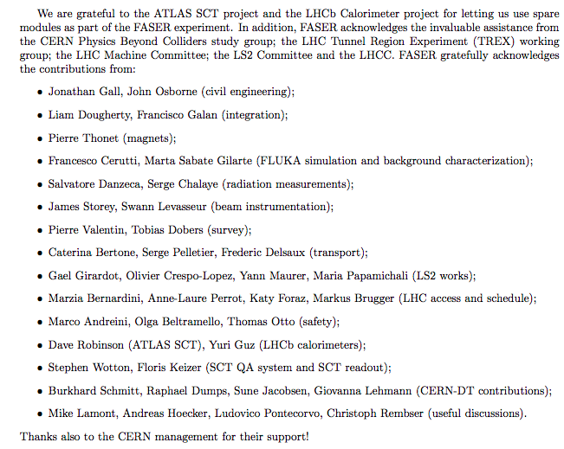
HELP FROM MANY OTHERS
The FASER Collaboration has received essential support from the Heising-Simons and Simons Foundations, CERN, the ATLAS SCT and LHCb Collaborations, and also many others at CERN and elsewhere

Slide 22
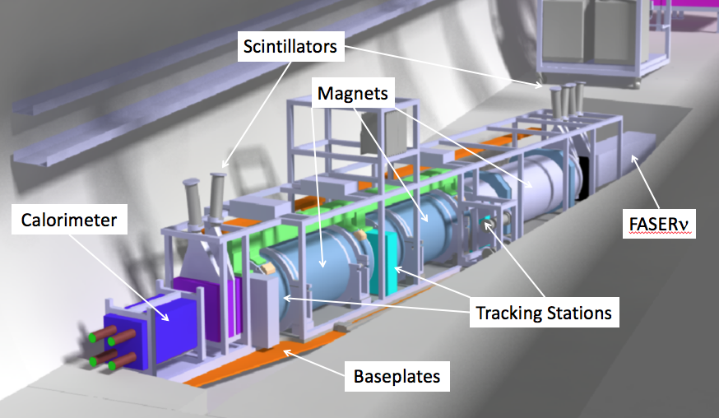
THE SIGNAL
Nothing incoming and 2 ~TeV, opposite-sign charged tracks pointing back to the ATLAS IP: a “light shining through (100 m-thick) wall” experiment.
Scintillators veto incoming charged tracks (muons), and permanent dipole magnets split the charged tracks, which are detected by 3 tracking stations and a calorimeter.
LLP
ν
e⁺
e⁻

Slide 23
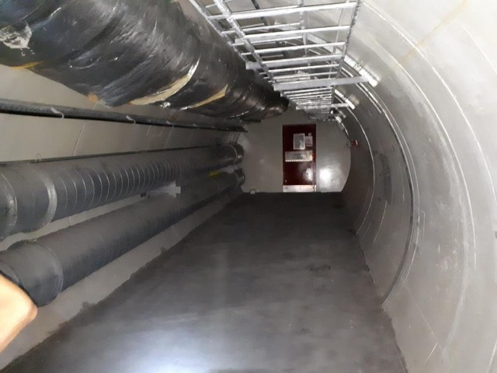
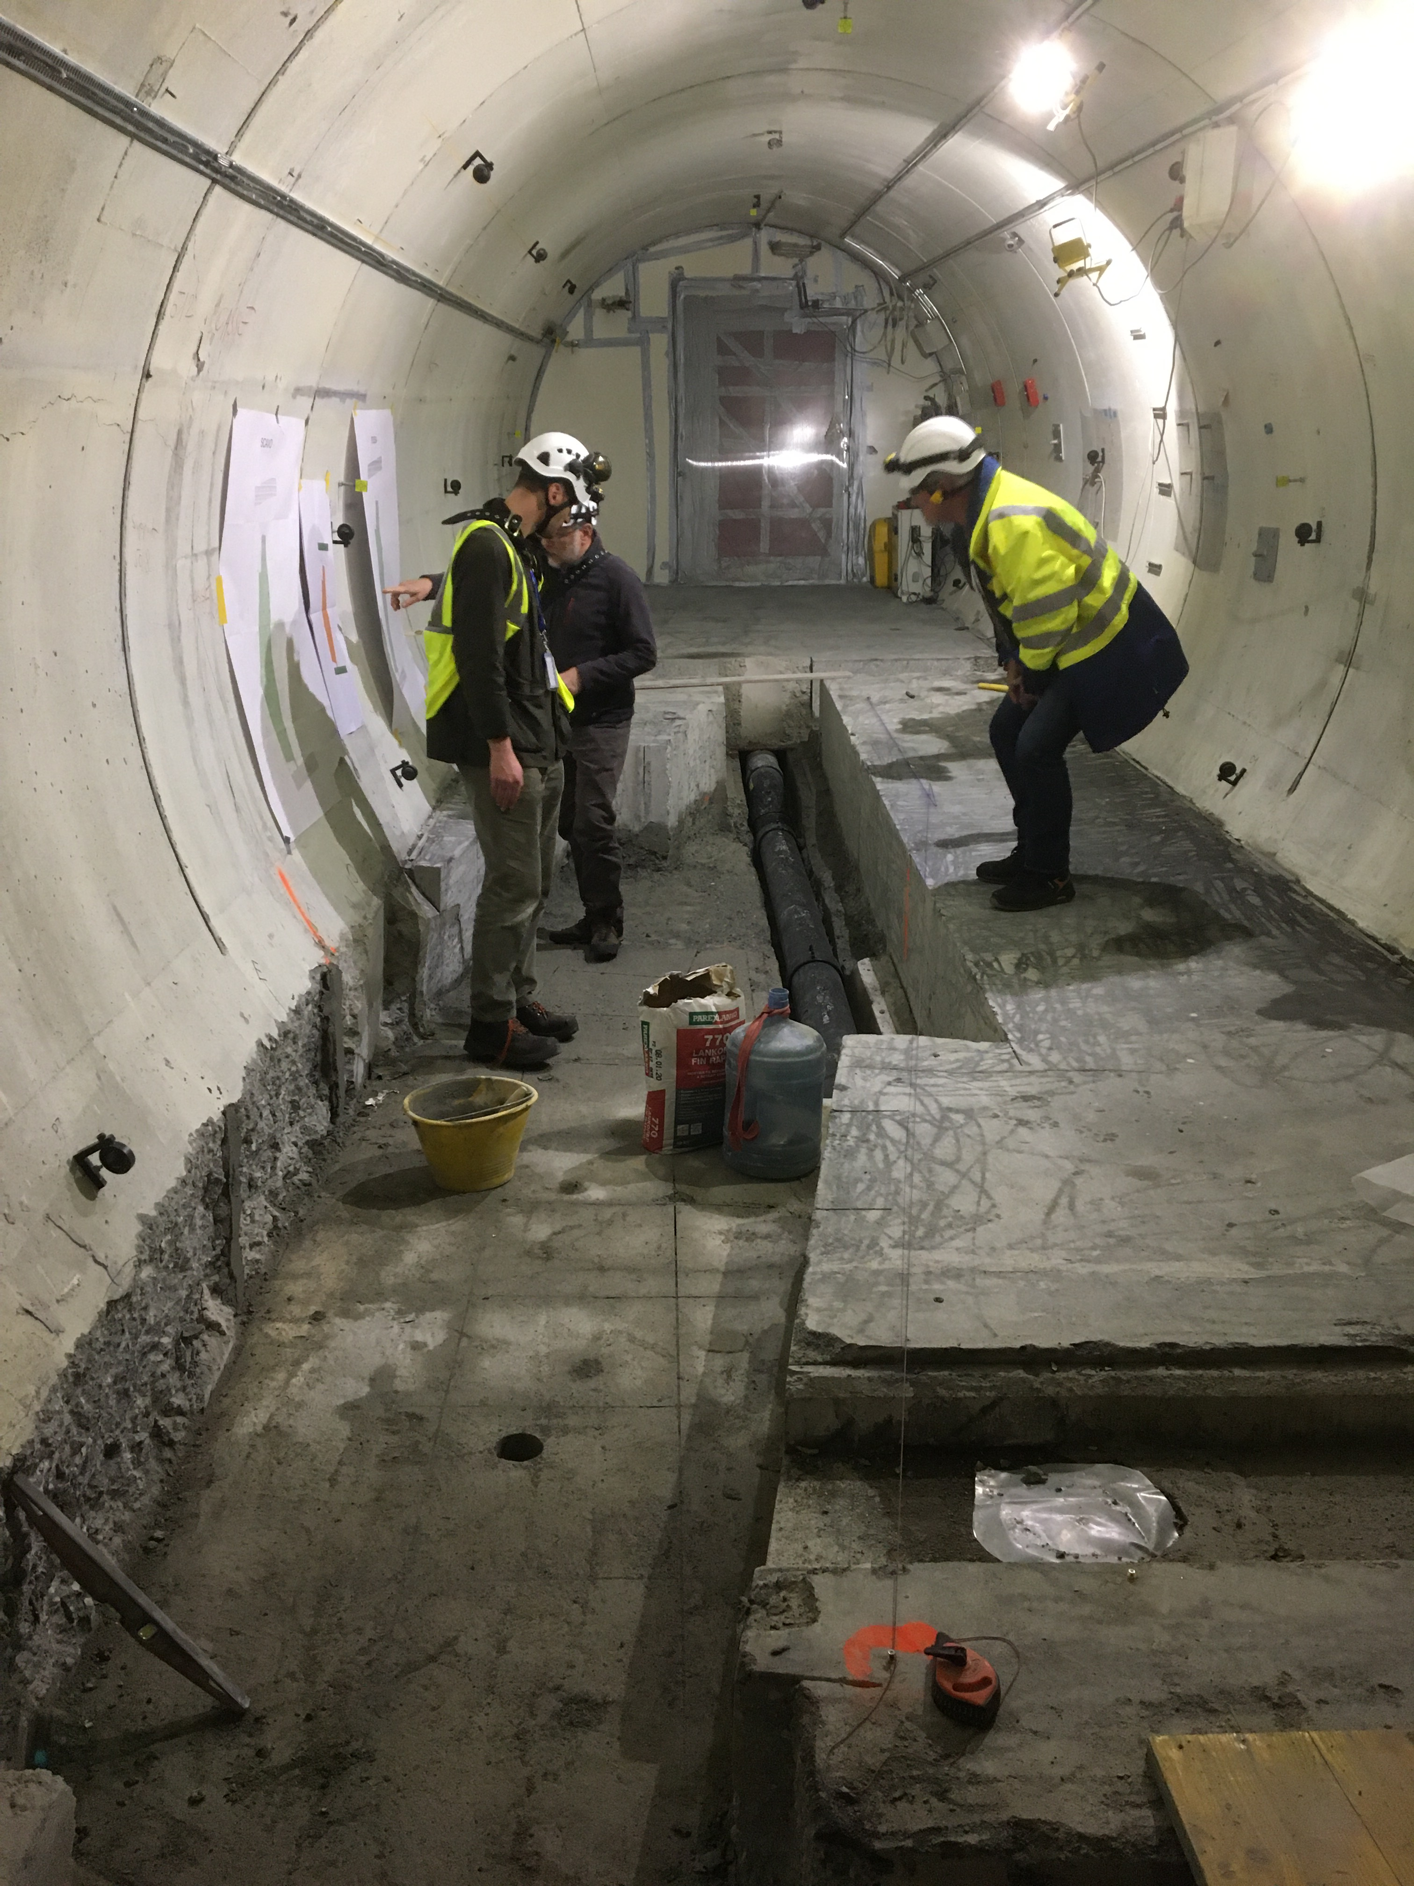
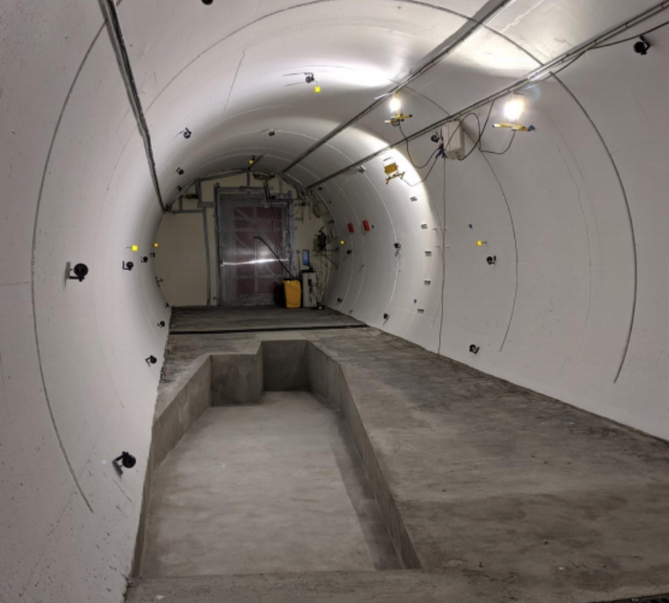
FASER IN TUNNEL TI12
The beam collision axis has been located to mm accuracy by the CERN survey department. To place FASER on this axis, a trench is required to lower the floor by 46 cm.
The trench was completed by an Italian firm just hours before COVID shut down CERN in Spring 2020.
2019
Spring 2020
Summer 2020

Slide 24
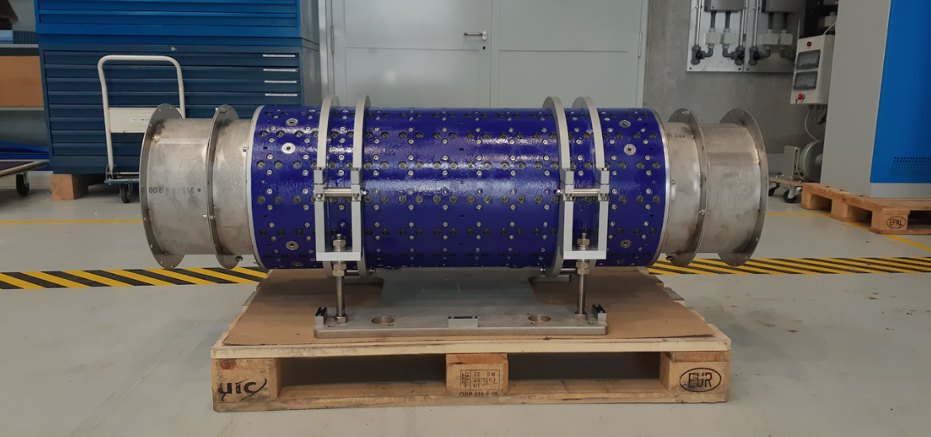
MAGNETS
FASER includes 3 magnets: 1.5 m, 1 m, and 1m long.
These magnets are 0.57 T permanent dipoles with an inner diameter of 20 cm, require little maintenance.
Constructed by the CERN magnet group.

Slide 25
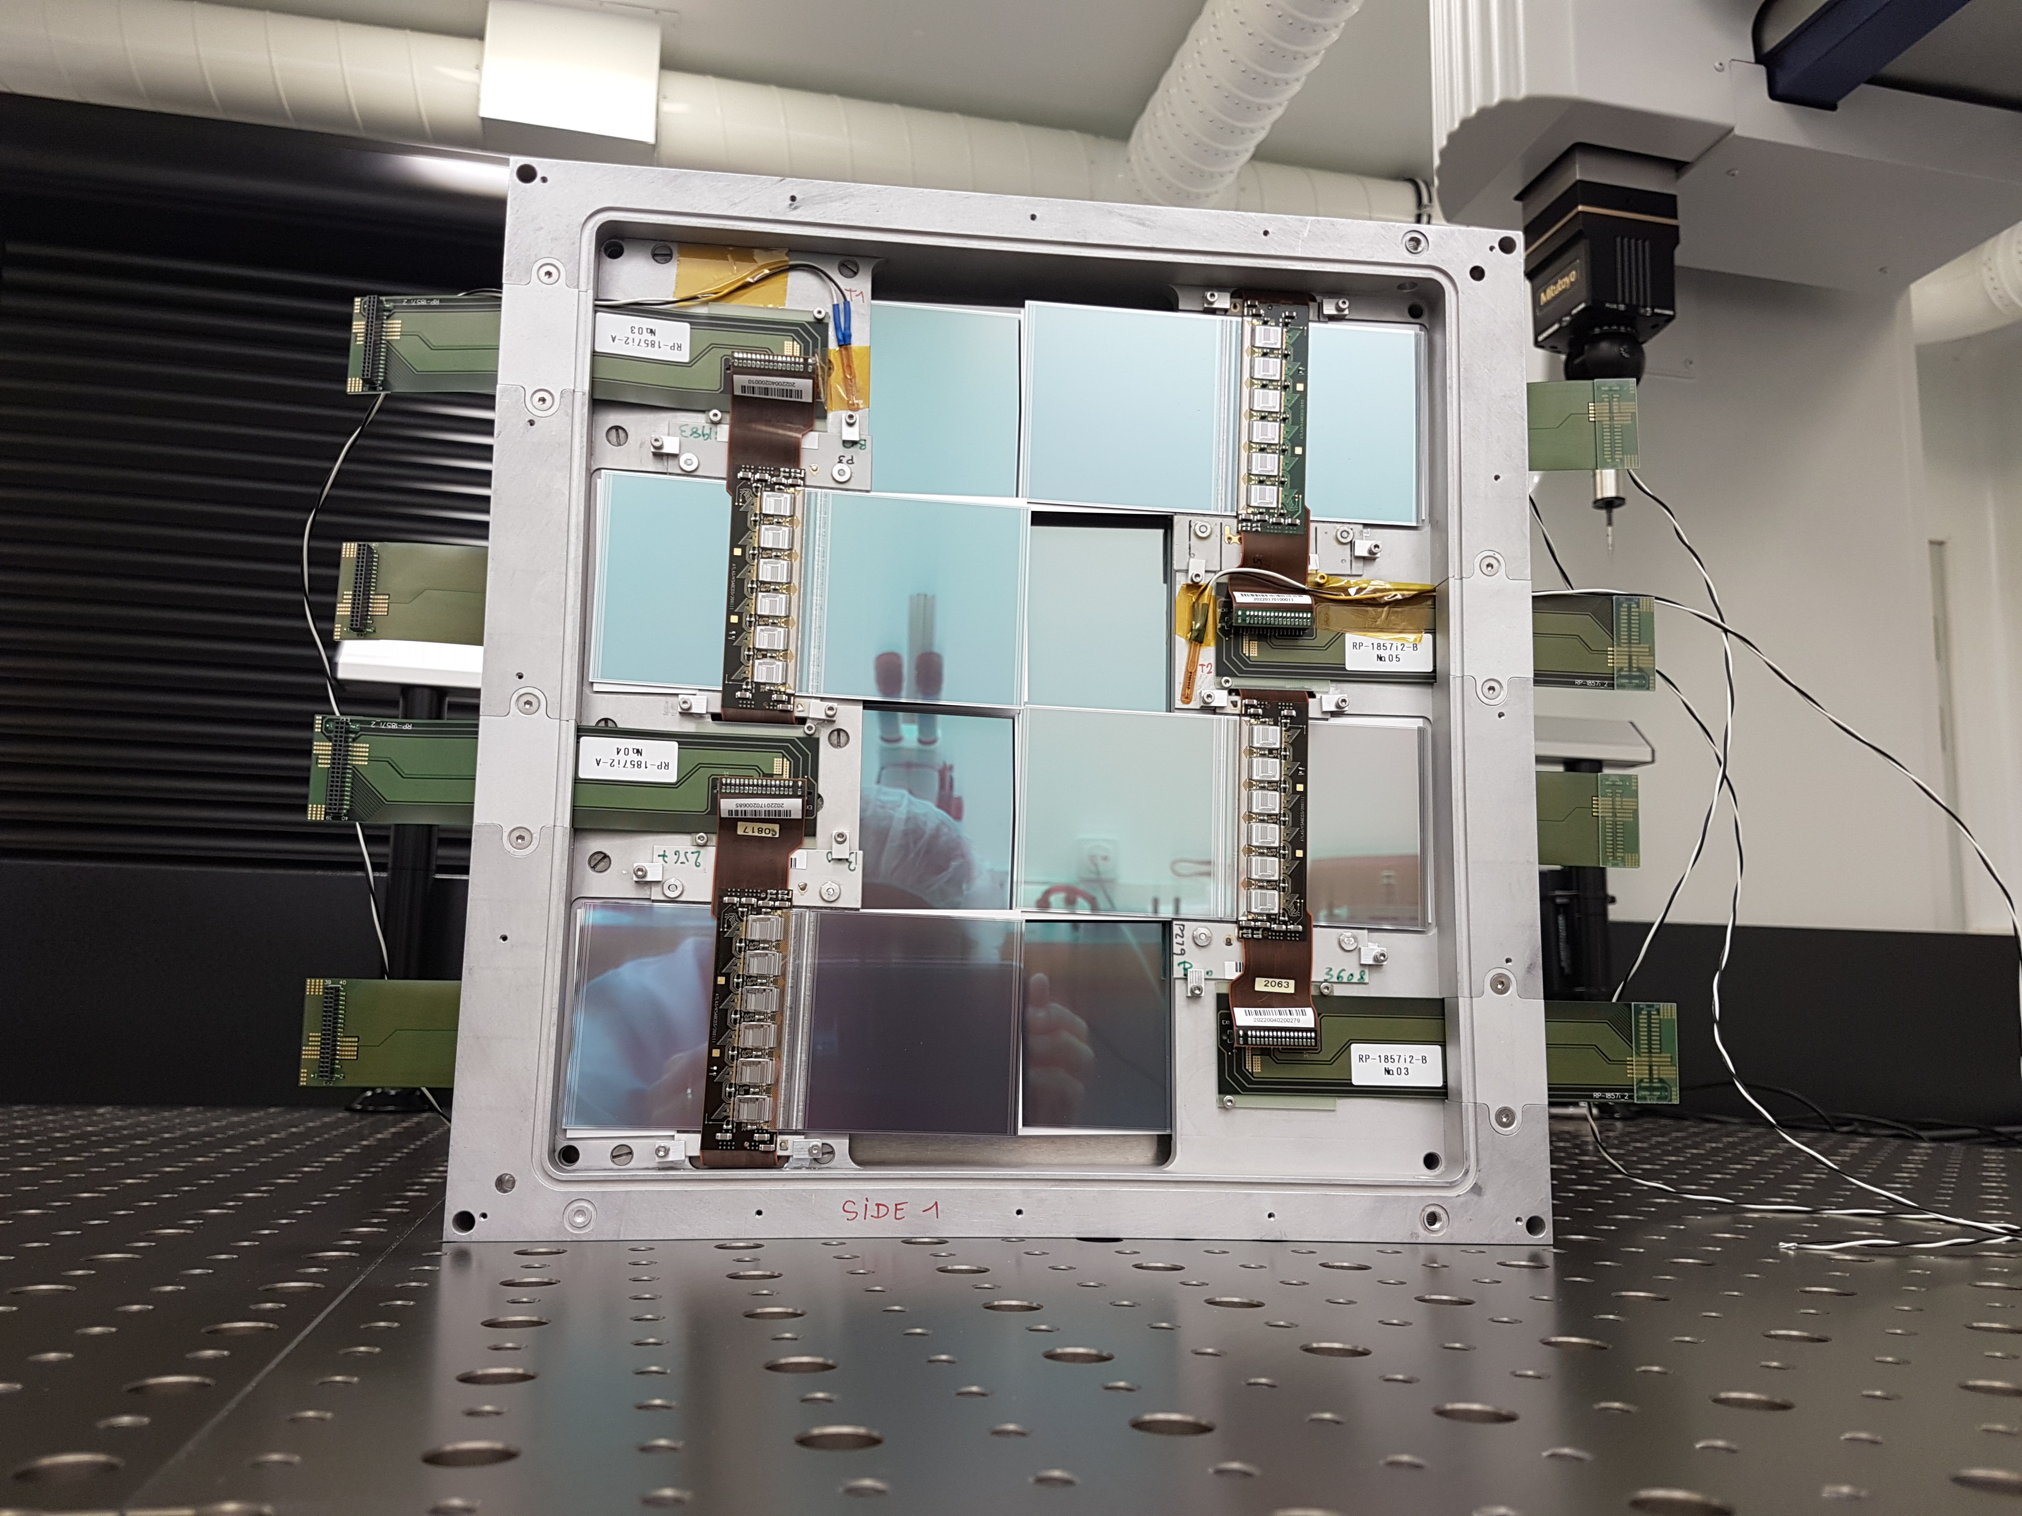
TRACKERS
8 ATLAS SCT modules per tracking plane, 3 tracking planes per tracking station, 3 tracking stations at FASER.

Slide 26
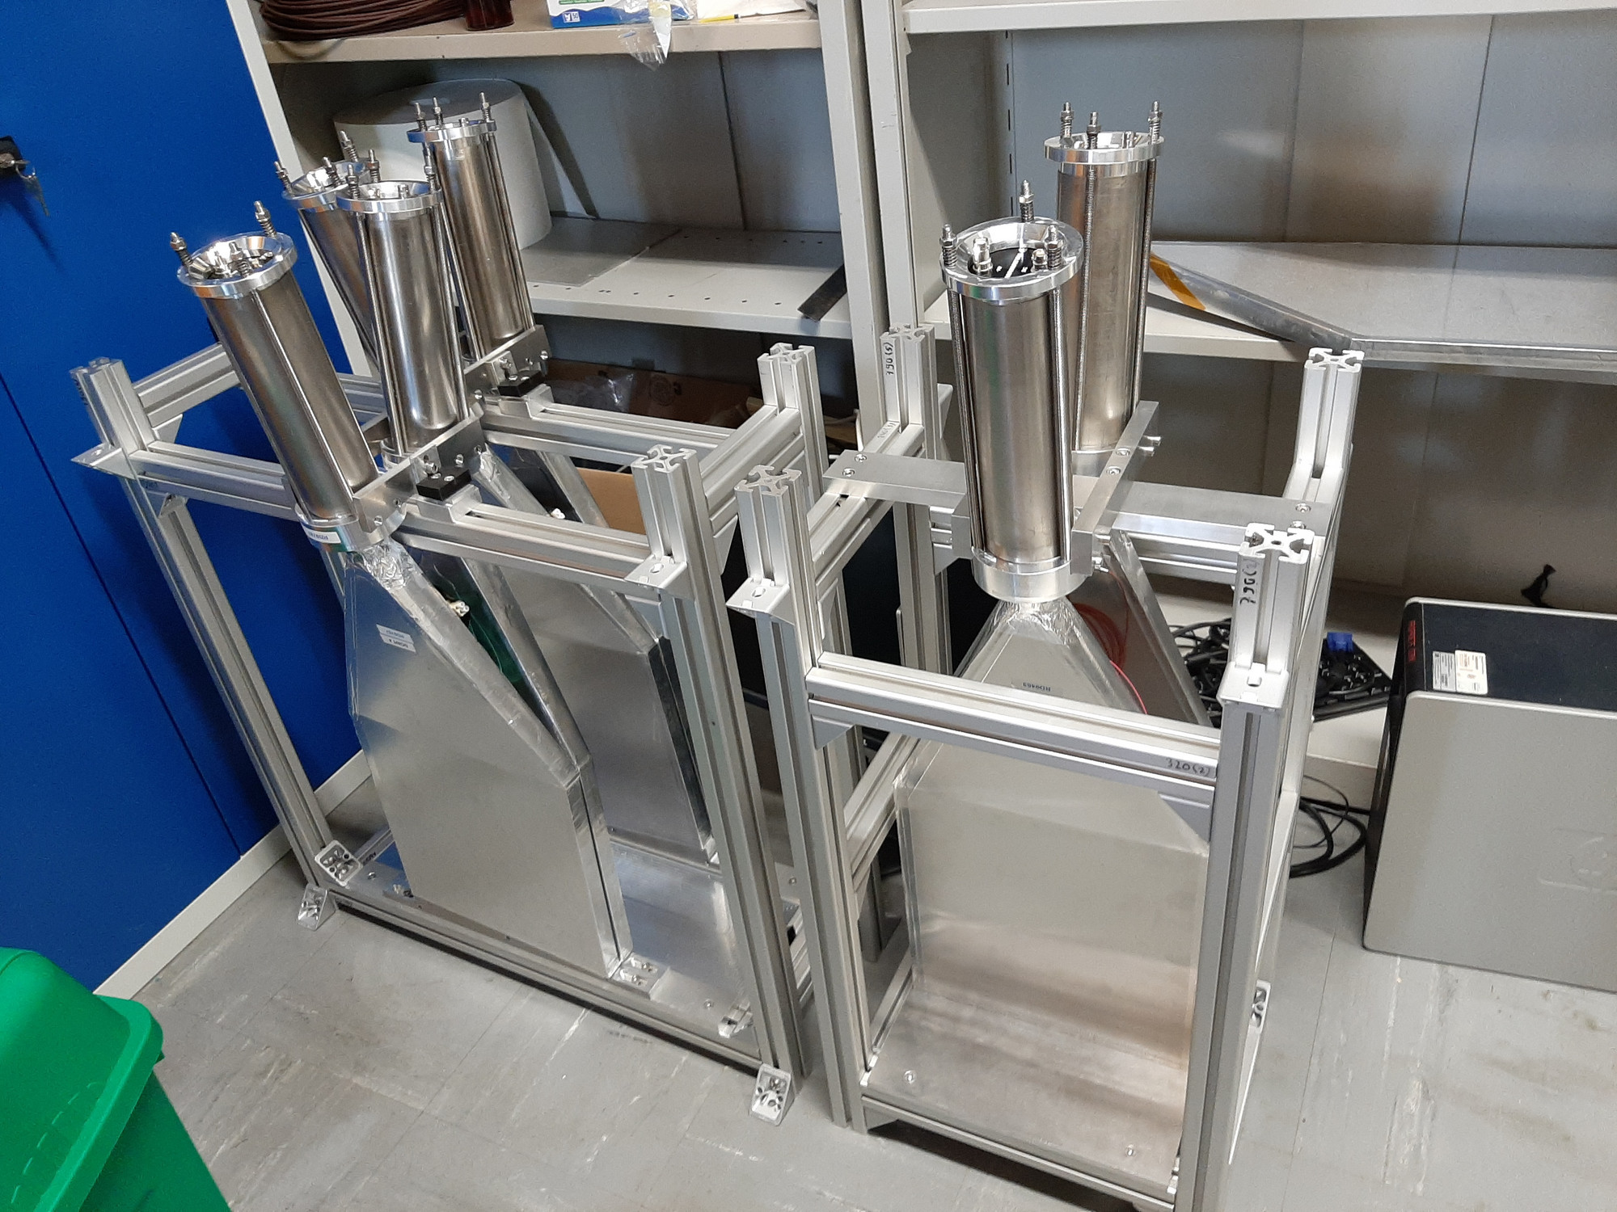
SCINTILLATORS
4 veto scintillators, each 2cm x 30cm x 30cm, upstream of the detector. Efficiency of each one is > 99.99%, which, barring correlations, reduces muon background to negligible levels.
Additional beam backgrounds, simulated with FLUKA and validated with pilot detectors in 2018, are also expected to be negligible.

Slide 27
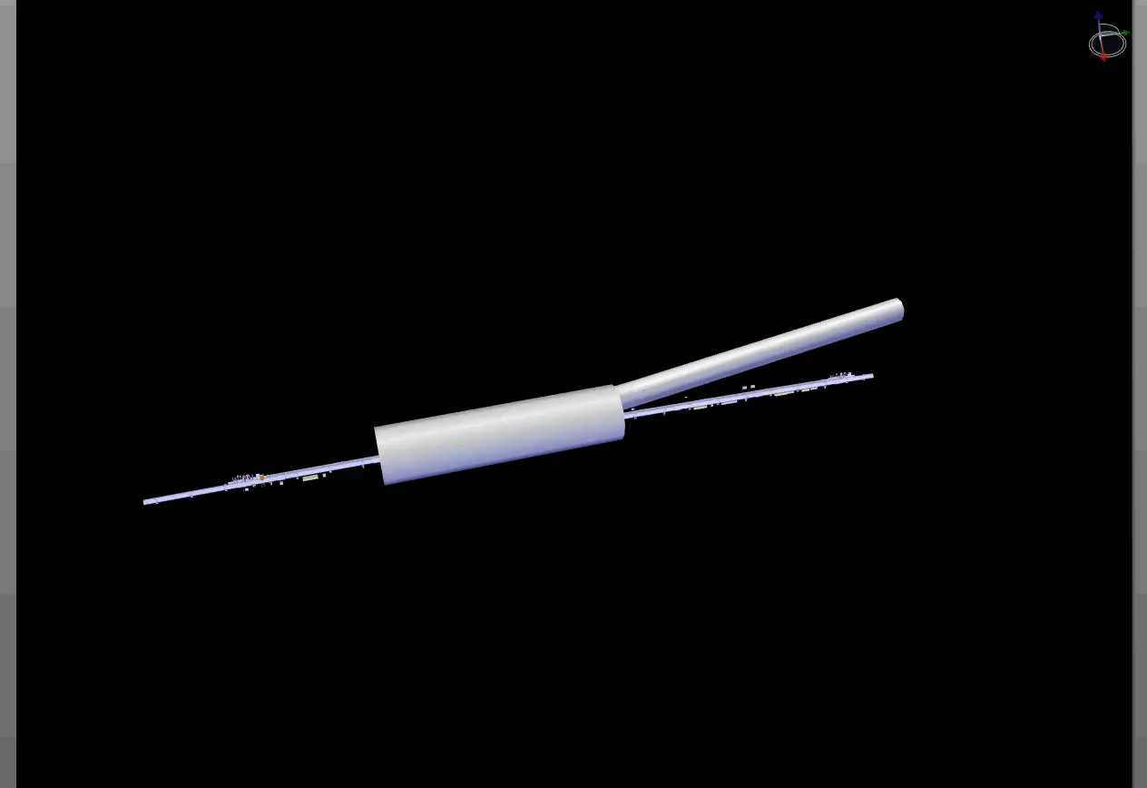
FASER INSTALLATION
Dougherty, CERN Integration (2019)

Slide 28
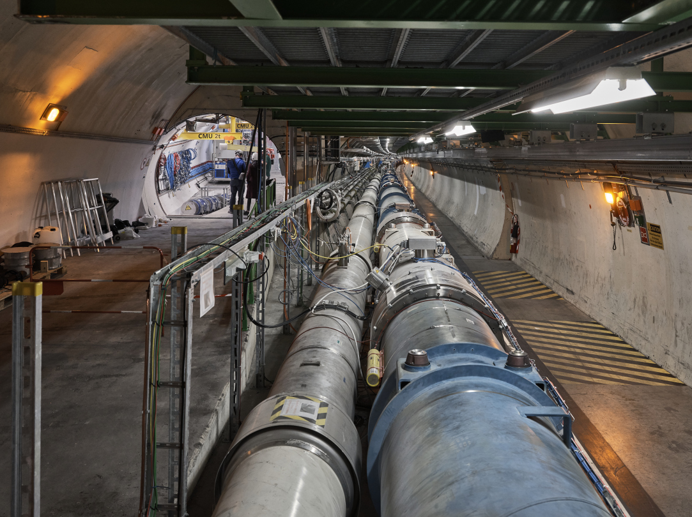
FASER CURRENT STATUS

Slide 29
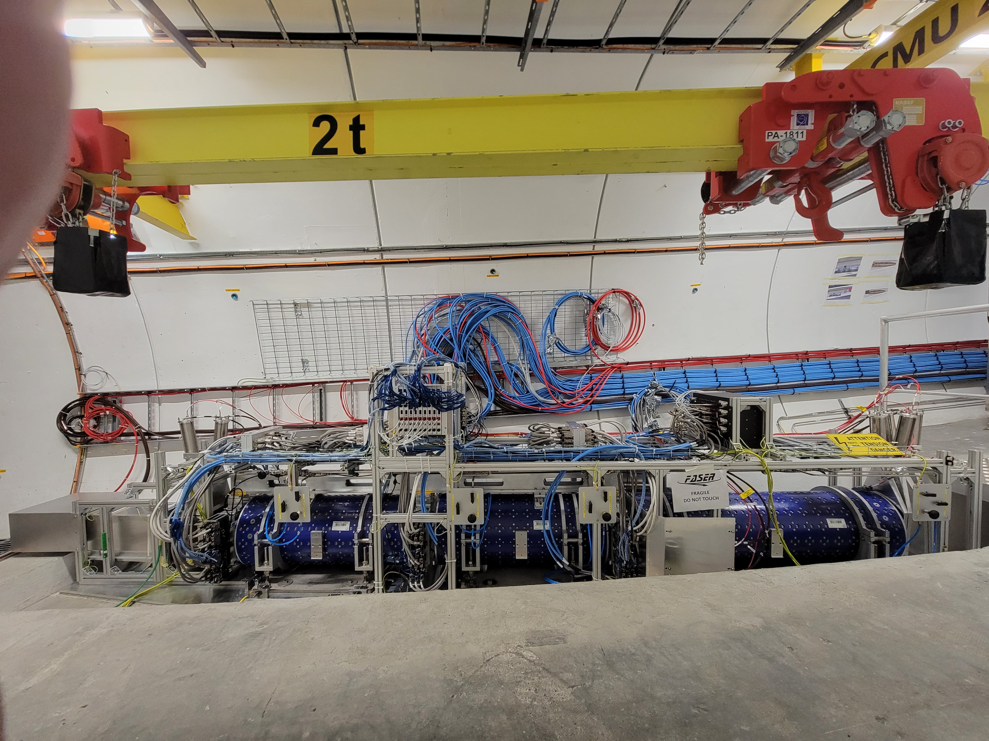
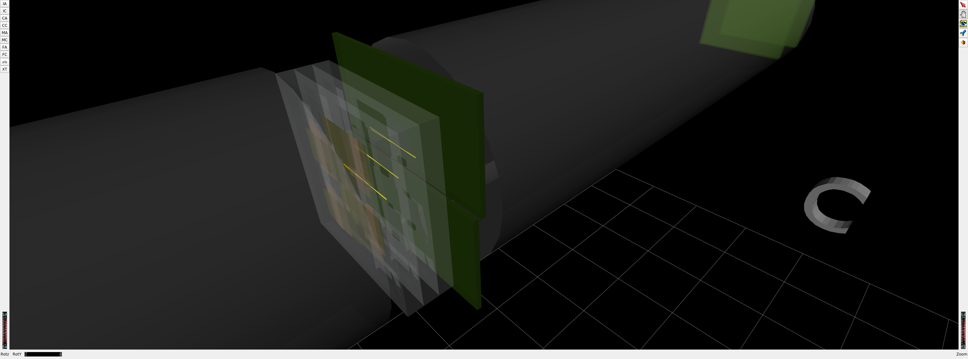
FASER CURRENT STATUS
1st Cosmic Ray
18 March 2021

Slide 30
DARK PHOTON SENSITIVITY REACH
FASER probes new parameter space with just 1 fb⁻¹ starting in 2022.
Without upgrade, HL-LHC extends (L*Volume) by factor of 3000; possible upgrade to FASER 2 (R = 1m, L = 10m) extends (L*Volume) by factor of ~10⁶.
FASER
_{FASER Collaboration (2018)}

Slide 31
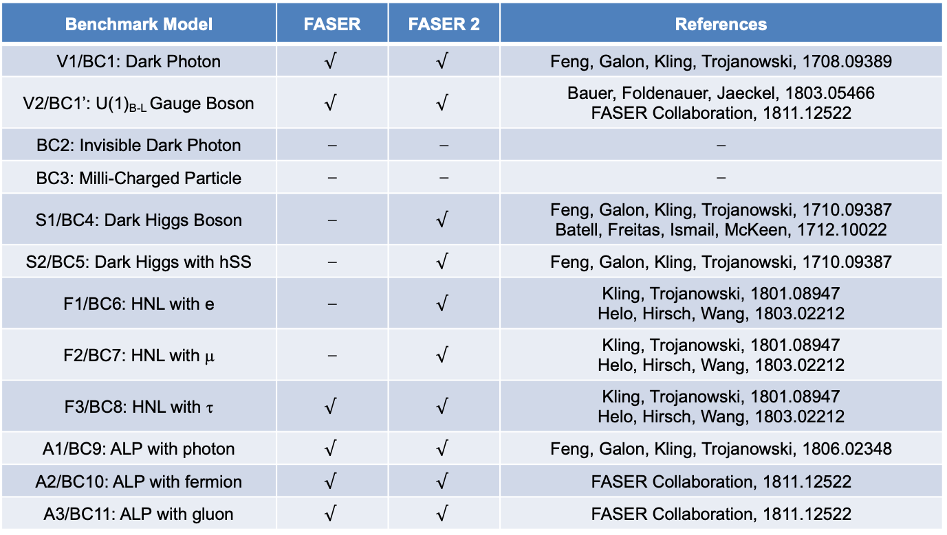
PHYSICS SUMMARY
Many other models have also be studied: FASER has discover prospects for many of the Physics Beyond Colliders Benchmark Cases; see 1811.12522.
Benchmark Model | FASER | FASER 2 | References
V1/BC1: Dark Photon | $$√$$ | $$√$$ | Feng, Galon, Kling, Trojanowski, 1708.09389
V2/BC1’: U(1)_{B-L} Gauge Boson | $$√$$ | $$√$$ | Bauer, Foldenauer, Jaeckel, 1803.05466 FASER Collaboration, 1811.12522
BC2: Invisible Dark Photon | ⎼ | ⎼ | ⎼
BC3: Milli-Charged Particle | ⎼ | ⎼ | ⎼
S1/BC4: Dark Higgs Boson | ⎼ | $$√$$ | Feng, Galon, Kling, Trojanowski, 1710.09387 Batell, Freitas, Ismail, McKeen, 1712.10022
S2/BC5: Dark Higgs with hSS | ⎼ | $$√$$ | Feng, Galon, Kling, Trojanowski, 1710.09387
F1/BC6: HNL with e | ⎼ | $$√$$ | Kling, Trojanowski, 1801.08947 Helo, Hirsch, Wang, 1803.02212
F2/BC7: HNL with μ | ⎼ | $$√$$ | Kling, Trojanowski, 1801.08947 Helo, Hirsch, Wang, 1803.02212
F3/BC8: HNL with τ | $$√$$ | $$√$$ | Kling, Trojanowski, 1801.08947 Helo, Hirsch, Wang, 1803.02212
A1/BC9: ALP with photon | $$√$$ | $$√$$ | Feng, Galon, Kling, Trojanowski, 1806.02348
A2/BC10: ALP with fermion | $$√$$ | $$√$$ | FASER Collaboration, 1811.12522
A3/BC11: ALP with gluon | $$√$$ | $$√$$ | FASER Collaboration, 1811.12522

Slide 32
FASERν

Slide 33
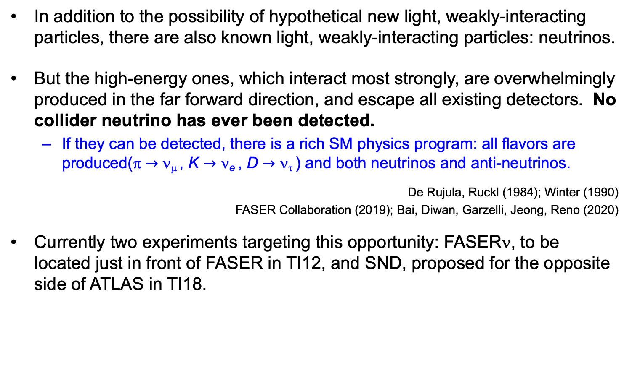
COLLIDER NEUTRINOS
In addition to the possibility of hypothetical new light, weakly-interacting particles, there are also known light, weakly-interacting particles: neutrinos.
But the high-energy ones, which interact most strongly, are overwhelmingly produced in the far forward direction, and escape all existing detectors. No collider neutrino has ever been detected.
  If they can be detected, there is a rich SM physics program: all flavors are produced(π $→$ ν_{μ} , K $→$ ν_{e} , D $→$ ν_{τ} ) and both neutrinos and anti-neutrinos.
De Rujula, Ruckl (1984); Winter (1990)
FASER Collaboration (2019); Bai, Diwan, Garzelli, Jeong, Reno (2020)
Currently two experiments targeting this opportunity: FASERν, to be located just in front of FASER in TI12, and SND, proposed for the opposite side of ATLAS in TI18.

Slide 34
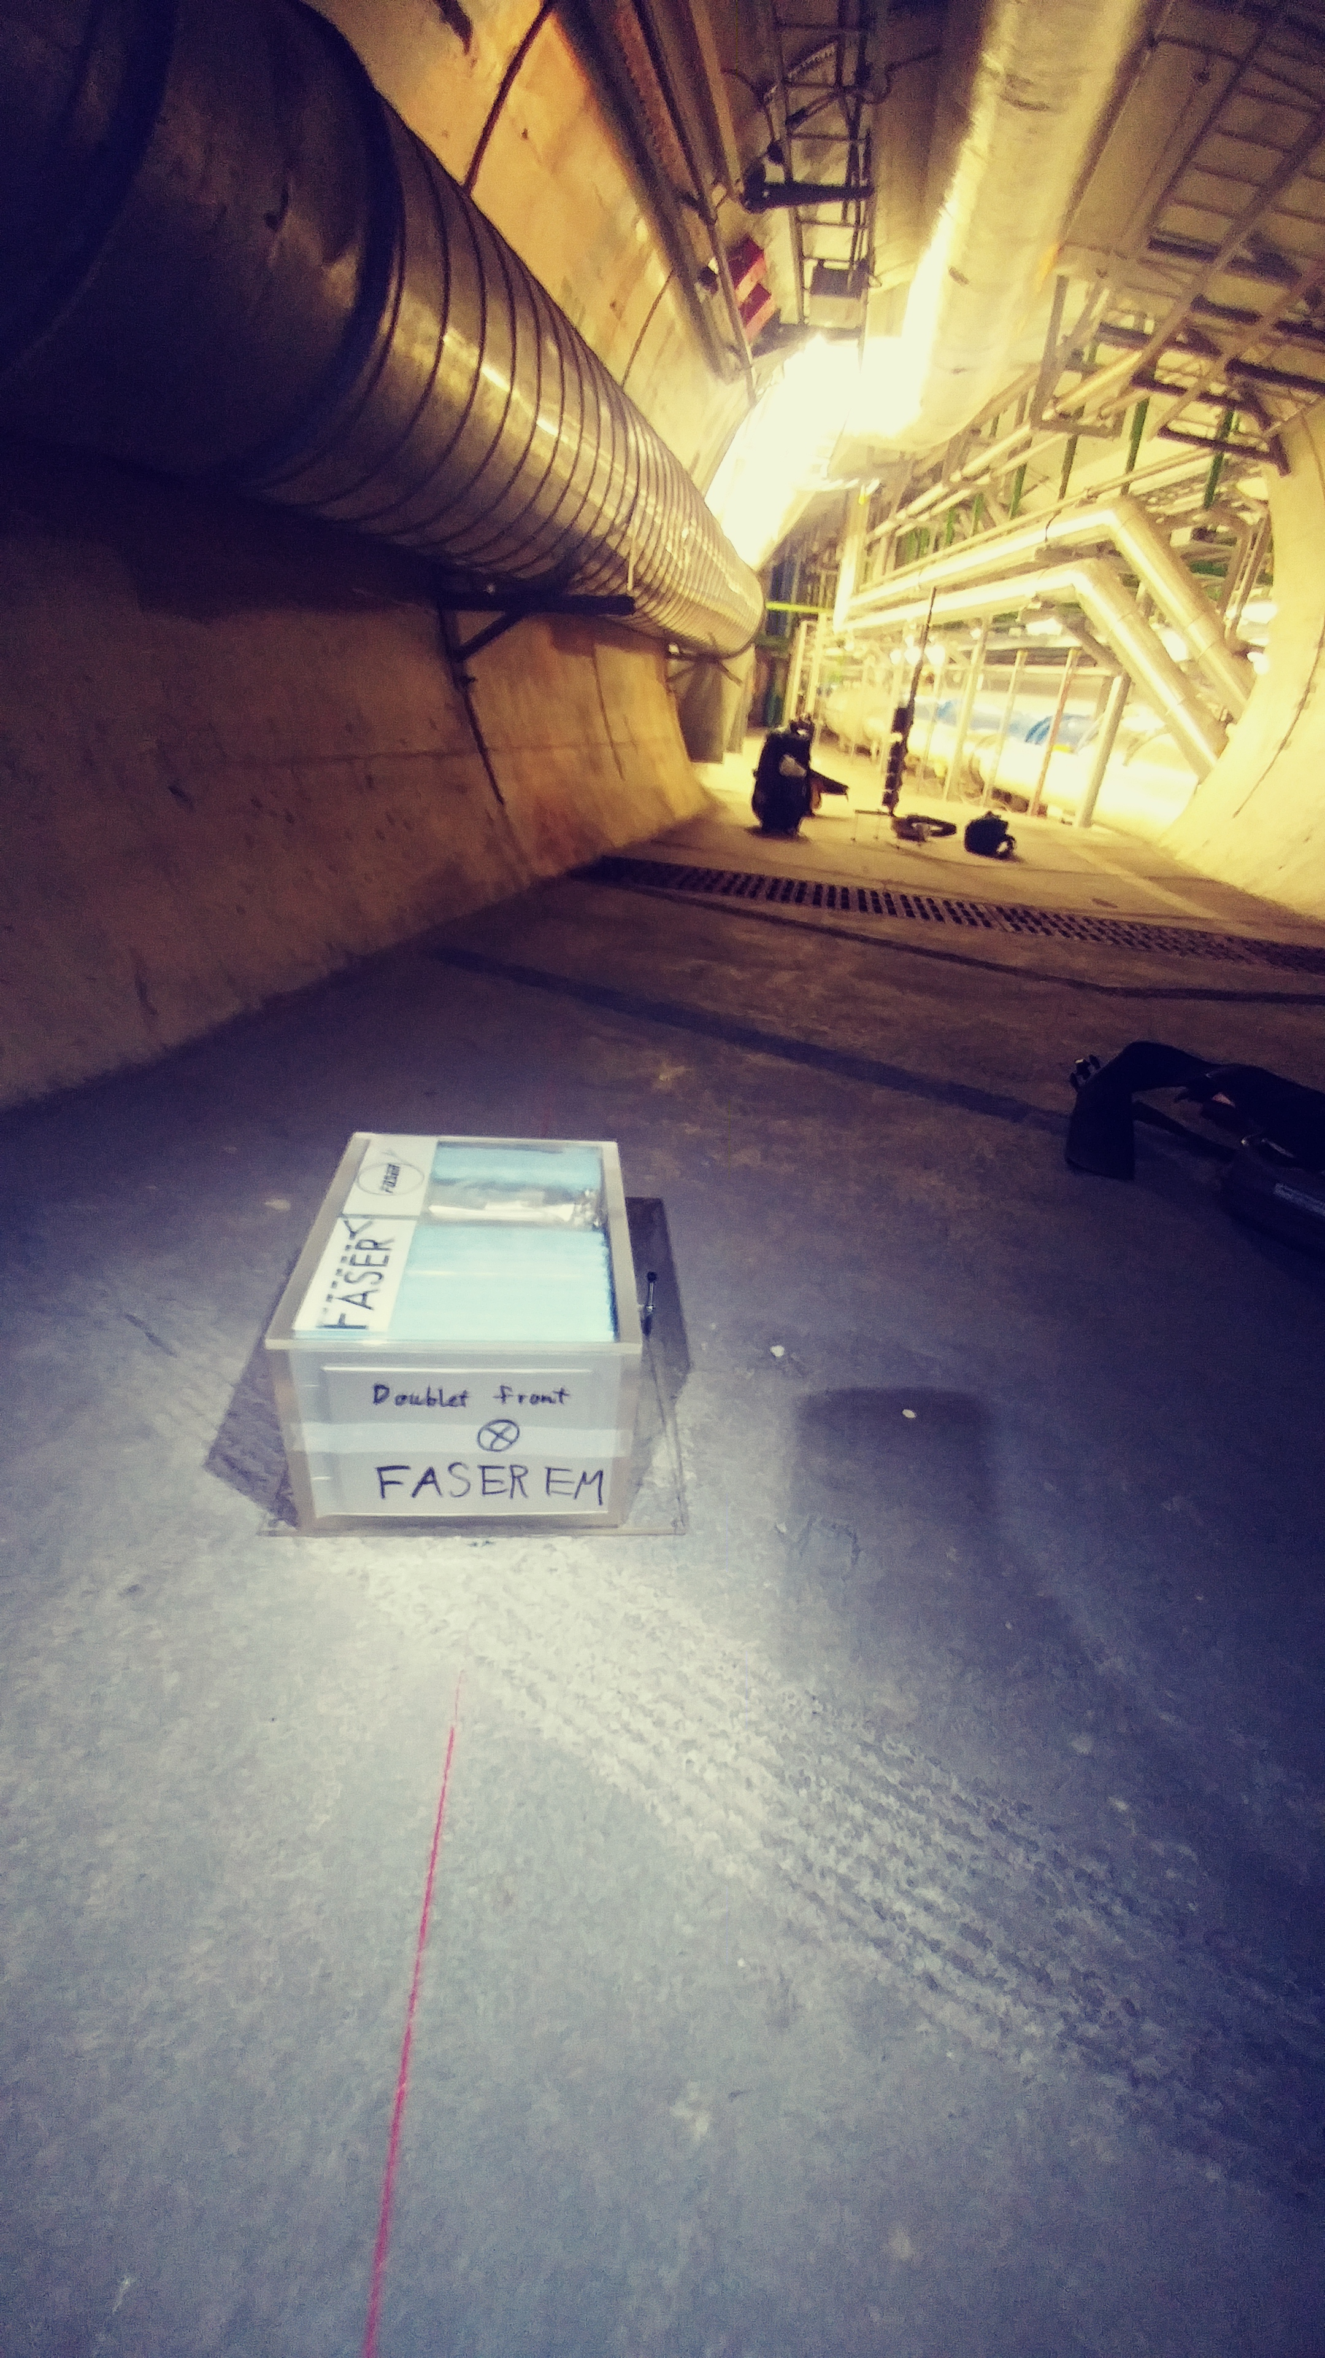
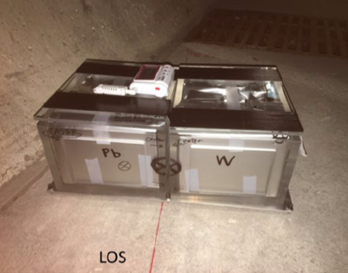
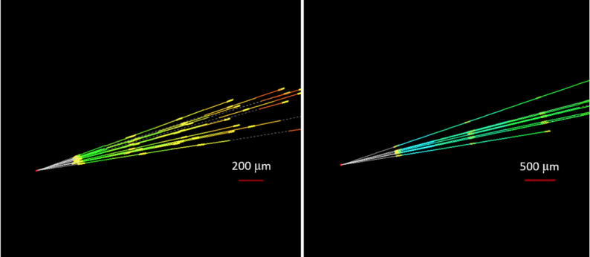
NEUTRINO FLUXES
In fact, we have probably already seen our first TeV collider neutrino.
In 2018 a 29 kg FASER pilot emulsion detector collected 12.5 fb⁻¹ on the beam collision axis (installed and removed during Technical Stops).
Expect ~10 neutrino interactions. Several neutral vertices identified, likely to be neutrinos. Analysis ongoing.
FASERν
preliminary
FASERν
preliminary

Slide 35
THE FASERν DETECTOR
FASERν is designed to detect neutrinos of all flavors.
  25cm x 30cm x 1.1m detector consisting of 770 emulsion layers interleaved with 1mm-thick tungsten plates; target mass = 1.1 tonne.
  Emulsion swapped out every ~10-30 fb⁻¹, total 10 sets of emulsion for Run 3.
LLP
ν
e⁺
e⁻

Slide 36
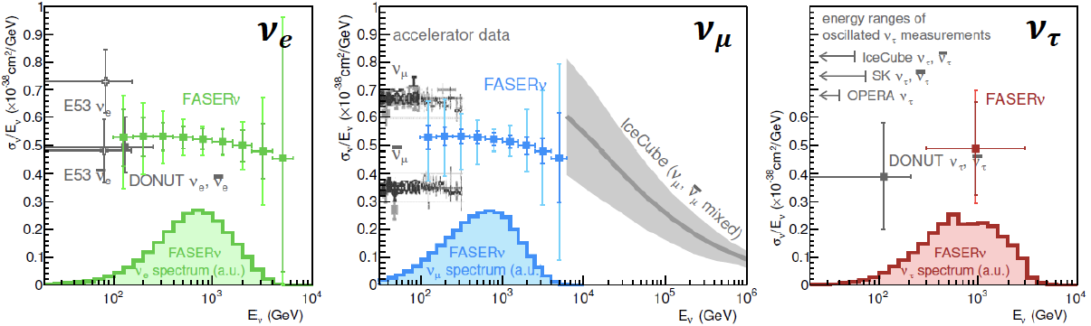
NEUTRINO PHYSICS
In Run 3 (2022-24), FASERν will
  Detect the first collider neutrino.
  Record ~1000 ν_{e} , ~10,000 ν_{μ} , and ~10 ν_{τ} interactions at TeV energies, the first direct exploration of this energy range for all 3 flavors.
  Double the world’s supply of tau neutrinos.
  Distinguish muon neutrinos from anti-neutrinos by combining FASER and FASERν data, and so measure their cross sections independently.
FASER Collaboration 1908.02310 (2019)

Slide 37
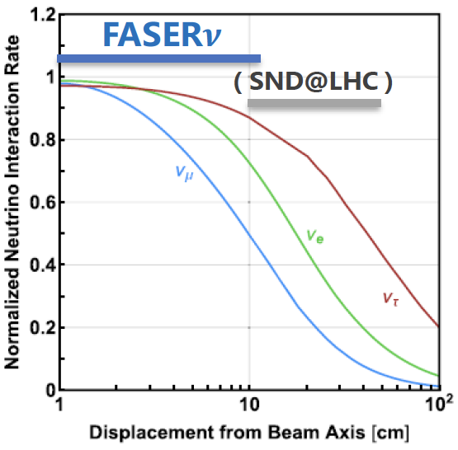
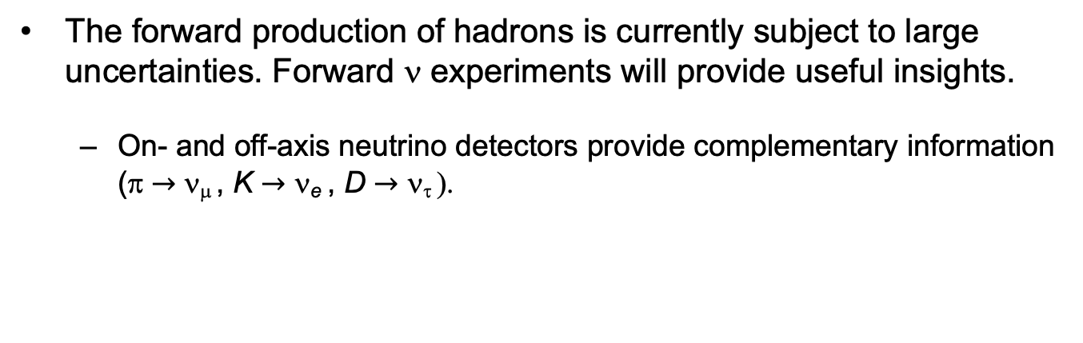
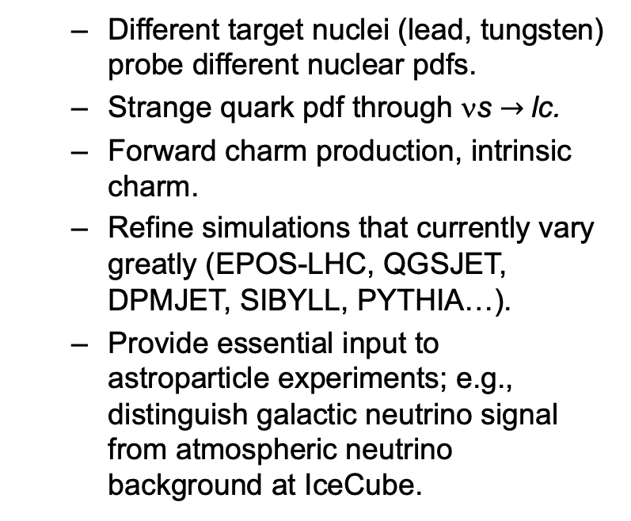
QCD PHYSICS
The forward production of hadrons is currently subject to large uncertainties. Forward ν experiments will provide useful insights.
  On- and off-axis neutrino detectors provide complementary information (π $→$ ν_{μ} , K $→$ ν_{e} , D $→$ ν_{τ} ).
  Different target nuclei (lead, tungsten) probe different nuclear pdfs.
  Strange quark pdf through νs $→$lc.
  Forward charm production, intrinsic charm.
  Refine simulations that currently vary greatly (EPOS-LHC, QGSJET, DPMJET, SIBYLL, PYTHIA…).
  Provide essential input to astroparticle experiments; e.g., distinguish galactic neutrino signal from atmospheric neutrino background at IceCube.

Slide 38
FORWARD PHYSICS FACILITY

Slide 39
FORWARD PHYSICS FACILITY
FASER, FASERν, and other proposed far-forward detectors are currently highly constrained by 1980’s infrastructure that was never intended to support experiments.
At the same time, it is becoming clear that there is a rich physics program in the far-forward region.
  New particle searches, neutrinos, QCD, MC event generators, milli-charged particles, dark matter, dark sector, cosmic neutrinos, …
Strongly motivates creating a dedicated facility to house far-forward experiments for the HL-LHC era from 2027-37.
  Snowmass LOI: 240 authors from many different communities
  FPF Kickoff Meeting: 9-10 Nov 2020, https://indico.cern.ch/event/955956, organized with Maria Garzelli and Felix Kling.
  2nd FPF Workshop: 27-28 May 2021, https://indico.cern.ch/event/1022352, announcement and talk solicitation coming soon.

Slide 40
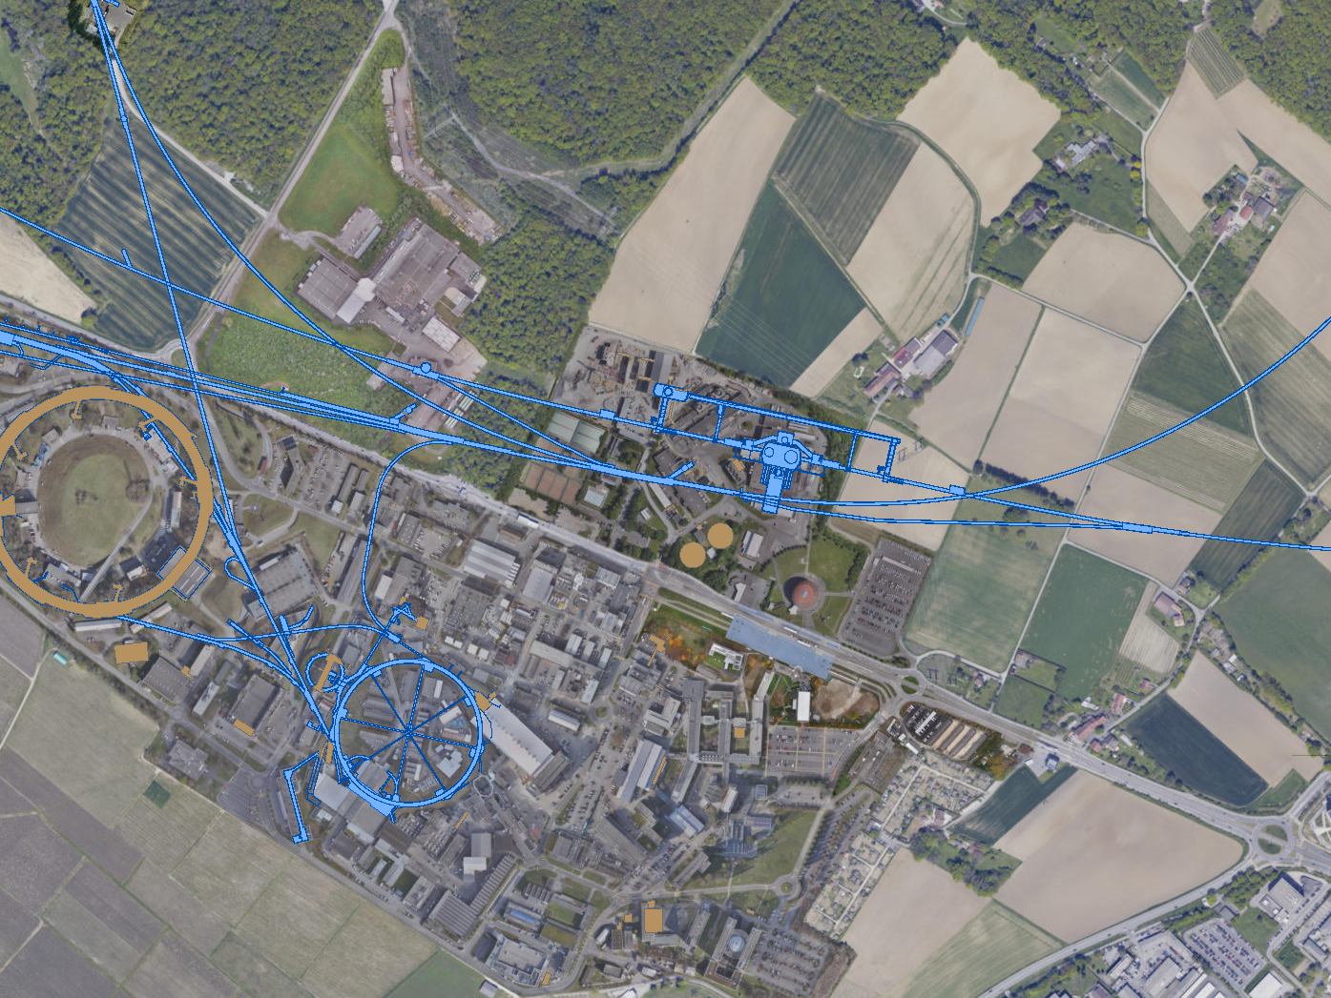
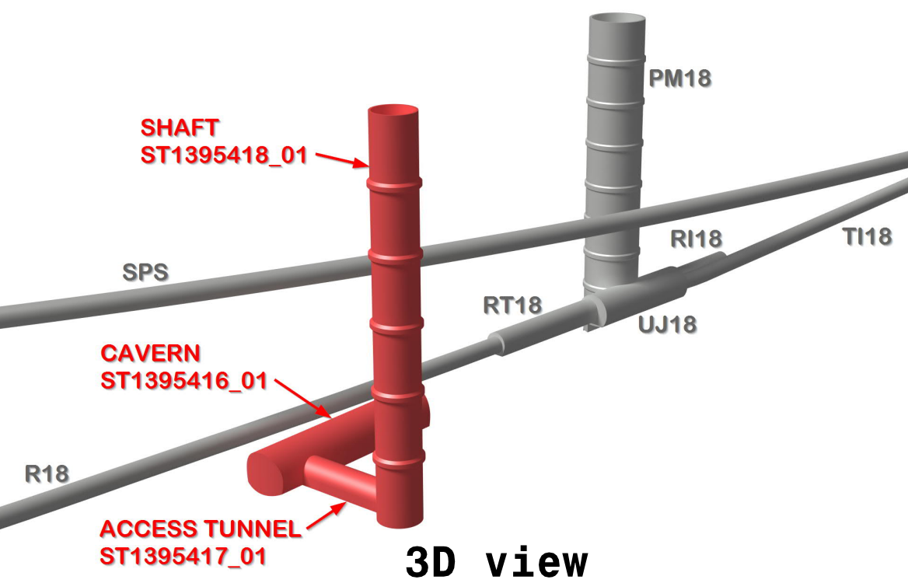
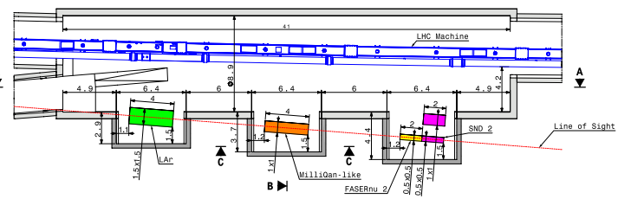
FPF LOCATION
Possibilities under active investigation: enlarge existing cavern UJ12, 480 m from ATLAS and shielded from the ATLAS IP by ~100 m of rock; or create a new shaft and cavern ~612 m from ATLAS past UJ18.
UJ18
ATLAS
SPS
UJ12
LHC
LOS
See John Osborne’s talk, PBC Workshop 3/3/21
CERN GIS

Slide 41
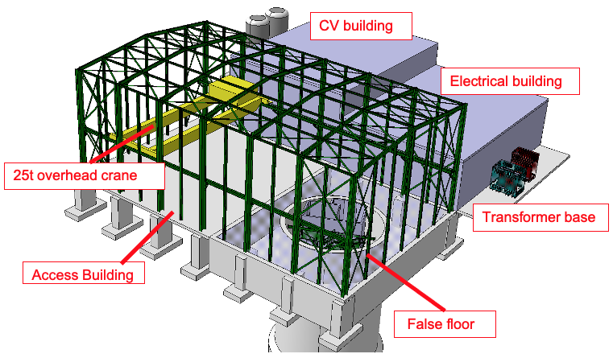
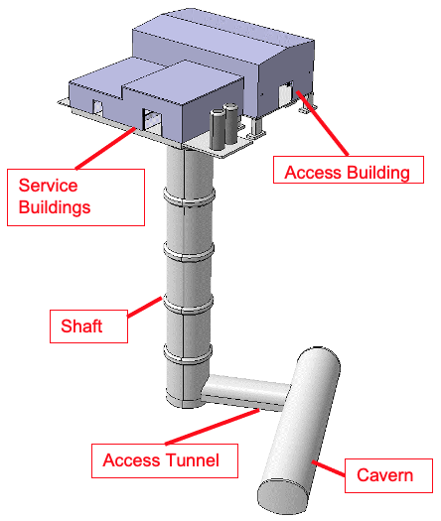
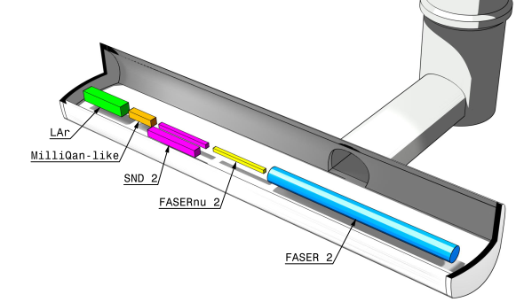
Jonathan Gall, FPF Workshop
FPF: NEW SHAFT AND CAVERN
Many advantages
  Construction access far easier
  Access possible during LHC operations
  Size and length of cavern more flexible
  Designed around needs of the experiments
Design by Liam Dougherty (EN-ACE-INT)

Slide 42
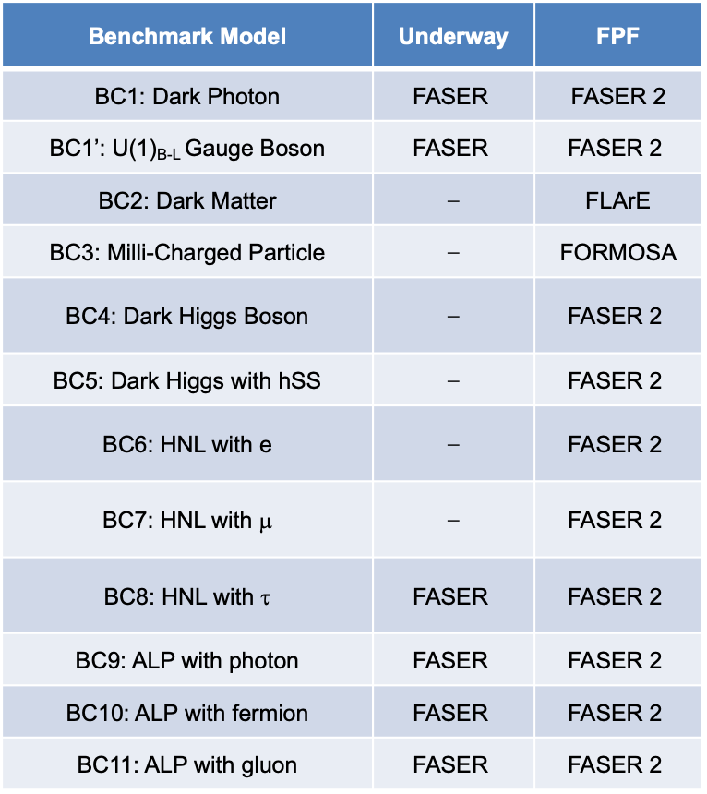
NEW PHYSICS SEARCHES AT THE FPF
The FPF will house a number of experiments
FASER 2, an upgraded FASER with R = 1 m, L = 10 m, can discover all candidates with renormalizable couplings (dark photon, dark Higgs, HNL); ALPs with all types of couplings (γ, f, g); and many other particles.
Other experiments can probe neutrinos and many other interesting ideas.
Benchmark Model | Underway | FPF
BC1: Dark Photon | $$\text{FASER}$$ | FASER 2
BC1’: U(1)_{B-L} Gauge Boson | $$\text{FASER}$$ | $$\text{FASER}\text{ 2}$$
BC2: Dark Matter | ⎼ | FLArE
BC3: Milli-Charged Particle | ⎼ | FORMOSA
BC4: Dark Higgs Boson | ⎼ | $$\text{FASER}\text{ 2}$$
BC5: Dark Higgs with hSS | ⎼ | $$\text{FASER}\text{ 2}$$
BC6: HNL with e | ⎼ | $$\text{FASER}\text{ 2}$$
BC7: HNL with μ | ⎼ | $$\text{FASER}\text{ 2}$$
BC8: HNL with τ | $$\text{FASER}$$ | $$\text{FASER}\text{ 2}$$
BC9: ALP with photon | $$\text{FASER}$$ | $$\text{FASER}\text{ 2}$$
BC10: ALP with fermion | $$\text{FASER}$$ | $$\text{FASER}\text{ 2}$$
BC11: ALP with gluon | $$\text{FASER}$$ | $$\text{FASER}\text{ 2}$$

Slide 43
FLArE

Slide 44
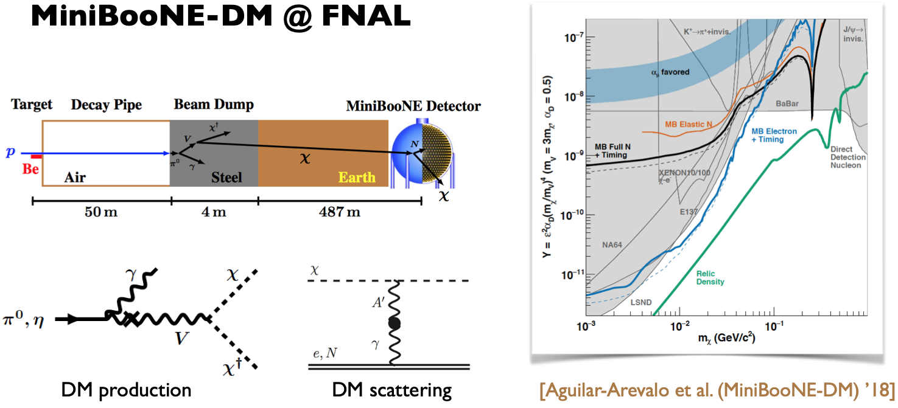

DARK MATTER AT THE FPF
Batell, Feng, Trojanowski (2021)
If m_{LLP} > 2m_{DM} , the LLP will typically decay in the dark sector to dark matter, leading to invisible decays.
This makes the signal much more difficult to find, but opens the possibility of detecting dark matter, not just dark portals.
It implies an intense beam of DM particles in the far-forward direction. Can look for the resulting DM to scatter off electrons and nuclei in a detector at the FPF.
SM
EM
M
Dark Sector
EM, X
A
A_{D}

Slide 45
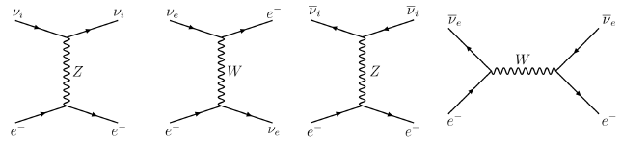
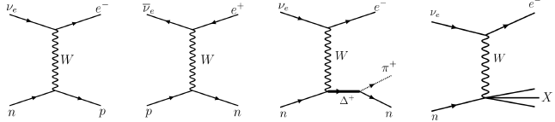
FLArE: FORWARD LIQUID ARGON EXPERIMENT
LAr detectors are now well-known for detecting neutrinos and dark matter. They have also been discussed specifically in this context of detecting dark matter produced by accelerators and colliders.
Consider two possible detectors placed on the beamline, ~500 m from the IP, running throughout the HL-LHC era with 3 ab⁻¹.
  FLArE-10: 10-tonne detector, 1m x 1m x 7m
  FLArE-100: 100-tonne detector, 1.6m x 1.6m x 30m
Batell, Pospelov, Ritz (2009); MiniBooNE (2017); SND@LHC (2020)
Focus here on the electron scattering signal. Main backgrounds are from νe scattering, and νN scattering.
Note: νN scattering and lots of interesting neutrino physics yet to be explored!

Slide 46
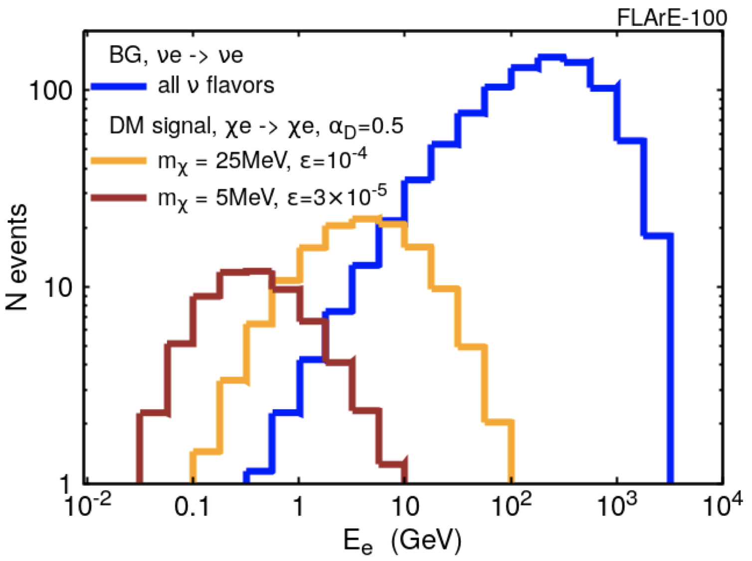
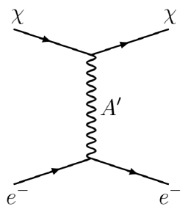
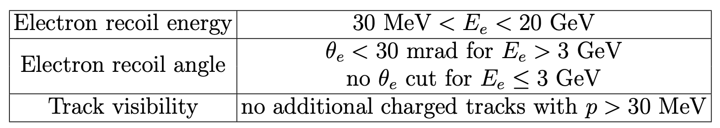
FLArE: FORWARD LIQUID ARGON EXPERIMENT
DM-e scattering is suppressed by ε, but also highly enhanced by a light mediator.
The DM-e cross section can be bigger than the SM ν−e cross section, and the resulting energy spectrum is softer.
The search benefits greatly from the low energy threshold of LAr detectors. Assuming electrons can be detected down to 30 MeV, reject events with additional charged tracks above this threshold, νe background can be reduced to ~10, νN reduced to even lower levels.
ε

Slide 47
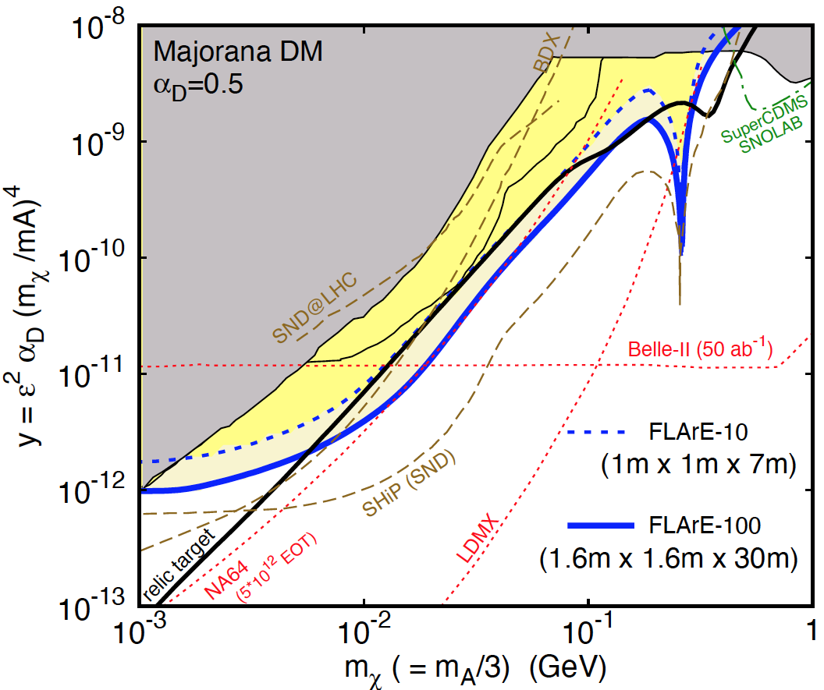


FLArE: SESITIVITY REACHES
FLArE will probe much of the favored/allowed relic target region.
Complementary to missing energy, missing momentum experiments that probe the “too large $Ω_{χ}h^{2}$” region, but don’t detect DM scattering.
Batell, Feng, Trojanowski (2021)

Slide 48
SUMMARY

Slide 49
SUMMARY
New target for discovery: neutrinos and light and weakly-interacting particles probed by fast, small, cheap experiments in the far-forward region of the LHC.
FASER and FASERν: 3.5 years from theory proposal to completion, 5 m long, ~$2M. Data-taking starts in 2022 with a rich physics program.
  BSM: searches for dark photons, HNLs, ALPs, new forces.
  SM: opens the new field of LHC neutrino physics. ~1000 ν_{e}, ~10,000 ν_{μ}, ~10 ν_{τ} at TeV energies. Implications for neutrino properties, forward hadron production, cosmic ray and cosmic neutrino physics.
Forward Physics Facility: Proposed facility to house a suite of far-forward experiments for the HL-LHC era from 2027-37.
FLArE: Forward Liquid Argon Experiment, proposed 10-100 tonne LArTPC for dark matter searches, neutrino physics.

