Slide 1



FASTER, SMALLER, CHEAPER
LOOKING FORWARD TO
NEW DISCOVERIES AT THE LHC
Department Colloquium, University of Hawaii
Jonathan Feng, UC Irvine, 4 February 2021

Slide 2
OUTLINE
PARTICLE PHYSICS NOW
LIGHT, WEAKLY–INTERACTING PARTICLES
FORWARD PHYSICS
FASER
FASERν
FORWARD PHYSICS FACILITY
SUMMARY

Slide 3
PARTICLE PHYSICS NOW

Slide 4
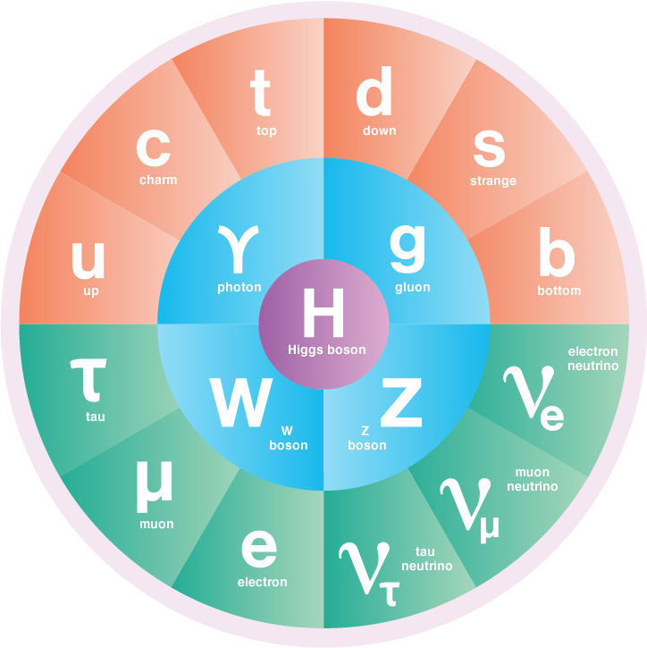
A BRIEF HISTORY OF PARTICLE PHYSICS
In the last century, we have been tremendously successful in discovering new particles and deepening our understanding of the laws of nature and the contents of the Universe.
The workhorse tools leading to much of this progress have been particle accelerators and colliders.

Slide 5
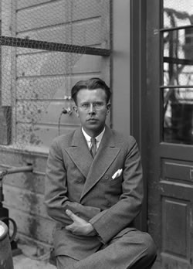
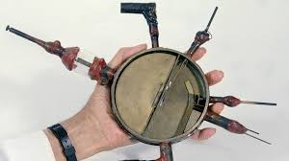
PARTICLE ACCELERATORS AND COLLIDERS
In the 1930’s, E. O. Lawrence made a cyclotron, which accelerated particles to higher velocities and energies.
The first cyclotron was small, but soon, bigger accelerators led to higher energies, which allowed heavier particles to be produced and discovered.

Slide 6

THE LARGE HADRON COLLIDER
The latest realization of Lawrence’s vision: the LHC in Geneva
MoEDAL
LHCf
.
FASER
TOTEM
Colliding protons at a center-of-mass energy of 13 TeV
Notes:
6

Slide 7

THE ATLAS DETECTOR
One of several giant detectors that observe particle collisions at the LHC
Notes:
7

Slide 8
HOW BIG IS BIG SCIENCE?
Size: Big. Colliders the size of cities, detectors the size of buildings.
Timescale: Long. The LHC was conceived in the 1980’s. It was constructed from 1998-2008, and has been running since 2008, with periodic shutdowns to upgrade and fix equipment.
Budget: Expensive. The cost of constructing the LHC and the various experiments was roughly $10 billion. The annual operations budget of CERN, the host laboratory, is about $1 billion/year, or roughly 1 coffee per year per EU citizen.
People: Many.

Slide 9
A RECENT CMS AUTHOR LIST

Slide 10
A RECENT CMS AUTHOR LIST (CONTINUED)

Slide 11
A RECENT CMS AUTHOR LIST (CONTINUED)

Slide 12
A RECENT CMS AUTHOR LIST (CONTINUED)

Slide 13
A RECENT CMS AUTHOR LIST (CONTINUED)
4000 collaborators from 230 institutions in 51 countries

Slide 14
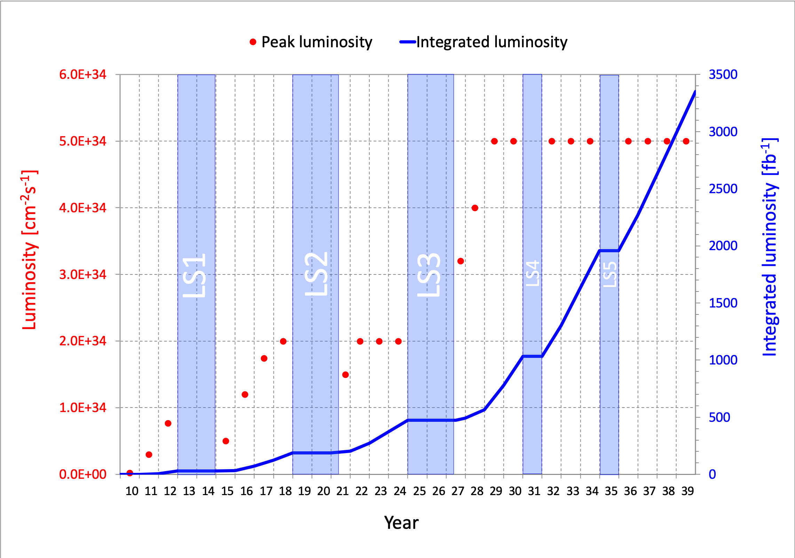
LHC: CURRENT STATUS
The discovery of the Higgs boson in 2012 completed the standard model of particle physics, a remarkable achievement, but so far there has been no other evidence for new particles.
The LHC is currently in Long Shutdown 2, but will start up again in 2022 and run till ~2037. Will we find new particles through conventional searches?
What other approaches can enhance the prospects for discovering new particles?

Slide 15
LIGHT, WEAKLY-INTERACTING PARTICLES

Slide 16
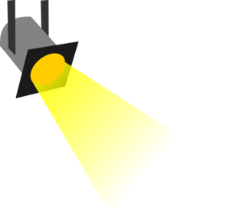
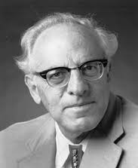
THE NEW PARTICLE LANDSCAPE
Particle
Colliders
Mass
MeV
GeV
TeV
1
Already
Discovered
Strongly Interacting
Heavy Particles
Interaction Strength
New Targets of Small Experiments
Traditional Targets
of Big Science
10⁻³
Weakly Interacting
Light Particles
Impossible to
Discover
10⁻⁶

Slide 17
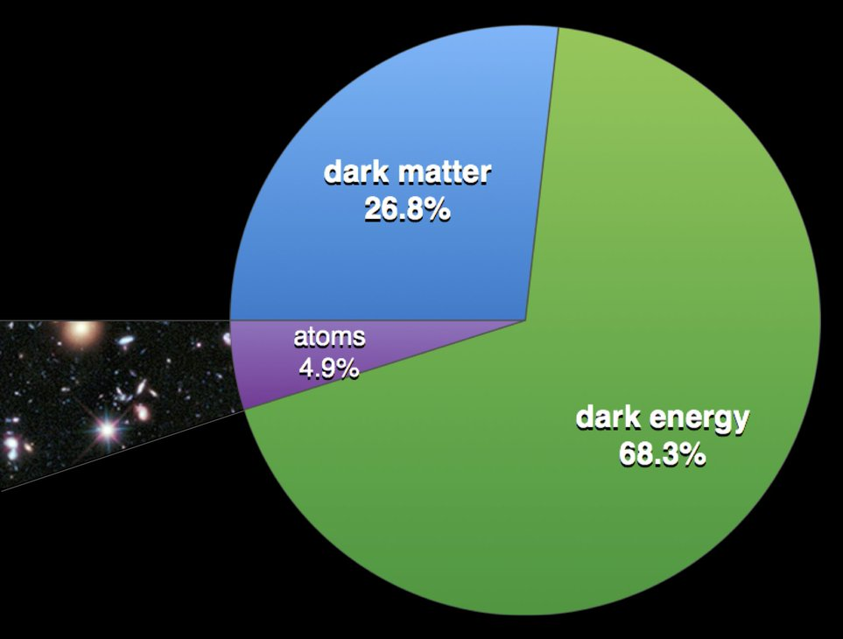
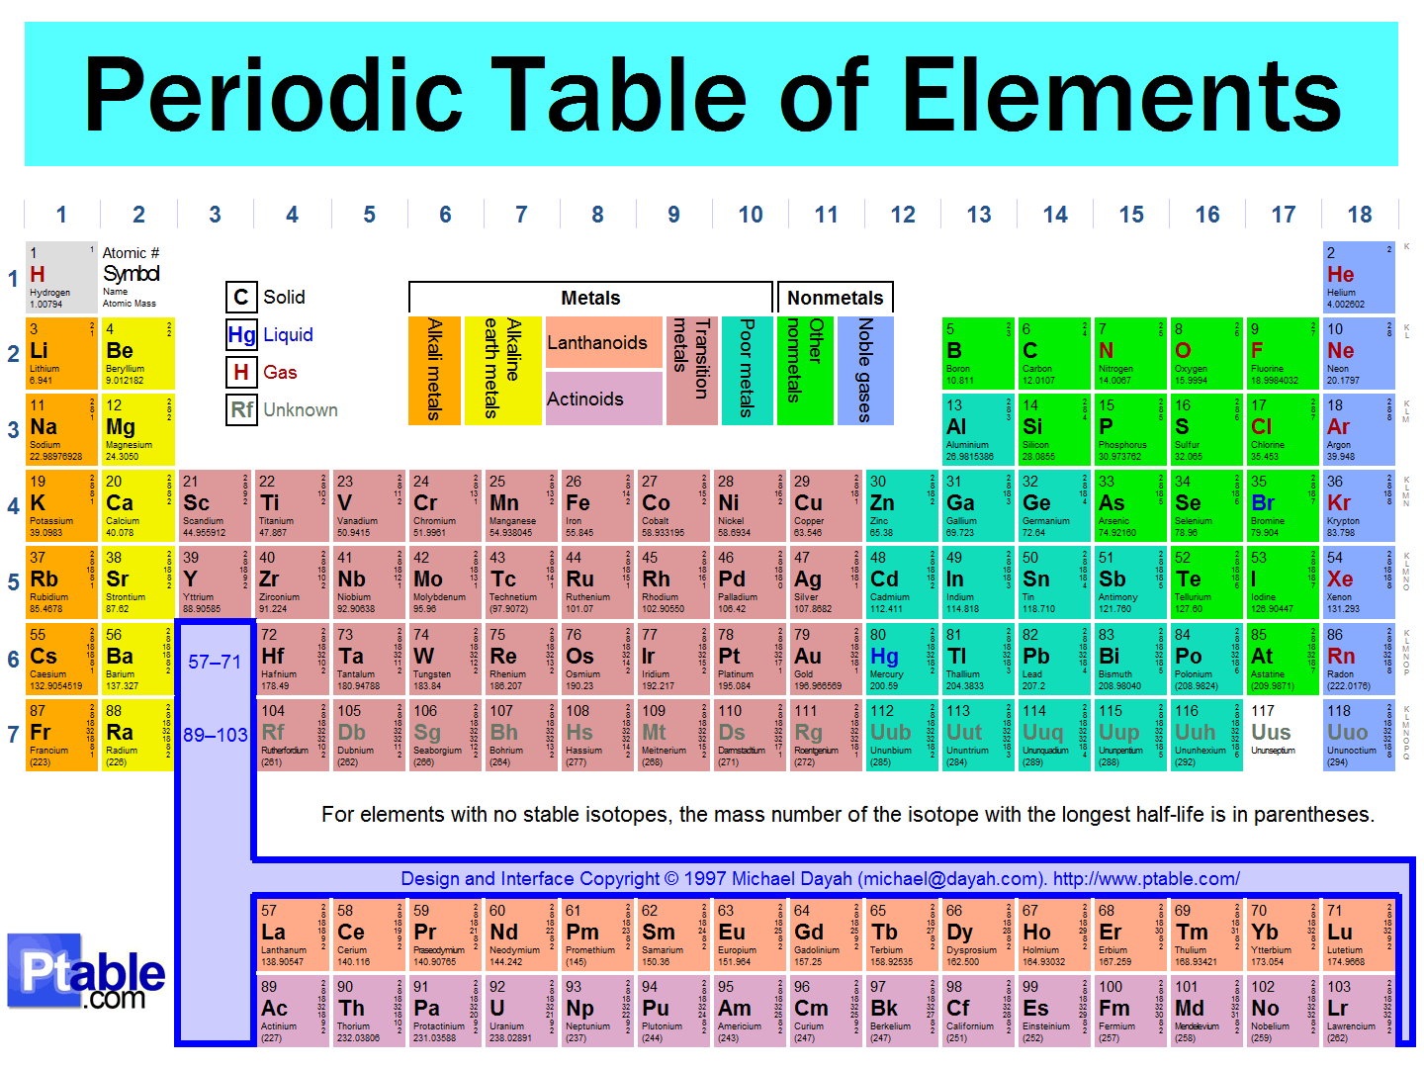
THE UNIVERSE TODAY
We now have an overall picture of the Universe.
We know a lot about a little: the normal matter (5%).
But we know little about a lot: dark matter / dark energy (95%). Dark matter provides a strong motivation for at least one new weakly-interacting particle.

Slide 18
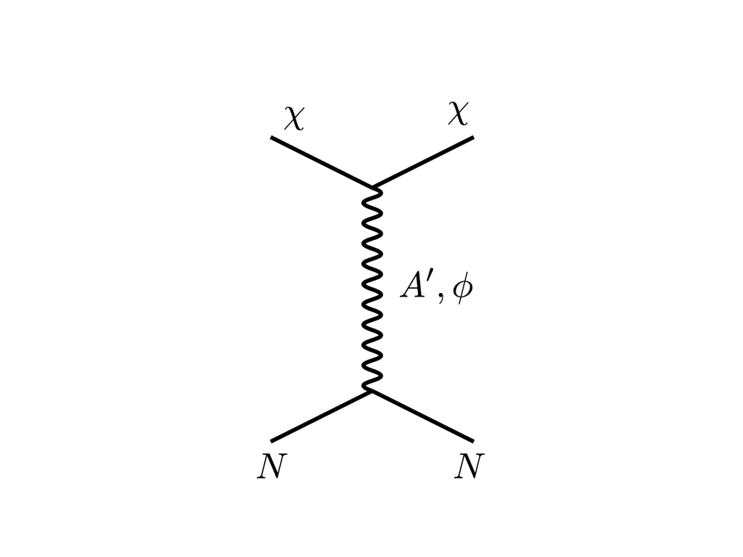





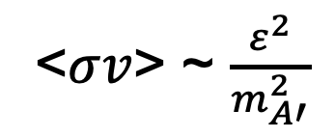
THE THERMAL RELIC LANDSCAPE
Particle
Colliders
Mass
MeV
GeV
TeV
1
Already
Discovered
Strongly Interacting
Heavy Particles
Too Little to be
Dark Matter
$$e$$
DM
$$ε$$
$$A’$$
$$ε$$
Interaction Strength
Just Right to
be Dark Matter
10⁻³
DM
$$e$$
<$σv$> ~ $\frac{ε^{2}}{m_{A′}^{2}}$
Weakly Interacting
Light Particles
Impossible to
Discover
10⁻⁶
Boehm, Fayet (2003)
Feng, Kumar (2008)
Too Much to be
Dark Matter

Slide 19
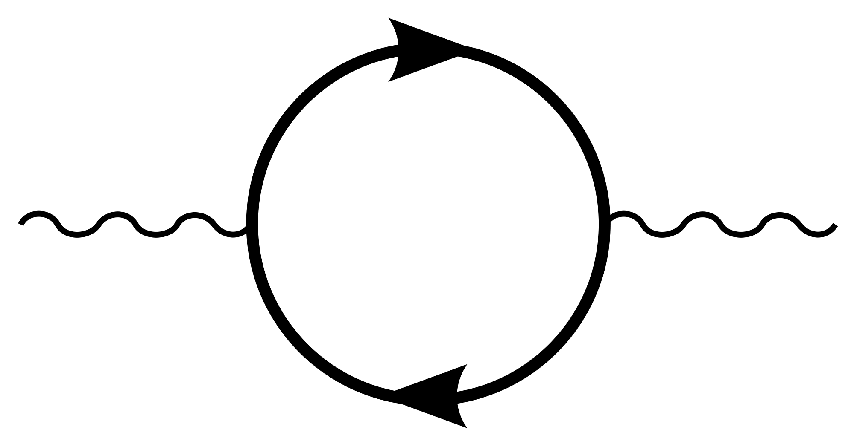
AN EXAMPLE: DARK PHOTONS
Suppose there is a dark sector that contains dark matter X and also a dark force: dark electromagnetism.
Generically, the force carriers of the SM and dark EM will mix
The resulting theory contains a new particle, the dark photon A’. It’s like a normal photon, except that it can have a small mass, and its couplings to charged particles are suppressed by a small parameter: it is a weakly-interacting, light particle.
Finding a dark photon would imply the discovery of a new fundamental force and also our first “portal” through which to view the dark sector.
SM
EM
Dark Sector
EM, X
M
A
A_{D}
Holdom (1986)

Slide 20
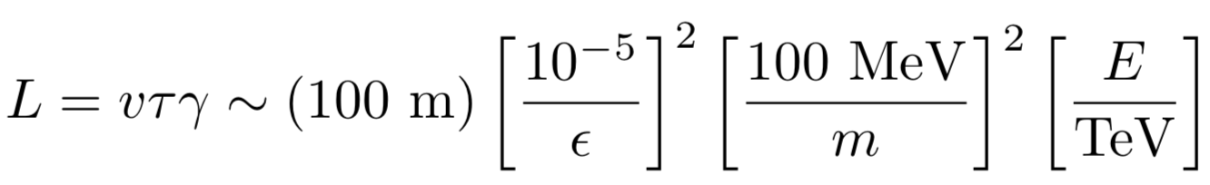
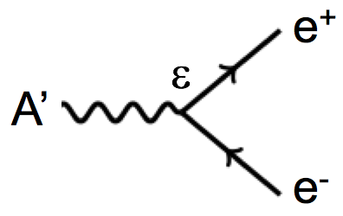
DARK PHOTON PROPERTIES
Consider dark photons with
  energy E ~ TeV, as can be produced at the LHC
  mass between electron (0.5 MeV) and proton (1 GeV): take m ~ 100 MeV
  coupling between milli-charged and micro-charged: take ε ~ 10⁻⁵
They pass through matter without interacting: radiation length is (10 cm) ε⁻² ~ 10⁹ m. The distance to the moon!
They go straight; unaffected by E and B fields.
They may decay to visible particles, but only after a long time:
Strong dependence on m and ε, but these are long-lived particles and decay lengths may be meters or kilometers: human length scales!

Slide 21
THE NEW PARTICLE LANDSCAPE
Particle
Colliders
Mass
MeV
GeV
TeV
1
Already
Discovered
Strongly Interacting
Heavy Particles
LONGER
LIFETIMES
Interaction Strength
10⁻³
Weakly Interacting
Light Particles
Impossible to
Discover
10⁻⁶

Slide 22
FORWARD PHYSICS

Slide 23

SEARCHES FOR NEW LIGHT PARTICLES
If new particles are light and weakly interacting, existing detectors are perfectly designed NOT to see them.
Existing detectors are designed to find new heavy particles. These particles are produced almost at rest and decay isotropically.
But new light particles are mainly produced in the decays of light particles: π, K, D and B mesons. These are mainly produced along the beamline, and so the new particles disappear through the holes that let the beams in.
Clearly what we need a detector to cover these “blind spots” in the forward region. If we go far enough away, the proton beams are bent by magnets (it’s a circular collider!), whereas the new light particles will go straight.

Slide 24
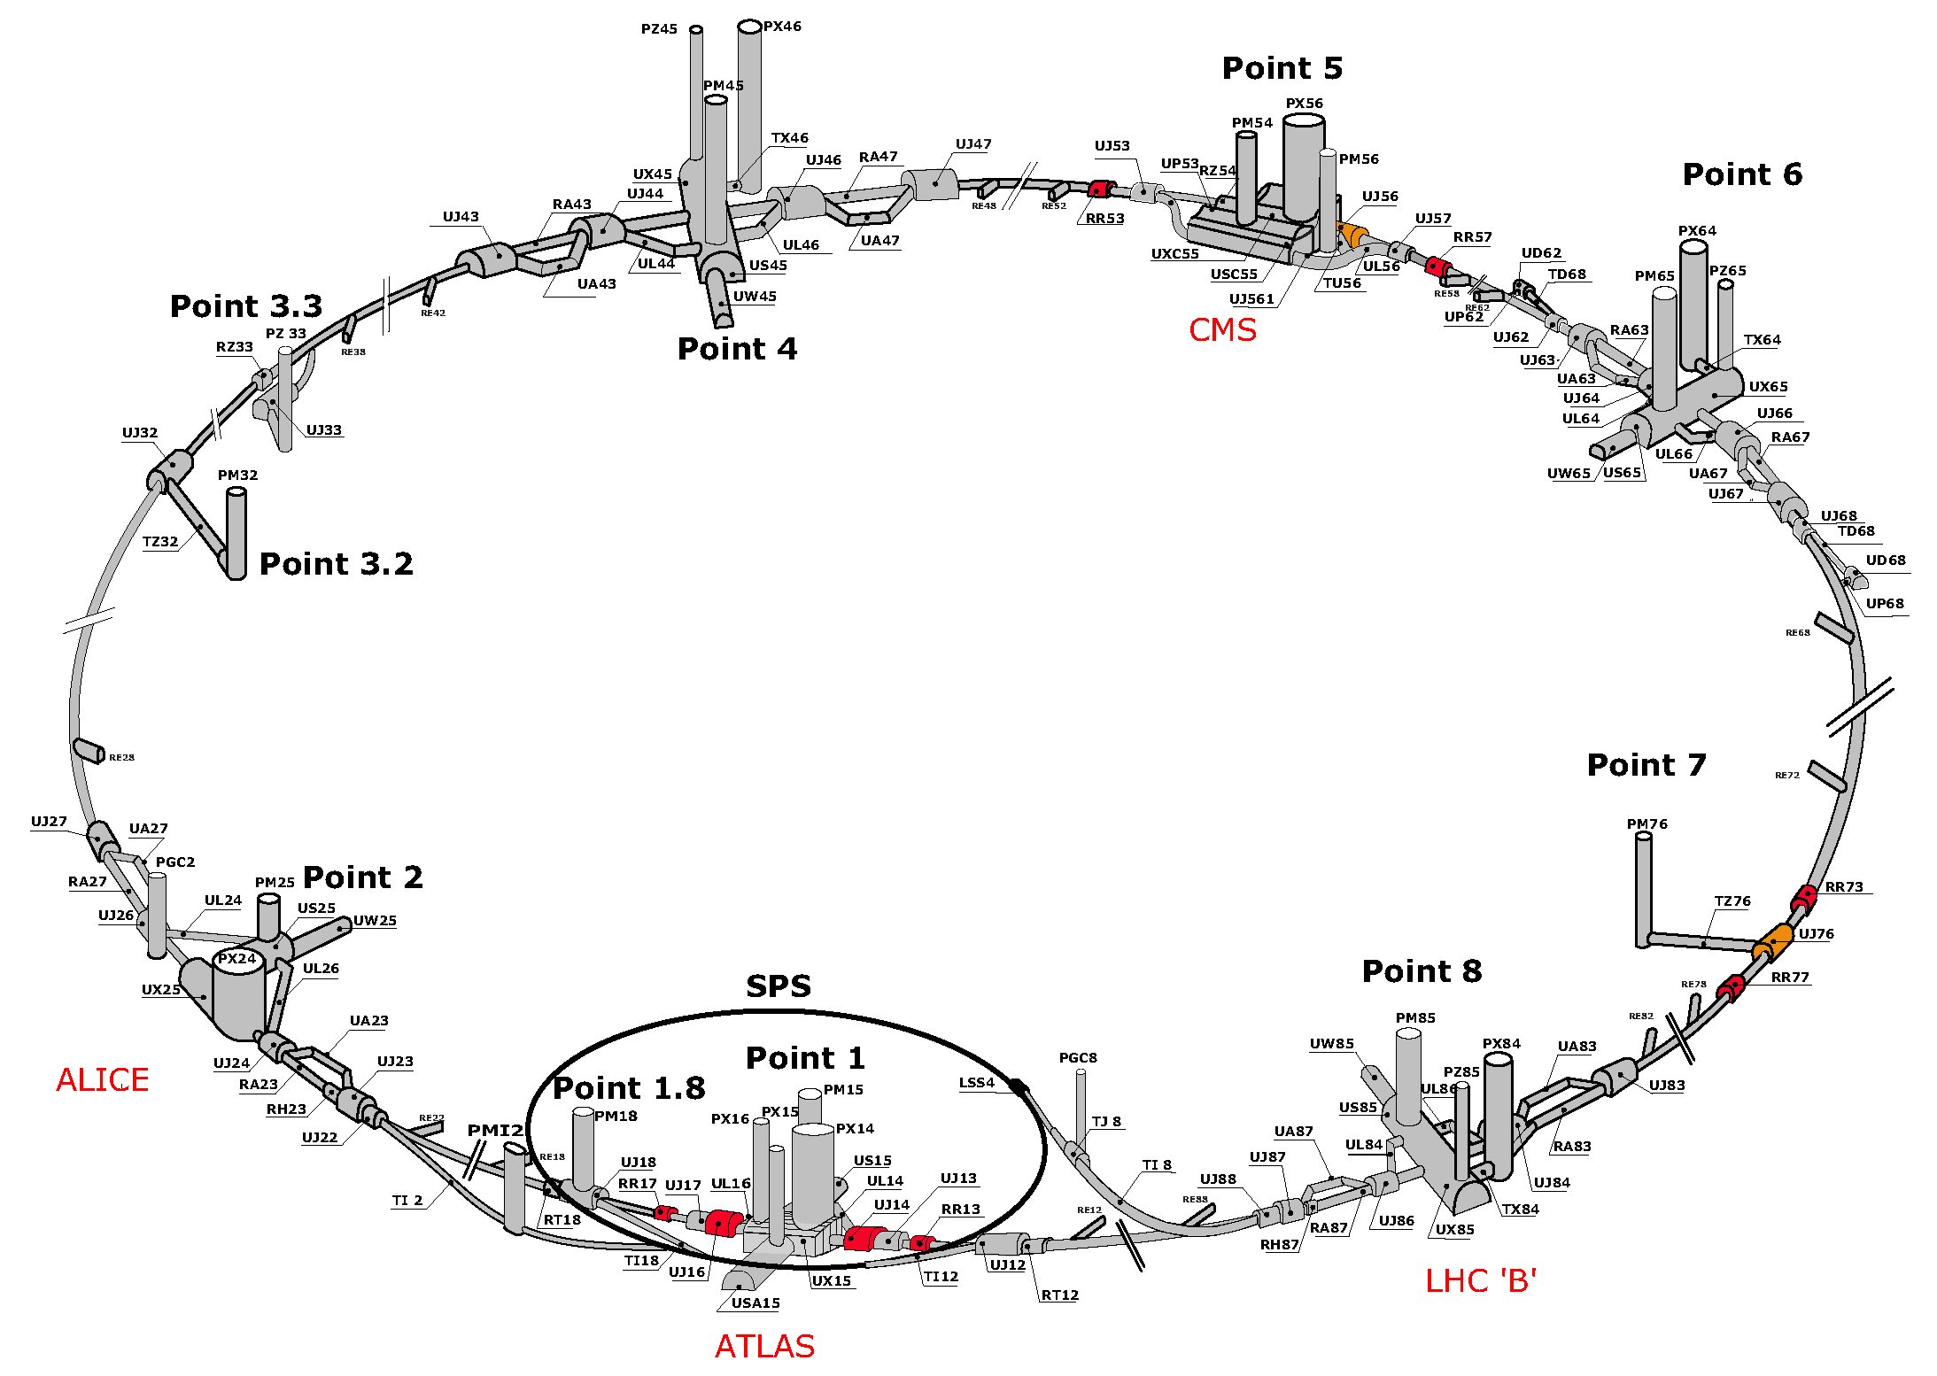
MAP OF LHC
!!!

Slide 25
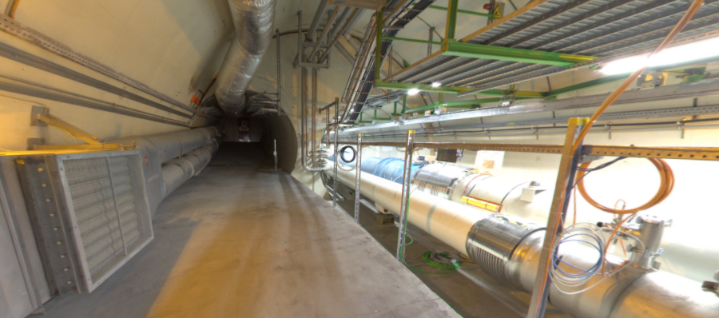
LOCATION, LOCATION, LOCATION
Beam collision axis passes
through 100 m of rock, emerges in tunnel TI12, 480 m from ATLAS
UJ12
TI12 near UJ12
The view in UJ12 looking west (2019)
TI12
Beam collision axis
LHC beamline

Slide 26
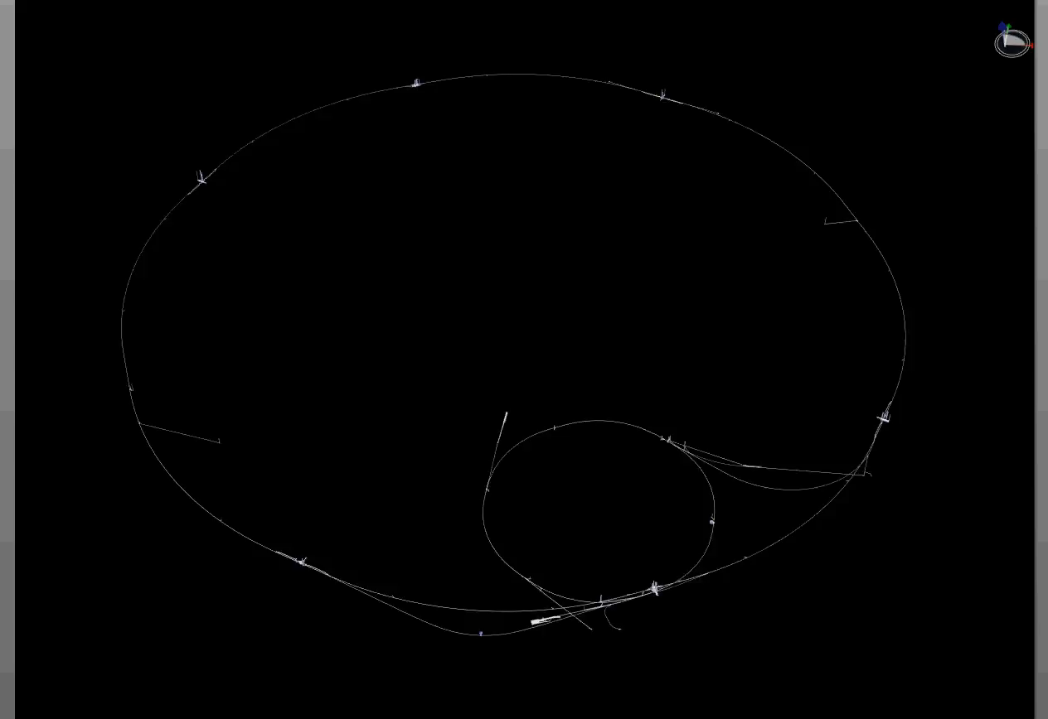
PARTICLE PATH FROM ATLAS TO TI12
Dougherty, CERN Integration (2019)

Slide 27
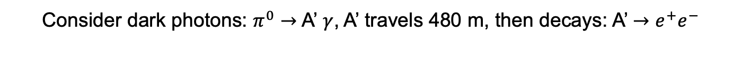
HOW BIG DOES THE DETECTOR HAVE TO BE?
Consider dark photons: $π^{0}→$ A’ $γ$, A’ travels 480 m, then decays: A’ $→$ $e^{+}e^{−}$
Pions at the IP
Production is peaked at p_{T} ~ m_{π},Λ_{QCD}~250 MeV
Enormous event rates: N_{π}~10¹⁵ per bin
A’s at the IP
Rates highly suppressed by ε² ~ 10⁻¹⁰
But still N_{A’} ~ 10⁵ per bin
A’s decay in [480m, 483m]
Only highly boosted ~TeV A’s decay in FASER
N_{A’} ~ 100 e⁺e⁻ events, within 20 cm of “on axis”
300 fb⁻¹
Feng, Galon, Kling, Trojanowski (2017)

Slide 28
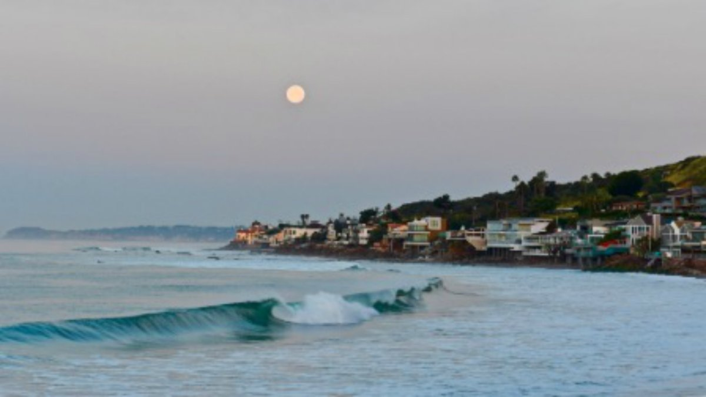
HOW BIG DOES THE DETECTOR HAVE TO BE?
Momentum:
Space:
200 MeV
1 TeV
10 cm
480 m
The opening angle is 0.2 mrad (η ~ 9); cf. the moon (7 mrad).
TeV dark photons (or any other new particle produced in π, K, D, B decay) is far more collimated than shown below, motivating a new, small, fast, cheap experiment at the LHC.

Slide 29
FASER

Slide 30

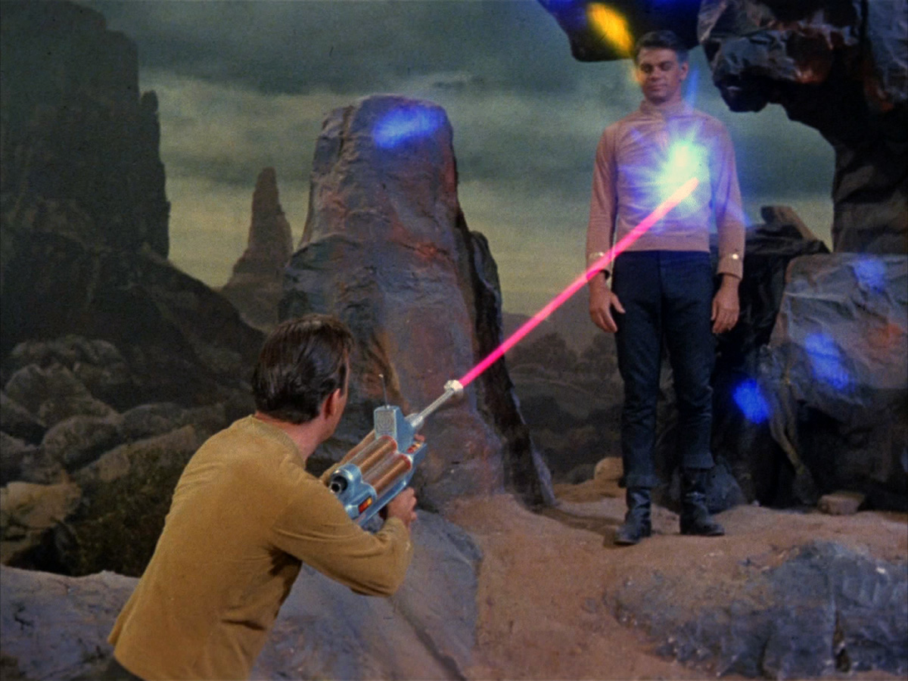
FORWARD SEARCH EXPERIMENT
“The acronym recalls another marvelous instrument that harnessed highly collimated particles and was used to explore strange new worlds.”
Feng, Galon, Kling, Trojanowski (2017)

Slide 31
FASER TIMELINE
September 2017: First theory paper
November 2017: Support from the two most famous living physicists
July 2018: Submitted LOI to CERN LHCC
October 2018: Approval from ATLAS SCT and LHCb Collaborations for use of spare detector modules
November 2018: Submitted Technical Proposal to LHCC
November 2018 – January 2019: Experiment funded by $1M grants from the Heising-Simons and Simons Foundations
March 2019: FASER fully approved by CERN LHCC and Research Board along with support for infrastructure costs
April 2019: 1st FASER Collaboration Meeting
November 2020 – March 2021: Installation of FASER in tunnel during Long Shutdown 2,commissioning of the detector
Early 2022: Start collecting data in Run 3

Slide 32

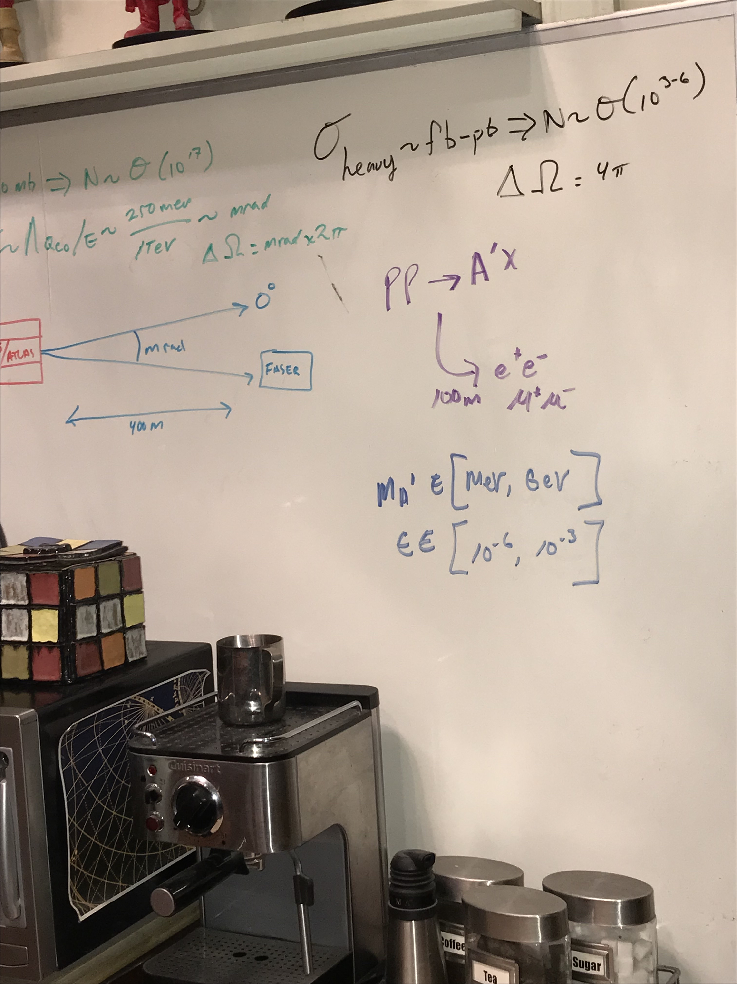
FASER ON BIG BANG THEORY
Credit: Saltzberg
Season 11, Episode 9, “The Bitcoin Entanglement” (November 2017)

Slide 33
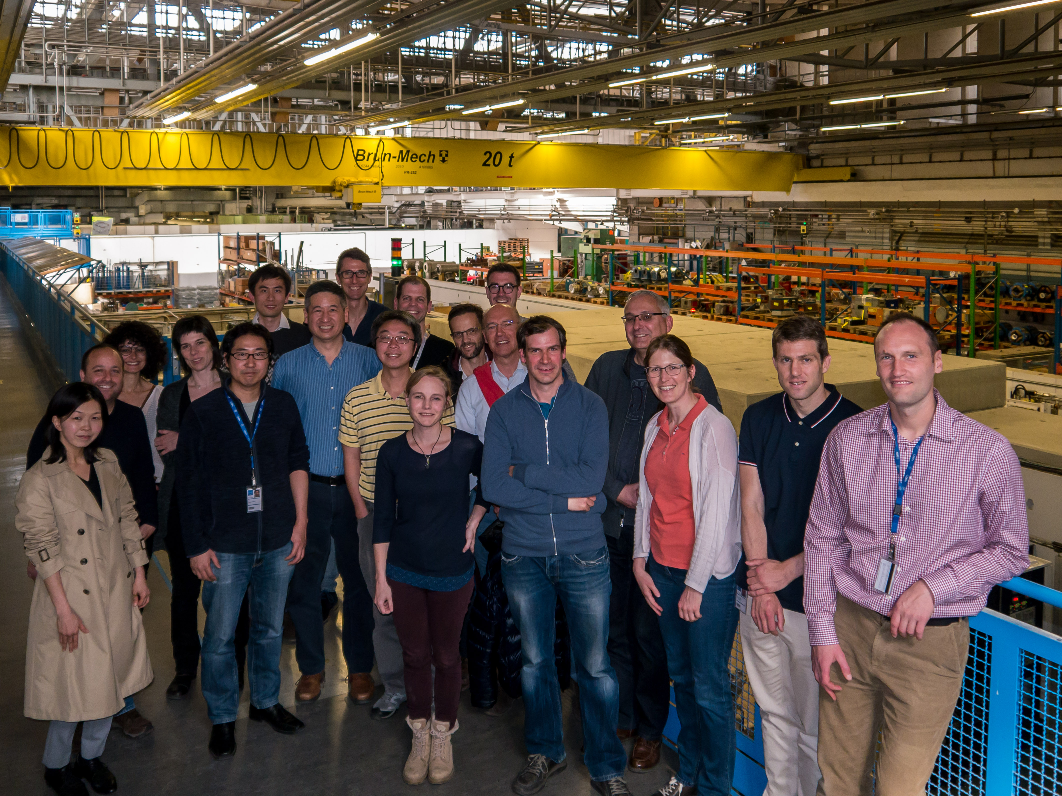
FIRST FASER COLLABORATION MEETING

Slide 34








THE FASER COLLABORATION TODAY
66 collaborators, 19 institutions, 8 countries
Henso Abreu (Technion), Yoav Afik (Technion), Claire Antel (Geneva), Akitaka Ariga (Bern), Tomoko Ariga (Kyushu/Bern), Florian Bernlochner (Bonn), Tobias Boeckh (Bonn), Jamie Boyd (CERN), Lydia Brenner (CERN), Franck Cadoux (Geneva), Dave Casper (UC Irvine), Charlotte Cavanagh (Liverpool), Xin Chen (Tsinghua), Andrea Coccaro (INFN), Monica D’Onofrio (Liverpool), Candan Dozen (Tsinghua), Yannick Favre (Geneva), Deion Fellers (Oregon), Jonathan Feng (UC Irvine), Didier Ferrere (Geneva), Stephen Gibson (Royal Holloway), Sergio Gonzalez-Sevilla (Geneva), Carl Gwilliam (Liverpool), Shih-Chieh Hsu (Washington), Zhen Hu (Tsinghua), Peppe Iacobucci (Geneva), Sune Jakobsen (CERN), Enrique Kajomovitz (Technion), Felix Kling (SLAC), Umut Kose (CERN), Susanne Kuehn (CERN), Helena Lefebvre (Royal Holloway), Lorne Levinson (Weizmann), Ke Li (Washington), Jinfeng Liu (Tsinghua), Chiara Magliocca (Geneva), Josh McFayden (Sussex), Sam Meehan (CERN), Dimitar Mladenov (CERN), Mitsuhiro Nakamura (Nagoya), Toshiyuki Nakano (Nagoya), Marzio Nessi (CERN), Friedemann Neuhaus (Mainz), Laurie Nevay (Royal Holloway), Hidetoshi Otono (Kyushu), Carlo Pandini (Geneva), Hao Pang (Tsinghua), Brian Petersen (CERN), Francesco Pietropaolo (CERN), Markus Prim (Bonn), Michaela Queitsch-Maitland (CERN), Filippo Resnati (CERN), Jakob Salfeld-Nebgen (CERN), Osamu Sato (Nagoya), Paola Scampoli (Bern), Kristof Schmieden (Mainz), Matthias Schott (Mainz), Anna Sfyrla (Geneva), Savannah Shively (UC Irvine), John Spencer (Washington), Yosuke Takubo (KEK), Ondrej Theiner (Geneva), Eric Torrence (Oregon), Serhan Tufanli (CERN), Benedikt Vormvald (CERN), Di Wang (Tsinghua), Gang Zhang (Tsinghua)

Slide 35
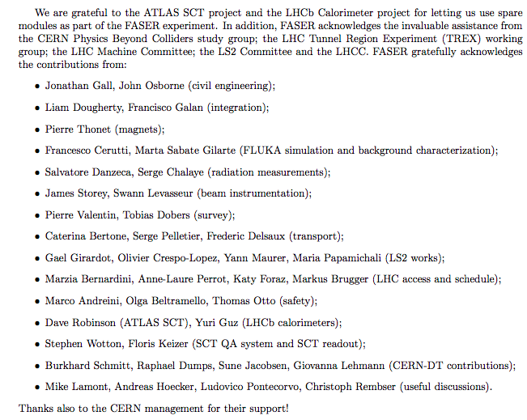
HELP FROM MANY OTHERS
The FASER Collaboration has received essential support from the Heising-Simons and Simons Foundations, CERN, the ATLAS SCT and LHCb Collaborations, and also many others at CERN and elsewhere

Slide 36
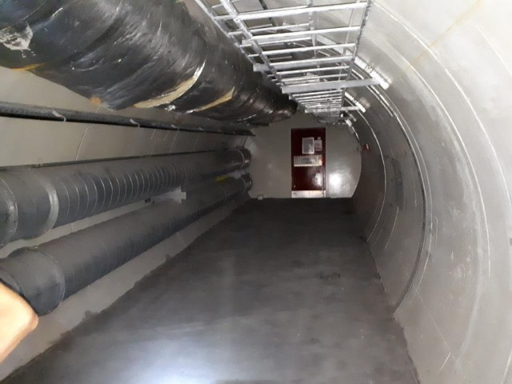
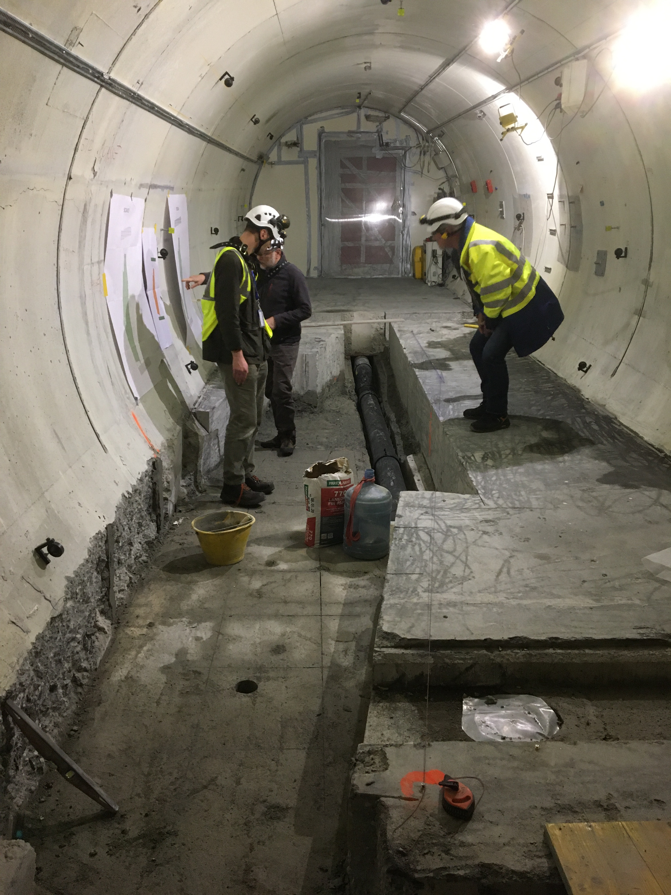
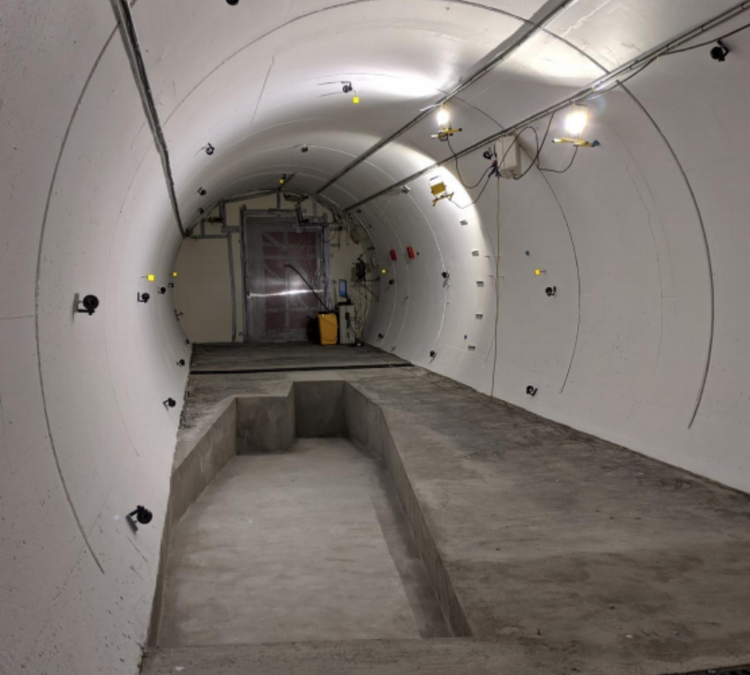
FASER IN TUNNEL TI12
The beam collision axis has been located to mm accuracy by the CERN survey department. To place FASER on this axis, a trench is required to lower the floor by 46 cm.
The trench was completed by an Italian firm just hours before COVID shut down CERN in Spring 2020.
2019
Spring 2020
Summer 2020

Slide 37
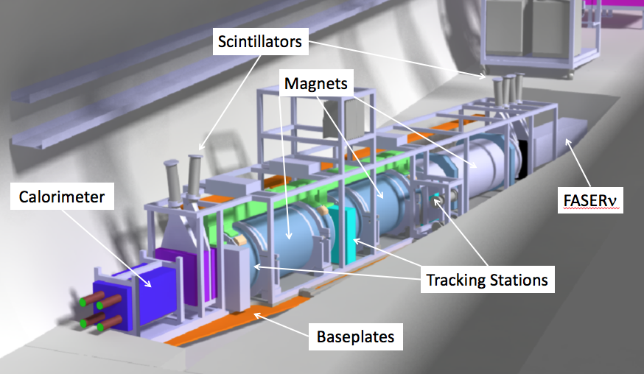
THE FASER DETECTOR
The signal is spectacular: 2 TeV, opposite-sign charged tracks pointing back to ATLAS IP; a “light shining through (100 m-thick) wall” experiment.
Permanent dipole magnets split the charged tracks, which are detected by 3 tracking stations and a calorimeter.
Scintillators veto incoming charged tracks.
LLP
ν
e⁺
e⁻

Slide 38
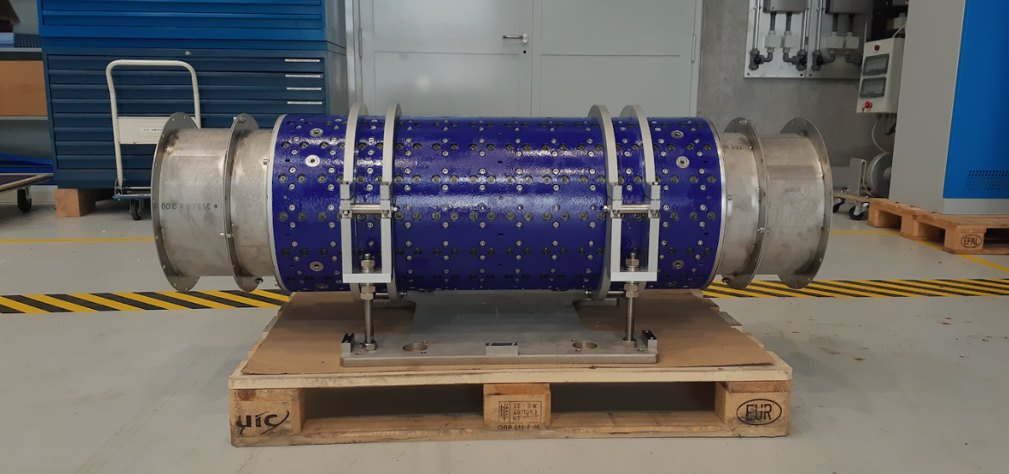
MAGNETS
FASER includes 3 magnets: 1.5 m, 1 m, and 1m long.
These magnets are 0.57 T permanent dipoles with an inner diameter of 20 cm, require little maintenance.
Constructed by the CERN magnet group.

Slide 39
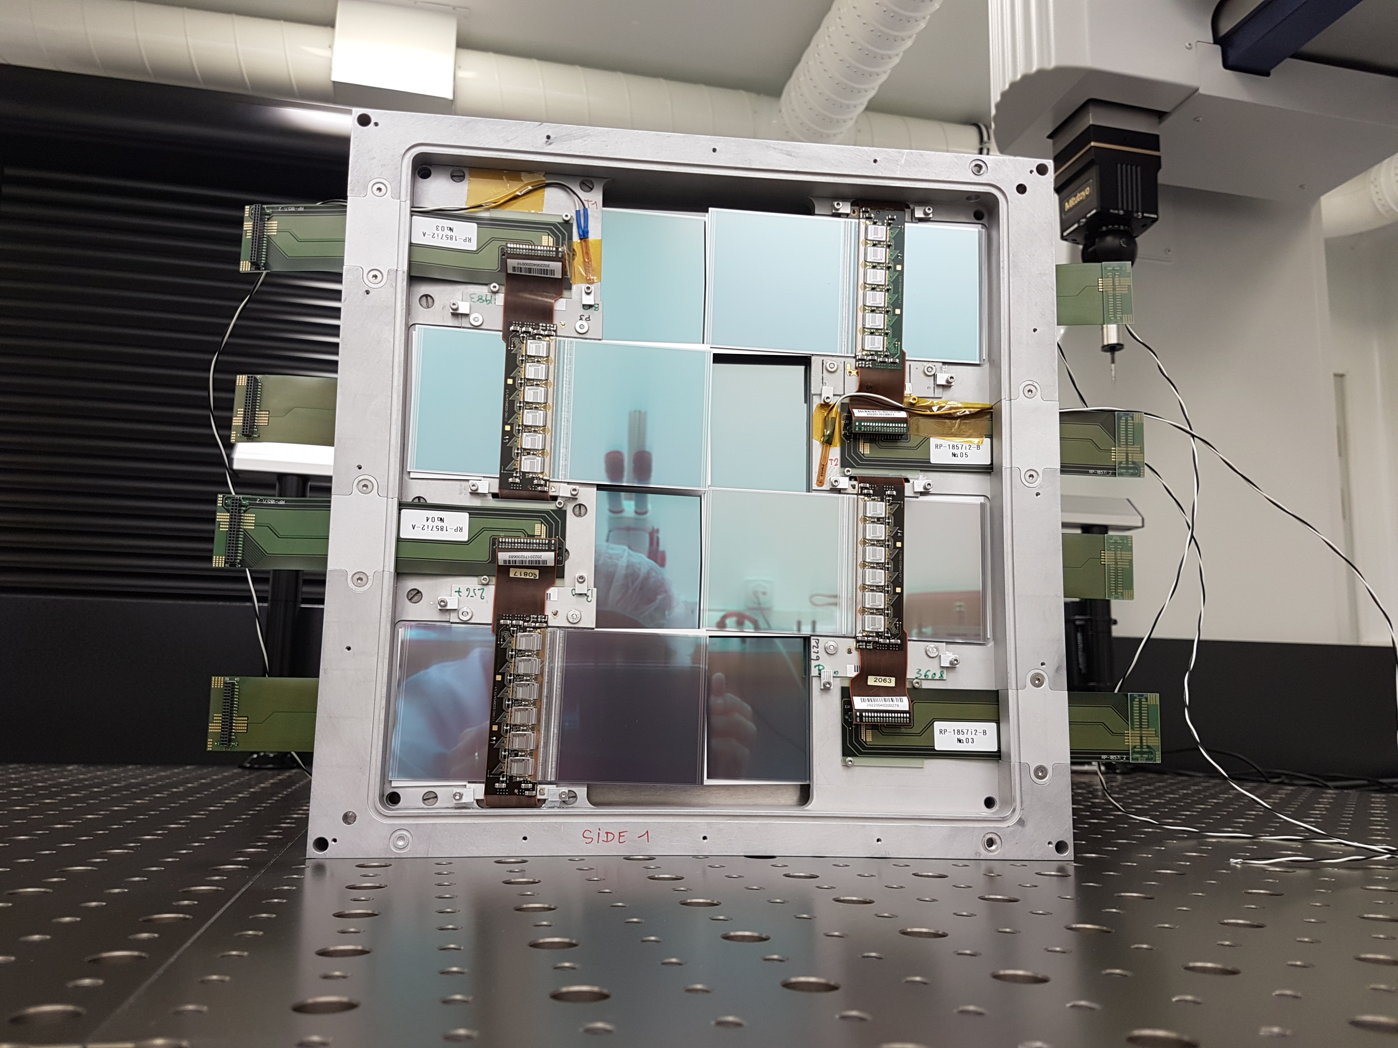
TRACKERS
8 ATLAS SCT modules per tracking plane, 3 tracking planes per tracking station, 3 tracking stations at FASER.

Slide 40
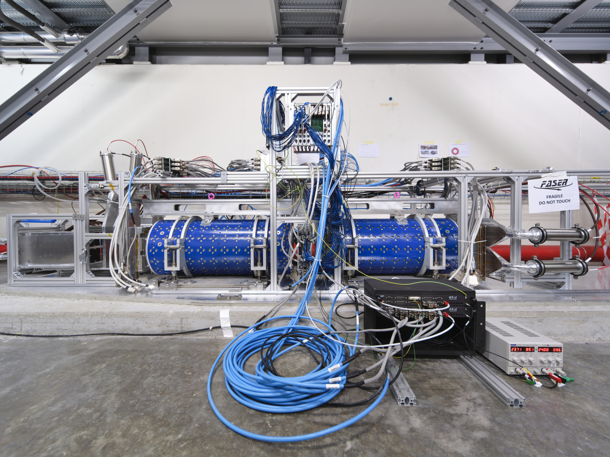
FASER COMMISSIONING ON SURFACE

Slide 41
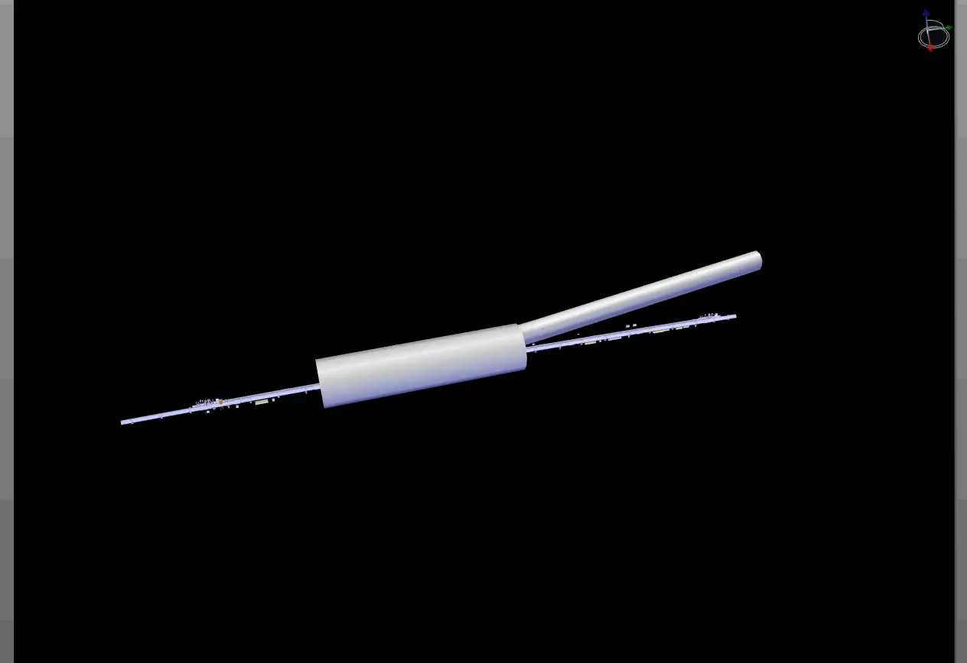
FASER INSTALLATION
Dougherty, CERN Integration (2019)

Slide 42
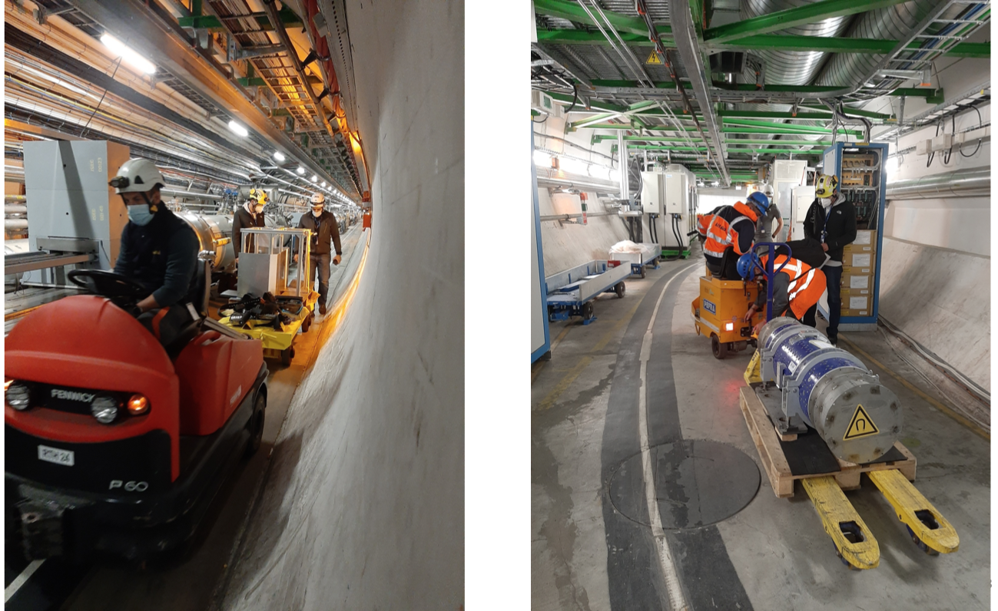
FASER INSTALLATION

Slide 43
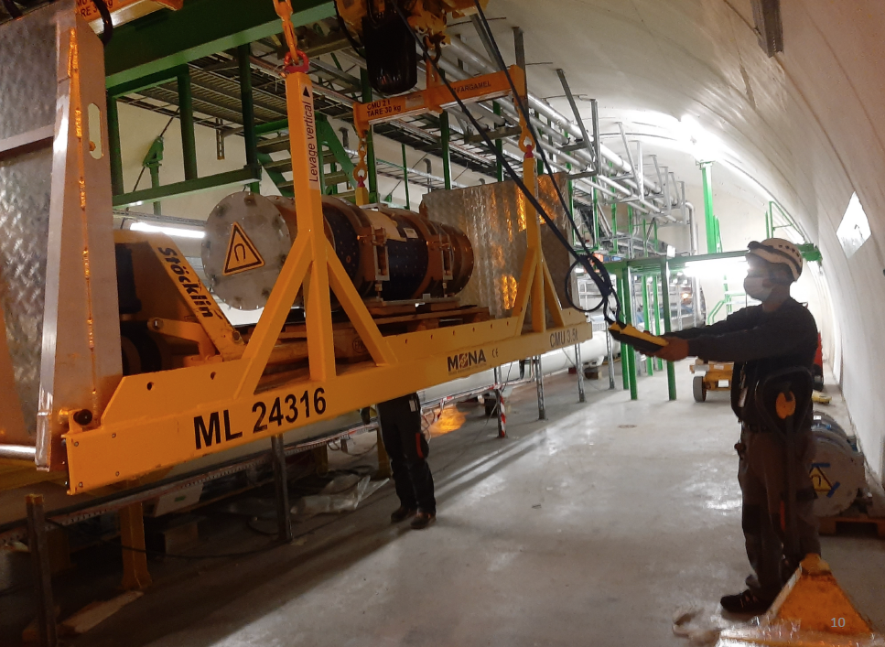
FASER INSTALLATION

Slide 44
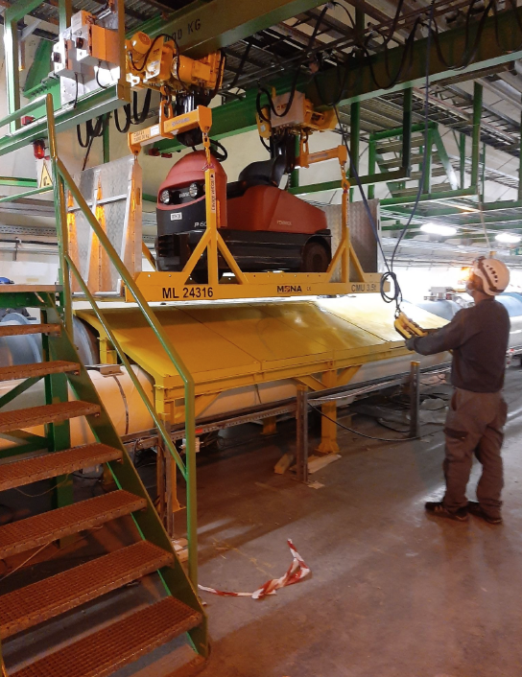
FASER INSTALLATION

Slide 45
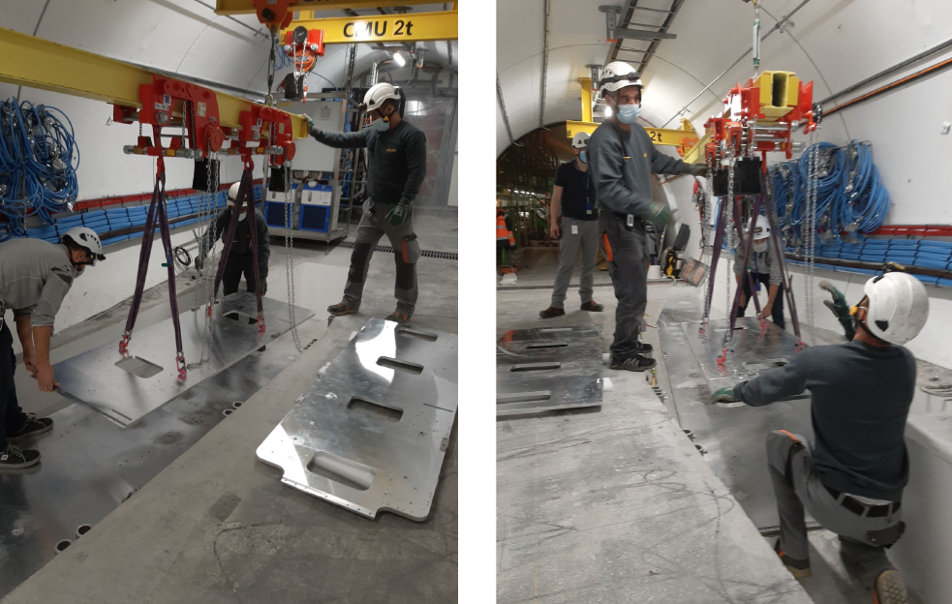
FASER INSTALLATION

Slide 46
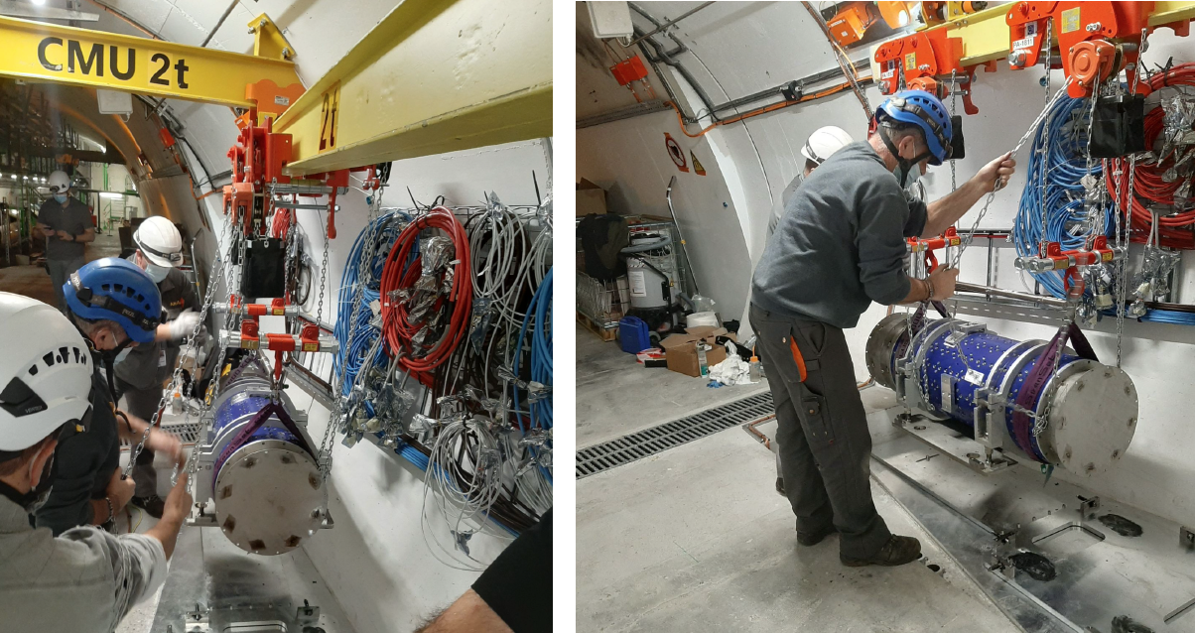
FASER INSTALLATION

Slide 47
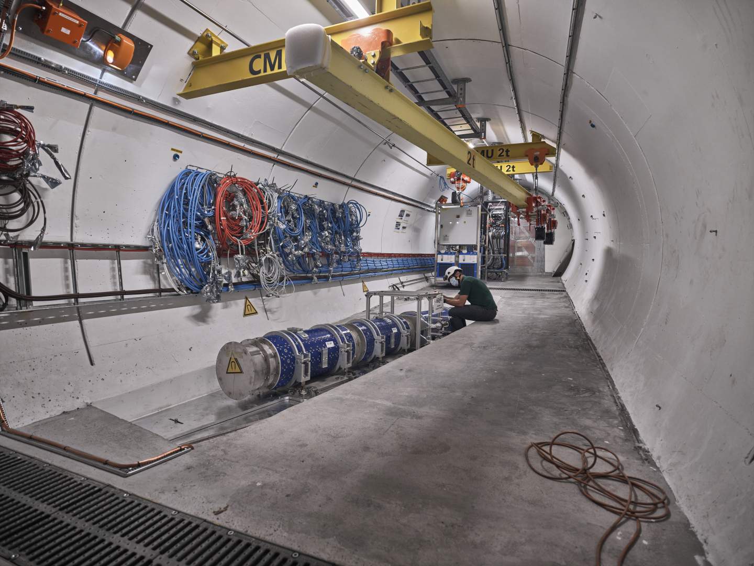
FASER CURRENT STATUS

Slide 48
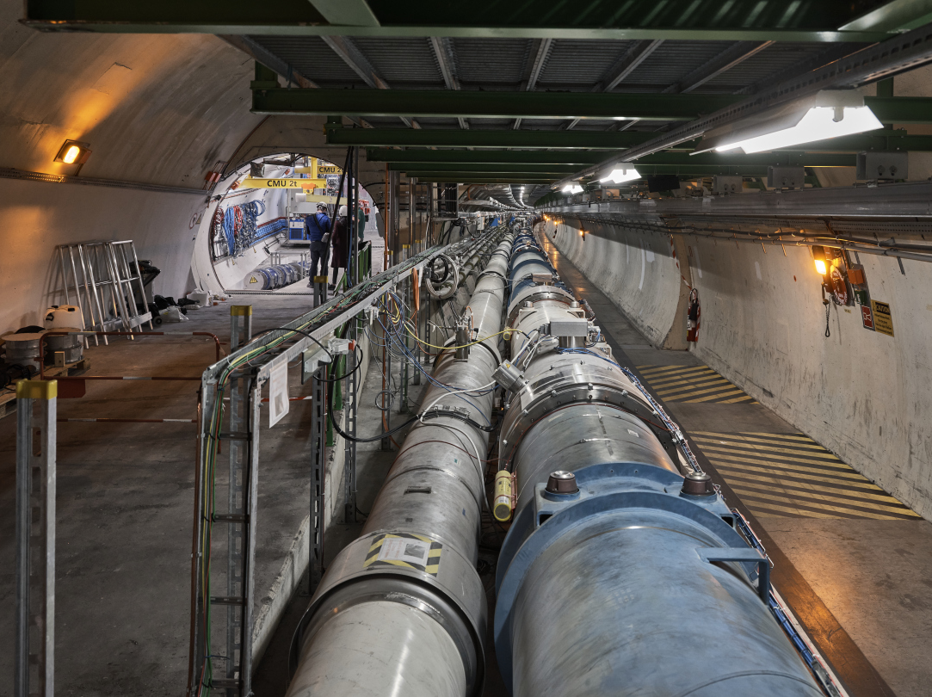
FASER CURRENT STATUS

Slide 49
DARK PHOTON SENSITIVITY REACH
FASER probes new parameter space with just 1 fb⁻¹ starting in 2022.
Without upgrade, HL-LHC extends (L*Volume) by factor of 3000; possible upgrade to FASER 2 extends (L*Volume) by ~10⁶.
FASER
_{FASER Collaboration (2018)}

Slide 50
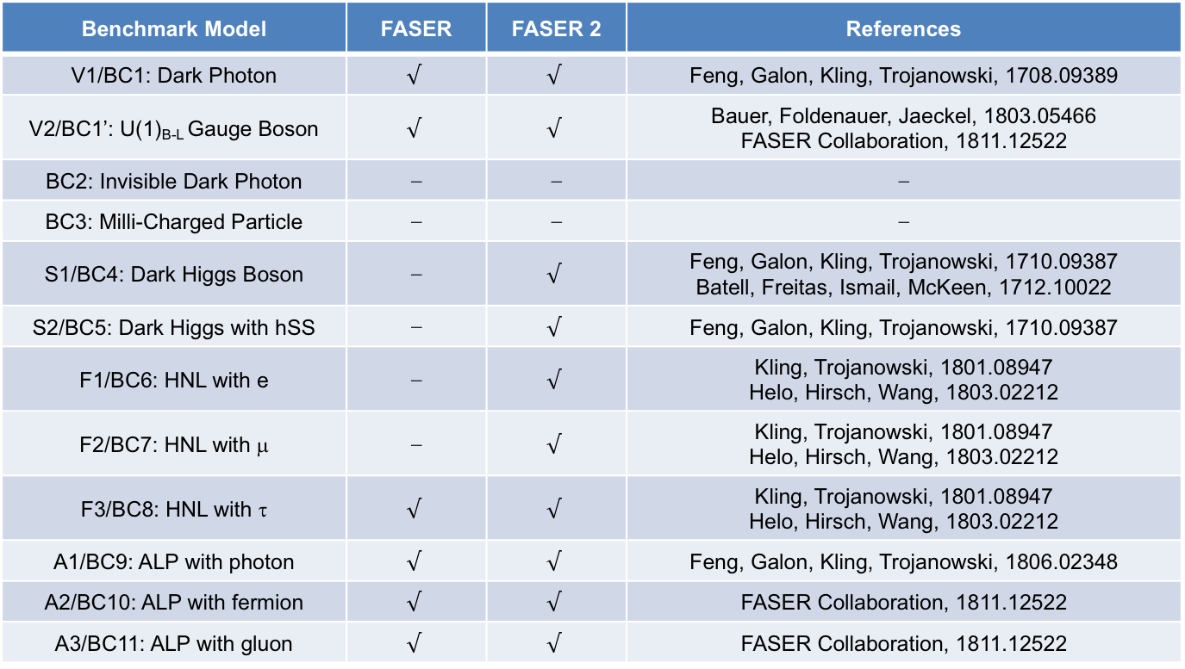
PHYSICS SUMMARY
Many other studies: FASER has discover prospects for all candidates with renormalizable couplings (dark photon, dark Higgs, HNL); ALPs with all types of couplings (γ, f, g); and many other examples; see 1811.12522.
Benchmark Model | FASER | FASER 2 | References
V1/BC1: Dark Photon | $$√$$ | $$√$$ | Feng, Galon, Kling, Trojanowski, 1708.09389
V2/BC1’: U(1)_{B-L} Gauge Boson | $$√$$ | $$√$$ | Bauer, Foldenauer, Jaeckel, 1803.05466 FASER Collaboration, 1811.12522
BC2: Invisible Dark Photon | ⎼ | ⎼ | ⎼
BC3: Milli-Charged Particle | ⎼ | ⎼ | ⎼
S1/BC4: Dark Higgs Boson | ⎼ | $$√$$ | Feng, Galon, Kling, Trojanowski, 1710.09387 Batell, Freitas, Ismail, McKeen, 1712.10022
S2/BC5: Dark Higgs with hSS | ⎼ | $$√$$ | Feng, Galon, Kling, Trojanowski, 1710.09387
F1/BC6: HNL with e | ⎼ | $$√$$ | Kling, Trojanowski, 1801.08947 Helo, Hirsch, Wang, 1803.02212
F2/BC7: HNL with μ | ⎼ | $$√$$ | Kling, Trojanowski, 1801.08947 Helo, Hirsch, Wang, 1803.02212
F3/BC8: HNL with τ | $$√$$ | $$√$$ | Kling, Trojanowski, 1801.08947 Helo, Hirsch, Wang, 1803.02212
A1/BC9: ALP with photon | $$√$$ | $$√$$ | Feng, Galon, Kling, Trojanowski, 1806.02348
A2/BC10: ALP with fermion | $$√$$ | $$√$$ | FASER Collaboration, 1811.12522
A3/BC11: ALP with gluon | $$√$$ | $$√$$ | FASER Collaboration, 1811.12522

Slide 51
FASERν

Slide 52
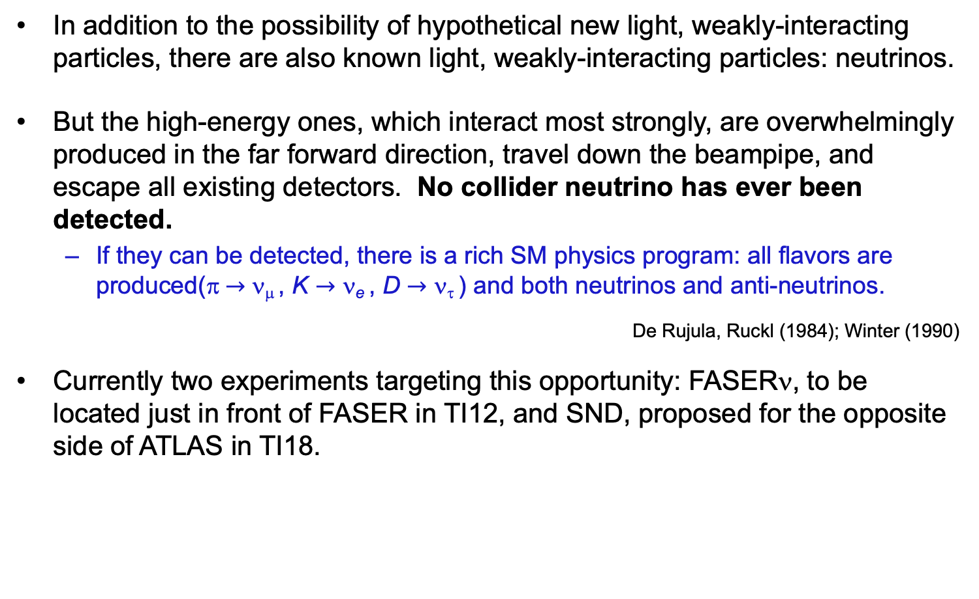
COLLIDER NEUTRINOS
In addition to the possibility of hypothetical new light, weakly-interacting particles, there are also known light, weakly-interacting particles: neutrinos.
But the high-energy ones, which interact most strongly, are overwhelmingly produced in the far forward direction, travel down the beampipe, and escape all existing detectors. No collider neutrino has ever been detected.
  If they can be detected, there is a rich SM physics program: all flavors are produced(π $→$ ν_{μ} , K $→$ ν_{e} , D $→$ ν_{τ} ) and both neutrinos and anti-neutrinos.
De Rujula, Ruckl (1984); Winter (1990)
Currently two experiments targeting this opportunity: FASERν, to be located just in front of FASER in TI12, and SND, proposed for the opposite side of ATLAS in TI18.

Slide 53
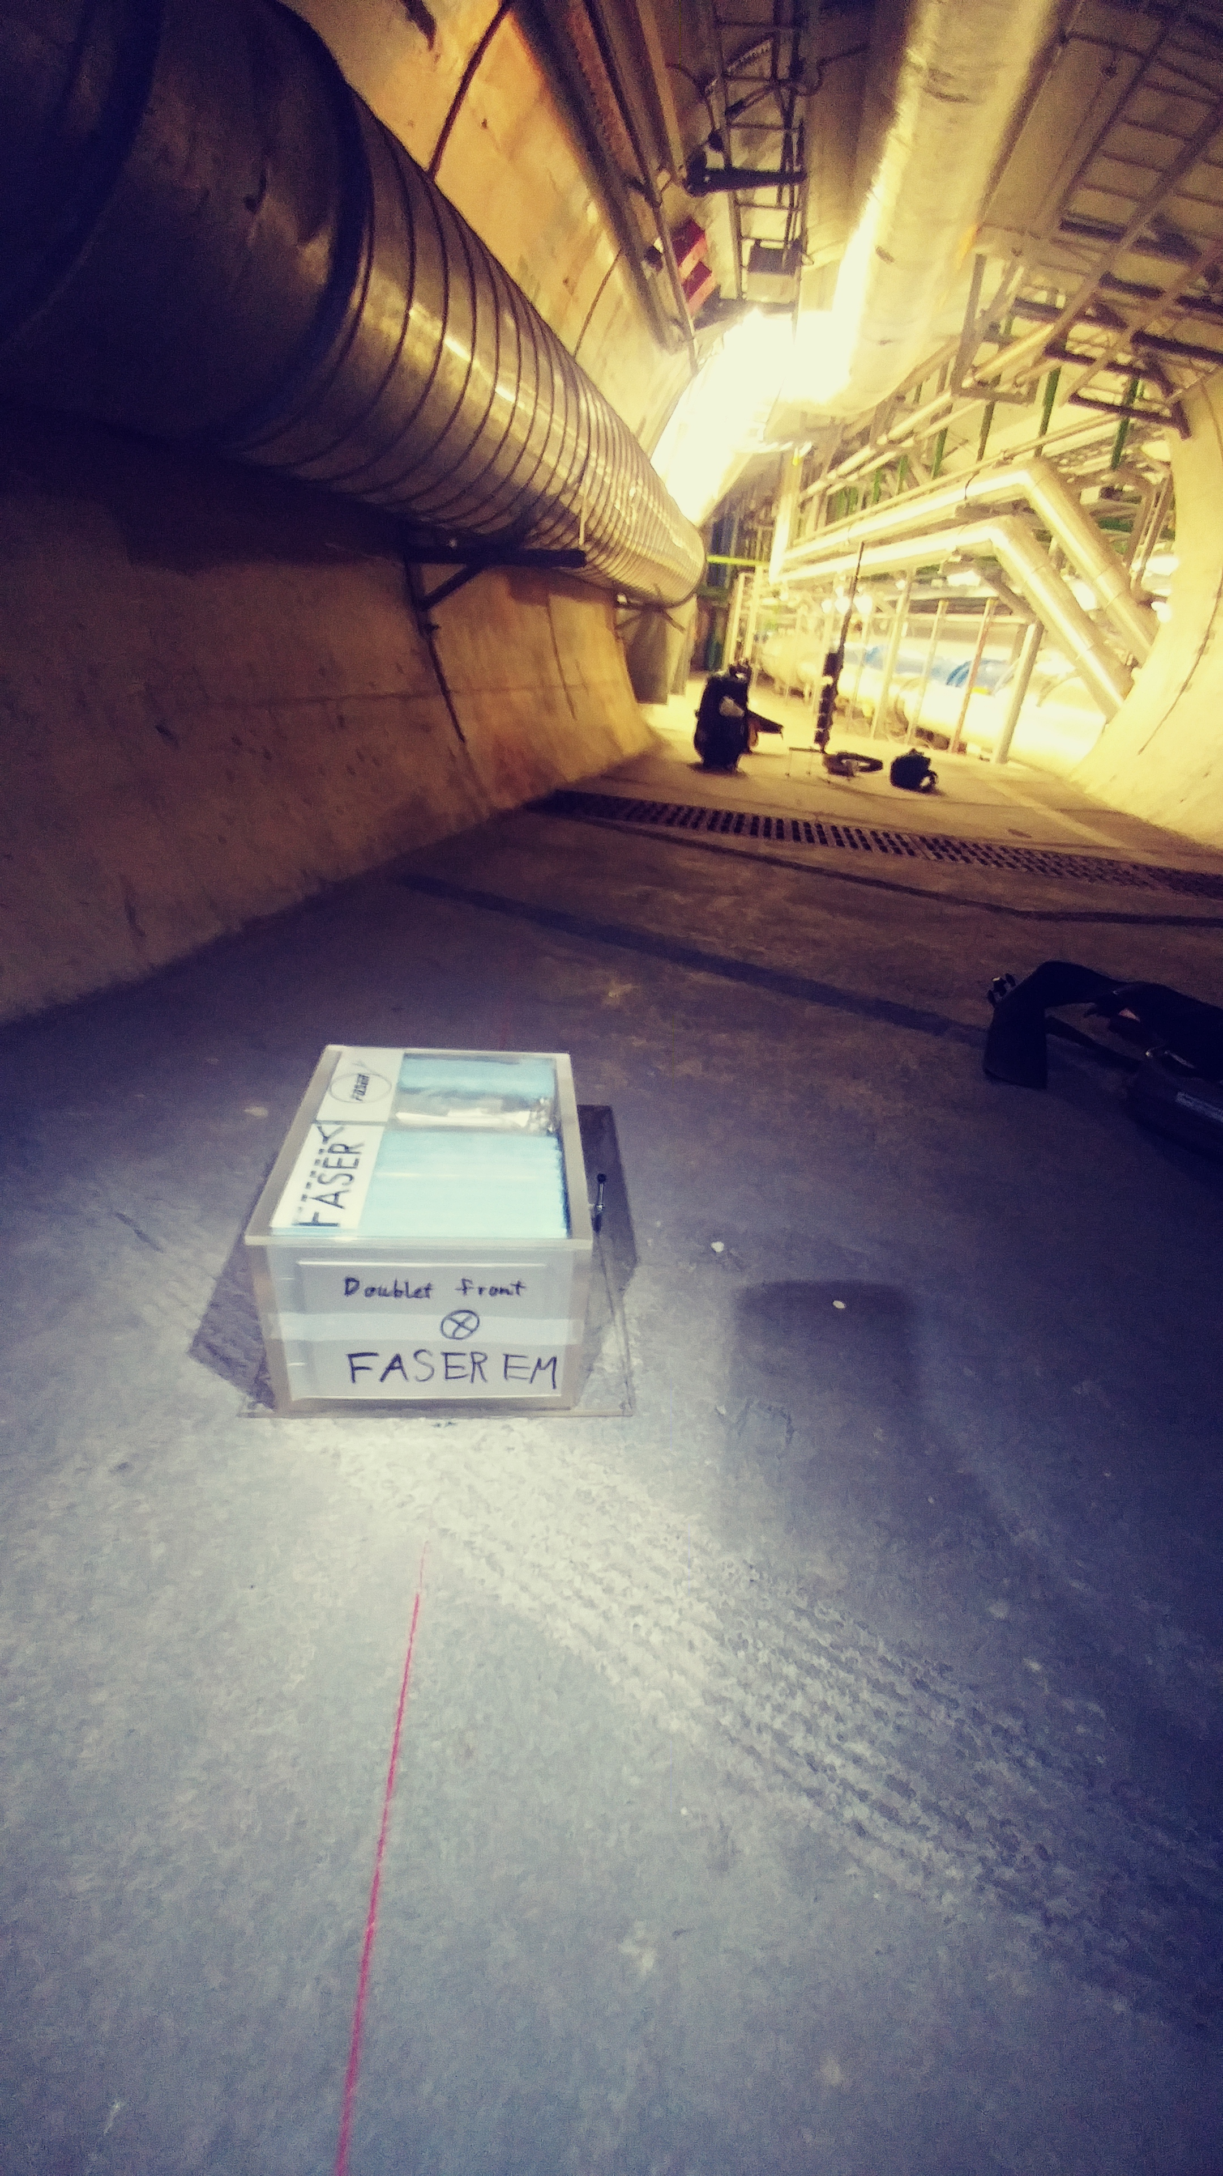
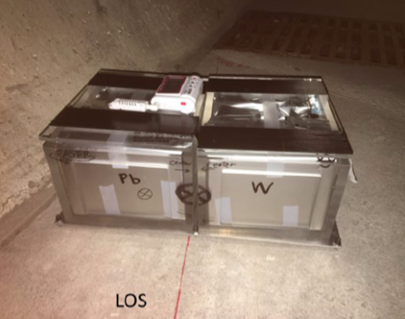
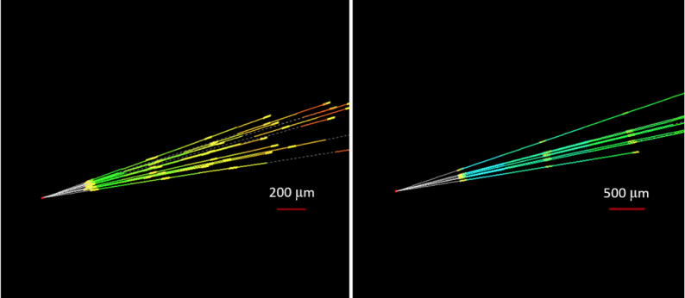
NEUTRINO FLUXES
In fact, we have probably already seen our first TeV collider neutrino.
In 2018 a 29 kg FASER pilot emulsion detectors collected 12.5 fb⁻¹ on the beam collision axis (installed and removed during Technical Stops).
Expect ~10 neutrino interactions. Several neutral vertices identified, likely to be neutrinos. Analysis ongoing.
FASERν
preliminary
FASERν
preliminary

Slide 54
THE FASERν DETECTOR
FASERν is designed to detect neutrinos of all flavors.
  25cm x 30cm x 1.1m detector consisting of 770 emulsion layers interleaved with 1mm-thick tungsten plates.
  Emulsion is swapped out every ~10-30 fb⁻¹, total 10 sets of emulsion for Run 3.
LLP
ν
e⁺
e⁻

Slide 55
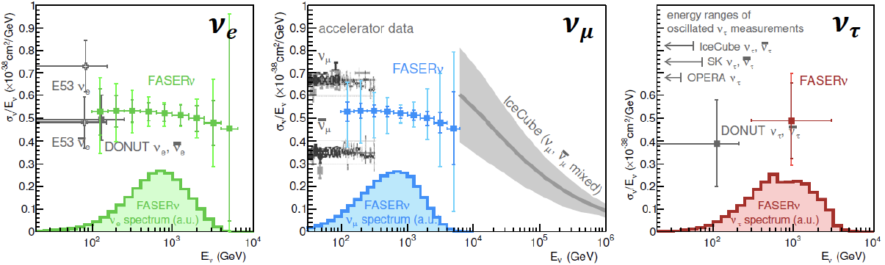
NEUTRINO PHYSICS
2022-24: FASERν will collect data with 1.1-tonne detector in Run 3
  Will detect the first collider neutrino.
  Will record ~1000 ν_{e} , ~10,000 ν_{μ} , and ~10 ν_{τ} interactions at TeV energies, the first direct exploration of this energy range for all 3 flavors.
  Will double the world’s supply of tau neutrinos.
  Will be able to distinguish muon neutrinos from anti-neutrinos by combining FASER and FASERν data, and so measure their cross sections independently.
FASER Collaboration 1908.02310 (2019)

Slide 56
FORWARD PHYSICS FACILITY

Slide 57
FORWARD PHYSICS FACILITY
FASER, FASERν, and other proposed detectors are currently highly constrained by 1980’s infrastructure that was never intended to support experiments.
At the same time, it is becoming clear that there is a rich physics program in the far-forward region.
  New particle searches, neutrinos, QCD, MC event generators, milli-charged particles, dark matter, dark sector, cosmic rays, and cosmic neutrinos.
Strongly motivates creating a dedicated facility to house far-forward experiments for the HL-LHC era from 2027-37.
  Snowmass LOI: 240 authors from many different communities
  FPF Kickoff Meeting: 9-10 November 2020. 40 talks, lots of fascinating discussion. For talk slides and Zoom recordings, see https://indico.cern.ch/event/955956.

Slide 58
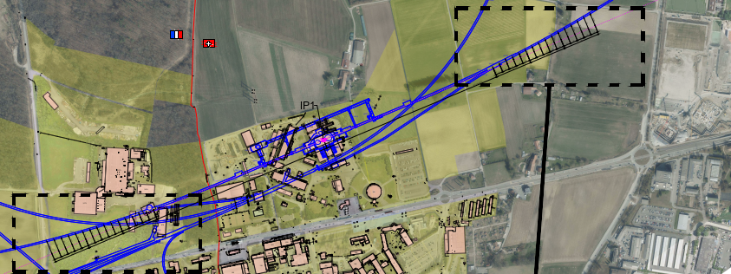
Jonathan Gall, FPF Workshop
FPF LOCATION: NEW SHAFT AND CAVERN
Jonathan Gall, work in progress

Slide 59
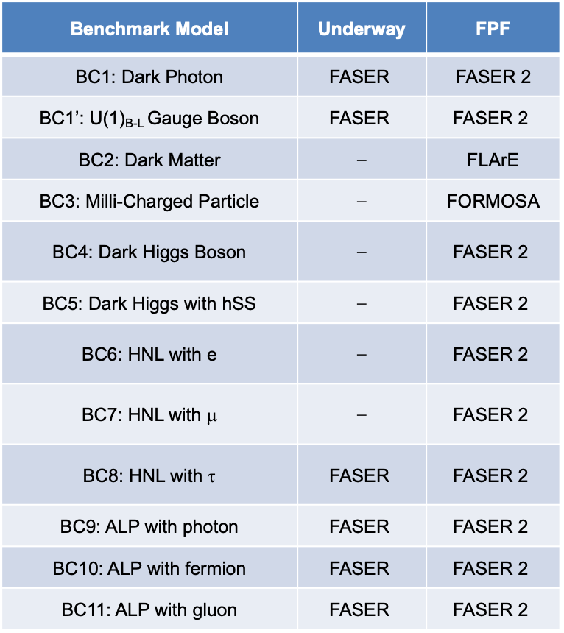
NEW PHYSICS SEARCHES AT THE FPF
The FPF will house a number of experiments
FASER 2, an upgraded FASER with R = 1 m, L = 10 m, can discover all candidates with renormalizable couplings (dark photon, dark Higgs, HNL); ALPs with all types of couplings (γ, f, g); and many other particles.
Other experiments that can probe neutrinos and many other interesting ideas.
Benchmark Model | Underway | FPF
BC1: Dark Photon | $$\text{FASER}$$ | FASER 2
BC1’: U(1)_{B-L} Gauge Boson | $$\text{FASER}$$ | $$\text{FASER}\text{ 2}$$
BC2: Dark Matter | ⎼ | FLArE
BC3: Milli-Charged Particle | ⎼ | FORMOSA
BC4: Dark Higgs Boson | ⎼ | $$\text{FASER}\text{ 2}$$
BC5: Dark Higgs with hSS | ⎼ | $$\text{FASER}\text{ 2}$$
BC6: HNL with e | ⎼ | $$\text{FASER}\text{ 2}$$
BC7: HNL with μ | ⎼ | $$\text{FASER}\text{ 2}$$
BC8: HNL with τ | $$\text{FASER}$$ | $$\text{FASER}\text{ 2}$$
BC9: ALP with photon | $$\text{FASER}$$ | $$\text{FASER}\text{ 2}$$
BC10: ALP with fermion | $$\text{FASER}$$ | $$\text{FASER}\text{ 2}$$
BC11: ALP with gluon | $$\text{FASER}$$ | $$\text{FASER}\text{ 2}$$

Slide 60
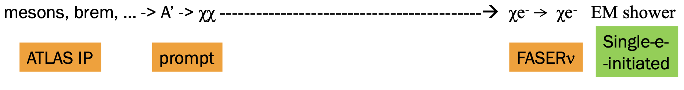
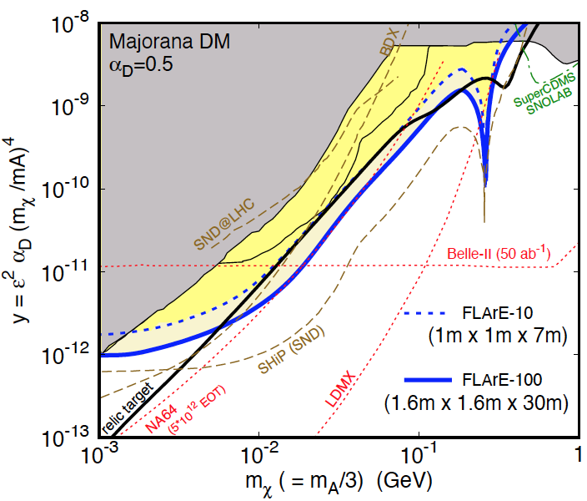
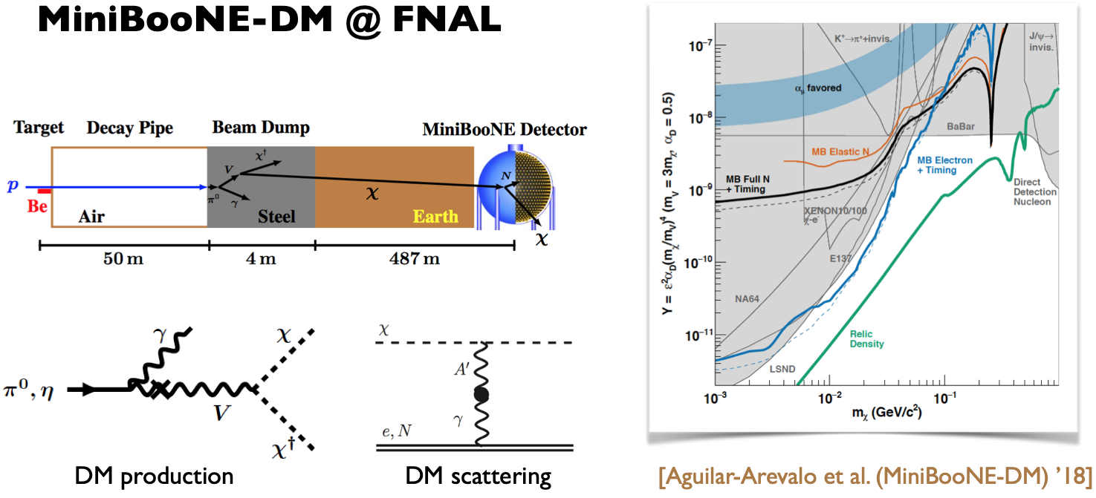

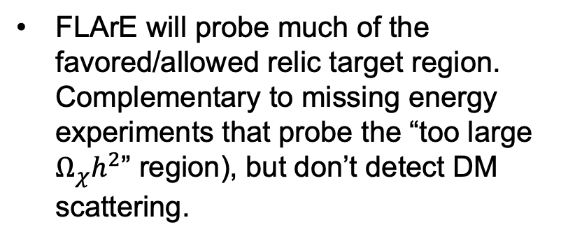
FLArE: DARK MATTER AT THE FPF
If m_{LLP} > 2m_{DM} , the LLP will typically decay in the dark sector to dark matter, leading to invisible decays.
Can look for the resulting DM to scatter off electrons at FLArE, a proposed LArTPC. Dominant background from neutrinos reduced for 1 < $E_{e}$ < 20 GeV.
Batell, Feng, Trojanowski (2021)
FLArE will probe much of the favored/allowed relic target region. Complementary to missing energy experiments that probe the “too large $Ω_{χ}h^{2}$” region), but don’t detect DM scattering.

Slide 61


FORMOSA:MILLICHARGED PARTICLES AT THE FPF
Currently the target of the MilliQan experiment near the CMS IP.
MilliQan Demonstrator (Proto-MilliQan) already probes new region. Full MilliQan planned to run in this location at HL-LHC, but the sensitivity can be improved greatly by moving it to the FPF (FORMOSA).
Foroughi-Abari, Kling, Tsai (2020)

Slide 62
SUMMARY

Slide 63
SUMMARY
A new target for discovery: light and weakly-interacting particles probed by fast, small, and cheap experiments with world-leading sensitivities.
FASER: 18 months from theory paper to beginning of construction, fits on a tabletop, ~$2M. Data-taking starts 2022 with rich physics program.
  New particles: searches for dark photons, dark Higgs bosons, HNLs, ALPs, milli-charged particles, dark matter, new forces, ...
  Known particles: guaranteed discovery of the first collider neutrino, ~1000 ν_{e} ~10,000 ν_{μ} , ~10 ν_{τ} at TeV energies where there are no or few existing measurements. Implications for neutrino properties, forward hadron production, cosmic ray and cosmic neutrino physics.
Forward Physics Facility: proposed to house a suite of far-forward experiments for the HL-LHC era from 2027-37.

