Slide 1



LLP DETECTORS
AT THE LHC
Searching for Long-Lived Particles at the LHC and Beyond
Eighth Workshop of the LHC LLP Community
16-19 November 2020
Jonathan Feng, UC Irvine

Slide 2
INTRODUCTION
The next breakthrough in particle physics is likely to involve LLPs
  LLPs have historically played an enormous role in breakthroughs in our field
  LLPs are now prevalent in BSM theories, especially those with cosmological significance
  LLPs can be detected through a huge variety of spectacular signatures – even a few events can be a discovery
  LLPs have been largely ignored for decades; there is a lot of low-hanging fruit that can be targeted by dedicated experiments, and now is the time to do them.

Slide 3

HISTORICAL PRECEDENT
Long-Lived Particles are not “exotica” in the Standard Model. There are plenty of symmetries (Lorentz, Q, L, B, isospin, …) that lead to several LLPs that have played an essential role in establishing what we know today: e, p, n, μ, $π^{±}$, K, ν, …
Alimena et al. (eds. Beacham, Shuve) (2019)

Slide 4
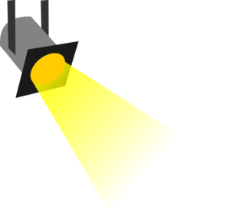
THE PARTICLE PHYSICS LANDSCAPE
Particle
Colliders
Mass
MeV
GeV
TeV
1
Already
Discovered
Strongly Interacting
Heavy Particles
Interaction Strength
LLPs from Light Physics
LLPs from Weak-Scale Physics
10⁻³
Weakly Interacting
Light Particles
Impossible to
Discover
10⁻⁶

Slide 5
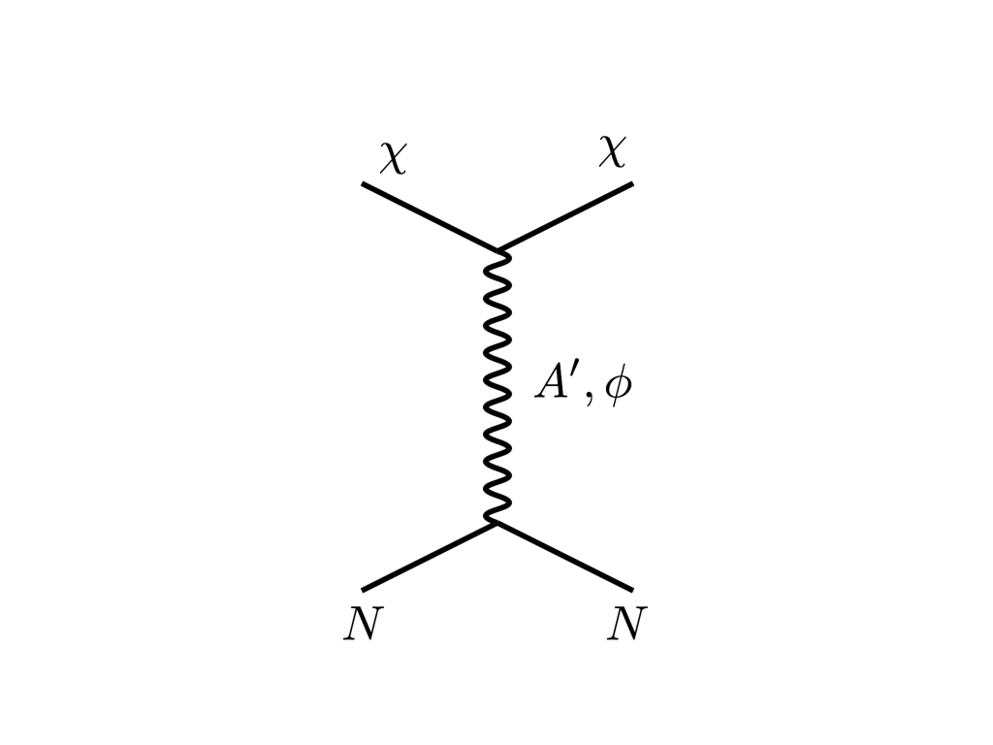
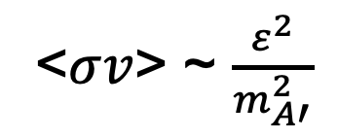




THE COSMOLOGICAL LANDSCAPE
Particle
Colliders
Mass
MeV
GeV
TeV
1
Dark matter provides strong evidence for at least 1 new LLP
Already
Discovered
Strongly Interacting
Heavy Particles
Too Little to be
Dark Matter
DM
$$e$$
Interaction Strength
Just Right to
be Dark Matter
$$ε$$
10⁻³
$$A’$$
DM
$$e$$
Weakly Interacting
Light Particles
Impossible to
Discover
<$σv$> ~ $\frac{ε^{2}}{m_{A′}^{2}}$
10⁻⁶
Too Much to be
Dark Matter

Slide 6
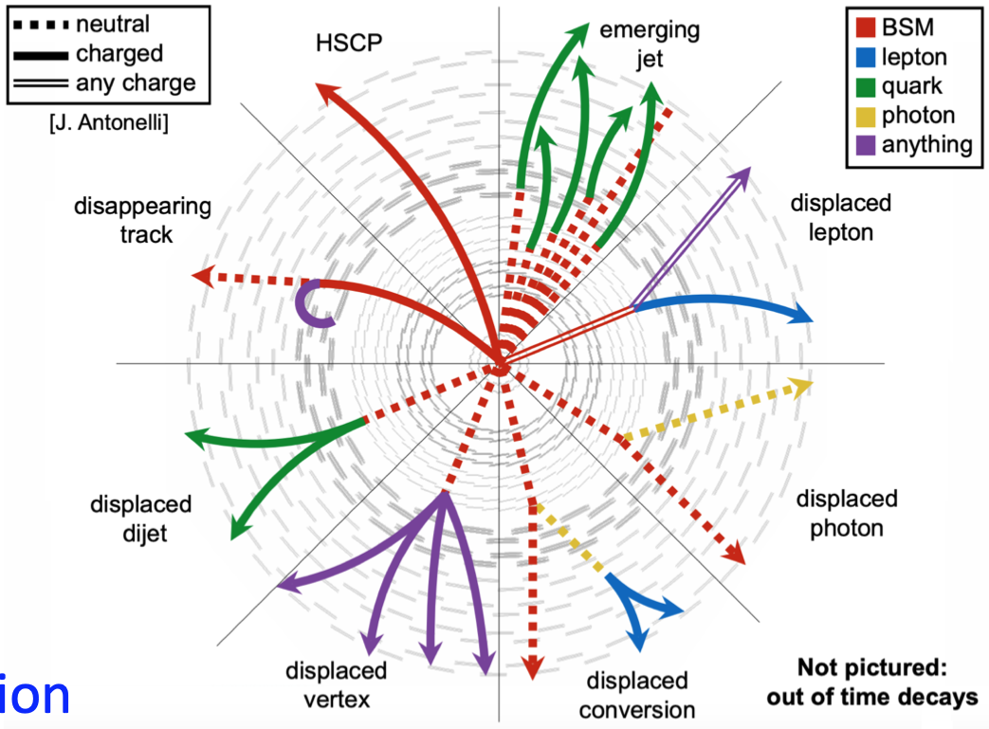
LLP SIGNATURES ARE SPECTACULAR
This is true for searches at ATLAS, CMS, and LHCb.
But, if anything, it is even more true for dedicated LLP detectors, where one typically goes to some out-of-the-way tunnel/cavern/shaft/plot of land around the LHC and looks for light-shining-through-wall types of signatures.

Slide 7
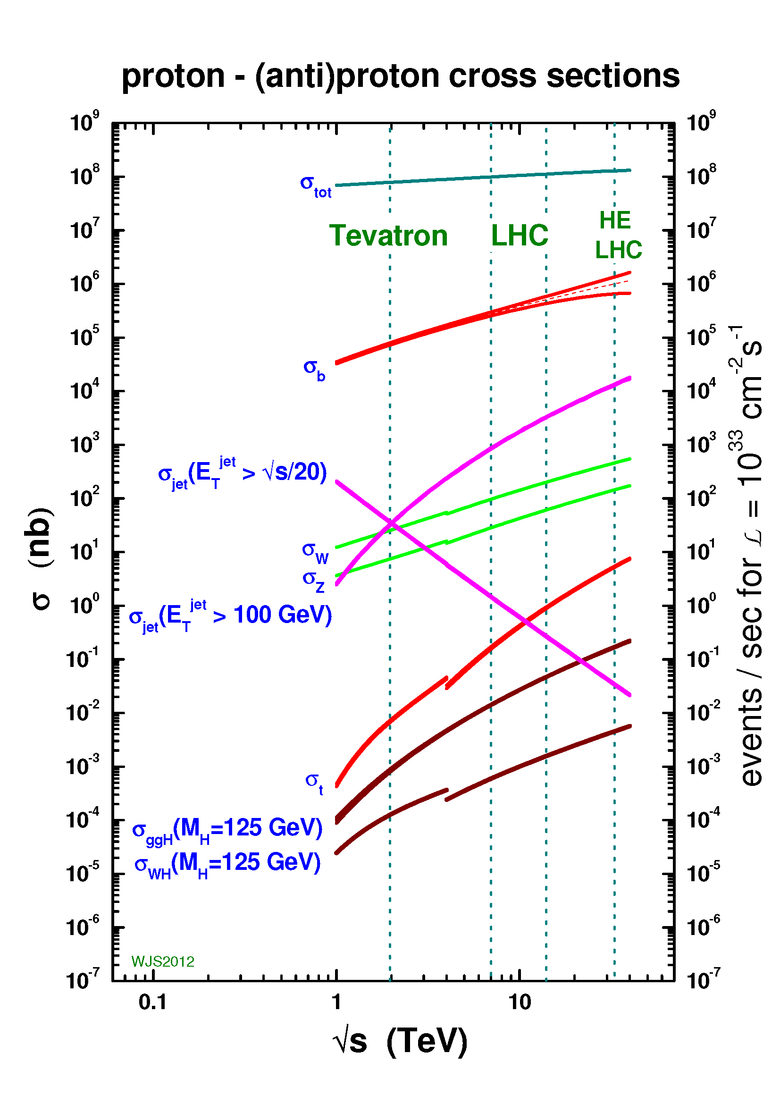
LLPS ARE LOW-HANGING FRUIT
For decades our field has been consumed by the expectation that new physics would appear as strongly-interacting, heavy states.
This has largely focused attention on processes with low (fb, pb, even nb) cross sections.
But LLPs can be light, produced in the currently “wasted” 100 mb total cross section!

Slide 8

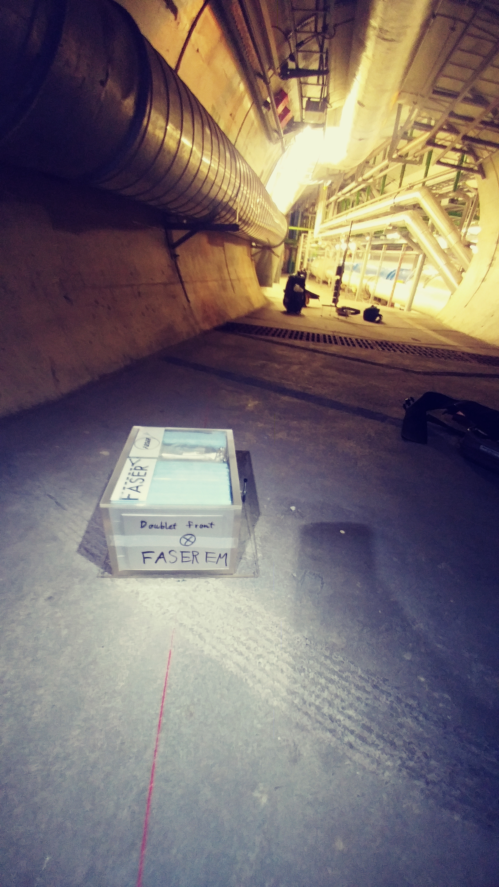
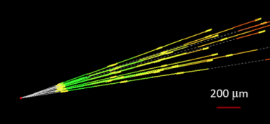

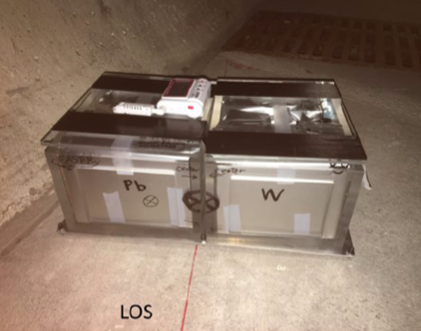
AN EXAMPLE: NEUTRINOS
No collider neutrino has ever been detected.
But there is a huge flux of TeV neutrinos in the far forward direction. _{De Rujula et al. (1980s)}
In 2018, FASER installed ~30 kg emulsion pilot detectors in the far forward region for a few weeks (inserted and removed in TSs).
Expect ~10 neutrino interactions. Several neutral vertices have been identified, likely to be neutrinos. Analysis ongoing.
For Run 3, expect 10,000 TeV neutrino events!

Slide 9
SUMMARY
These are exciting times for LLPs, LLP detectors, and LLP facilities. In this session: Forward Physics Facility, FASER, FASERν, CMS Forward Detector, Codex-b/β, MilliQan, MoEDAL-MAPP, MATHUSLA, ANUBIS, SND@LHC, and FORMOSA (and there are others).
The potential for new and better ideas is significant.
In many cases, a modest investment can significantly enhance the LHC’s search sensitivity and physics potential.
And the future is now: if these investments are not made soon, many opportunities will disappear for decades.

