Slide 1



FPF OVERVIEW
Forward Physics Facility Kickoff Meeting
9-10 November 2020
Jonathan Feng, UC Irvine

Slide 2



INTRODUCTION
On behalf of my co-organizers Felix Kling and Maria Garzelli:
WELCOME!
And thank you to the following for their support:

Slide 3
FORWARD PHYSICS FACILITY
As the LHC runs at higher energies and much higher luminosities in the next 15 years, how can its potential be maximally exploited?
Attention has focused on high p_{T} / low cross section physics (~fb, pb, nb).
But the total cross section is ~100 mb, and most of these events (and most of the highest energy particles) are in the far forward region / low p_{T}.
In recent years, it has become clear that there is a rich SM and BSM physics program that remains to be explored in the far forward region, and this can be done with relatively little additional investment.
The proposal: create a Forward Physics Facility for the HL-LHC to house a suite of experiments that will greatly enhance the LHC’s physics potential for neutrinos, LLP searches, QCD, dark matter, dark sectors, and cosmic ray physics.

Slide 4
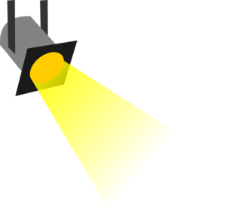
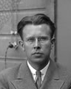
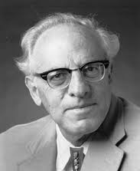
THE NEW PARTICLE LANDSCAPE
Particle
Colliders
Mass
MeV
GeV
TeV
1
Already
Discovered
Strongly Interacting
Heavy Particles
New Targets of Experiments at the FPF
Traditional Targets
of Existing LHC Experiments
Interaction Strength
10⁻³
Weakly Interacting
Light Particles
Impossible to
Discover
10⁻⁶

Slide 5
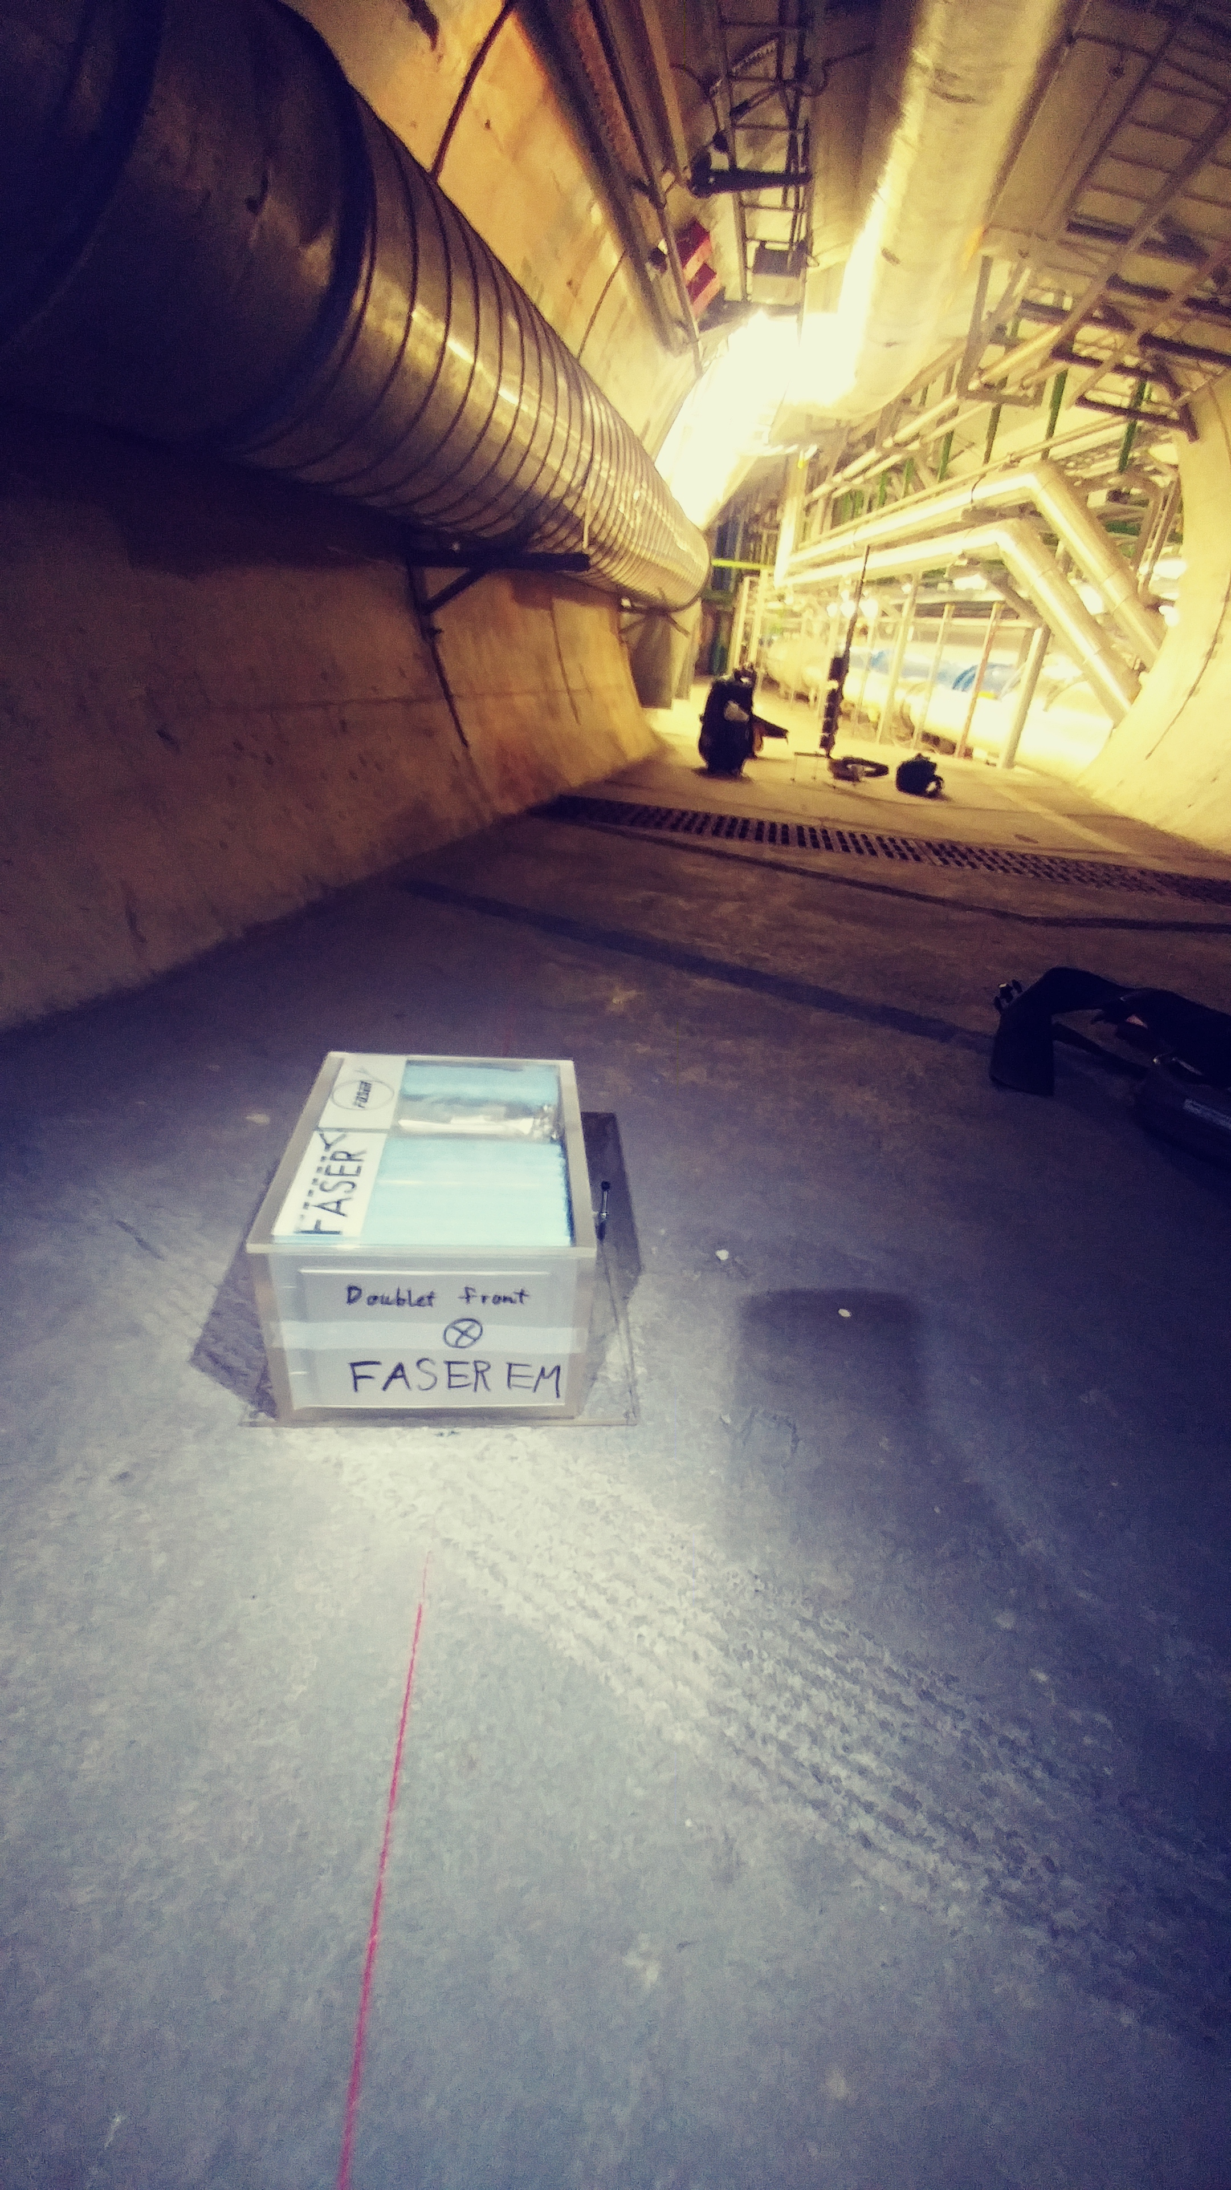
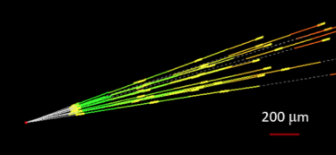
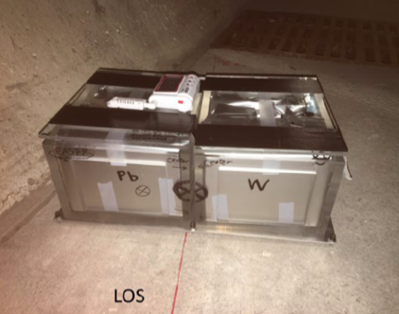
AN EXAMPLE: NEUTRINOS
No collider neutrino has ever been detected.
But there is a huge flux of TeV neutrinos in the far forward direction. _{De Rujula et al. (1980s)}
In 2018, FASER pilot ~30 kg emulsion detectors were placed in the far forward region for a few weeks (inserted and removed in TSs).
Expect ~10 neutrino interactions. Several neutral vertices have been identified, likely to be neutrinos. Analysis ongoing.

Slide 6
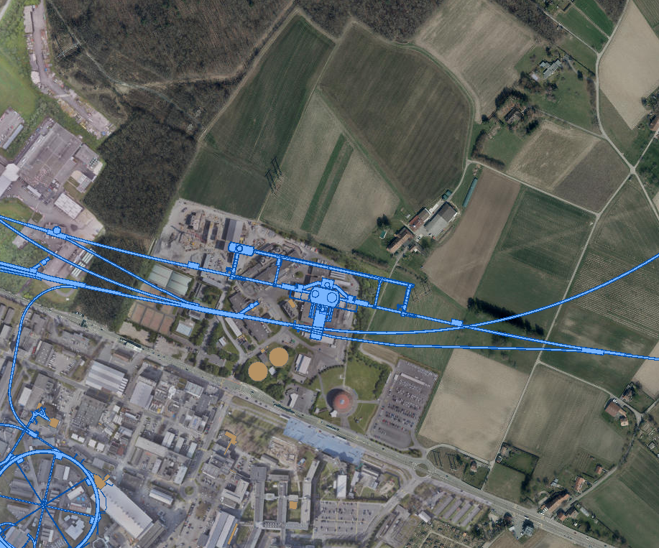
FPF LOCATION
FPF LOCATION
Two promising locations: caverns UJ12 and UJ18, each ~500 m from ATLAS and shielded from the ATLAS IP by ~100 m of rock, creating extremely quiet environments.
FPF would require enlarging these caverns to the south by a few meters. Alternatively, could construct a new cavern and new shaft to the surface.
Two promising locations: caverns UJ12 and UJ18, each ~500 m from ATLAS and shielded from the ATLAS IP by ~100 m of rock, creating extremely quiet environments.
See Jamie Boyd’s talk
FPF would require enlarging these caverns to the south by a few meters. Alternatively, construct a new cavern and new shaft to the surface.
See Jonathan Gall’s talk
UJ18
TI18
ATLAS
SPS
UJ12
TI12
CERN GIS

Slide 7
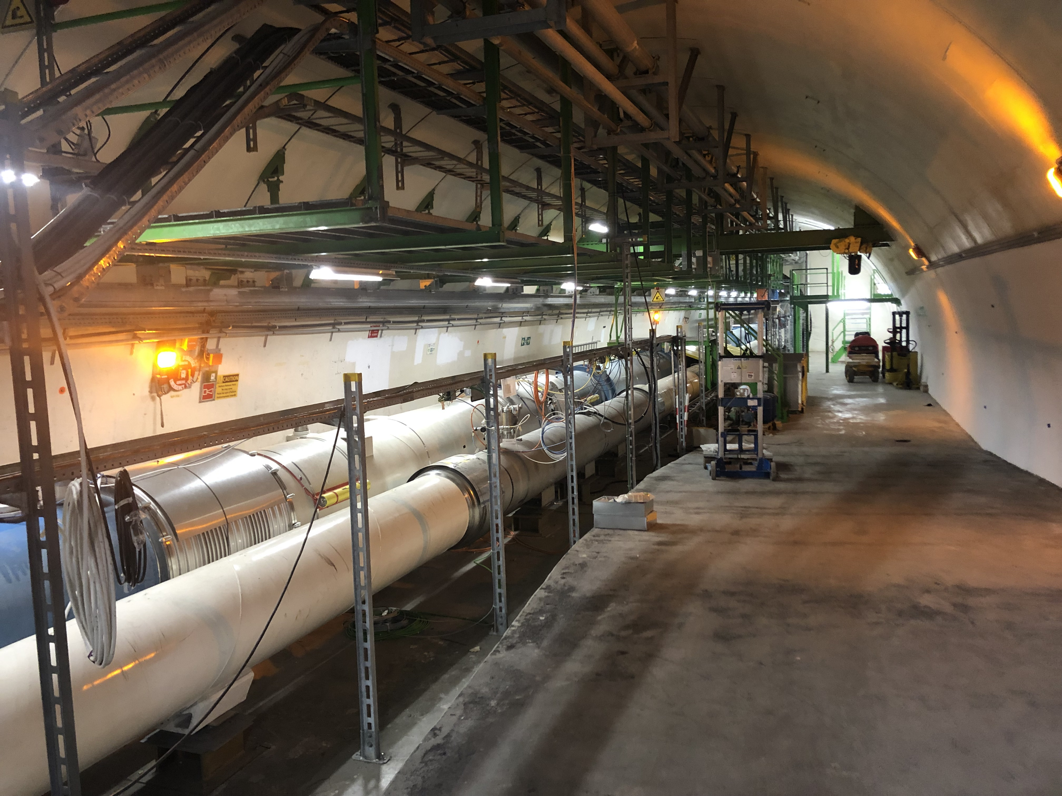
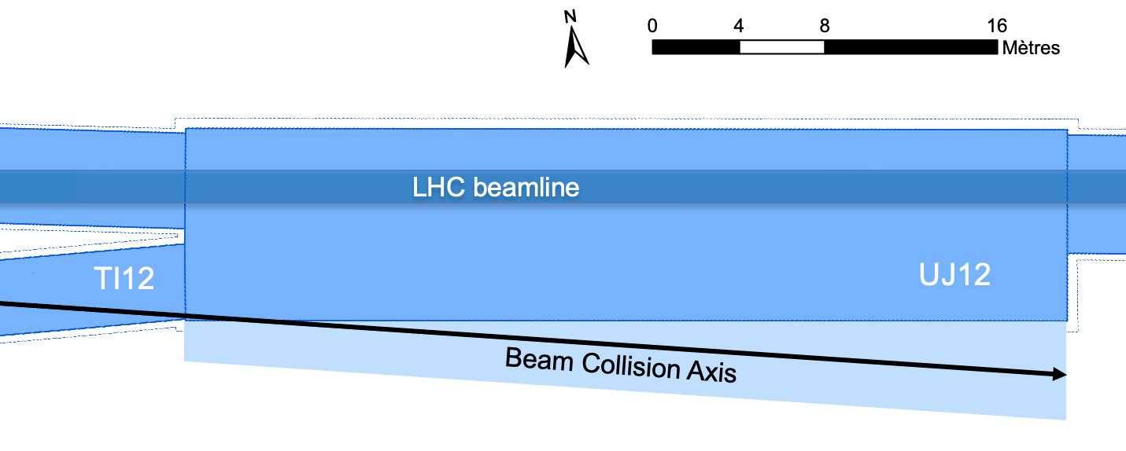
UJ12
UJ12: POSSIBLE SITE OF THE FPF
East

Slide 8
FPF EXPERIMENTS
There are already many experiments that would be excellent fits for the FPF. These build on current experiments, such as FASER, FASERν, SND@LHC, and MilliQan, but ideas, such as a LAr detector, are also being discussed. Lots of room for new ideas here.
The physics topics addressed by these experiments are already astoundingly diverse: measurements of TeV neutrino properties, proton pdfs, nuclear pdfs, forward hadron production, implications for IceCube and other cosmic ray experiments, searches for dark portal particles, light gauge bosons, axion-like particles, other LLPs, dark matter scattering, milli-charged particles, …
Ideally we would like to determine the optimal suite of experiments that will maximize the physics potential within the physical constraints. An interesting and multi-faceted optimization problem!

Slide 9
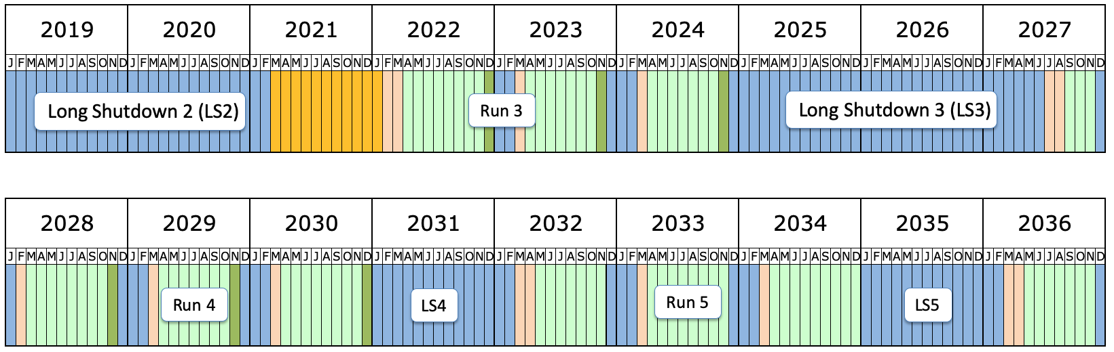
FPF SCHEDULE AND GLOBAL CONTEXT
The FPF is well-aligned with
  the European Strategy Update’s recommendations for a diverse experimental program
  CERN’s Physics Beyond Colliders study
  the American Snowmass community study and P5 prioritization exercise (FPF LOI completed July 2020, white paper to be completed in Spring 2021)
The current, COVID-delayed LHC schedule has Run 3 from 2022-24, LS3 from 2025-27, and the HL-LHC era from 2027-36.
Clearly, now is the time to establish the FPF’s physics case and feasibility if it is to be included in the LS3 schedule.
We hope this workshop stimulates many good discussions and ideas and provides a good start toward that goal.

