Slide 1



ACCELERATOR SEARCHES
FOR THE DARK SECTOR
The Almost Invisibles: Exploring the Weakly Coupled Universe
SLAC Summer Institute
Jonathan Feng, UC Irvine, 17-18 August 2020

Slide 2
LECTURE 1

Slide 3
INTRODUCTION
Before we begin, we should acknowledge the temerity of the title of these two lectures: “Accelerator Searches for the Dark Sector.”
Why should these completely human-made experiments on Earth have any hope of telling us about what the universe looks like a Gpc away?
In fact, it is one of the great wonders of our field that there are reasons for optimism.
  The existence of the dark sector is now one of the strongest reasons to expect not only that new particles exists, but also that new particles will appear at the particle experiments we are now building.
  General arguments have motivated a huge number of new ideas for experiments at accelerators and colliders in the coming years.
Accelerators
Particle Physics
L ~ 10⁻¹⁸ m
Dark Sector
Cosmology
L ~ 10²⁵ m

Slide 4
OUTLINE
I: Particle Physics and the Relic Density of Dark Matter
II: Heavy Dark Sectors at Accelerators
III: Light Dark Sectors at Accelerators

Slide 5
I: Particle Physics and the Relic Density of Dark Matter

Slide 6
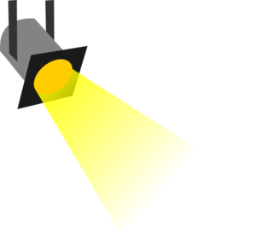
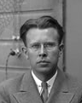
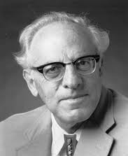
THE NEW PARTICLE LANDSCAPE
Particle
Colliders
Mass
MeV
GeV
TeV
1
Already
Discovered
Strongly Interacting
Heavy Particles
Interaction Strength
Light
Dark Sectors
Heavy
Dark Sectors
10⁻³
Weakly Interacting
Light Particles
Impossible to
Discover
10⁻⁶

Slide 7
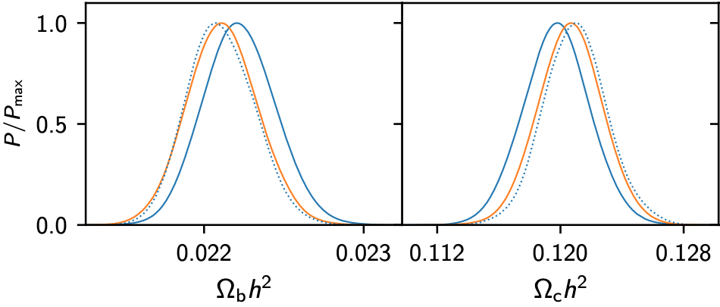
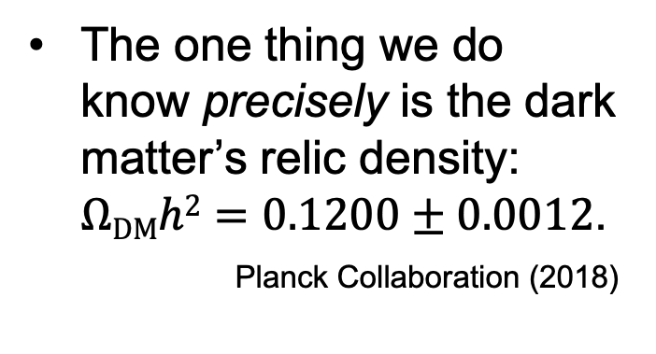
DARK MATTER’S RELIC DENSITY
We know little about dark matter and the dark sector.
The one thing we do know precisely is the dark matter’s relic density: $ΩDMh2=0.1200±0.0012$.
_{Planck Collaboration (2018)}
What can we learn from this about dark matter’s particle properties?
  Generically: nothing.
  But if we assume dark matter is produced through thermal freezeout: a lot.

Slide 8
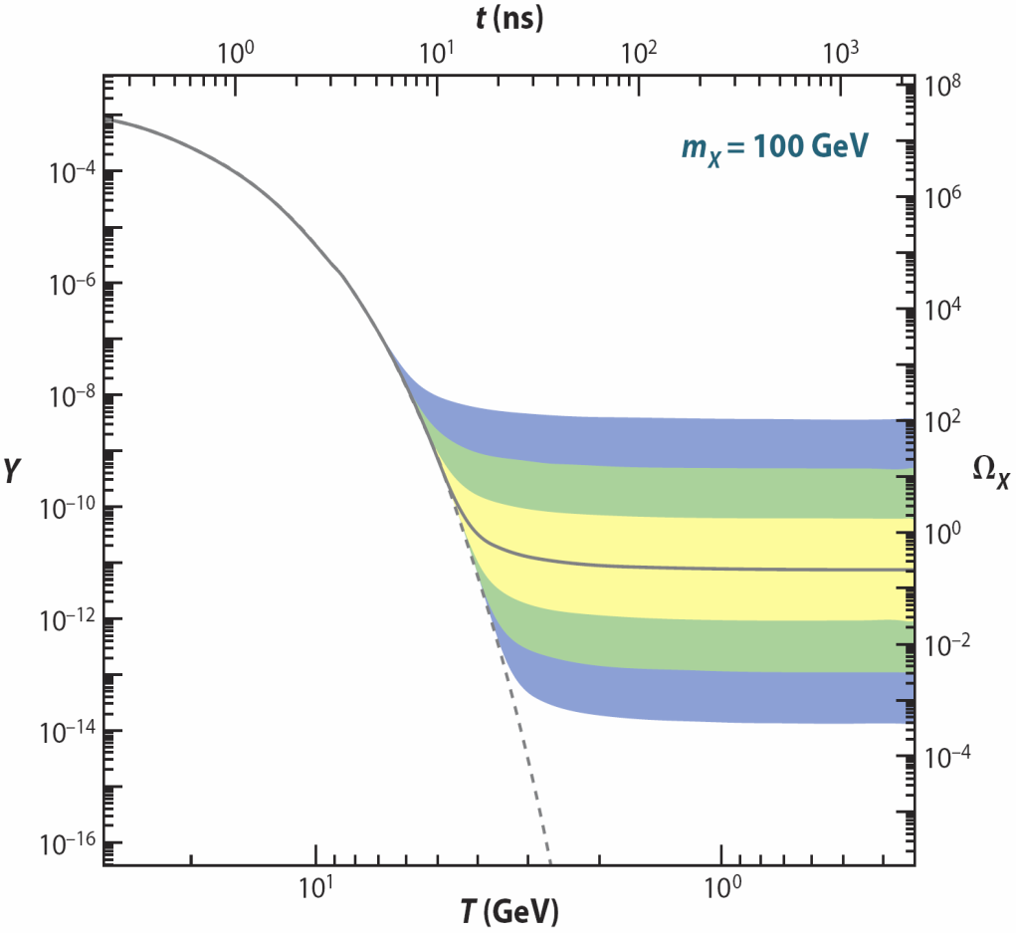
THERMAL FREEZE OUT
See Tim Tait’s Lectures
(1) Assume a new heavy particle X is initially in thermal equilibrium:
XX ↔ qq
(2) Universe cools:
XX qq
(3) Universe expands:
XX qq
(1)
Increasing
annihilation
strength
↓
(2)
←
(3)
/
→
→
/
←
/
Zeldovich et al. (1960s)

Slide 9
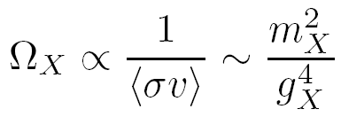
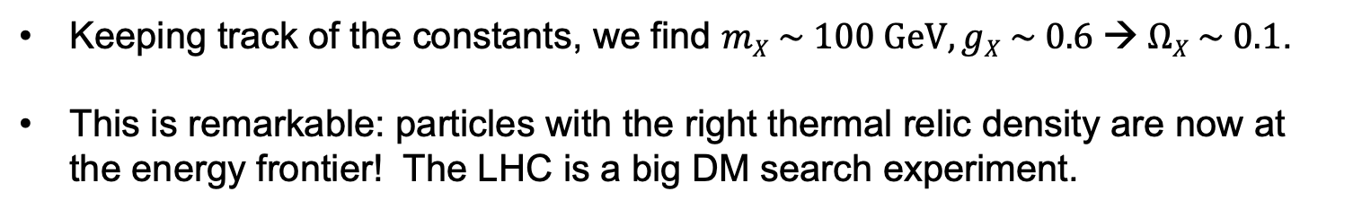
THE WIMP MIRACLE
It turns out that the relation between Ω_{X} and annihilation strength is wonderfully simple:
where we’ve assumed that the annihilation is characterized by a single mass scale.
X
q
_
X
q
Keeping track of the constants, we find $mX \sim 100 GeV, gX \sim 0.6 → ΩX \sim 0.1$.
This is remarkable: particles with the right thermal relic density are now at the energy frontier! The LHC is a big DM search experiment.

Slide 10
WIMP STABILITY
The WIMP Miracle is well appreciated. But its success relies another less well-advertised “miracle.”
DM must be stable.
How natural is this? A priori, not very: the only stable particles we know about are very light.
New Particle States
Stable
Standard Model
Particles

Slide 11
THE DISCRETE WIMP MIRACLE
Gauge Hierarchy requires
Precision EW excludes
new
particle
SM
SM
Higgs
Higgs
new
particle
SM
SM
In some cases, there are even stronger reasons to exclude these 4-particle interactions (e.g., proton decay in SUSY)
Simple solution: impose a discrete parity, so all interactions require pairs of new particles. This also makes the lightest new particle stable: Discrete Symmetry ↔ Stability
Cheng, Low (2003); Wudka (2003)
Remarkable coincidence: particle physics independently motivates particles that are stable enough to be dark matter

Slide 12
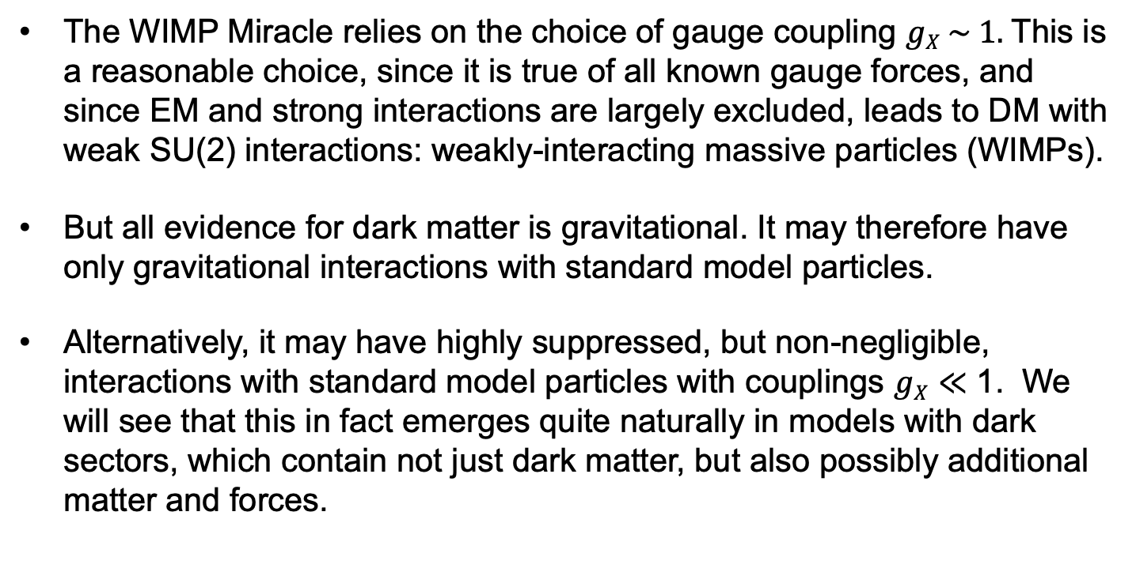
DARK SECTORS
The WIMP Miracle relies on the choice of gauge coupling $gX \sim 1.$This is a reasonable choice, since it is true of all known gauge forces, and since EM and strong interactions are largely excluded, leads to DM with weak SU(2) interactions: weakly-interacting massive particles (WIMPs).
But all evidence for dark matter is gravitational. It may therefore have only gravitational interactions with standard model particles.
Alternatively, it may have highly suppressed, but non-negligible, interactions with standard model particles with couplings $gX≪$ 1. We will see that this in fact emerges quite naturally in models with dark sectors, which contain not just dark matter, but also possibly additional matter and forces.
Visible Sector
SM
Dark Sector
DM + Other Particles

Slide 13
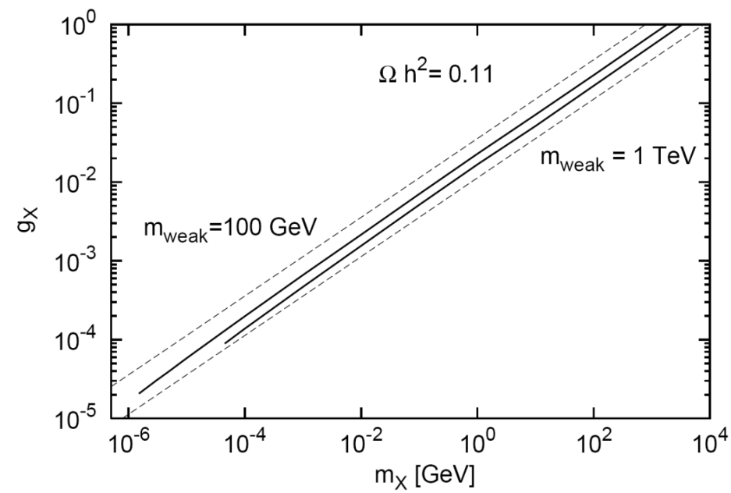


WIMPLESS MIRACLE
Boehm, Fayet (2003); Feng, Kumar (2008); Feng, Tu, Yu (2008)
Recall the WIMP miracle: the relation between Ω_{X} and annihilation strength is wonderfully simple:
$$mX \sim 100 GeV, gX \sim 0.6 → ΩX \sim 0.1$$
With a dark sector, the coupling $gX$ doesn’t have to be ~ 1
_{WIMPs}
X
q
_
_{WIMPless DM}
X
q
WIMPless miracle: with dark sectors, light, weakly-coupled DM can also have the correct thermal relic density, opening up a whole new set of dark matter and dark sector signals, all within standard cosmology.

Slide 14
THE THERMAL RELIC LANDSCAPE
Particle
Colliders
Mass
MeV
GeV
TeV
1
Already
Discovered
Strongly Interacting
Heavy Particles
Too Little to be
Dark Matter
Interaction Strength
Just Right to
be Dark Matter
10⁻³
Weakly Interacting
Light Particles
Impossible to
Discover
10⁻⁶
Too Much to be
Dark Matter

Slide 15
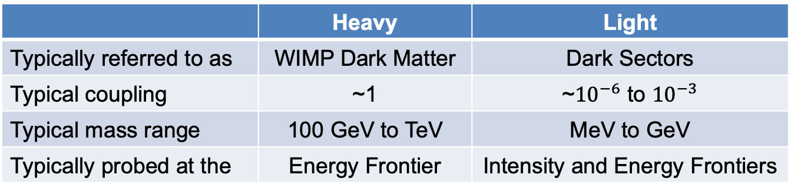
I. SUMMARY
We know little about dark matter, but we know its relic density precisely.
If dark matter is produced through thermal freezeout, this relic density tells us about its particle properties, and remarkably, it favors particles with masses and couplings that are not yet excluded, but are within reach of current and near future experiments.
There is a continuum of ideas, but roughly they break into two classes:
Note: there are many caveats, exceptions, and extensions to what I have presented above. Some will be discussed below, some are still unexplored.
 | Heavy | Light
Typically referred to as | WIMP Dark Matter | Dark Sectors
Typical coupling | ~1 | ~${10}^{−6}$ to ${10}^{−3}$
Typical mass range | 100 GeV to TeV | MeV to GeV
Typically probed at the | Energy Frontier | Intensity and Energy Frontiers

Slide 16
II: Heavy Dark Sectors at Accelerators

Slide 17
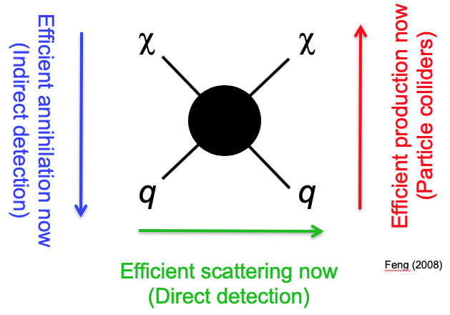
PARTICLE COLLIDERS
If dark matter particles (and other particles associated with dark matter) have masses in the 100 GeV to TeV range, they are not easy to make. Two options:
Use nature to make them (e.g., in the Big Bang)
  Indirect Detection
  Direct Detection
  UHE Cosmic Rays
Use particle colliders (not just accelerators, fixed target experiments), to reach the highest possible center-of-mass energies.
See Tracy Slatyer’s Lectures
See Tim Tait’s Lectures
See Jodi Cooley’s Lectures

Slide 18
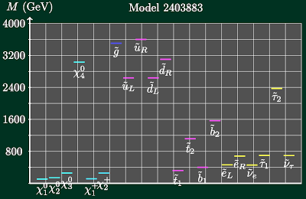
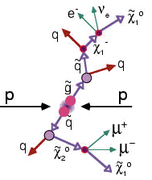

MISSING $ET$
Consider full models (e.g., SUSY), or simplified models. Produce other particles that decay to DM, look for missing $ET$ signatures.

Slide 19
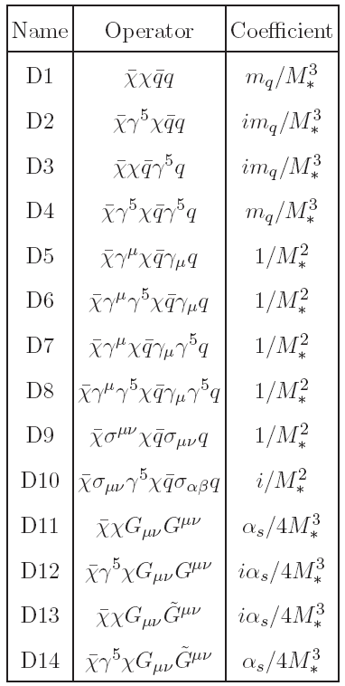
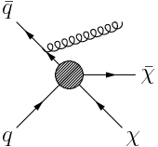

MONO-$X$
Alternatively, produce the DM directly, but in association with something else that can be seen. Model the blob as an effective operator, look for mono-$X$, where $X=$ photon, jet, $W, Z, h, b, t$, ….
Birkedal, Matchev, Perelstein (2004)
Goodman, Ibe, Rajaraman, Shepherd, Tait, Yu (2010)
_{Bai, Fox, Harnik (2010)}

Slide 20
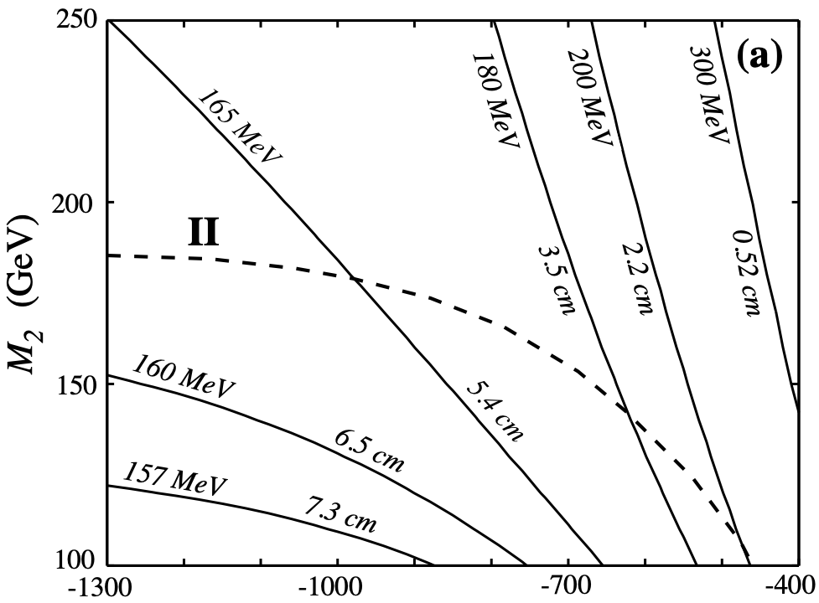

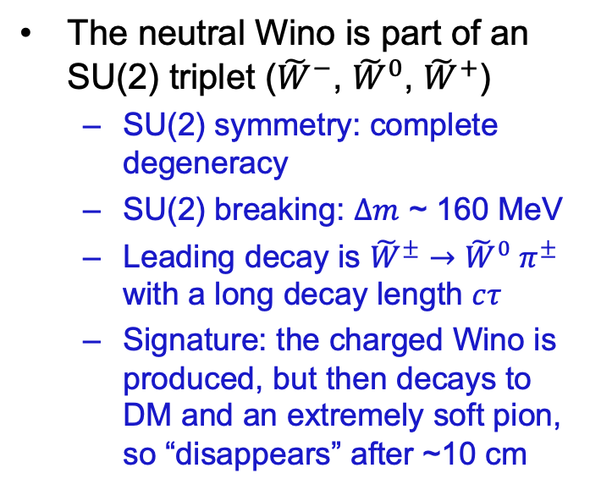
WINO DM AND DISAPPEARING TRACKS
Although missing $ET$ and mono-$X$ are by far the most-studied signatures of DM, there are actually many others. To give a flavor of these, and to prepare us for the wonderful zoo of interesting signatures to be discussed next for light dark sectors, let’s give a few examples.
DM may be the neutral Wino, the SUSY partner of an SU(2) gauge boson.
The neutral Wino is part of an SU(2) triplet (${\tilde{W}}^{−}$, ${\tilde{W}}^{0}$, ${\tilde{W}}^{+}$)
  SU(2) symmetry: complete degeneracy
  SU(2) breaking: $∆m$ ~ 160 MeV
  Leading decay is ${\tilde{W}}^{±}$ $→$ ${\tilde{W}}^{0} π^{±}$ with a long decay length $cτ$
  Signature: the charged Wino is produced, but then decays to DM and an extremely soft pion, so “disappears” after ~10 cm
Feng, Moroi, Randall, Strassler, Su (1999)
Notes:
20

Slide 21





GRAVITINO DM AND LONG-LIVED PARTICLES
In all supersymmetric models, the graviton has a superpartner, the gravitino $\tilde{G}$. Its mass can be anything from eV to PeV, but its couplings are typically extremely weak (as expected for the graviton’s partner).
$G$̃ not LSP
Assumption of most of literature
$G$̃ LSP
Completely different cosmology and particle physics
SM
SM
$G$̃
NLSP
LSP
$G$̃
Dine, Nelson, Nir, Shirman (1994, 1995); Dimopoulos, Dine, Raby, Thomas (1996)

Slide 22
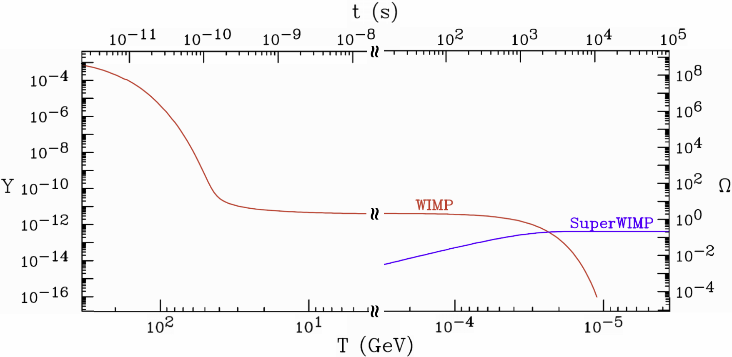
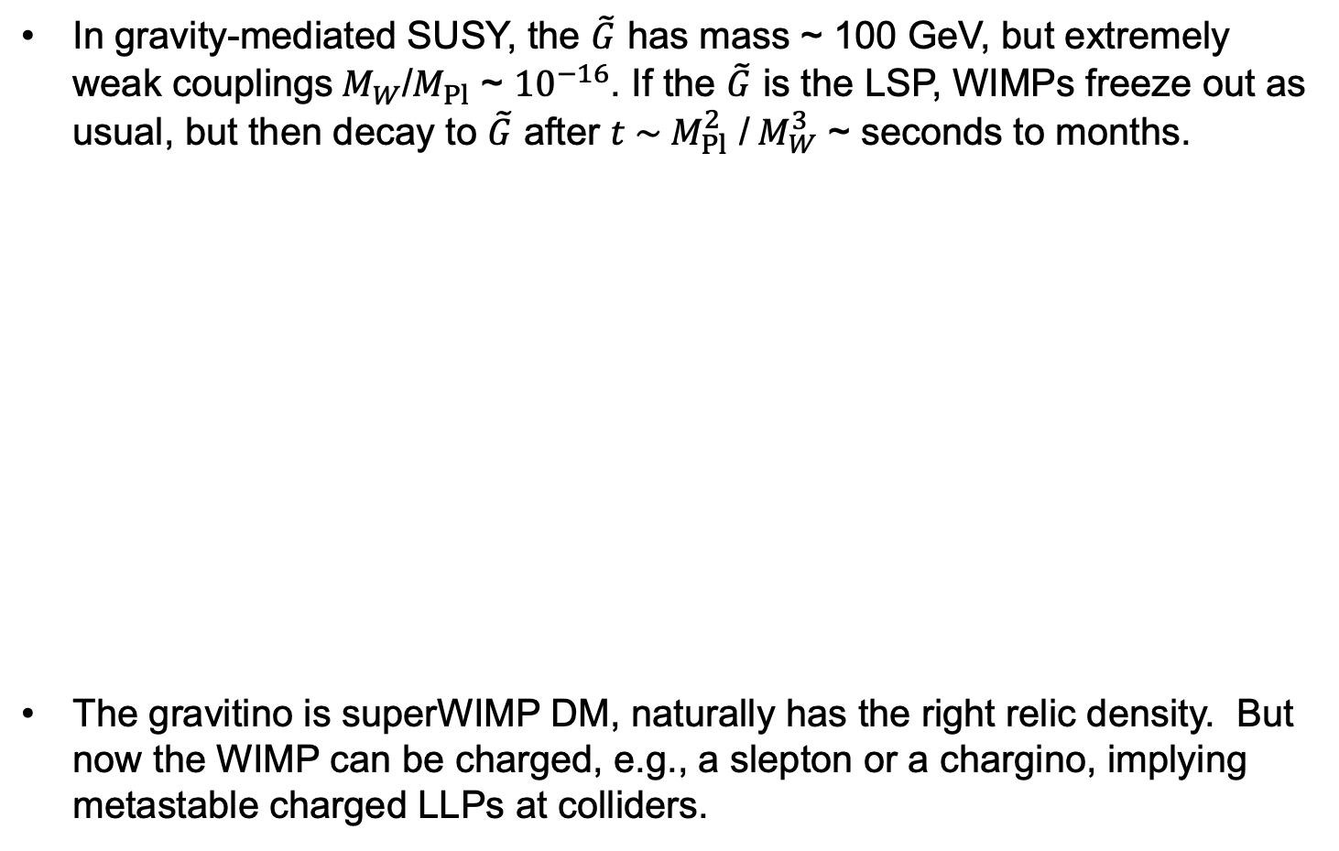
SUPERWIMP DARK MATTER
In gravity-mediated SUSY, the $\tilde{G}$ has mass ~ 100 GeV, but extremely weak couplings${ M}_{W}$/$M_{Pl}$ ~ ${10}^{−16}$. If the $\tilde{G}$ is the LSP, WIMPs freeze out as usual, but then decay to $\tilde{G}$ after $t \sim M_{Pl}^{2}$ /${ M}_{W}^{3}$ ~ seconds to months.
The gravitino is superWIMP DM, naturally has the right relic density. But now the WIMP can be charged, e.g., a slepton or a chargino, implying metastable charged LLPs at colliders.
Feng, Rajaraman, Takayama (2003)

Slide 23
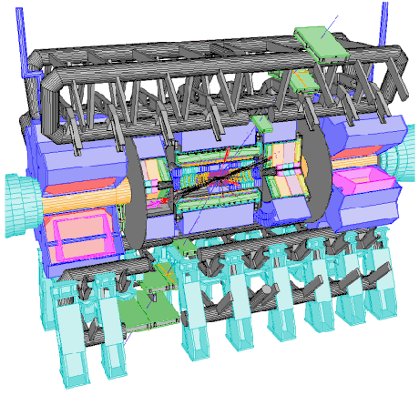
METASTABLE CHARGED PARTICLES
If we see long-lived charged particles, e.g., sleptons, we know they can’t be DM, must decay.
We can collect these particles and study their decays.
Several ideas have been proposed
  Trap sleptons a 1m thick water tank (a supplementary detector!) and then move them to a quiet place to observe their decays Feng, Smith (2004)
  Catch sleptons in LHC detectors
Hamaguchi, Kuno, Nakawa, Nojiri (2004)
  Dig sleptons out of detector hall walls
De Roeck, Ellis, Gianotti, Moortgat, Olive, Pape (2005)
Charged particle trap
Reservoir
Notes:
23

Slide 24
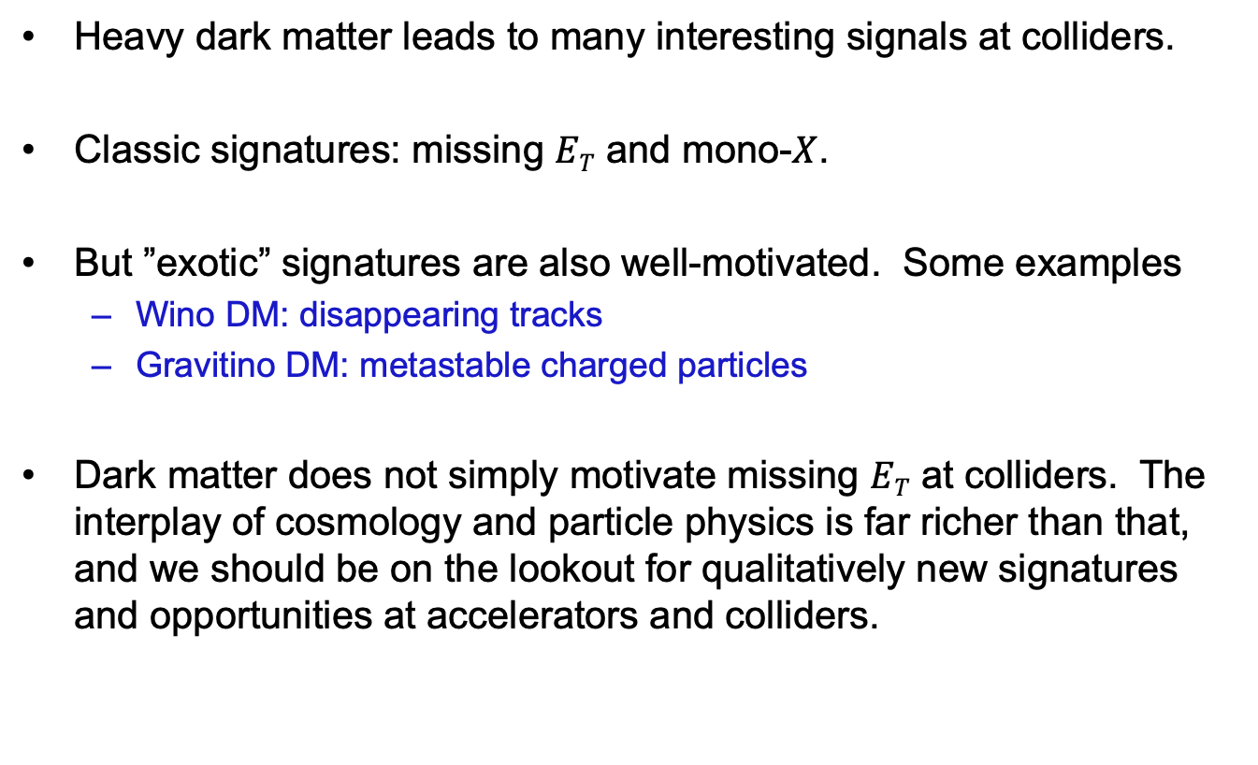
II. SUMMARY
Heavy dark matter leads to many interesting signals at colliders.
Classic signatures: missing $ET$ and mono-$X$.
But ”exotic” signatures are also well-motivated. Some examples
  Wino DM: disappearing tracks
  Gravitino DM: metastable charged particles
Dark matter does not simply motivate missing $ET$ at colliders. The interplay of cosmology and particle physics is far richer than that, and we should be on the lookout for qualitatively new signatures and opportunities at accelerators and colliders.

Slide 25
III: Light Dark Sectors at Accelerators

Slide 26
DARK SECTORS
This is how we have traditionally thought about dark matter:
But this is probably closer to the truth:
What are the consequences of a dark sector containing dark matter, but also additional matter and forces?
Standard Model
Dark Matter
Visible Sector
Standard Model
Dark Sector
DM + Other Particles

Slide 27

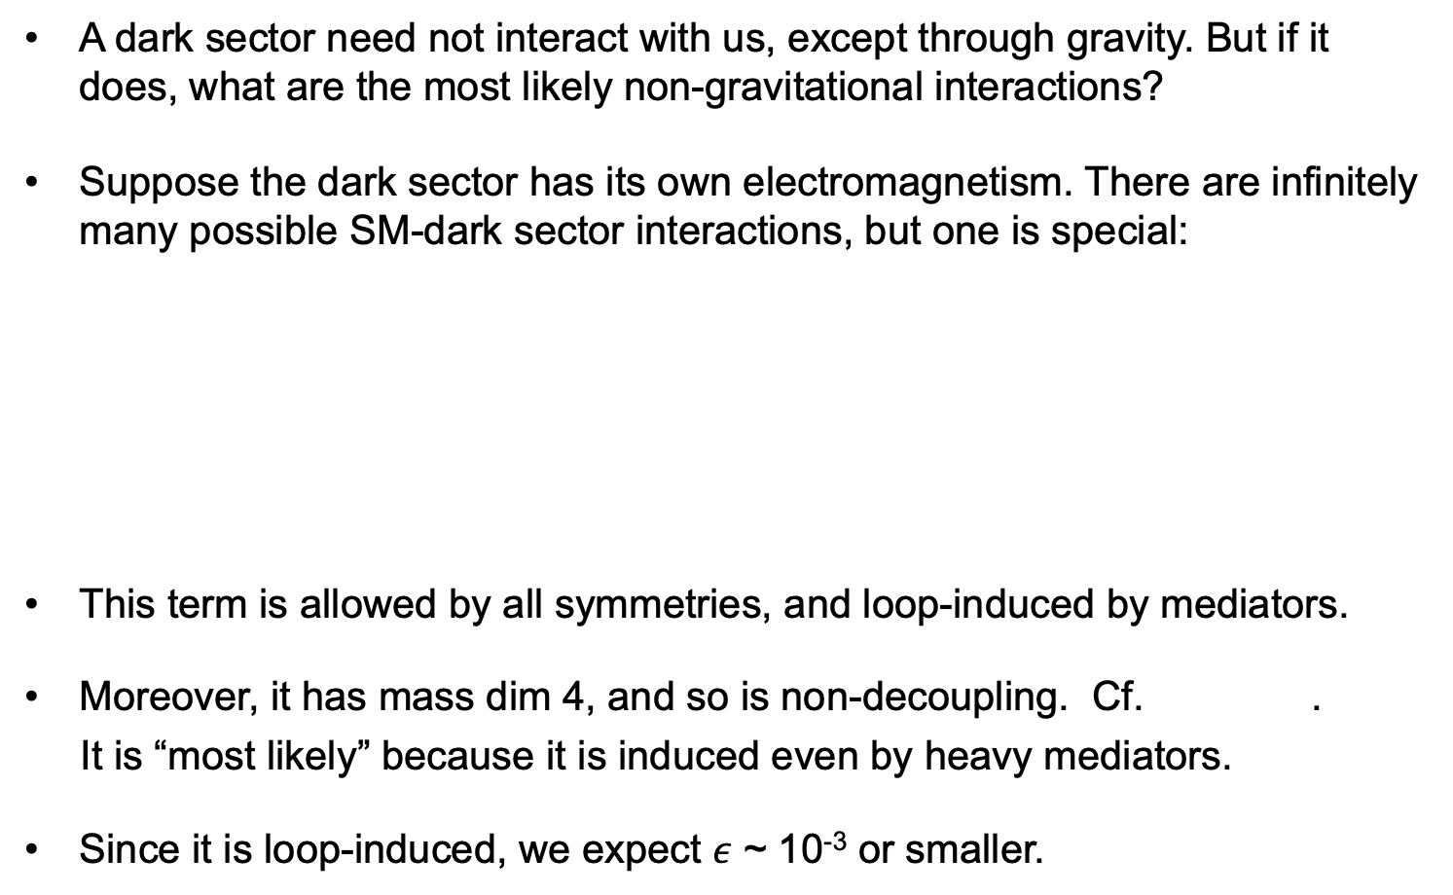
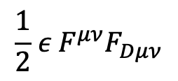
DARK PHOTONS
A dark sector need not interact with us, except through gravity. But if it does, what are the most likely non-gravitational interactions?
Suppose the dark sector has its own electromagnetism. There are infinitely many possible SM-dark sector interactions, but one is special:
This term is allowed by all symmetries, and loop-induced by mediators.
Moreover, it has mass dim 4, and so is non-decoupling. Cf. .
It is “most likely” because it is induced even by heavy mediators.
Since it is loop-induced, we expect $ε$ ~ 10⁻³ or smaller.
Visible Sector
SM, U(1)_{EM}
$$\frac{1}{2}{ ε{ F}^{μν}F}_{Dμν}$$
Dark Sector
DM, U(1)_{D}
M
Okun (1982), Galison, Manohar (1984), Holdom (1986)

Slide 28
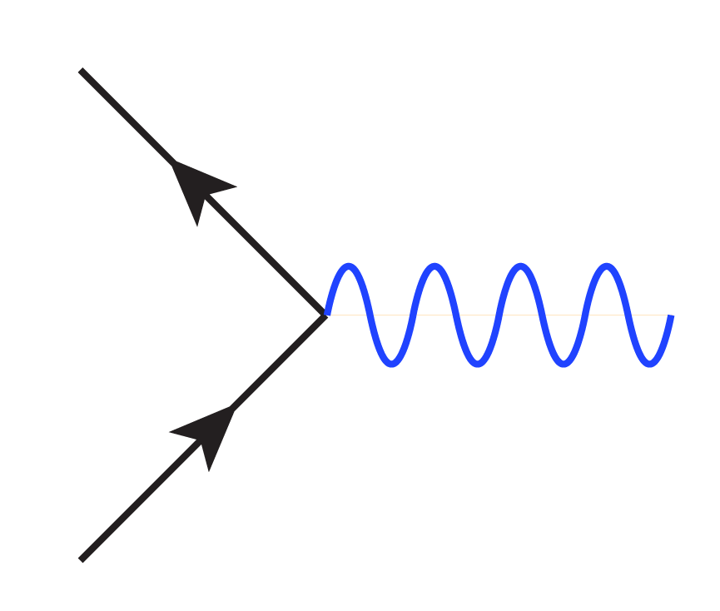

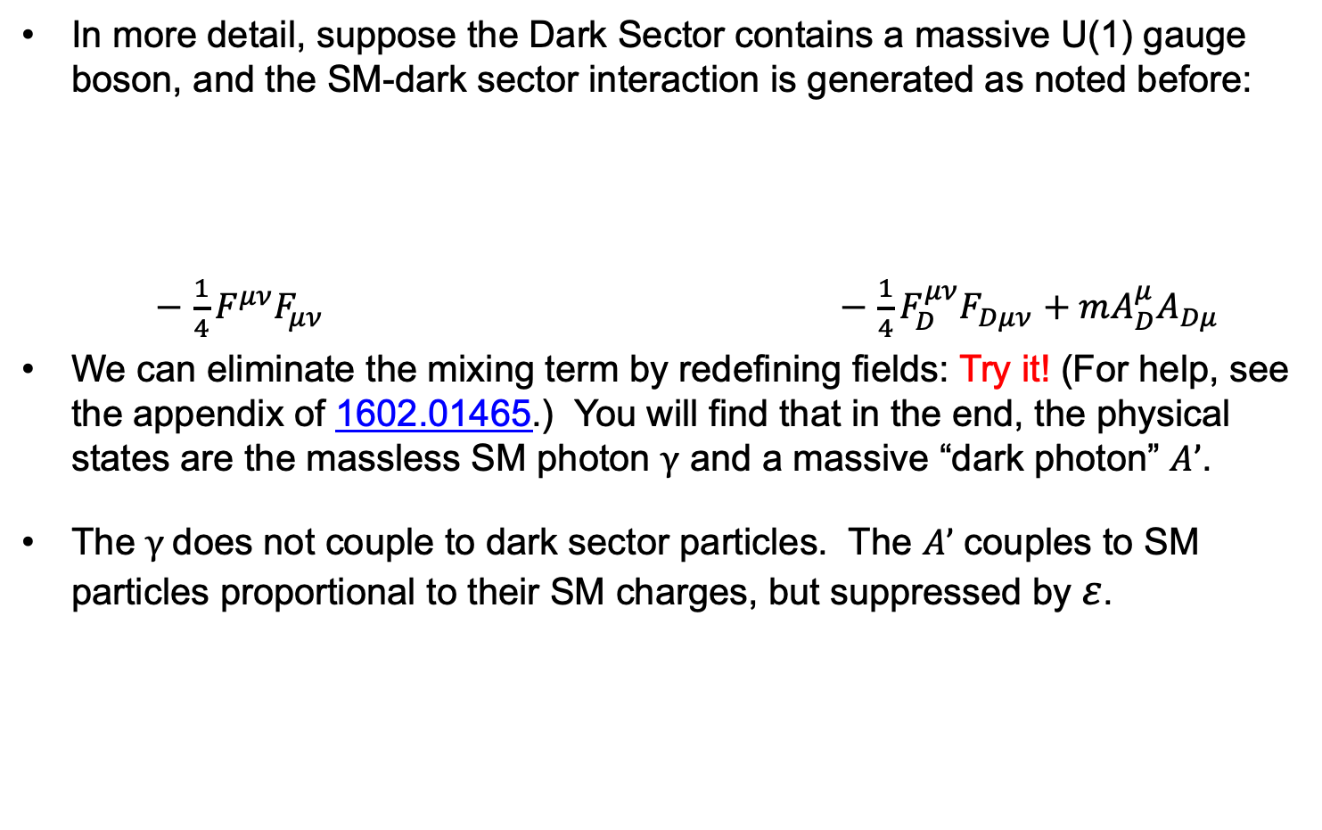





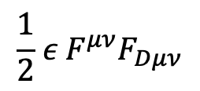

DARK PHOTONS
In more detail, suppose the Dark Sector contains a massive U(1) gauge boson, and the SM-dark sector interaction is generated as noted before:
$−$ ${\frac{1}{4}F}^{μν}F_{μν}$ $−$ $\frac{1}{4}{F_{D}^{μν}F}_{Dμν}$ $+ m{A_{D}^{μ}A}_{Dμ}$
We can eliminate the mixing term by redefining fields: Try it! (For help, see the appendix of 1602.01465.) You will find that in the end, the physical states are the massless SM photon $γ$ and a massive “dark photon” $A’$.
The $γ$does not couple to dark sector particles. The $A’$ couples to SM particles proportional to their SM charges, but suppressed by $ε$.
Visible Sector
SM, U(1)_{EM}
$$\frac{1}{2}{ ε{ F}^{μν}F}_{Dμν}$$
Dark Sector
DM, U(1)_{D}
$$fD$$
$$f$$
0
$$εeQf$$
$$γ$$
$$A’$$
$$fD$$
$$f$$

Slide 29
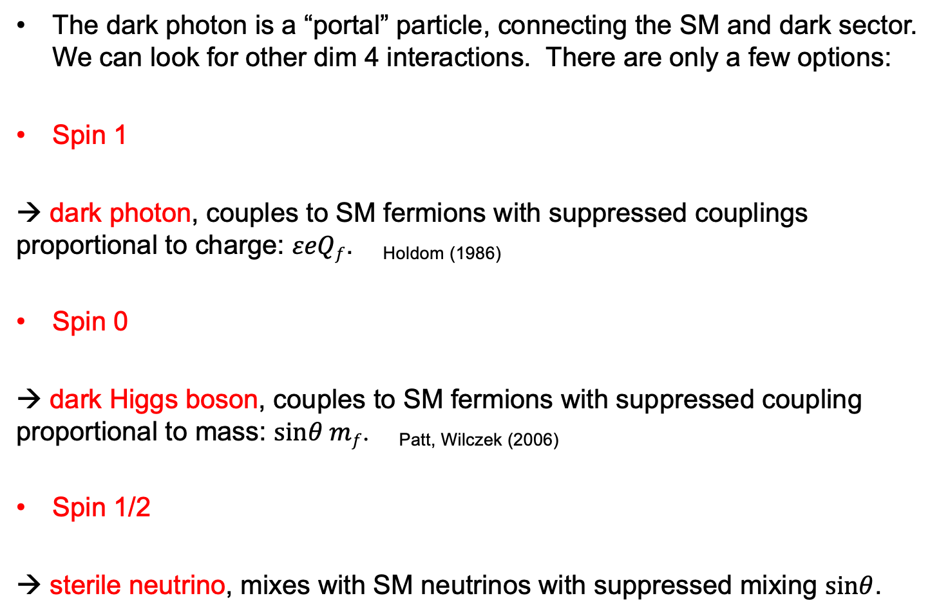
PORTALS
The dark photon is a “portal” particle, connecting the SM and dark sector. We can look for other dim 4 interactions. There are only a few options:
Spin 1
→ dark photon, couples to SM fermions with suppressed couplings proportional to charge: $εeQf$. _{Holdom (1986)}
Spin 0
→ dark Higgs boson, couples to SM fermions with suppressed coupling proportional to mass: $sinθ mf$. _{Patt, Wilczek (2006)}
Spin 1/2
→ sterile neutrino, mixes with SM neutrinos with suppressed mixing $sinθ$.
SM
Dark
Force
SM
Dark
Scalar
SM
Dark
Fermion

Slide 30
LECTURE 2

Slide 31


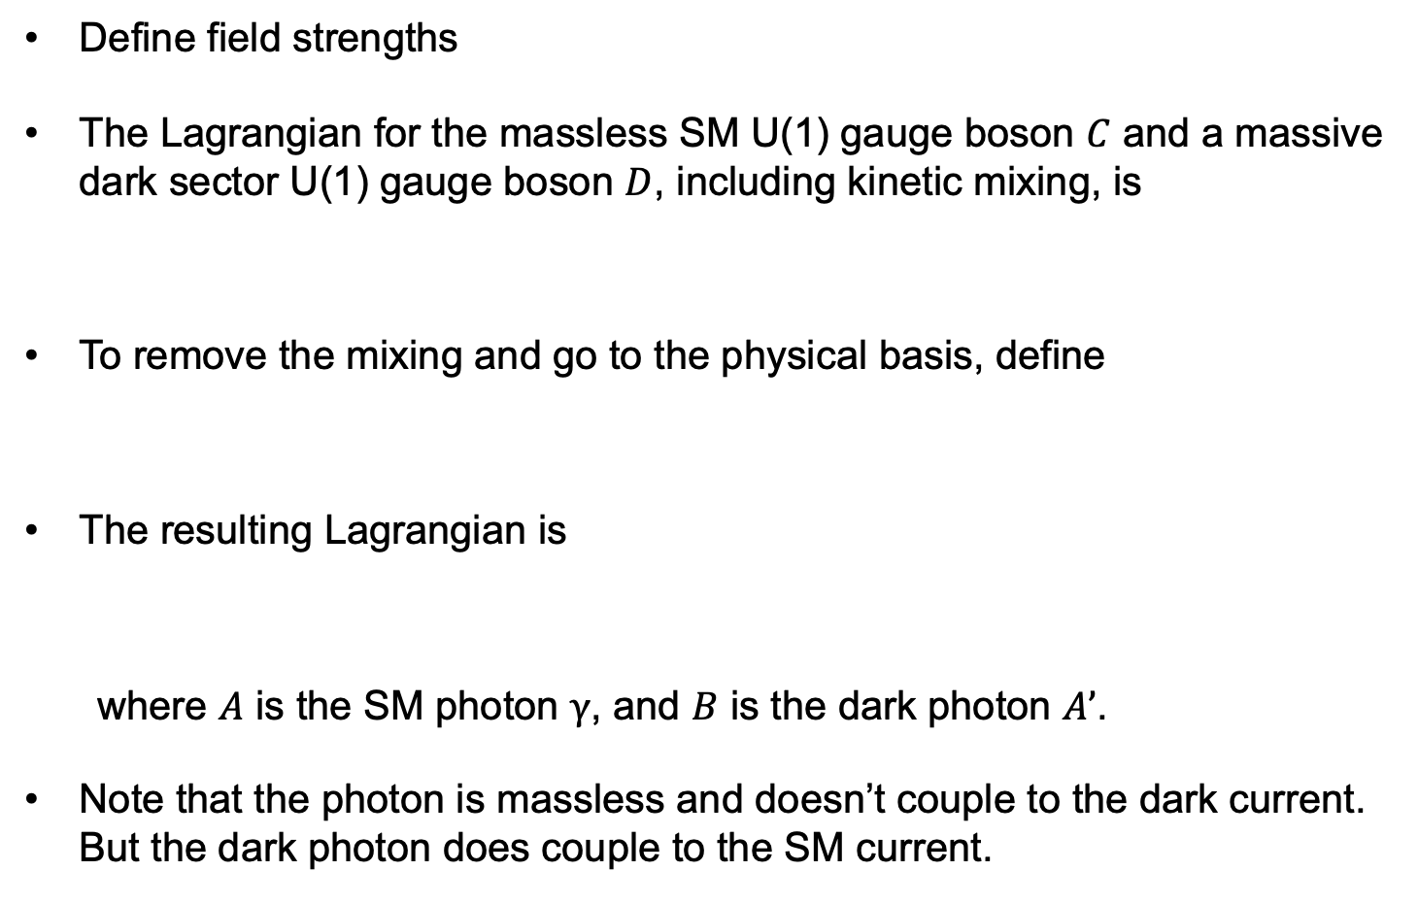
DARK PHOTON LAGRANGIAN
Define field strengths
The Lagrangian for the massless SM U(1) gauge boson $C$ and a massive dark sector U(1) gauge boson $D$, including kinetic mixing, is
To remove the mixing and go to the physical basis, define
The resulting Lagrangian is
where $A$ is the SM photon $γ$, and $B$ is the dark photon $A’$.
Note that the photon is massless and doesn’t couple to the dark current. But the dark photon does couple to the SM current.

Slide 32
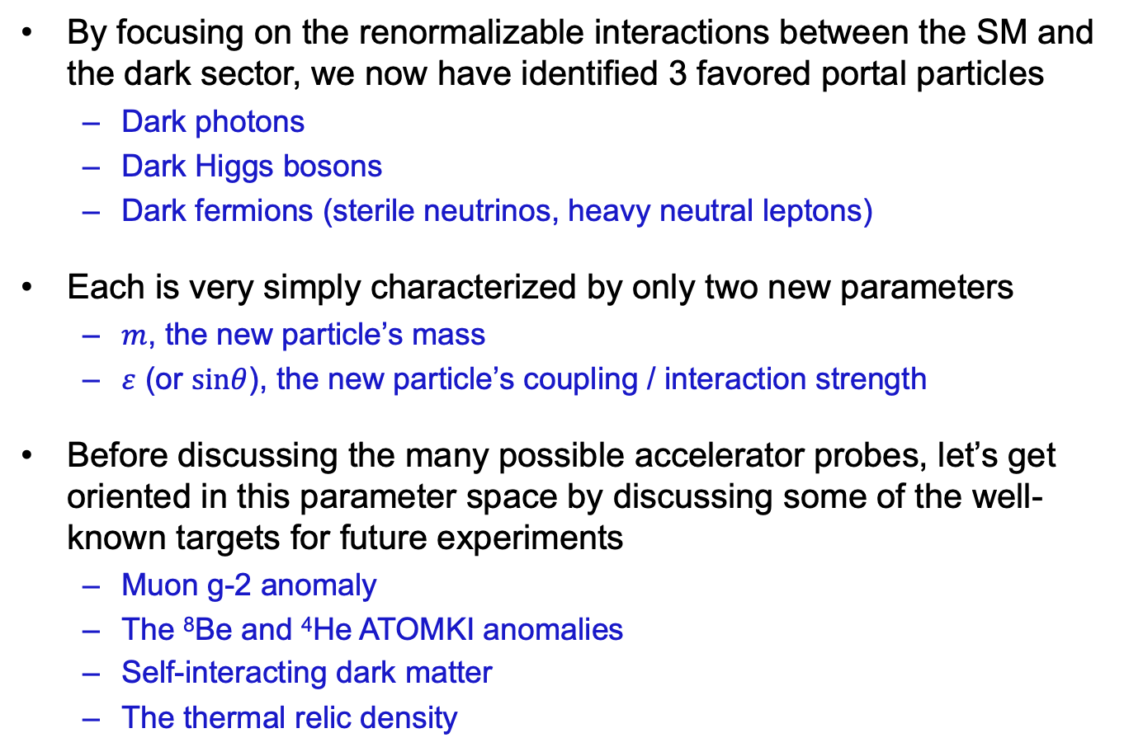
PORTAL PARAMETER SPACE
By focusing on the renormalizable interactions between the SM and the dark sector, we now have identified 3 favored portal particles
  Dark photons
  Dark Higgs bosons
  Dark fermions (sterile neutrinos, heavy neutral leptons)
Each is very simply characterized by only two new parameters
  $m$, the new particle’s mass
  $ε$ (or $sinθ$), the new particle’s coupling / interaction strength
Before discussing the many possible accelerator probes, let’s get oriented in this parameter space by discussing some of the well-known targets for future experiments
  Muon g-2 anomaly
  The ⁸Be and ⁴He ATOMKI anomalies
  Self-interacting dark matter
  The thermal relic density

Slide 33
Dark Sector Candidates, Anomalies, and Search Techniques
zeV
aeV
feV
peV
neV
μeV
meV
eV
keV
MeV
GeV
TeV
PeV
30M☉
≈
QCD Axion
Sterile Neutrino
WIMPs
Ultralight Dark Matter
Hidden Thermal Relics / WIMPless DM
Black Holes
SIMPs / ELDERS
Asymmetric DM
X-ray Line
Beryllium-8
Muon g-2
Small-Scale Structure
Coherent Field Searches
Nuclear and Atomic Physics
Microlensing
Direct Detection (Low-Threshold and Spin-Dependent)
Accelerators
≈
zeV
aeV
feV
peV
neV
μeV
meV
eV
keV
MeV
GeV
TeV
PeV
30M☉
Cosmic Visions Report (2017)
Notes:
Targets: Freeze-In, Inflation Mechanism, Misalignment Mechanism

Slide 34
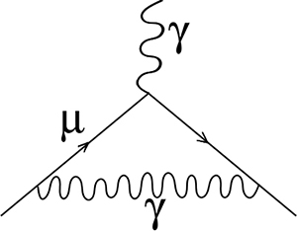
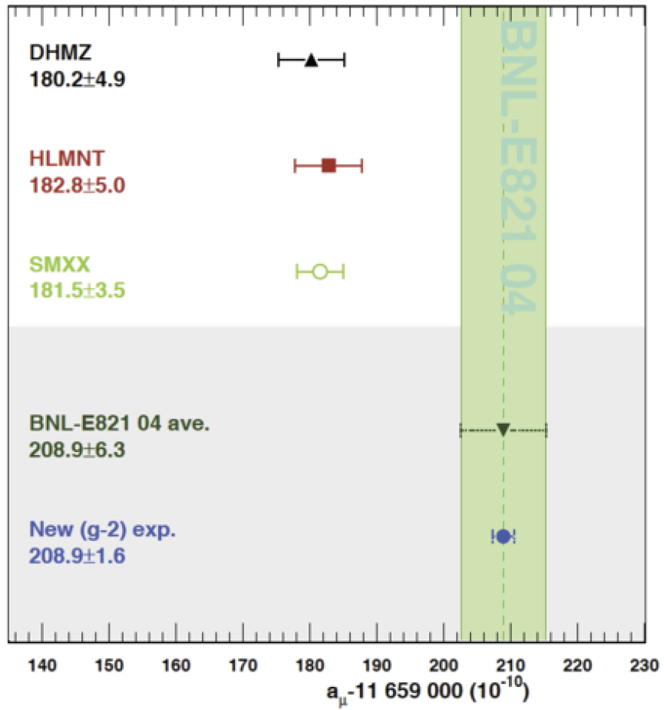
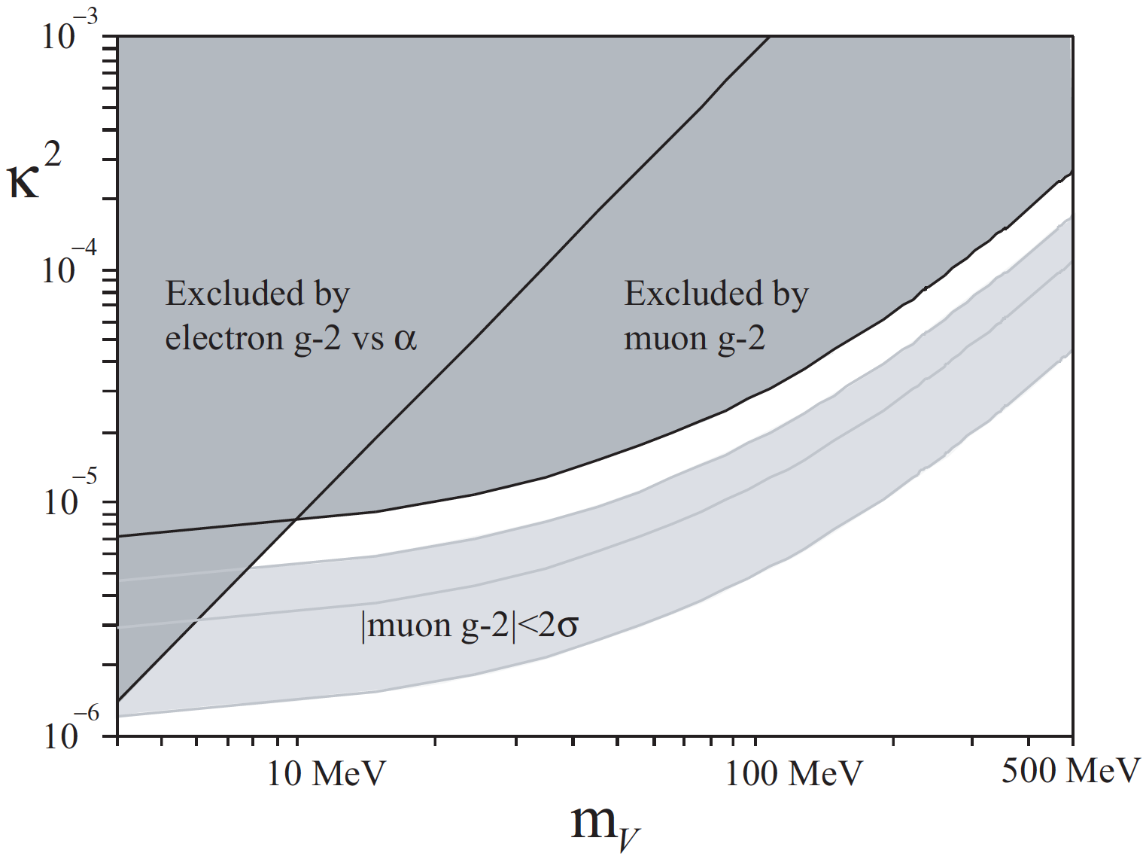

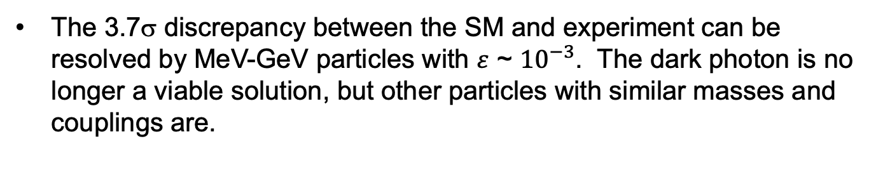
THE MUON’S ANOMALOUS MAGNETIC MOMENT
The 3.7σ discrepancy between the SM and experiment can be resolved by MeV-GeV particles with $ε$ ~ ${10}^{−3}$. The dark photon is no longer a viable solution, but other particles with similar masses and couplings are.
$$γ, A’$$
Hagiwara et al. (2017); Aoyama et al. (2020)
Boehm, Fayet (2003); Pospelov (2008)

Slide 35
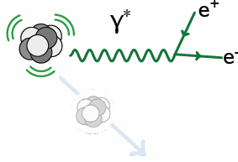
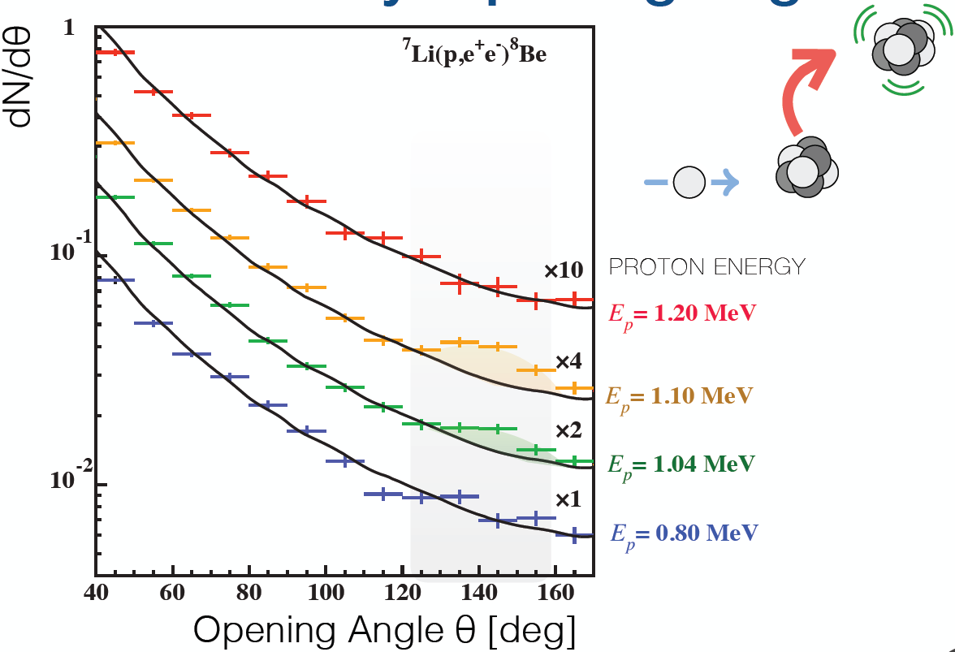
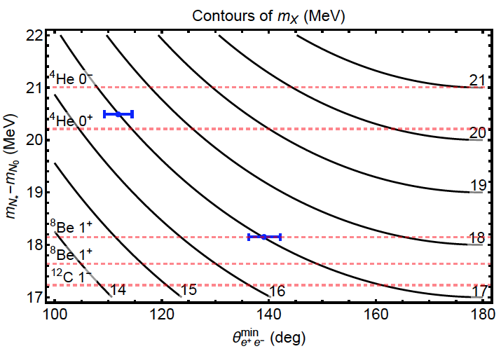
THE ⁸Be and ⁴He ATOMKI ANOMALIES
A 7σ anomaly in the decays of excited ⁸Be nuclei can be explained by a new particle with mass 17 MeV and couplings ~ 10⁻⁴ - 10⁻³.
A new 7σ anomaly in the decays of excited ⁴He nuclei can be explained by the same new particle.
X
$$θ$$
Krasznahorkay et al. (2015, 2019)
Feng, Fornal, Galon, Gardner, Smolinsky, Tanedo, Tait (2016)
Feng, Tait, Verhaaren (2020)

Slide 36
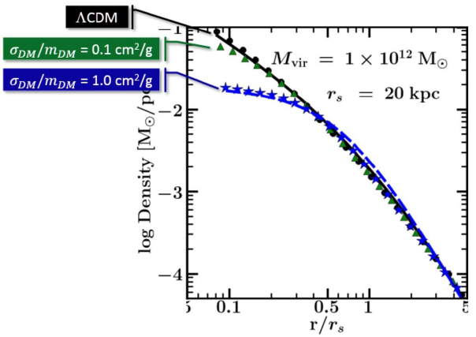
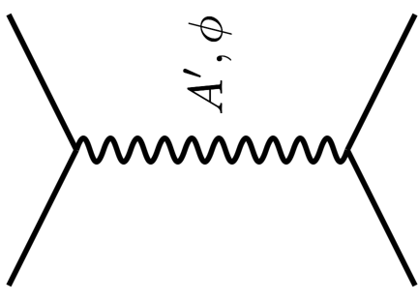


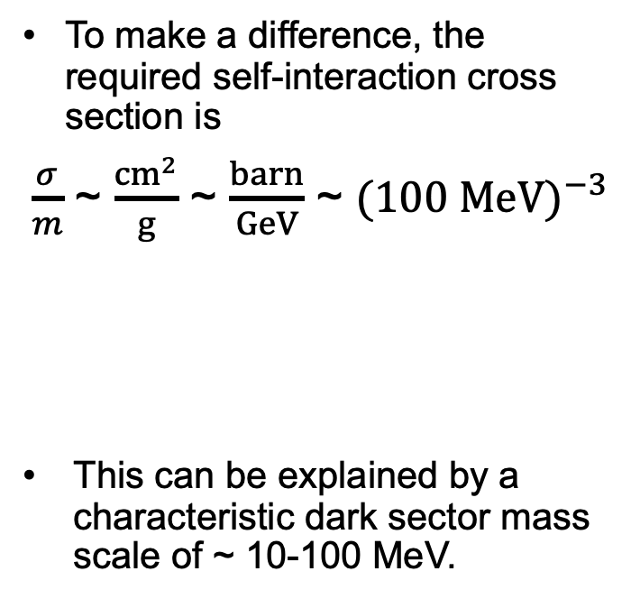

SELF-INTERACTING DARK MATTER
There are indications from small-scale structure that dark matter may be strongly self-interacting.
For example, there appear to be halo profiles that are not as cuspy as predicted by standard cold dark matter.
To make a difference, the required self-interaction cross section is
$\frac{σ}{m}$ ~ $\frac{{cm}^{2}}{g}$ ~ $\frac{barn}{GeV}$ ~ ${(100 MeV)}^{−3}$
This can be explained by a characteristic dark sector mass scale of ~ 10-100 MeV.
DM
$$\text{DM}$$
$$A’$$
DM
$$\text{DM}$$
Tulin, Yu (2017)
Rocha et al. (2012), Peter et al. (2012);
Vogelsberger et al. (2012); Zavala et al. (2012)
Notes:
36

Slide 37


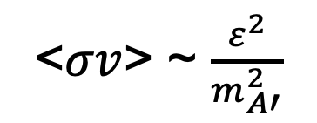


THE THERMAL RELIC LANDSCAPE
Particle
Colliders
Mass
MeV
GeV
TeV
1
Already
Discovered
Strongly Interacting
Heavy Particles
Too Little to be
Dark Matter
DM
$$e$$
Just Right to
be Dark Matter
$$A’$$
$$ε$$
Interaction Strength
10⁻³
DM
$$e$$
Weakly Interacting
Light Particles
Impossible to
Discover
<$σv$> ~ $\frac{ε^{2}}{m_{A′}^{2}}$
10⁻⁶
Too Much to be
Dark Matter

Slide 38
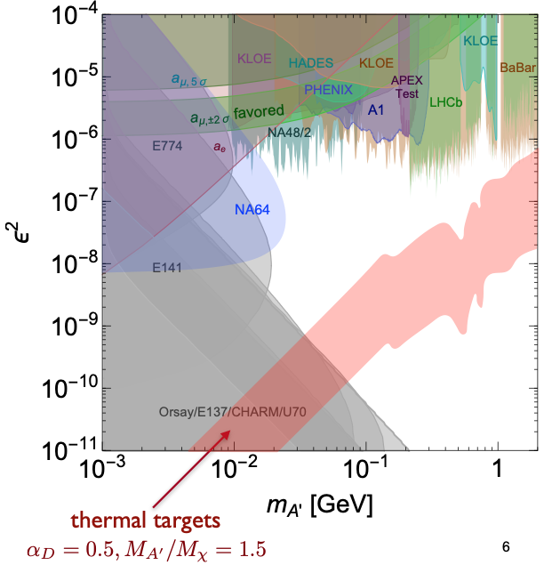
TARGETS IN DARK PHOTON PARAMETER SPACE
Muon
g-2 Anomaly
8Be and 4He
ATOMKI
Anomalies
Self-interacting
Dark Matter
Tim Nelson, Snowmass RP6 (2020)

Slide 39





DARK PHOTON DECAY
How can we look for portal particles at colliders? As an example, consider again the case of a dark photon.
It passes through matter essentially without interacting: radiation length is (10 cm) ε⁻² ~ 10⁹ m, the distance to the moon!
It decays to visible particles, but only after traveling a long distance.
Velocity near the speed of light
Rest lifetime enhanced by small mass, small ε
Lifetime further enhanced by time dilation

Slide 40

THE NEW PARTICLE LANDSCAPE
Particle
Colliders
Mass
MeV
GeV
TeV
1
Already
Discovered
Strongly Interacting
Heavy Particles
MUCH LONGER
LIFETIMES
Interaction Strength
10⁻³
Weakly Interacting
Light Particles
Impossible to
Discover
10⁻⁶

Slide 41

DARK PHOTON PRODUCTION
There are many processes that may produce dark photons: take any SM process with a SM photon and replace the SM photon with a dark photon. For example:
This opens up the floodgates to experimental probes at both the energy and intensity frontiers. Here mention just a small sampling, try to give an impression of the diversity of existing and planned experiments.
Meson decay
Dark bremsstrahlung
Hard scattering

Slide 42


EXISTING CONSTRAINTS ON DARK PHOTONS
For high $ε$, constraints are from bump hunts. These fail when $ε$becomes too small and the production rate is low, but they exclude $ε$above ${10}^{−3}$.
For low $ε$, constraints are from beam dump experiments. These fail when $ε$ becomes too high and the decays are too short.
Tim Nelson, Snowmass RP6 (2020)

Slide 43


FUTURE PROBES OF DARK PHOTONS
Many improved bump hunts (e.g., Belle II) and beam dumps (e.g., NA62, DarkQuest, SHiP).
Also new qualitatively different proposals: REDTOP, proposed for CERN PS, probing rare decays of $η, η→$ $γ (A^{′}→$ $e^{+}e^{−});$ and FASER, located in the far-forward region of ATLAS at the LHC.
Existing bounds are gray
Future searches are colored
Physics Beyond Colliders BSM WG (2019)

Slide 44


FASER @ CERN
Located in a side tunnel off the LHC beamline 480 m from ATLAS, currently under construction to begin in LHC Run 3 from 2021-24.
Will probe new parameter space with just 1 fb⁻¹ of data in Run 3, test the ⁸Be anomaly.
Michaela Queitsch-Maitland, ICHEP (2020)

Slide 45

INVISIBLY DECAYING DARK PHOTONS
If m_{LLP} > 2m_{DM} , the LLP will typically decay into the dark sector, presumably to DM, leading to invisible decays.
Can look for look for the resulting DM to scatter, much like one would look for neutrino production and scattering.
Brian Batell, Snowmass RP6 (2020)

Slide 46


LDMX @ SLAC
Alternatively, can look for missing energy or momentum. Without having to see the DM scattering, can probe deep into parameter space, cover the typical thermal relic region.
Tim Nelson, Snowmass RP6 (2020)

Slide 47



DARK HIGGS BOSONS
Dark Higgs boson couplings are proportional to Yukawa couplings. Best probes are from decays of B mesons, produced in very high energy collisions: e.g., FASER, Codex-b, and MATHUSLA at the LHC.
φ
Physics Beyond Colliders BSM WG (2019)

Slide 48

MATHUSLA @ CERN
A large detector proposed for the surface near CMS at the LHC.
Henry Lubatti, Snowmass LLP (2020)

Slide 49

CODEX-B @ CERN
A large detector proposed for the surface near CMS at the LHC.
Simon Knapen, Snowmass LLP (2020)

Slide 50



NEUTRINOS AT COLLIDERS
An “almost invisibles” success story, currently in progress.
No collider neutrino has ever been detected.
1984: de Rujula and Ruckl: to detect neutrinos, look in the forward direction: high energy, high cross section.
2018: FASER pilot ~30 kg emulsion detectors were placed on the beam collision axis and collected 12.5 fb⁻¹ of data in 6 weeks.
2020: Expect ~10 neutrino interactions. Several neutral vertices identified, likely to be neutrinos. Analysis ongoing, expected in coming months.

Slide 51

NEUTRINOS AT COLLIDERS
2021-24: FASERν will collect data with 1.3 ton tungsten/emulsion in Run 3
  Detect ~1000 ν_{e} , ~10,000 ν_{μ} , and ~10 ν_{τ} .
  Probe neutrino properties at energies E_{ν} ~ TeV, first direct exploration of this energy range for all 3 flavors.
2027-36: With Forward Physics Facility, can upgrade to ~10 tons in HL-LHC
  Detect ~100,000 ν_{e} , ~1,000,000 ν_{μ} , and ~1000 ν_{τ} at TeV energies.
  Study production, propagation, and interactions for all 3 ν flavors, lepton universality, ν oscillations, ν_{τ} magnetic moment, NSI, neutrino tridents, …
  This will open up a new world of TeV neutrino physics at colliders.
FASER Collaboration 1908.02310 (2019)

Slide 52
III. SUMMARY
Dark sectors open up many new opportunities for probing new physics at accelerators.
Most likely interactions of the standard model with the dark sector are through portal particles: dark photons, dark Higgs bosons, sterile neutrinos (heavy neutral leptons, dark fermions).
In these models, there are enormous untouched regions of parameter space, all characterized by light, very weakly-interacting particles with long lifetimes.
Many other candidates and many new experimental opportunities at both the intensity and energy frontiers. For more, see
  US Cosmic Visions: New Ideas in Dark Matter [arxiv:1707.04591 hep-ph]
  Physics Beyond Colliders at CERN: BSM Report [arxiv:1901.09966 hep-ex]
  Snowmass RP6 Kickoff Meeting, [https://indico.fnal.gov/event/44819]

