Slide 1



FORWARD PHYSICS FACILITY
Dark Sectors and Light Long-Lived Particles
Snowmass AF-EF-RF Meeting
Jonathan Feng, UC Irvine, 15 July 2020

Slide 2
FORWARD PHYSICS FACILITY
As the LHC runs at higher energies and much higher luminosities in the next 15 years, how can its potential be maximally exploited?
Attention has focused on high p_{T} / low cross section physics (~fb, pb, nb).
But the total cross section is ~100 mb, and most of it (and most of the highest energy particles) is in the far forward region at low p_{T} .
In recent years, it has become clear that there is an entire physics program that remains to be explored in the far forward region, and this can be done with relatively small additional investment.
The proposal: create a Forward Physics Facility for the HL LHC. Enlarge an existing cavern in the far forward region of ATLAS to house a suite of experiments with groundbreaking new capabilities for neutrinos, LLP searches, QCD, dark matter, dark sectors, and cosmic rays.

Slide 3

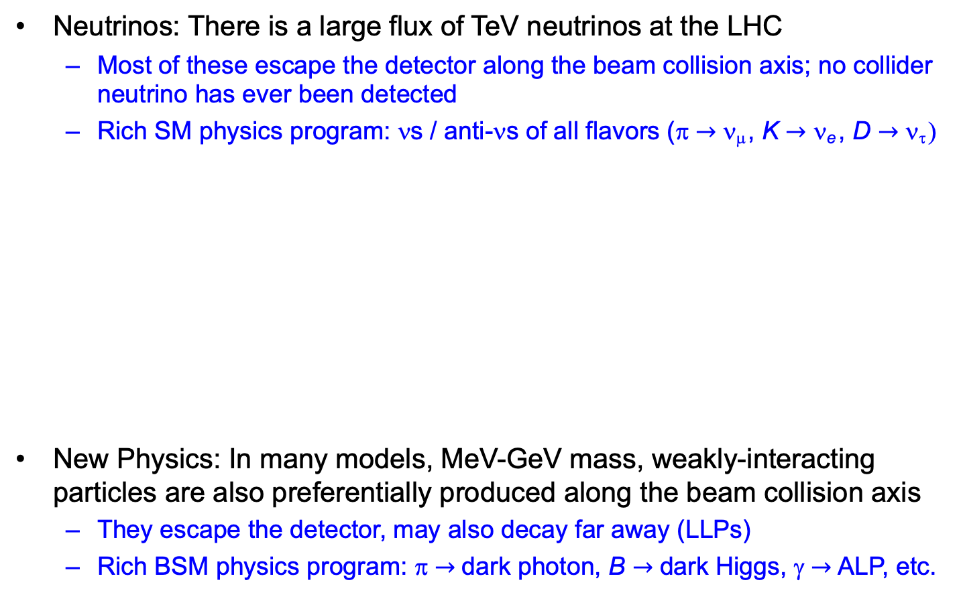
SM AND BSM PHYSICS POTENTIAL
Neutrinos: There is a large flux of TeV neutrinos at the LHC
  Most of these escape the detector along the beam collision axis; no collider neutrino has ever been detected
  Rich SM physics program: νs / anti-νs of all flavors (π $→$ ν_{μ} , K $→$ ν_{e} , D $→$ ν_{τ} )
New Physics: In many models, MeV-GeV mass, weakly-interacting particles are also preferentially produced along the beam collision axis
  They escape the detector, may also decay far away (LLPs)
  Rich BSM physics program: π $→$ dark photon, B $→$ dark Higgs, γ $→$ ALP, etc.
See Felix Kling’s talk

Slide 4
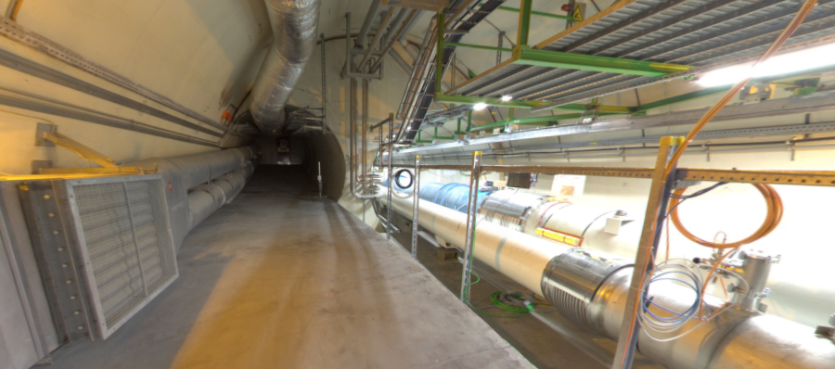
BEAM COLLISION AXIS
Beam collision axis passes
through 100 m of rock, emerges in tunnel TI12 near cavern UJ12
UJ12
TI12 near UJ12
The view in UJ12 looking west
TI12
Beam collision axis
LHC beamline

Slide 5
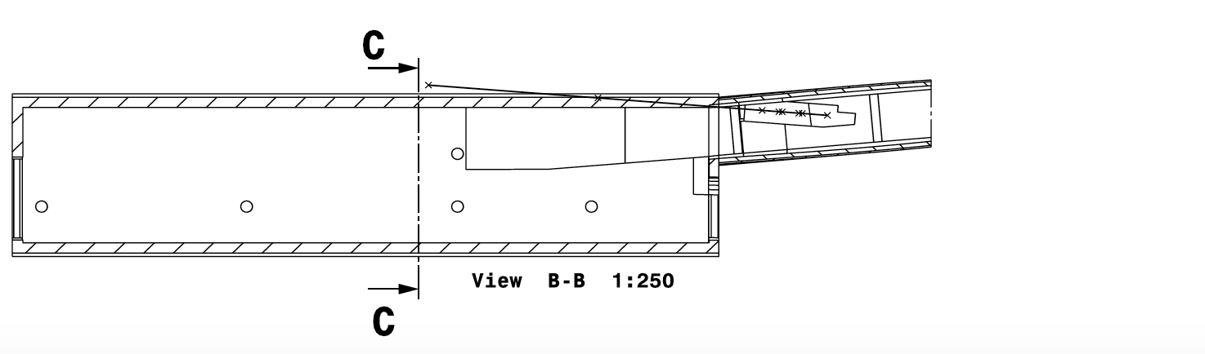
FORWARD PHYSICS FACILITY
A few experiments are under construction or proposed for this location. But they are severely limited by the tunnels and infrastructure that were created long before the physics potential of this space was appreciated.
FASER, FASERν
Beam Collision Axis
Tunnel TI12
Cavern UJ12
30 m
Dougherty (2020)

Slide 6
FORWARD PHYSICS FACILITY
A few experiments are under construction or proposed for this location. But they are severely limited by the tunnels and infrastructure that were created long before the physics potential of this space was appreciated.
A Forward Physics Facility, dedicated to supporting a suite of far forward experiments, would lead to a huge gain in sensitivity to new physics, neutrino studies, hadronic physics, etc.
Exploits pre-existing cavern, but requires widening by a few meters to provide space on the beam collision axis.
FORWARD
PHYSICS
FACILITY
Beam Collision Axis
30 m
Dougherty (2020)

Slide 7
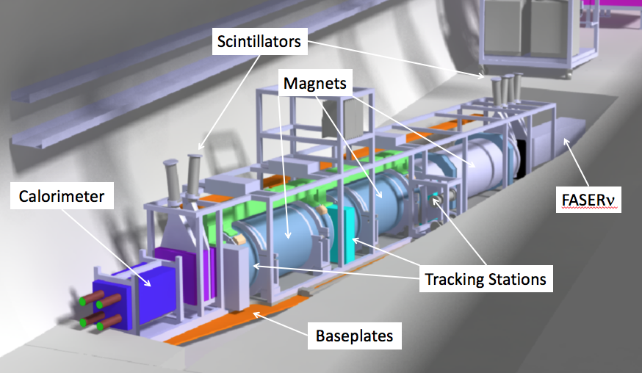
WHAT’S IT GOOD FOR?
FASER and FASERν are approved, funded, under construction for Run 3.
  65 collaborators from 19 institutions in 8 countries.
  50cm deep trench puts the detectors on axis. Coverage: η > 9, total length: 6 m.
  FASER: tracker and calorimeter, detects LLP decay to pair of TeV charged tracks. Background negligible (FLUKA simulations validated by prototype detector in 2018).
  FASERν: emulsion detector, detects CC and NC neutrino interactions.
SND has also been proposed as a (slightly) off-axis ν experiment in TI18.
LLP
ν
e⁺
e⁻

Slide 8
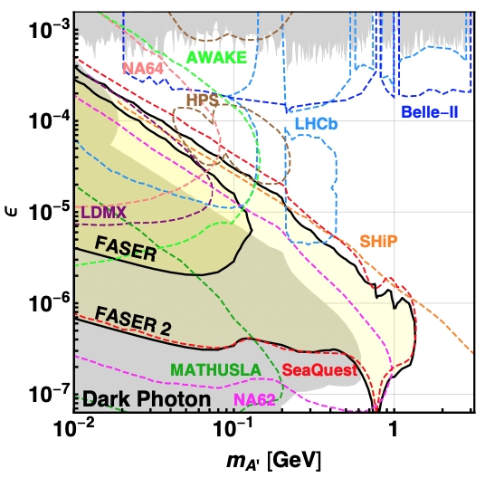
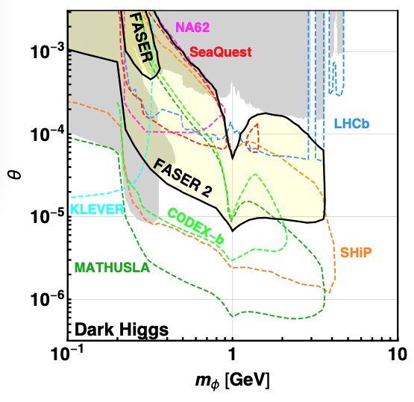
LLP SEARCHES
FASER probes new parameter space in many models with just 1 fb⁻¹.
With a Forward Physics Facility, could upgrade
FASER (R=10cm, L=1.5m, Run 3) → FASER 2 (R=1m, L=5m, HL-LHC),
extending sensitivity greatly, complementary to other experiments
FASER Collaboration, 1811.12522 (2018)

Slide 9
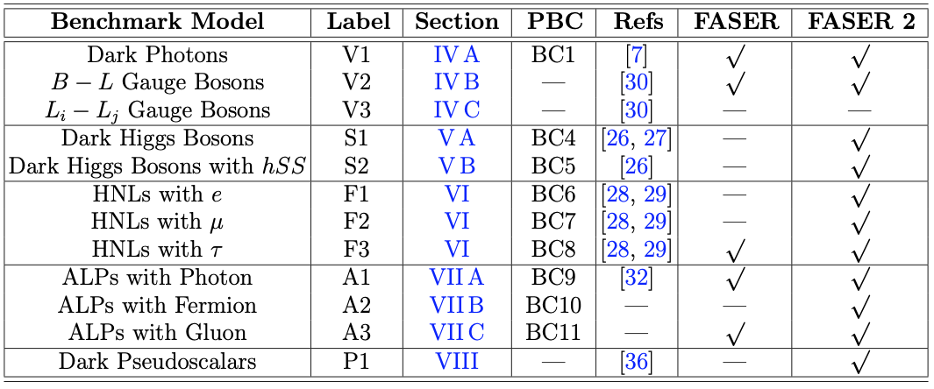
LLP SEARCHES
With a Forward Physics Facility, there is discovery potential for all portal particles (dark photons, dark Higgs bosons, heavy neutral leptons), ALPs with all types of couplings (photon, fermion, gluon), and many other models.
FASER Collaboration, 1811.12522 (2018)

Slide 10
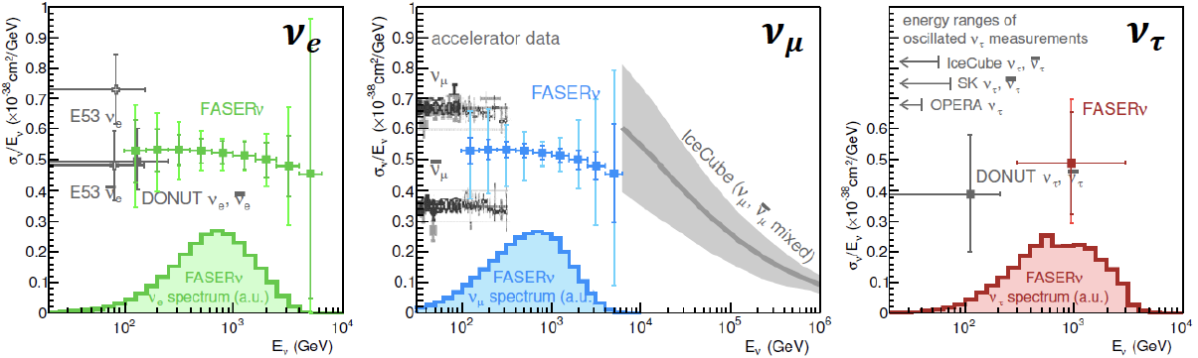
FPF NEUTRINO PHYSICS
FASERν will detect 1000s of νs with 1.3 ton tungsten/emulsion in Run 3.
  Will detect first collider neutrino (see de Rujula and Ruckl, 1984!)
  Detect ~1000 ν_{e} , ~10,000 ν_{μ} , and ~10 ν_{τ} .
  Probe neutrino properties at energies E_{ν} ~ TeV.
With FPF, could upgrade to ~10 tons in HL-LHC, precisely study neutrino production, propagation, and interactions for all 3 flavors, lepton universality, ν oscillations, ν_{τ} magnetic moment, NSI, neutrino tridents, …
FPF will open up a new world of TeV neutrino physics at colliders.
FASER Collaboration 1908.02310 (2019)

Slide 11
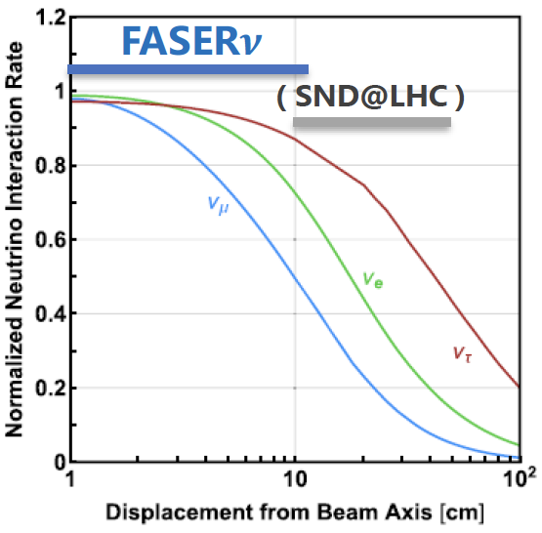
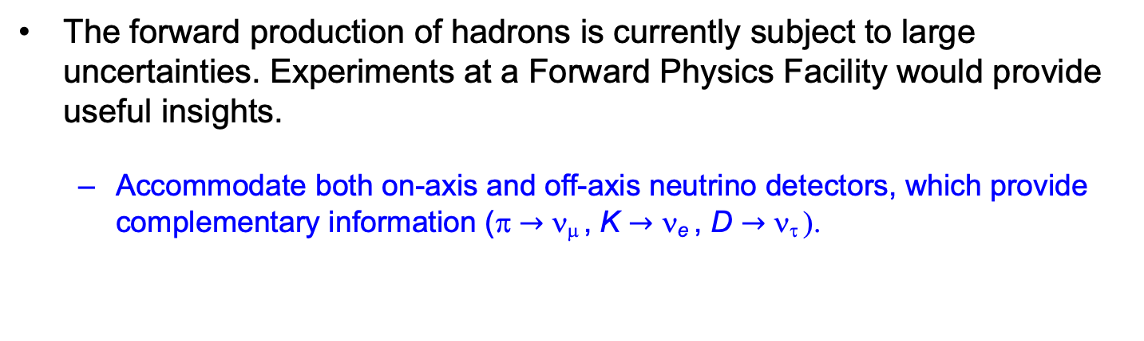
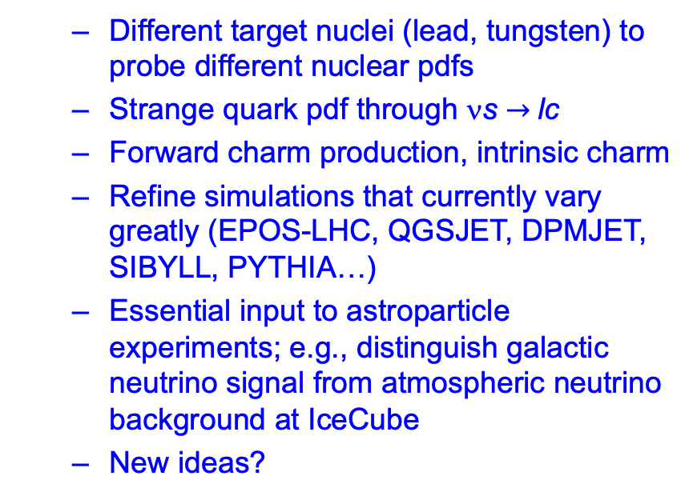
FPF QCD PHYSICS
The forward production of hadrons is currently subject to large uncertainties. Experiments at a Forward Physics Facility would provide useful insights.
  Accommodate both on-axis and off-axis neutrino detectors, which provide complementary information (π $→$ ν_{μ} , K $→$ ν_{e} , D $→$ ν_{τ} ).
  Different target nuclei (lead, tungsten) to probe different nuclear pdfs
  Strange quark pdf through νs $→$lc
  Forward charm production, intrinsic charm
  Refine simulations that currently vary greatly (EPOS-LHC, QGSJET, DPMJET, SIBYLL, PYTHIA…)
  Essential input to astroparticle experiments; e.g., distinguish galactic neutrino signal from atmospheric neutrino background at IceCube
  New ideas?

Slide 12
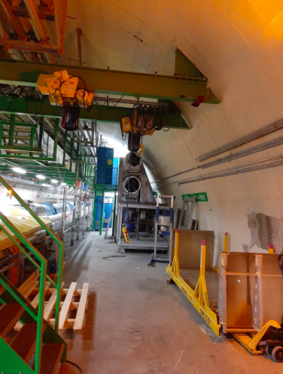
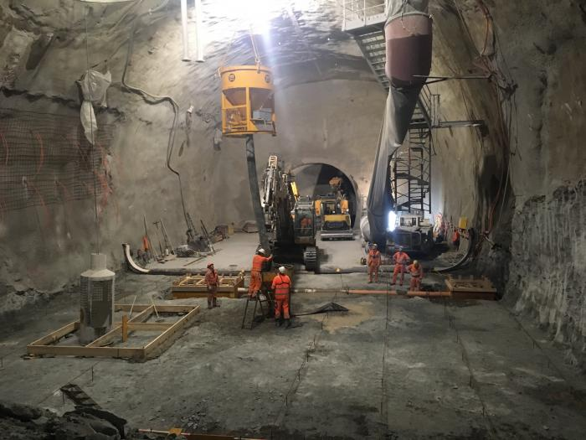
UJ12 CAVERN
The Forward Physics Facility would require widening UJ12 or UJ18 by a few meters.
Requires significant civil engineering near the LHC beam, but not much compared to what has already been invested in excavation for the HL LHC.
UJ12
HL LHC

Slide 13
SNOWMASS PLANS
Bring together physicists with diverse interests to study the physics potential and feasibility of the Forward Physics Facility at the HL LHC.
Snowmass provides an ideal setting: this is an inherently cross-frontier topic, with relevance for EF, NF, RF, CF, TF, and AF.
Many open questions
  What is the ideal mix of experiments? Could imagine on- and off-axis LLP experiments, on- and off-axis detectors targeting neutrinos and QCD, a milli-charge search experiment, …
  What is the optimal design for each experiment?
  Complementarity with other experiments closer to the IP?
  Is it feasible to construct the FPF in LS3? Cost, schedule, …
Short time window: if no Forward Physics Facility at the HL LHC, many of these physics opportunities will disappear for decades.
New ideas welcome! All invited to join the Forward Physics Facility LOI.

Slide 14
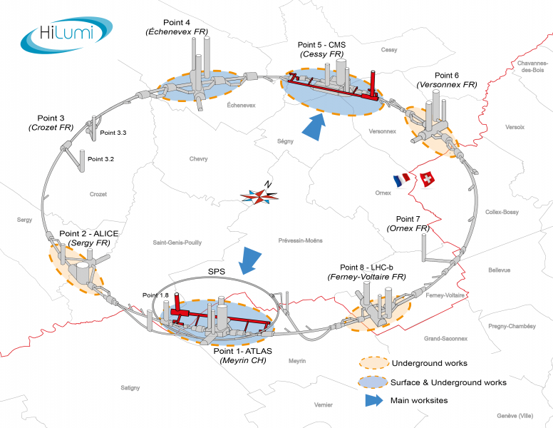
LHC TUNNELS
LHC tunnel infrastructure; HL-LHC tunnels in red (artist’s rendition)

Slide 15
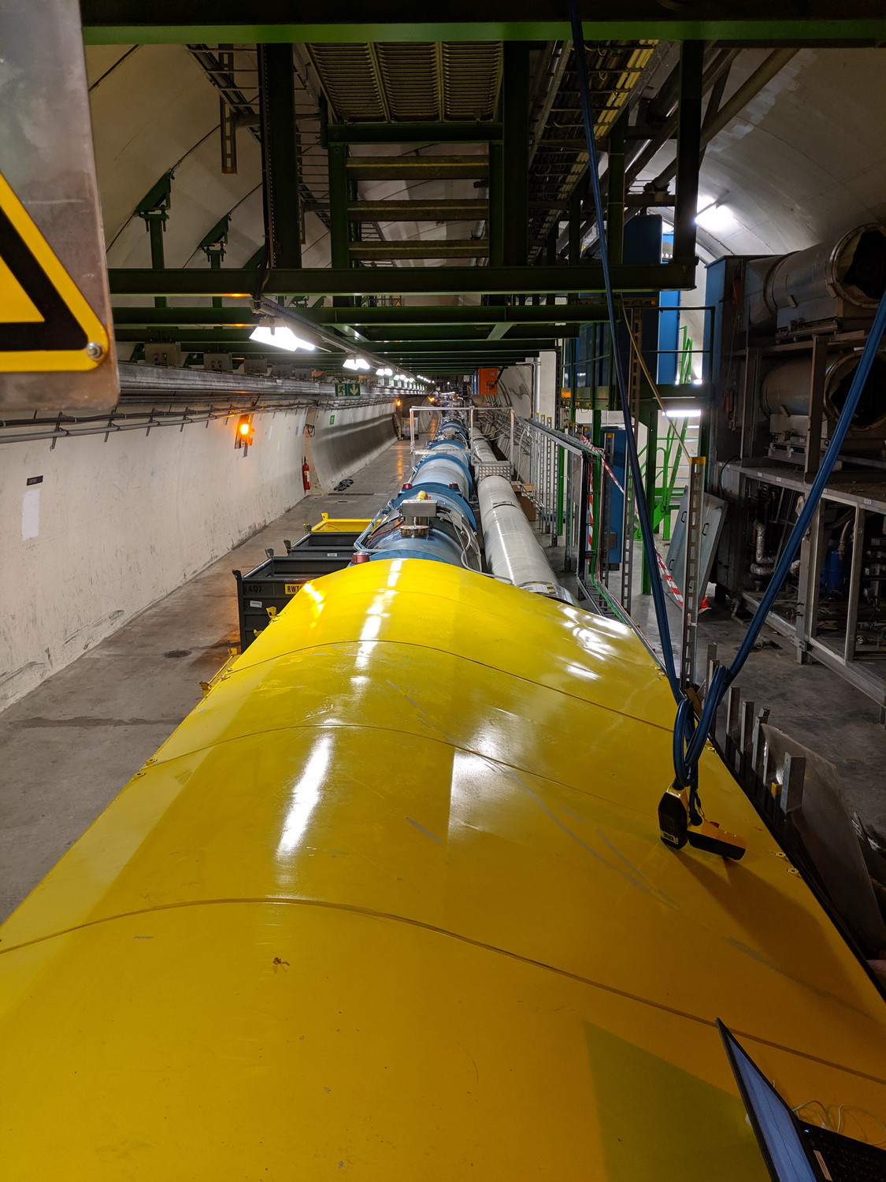
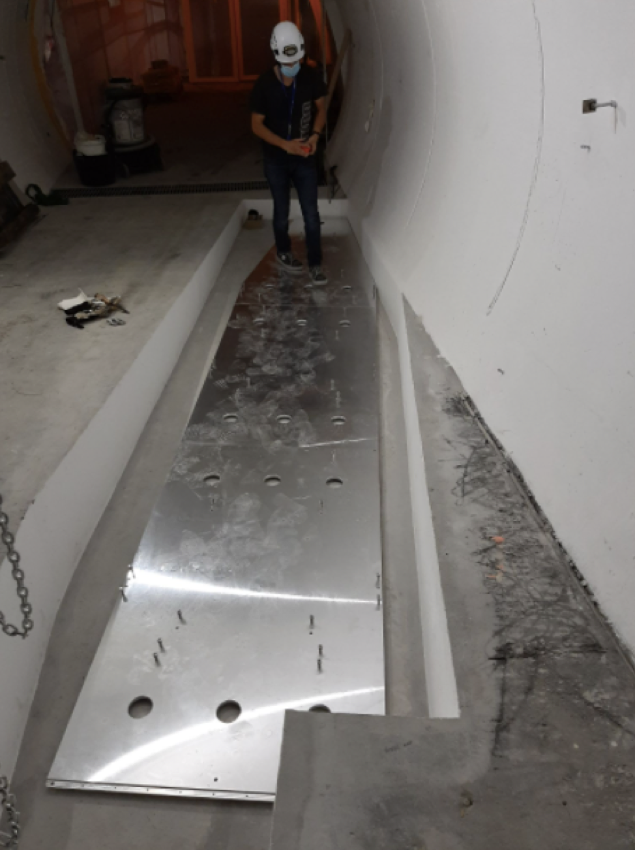
UJ12 AND TI12
UJ12, looking east, away from ATLAS
TI12, looking toward UJ12, with FASER baseplate installed

