Slide 1



FORWARD PHYSICS FACILITY
Open Questions and New Ideas
Joint Session, Snowmass Energy Frontier
Jonathan Feng, UC Irvine, 8 July 2020

Slide 2
FORWARD PHYSICS
As the LHC extends the energy frontier to higher energies and much higher luminosities in the coming 15 years, how can its physics potential be maximally exploited?
Much of the attention has focused on high p_{T} physics with low (~fb, pb, nb) cross sections.
But the total cross section is ~100 mb, and most of it, and most of the highest energy particles, are in the far forward region at low p_{T} .
Many detectors are already there: HF, CASTOR, TOTEM, PPS, LUCID, ZDC, LHCf, AFP, ALFA.
But in recent years, it has become clear that there is an entire physics program that remains to be explored in the far forward region, and this can be done with relatively small investments.

Slide 3
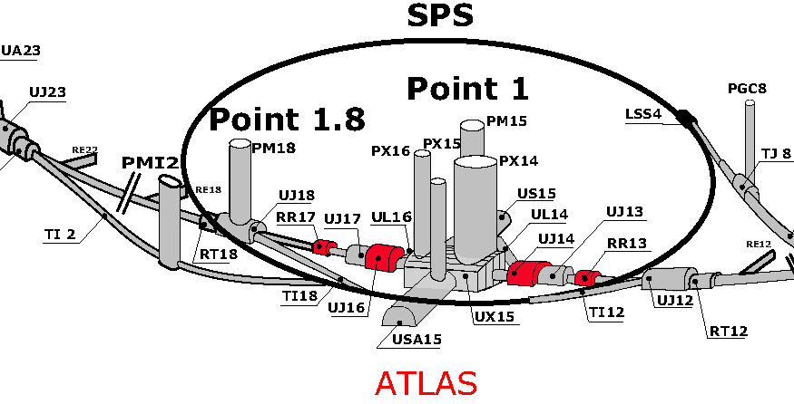
A PROPOSAL
Create a Forward Physics Facility to house a suite of experiments in the far forward region during HL-LHC running.
Promising locations are the existing caverns UJ12 or UJ18, ~500m from the ATLAS IP, possibly supplemented by a location closer to the IP.
Cost: Need to extend the cavern slightly and create the necessary infrastructure.
Benefit: Groundbreaking new capabilities for neutrinos, new physics searches, QCD, dark matter, dark sectors, and cosmic rays.

Slide 4

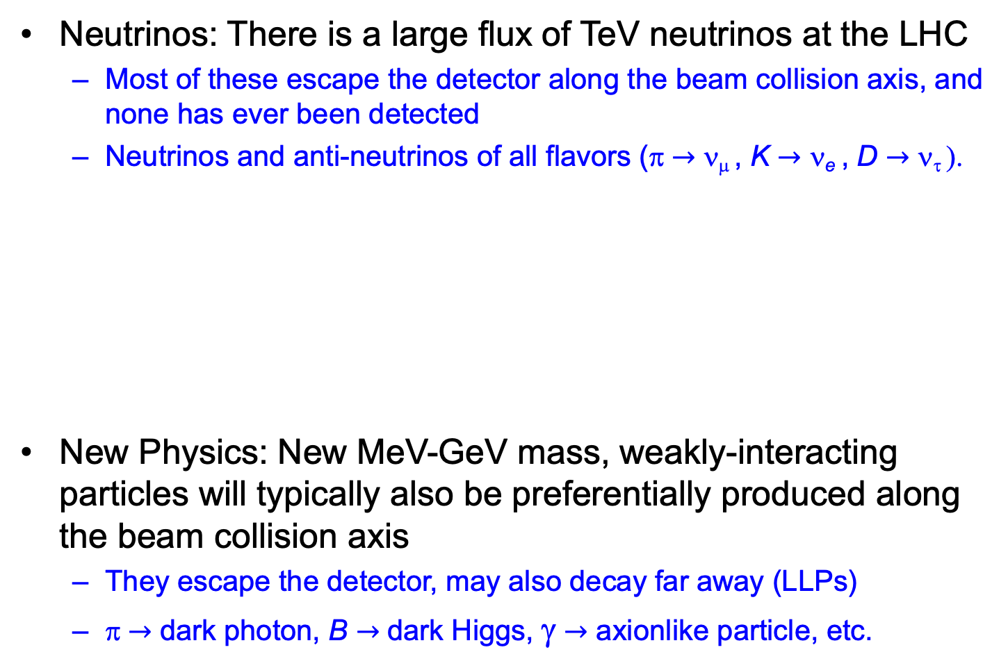
NEUTRINOS AND NEW PHYSICS
Neutrinos: There is a large flux of TeV neutrinos at the LHC
  Most of these escape the detector along the beam collision axis, and none has ever been detected
  Neutrinos and anti-neutrinos of all flavors (π $→$ ν_{μ} , K $→$ ν_{e} , D $→$ ν_{τ} ).
New Physics: New MeV-GeV mass, weakly-interacting particles will typically also be preferentially produced along the beam collision axis
  They escape the detector, may also decay far away (LLPs)
  π $→$ dark photon, B $→$ dark Higgs, γ $→$ axionlike particle, etc.

Slide 5
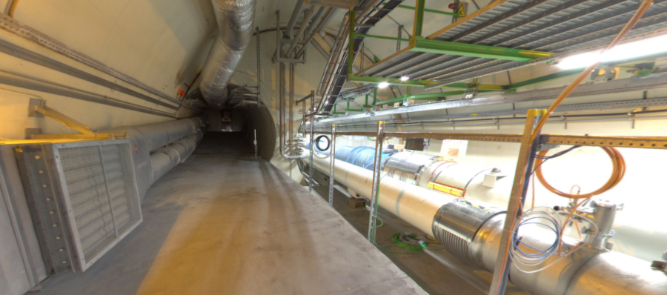
BEAM COLLISION AXIS
Beam collision axis passes
through 100 m of rock, emerges in tunnel TI12 near cavern UJ12
UJ12
TI12 near UJ12
The view in UJ12 looking west
TI12
Beam collision axis
LHC beamline

Slide 6
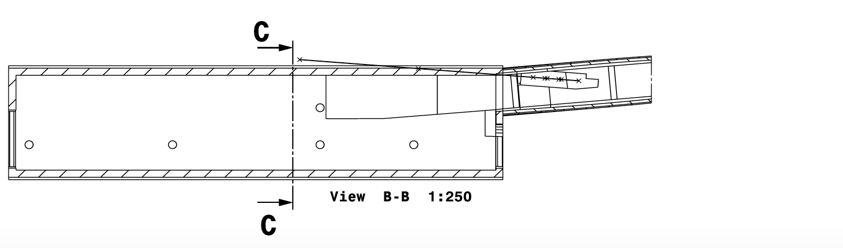
FORWARD PHYSICS FACILITY
A few experiments are under construction or proposed for this location. But they are severely limited by the tunnels and infrastructure that were created long before the physics potential of this space was appreciated.
FASER, FASERν
Beam Collision Axis
Tunnel TI12
Cavern UJ12
30 m
Dougherty (2020)

Slide 7
FORWARD PHYSICS FACILITY
A few experiments are under construction or proposed for this location. But they are severely limited by the tunnels and infrastructure that were created long before the physics potential of this space was appreciated.
A Forward Physics Facility, dedicated to supporting a suite of far forward experiments, would lead to a huge gain in sensitivity to new physics, neutrino studies, hadronic physics, etc.
Exploits pre-existing cavern, but requires widening by a few meters. Could also bore a hole toward the IP or prepare a near site along the beamline.
FORWARD
PHYSICS
FACILITY
Beam Collision Axis
30 m
Dougherty (2020)

Slide 8
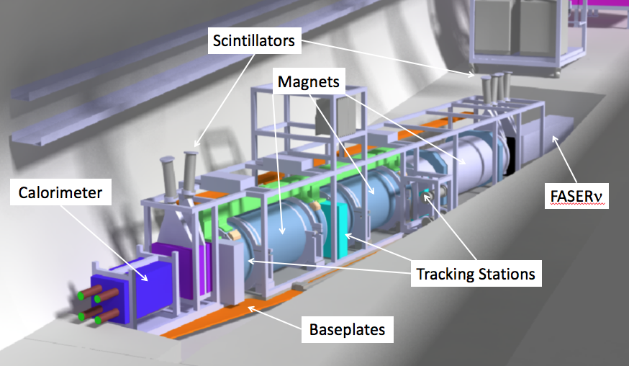
WHAT’S IT GOOD FOR?
FASER and FASERν are approved, funded, under construction for Run 3.
  65 collaborators from 19 institutions in 8 countries.
  50cm deep trench puts the detectors on axis. Coverage is η > 9, total length 6 m.
  FASER is a tracker and calorimeter, detects LLP decay in flight to TeV e⁺e⁻ pair. Background negligible (FLUKA simulations validated by prototype detector in 2018).
  FASERν is an emulsion detector, detects CC and NC neutrino interactions.
SND has also been proposed as a (slightly) off-axis ν experiment in TI18.
LLP
ν
e⁺
e⁻

Slide 9
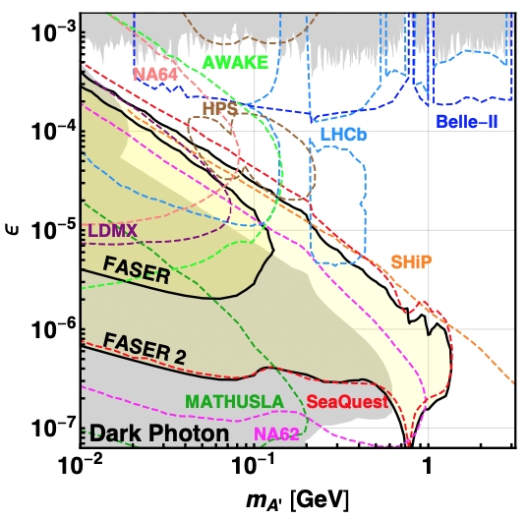
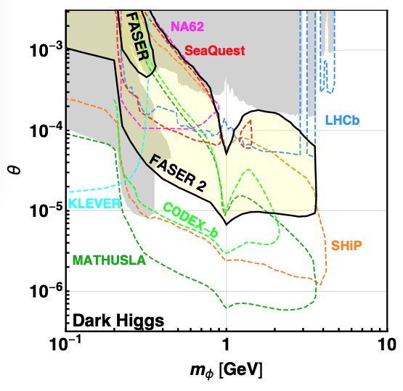
FPF NEW PHYSICS
FASER probes new parameter space in many models with just 1 fb⁻¹.
With a Forward Physics Facility, could upgrade from FASER (R = 10 cm, L = 1.5 m, Run 3) → FASER 2 (R = 1 m, L = 5 m, HL-LHC), extending sensitivity greatly, with discovery potential for all portal particles (dark photons, dark Higgs bosons, heavy neutral leptons), ALPs with all types of couplings (photon, fermion, gluon), and many other models.
FASER Collaboration, 1811.12522 (2018)

Slide 10
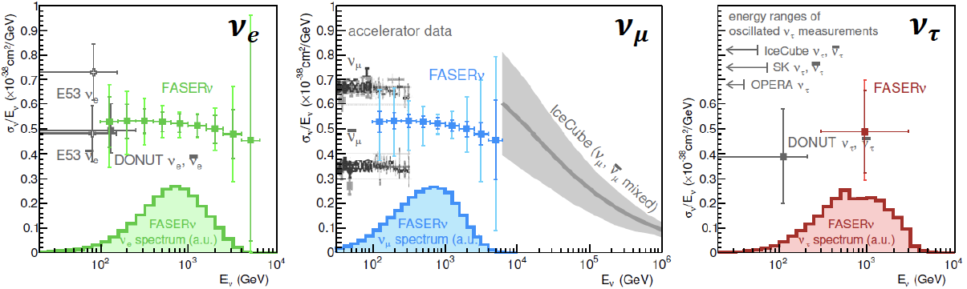
FPF NEUTRINO PHYSICS
FASERν will detect 1000s of νs with 1.3 ton tungsten/emulsion in Run 3.
  Will detect first collider neutrino (see de Rujula and Ruckl, 1984!)
  Detect ~1000 ν_{e} , ~10,000 ν_{μ} , and ~10 ν_{τ} .
  Probe neutrino properties at energies E_{ν} ~ TeV.
With FPF, could upgrade to ~10 tons in HL-LHC, precisely study neutrino production, propagation, and interactions for all 3 flavors, lepton universality, ν oscillations, ν_{τ} magnetic moment, NSI, neutrino tridents, …
FPF will open up a new world of TeV neutrino physics at colliders.
FASER Collaboration 1908.02310 (2019)

Slide 11
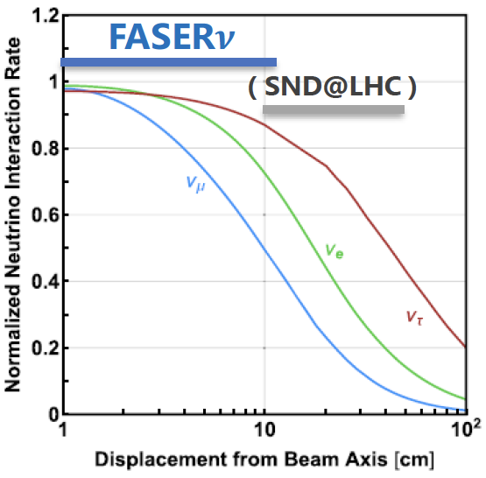
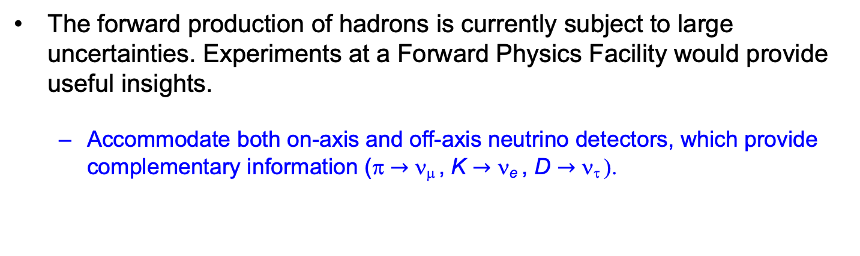
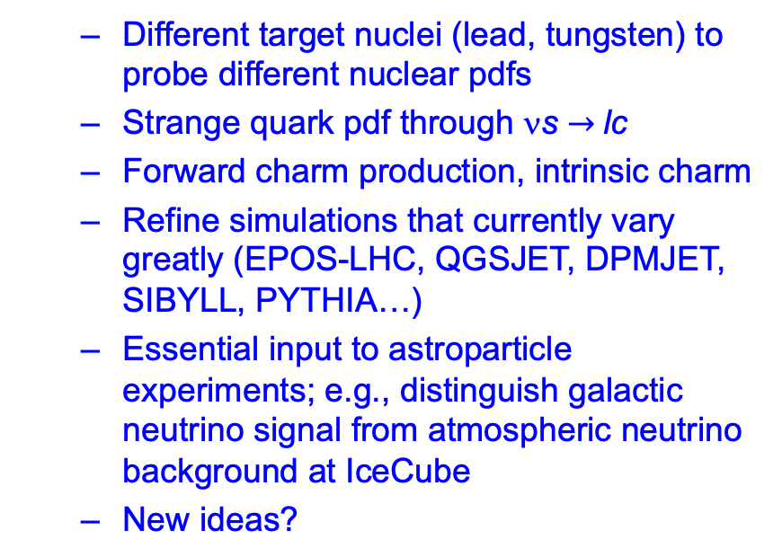
FPF QCD PHYSICS
The forward production of hadrons is currently subject to large uncertainties. Experiments at a Forward Physics Facility would provide useful insights.
  Accommodate both on-axis and off-axis neutrino detectors, which provide complementary information (π $→$ ν_{μ} , K $→$ ν_{e} , D $→$ ν_{τ} ).
  Different target nuclei (lead, tungsten) to probe different nuclear pdfs
  Strange quark pdf through νs $→$lc
  Forward charm production, intrinsic charm
  Refine simulations that currently vary greatly (EPOS-LHC, QGSJET, DPMJET, SIBYLL, PYTHIA…)
  Essential input to astroparticle experiments; e.g., distinguish galactic neutrino signal from atmospheric neutrino background at IceCube
  New ideas?

Slide 12
SNOWMASS PLANS
Bring together physicists with diverse interests to study the physics potential and feasibility of a Forward Physics Facility for HL-LHC.
What is the ideal mix of experiments? Could imagine 1 or 2 LLP experiments, on- and off-axis detectors targeting neutrinos and QCD, milli-charged search, …
Snowmass provides an ideal setting: this is an inherently cross-frontier topic, with relevance for EF, NF, RPF, CF, TF, and AF.
Short time window: if no FPF at the HL-LHC, many of these physics opportunities will disappear for decades.
New ideas welcome! There is much more to be done, and we invite all interested to join us in writing the Forward Physics Facility LOI.

