Slide 1

FORWARD PHYSICS FACILITY
AND SNOWMASS INPUT
Jonathan
FASER Collaboration General Meeting
15 May 2020

Slide 2
FASER 2
The physics motivations for upgrading FASER and FASERν are strong.
FASER will extend sensitivity ~ (luminosity * decay volume) by 200 to 3000, FASER 2 could extend it by 10⁶. This is for R=1m, L=5m at the far location; a near location also has good features.
FASERν: will discover 1st collider neutrino, eventually ~20,000 ν_{μ} at TeV energies. Discovery → study → precision measurements all in one experiment. FASERν 2 may be able to move tau neutrinos, the least understood SM particle, into the realm of precision studies.
Detector | Luminosity | Sensitivity (Lumi * Volume)
FASER | First fb⁻¹ of Run 3 | 1
FASER | End of Run 3 | 200
FASER | End of HL-LHC | 3000
FASER 2 | End of HL-LHC | 1,000,000

Slide 3
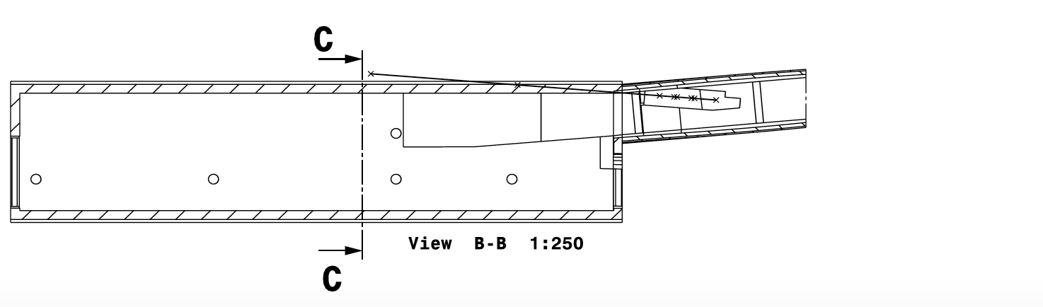
FORWARD PHYSICS FACILITY
At present, all future plans are severely limited by infrastructure that was created long before the physics potential of this space was appreciated.
Dougherty (2020)

Slide 4
FORWARD PHYSICS FACILITY
At present, all future plans are severely limited by infrastructure that was created long before the physics potential of this space was appreciated.
A new “Forward Physics Facility,” similar to CERN’s North Area or to an underground lab, prepared specifically for a suite of forward physics experiments, would lead to a huge gain in sensitivity to new physics, neutrino studies, hadronic physics, etc.
Doesn’t take much: extend UJ12 or UJ18 by a few meters; bore a long, narrow hole toward the IP; prepare a near site along the beamline.
Dougherty (2020)

Slide 5
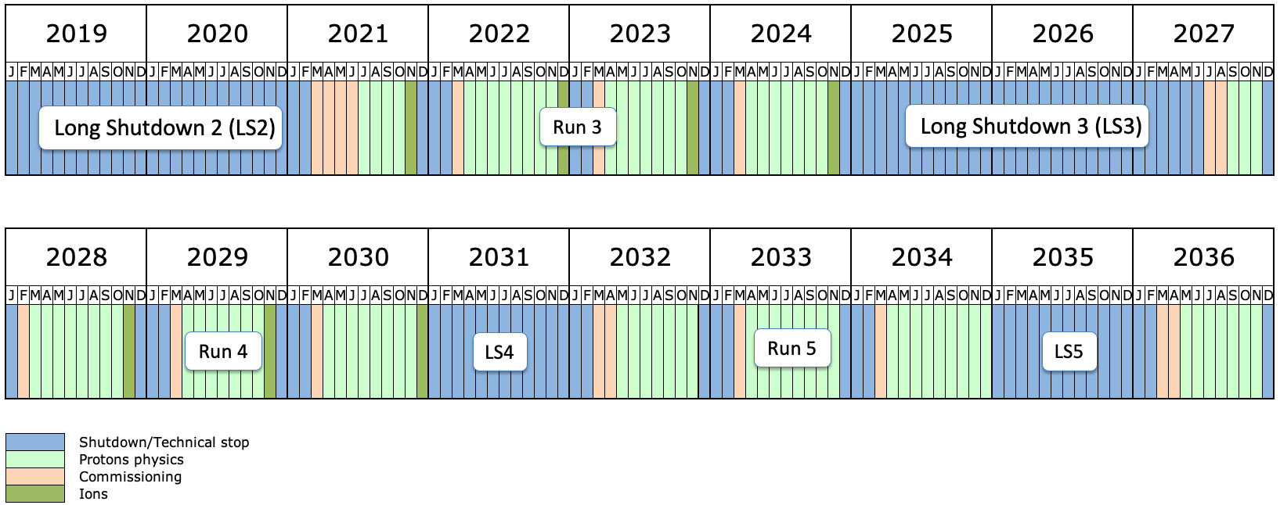
QUESTIONS TO ANSWER
What combination of experiments would be best?
What is the cost? Could it be done in LS3 or LS4?
What is the physics potential of Forward Physics Facilities at future colliders?

Slide 6
SNOWMASS 2021
In the U.S., prioritization for the next 10 to 20 years has started.
Snowmass community input (https://snowmass21.org)
  1 April 2020 – 31 August 2020: 2-page Letters of Interest due. The primary purpose is to help conveners prepare for the Snowmass Planning Meeting.
  4-6 November 2020: Snowmass Planning Meeting (kickoff meeting at Fermilab).
  1 April 2020 – 31 July 2021: Contributed Papers due. These are posted on arXiv and become part of the Snowmass proceedings.
  11-21 July 2021: Snowmass Community Study (final meeting at University of Washington, Seattle, LOC chairs: Shih-Chieh Hsu and Gordon Watts).
P5 DOE/NSF prioritization panel expected 2021-22.

Slide 7
NOTES ON SNOWMASS 2021
Snowmass/P5 is a rare opportunity in the U.S. for physicists to direct funding.
Snowmass doesn’t decide anything. Snowmass sets the menu, P5 chooses what to order.
But Snowmass can be a good opportunity to think about fresh ideas, do studies, and build support.
Proposed input to Snowmass
  LOIs for FASER 2 (FASER Collaboration), FASERν 2 (FASER Collaboration), Forward Physics Facility (all interested); purpose is to propose interesting possibilities (far and near locations, etc.) for community study.
  All FASER collaborators will be invited to be authors, but should feel free to opt out.
  Contributed papers to be decided later.

Slide 8
SNOWMASS WORKING GROUPS
DPF Chair Line (Kim, Han, Butler)
Energy Frontier (Narain, Reina, Tricoli)
Neutrino Frontier (Huber, Scholberg, Worcester)
Rare Processes (Artuso, Bernstein, Petrov)
Cosmic Frontier (Chou, Soares-Santos, Tait)
EF01: EW Physics: Higgs Boson properties and couplings
EF02: EW Physics: Higgs Boson as a portal to new physics
EF03: EW Physics: Heavy flavor and top quark physics
EF04: EW Precision Physics and constraining new physics
EF05: QCD and strong interactions: Precision QCD
EF06: QCD and strong interactions: Hadronic structure and forward QCD
EF07: QCD and strong interactions: Heavy Ions
EF08: BSM: Model specific explorations
EF09 – BSM: More general explorations
EF10: BSM: Dark Matter at colliders
NF01: Neutrino Oscillations
NF02: Sterile Neutrinos
NF03: BSM
NF04: Neutrinos from natural sources
NF05: Neutrino properties
NF06: Neutrino Interaction Cross Sections
NF07: Nuclear safeguards and other applications
NF08: Theory of Neutrino Physics
NF09: Artificial Neutrino Sources
NF10: Neutrino Detectors
RP1: Weak Decays of b and c quarks
RP2: Weak Decays of strange and light Quarks
RP3: Fundamental Physics in Small Experiments
RP4: Baryon-Lepton Number Violation
RP5: Charged Lepton Flavor Violation
RP6: Dark Sector at Low Energies
CF1. Dark Matter: Particle-like
CF2. Dark Matter: Wave-like
CF3. Dark Matter: Cosmic Probes
CF4. Dark Energy and Cosmic Acceleration: The Modern Universe
CF5. Dark Energy and Cosmic Acceleration: Cosmic Dawn and Before
CF6. Dark Energy and Cosmic Acceleration: Complementarity of Probes and New Facilities
CF7. Cosmic Probes of Fundamental Physics
From conversations with the top-level conveners, it seems the highlighted subgroups are the ones most relevant for FASER (but these are early days and there are also other frontiers).
FASER Subgroups
in Blue
FASERν Subgroups
in Green

