Slide 1
DARK PHOTONS FROM THE SUN
A NEW DARK MATTER SIGNAL FOR AMS
[work with Jordan Smolinsky and Philip Tanedo, 1602.01465]
Jonathan Feng, UC Irvine
3 April 2019

Slide 2
THE CONVENTIONAL DARK MATTER SIGNAL
There is now overwhelming evidence for dark matter.
A promising search method is indirect detection, particularly dark matter annihilating to positrons and detected by AMS:
The signal is nearly isotropic, coming from the whole halo.
Is there a smoking gun signal that makes better use of AMS’s remarkable angular resolution?
_{AMS Days at CERN, 2015}
DM
e⁺
DM
e⁻

Slide 3
DARK SECTOR
Dark matter X may be part of a dark sector, with its own matter and forces.
Consider a simple example, where the dark sector contains dark matter, but also a U(1) gauge interaction, “dark electromagnetism.”
SM
Dark Sector
X, U(1)

Slide 4

SM-DARK SECTOR INTERACTIONS
If the dark matter doesn’t interact with us, then it only has gravitational signals.
However, generically, there will be a mixing between our U(1) gauge boson A and the dark U(1) gauge boson A_{D}.
This mixing will be generated by any matter field that has both standard model EM charge and dark EM charge.
It is typically small, since it is induced by a loop.
SM
U(1)
Dark Sector
U(1)
A
M
A_{D}
Okun (1982), Galison, Manohar (1984), Holdom (1986)

Slide 5
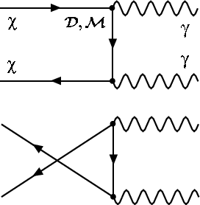
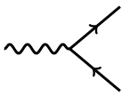
DARK PHOTONS
We can re-define fields to remove the mixing. The result is two physical particles: our SM photon γ, and a new particle, the dark photon A’.
The dark photon is like the SM photon, but
  It can have a mass m_{A’}
  Its coupling to dark sector particles is large
  Its coupling to SM particles is suppressed by a small coupling ε
e⁺
X
A’
ε
A’
X
A’
e⁻

Slide 6
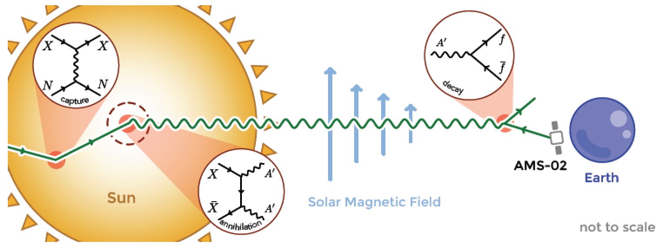
A NEW DARK MATTER SIGNAL
In this dark matter model, dark matter collects in the Sun and then annihilates to dark photons (“dark sunshine”).
These can then travel out of the Sun and decay to e⁺e⁻.
A new DM signal for AMS: high energy positrons from the Sun.

Slide 7
SIGNAL CHARACTERISTICS
We will consider parameters
  Dark matter m_{X} ~ 100 GeV – 10 TeV
  Dark photon m_{A’} ~ MeV – GeV
  Couplings ε ~ 10⁻¹² – 10⁻⁶
The typical positron energy is ~100 GeV – 10 TeV
The size of the DM population at the core of the Sun is ~1°.
AMS’s angular resolution:
from ECAL (and even better with tracker); negligible.
The signal is essentially a point source of TeV positrons from the center of the Sun. No background looks like this!

Slide 8
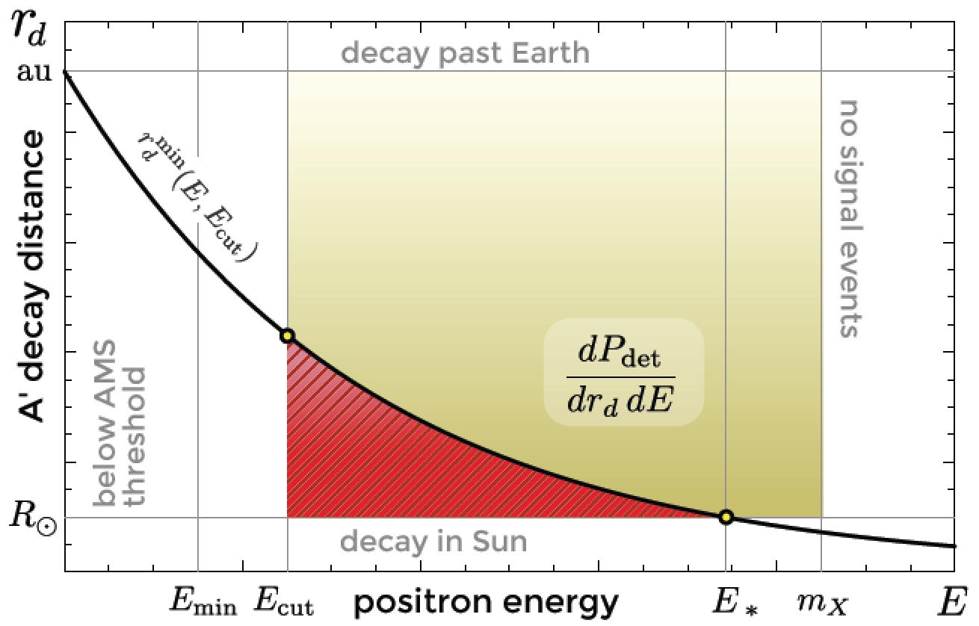
MAGNETIC FIELDS
In more detail, TeV positrons are bent in the magnetic fields of the Sun and Earth.
The Sun’s magnetic field is not well understood. Conservatively, we can consider only dark photons that travel far enough before decaying.
The Earth’s magnetic field is well understood. Assume we can deconvolute for this effect. (But note, without deconvoluting, the signal will not appear point-like.)

Slide 9
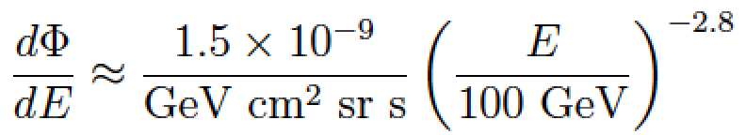

ISOTROPIC BACKGROUND AND EXPOSURE
The background isotropic positron flux from AMS is
  We consider an energy and angle window that fixes N_{background} = 1 and maximizes signal.
Last, of course, the Sun is not always in AMS’s field of view. In 924 days, the exposure for E > 50 GeV was
  The effective area is ~20 cm², would be 80 times larger if AMS pointed at the Sun continuously.
  Machate, Gast, Schael for the AMS Collaboration (2016)

Slide 10
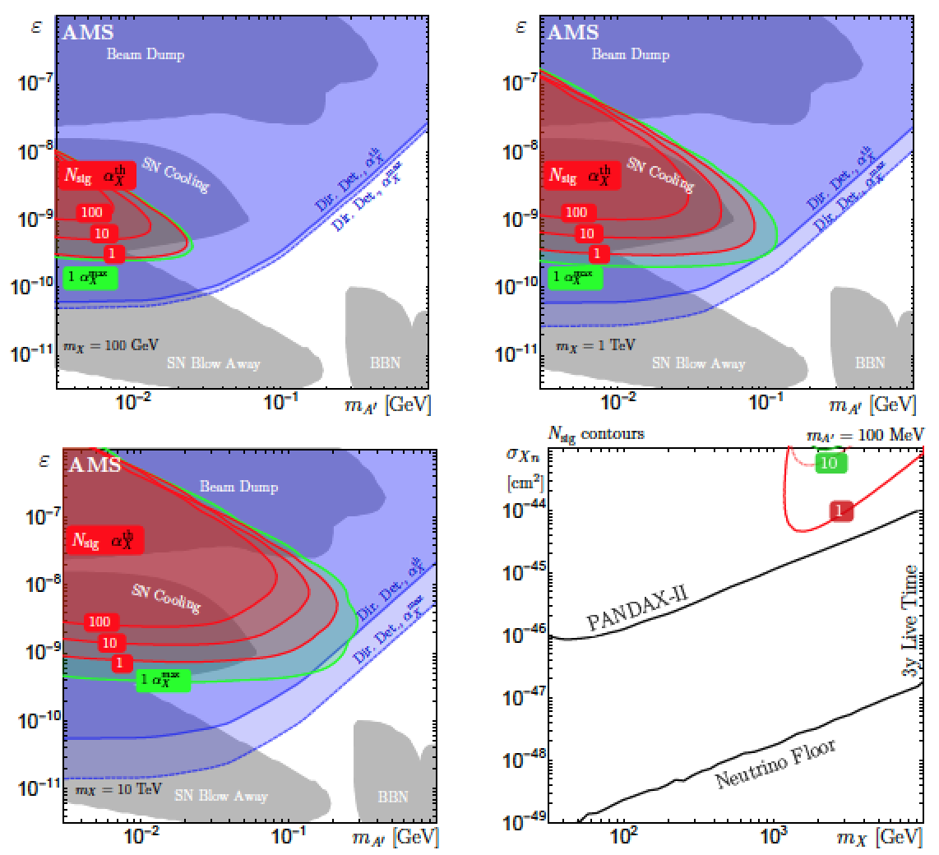
RESULTS
For 3 years of AMS data, AMS probes new regions of parameter space beyond existing constraints.
Direct detection constraints are competitive, but model-dependent.
_{Smolinsky, Tanedo, 1701.03168}

Slide 11
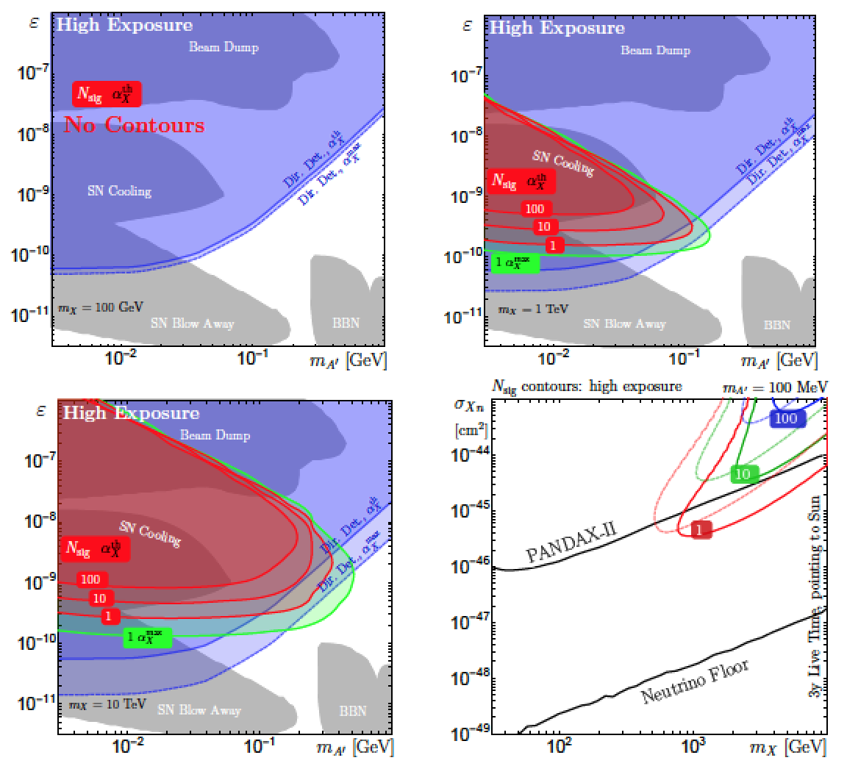
RESULTS
Same as above, but for high exposure (80 times larger).
All results can be greatly improved with knowledge of Sun’s magnetic field.

Slide 12
CONCLUSIONS
If dark matter is generalized to a dark sector with its own forces, many new dark matter signals are possible.
For AMS, an interesting one is “dark sunshine,” dark photons from the Sun, which decay to positrons and electrons.
Exploits AMS’s fantastic angular resolution and event rates. Potentially a smoking gun signal with no astrophysical background.

