Slide 1

FORWARD SEARCH EXPERIMENT AT THE LHC
Annual Theory Meeting
National Center for Theoretical Sciences, Taiwan
Jonathan Feng, UC Irvine
18 December 2018

Slide 2

THE LAMPPOST LANDSCAPE
Traditional Targets
of Big Science
1
Already
Discovered
Strongly Interacting
Heavy Particles
New Targets of Small Experiments
10⁻³
Interaction Strength
Weakly Interacting
Light Particles
Impossible to
Discover
10⁻⁶
MeV
GeV
TeV
Mass

Slide 3

THE IDEA
New physics searches at the LHC focus on high p_{T}. This is appropriate for heavy, strongly interacting particles
  σ ~ fb to pb → N_{events} ~ 10³ – 10⁶, produced ~isotropically
However, if new particles are light and weakly interacting, this may be completely misguided
  Weakly-interacting → need large SM event rate to see them
  Light → we can produce them in π, K, D, B decays
Conclusion: we should go where the pions are: at low p_{T} along the beamline
  σ_{inel} ~ 100 mb → N_{events} ~ 10¹⁷, and 10% of the pions are produced within 2 mrad of the beamline

Slide 4
THE IDEA
Of course, we can’t put a reasonably-sized detector on the beamline near the IP – it would block the proton beams
However, weakly-interacting particles are also typically long-lived, so we can place the detector O(100) m away, after the beam curves away
(100 m) (mrad) = 10 cm → particles are still highly collimated
These general considerations motivate a small, fast, inexpensive experiment placed in the very forward region of ATLAS/CMS, a few 100m downstream: FASER, the Forward Search Experiment at the LHC.

Slide 5
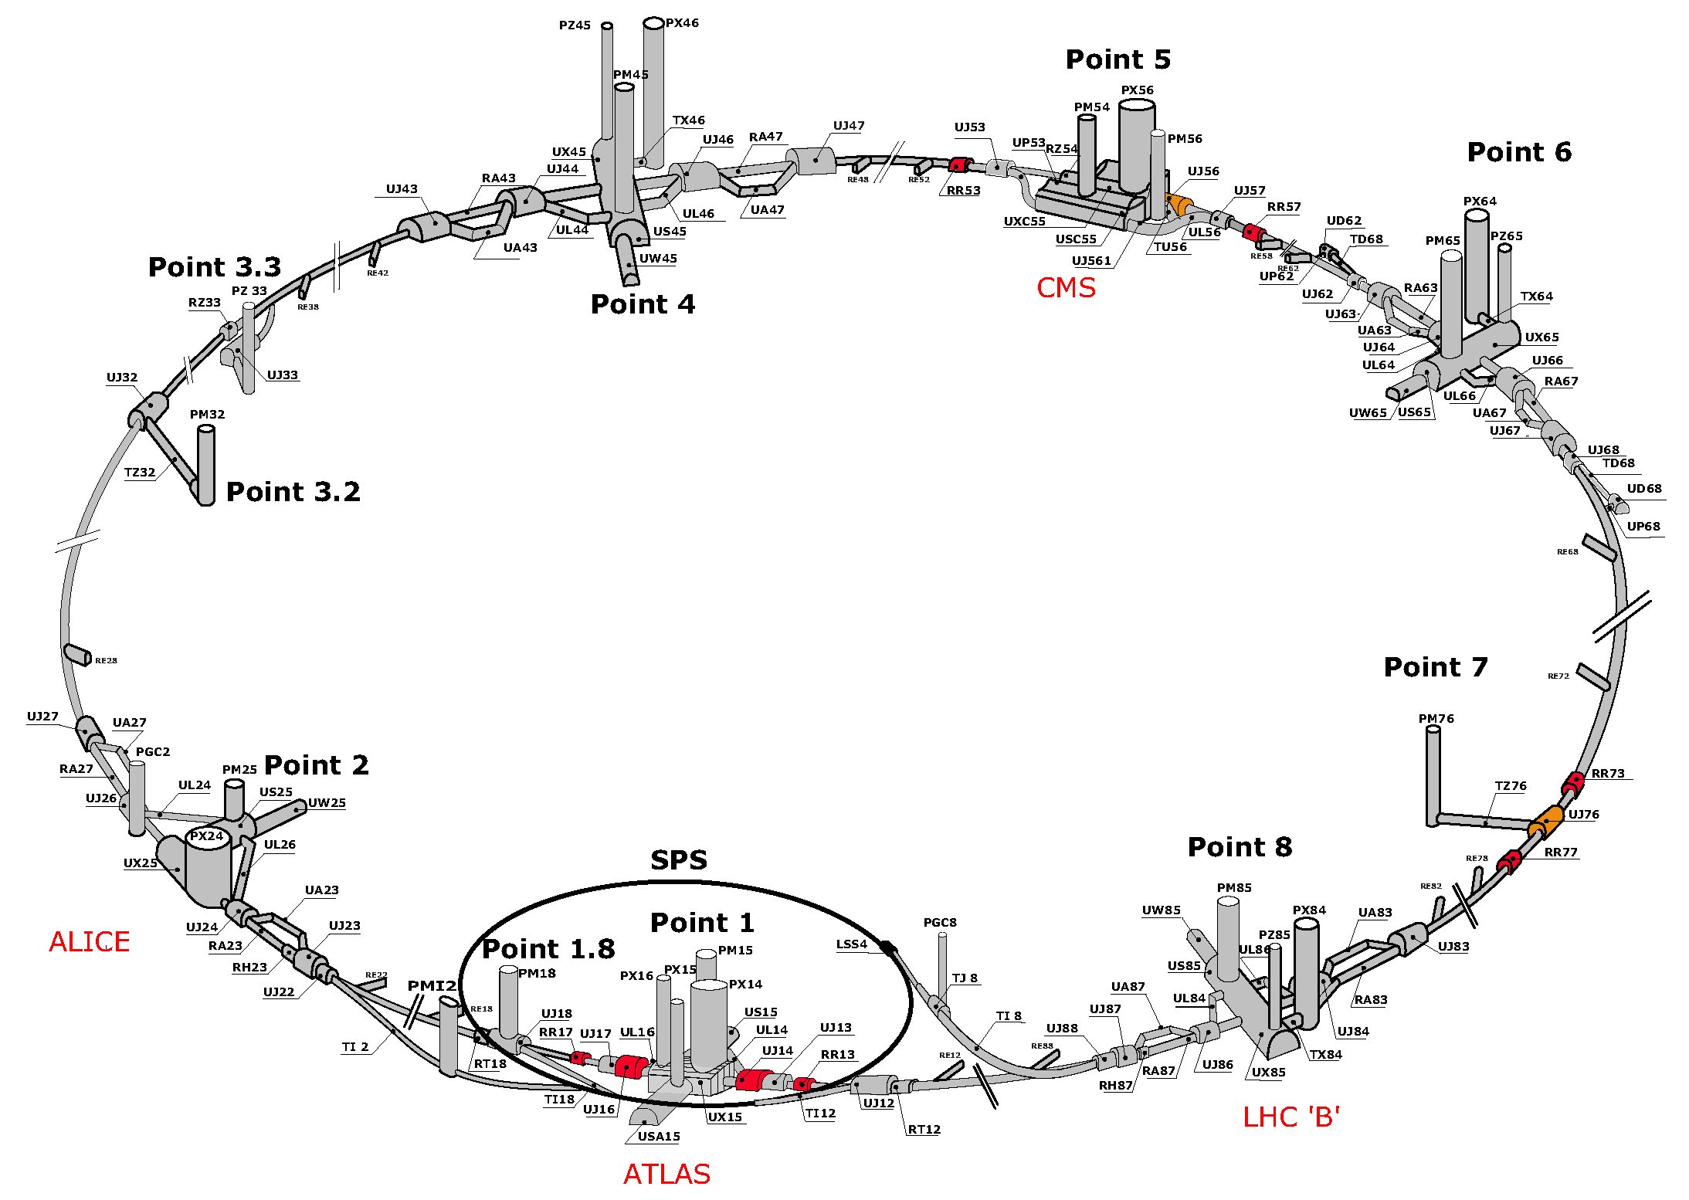
FASER LOCATION

Slide 6
FASER LOCATION
FASER

Slide 7
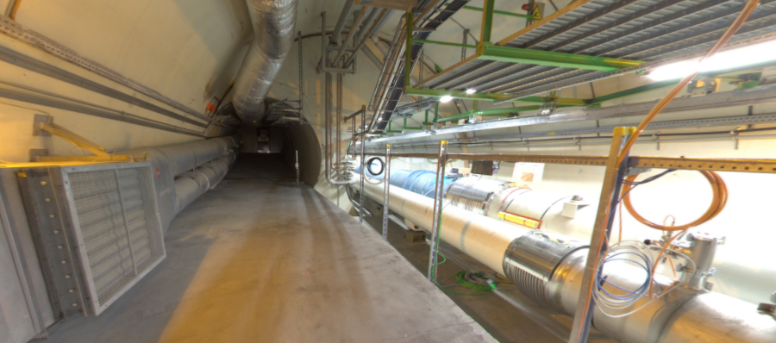
FASER LOCATION
The view looking west
New Physics
(Dark Sector)
LHC Beamline
(Visible Sector)

Slide 8
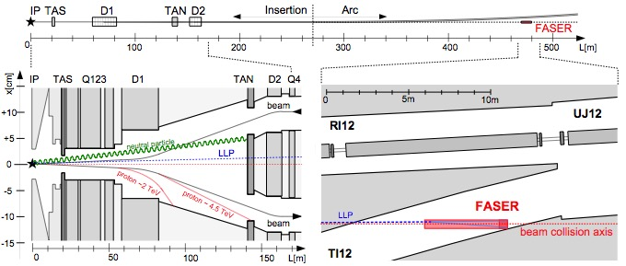
LONG LIVED PARTICLES IN FASER
Typical FASER event: LLP produced at IP, travels 380 m, leaves LHC tunnel, passes through 100 m of concrete and rock, enters TI12, decays to two charged particles in FASER.

Slide 9
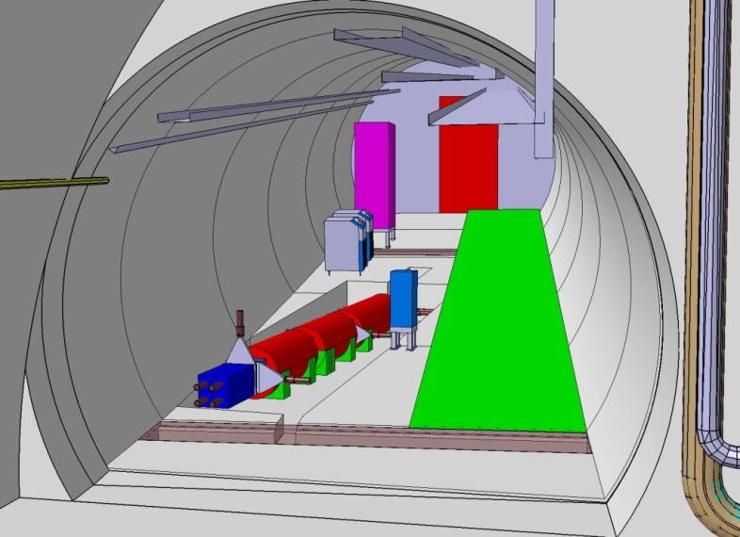
FASER IN TUNNEL TI12
The beam collision axis has been located to mm accuracy by the CERN survey department. To place FASER on this axis, a little digging is required to lower the floor by 46 cm.
The beam crossing angle also matters: if 285 (590) μrad, the “on axis” location at FASER shifts by 6 (12) cm.
The view looking west

Slide 10
PHYSICS EXAMPLE: DARK PHOTONS
Pions at the IP
Simulations greatly refined by LHC data
Production is peaked at p_{T} ~ Λ_{QCD} ~ 250 MeV
Enormous event rates: N_{π}~10¹⁵ per bin
A’s at the IP
Production is peaked at p_{T} ~ Λ_{QCD} ~ 250 MeV
Rates highly suppressed by ε² ~ 10⁻¹⁰
But still N_{A’} ~ 10⁵ per bin
A’s decay in [480m, 483m]
Only highly boosted ~TeV A’s decay in FASER
Rates again suppressed by decay requirement
But still N_{A’} ~ 100 signal events, and almost all are within 20 cm of “on axis”
300 fb⁻¹

Slide 11
DARK PHOTON SENSITIVITY REACH
Feng, Galon, Kling, Trojanowski (2017)
FASER 1: R=10cm, L=1.5 m, Run 3; FASER 2: R=1m, L=5m, HL-LHC
For low ε, FASER is not competitive with SHiP.
For high ε, FASER may have world-leading sensitivity. Note: contours are very closely spaced: ~50% signal efficiency, N=3 vs.10, e⁺e⁻ vs. e⁺e⁻ + μ⁺μ⁻, L=3m vs. 5m, … each lead to nearly imperceptible shifts in reach.

Slide 12
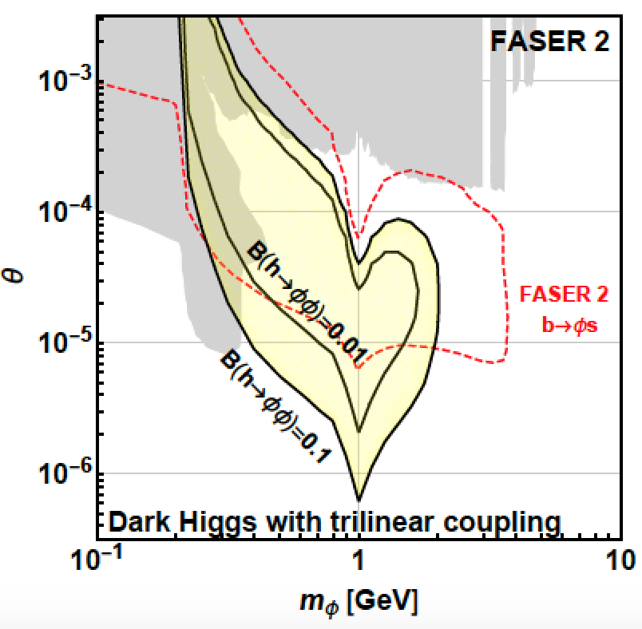
PHYSISCS EXAMPLE: DARK HIGGS BOSONS
SINGLE PRODUCTION
Dark Higgs produced in B decays. N_{B}/N_{π}~10⁻² at FASER (N_{B}/N_{π}~10⁻⁷ at beam dumps)
Probes h-φ mixing, reach is complementary to other experiments
DOUBLE PRODUCTION
Probes hφφ trilinear coupling
Complementary to probes of exotic Higgs decays h→φφ
FASER probes SM Higgs properties!
φ
Feng, Galon, Kling, Trojanowski (2017)

Slide 13
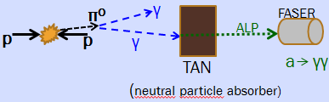
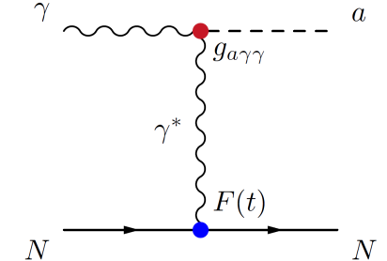
PHYSICS EXAMPLE: ALPS COUPLED TO PHOTONS
PRODUCTION THROUGH PRIMAKOFF PROCESS
ALP not produced at IP: ~TeV photon from IP collides with TA(X)N, creates ALP through Primakoff, and a → γγ in FASER
“Photon beam dump” or “light shining through walls”
ALPS WITH PHOTON
Feng, Galon, Kling, Trojanowski (2018)
Requires calorimeter

Slide 14
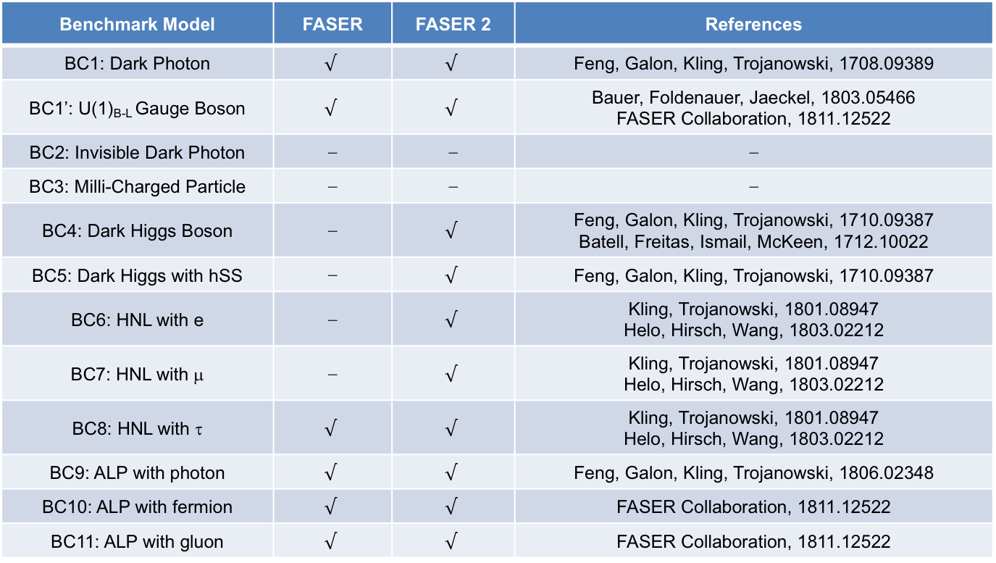
PHYSICS SUMMARY
FASER has a full physics program: can discover all candidates with renormalizable couplings (dark photon, dark Higgs, HNL); ALPs with all types of couplings (γ, f, g); and many other examples.
Benchmark Model | FASER | FASER 2 | References
BC1: Dark Photon | $$√$$ | $$√$$ | Feng, Galon, Kling, Trojanowski, 1708.09389
BC1’: U(1)_{B-L} Gauge Boson | $$√$$ | $$√$$ | Bauer, Foldenauer, Jaeckel, 1803.05466 FASER Collaboration, 1811.12522
BC2: Invisible Dark Photon | ⎼ | ⎼ | ⎼
BC3: Milli-Charged Particle | ⎼ | ⎼ | ⎼
BC4: Dark Higgs Boson | ⎼ | $$√$$ | Feng, Galon, Kling, Trojanowski, 1710.09387 Batell, Freitas, Ismail, McKeen, 1712.10022
BC5: Dark Higgs with hSS | ⎼ | $$√$$ | Feng, Galon, Kling, Trojanowski, 1710.09387
BC6: HNL with e | ⎼ | $$√$$ | Kling, Trojanowski, 1801.08947 Helo, Hirsch, Wang, 1803.02212
BC7: HNL with μ | ⎼ | $$√$$ | Kling, Trojanowski, 1801.08947 Helo, Hirsch, Wang, 1803.02212
BC8: HNL with τ | $$√$$ | $$√$$ | Kling, Trojanowski, 1801.08947 Helo, Hirsch, Wang, 1803.02212
BC9: ALP with photon | $$√$$ | $$√$$ | Feng, Galon, Kling, Trojanowski, 1806.02348
BC10: ALP with fermion | $$√$$ | $$√$$ | FASER Collaboration, 1811.12522
BC11: ALP with gluon | $$√$$ | $$√$$ | FASER Collaboration, 1811.12522

Slide 15
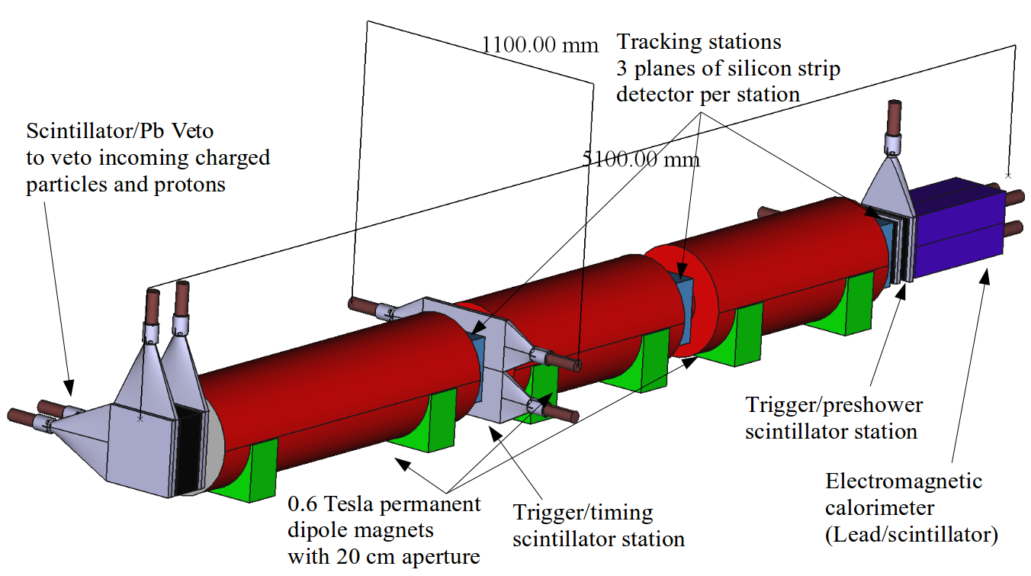
THE FASER DETECTOR
The detector consists of
  Scintillator veto
  1.5 m-long decay volume
  2 m-long spectrometer
  3 tracking stations
  EM calorimeter
Empty Decay Volume
particles from IP1

Slide 16
THE FASER DETECTOR
Signal Signature
  No signal in the veto scintillator
  2 high-energy, oppositely charged tracks consistent with originating from a common vertex in the decay volume and with a combined momentum pointing back to the IP
  For e⁺e⁻ signature, also get a large EM deposit in the calorimeter
  Magnets are needed to separate the 2 charged tracks sufficiently to resolve them in the tracker
A’
e⁺
e⁻

Slide 17
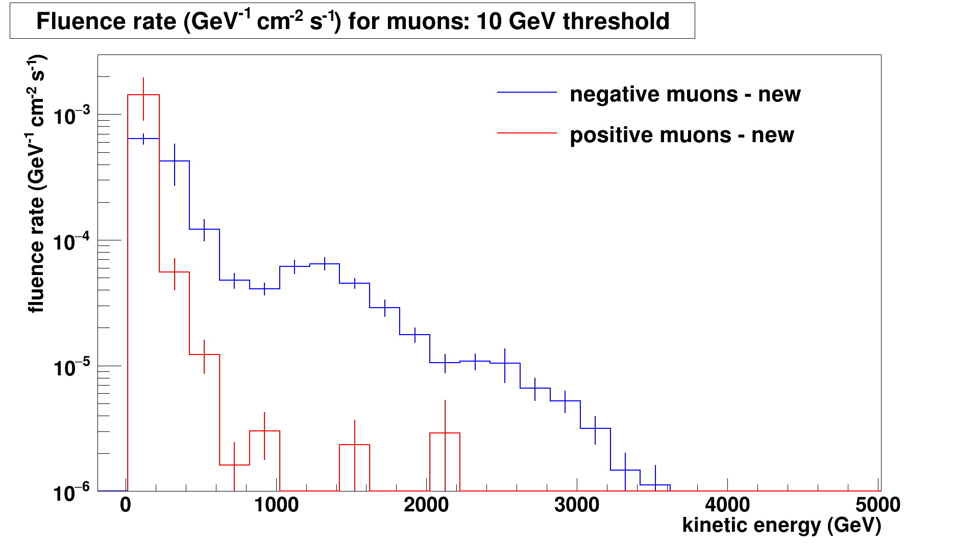
BACKGROUNDS
FASER’s location is very quiet – the only particles that get through from the IP are muons and neutrinos.
A high-energy muon that brems off a photon or an EM or hadronic jet is a leading background if the incoming muon is not vetoed.
The muon event rate has been estimated by EPOS+theory and a FLUKA study, yielding consistent results. Assuming each scintillator layer gives an uncorrelated 10⁻⁴ veto suppression for muons entering the detector, the resulting backgrounds appear to be negligible.
FLUKA study: Sabate-Gilarte, Cerutti, Tsinganis (2018)

Slide 18
MORE BACKGROUNDS
The FLUKA study also finds that proton showers in dispersion suppressor and beam-gas background (from “beam 2”) are also negligible.
The dispersion of the machine means activity close to FASER from diffractive proton losses is very small. It would be orders of magnitude higher 50m along LHC in either direction. The radiation level in TI18 is low (<10⁻² Gy/year), which is encouraging for detector electronics.
Sabate-Gilarte, Cerutti, Tsinganis (2018)

Slide 19
IN SITU MEASUREMENTS
To validate the FLUKA background study, we installed detectors in Technical Stops 1 and 2 to provide the first in situ measurements at the FASER site.
An emulsion detector was prepared and placed at the FASER location.
A BatMon (battery-operated radiation monitor) was also installed.

Slide 20
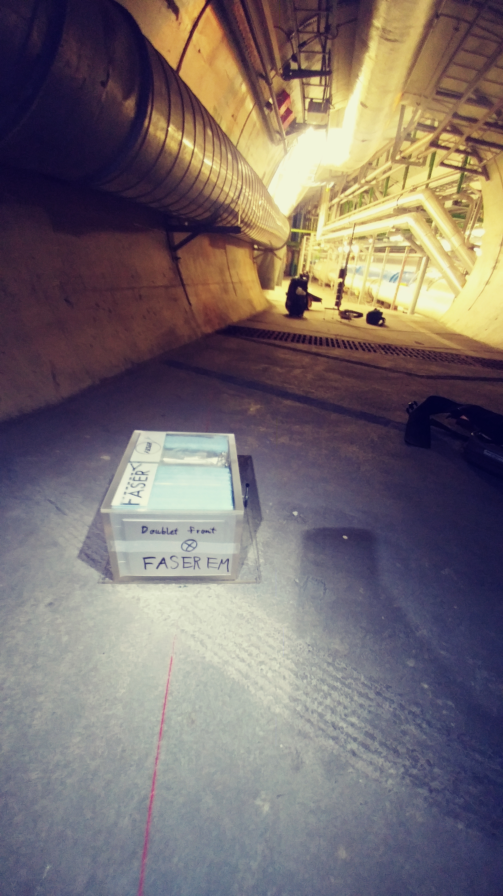
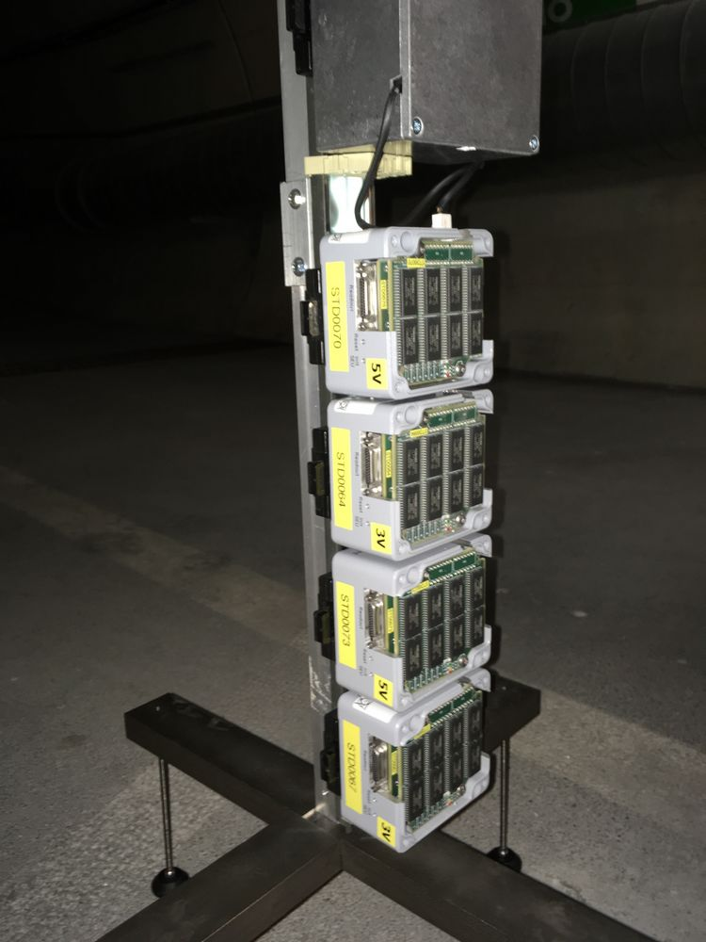
IN SITU MEASUREMENTS
The emulsion detector results are within measurement accuracy (factor of 2) of FLUKA predictions.
Preliminary BatMon results received August 7, also look promisingly low.

Slide 21
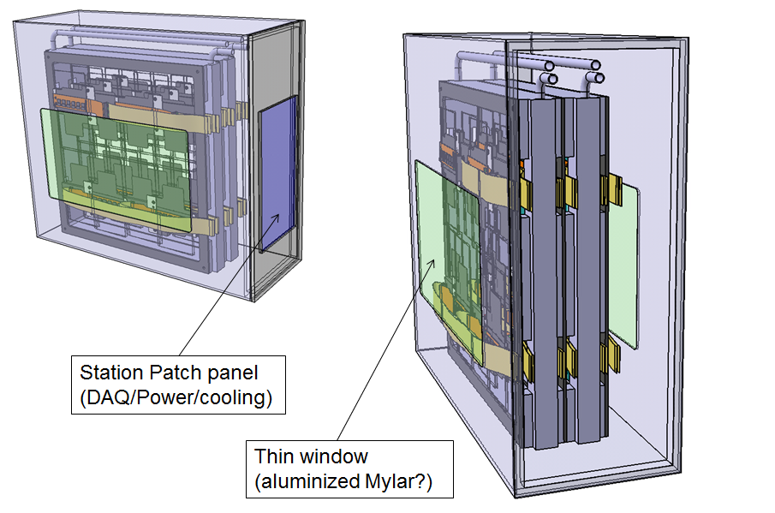
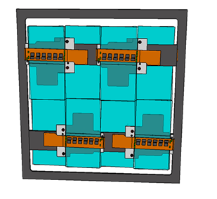
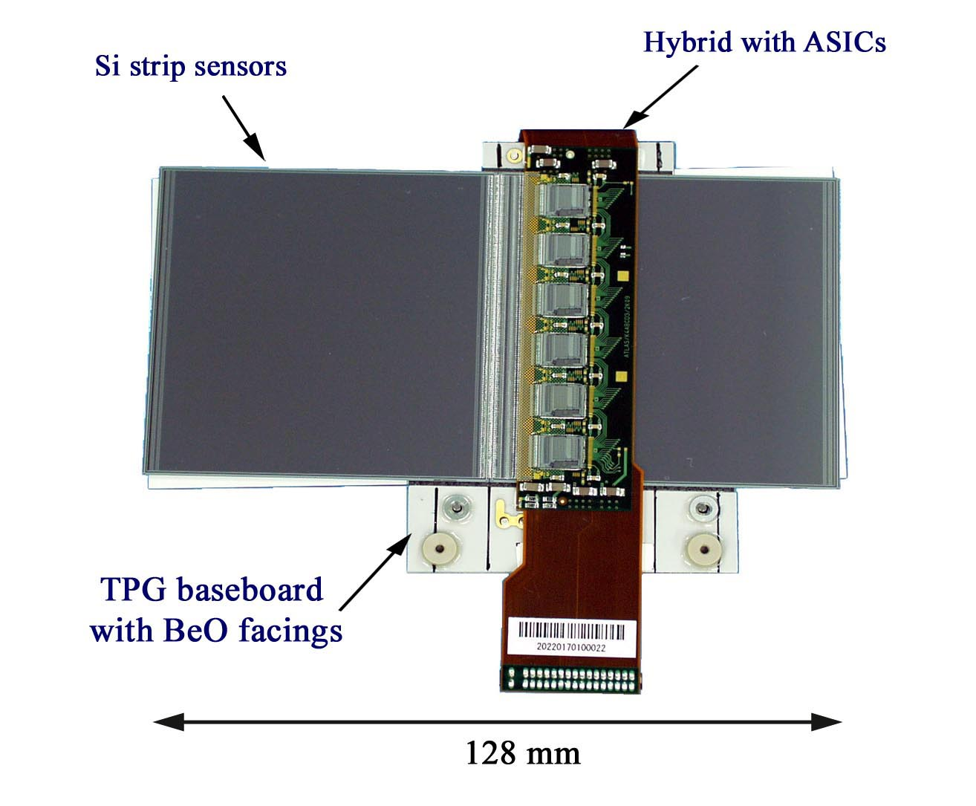
FASER TRACKER
The FASER tracker is composed of spare SCT modules from ATLAS. About 350 spares were prepared. They were not needed, and the ATLAS SCT collaboration has now kindly allowed us to use 80 of them.
8 SCT modules make up a 24cm x 24cm tracking layer, 3 layers make up a tracking station, and FASER has 3 tracking stations.
SCT module
Tracking layer
Tracking station

Slide 22
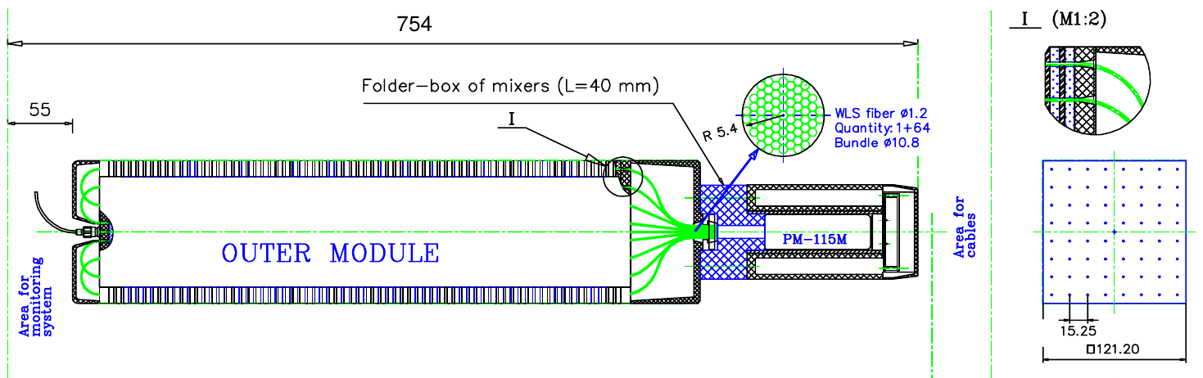
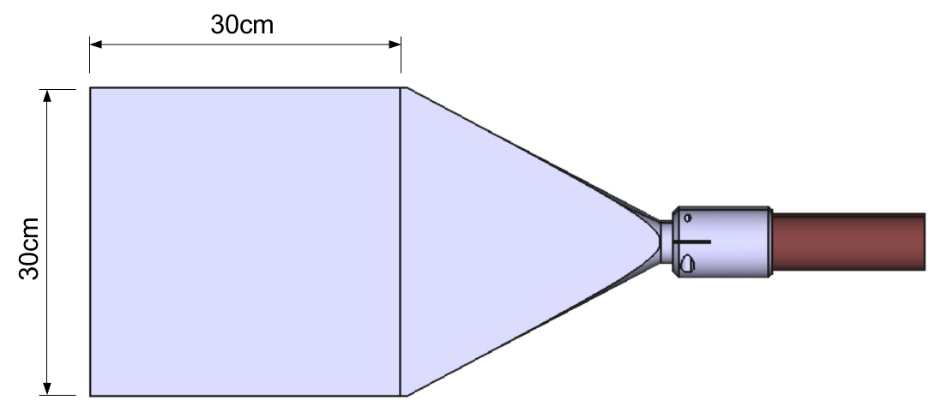
FASER CALORIMETER / SCINTILLATORS
PMT
light guide
The FASER ECAL will consist of spare LHCb outer ECAL modules, which the LHCb Collaboration has kindly allowed us to use.
  Dimensions: 12cm x 12cm – 75cm long (including PMT)
  66 layers of lead/scintillator, light out by wavelength shifting fibres, and readout by PMT (no longitudinal shower information)
  25 radiation lengths long
  Provides ~1% energy resolution for 1 TeV electrons
Scintillators used for vetoing charged particles entering the decay volume and for triggering, to be produced by the CERN scintillator lab

Slide 23
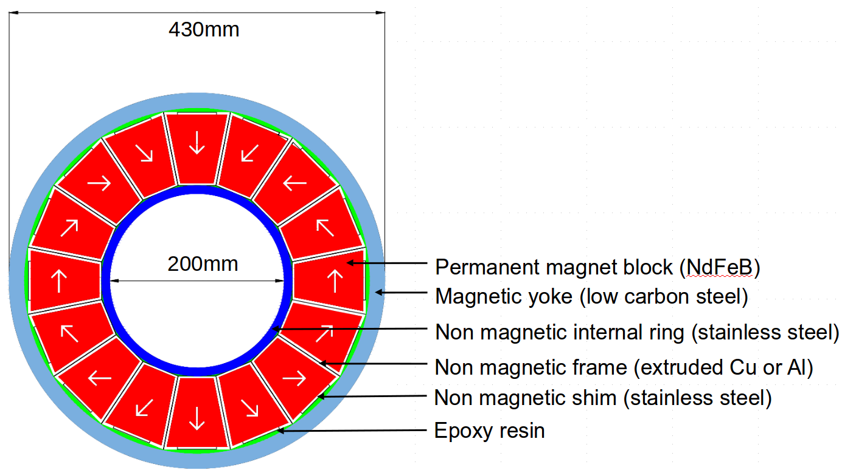
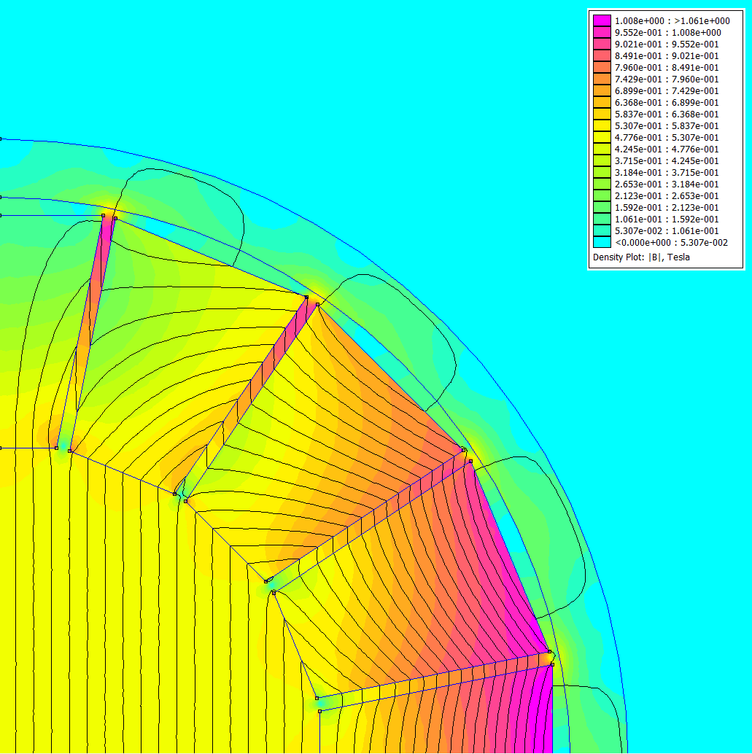
FASER MAGNETS
The FASER magnets are 0.6T permanent dipole magnets based on the Halbach array design
  Thin enough to allow the LOS to pass through the magnet center with minimum digging to the floor in TI12
  Minimizes needed services (power, cooling etc..)
To be constructed by the CERN magnet group

Slide 24
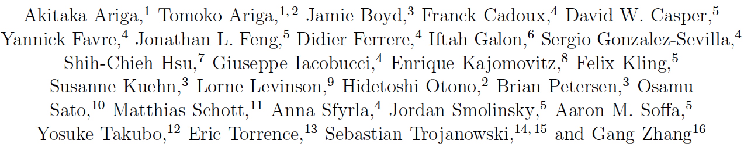


CURRENT STATUS
The FASER Collaboration: 27 collaborators, 15 institutions, 8 countries

Slide 25
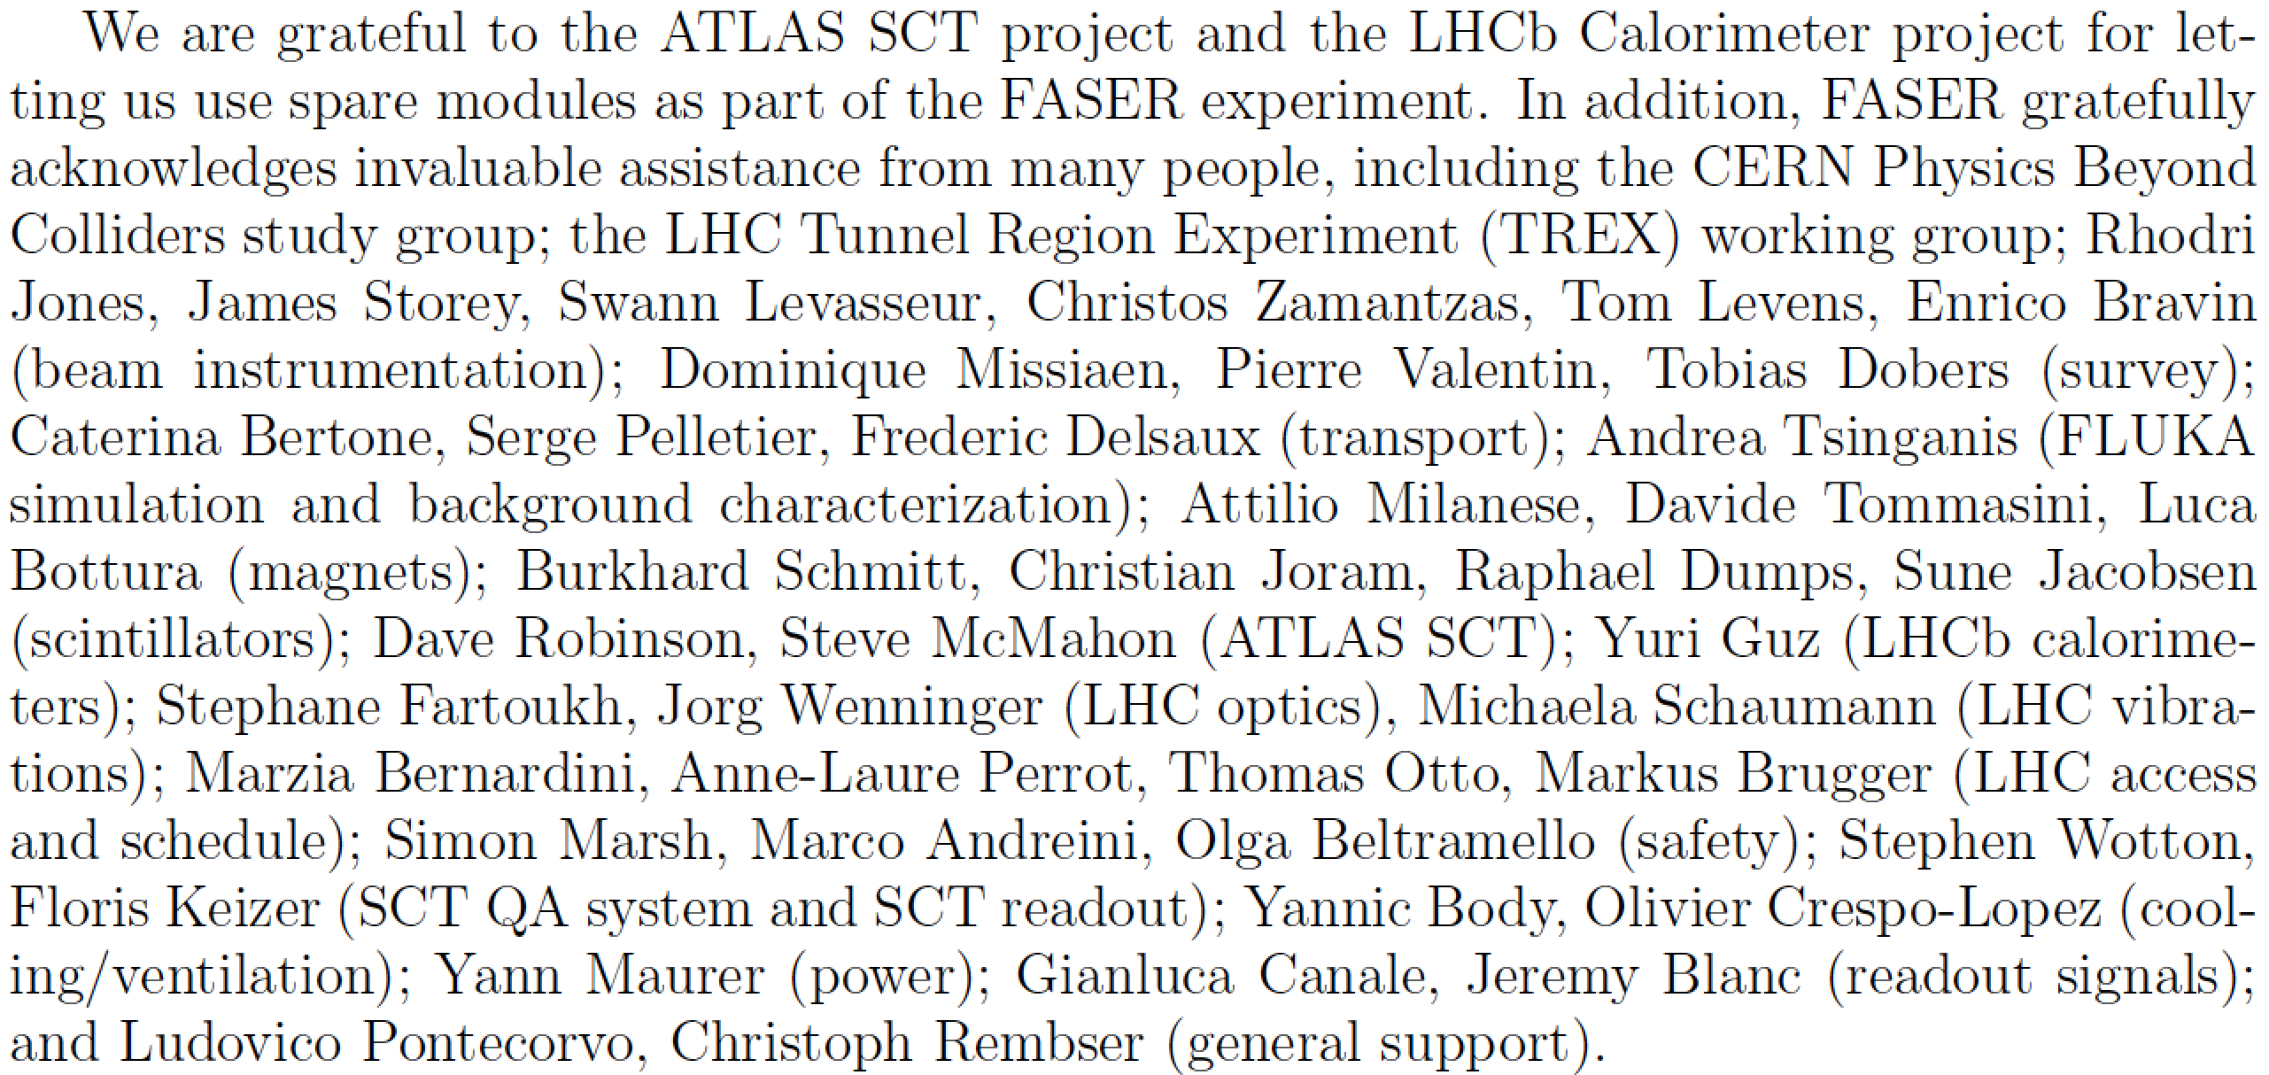
ACKNOWLEDGEMENTS
Many others have also played essential roles in supporting FASER

Slide 26
TIMELINE
CERN Approval Process
  Submitted LOI to LHCC in July 2018. This was received favorably and we were invited to submit a Technical Proposal.
  Submitted Technical Proposal in November, this was also received favorably, LHCC recommended approval to the CERN Research Board.
  The remaining work is to finalize integration of FASER into the LS2 schedule. Assuming no problems, Research Board will consider FASER for full approval in March 2019. Magnet construction set to begin in January 2019.
Funding
  Cost be borne by CERN is ~$300 kCHF. Additional cost of FASER is expected to be supported by 2 private foundations through grants for ~$2M, sufficient for FASER construction and some operations costs.

Slide 27
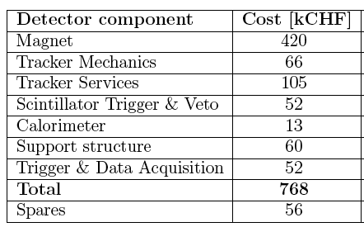
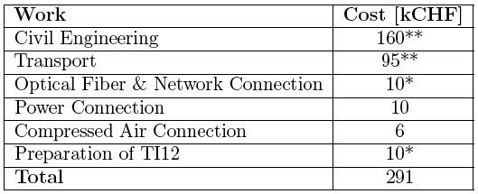
COSTS
For detector:
To be borne by CERN:
*/** not completely costed

Slide 28
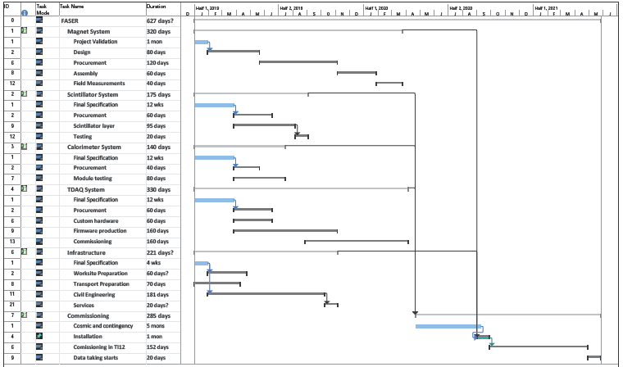
SCHEDULE

Slide 29
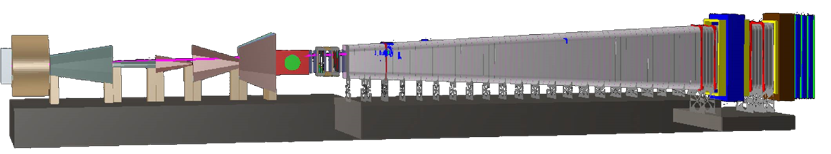
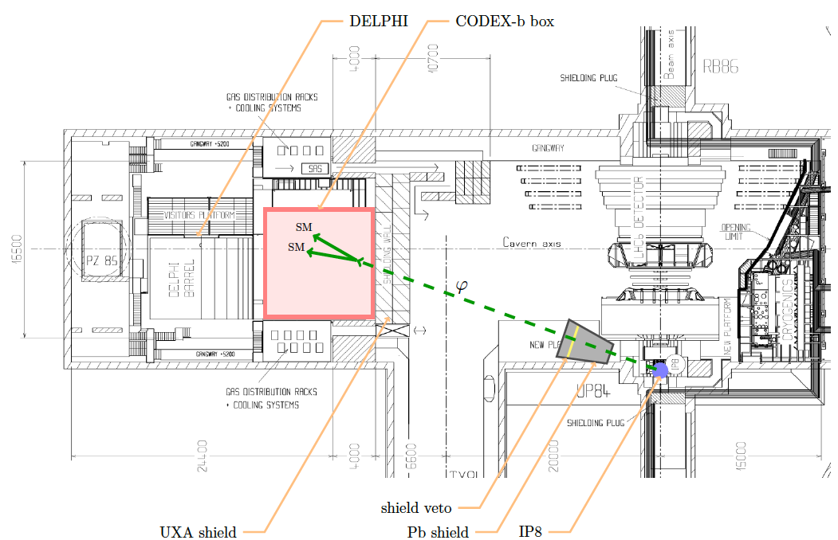
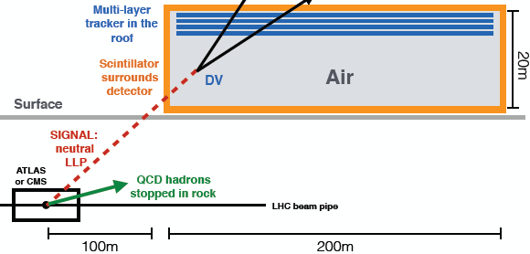
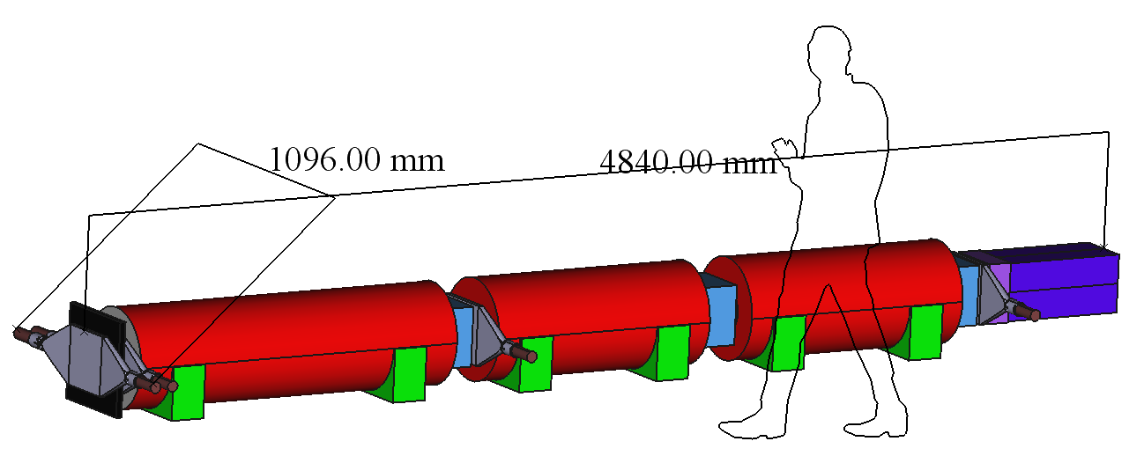
COMPLEMENTARY PROPOSED EXPERIMENTS
SHiP
CODEX-b
~1000 m³, ~100M CHF + beam
Alekhin et al. (2015)
~1000 m³ ~ 1 mIKEAs
Gligorov, Knapen, Papucci, Robinson (2017)
FASER
MATHUSLA
~1 m³ ~ 1 μIKEAs
~800,000 m³ ~ 1 IKEA, ~$50M
Feng, Galon, Kling, Trojanowski (2017)
Chou, Curtin, Lubatti (2016)

Slide 30
SUMMARY AND OUTLOOK
FASER is an opportunity for a small and inexpensive experiment to search for a full range of light and weakly-interacting particles, complementing other experiments. FASER collects data when ATLAS collects data, but is independent (requires only bunch crossing timing).
Currently in advanced stage of CERN approval and funding. If successful:
Install FASER 1 in LS2 (2019-20) for Run 3 (2021-23, 150 fb⁻¹)
    Decay volume: R = 10 cm, L = 1.5 m. Total length < 5 m, requires lowering floor by 50cm in existing tunnel.
    Discovery prospects for dark photons, B-L gauge bosons, ALPs, etc.
After successful operation of FASER, FASER 2 could be installed in LS3 (2023-25) for HL-LHC (2026-35, 3 ab⁻¹)
    Decay volume: R = 1 m, L = 5 m. Requires extension of existing tunnel (widening of UJ12 or UJ18 areas).
    Full physics program: dark photons, B-L, ALPs, dark Higgs, HNLs, etc.
More info: https://twiki.cern.ch/twiki/bin/viewauth/FASER/WebHome.

