Slide 1
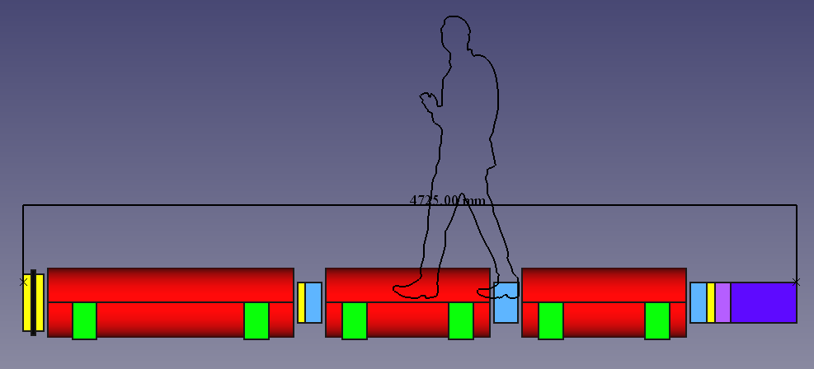
FASTER, SMALLER, CHEAPER
DISCOVERING THE UNIVERSE ON A SHOESTRING BUDGET
Pagels Public Lecture, Aspen Center for Physics
Jonathan Feng, University of California, Irvine
9 August 2018

Slide 2
OUTLINE
1. Discovering the Universe
2. Traditional Experiments: Big Science
3. New Experiments: Faster, Smaller, Cheaper

Slide 3
PART 1
1. Discovering the Universe
2. Traditional Experiments: Big Science
3. New Experiments: Faster, Smaller, Cheaper

Slide 4
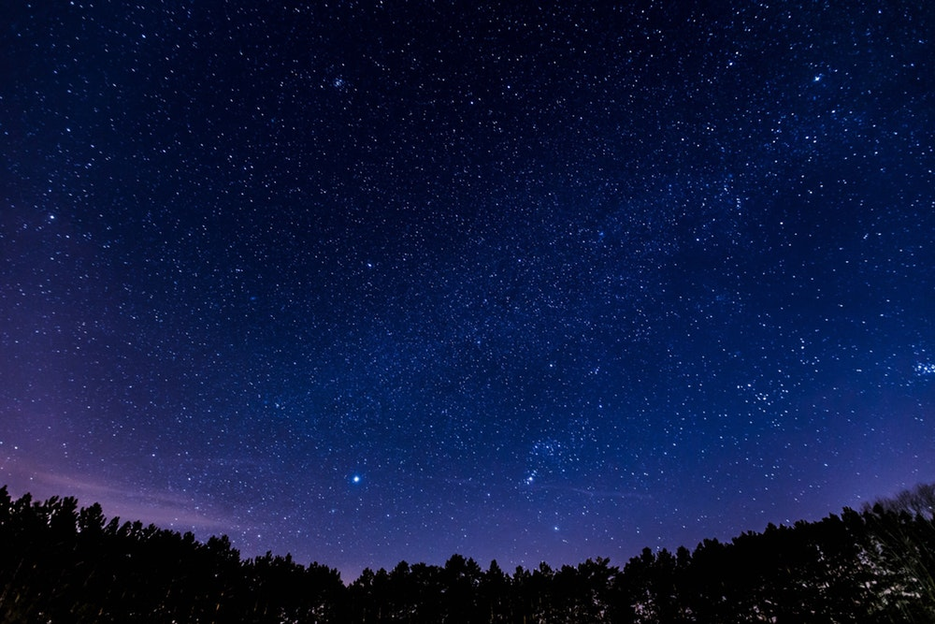
DISCOVERING THE UNIVERSE
If you lived in early times, how would you begin to map out the Universe?
View of Aspen from the top of the Ute Trail

Slide 5
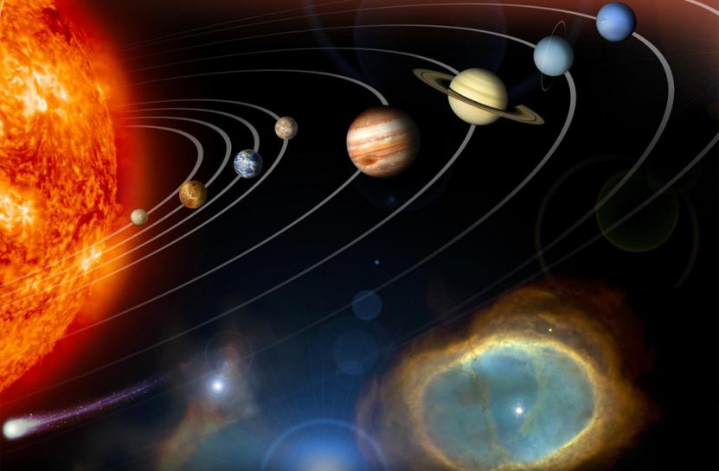
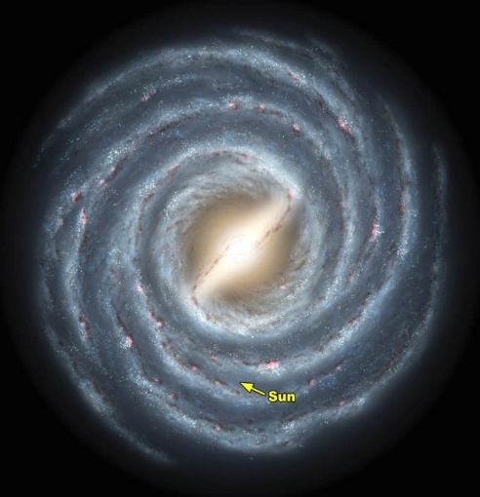
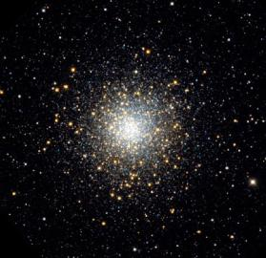
THE VISIBLE UNIVERSE
clusters of
galaxies
solar system
galaxy
10¹²
meters
10¹⁷
meters
10²³
meters

Slide 6

THE INVISIBLE UNIVERSE
Left is what we expect Right is what we see
Stars on the outskirts rotate faster than expected given the visible matter; something else is pulling them toward the center and preventing them from flying off to infinity

Slide 7
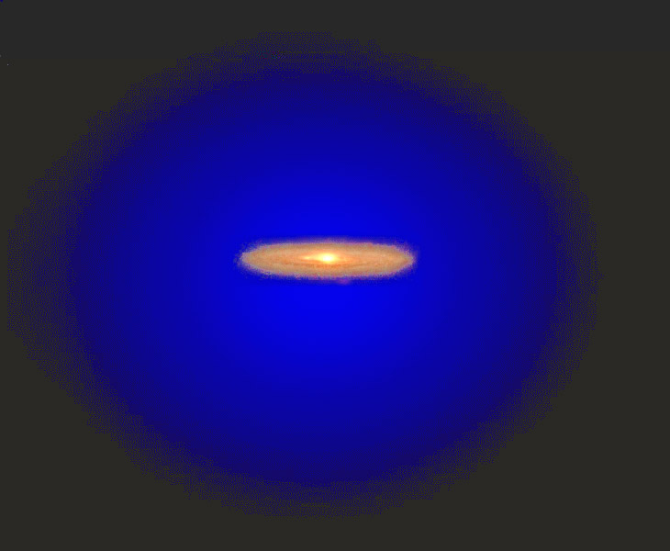
DARK MATTER
With this and other evidence, it is apparent now that the stars we see are just islands in an ocean of invisible “dark matter.”
In fact, the surprising result is that there is actually 5 times more dark matter than normal matter. And it is not “out there”: lots of it is currently passing through your body and this room!

Slide 8
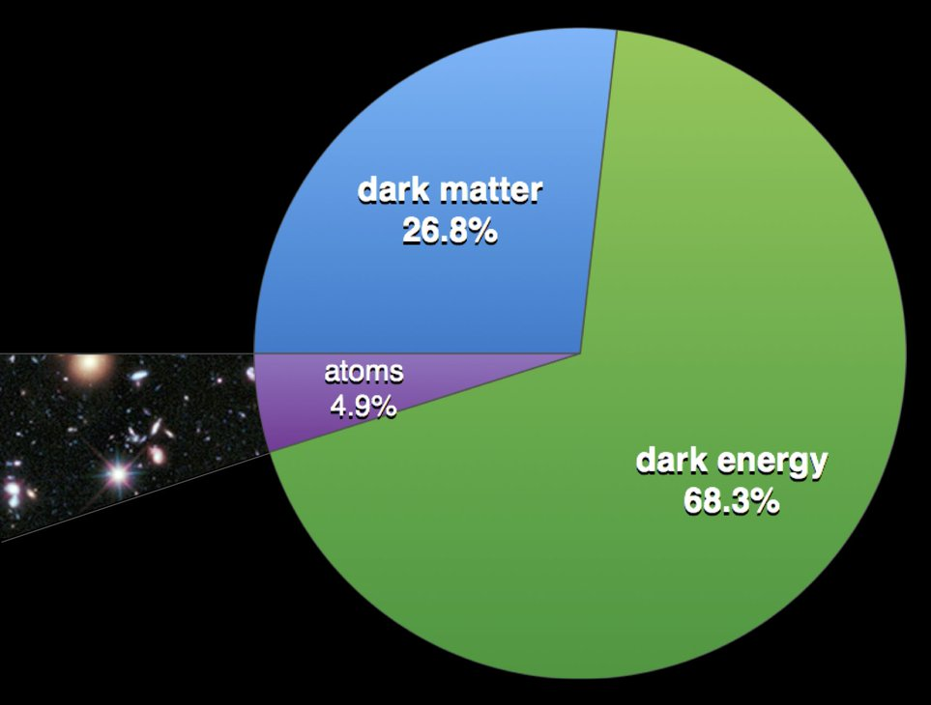
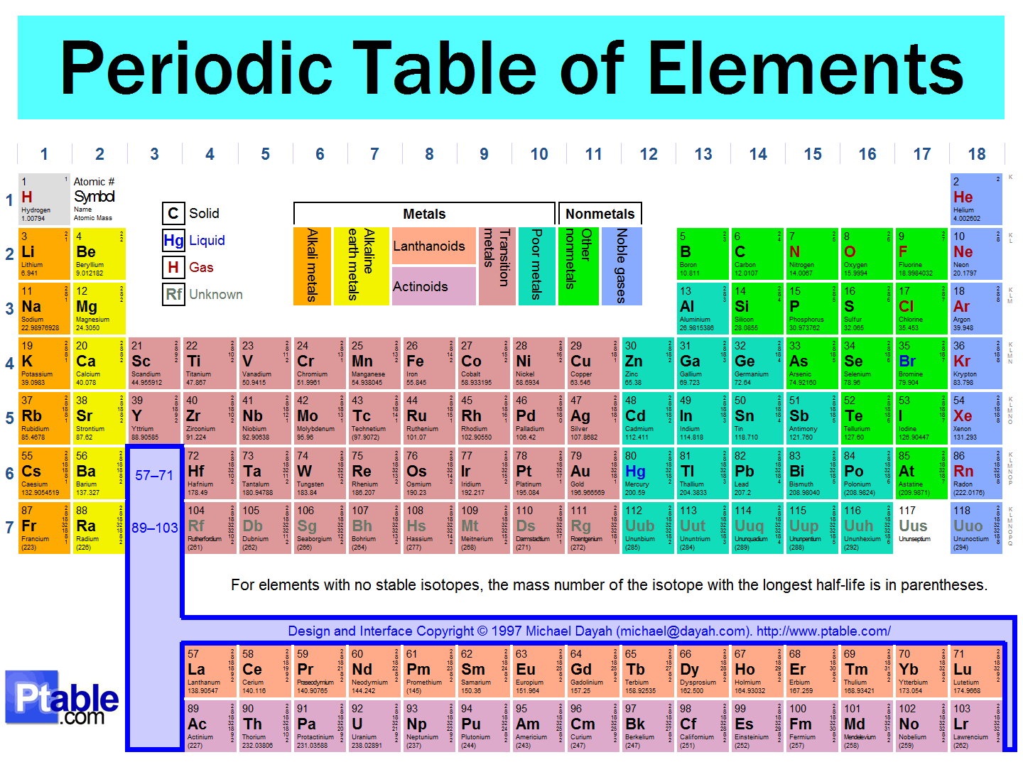
THE UNIVERSE TODAY
We now have an overall picture of the Universe
We know a lot about a little: the normal matter (5%)
But we know little about a lot: dark matter / dark energy (95%). Most of the universe is still to be discovered and understood.

Slide 9

AN HISTORICAL PRECEDENT
If you lived in early times, how would you begin to map out the Earth?

Slide 10
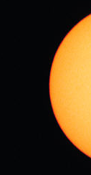
A MORE GLOBAL VIEW
Eratosthenes measured the size of the Earth in 200 B.C.
His answer was thought to be unbelievably large for a long time, but we now know that it was accurate to about 10%.
Alexandria
Earth
Syene
Sun

Slide 11
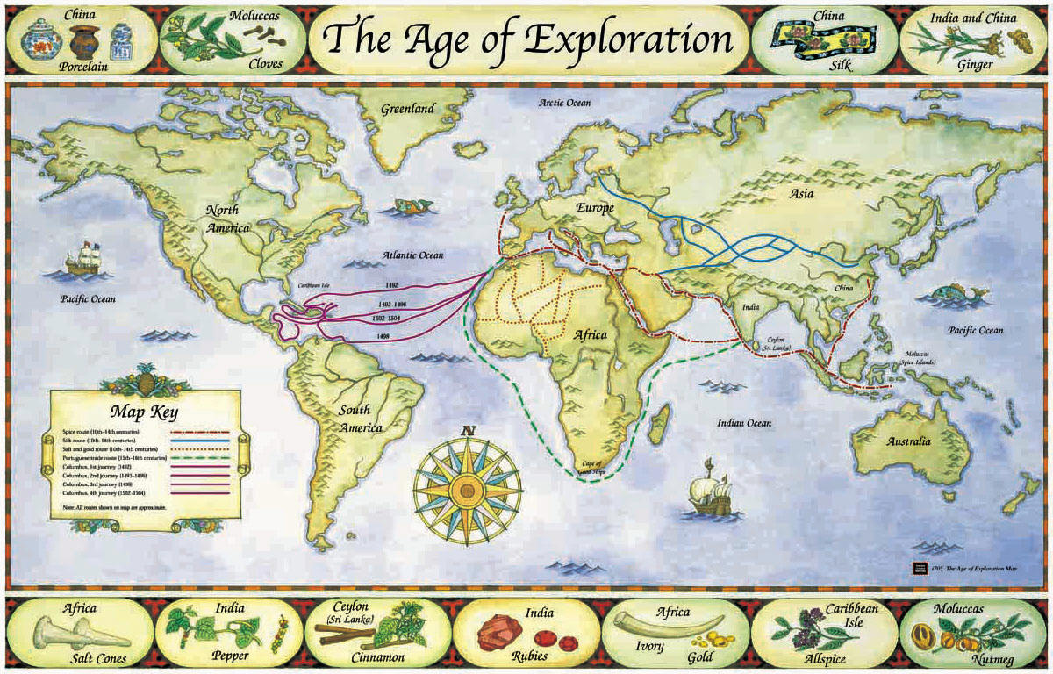
THE AGE OF EXPLORATION
Eratosthenes’ result gave an overall picture of the Earth, but it was hardly a complete understanding; this required an age of exploration.
For the Universe, we are now starting on our own age of exploration.

Slide 12
PART 2
1. Discovering the Universe
2. Traditional Experiments: Big Science
3. New Experiments: Faster, Smaller, Cheaper

Slide 13
TRADITIONAL EXPERIMENTS: BIG SCIENCE
So there is a lot of the Universe left to discover. How do we go about it?
In the case of the Earth we needed to prepare ships that could take us into the unknown.
For the Universe, we need to prepare experiments that can find the unknown. But if it is unknown, how do we prepare experiments to find it?
The answer can be traced back to two giants of physics and has led to what we now call “big science.”

Slide 14
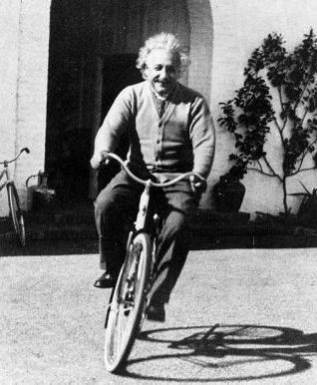
ALBERT EINSTEIN
In 1905, Einstein discovered E = mc²: mass can be converted to energy and vice versa.
This allows the process
Energy is the “universal translator”: we can take known particles (protons p) and collide them to form energy, which then turns back into new particles (X).
We can therefore discover new particles, even if we don’t know much about them beforehand.
X
X
Energy
time
p
p

Slide 15
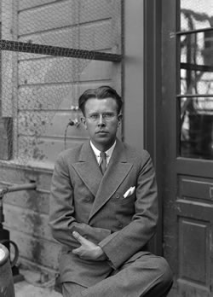
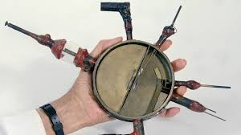
ERNEST O. LAWRENCE
In the 1930’s Lawrence made a cyclotron, which accelerated particles to higher velocities and energies.
The first cyclotron was small, but soon, bigger accelerators led to higher energies, which allowed heavier particles to be produced and discovered.
This has led to “big science” and the discovery of many new particles.

Slide 16
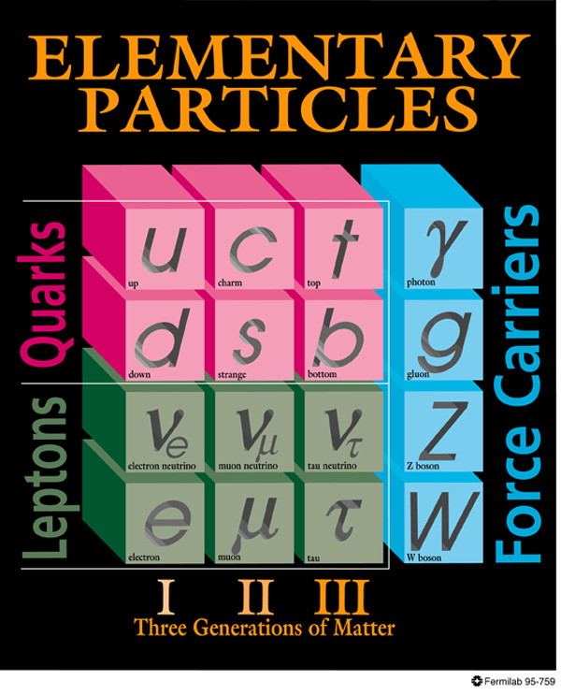
THE KNOWN PARTICLES
We now know that normal matter is made of 3 kinds of particles: u and d quarks, which bind together to form protons and neutrons, and electrons.
Many more particles have been discovered at particle colliders (and elsewhere). The latest was the Higgs particle in 2012.
But none of these can be dark matter. There must be more particles and the search goes on at bigger and bigger machines.
Atoms

Slide 17
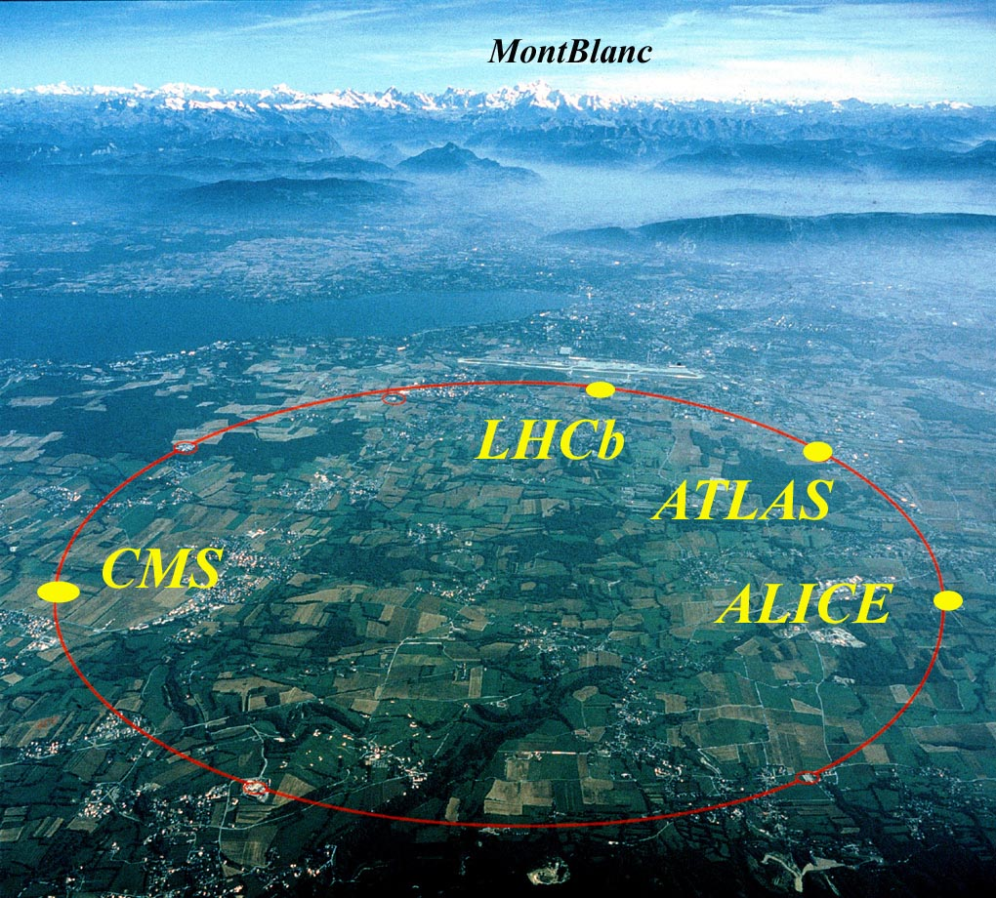
THE LARGE HADRON COLLIDER
The biggest realization of Lawrence’s vision today: the LHC in Geneva
Colliding protons at 99.999999% the speed of light
Notes:
17

Slide 18

THE ATLAS DETECTOR
One of several giant detectors that observe particle collisions at the LHC
Notes:
18

Slide 19
HOW BIG IS BIG SCIENCE?
Size: Big.
Timescale: The LHC was conceived in the 1980’s. It was constructed from 1998-2008, and has been running since 2008, with periodic shutdowns to upgrade and fix equipment.
Budget: The cost of constructing the LHC and the various experiments was roughly $10 billion. The annual operations budget of CERN, the host laboratory, is about $1 billion/year, or roughly 1 coffee per year per EU citizen.
People: The number of physicists working on each experiment is large.

Slide 20
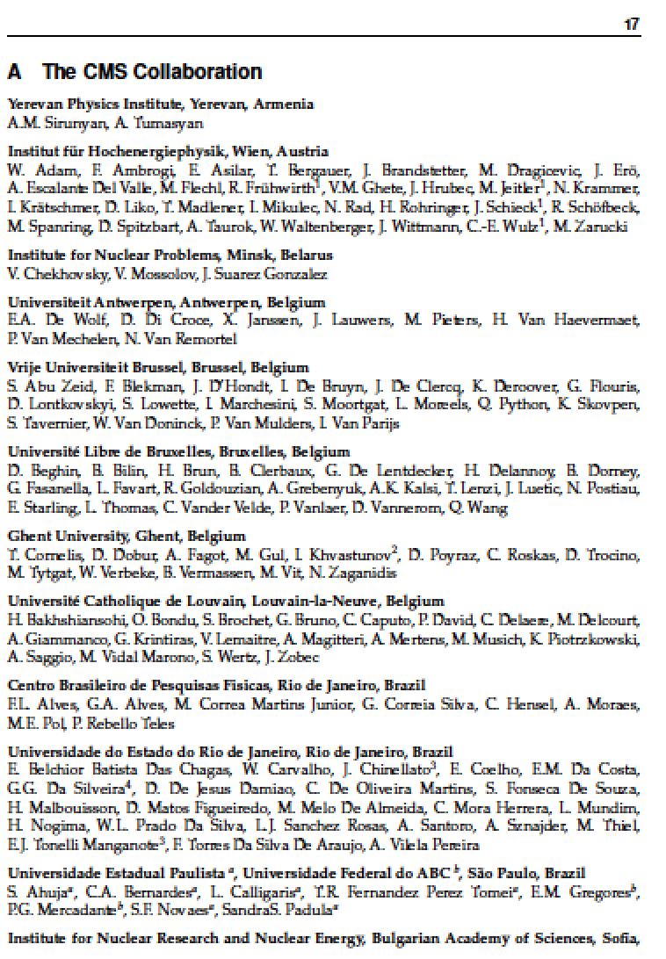
A RECENT CMS AUTHOR LIST

Slide 21
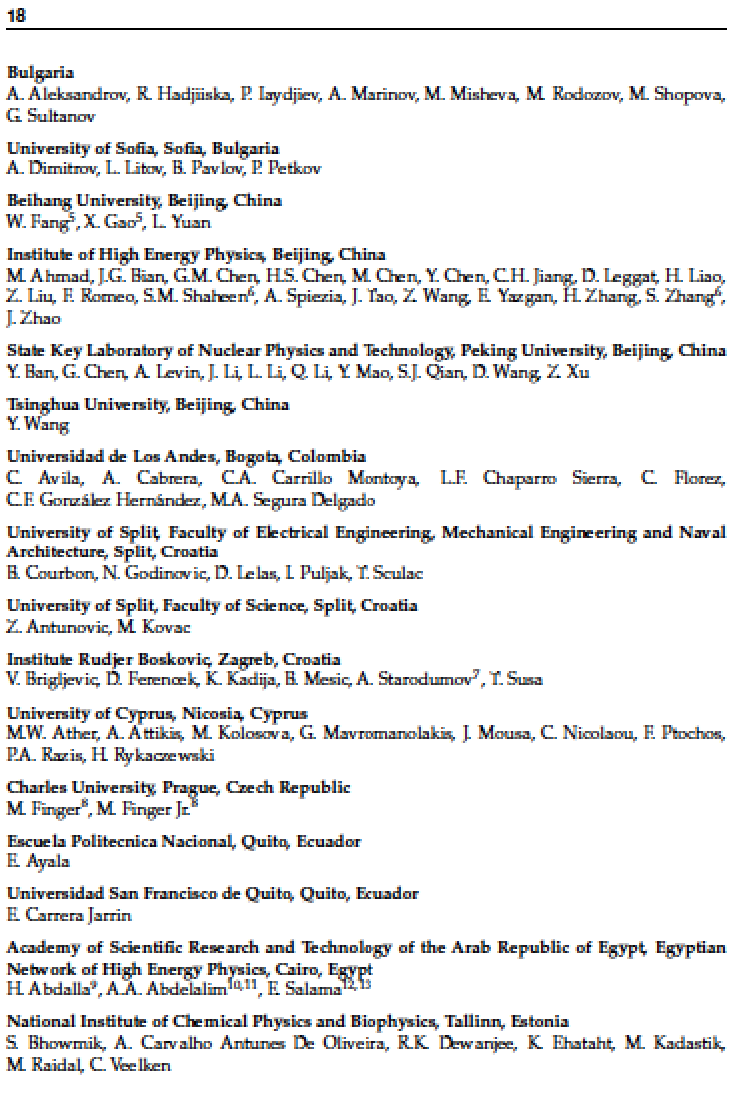
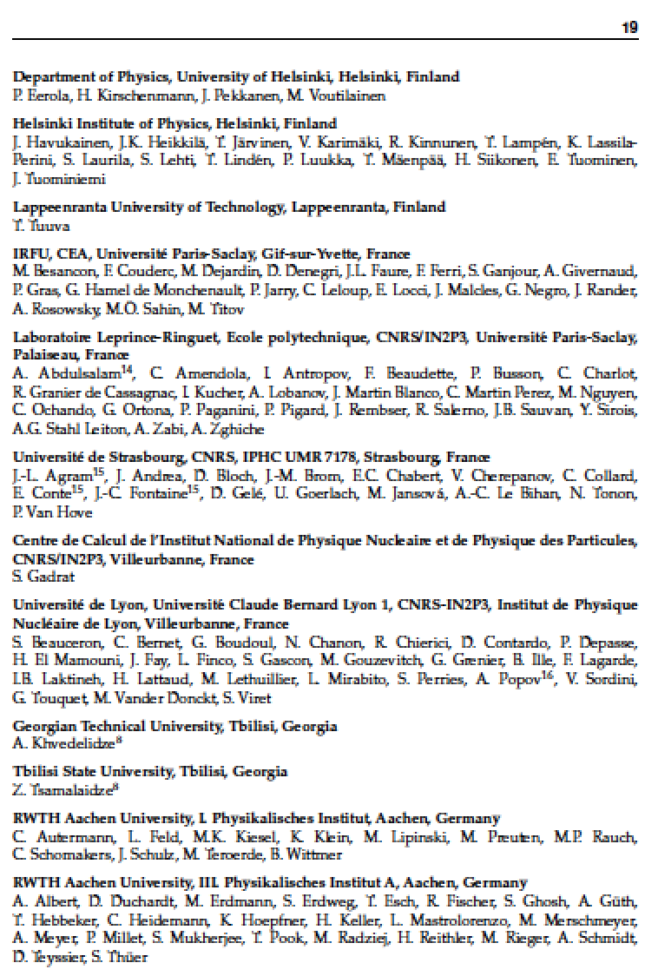
A RECENT CMS AUTHOR LIST (cont’d)

Slide 22
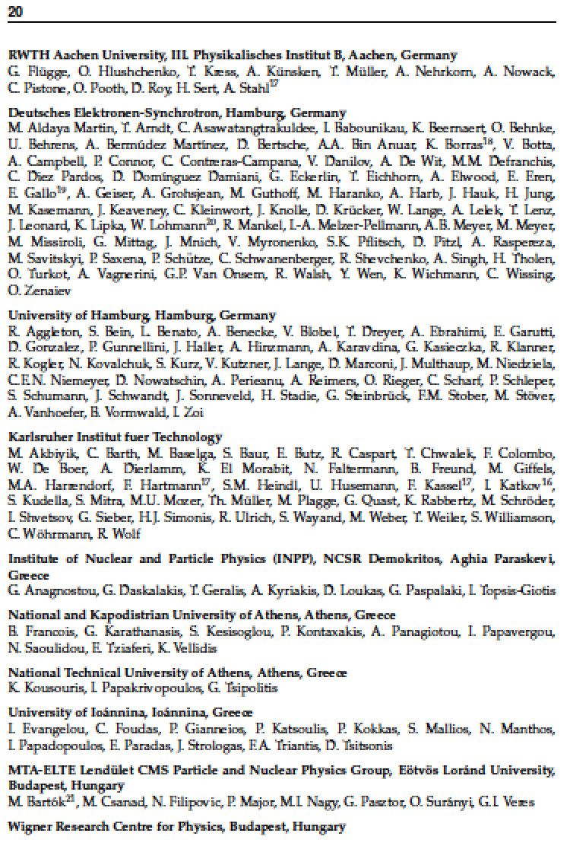
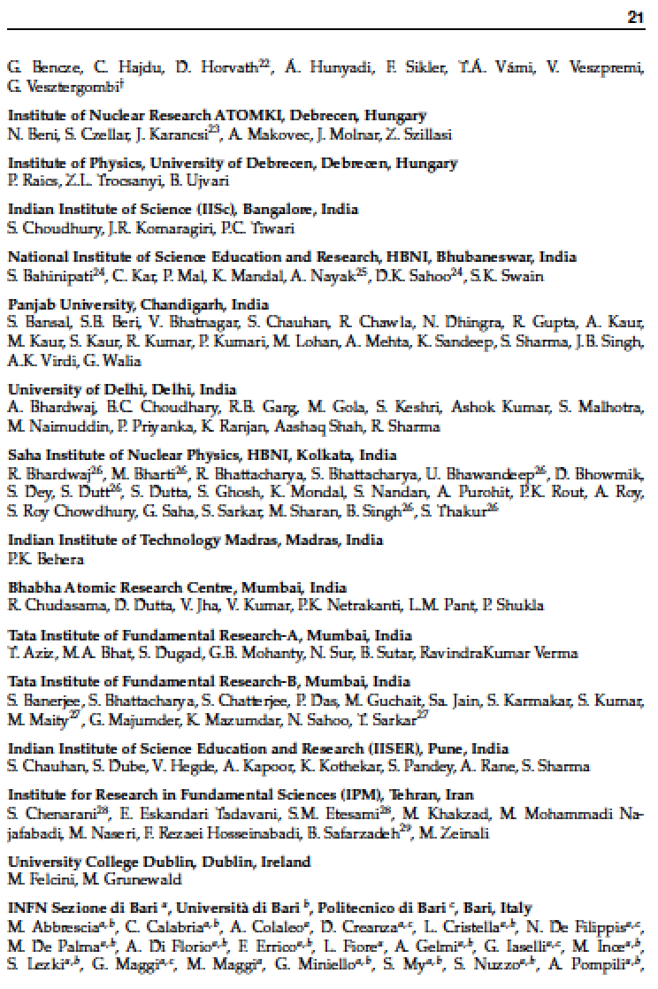
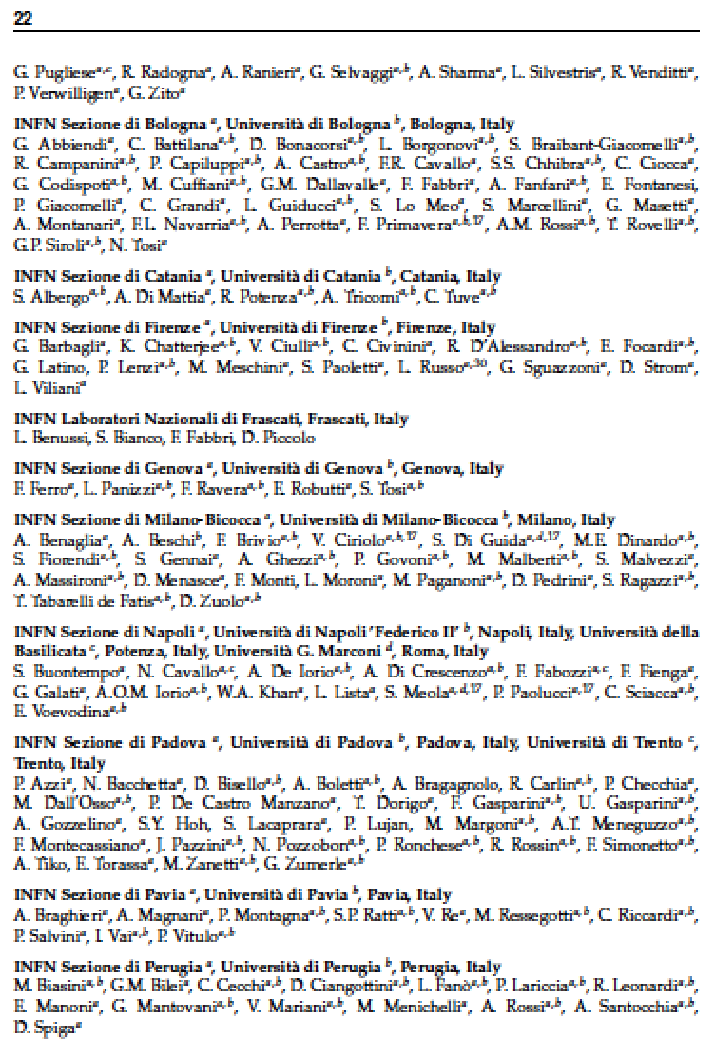
A RECENT CMS AUTHOR LIST (cont’d)

Slide 23
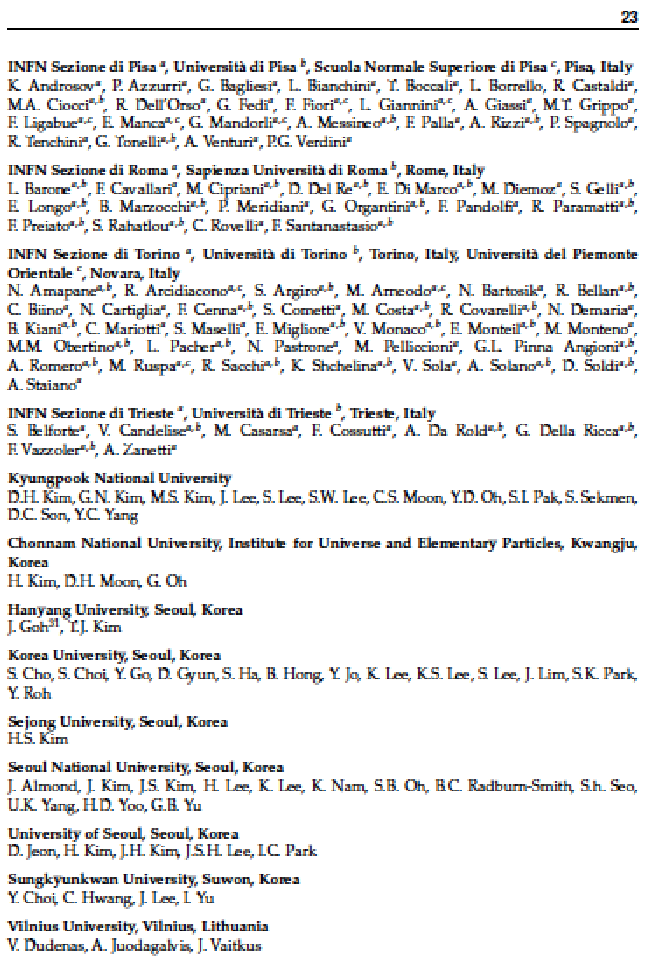
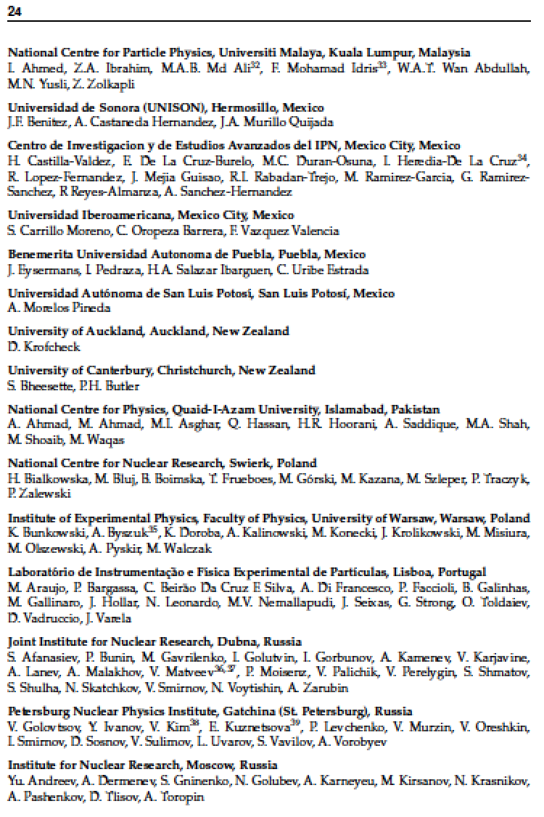
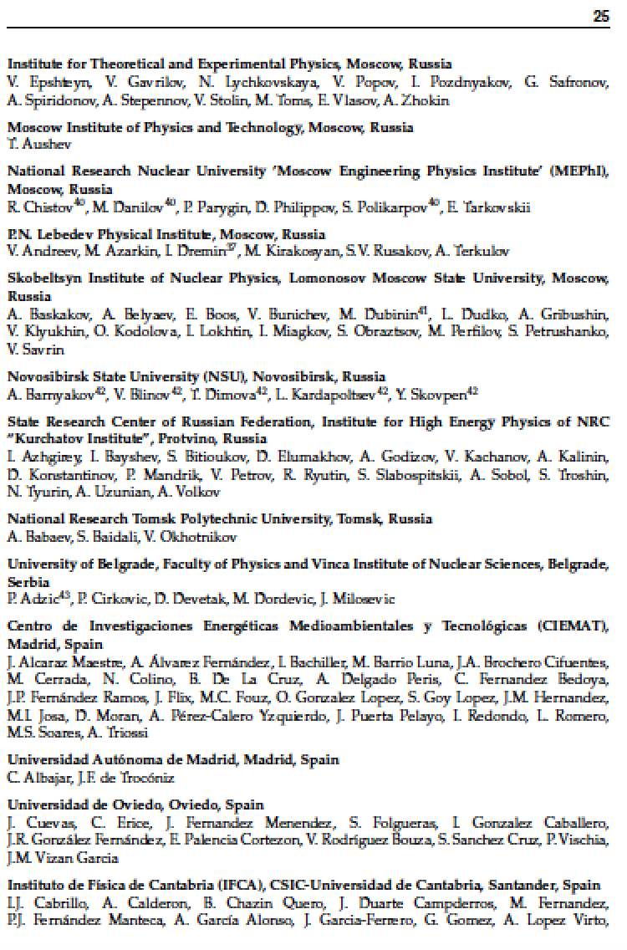
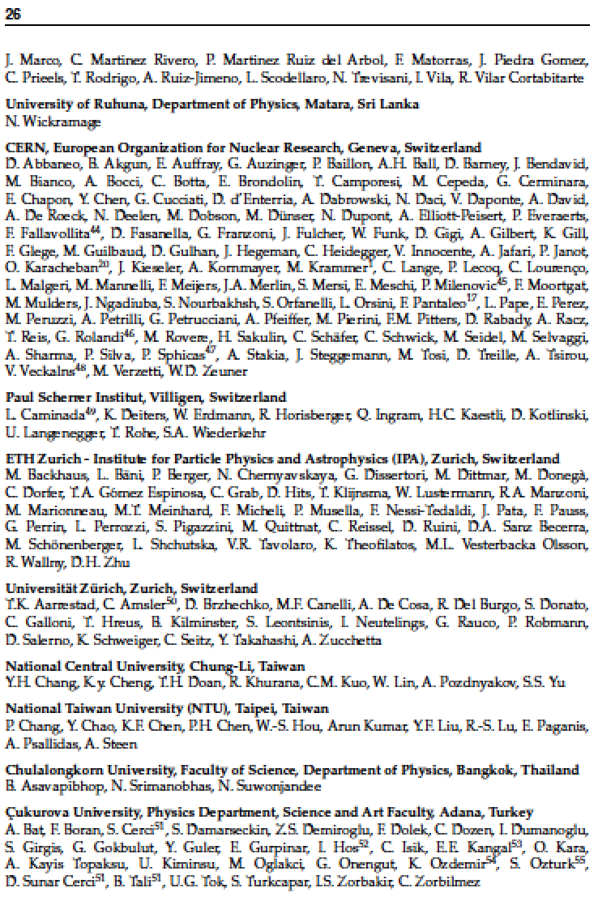
A RECENT CMS AUTHOR LIST (cont’d)

Slide 24
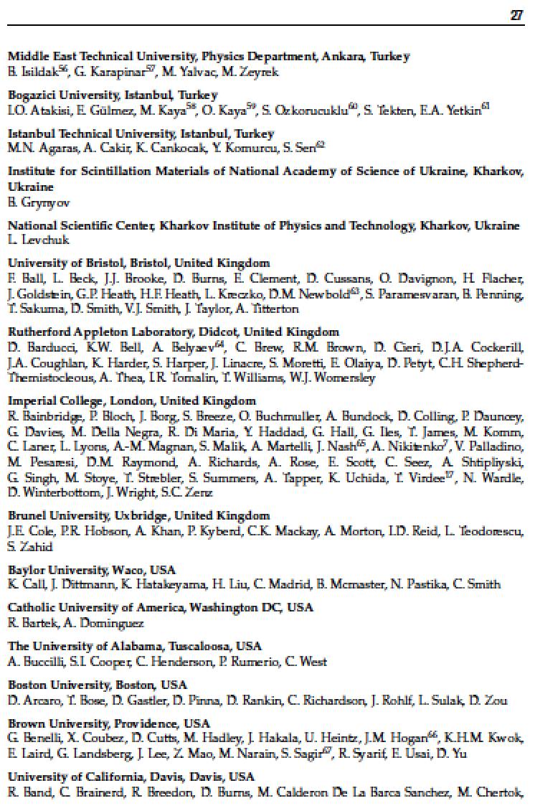
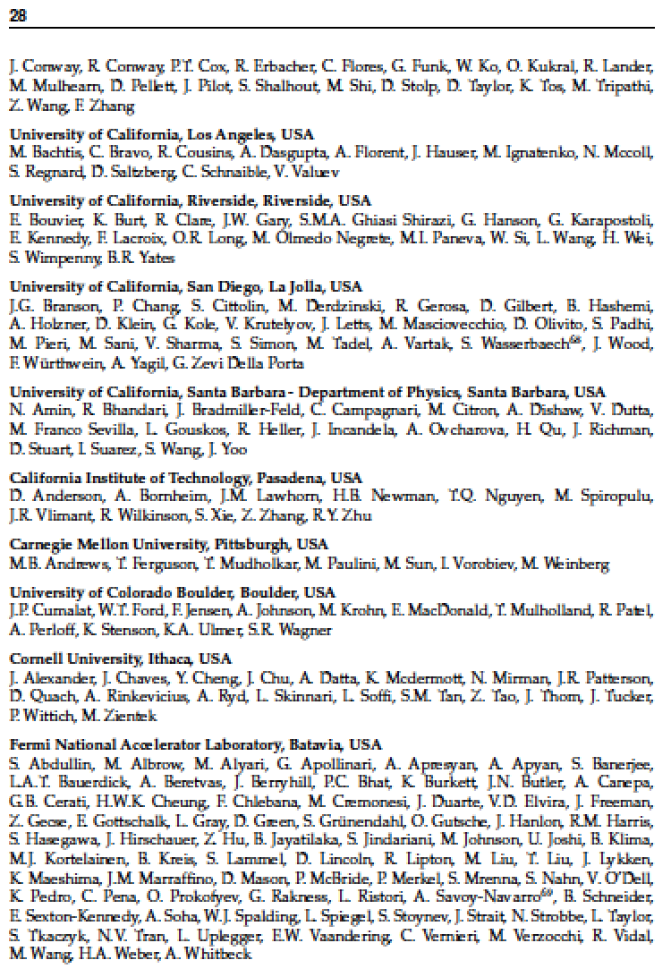
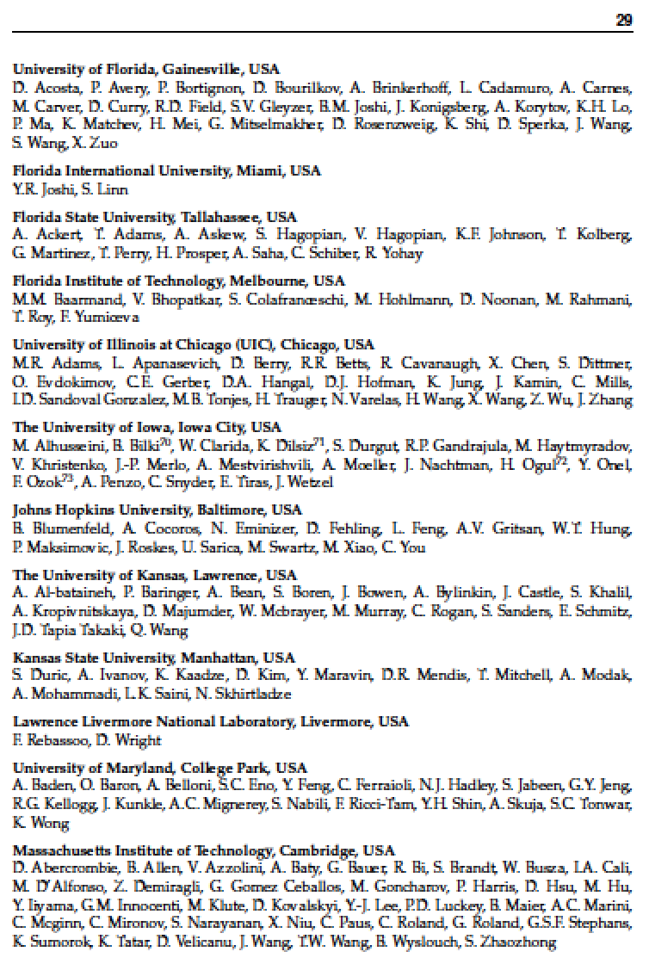
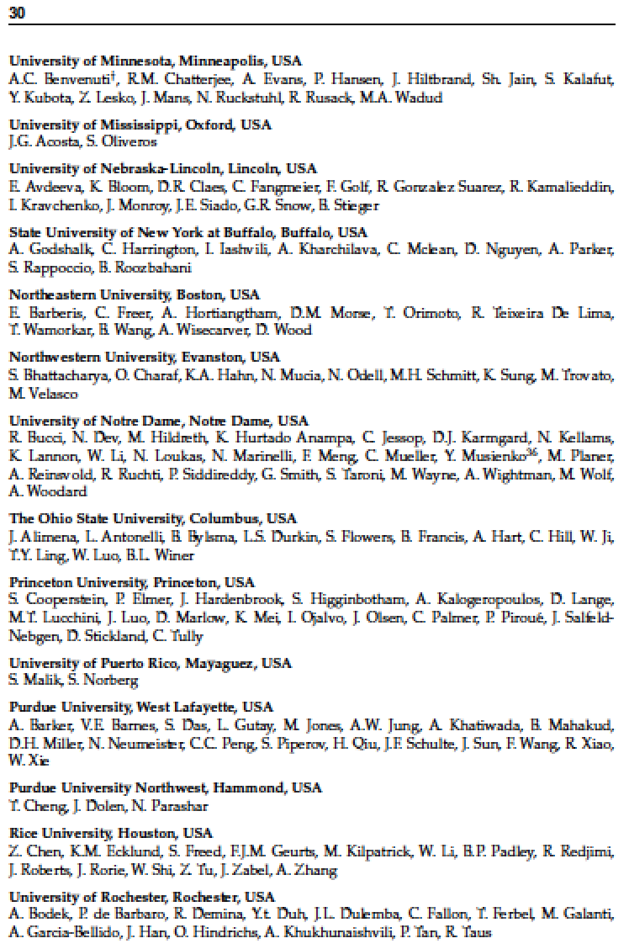
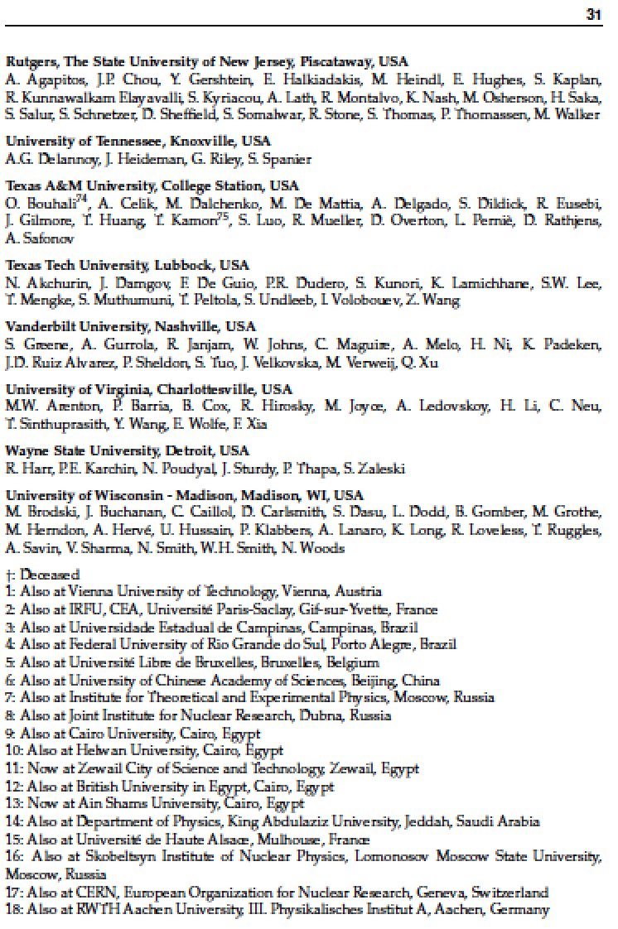
A RECENT CMS AUTHOR LIST (cont’d)
About 4000 physicists from 200 institutions in 43 countries

Slide 25
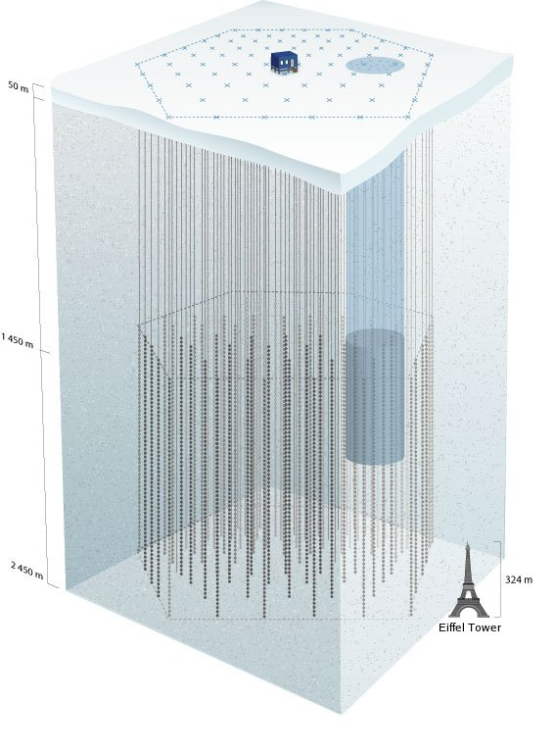
ICECUBE IN ANTARCTICA
There are many other extraordinary examples of big science.
IceCube looks for neutrinos, which can be produced, for example, when dark matter particles collide with each other in our galaxy.
DM
DM
time
ν
ν
Feng 25

Slide 26
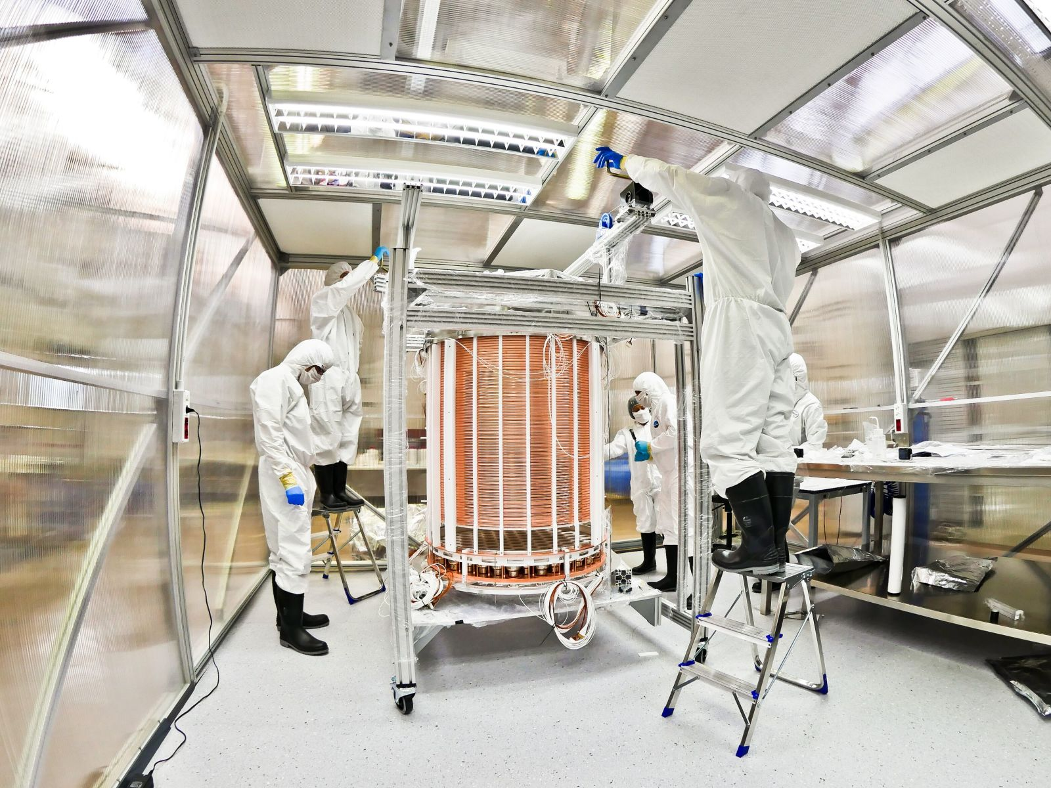
DARK MATTER DETECTORS
DM
DM
N
N
XENON 1T detector
time
These experiments are looking for evidence that a dark matter particle collides with a normal nucleus, causing it to recoil. They are currently sensitive to 1 collision per ton per year.
Notes:
26

Slide 27
TRADITIONAL EXPERIMENTS: STATUS
Each of these experiments is a testament to human ingenuity and what can happen when large groups of people from many countries and backgrounds work together. They continue to gather data and any one could announce a groundbreaking discovery at almost any time – very exciting!
But so far, none has discovered evidence for new particles. In the absence of discovery, what other approaches are possible?
“If you plan to make a voyage of discovery, choose a ship of small draught.” Captain James Cook, when rejecting the giant ships offered to him for his Pacific voyages.
A few small groups of physicists are now taking Captain Cook’s advice to heart.

Slide 28
PART 3
1. Discovering the Universe
2. Traditional Experiments: Big Science
3. New Experiments: Faster, Smaller, Cheaper

Slide 29

THE LAMPPOST LANDSCAPE
Traditional Targets
of Big Science
1
Already
Discovered
Strongly Interacting
Heavy Particles
New Targets of Small Experiments
10⁻³
Interaction Strength
Weakly Interacting
Light Particles
Impossible to
Discover
10⁻⁶
MeV
GeV
TeV
Mass

Slide 30
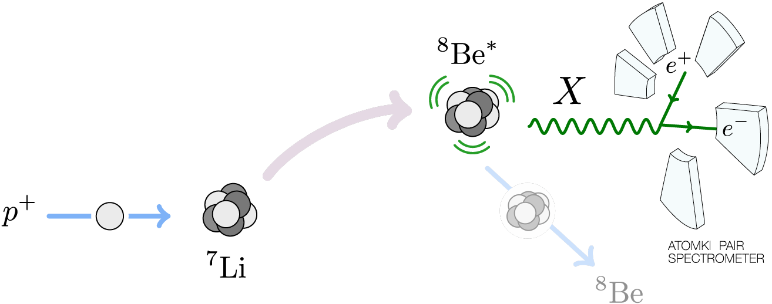
LIGHT PARTICLES IN NUCLEAR EXPERIMENTS
If new particles are light, we don’t need giant colliders to produce them. We can look for them by re-doing 1960’s era physics experiments in a more precise way.
For example, we can make lots of excited Beryllium-8 nuclei and see if they produce new particles when they decay.

Slide 31
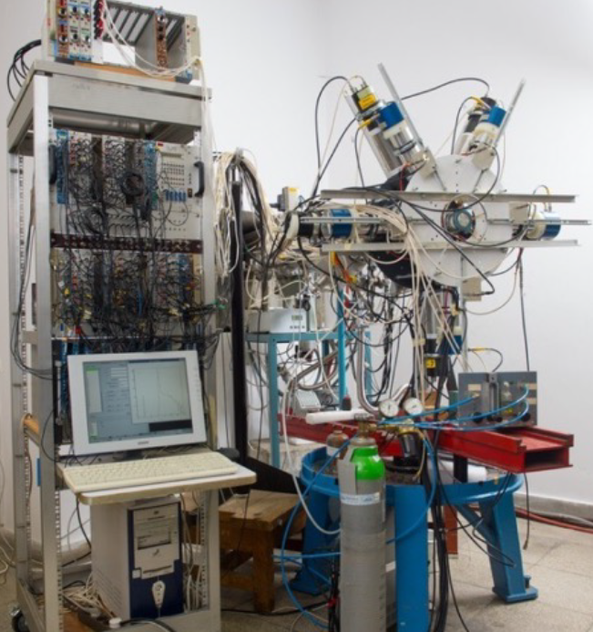
THE ATOMKI ⁸BE EXPERIMENT
ATOMKI nuclear physics lab in Debrecen, Hungary

Slide 32
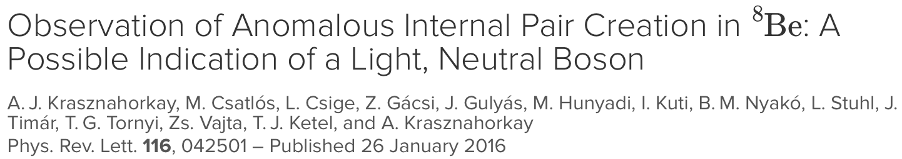
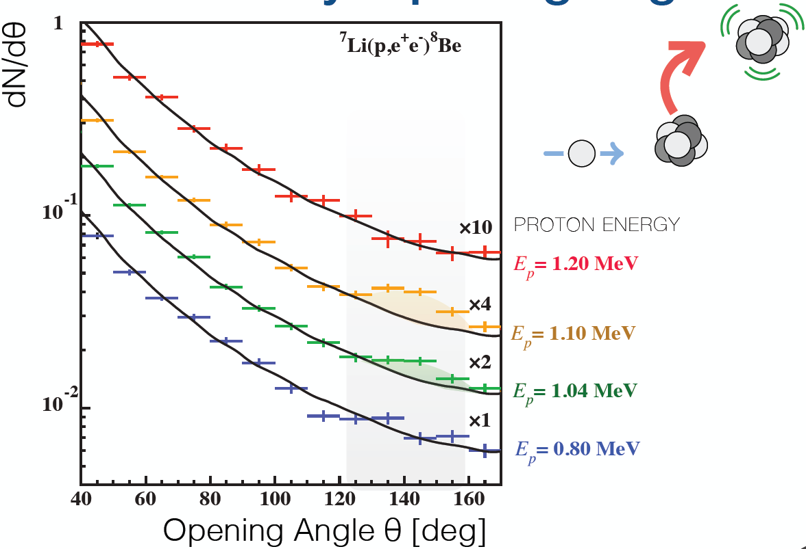
THE ATOMKI ANOMALY
In 2016, the ATOMKI group reported evidence that ⁸Be nuclei are indeed decaying to new particles X, which then further decay to electron-positron pairs. The new particle is only 1/50 the mass of a proton.
The probability that it is background: 5.6 x 10⁻¹² (6.8σ).
This is either the first sign of a new particle or an experimental error; follow-up experiments are underway.

Slide 33


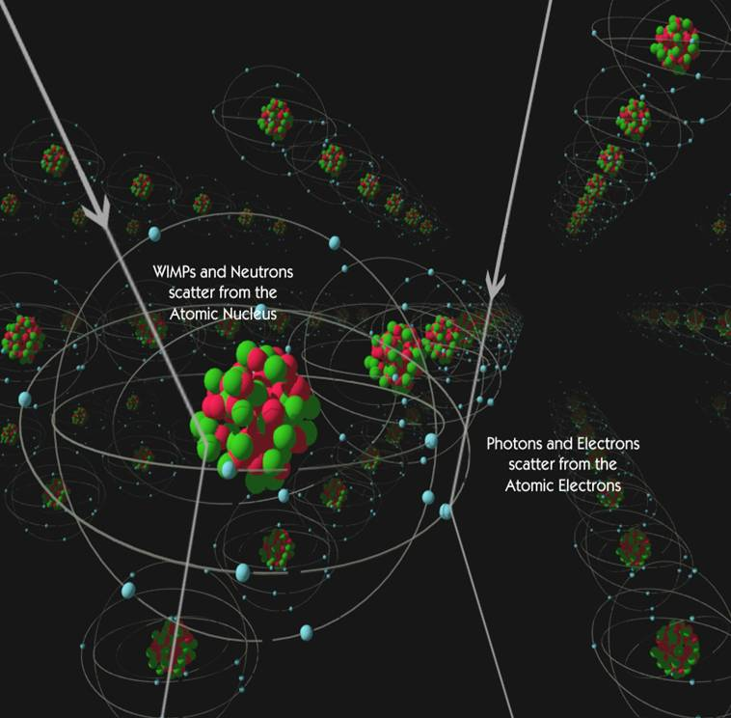
LIGHT PARTICLES IN DARK MATTER DETECTORS
If the dark matter particle is very light, traditional detectors looking for nuclear recoils are ineffective.
Better to look for electron recoils.
Current bounds are very poor for light dark matter, and so even very small electron recoil detectors can discover dark matter.

Slide 34
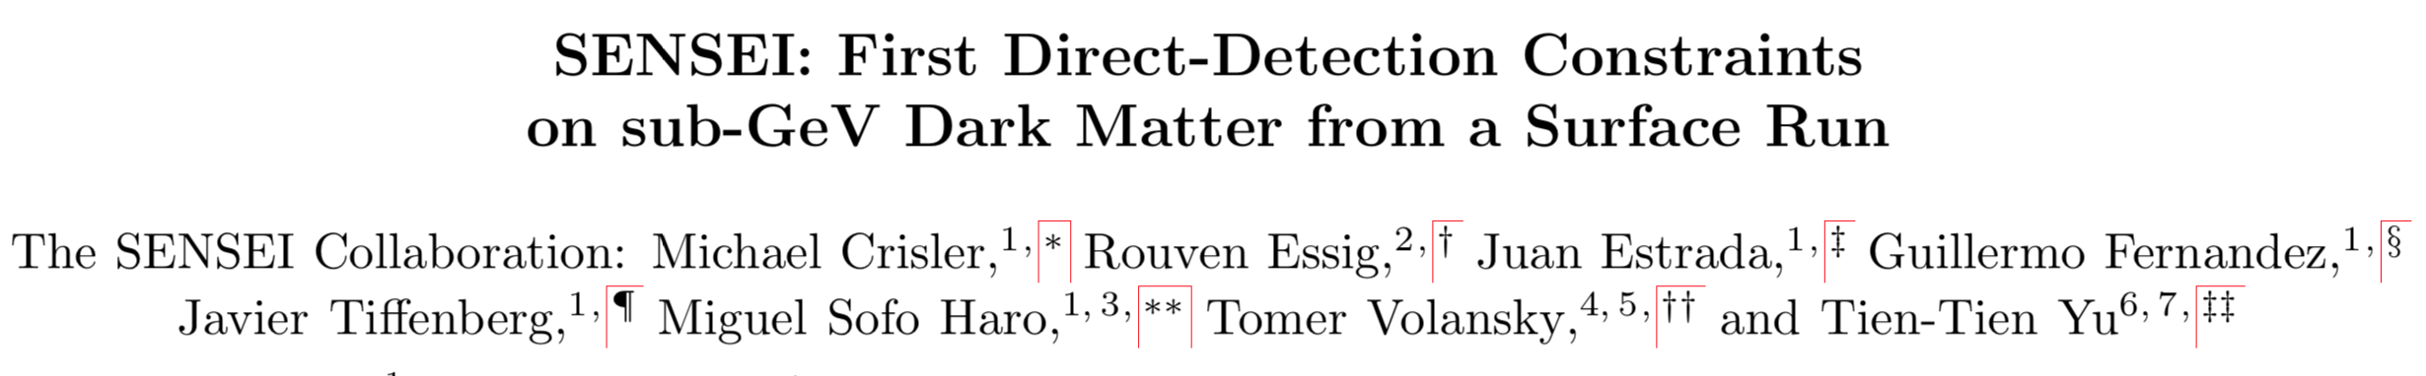
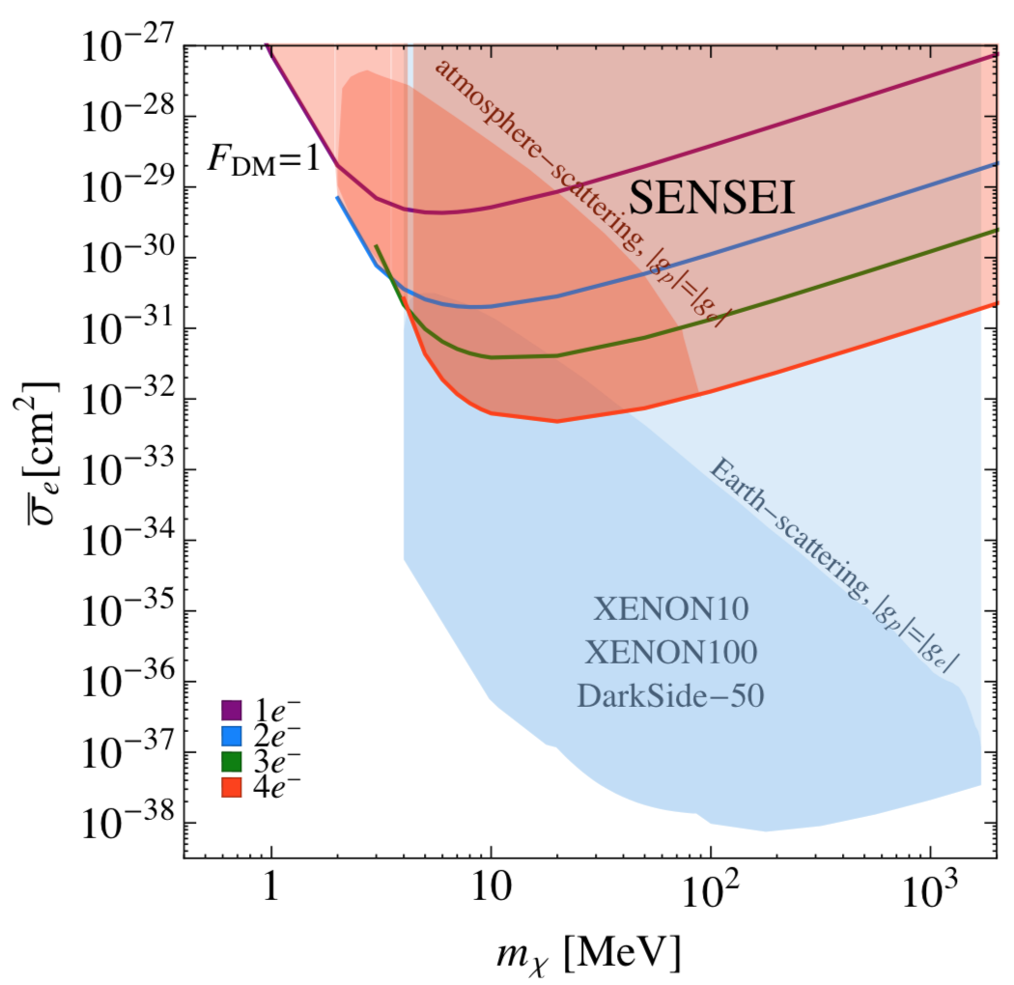
THE SENSEI EXPERIMENT
In 2018 with 0.019 gram-days of data (not ton-years!), the SENSEI experiment achieved world-leading sensitivity to light dark matter.
Cost: $1M supported by the Heising-Simons Foundation and Fermilab.
Time from funding to result: ~ 1 year.

Slide 35
LIGHT PARTICLE SEARCHES AT THE LHC
We can also look in new ways for light particles at existing colliders. If they are very light, they may have escaped traditional searches.
An example: at the LHC, light particles are dominantly produced parallel to the beam, not perpendicular to it. Unfortunately, this is exactly where the detectors have holes in them to let the proton beams in, and so these light particles would escape undetected.

Slide 36
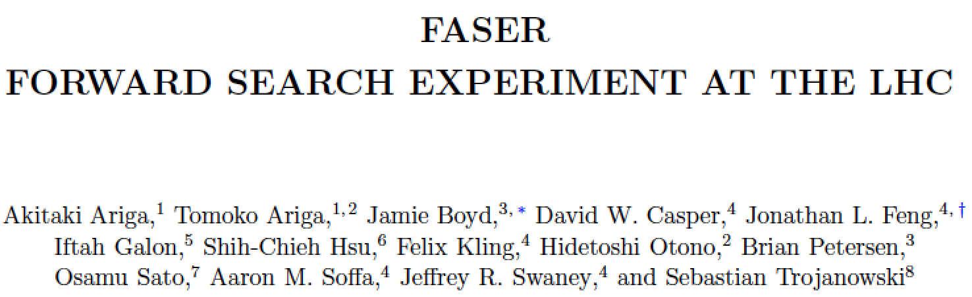
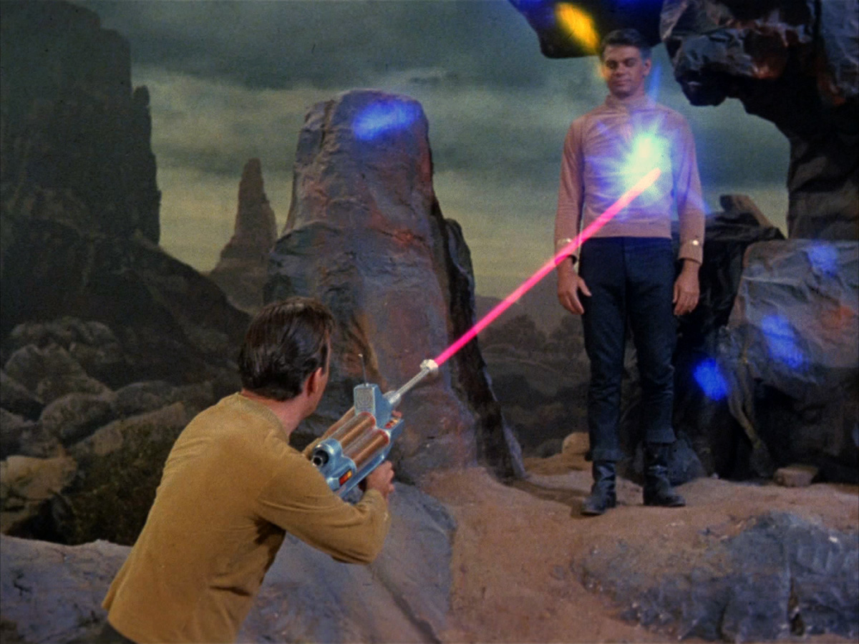
FASER: ForwArd Search ExpeRiment.
To take advantage of this, a few of us have joined together to propose a new detector for the LHC, called FASER.
“The acronym recalls another marvelous instrument that harnessed highly collimated particles and was used to explore strange new worlds.”

Slide 37
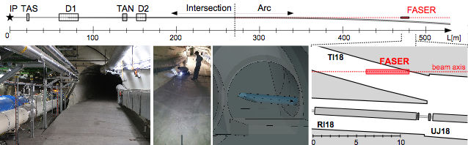
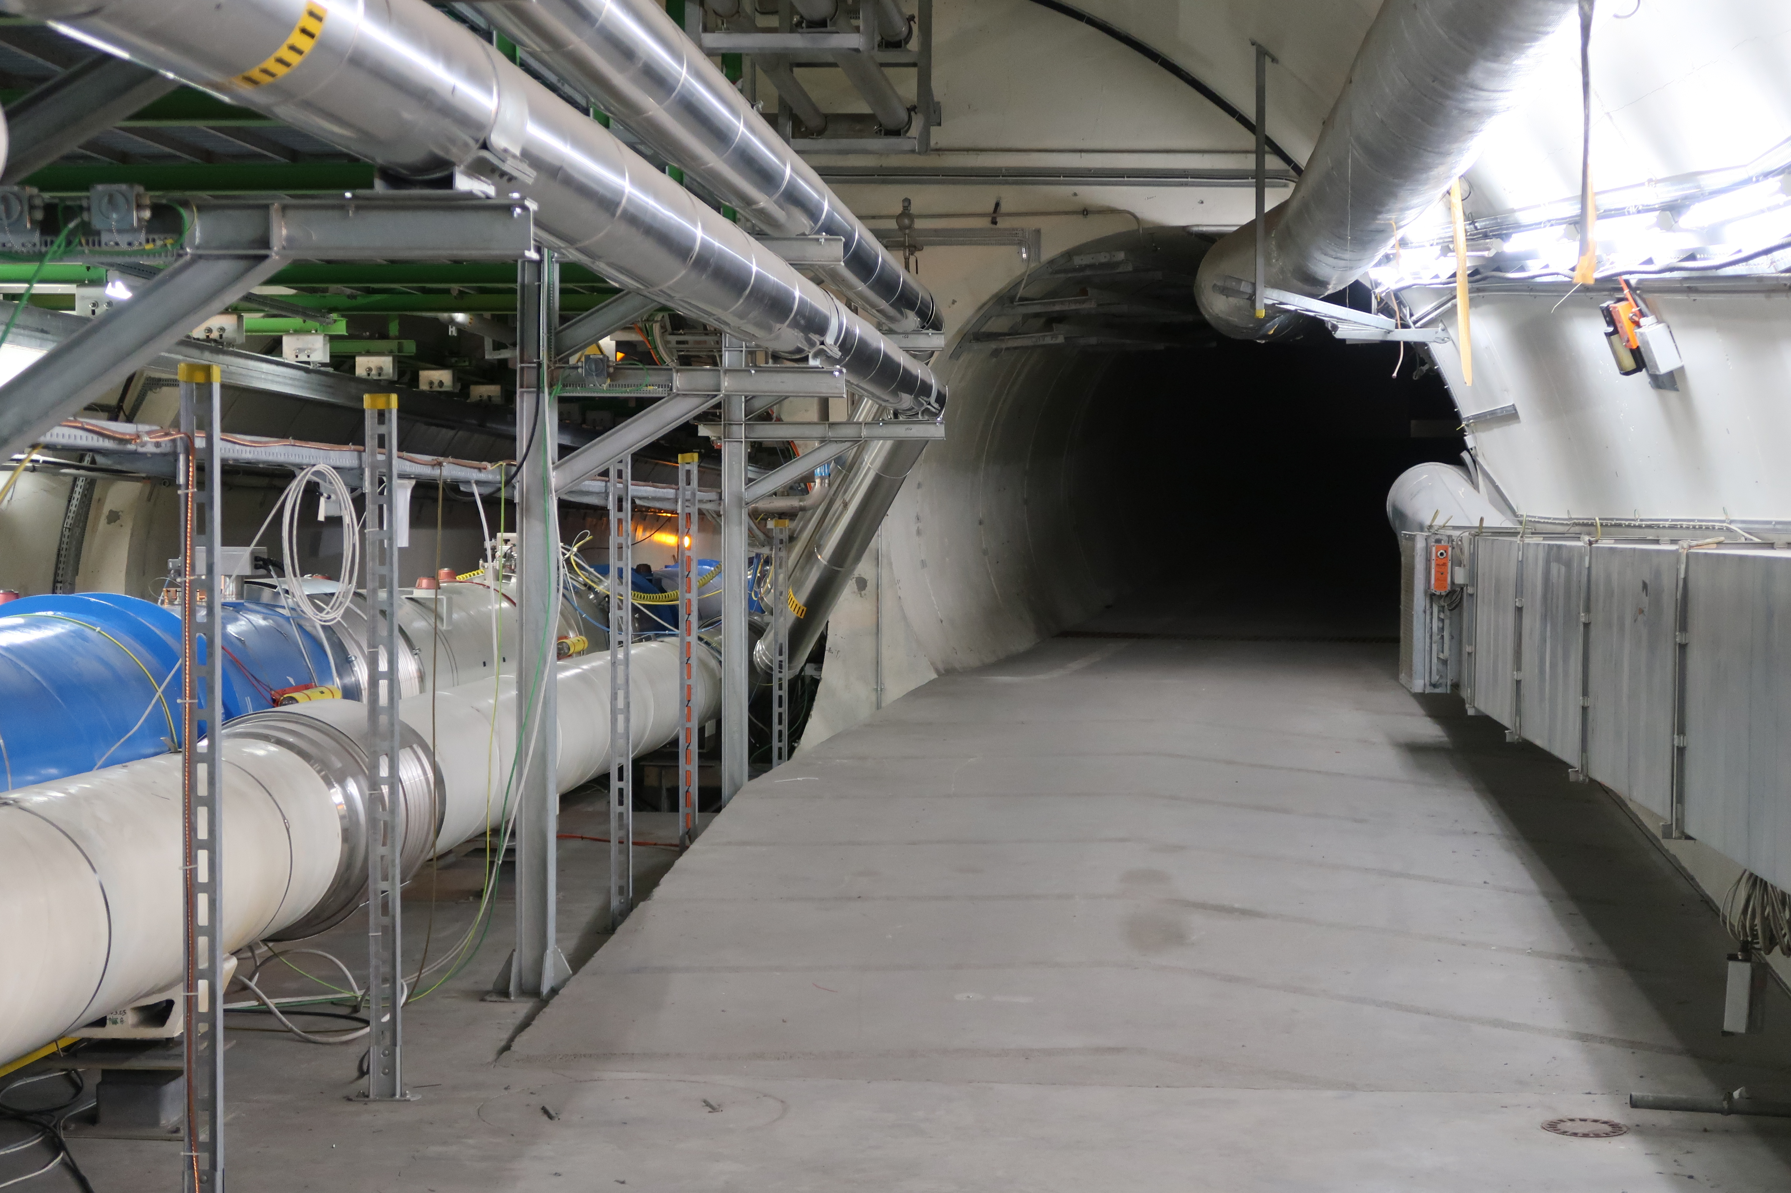
FASER
To avoid blocking the proton beams, FASER is placed 480 m downstream. At that location, the proton beams curve away, but the light new particles will travel straight into FASER.
The entire detector is under 5m long and fits in an existing, unused tunnel.

Slide 38

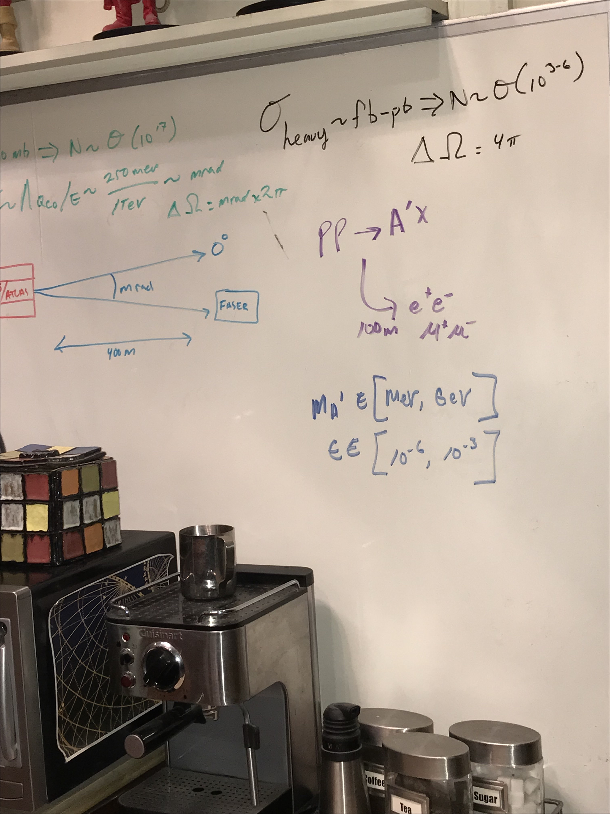
FASER
FASER is small, cheap, and fast, but there are many more hurdles to pass.
Fortunately, the most famous living physicists are already on board.

Slide 39
SUMMARY
95% of the Universe is still completely unexplored – we live in a new age of exploration.
Large experiments are underway and have exciting prospects for discovering new kinds of particles and identifying dark matter.
There are also now promising experiments that are relatively fast, small, and cheap: ~years, ~10 collaborators, and ~$1-10M. These were made possible by “big science,” just like the internet, MRIs, shrink wrap, etc., but probe different ideas and possibilities.
Lots of interesting results to come!

