Slide 1
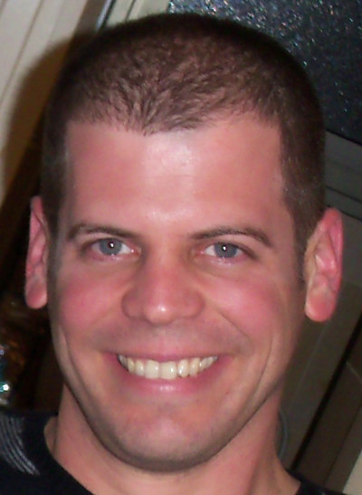
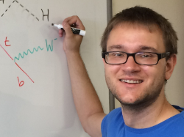
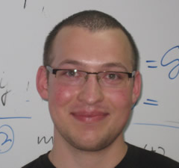
LIFETIME FRONTIER
EXPERIMENTS AT THE LHC
Simons Symposium: Illuminating Dark Matter
Jonathan Feng, UC Irvine
Much of talk based on 1708.09389, 1710.09387, and work in progress with
16 May 2018
Iftah Galon
Felix Kling
Sebastian Trojanowski

Slide 2
THE PLAN
This is an area of rapid progress, even in the last year. This is in stark contrast to the usual time it takes to mount an LHC experiment (~ decades).
The goal of this talk is to give a flavor of this progress by discussing
  Motivations
  Properties of new particles at the lifetime frontier
  FASER, one of the proposed experiments
Tomer: “Nowadays you are not a theorist unless you are working on an experiment.” I’m glad I just barely made the cut!

Slide 3
MOTIVATIONS

Slide 4

PARTICLE PHYSICS: THE LAMPPOST LANDSCAPE
1
Already
Discovered
Strongly Interacting
Heavy Particles
10⁻³
Coupling Strength
Weakly Interacting
Light Particles
Impossible to
Discover
10⁻⁶
MeV
GeV
TeV
Mass

Slide 5

COSMOLOGY: DARK SECTORS
In recent years, dark matter → dark sectors. What are the “most likely” non-gravitational interactions?
Suppose the dark sector has U(1) electromagnetism. There are infinitely many possible SM-dark sector interactions, but only one is induced by arbitrarily heavy mediators:
It is “most likely” because it is non-decoupling. Cf.
It is also naturally small, since it is induced by a loop.
SM
Dark
U(1)
M
Okun (1982), Galison, Manohar (1984), Holdom (1986)

Slide 6
DARK PHOTON, DARK HIGGS, STERILE NUS
This provides an organizing principle that motivates specific examples of new, weakly interacting light particles. There are just a few options:
Spin 1
→ dark photon, couples to SM fermions with suppressed couplings proportional to charge: εq_{f}.
Spin 0
→ dark Higgs boson, couples to SM fermions with suppressed coupling proportional to mass: sin θ m_{f}.
Spin 1/2
→ sterile neutrino, mixes with SM neutrinos with suppressed mixing sin θ.
SM
Dark
Force
SM
Dark
Scalar
SM
Dark
Fermion

Slide 7
PROPERTIES OF NEW PARTICLES AT THE LIFETIME FRONTIER

Slide 8
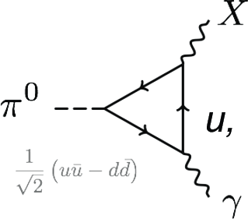
BASIC PROPERTIES
How do we find these particles?
E.g. dark photons with some “typical” parameters:
m_{A’} = 100 MeV, ε = 10⁻⁵.
Production: for example, pion decay:
Branching ratio suppressed by ε² = 10⁻¹⁰. Need lots of pions!
A’
ε

Slide 9
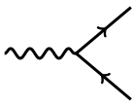
BASIC PROPERTIES
e⁺
Decay
Decay length is long, typically decays after leaving detector. (Note that the interaction length is even longer: ~10¹¹ cm!)
Motivates new analyses, new experiments at the lifetime frontier: LDMX, PADME, NA62, LHCb, Belle-II, SeaQuest, SHiP, HPS, MATHUSLA, FASER, Codex-b, and many others.
ε
A’
e⁻

Slide 10
FASER

Slide 11

FASER
New physics searches at the LHC focus on high p_{T}. This is appropriate for heavy, strongly interacting particles
  σ ~ fb to pb → N ~ 10³ – 10⁶, produced ~isotropically
However, if new particles are light and weakly interacting, this may be completely misguided. Instead should go where the pions are: at low p_{T} along the beamline
  σ_{inel} ~ 100 mb → N ~ 10¹⁷, θ ~ Λ_{QCD} / E ~ 250 MeV / TeV ~ mrad
Since the long-lived particles are extremely collimated, they motivate a small, fast, inexpensive experiment placed in the very forward region of ATLAS/CMS, a few 100m downstream

Slide 12
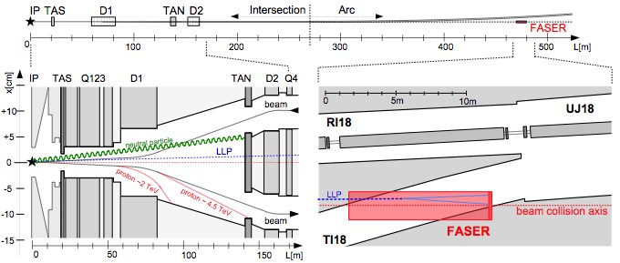
LONG LIVED PARTICLES IN FASER
LLP produced at IP, travels ~480 m, decays in FASER
If beam crossing angle = 285 (590) μrad in vertical/horizontal plane, the “on axis” location at FASER shifts by 6 (12) cm
Felix Kling

Slide 13
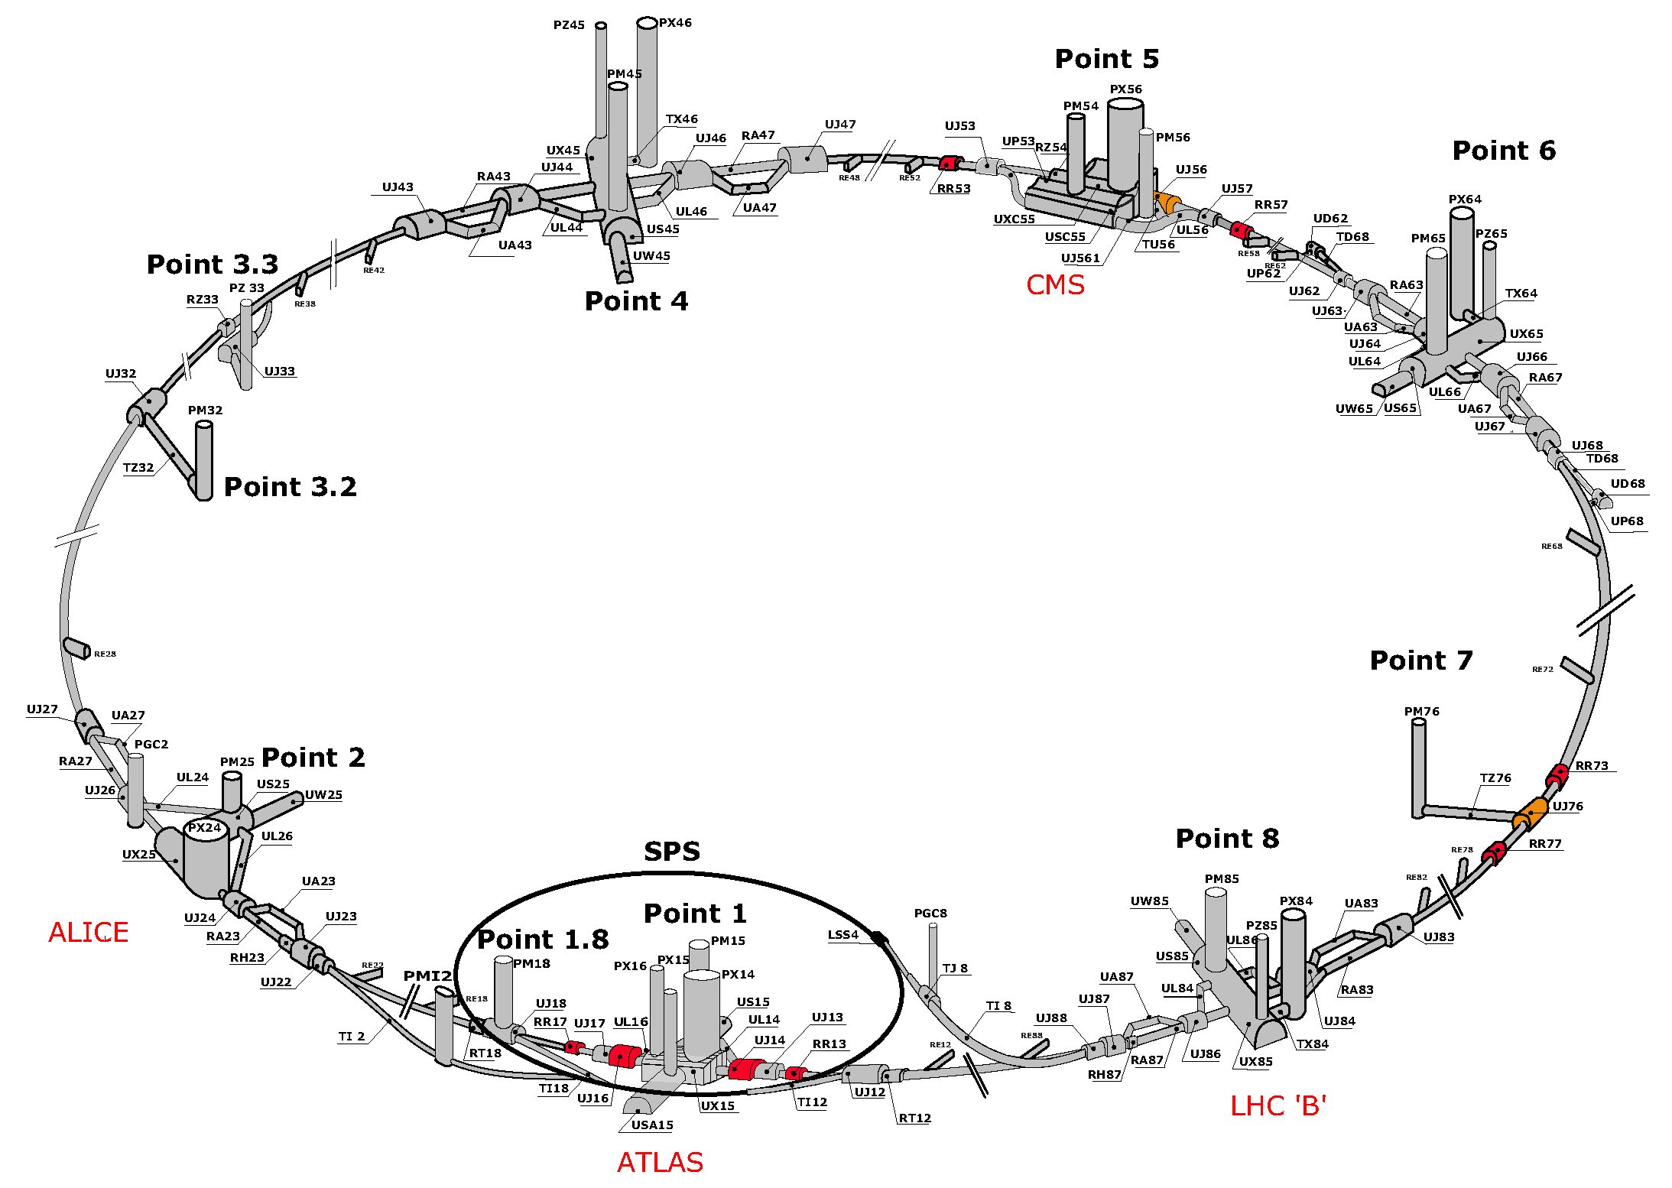
FASER LOCATION

Slide 14
FASER: LOCATION
TI18
FASER

Slide 15
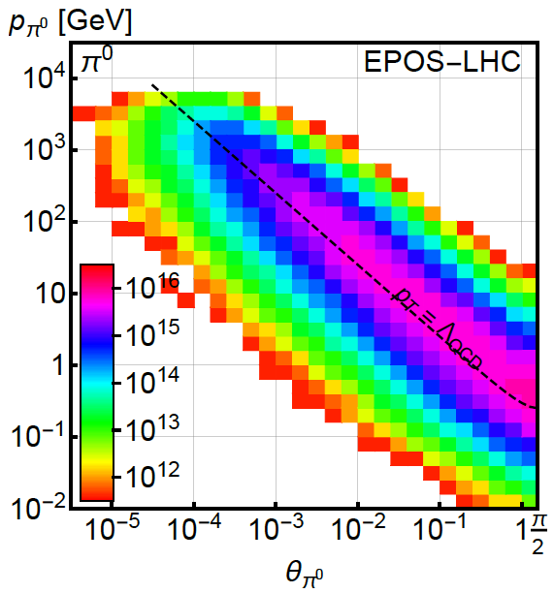
PION PRODUCTION AT THE LHC
Forward particle production simulations and models have been greatly constrained by LHC data
EPOS-LHC, SIBYLL 2.3, QGSJETII-04 agree very well
Enormous event rates (σ_{inel}~70 mb, N_{inel}~10¹⁷), production is peaked at p_{T} ~ Λ_{QCD}
300 fb⁻¹

Slide 16
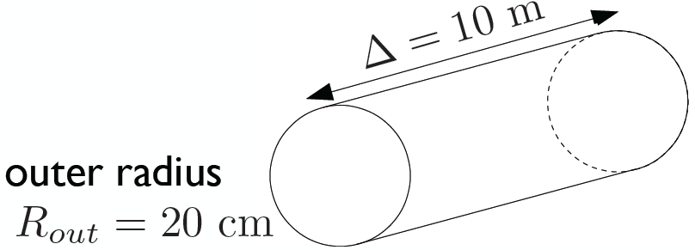
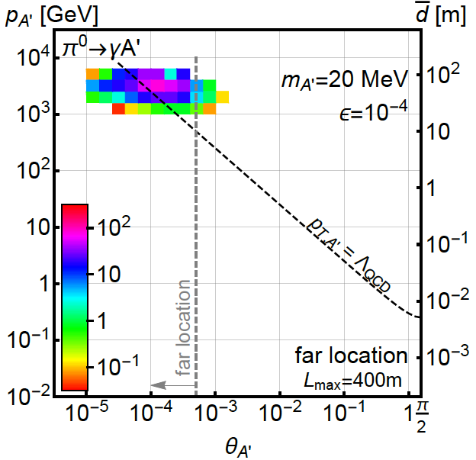
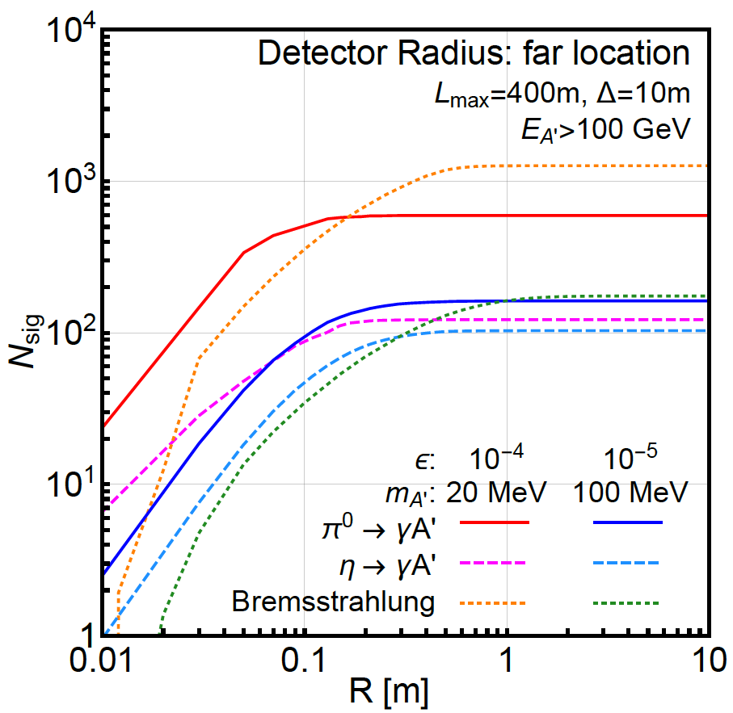
DARK PHOTONS IN FASER
Now require π⁰ → A’ γ, A’ → e⁺e⁻ in FASER: consider cylindrical detector with volume ~1 m²
Only the TeV A’s survive, but there are still many of them, and they are highly collimated within 20 cm of beam axis

Slide 17
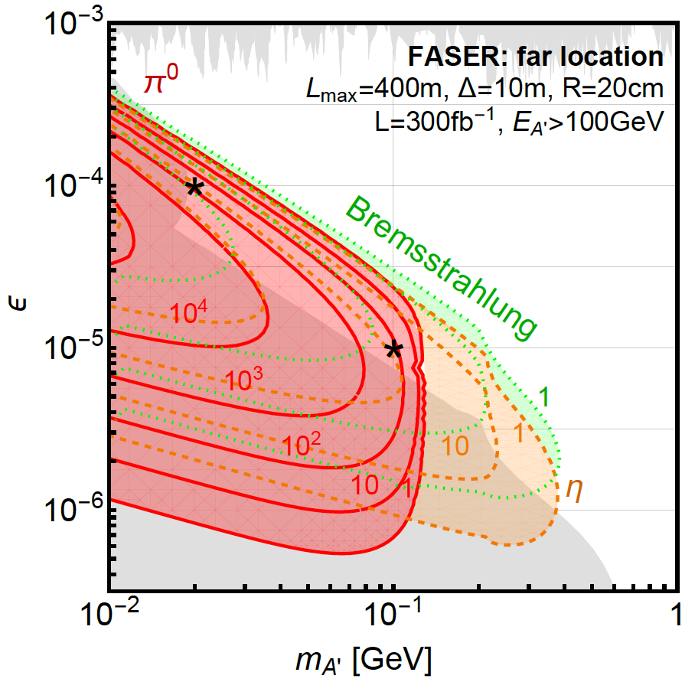
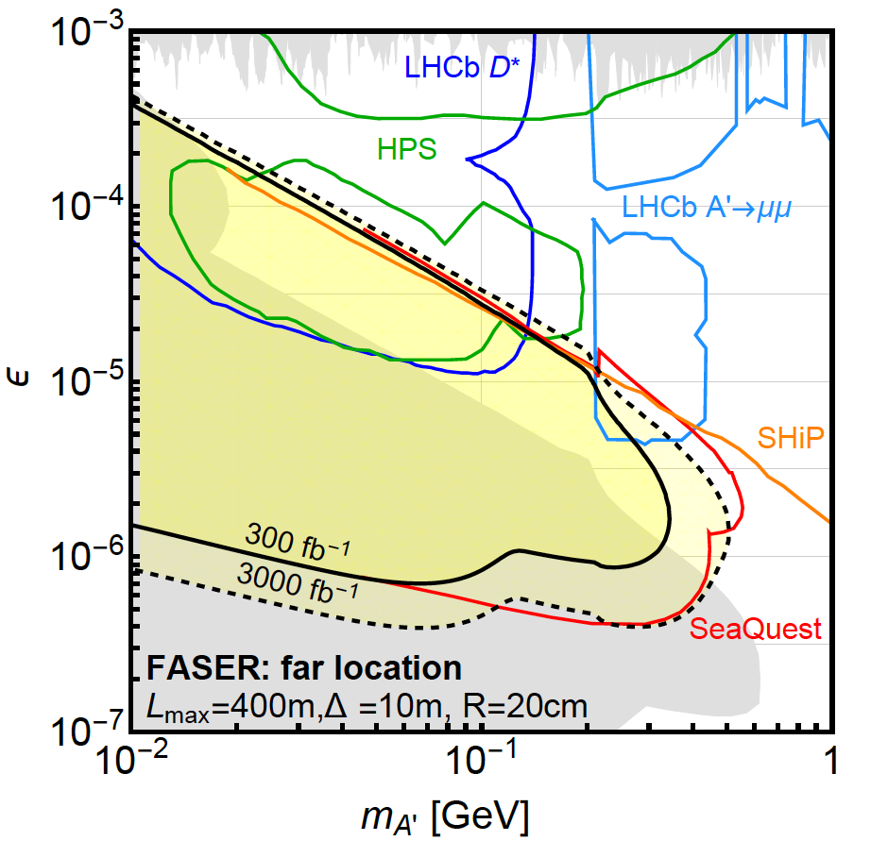
DARK PHOTON EVENT RATES AND REACH
Up to 10⁵ dark photons decay in FASER in 300 fb⁻¹ in parameter regions with m_{A’} ~ 10 - 500 MeV, ε ~ 10⁻⁶ – 10⁻³
At the upper ε boundary, rates are extremely sensitive to ε, reach is insensitive to background, provided it is known
N=3 contours

Slide 18
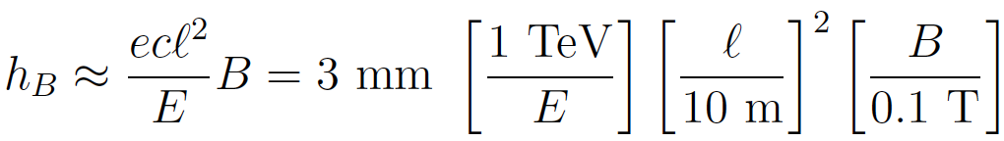
SIGNAL AND BACKGROUND
The signal is two simultaneous, opposite-sign, highly-energetic (E > 500 GeV) charged particles that start in the detector at a vertex and point back to IP → a tracker-based technology
The opening angle is θ_{ee} ~ m_{A’} / E ~ 10 μrad. After traveling ~1 m, this leads to 10 μm separation, too small to resolve, so we need a small magnetic field
Many backgrounds are eliminated simply by virtue of FASER’s location. Particles from IP must pass through ~50 m of matter to get to FASER. Cosmic ray background is negligible, charged particles from IP are bent away by D1 magnet
Leading backgrounds: neutrino-induced backgrounds are very small, beam-induced backgrounds (see FLUKA study).

Slide 19
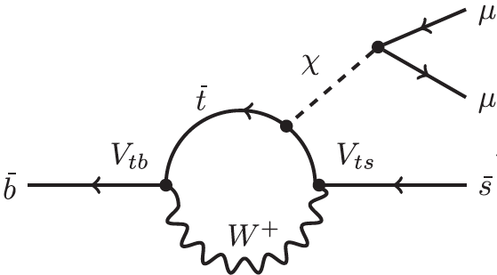
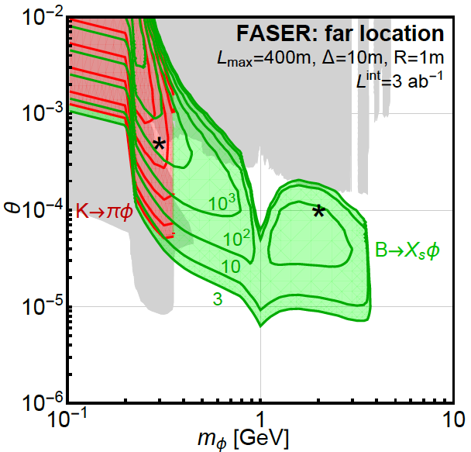
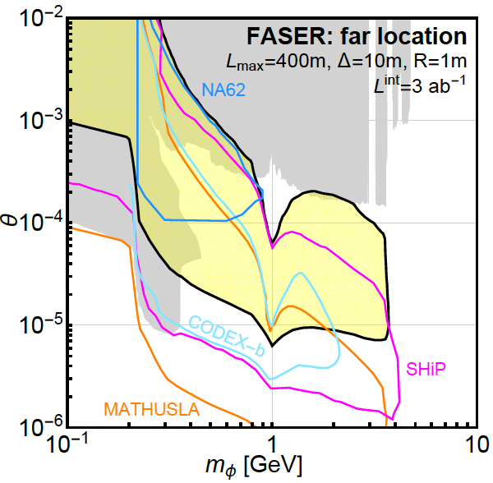
DARK HIGGS EVENT RATES AND REACH
FASER is especially good at probing LLPs from B decays: FASER: N_{B}/N_{π} ~ 10⁻². (Cf. SHiP: N_{B}/N_{π} ~ 10⁻⁷.)
FASER with 1m x 1m cross section probes a large swath of new parameter space, is complementary to other experiments
φ
LHCb

Slide 20
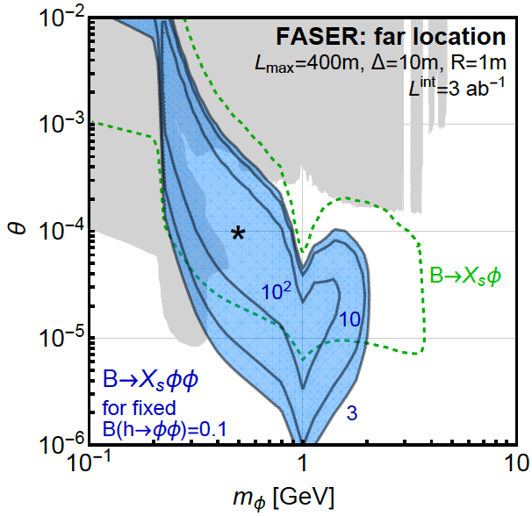
TRILINEAR COUPLINGS REACH
FASER can also probe the trilinear couplings through
φ
h
This competes with
h → φφ (ATLAS, CMS)
h → φφ ◊ charged particles (MATHUSLA)
Can get 100s of events from “double dark Higgs” production
φ

Slide 21

ALPS EVENT RATES AND REACH
FASER can probe ALPs as a high-energy photon beam dump
Primakoff
production
in TA(X)N
FASER probes a large swath of new parameter space

Slide 22
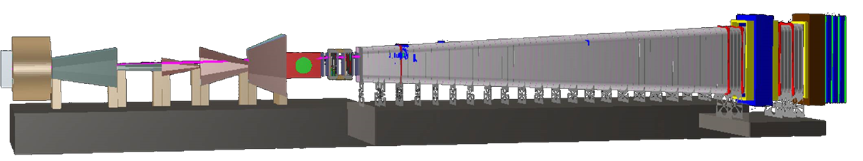
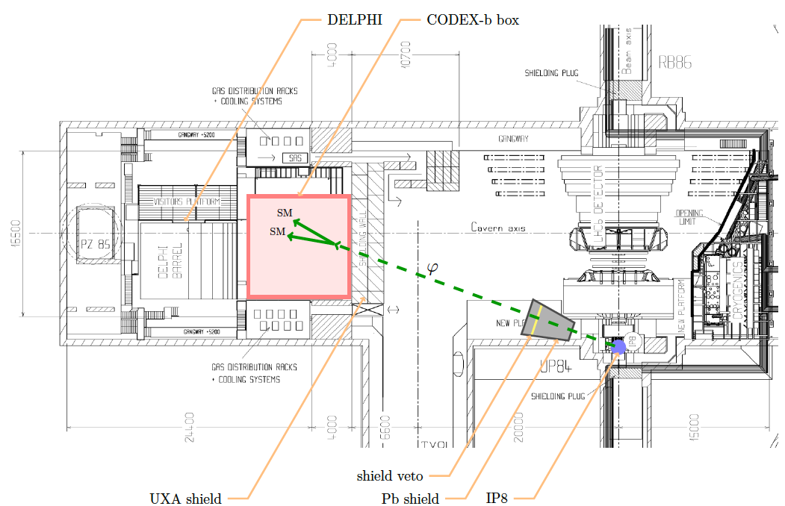
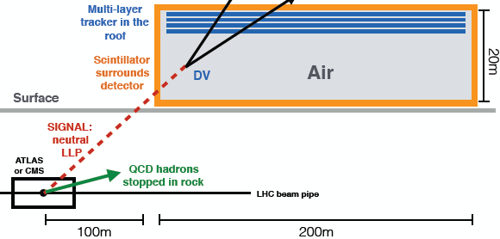
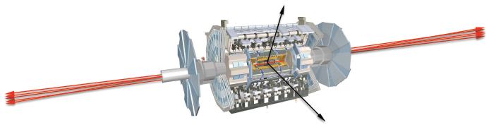
COMPLEMENTARY PROPOSED EXPERIMENTS
SHiP
CODEX-b
~1000 m³, ~100M CHF + beam
Alekhin et al. (2015)
~1000 m³ ~ 1 mIKEAs
Gligorov, Knapen, Papucci, Robinson (2017)
FASER
MATHUSLA
~1 m³ ~ 1 μIKEAs
~800,000 m³ ~ 1 IKEA, ~$50M
Feng, Galon, Kling, Trojanowski (2017)
Chou, Curtin, Lubatti (2016)

Slide 23
RECENT PROGRESS
Theory: see also studies of flavor-specific scalar mediators (Batell, Freitas, Ismail, McKeen, 1712.10022), HNLs (heavy neutral leptons, sterile neutrinos) (Kling, Trojanowski, 1801.08947; Helo, Hirsch, Wang, 1803.02212), other gauge bosons (Bauer, Foldenauer, Jaeckel, 1803.05466), ALPs (axion-like particles) and other models in progress
Experiment: FASER, MATHUSLA, CODEX-b, MilliQan have joined the CERN Physics Beyond Collider study. A few examples of recent progress follow. Thanks to Aki Ariga, Tomoko Ariga, Jamie Boyd, Dave Casper, Francesco Cerrutti and FLUKA team, Paolo Fessia, Shih-Chieh Hsu, Mike Lamont, Hide Otono, Brian Petersen, Osamu Sato, …

Slide 24
FASER: LOCATION
TI18
FASER

Slide 25
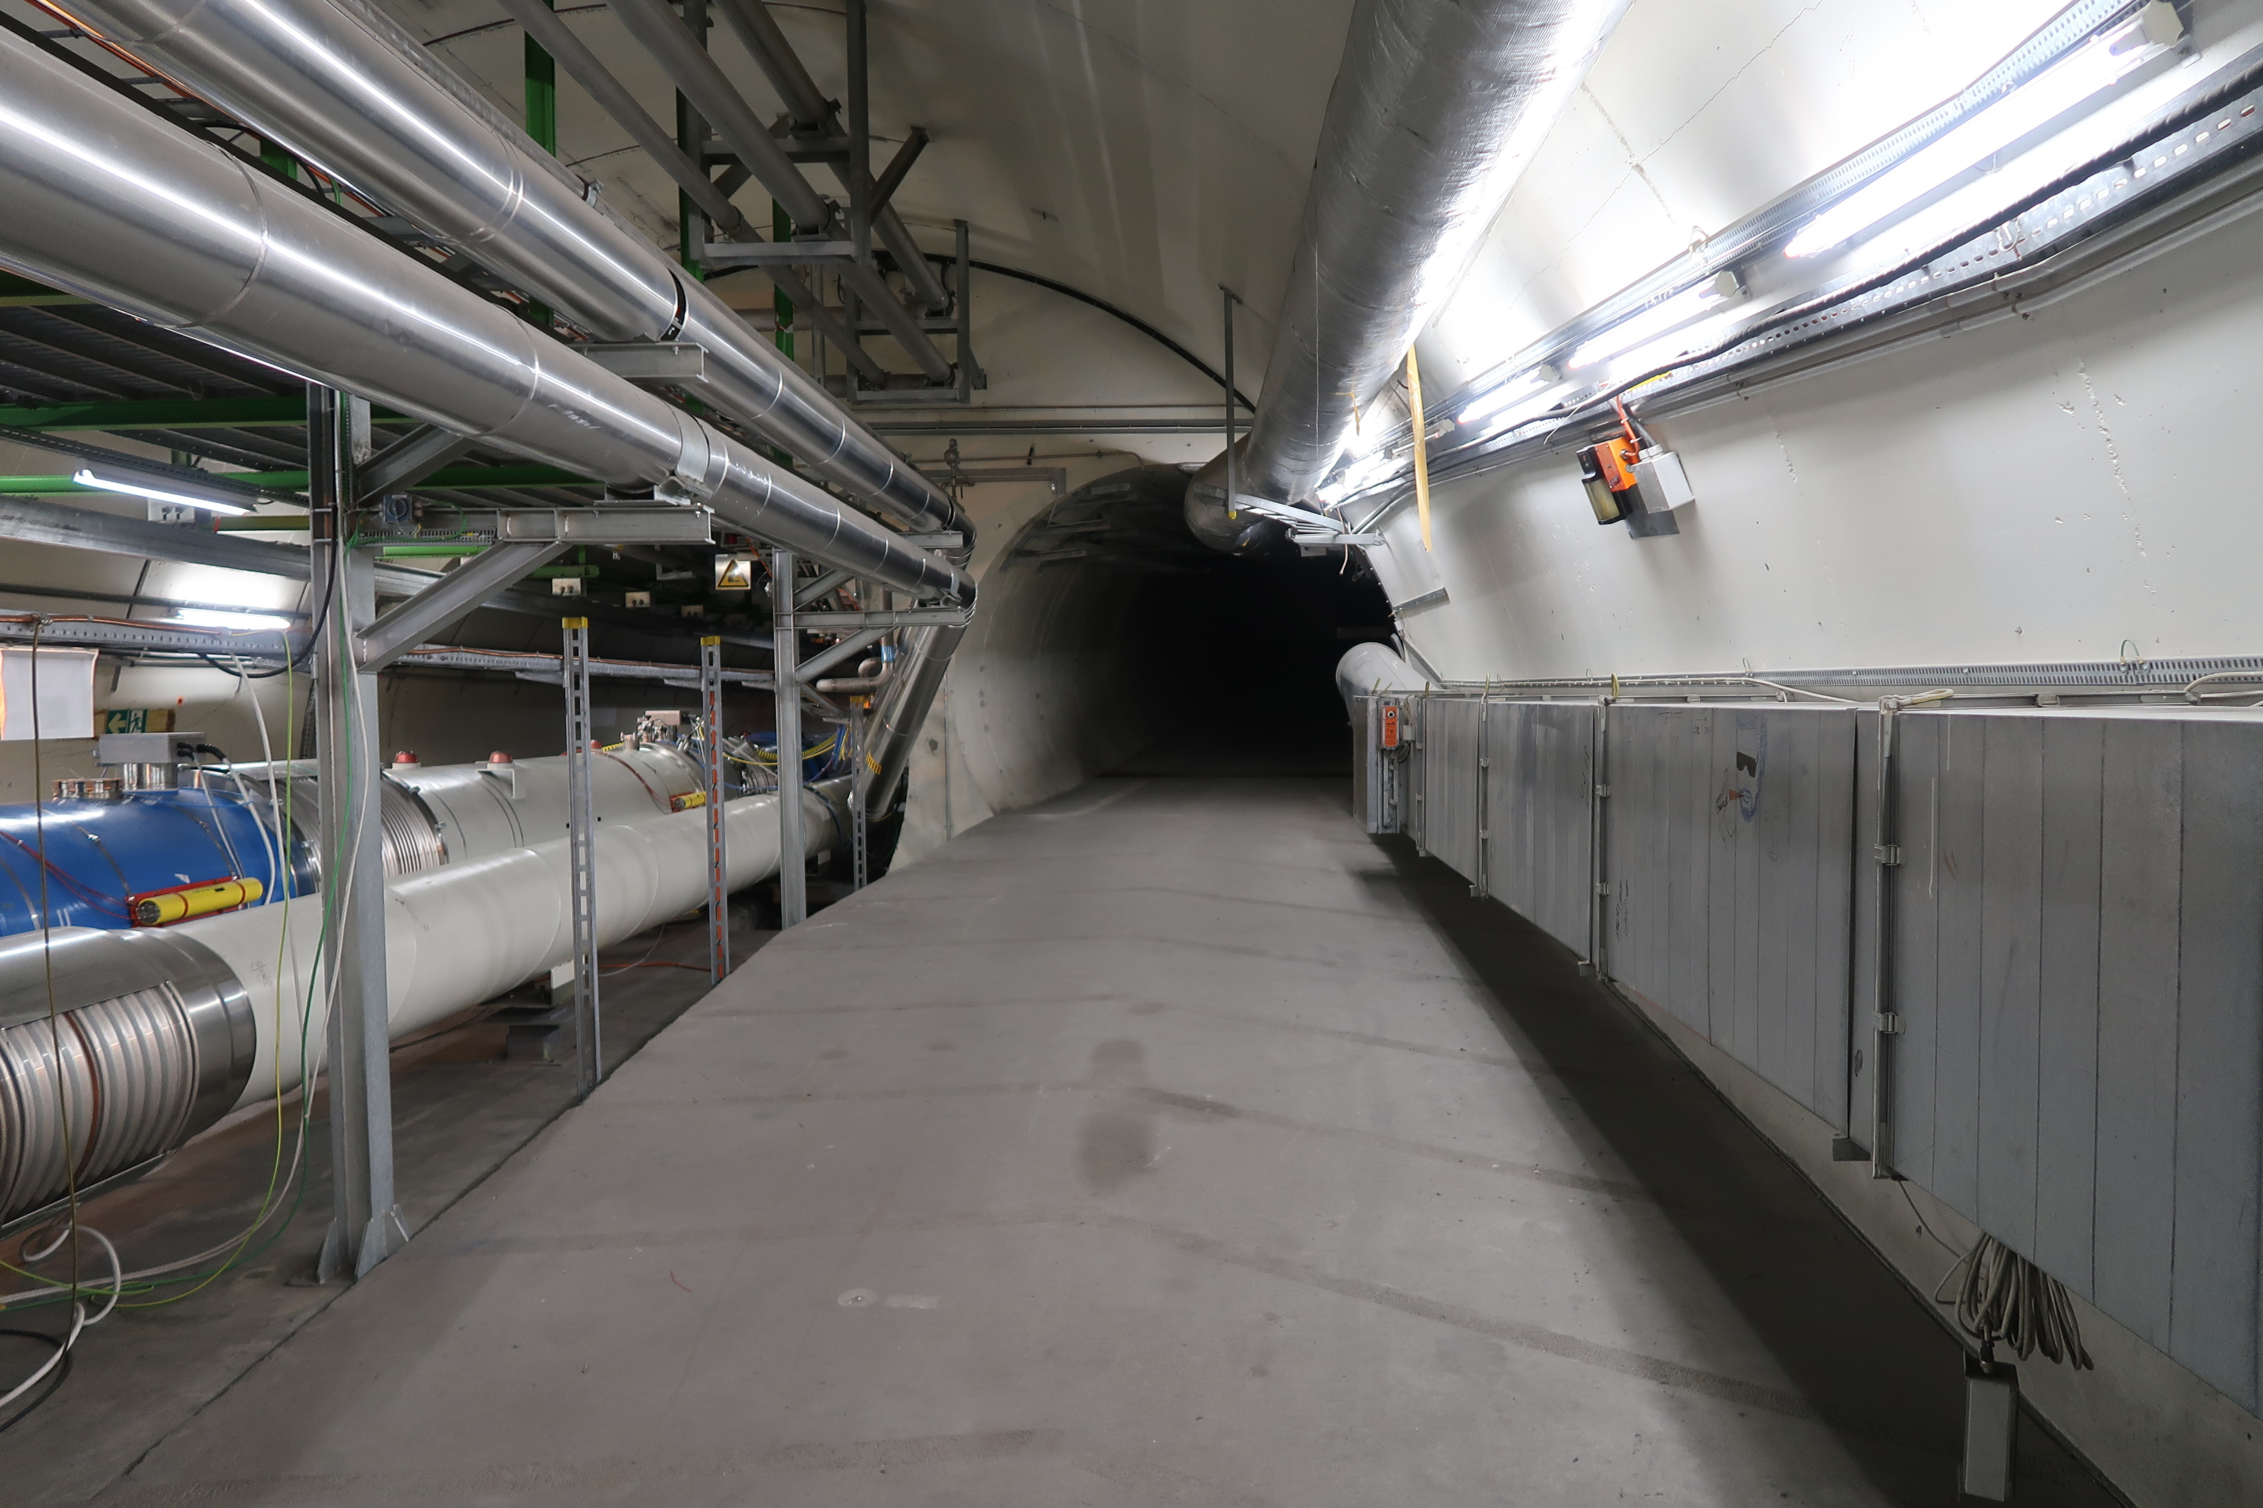
FASER: LOCATION

Slide 26
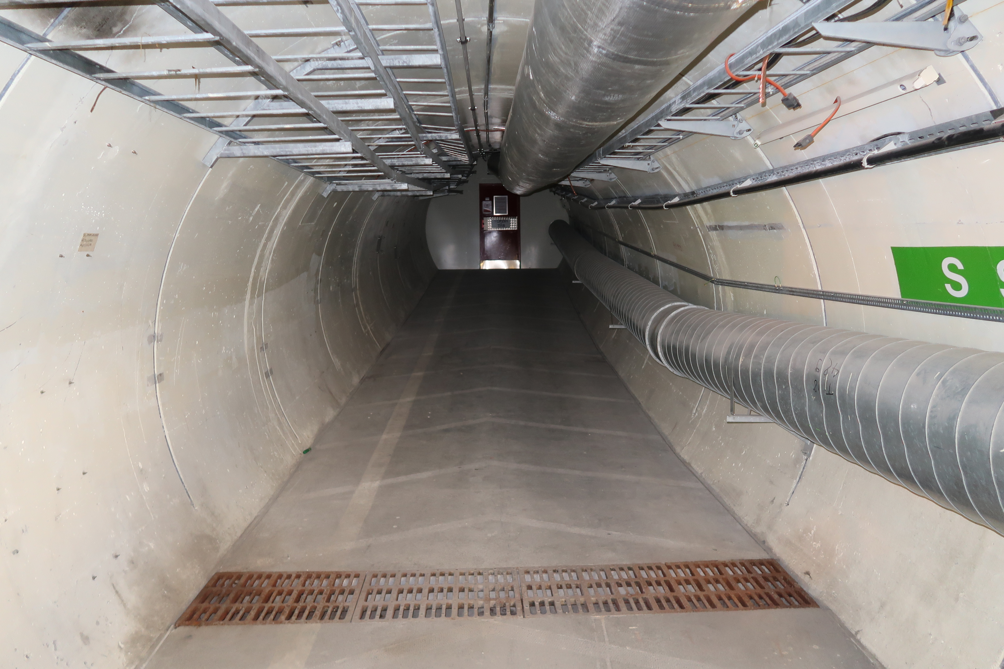
FASER: LOCATION

Slide 27
FASER: LOCATION
~TeV e+e- pairs from LLP decays may be
streaking across the floor of this tunnel every few minutes

Slide 28
DETECTOR DESIGN
GENAT study underway. Current design has an initial veto layer, followed by 3 tracking layers and EM calorimeter, with some of the volume in a 0.35 T permanent dipole magnet.

Slide 29
BACKGROUND SIMULATION AND MEASUREMENT
Initial FLUKA study shows very low backgrounds at FASER location. Details expected soon.
Hope to put RadMon and emulsion detector in TS1 (June 15) to validate FLUKA simulation, understand radiation levels for electronics, etc.

Slide 30
SUMMARY AND OUTLOOK
The LHC has seen no new physics. Adding supplementary detectors is a good idea, and there are many proposals targeting the lifetime frontier.
All have significant discover prospects for “dark” particles: dark photons, dark Higgs bosons, HNLs, ALPs, …
Possible timeline for FASER: install FASER 1 (20 cm x 20 cm) in LS2 (2019-20) for Run 3 (150-300 fb⁻¹), install FASER 2 (1m x 1m) in LS3 (2023-25) for HL-LHC (3 ab⁻¹).
https://twiki.cern.ch/twiki/bin/viewauth/FASER/WebHome

