Slide 1
THE PATH FORWARD
Dark Matter Detection and Detectability:
Paradigm Confirmation or Shift?
KITP, Santa Barbara
Jonathan Feng, University of California, Irvine
4 May 2018

Slide 2
OUTLINE
A rather one-sided debate! Of course, the real goal of a “debate” is to encourage people to get to the heart of the matter and give their frank opinions. In that spirit, I’ll provide my perspective about various topics that have come up at this conference:
Is dark matter particles?
Are there small scale structure problems?
Are WIMPs dead?
What are promising directions?
Is our field healthy?

Slide 3
IS DARK MATTER PARTICLES?

Slide 4
IS DARK MATTER PARTICLES?
Solving the dark matter problem is often posed as a choice: do you want to add new particles or do you want to find a new theory of gravity?
But this is a false dichotomy -- we need both! The dark matter problem does not exist in isolation.

Slide 5
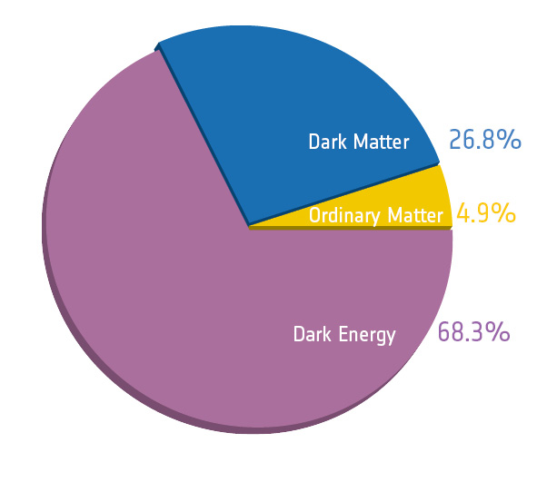
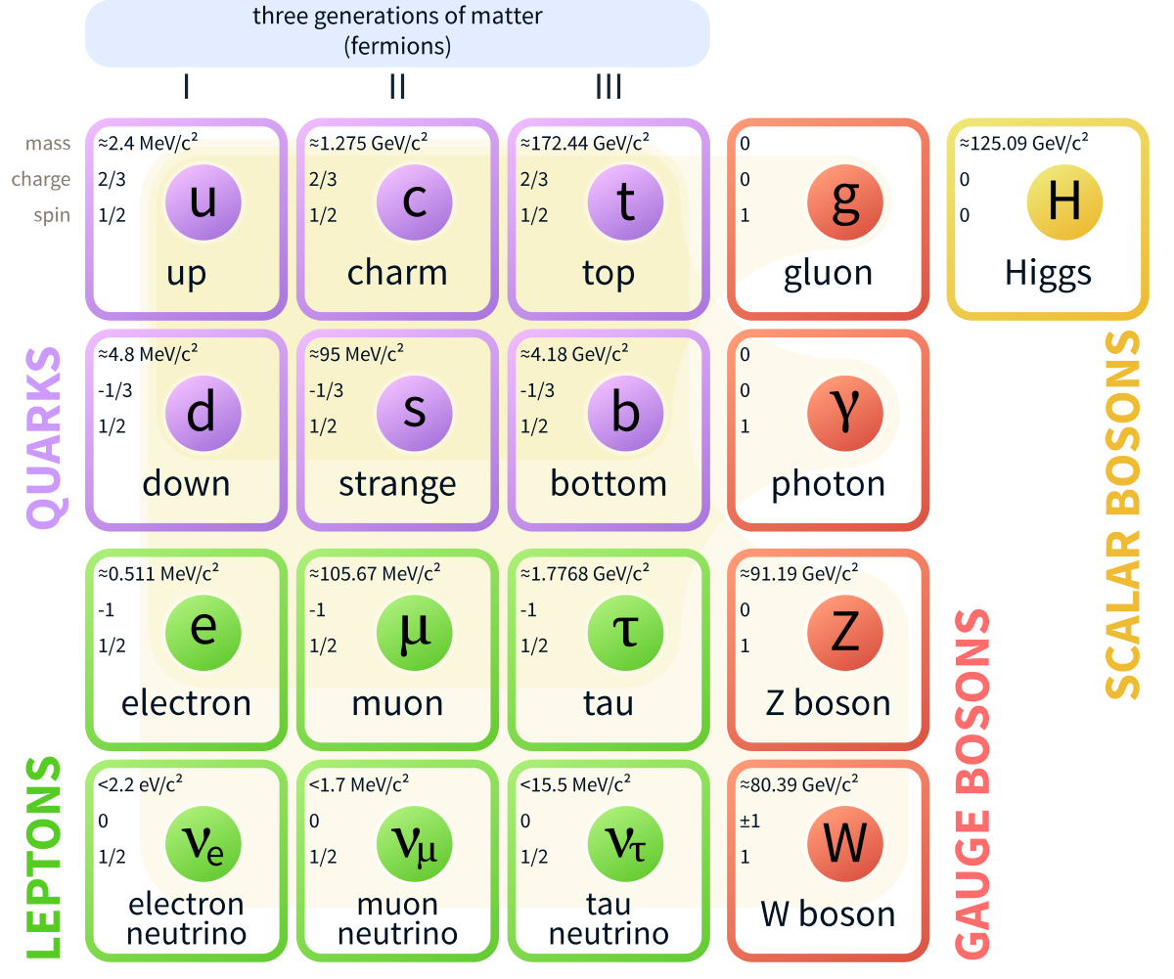
OUTSTANDING PROBLEMS
Dark Matter
Flavor, CP, Strong CP
Grand Unification
Inflation
Naturalness
Baryogenesis
Dark Energy
Neutrino Mass
G?
Quantum Gravity

Slide 6
IS DARK MATTER PARTICLES?
The lesson: our standard models are not crystalline gems of perfection; they are works in progress. There are many problems: some demand new particles, some demand new gravity. New theories of gravity do not save us from needing new particles.
Given that we need new particles, could some be dark matter? In fact, the new particle paradigm solves the dark matter problem with extraordinary efficiency: one particle explains a wonderfully broad range of phenomena, a unifying achievement to rival Maxwell’s. (Cf. baryogenesis.)
Of course, we need to find non-gravitational evidence for particle dark matter. But absent that, the case for particle dark matter could not be more compelling.

Slide 7
ARE THERE SMALL SCALE STRUCTURE PROBLEMS?

Slide 8
SMALL SCALE STRUCTURE PROBLEMS?
Number of subhalos, too big to fail, cusp vs. core: are these problems? Lots of interesting discussion at this meeting; some say Yes, some say No.
But this is not a Yes/No question. The real question is: can astrophysics tell us more about the particle properties of dark matter? Given null particle results, this is an essential part of the path forward.
Some seem enthusiastic when they confirm collisionless, cold DM. This seems odd to me. This means that we have failed to follow in the glorious footsteps of our predecessors by looking to the heavens and learning something significantly new about what makes up the universe. Of course, we want to find the truth, but a twinge of remorse would be more appropriate. (Cf. LHC experimentalists who gleefully confirm the SM.)

Slide 9
ARE WIMPS DEAD?

Slide 10
ARE WIMPS DEAD?
The WIMP miracle has been a driving force for a long time

Slide 11
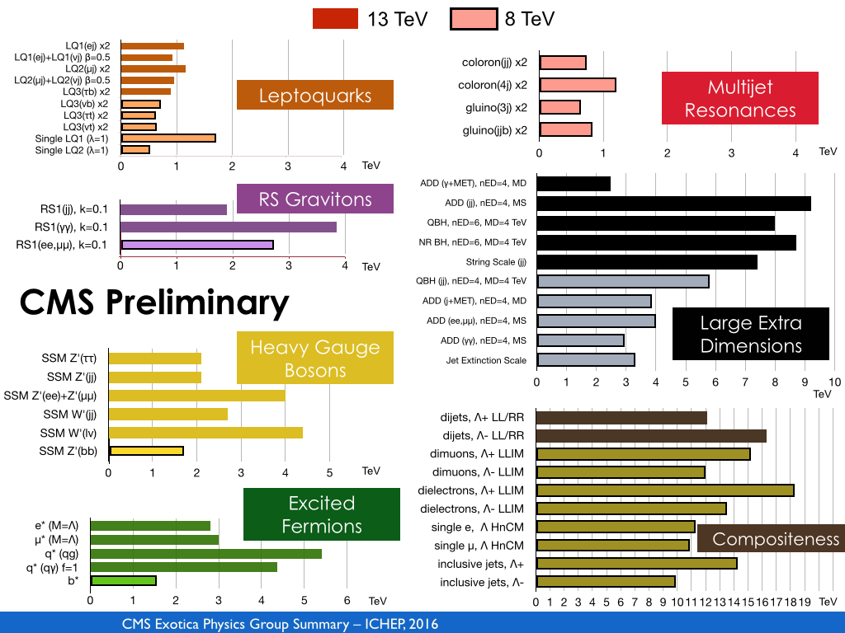
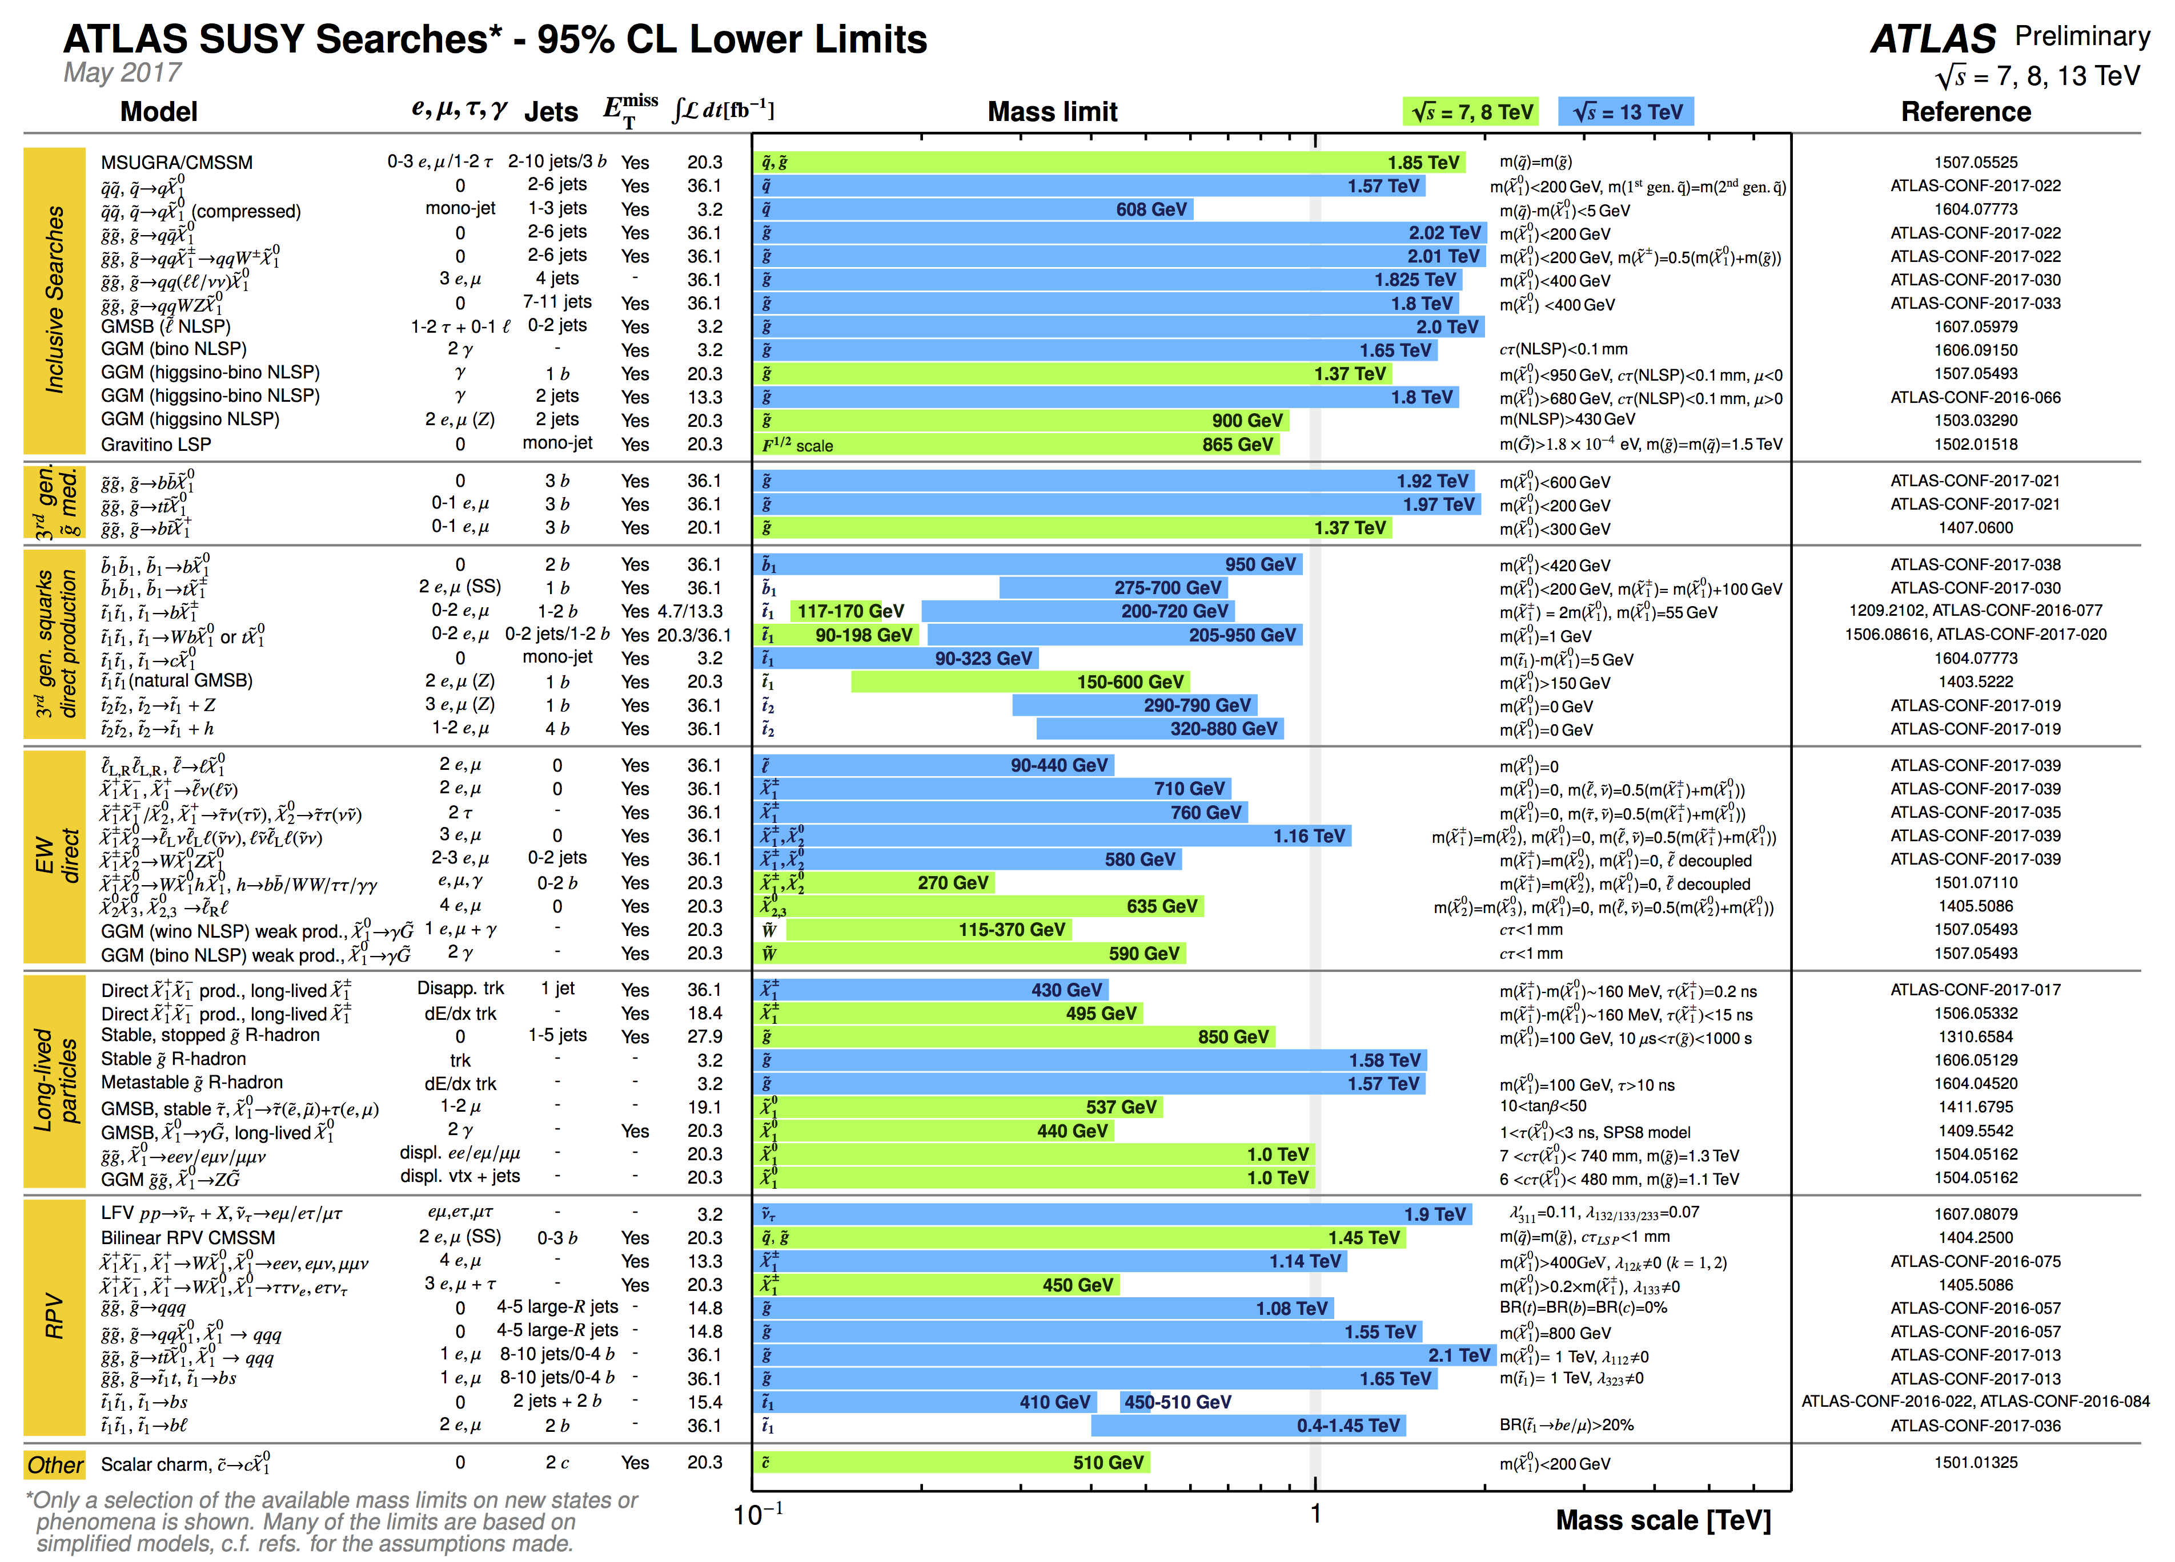
ARE WIMPS DEAD?
Of course, WIMPs aren’t dead. But a more interesting question is, how about the leading frameworks that include WIMPs along with other beautiful motivations (e.g., naturalness)? For example: weak-scale supersymmetry.
There are many constraints on SUSY from the LHC.

Slide 12
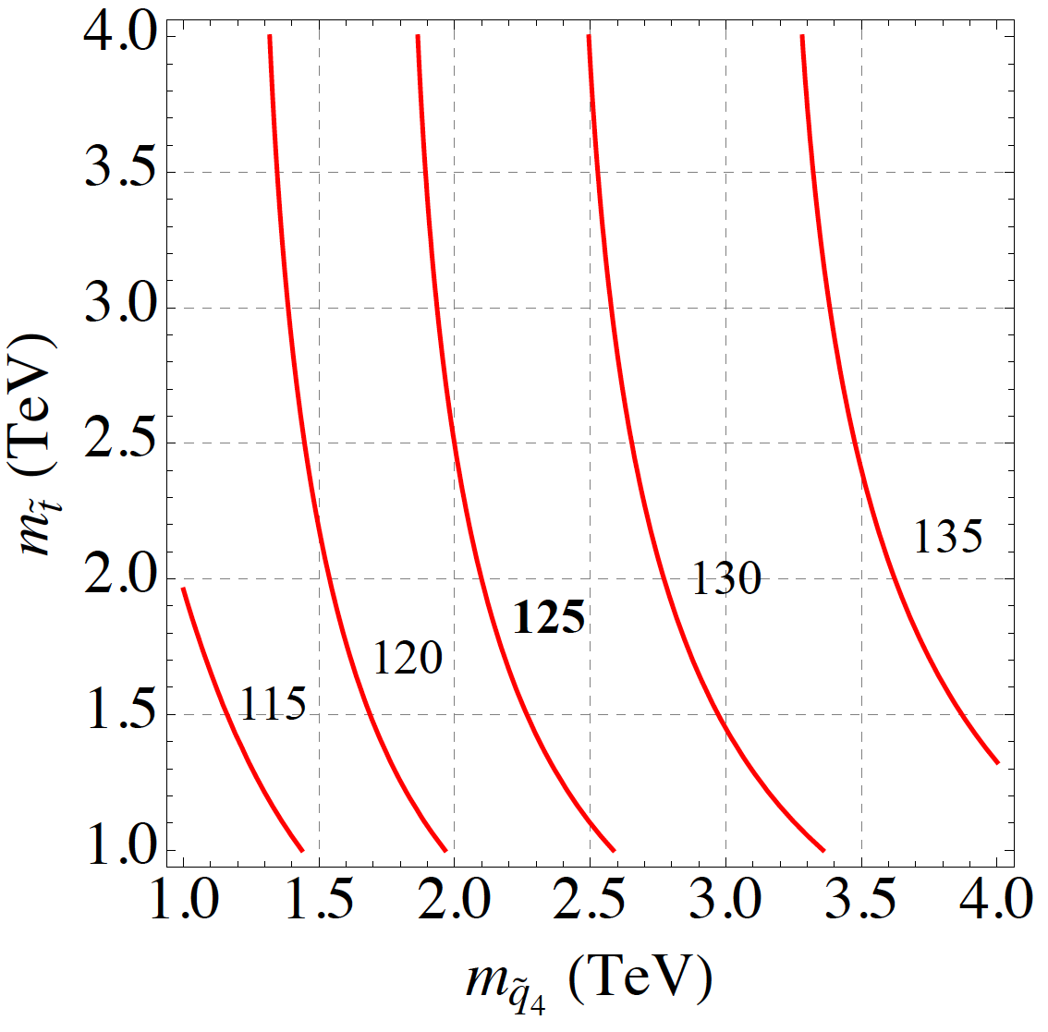
MSSM4G
But there remain viable models that preserve all of the central motivations for SUSY: e.g., MSSM4G.
Naturalness suggests light stops and sbottoms; m_{h} = 125 GeV suggests heavy stops and sbottoms.
m_{h} (GeV)
A resolution: introduce a vector-like 4th generation of particles to raise the Higgs mass.
For example, add a 10 of SU(5) consistent with gauge coupling unification:
Moroi, Okada (1992); Martin (2010)
_{Abdullah, Feng (2015)}

Slide 13
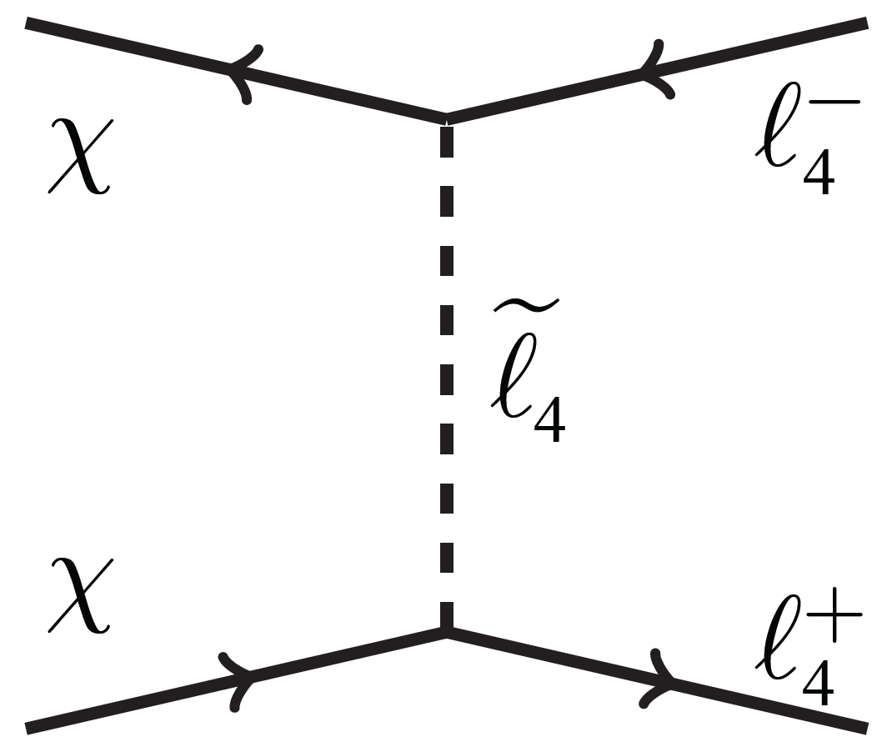
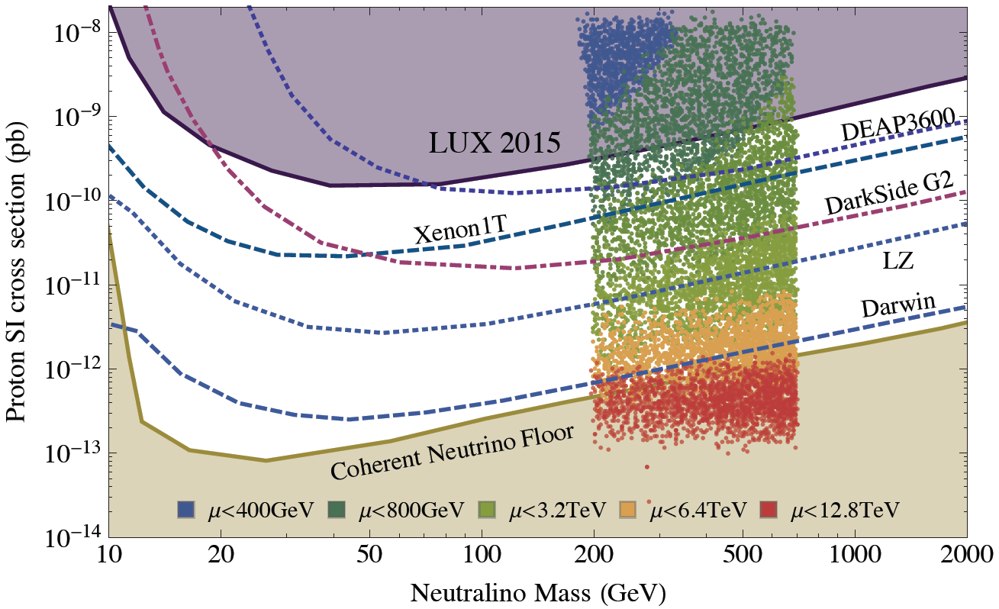
MSSM4G DARK MATTER
MSSM4G predicts heavy Bino-like dark matter that freezes out with the right thermal relic density through χχ → τ₄τ₄ .
Direct detection cross sections naturally fall between current bounds and the neutrino floor.
Also interesting signals for LHC, indirect detection (CTA).
Abdullah, Feng, Iwamoto, Lillard ( 2016)
Models like these preserve all the fundamental motivations of SUSY and promise an exciting program of discovery for DM and collider searches. The WIMP paradigm is doing fine.

Slide 14
WHAT ARE PROMISING DIRECTIONS?

Slide 15
LAMPPOST LANDSCAPE
1
Already
Discovered
Strongly Interacting
Heavy Particles
10⁻³
Coupling Strength
Weakly Interacting
Light Particles
Impossible to
Discover
10⁻⁶
MeV
GeV
TeV
Mass

Slide 16
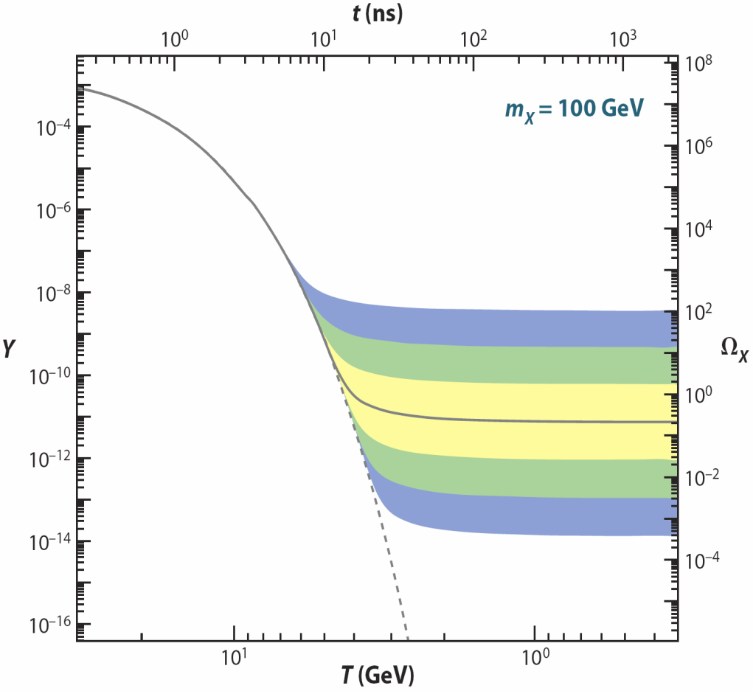
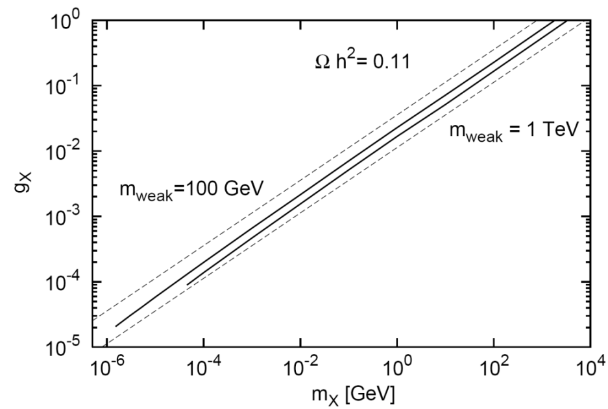
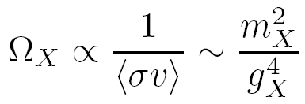
WEAKLY INTERACTING, LIGHT PARTICLES
A new target for new physics searches, but with similarly strong motivations
Weakly interacting, light particles can be thermal relic dark matter.
_{Boehm, Fayet (2003)}
WIMPless Miracle: in fact, in analogy with the WIMP miracle, the structure of theories motivated by particle physics alone (SUSY with GMSB, AMSB) produces particles with exactly the required properties. _{Feng, Kumar (2008)}
Feng, Tu, Yu (2008)
_{WIMPs}
_{WIMPless DM}
Weakly-interacting, light particles can naturally have the right thermal relic density, be probed by the intensity frontier, nuclear, AMO, and CM physics.

Slide 17
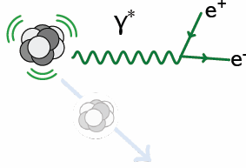
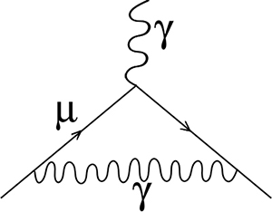
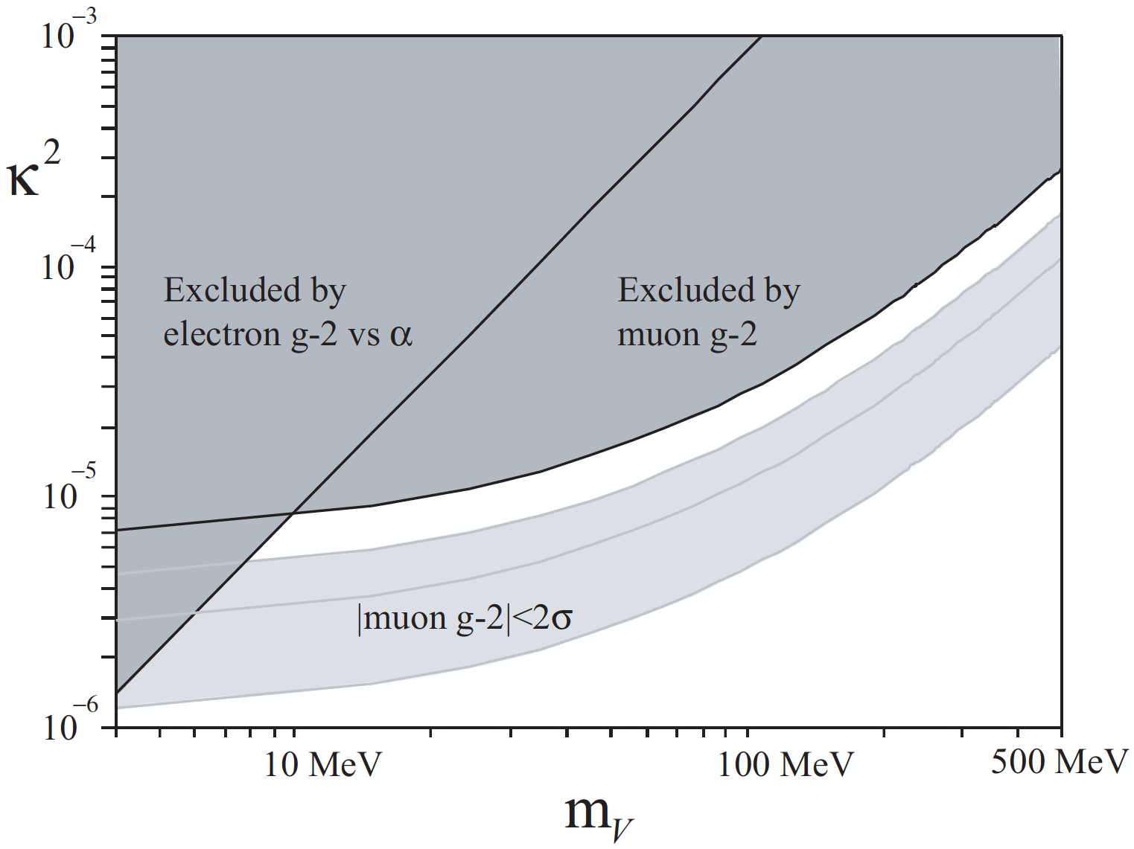
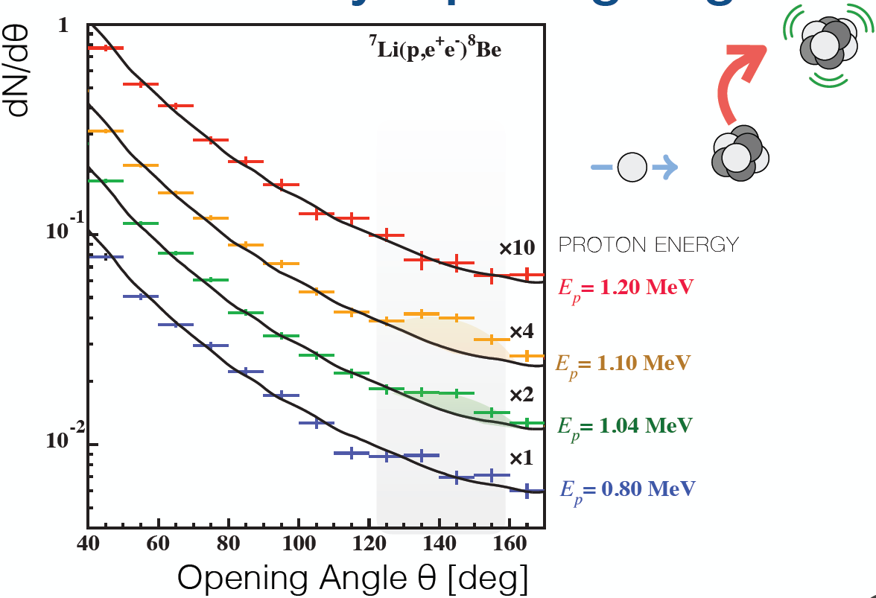
WEAKLY INTERACTING, LIGHT PARTICLES
Anomalies
Muon g-2
X
⁸Be
6.8σ anomaly seen in decays → milli-charged, 17 MeV boson
γ, A’
Krasznahorkay et al. (2015)
Feng, Fornal,Galon, Gardner, Smolinsky, Tanedo, Tait (2016)
Boehm, Fayet (2003); Pospelov (2008)

Slide 18
Dark Sector Candidates, Anomalies, and Search Techniques
zeV
aeV
feV
peV
neV
μeV
meV
eV
keV
MeV
GeV
TeV
PeV
30M☉
≈
QCD Axion
Sterile Neutrino
WIMPs
Ultralight Dark Matter
Hidden Thermal Relics / WIMPless DM
Black Holes
SIMPs / ELDERS
Asymmetric DM
X-ray Line
Beryllium-8
Muon g-2
Small-Scale Structure
Coherent Field Searches
Nuclear and Atomic Physics
Microlensing
Direct Detection (Low-Threshold and Spin-Dependent)
Accelerators
≈
zeV
aeV
feV
peV
neV
μeV
meV
eV
keV
MeV
GeV
TeV
PeV
30M☉
Cosmic Visions Report (2017)
Notes:
Targets: Freeze-In, Inflation Mechanism, Misalignment Mechanism

Slide 19
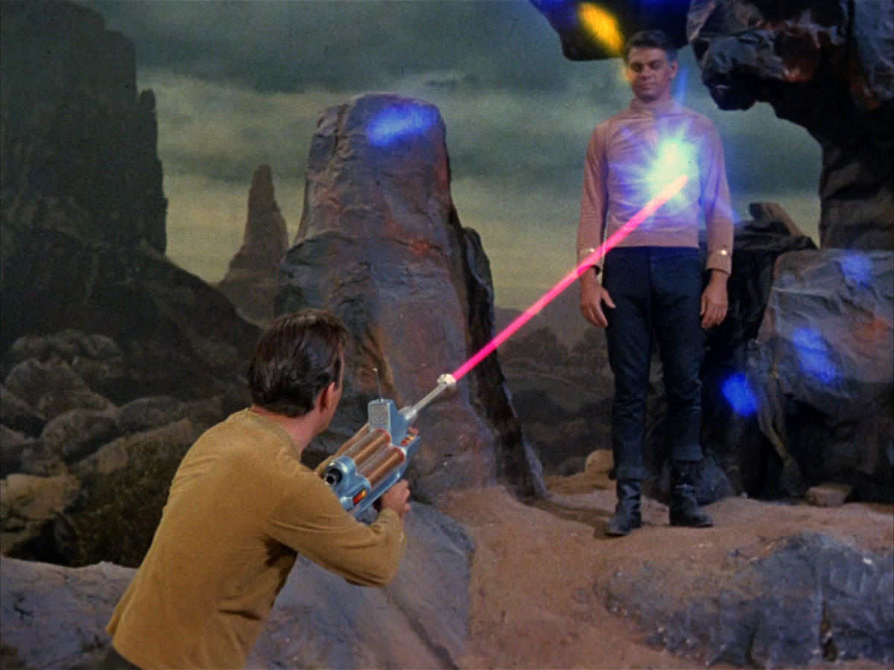
THE LIFETIME FRONTIER
Light, weakly-interacting particles motivate new connections to other fields of physics: nuclear physics, condensed matter physics, AMO, etc.
They also typically live a long time, and so motivate new particle physics analyses and experiments, including LHCb, HPS, Belle-II, NA62, SHiP, SeaQuest, MilliQan, MATHUSLA, Codex-b, and many others.
One example: FASER: ForwArd Search ExpeRiment. “The acronym recalls another marvelous instrument that harnessed highly collimated particles and was used to explore strange new worlds.”

Slide 20
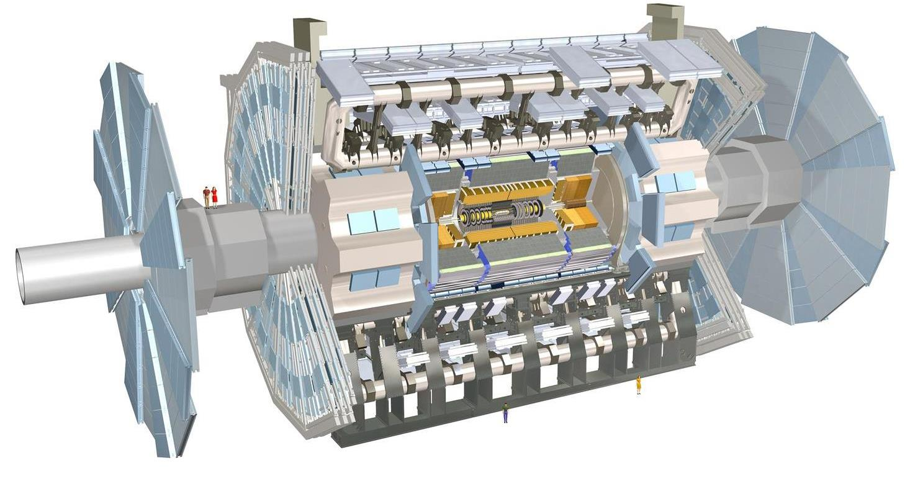
FASER: THE IDEA
New physics searches at the LHC focus on high p_{T}. This is appropriate for heavy, strongly interacting particles
σ ~ fb to pb → N ~ 10³ – 10⁶, produced ~isotropically
However, if new particles are light and weakly interacting, this may be completely misguided. Instead should exploit
σ_{inel} ~ 100 mb → N ~ 10¹⁷, θ ~ Λ_{QCD} / E ~ 250 MeV / TeV ~ mrad
FASER is a small (~1 m³), inexpensive experiment, designed to catch these particles in the very forward region of ATLAS/CMS, a few 100m downstream of the IP.

Slide 21
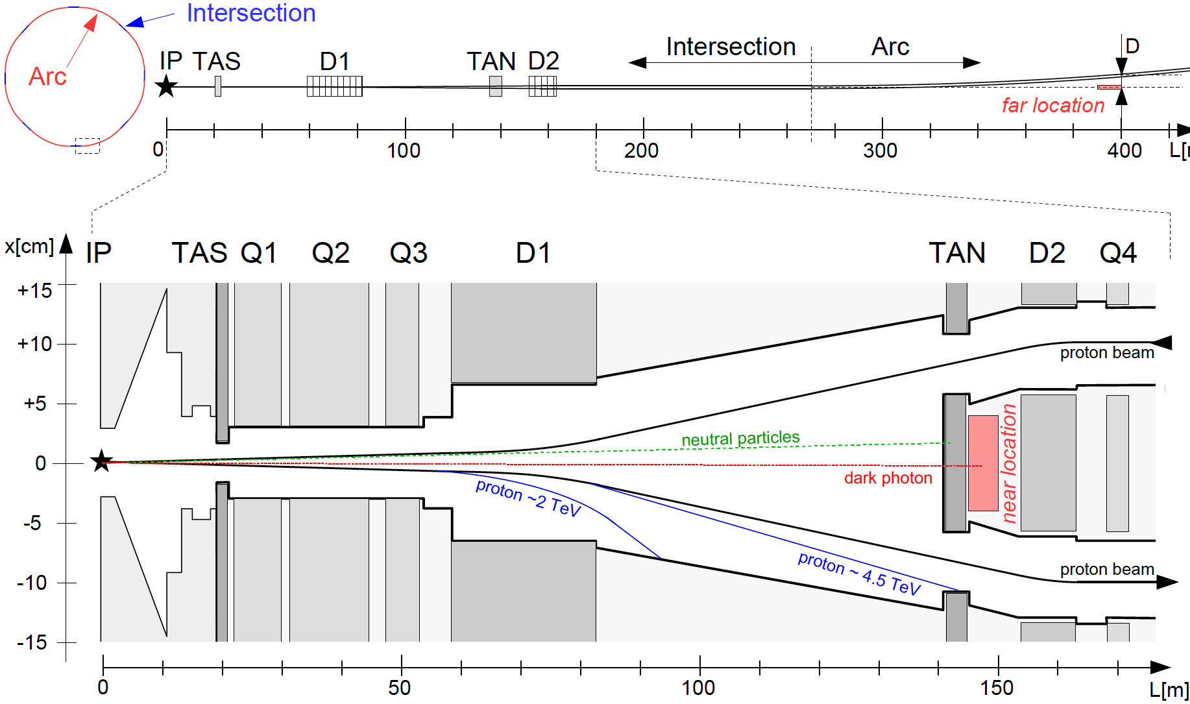
FASER LOCATION
We want to place FASER along the beam collision axis
Far location: ~400 m from IP, after beams curve, ~3 m from the beams
Near location: 150 m, after TAN, between the beams
Here, focus on far location, assume FASER is exactly on-axis
If ATLAS/CMS beams cross at 285 (590) μrad in vertical/horizontal plane, far location shifts by 6 (12) cm
Feng, Galon, Kling, Trojanowski (2017)

Slide 22
DARK PHOTONS
Dark matter is our most solid evidence for new particles. In recent years, the idea of dark matter has been generalized to dark sectors.
A prominent example: vector portal, leading to dark photons
The resulting theory contains a new gauge boson A’ with mass m_{A’} and εQ_{f} couplings to SM fermions f.
Dark photons are produced in π⁰ → A’ γ, decay after ~100 m.
SM
Hidden
U(1)

Slide 23
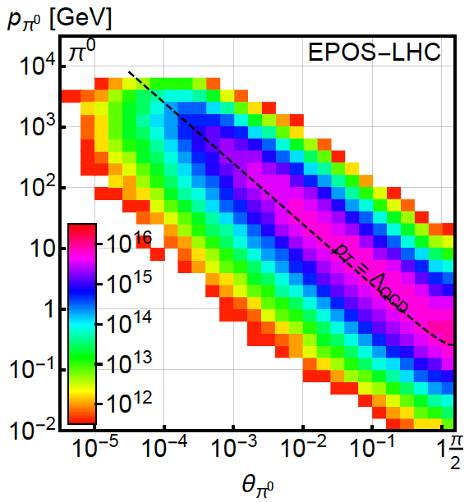
PION PRODUCTION AT THE LHC
Forward particle production simulations and models have been greatly constrained by LHC data
EPOS-LHC, SIBYLL 2.3, QGSJETII-04 agree very well
Enormous event rates (σ_{inel}~70 mb, N_{inel}~10¹⁷), production is peaked at p_{T} ~ Λ_{QCD}
300 fb⁻¹

Slide 24
DARK PHOTON PRODUCTION
Consider π⁰ decay, η decay, dark bremsstrahlung
Results for 1st model point: (m_{A’}, ε) = (20 MeV, 10⁻⁴)
From π⁰ → γ A’, E_{A’} ~ E_{π} / 2 ( no surprise)
But note rates: even after ε² suppression, N_{A’} ~ 10⁸ ; LHC may be a dark photon factory!

Slide 25
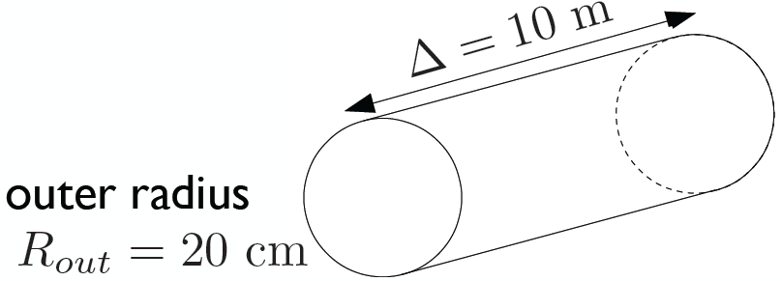
DARK PHOTONS IN FASER
Now require dark photons to decay in FASER: consider cylindrical detector with volume ~1 m²
Only the highest energy A’s survive, but there are still many of them, and they are highly collimated

Slide 26
DARK PHOTON EVENT RATES AND REACH
Up to 10⁵ dark photons decay in FASER in 300 fb⁻¹ in parameter regions with m_{A’} ~ 10 - 500 MeV, ε ~ 10⁻⁶ – 10⁻³
Note that at upper ε boundary, rates are extremely sensitive to ε and the reach is quite insensitive to background, provided it is known
N=3 contours

Slide 27
DARK HIGGS BOSONS
Another renormalizable coupling: Higgs portal
The resulting theory contains a new scalar boson φ with mass m_{φ} , Higgs-like couplings suppressed by sin θ, and a trilinear coupling λ
SM
Hidden
Higgs

Slide 28
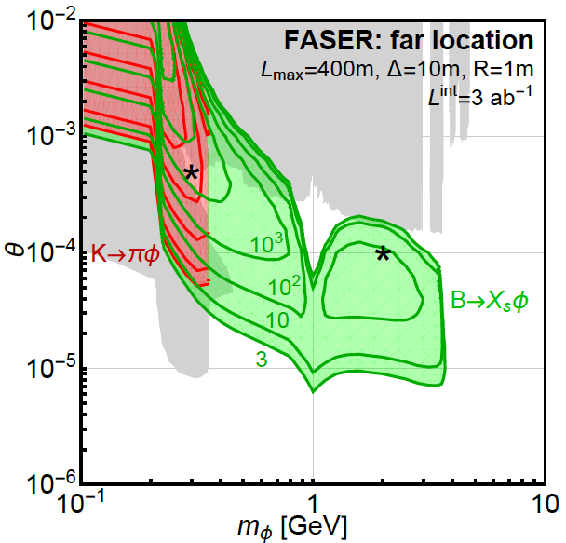
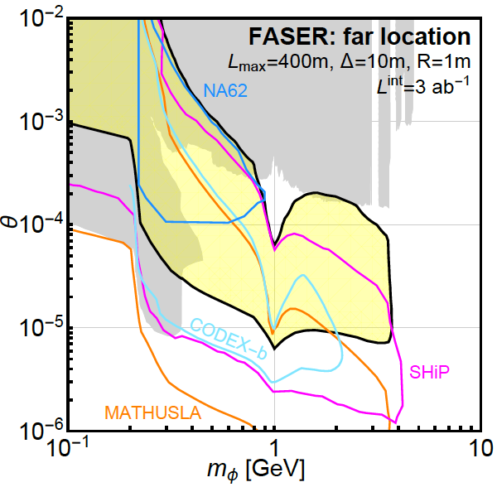
DARK HIGGS EVENT RATES AND REACH
LHCb
FASER probes a large swath of new parameter space and is complementary to other current and proposed experiments

Slide 29
FASER: LOCATION
TI18
FASER

Slide 30
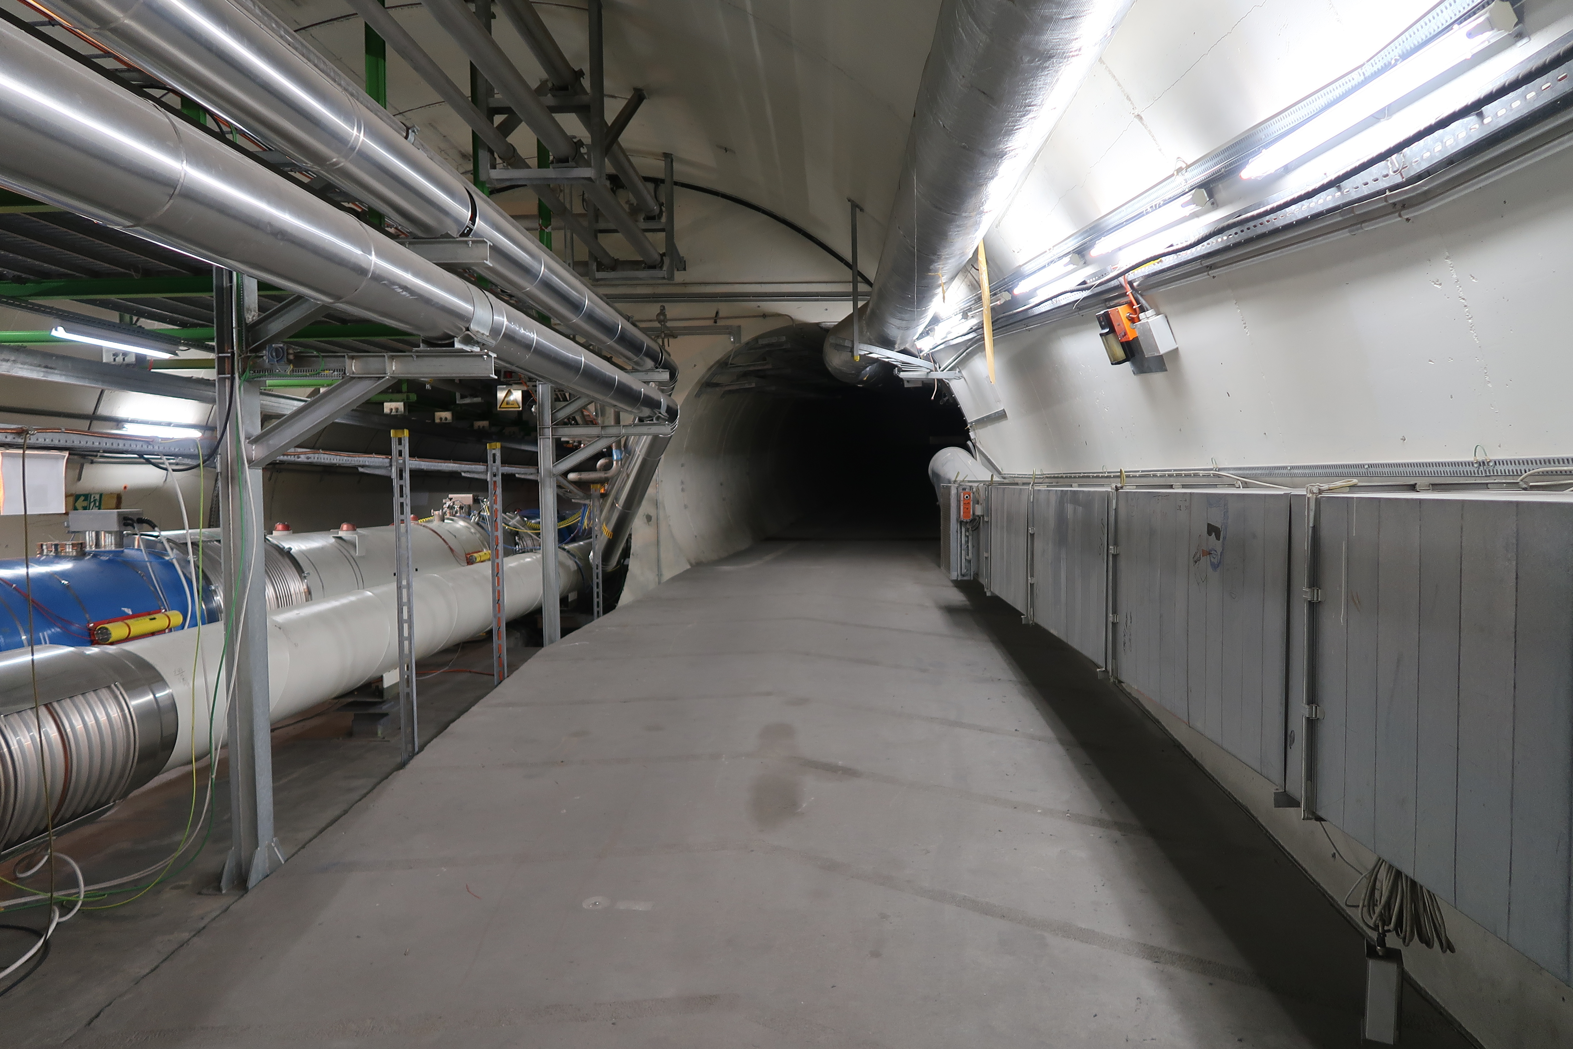
FASER: LOCATION

Slide 31
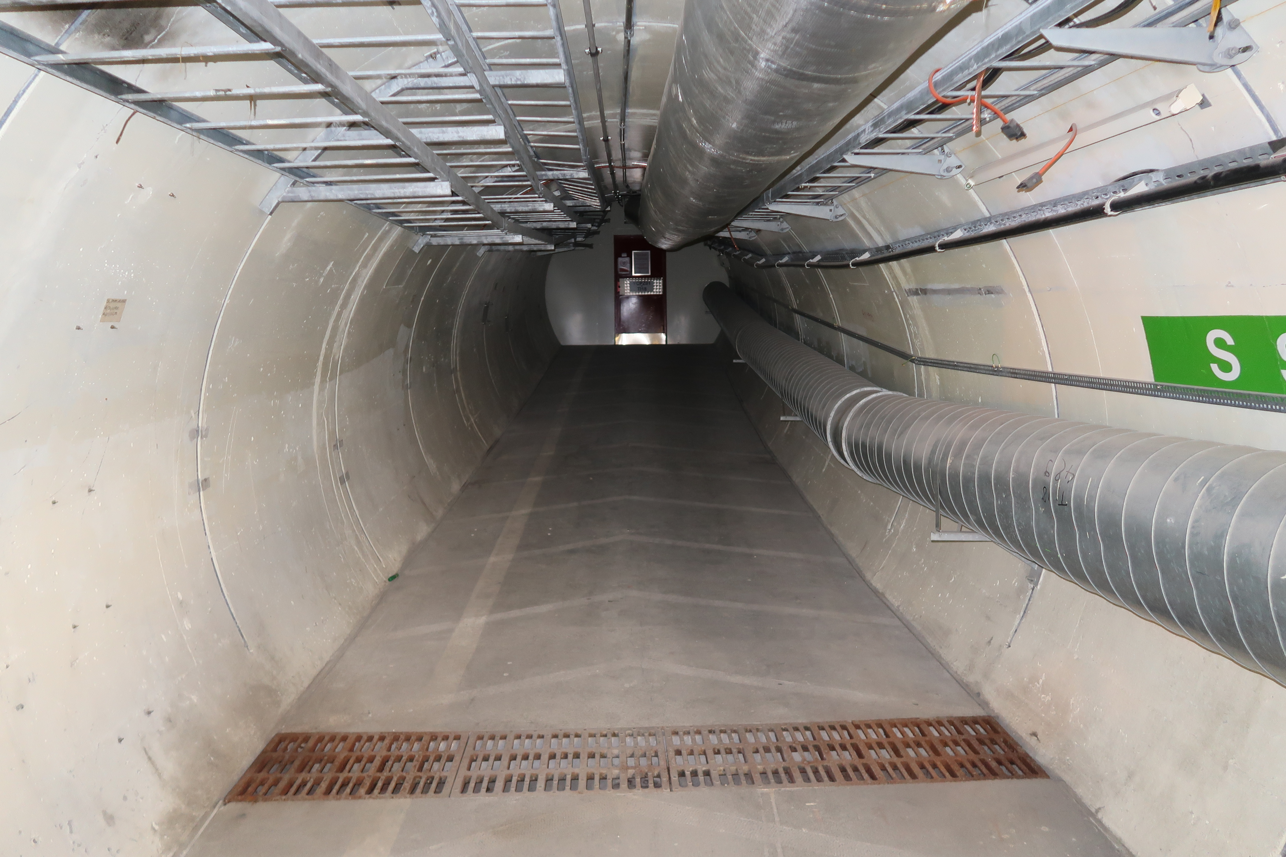
FASER: LOCATION

Slide 32
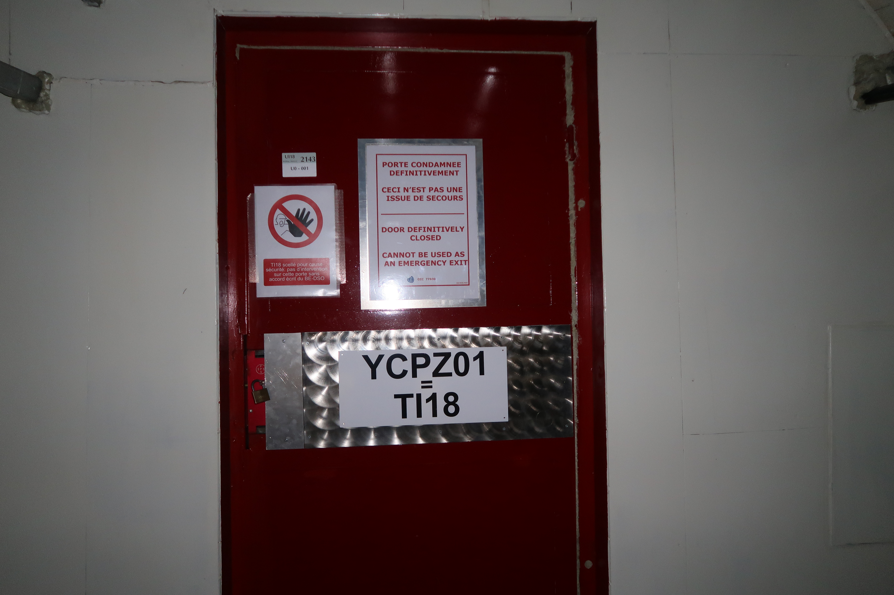
FASER: LOCATION

Slide 33
FASER: LOCATION

Slide 34
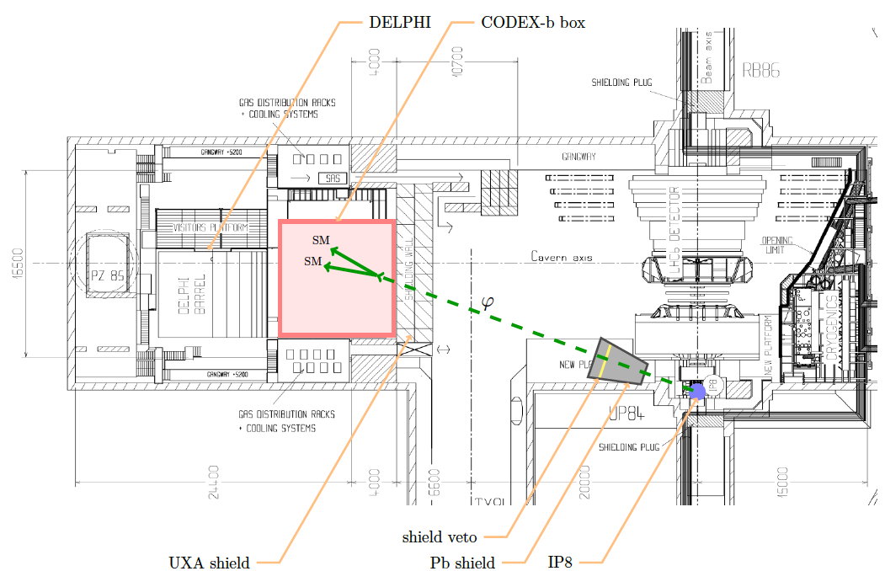
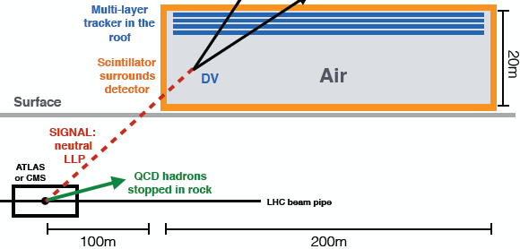
COMPLEMENTARY PROPOSED EXPERIMENTS
SHiP
CODEX-b
~1000 m³, ~100M CHF + beam
Alekhin et al. (2015)
~1000 m³
Gligorov, Knapen, Papucci, Robinson (2017)
FASER
MATHUSLA
~1 m³ ~ 1 μIKEA
~800,000 m³ ~ 1 IKEA, ~$50M
Feng, Galon, Kling, Trojanowski (2017)
Chou, Curtin, Lubatti (2016)

Slide 35
IS OUR FIELD HEALTHY?

Slide 36
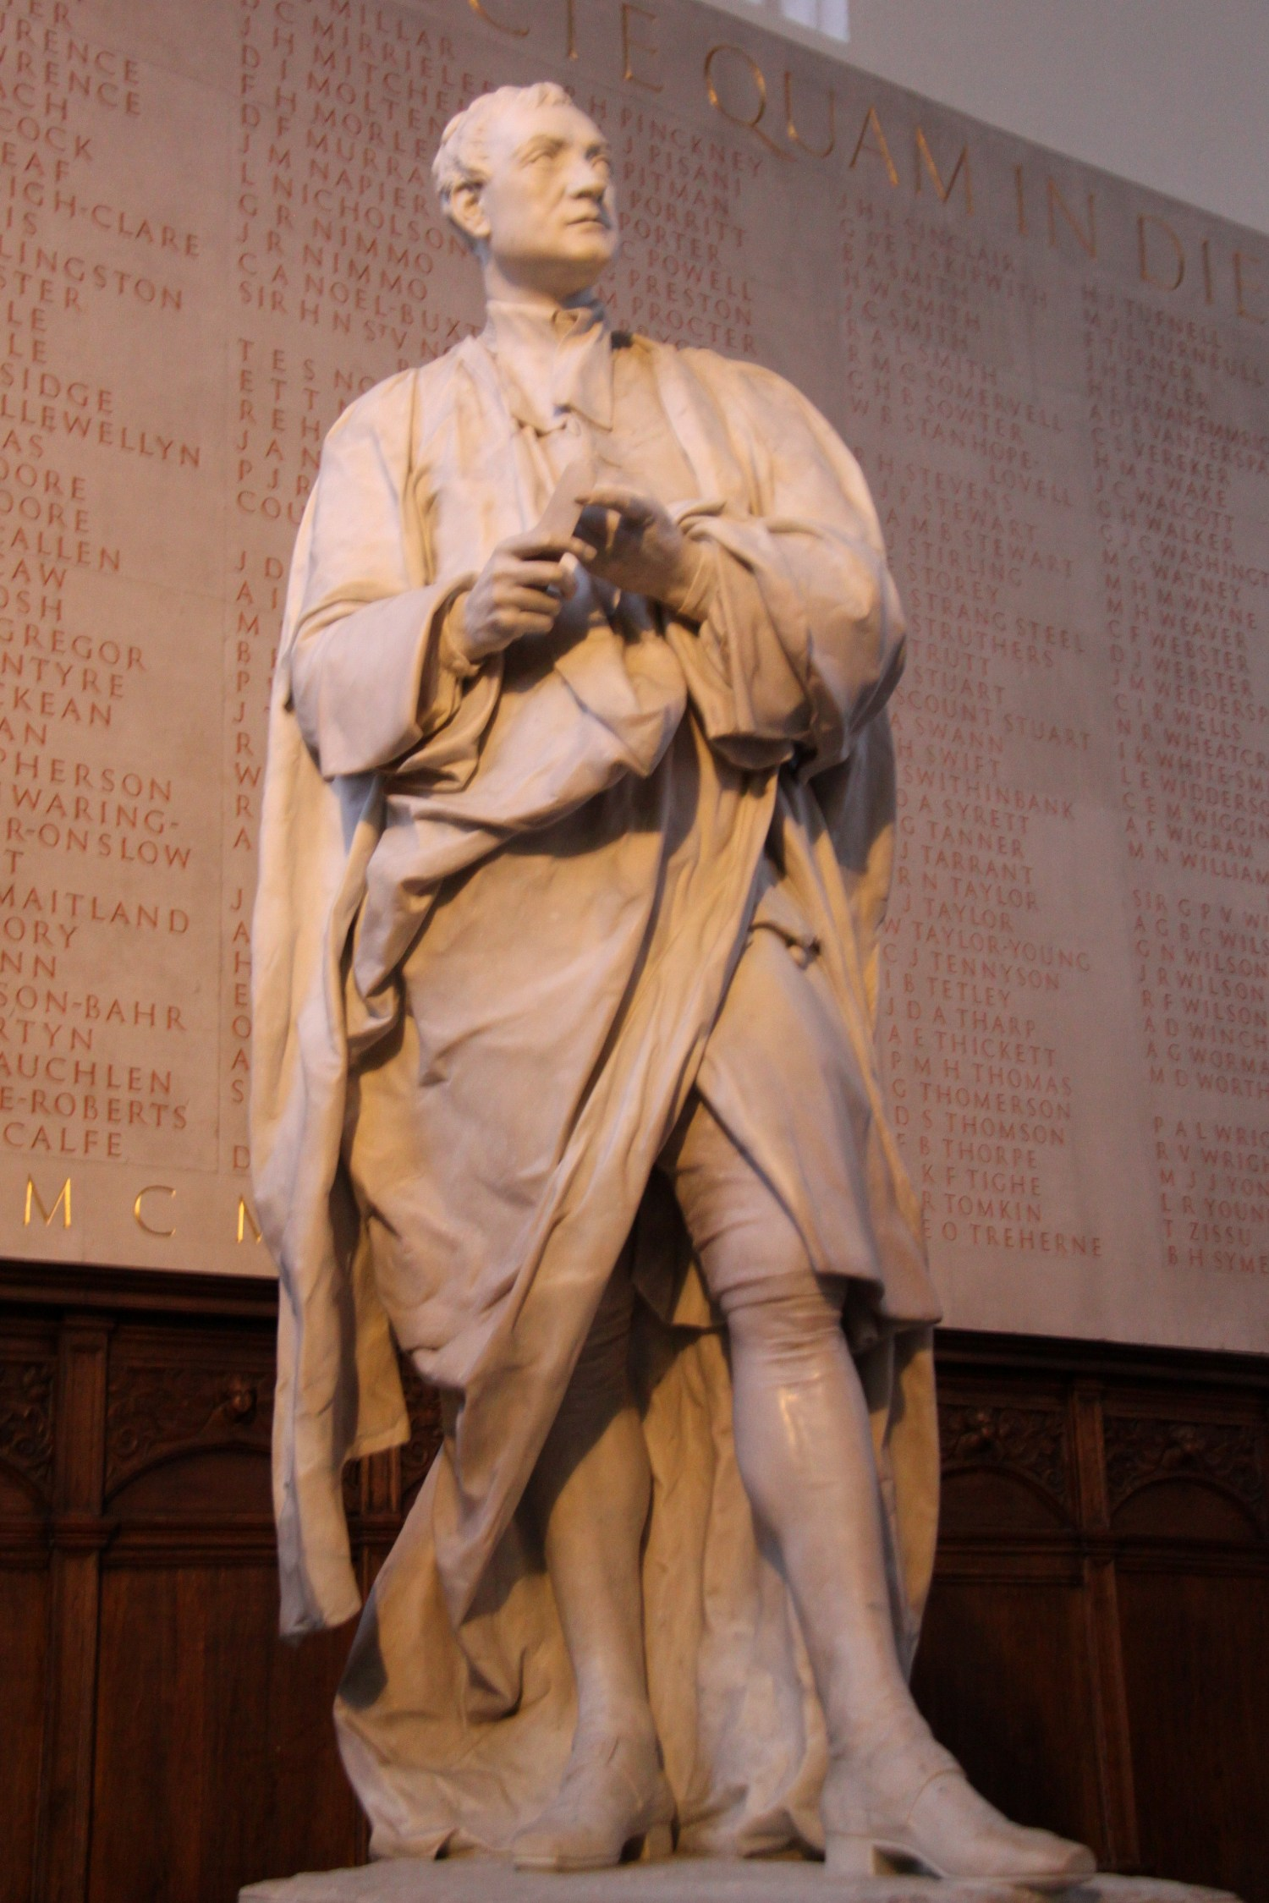
NEWTON AND NATURALNESS
In 1687, Isaac Newton published the Principia. 6 years later, a clergyman, Robert Bentley, asked him how the law of universal gravitation could be consistent with a static universe.
Newton’s rueful reply: “That there should be a central particle, so accurately placed in the middle, as to be always equally attracted on all sides, and thereby continue without motion, seems to me a supposition fully as hard as to make the sharpest needle stand upright on its point upon a looking-glass.”

Slide 37
IS OUR FIELD HEALTHY?
It would be hundreds of years before the answer was clear: the universe is not actually static.
We are in a similar situation: we are 6 years past a triumphant discovery, the completion of the standad model, and it seems to have a small naturalness problem.
It would be great to discover dark matter tomorrow, and it could very well happen, but there is no guarantee of fast answers.

Slide 38
IS OUR FIELD HEALTHY?
There are many good signs, though.
Huge influx of new ideas, cross pollination between particle physics and astrophysics, of course, but also now nuclear physics, condensed matter physics, AMO.
Experiments: ~10 collaborators, ~$1M, ~few years.
The barrier between experiment and theory (on the particle side) has never been lower in my scientific lifetime. (Overheard conversation among theory graduate students: “The only way to get a job now is to propose and build an experiment.”)
Lots of interested, talented young people. (Compare DMSAG and Cosmic Visions.)

Slide 39
CONCLUSIONS
Is dark matter particles?
SURE LOOKS LIKE IT
Small scale structure problems?
LET’S HOPE SO
Are WIMPs dead?
NO
What are promising directions?
LIGHT DM
Is our field healthy?
YES!

