Slide 1
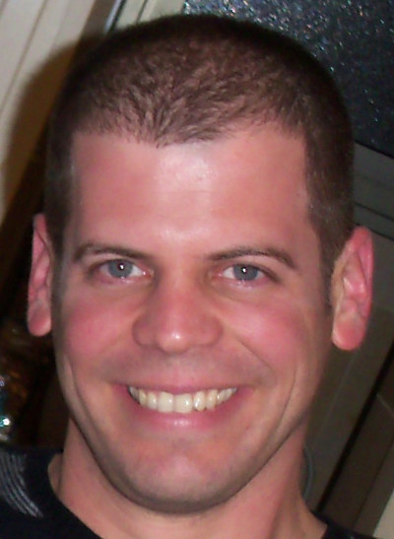
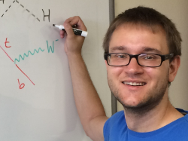
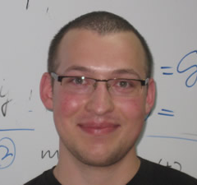
FASER AND OTHER OUTPOSTS
ON THE LIFETIME FRONTIER
New Probes for Physics Beyond the Standard Model, KITP, Santa Barbara
Jonathan Feng, UC Irvine
Based on 1708.09389 and 1710.09387 with
9 April 2018
Iftah Galon
Felix Kling
Sebastian Trojanowski

Slide 2

LAMPPOST LANDSCAPE
1
Already
Discovered
Strongly Interacting
Heavy Particles
10⁻³
Coupling Strength
Weakly Interacting
Light Particles
Impossible to
Discover
10⁻⁶
MeV
GeV
TeV
Mass

Slide 3
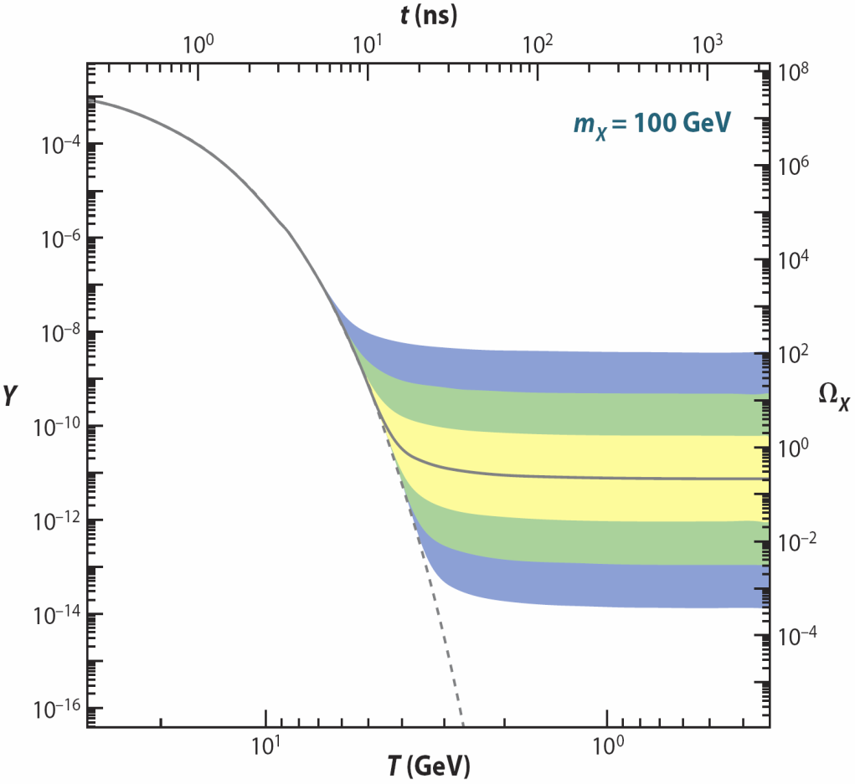
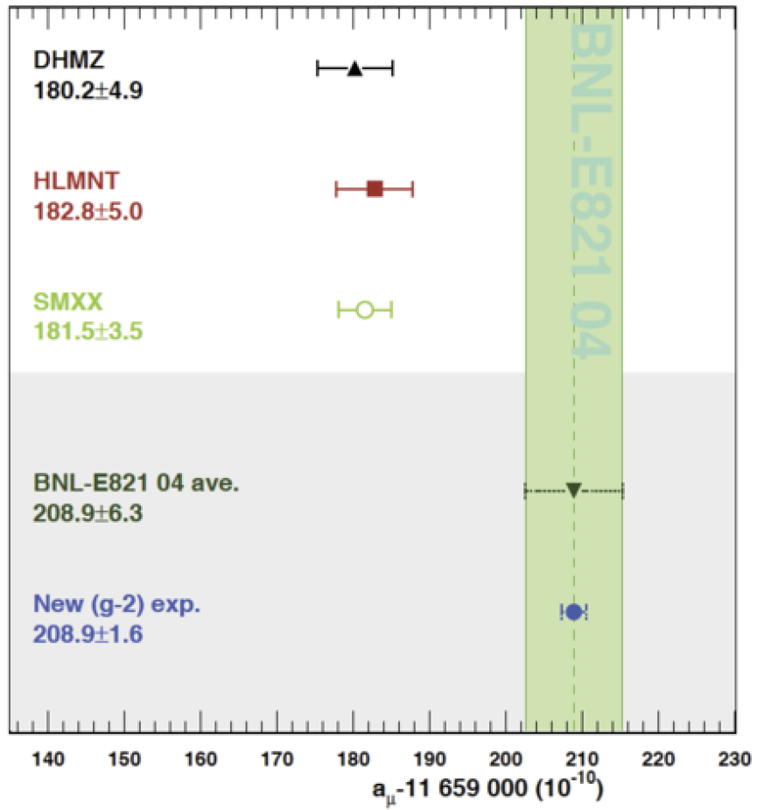
STRONGLY INTERACTING, HEAVY PARTICLES
The traditional target for new physics searches: the high energy frontier
Motivations: WIMP miracle, gauge hierarchy, anomalies (muon g-2, ...)
Hagiwara et al. (2017)
new
particle
Higgs
Higgs

Slide 4
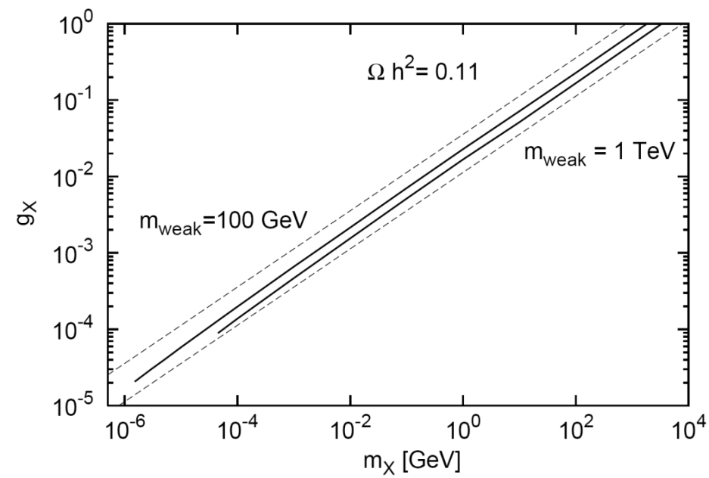
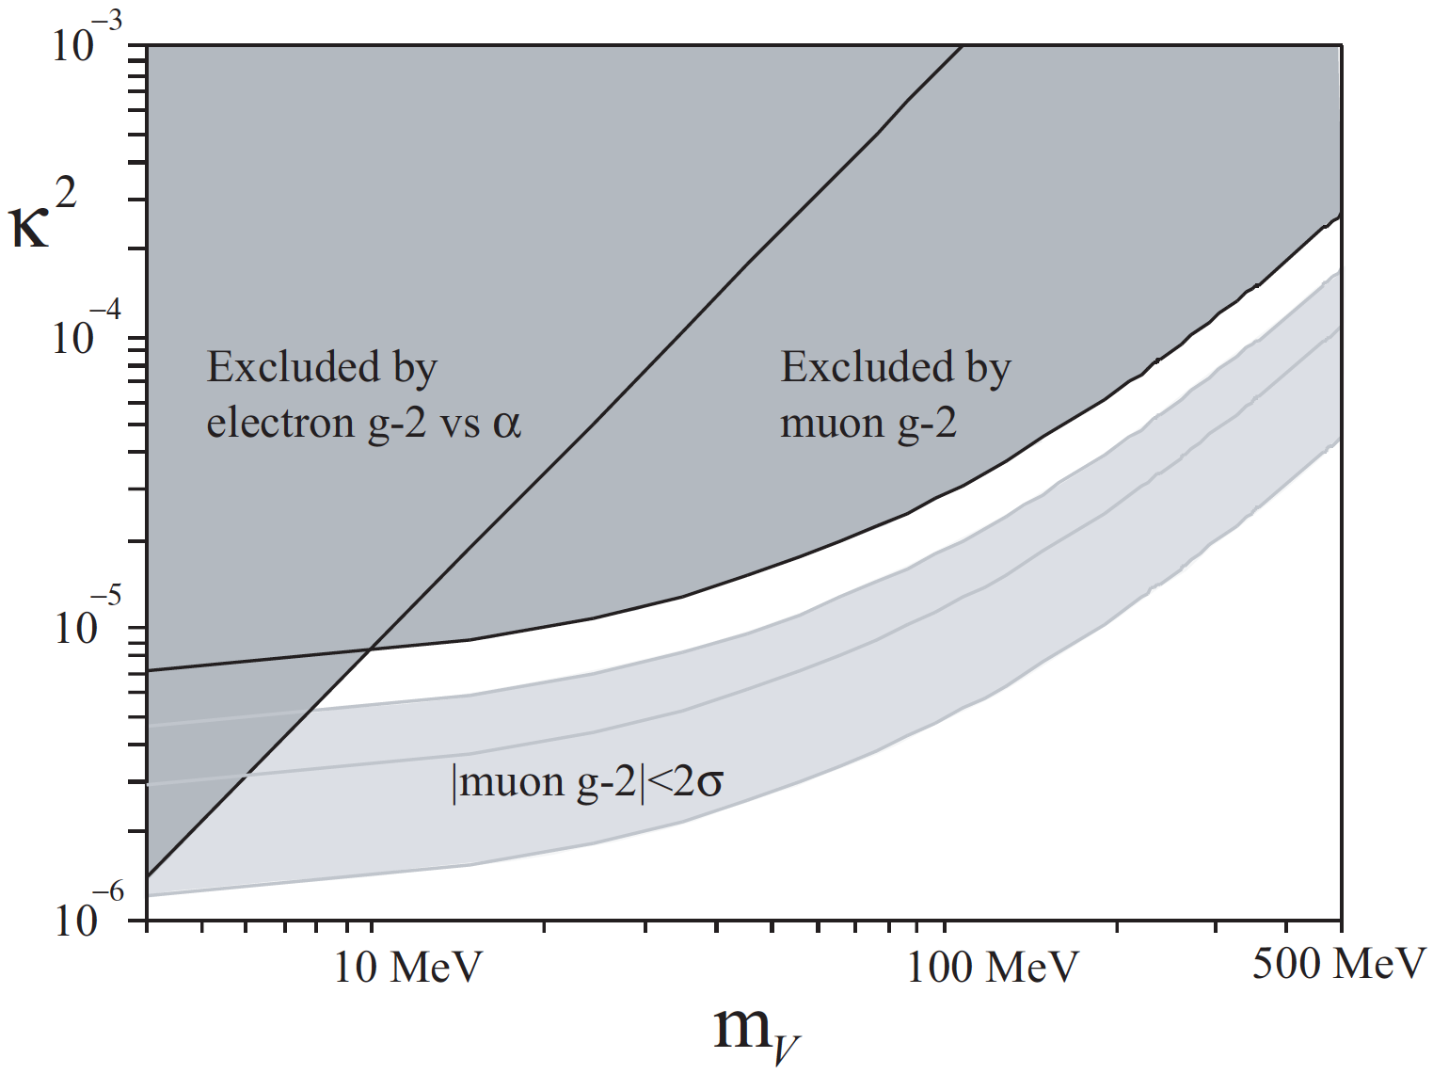
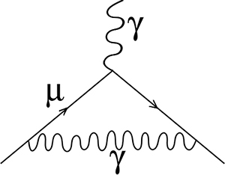
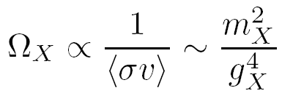
WEAKLY INTERACTING, LIGHT PARTICLES
A new target for new physics searches
Similar motivations: WIMPless miracle, anomalies (muon g-2, ⁸Be, ...)
Feng, Kumar (2008)
Feng, Tu, Yu (2008)
_{WIMPs}
Fayet (2007); Pospelov (2008)
Feng, Fornal, Galon, Gardner
Tait, Tanedo, Smolinsky (2016)
A’,
_{WIMPless DM}
⁸Be
Weakly interacting, light particles can be thermal relic dark matter, resolve existing anomalies, open new possibilities for experimental detection

Slide 5

FASER: THE IDEA
New physics searches at the LHC focus on high p_{T}. This is appropriate for heavy, strongly interacting particles
  σ ~ fb to pb → N ~ 10³ – 10⁶, produced ~isotropically
However, if new particles are light and weakly interacting, this may be completely misguided. Instead should exploit
  σ_{inel} ~ 100 mb → N ~ 10¹⁷, θ ~ Λ_{QCD} / E ~ 250 MeV / TeV ~ mrad
We propose a small, inexpensive experiment, FASER, to be placed in the very forward region of ATLAS/CMS, a few 100m downstream of the IP, and analyze its discovery potential

Slide 6

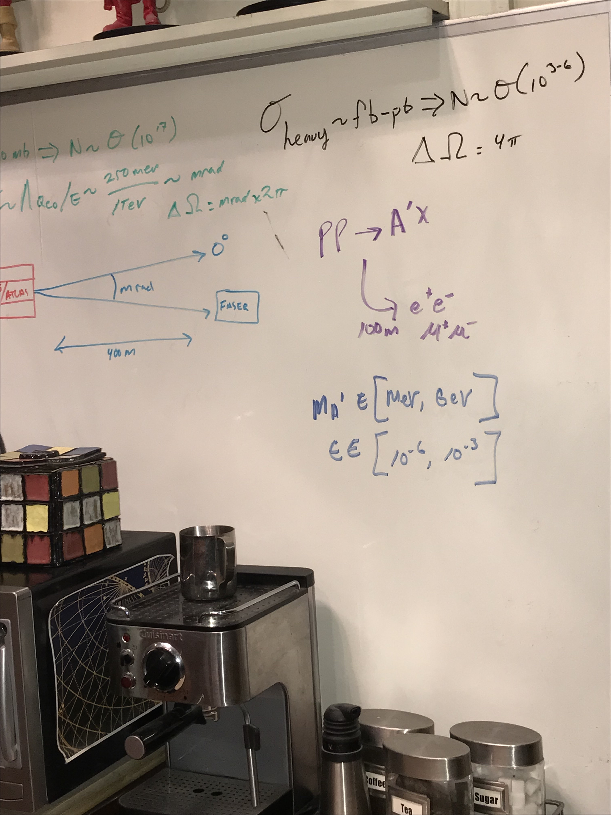
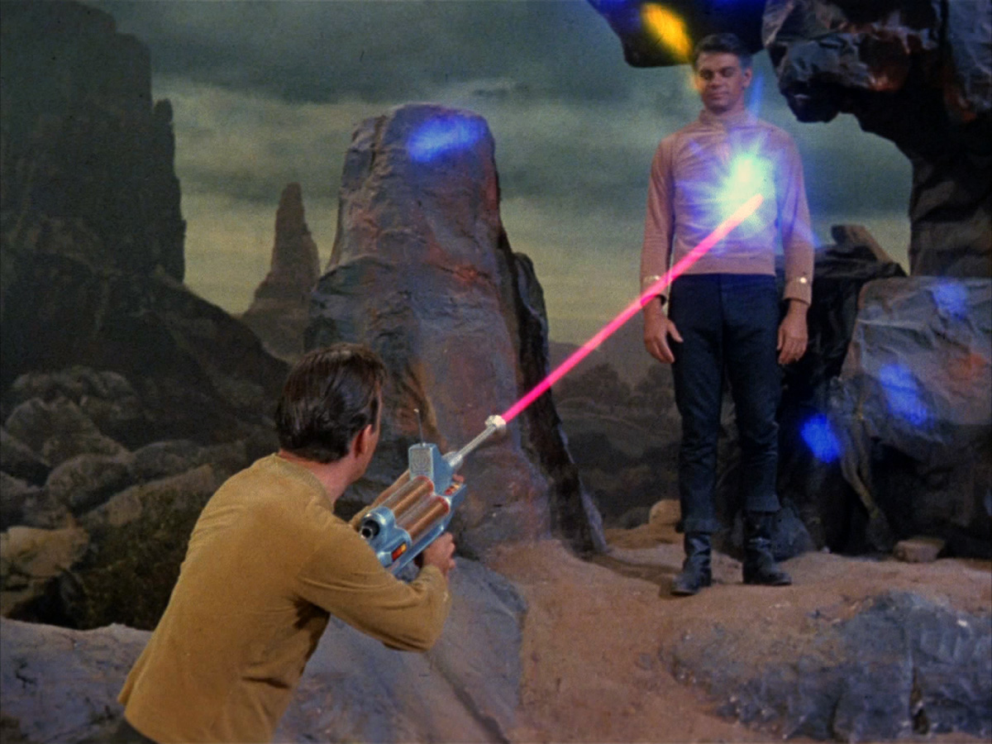
THE LIFETIME FRONTIER
Very popular, many interesting experiments: LHCb, Belle-II, NA62, SHiP, SeaQuest, MilliQan, MATHUSLA, Codex-b, and many others
FASER: ForwArd Search ExpeRiment. “The acronym recalls another marvelous instrument that harnessed highly collimated particles and was used to explore strange new worlds.”

Slide 7
OUTLINE
Very Forward Region Infrastructure
New Physics Example: Dark Photons
Signal and Backgrounds
Event Rates and Reach
New Physics Example: Dark Higgs Bosons
Recent Progress
Summary and Outlook

Slide 8
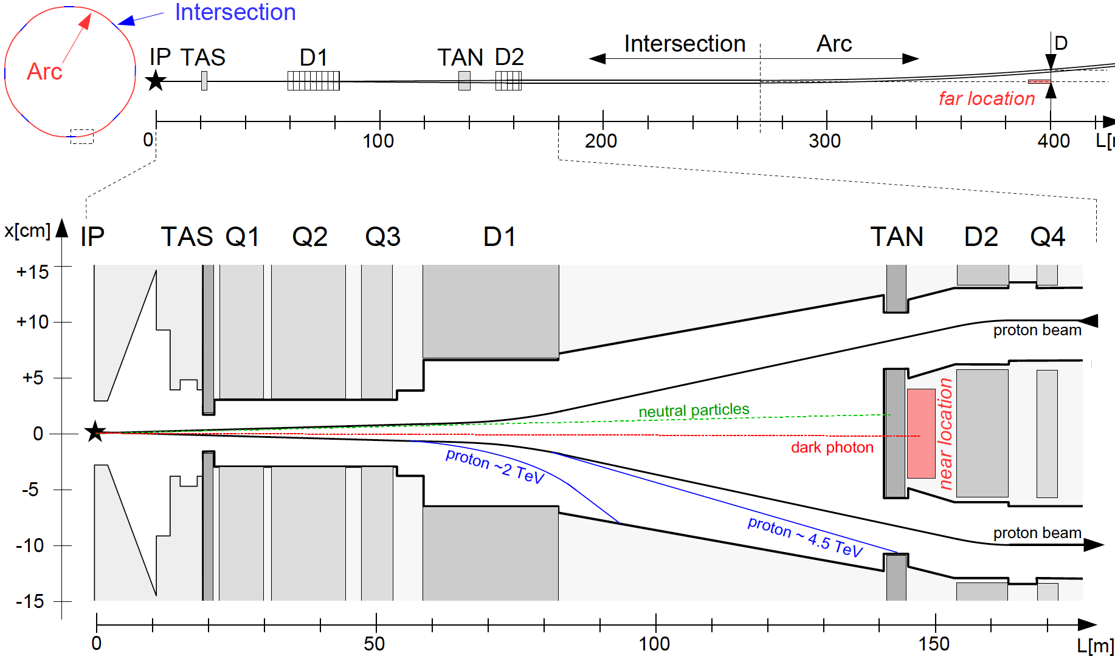
FASER LOCATION
We want to place FASER along the beam collision axis
  Far location: ~400 m from IP, after beams curve, ~3 m from the beams
  Near location: 150 m, after TAN, between the beams
Here, focus on far location, assume FASER is exactly on-axis
If ATLAS/CMS beams cross at 285 (590) μrad in vertical/horizontal plane, far location shifts by 6 (12) cm
Feng, Galon, Kling, Trojanowski (2017)

Slide 9
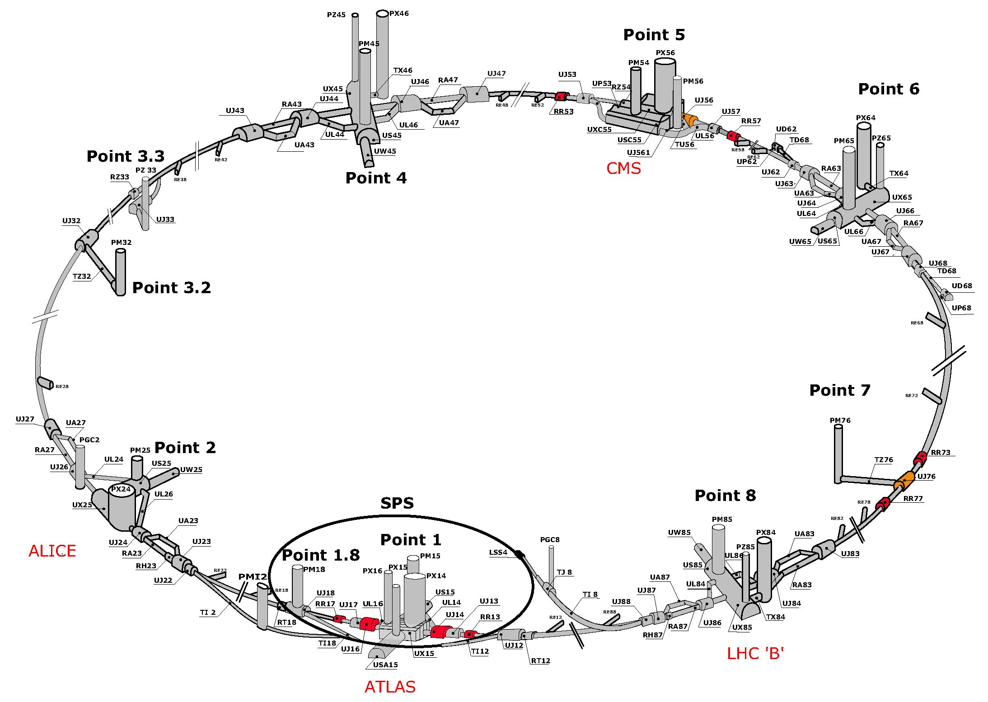
LHC RING

Slide 10
SERVICE TUNNEL TI18
TI18
FASER

Slide 11

DARK PHOTONS
Dark matter is our most solid evidence for new particles. In recent years, the idea of dark matter has been generalized to dark sectors
Dark sectors motivate light, weakly coupled particles (WIMPless miracle, SIMP miracle, small-scale structure, ..)
A prominent example: vector portal, leading to dark photons
The resulting theory contains a new gauge boson A’ with mass m_{A’} and εQ_{f} couplings to SM fermions f
SM
Hidden
U(1)

Slide 12
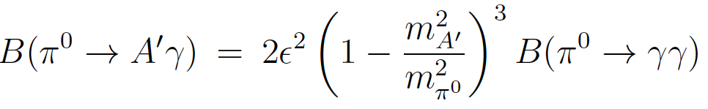
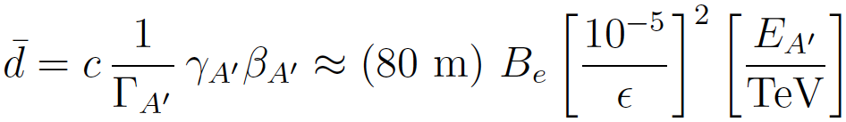

DARK PHOTON PROPERTIES
Produced in meson decays, e.g.,
                , ,
and also through dark bremsstrahlung pp → p A’ X and direct QCD processes qq → A’ X (requires pdfs at low Q², x)
Travels long distances through matter without interacting, decays to e⁺e⁻ , μ⁺μ⁻ for m_{A’} > 2 m_{μ} , other charged pairs
TeV energies at the LHC → huge boost, decay lengths of ~100 m are possible for viable and interesting parameters

Slide 13
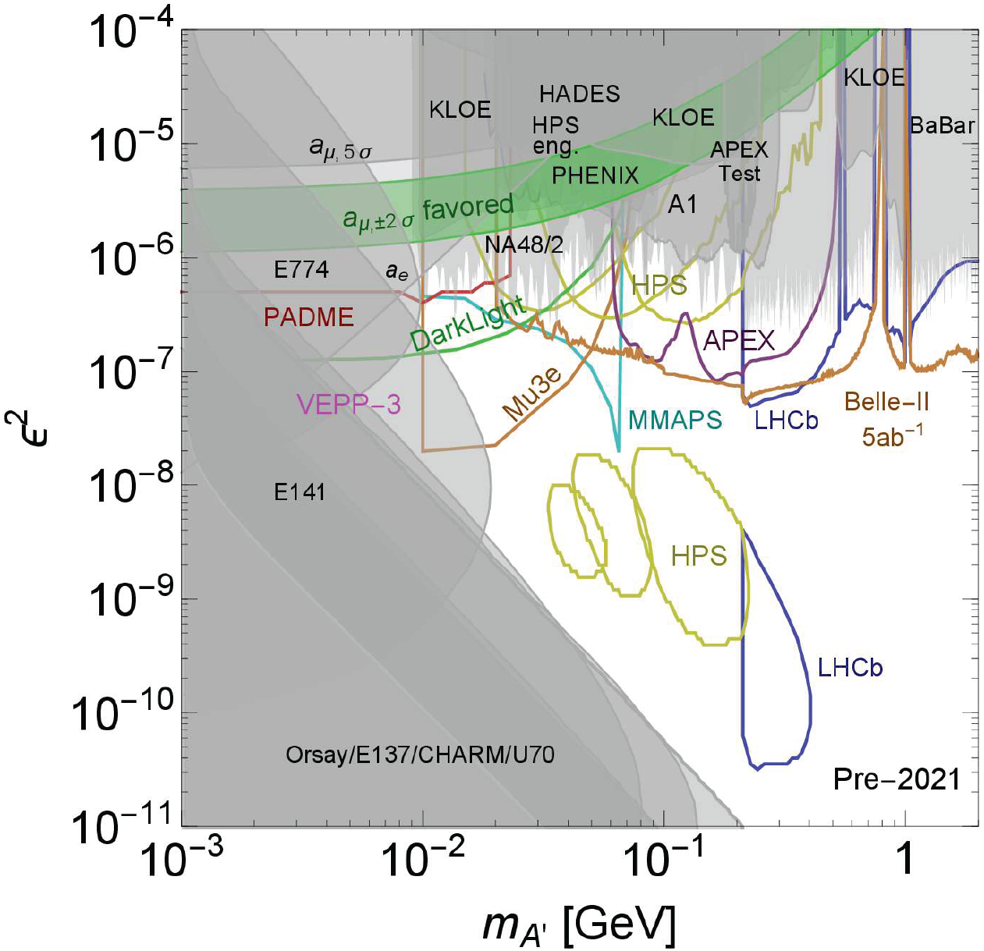
DARK PHOTON STATUS
Low ε → fixed target constraints, high ε → collider, precision constraints
But still lots of open parameter space with
m_{A’} > 10 MeV
~ 10⁻⁶ – 10⁻³
E.g., 2 representative model points: (m_{A’}, ε) =
(20 MeV, 10⁻⁴)
(100 MeV, 10⁻⁵)
Cosmic Visions White Paper (2017)

Slide 14
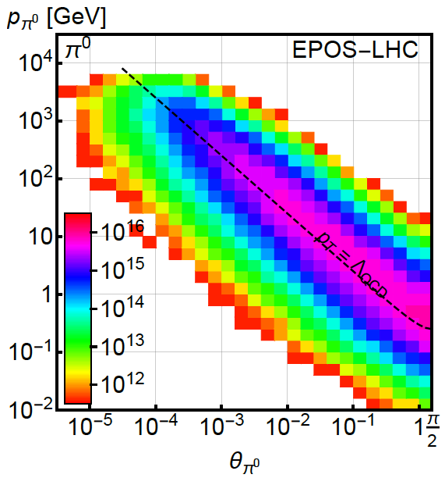
PION PRODUCTION AT THE LHC
Forward particle production simulations and models have been greatly constrained by LHC data
EPOS-LHC, SIBYLL 2.3, QGSJETII-04 agree very well
Enormous event rates (σ_{inel}~70 mb, N_{inel}~10¹⁷), production is peaked at p_{T} ~ Λ_{QCD}
300 fb⁻¹

Slide 15
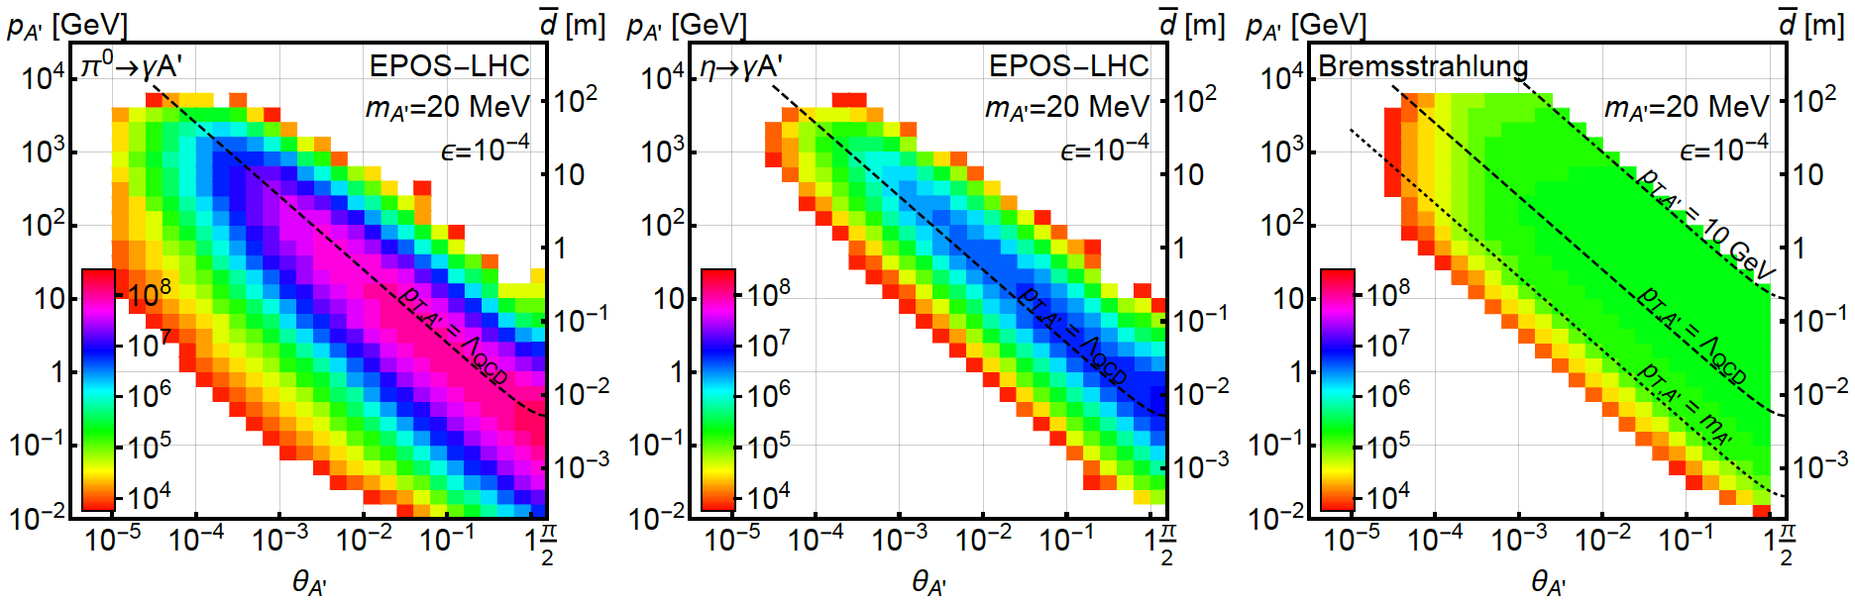
DARK PHOTON PRODUCTION
Consider π⁰ decay, η decay, dark bremsstrahlung
Results for 1st model point: (m_{A’}, ε) = (20 MeV, 10⁻⁴)
From π⁰ → γ A’, E_{A’} ~ E_{π} / 2 ( no surprise)
But note rates: even after ε² suppression, N_{A’} ~ 10⁸ ; LHC may be a dark photon factory!

Slide 16
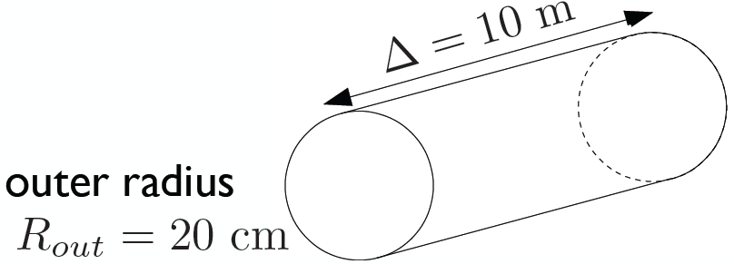
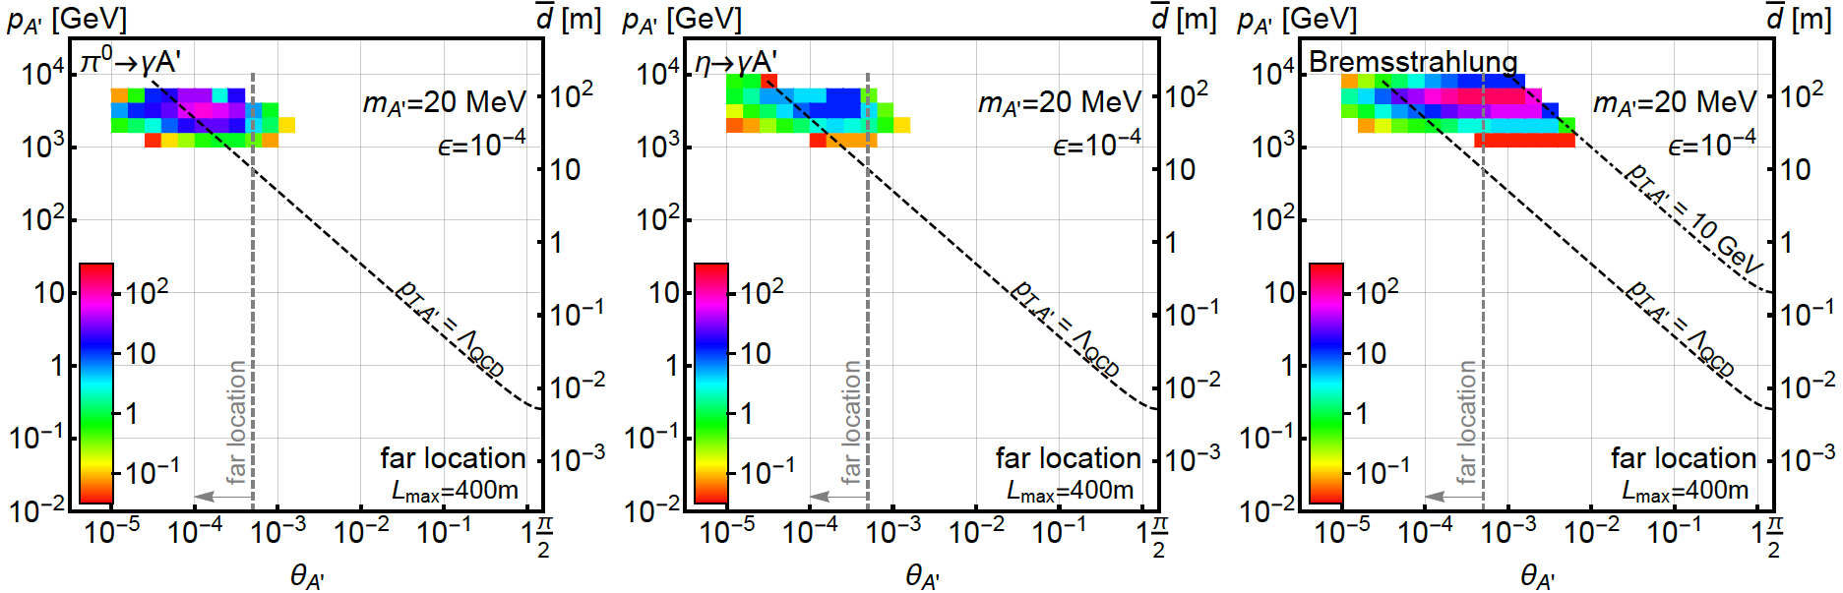
DARK PHOTONS IN FASER
Now require dark photons to decay in FASER: consider cylindrical detector with volume ~1 m²
Only the highest energy A’s survive, but there are still many of them, and they are highly collimated

Slide 17
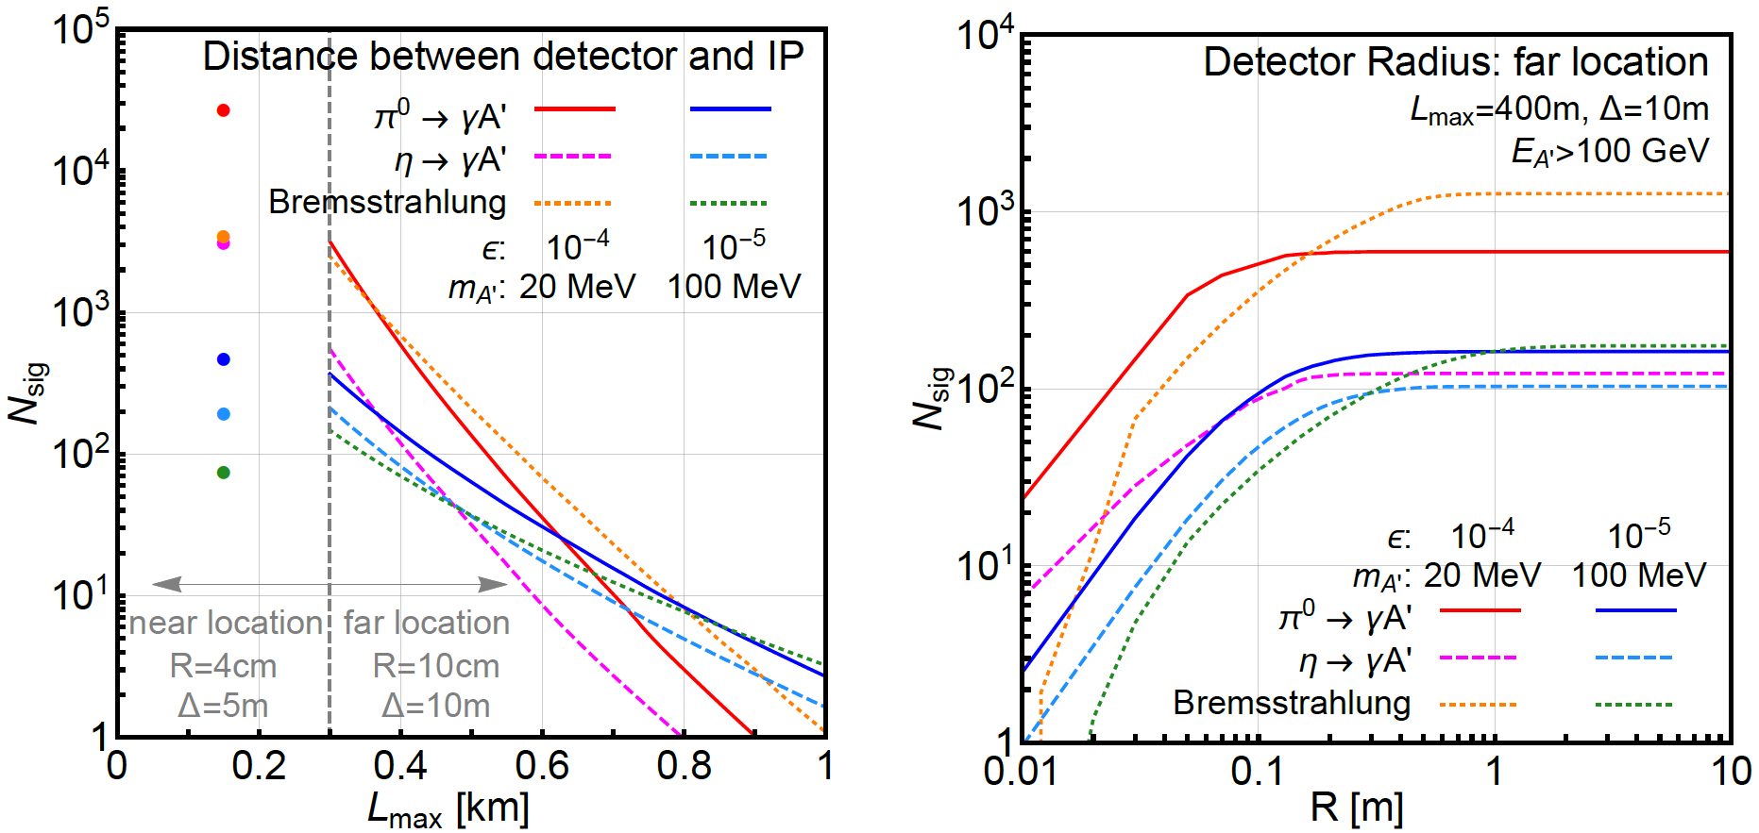
SIGNAL DEPENDENCE ON DETECTOR SPECS
For dark photons, moving the detector closer helps
At the far location, R = 20 cm captures almost all the A’

Slide 18
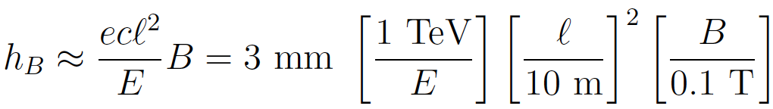
BACKGROUNDS
The signal is two simultaneous, opposite-sign, highly-energetic (E > 500 GeV) charged particles that start in the detector at a vertex and point back to IP → a tracker-based technology
The opening angle is θ_{ee} ~ m_{A’} / E ~ 10 μrad. After traveling ~1 m, this leads to 10 μm separation, too small to resolve, so we need a small magnetic field
Many backgrounds are eliminated simply by virtue of FASER’s location. Particles from IP must pass through ~50 m of matter to get to FASER. Cosmic ray background is negligible, charged particles from IP are bent away by D1 magnet
Leading backgrounds: neutrino-induced backgrounds and beam-induced backgrounds

Slide 19


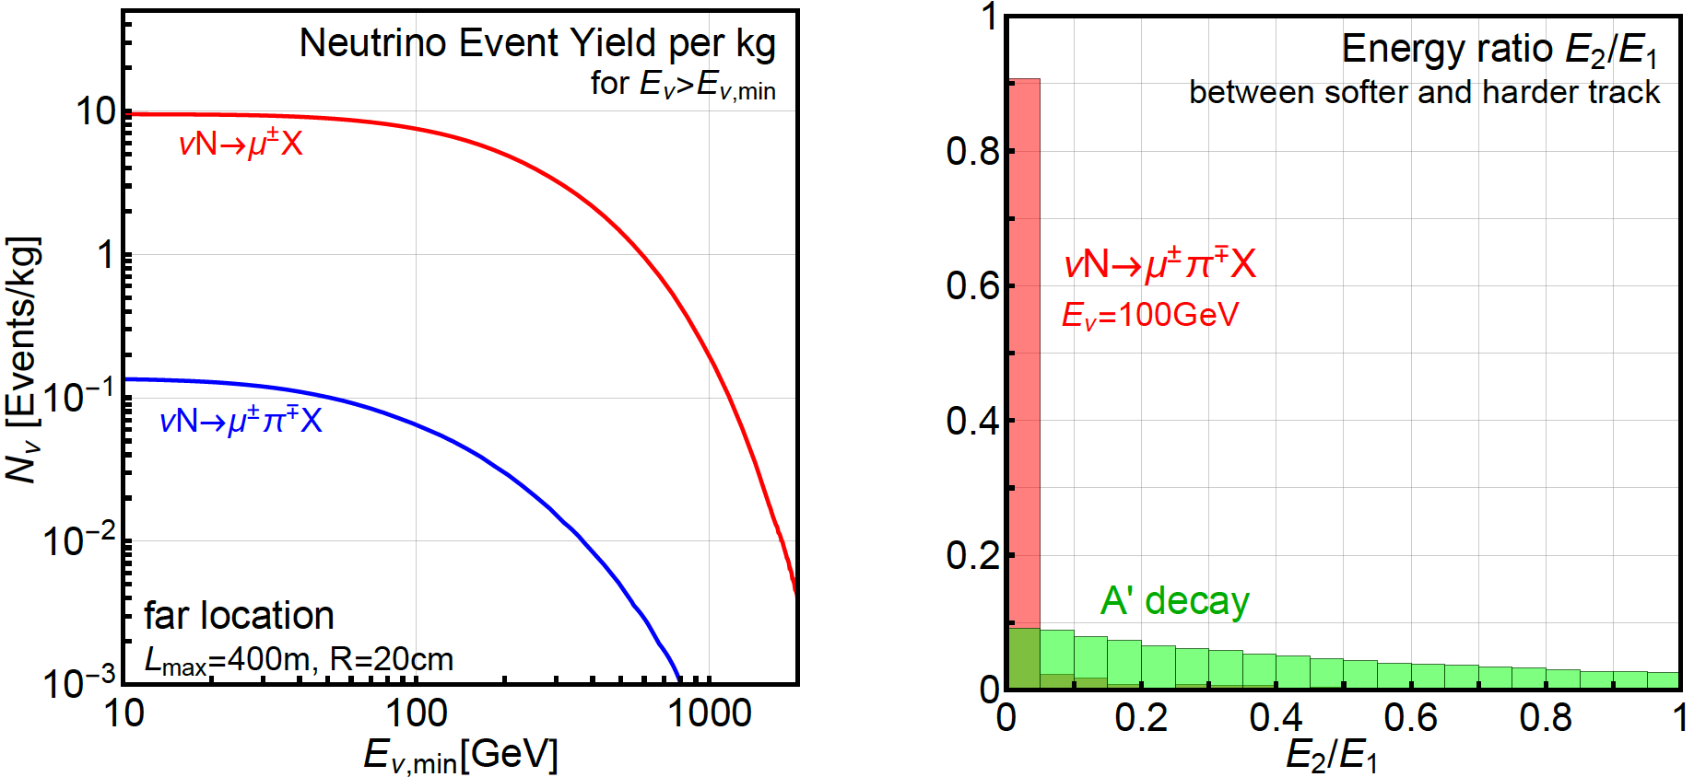
BACKGROUNDS
If π⁺ → μν before D1 magnet, neutrinos can propagate into FASER, produce charged tracks through CC interactions
Coincident single tracks that fake double tracks are negligible; second process eliminated by requiring no other activity, tracks start in the detector and have high and symmetric energies
Beam-induced backgrounds currently being investigated by CERN FLUKA study
GENIE

Slide 20
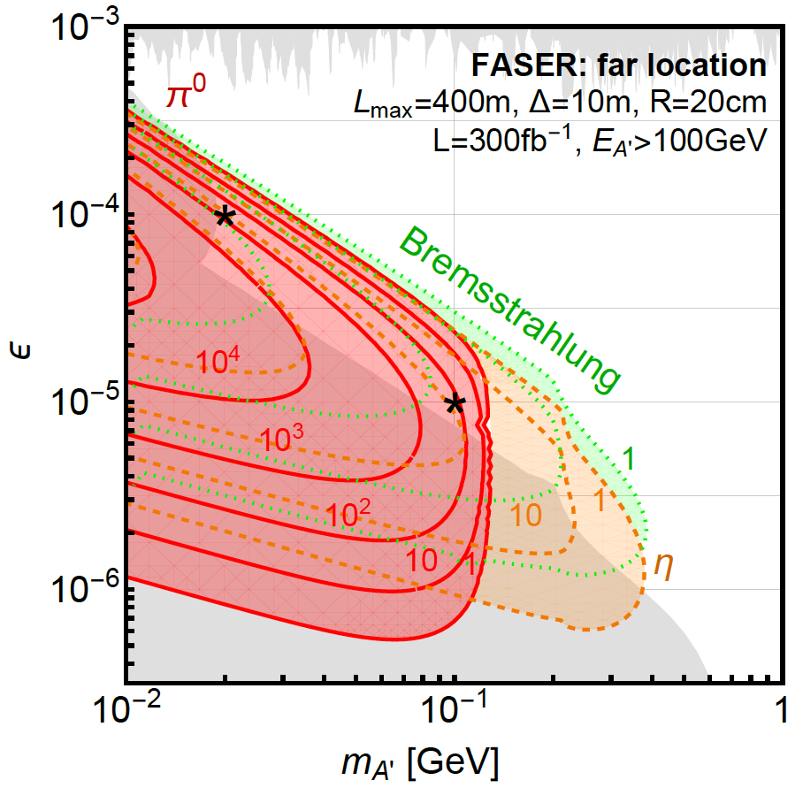
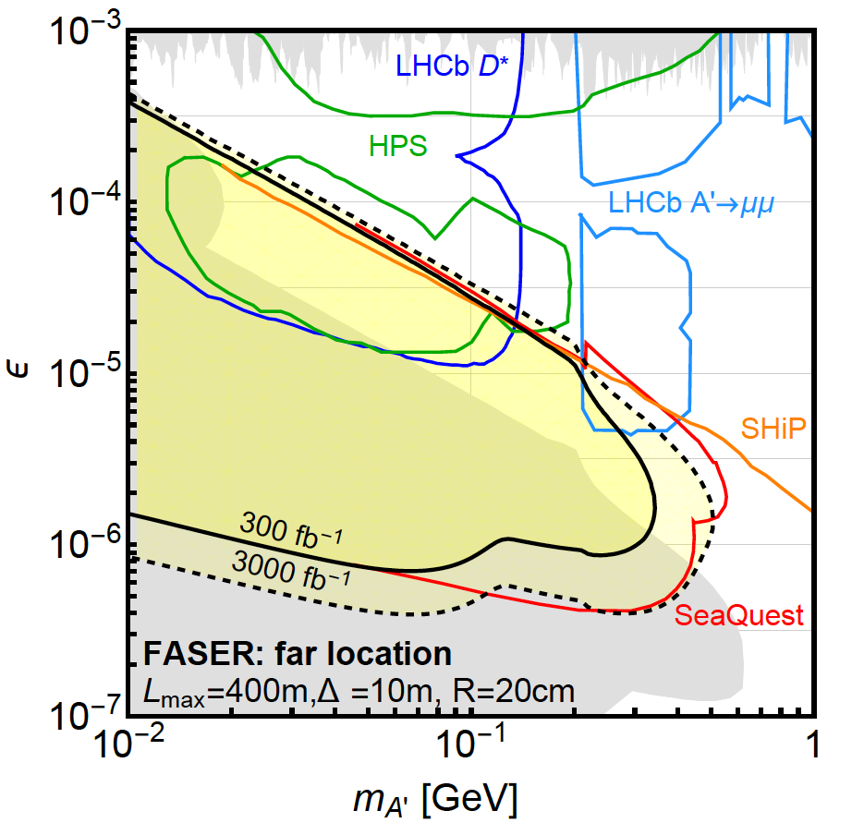
DARK PHOTON EVENT RATES AND REACH
Up to 10⁵ dark photons decay in FASER in 300 fb⁻¹ in parameter regions with m_{A’} ~ 10 - 500 MeV, ε ~ 10⁻⁶ – 10⁻³
Note that at upper ε boundary, rates are extremely sensitive to ε and the reach is quite insensitive to background, provided it is known
N=3 contours

Slide 21

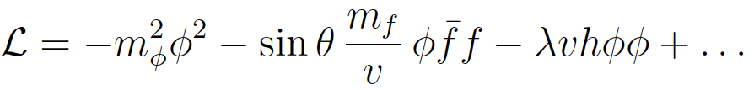
DARK HIGGS BOSONS
Another renormalizable coupling: Higgs portal
The resulting theory contains a new scalar boson φ with mass m_{φ} , Higgs-like couplings suppressed by sin θ, and a trilinear coupling λ
SM
Hidden
Higgs

Slide 22
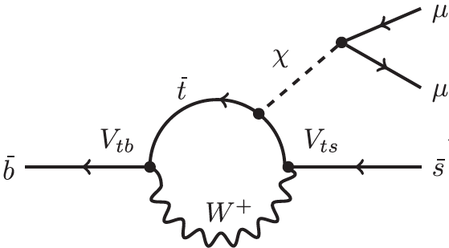

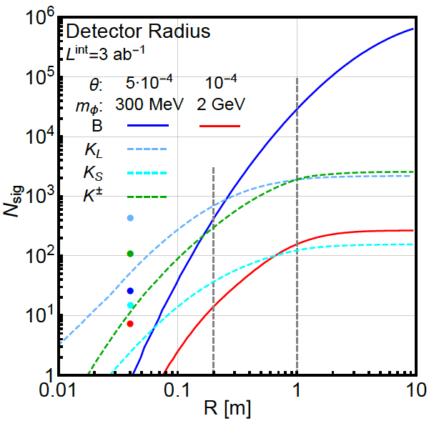
DARK HIGGS PROPERTIES
Dark Higgs couples to mass, so favors decays to heaviest possible states
φ
In contrast to fixed target experiments, lots of COM energy to produce ~10¹⁵ B mesons, excellent probe of new physics that couples to 3rd generation
In B decays, p_{T} ~ m_{B}, dark Higgs bosons are less collimated than dark photons

Slide 23
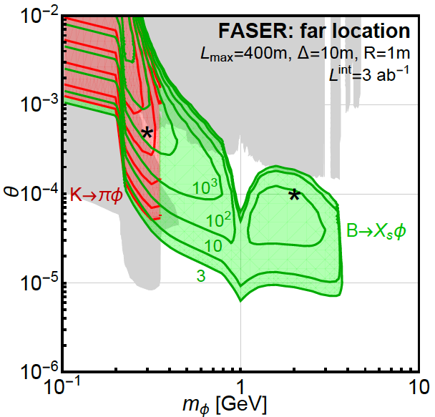
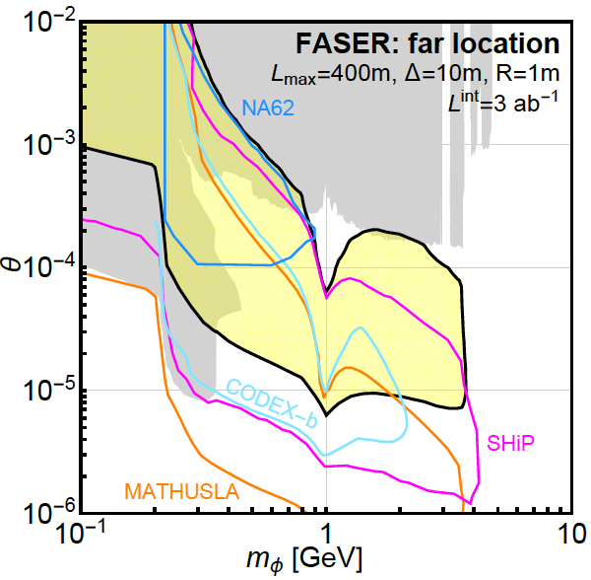
DARK HIGGS EVENT RATES AND REACH
LHCb
FASER probes a large swath of new parameter space and is complementary to other current and proposed experiments

Slide 24
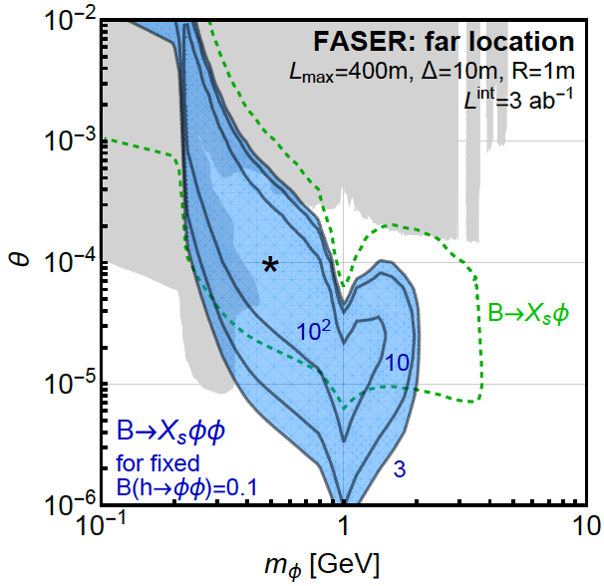
TRILINEAR COUPLINGS REACH
FASER can also probe the trilinear couplings through
φ
h
φ
This competes with
h → φφ (invisible)
Can get 100s of events from “double dark Higgs” production

Slide 25
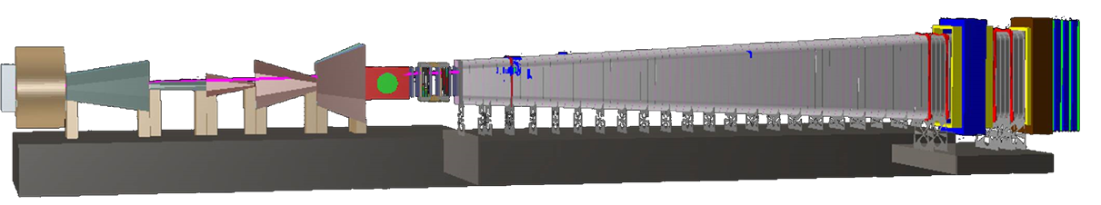
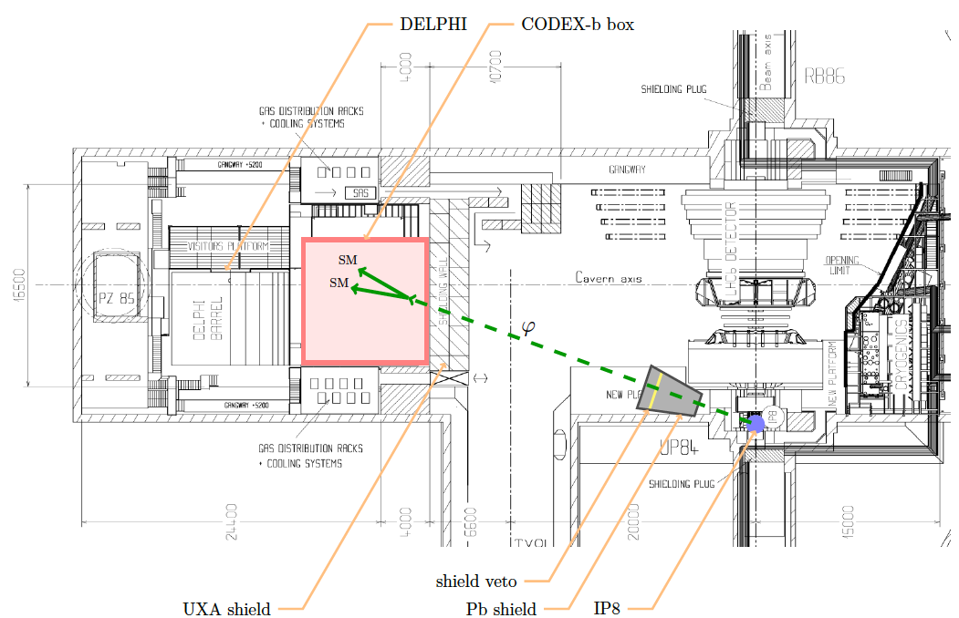
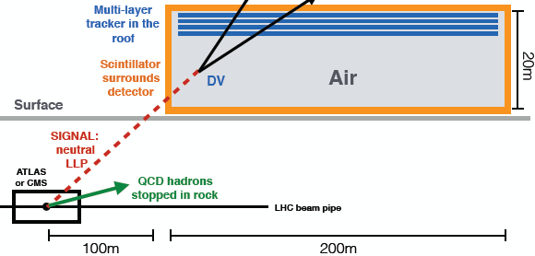
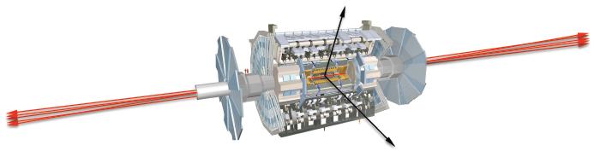
COMPLEMENTARY PROPOSED EXPERIMENTS
SHiP
CODEX-b
~1000 m³, ~100M CHF + beam
Alekhin et al. (2015)
~1000 m³
Gligorov, Knapen, Papucci, Robinson (2017)
FASER
MATHUSLA
~1 m³ ~ 5 μIKEAs
~200,000 m³ ~ 1 IKEA, ~$50M
Feng, Galon, Kling, Trojanowski (2017)
Chou, Curtin, Lubatti (2016)

Slide 26
RECENT PROGRESS
Theory: see also studies of flavor-specific scalar mediators (Batell, Freitas, Ismail, McKeen, 1712.10022), HNLs (heavy neutral leptons, sterile neutrinos) (Kling, Trojanowski, 1801.08947; Helo, Hirsch, Wang, 1803.02212), other gauge bosons (Bauer, Foldenauer, Jaeckel, 1803.05466), ALPs (axion-like particles) and other models in progress
Experiment: FASER, MATHUSLA, CODEX-b, MilliQan have joined the CERN Physics Beyond Collider study. A few examples of recent progress follow. Thanks to Jamie Boyd, Dave Casper, Francesco Cerrutti and FLUKA team, Paolo Fessia, Shih-Chieh Hsu, and Mike Lamont.

Slide 27
FASER: LOCATION
TI18
FASER

Slide 28
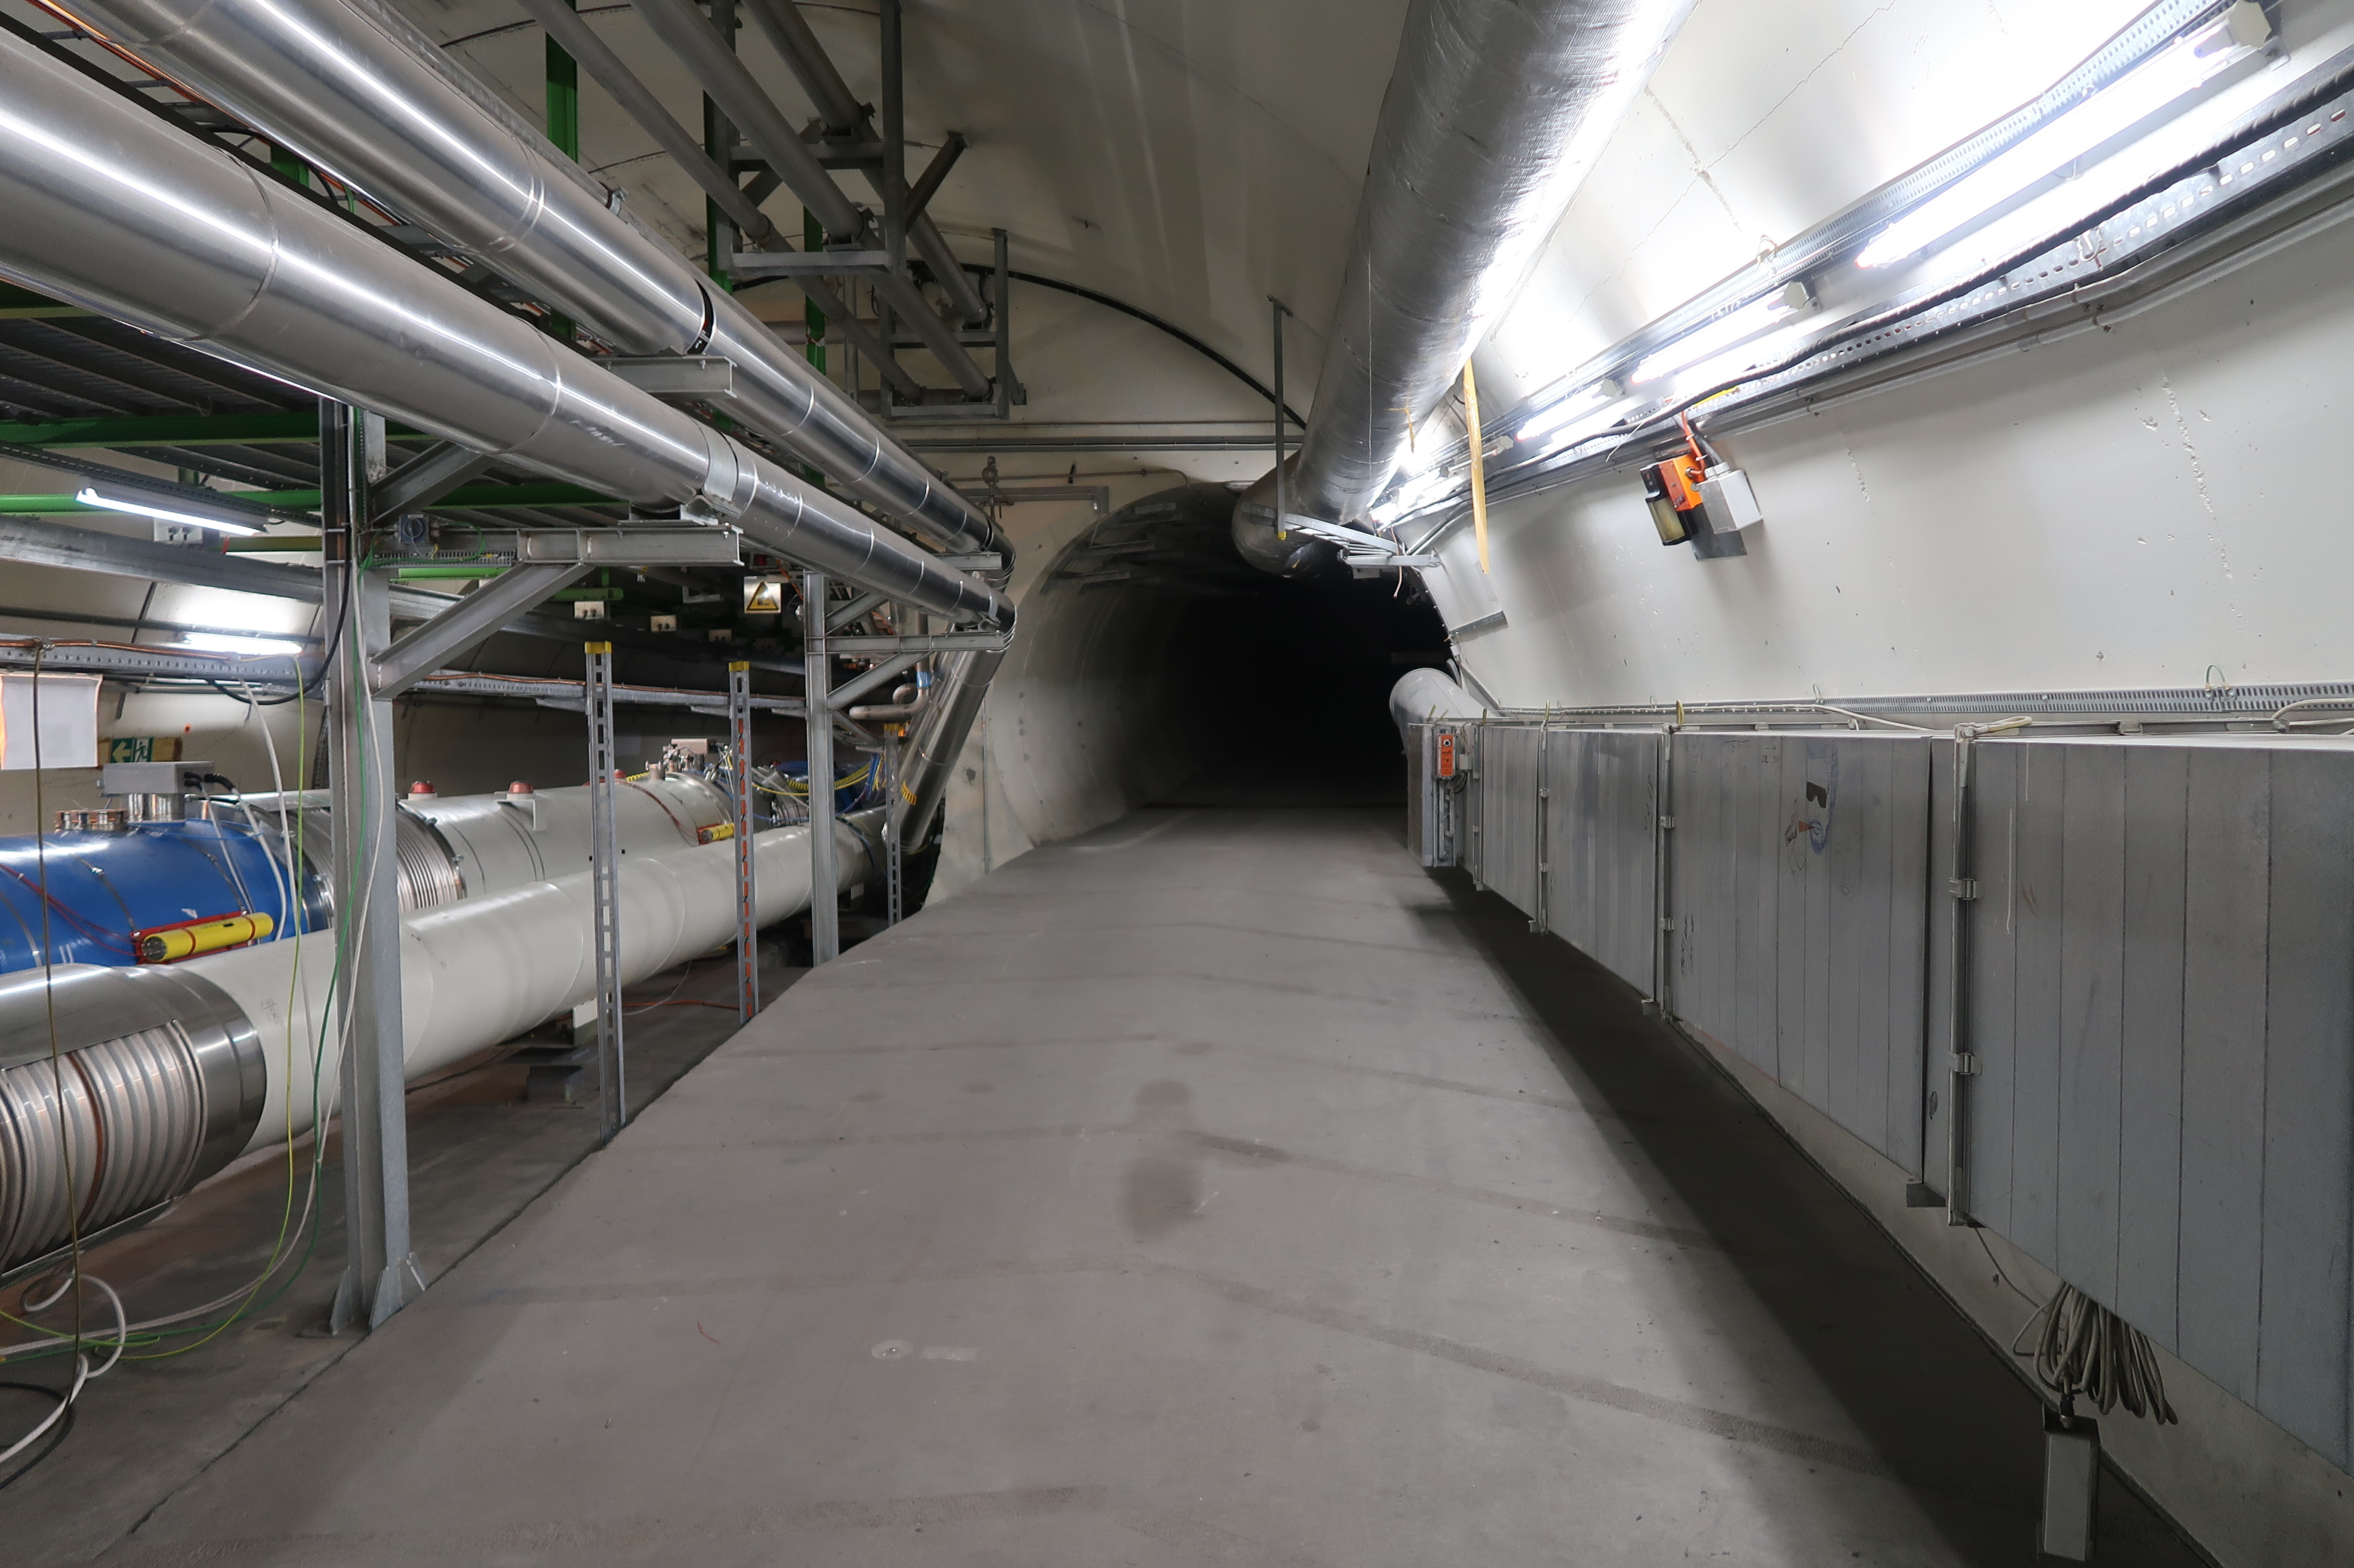
FASER: LOCATION

Slide 29
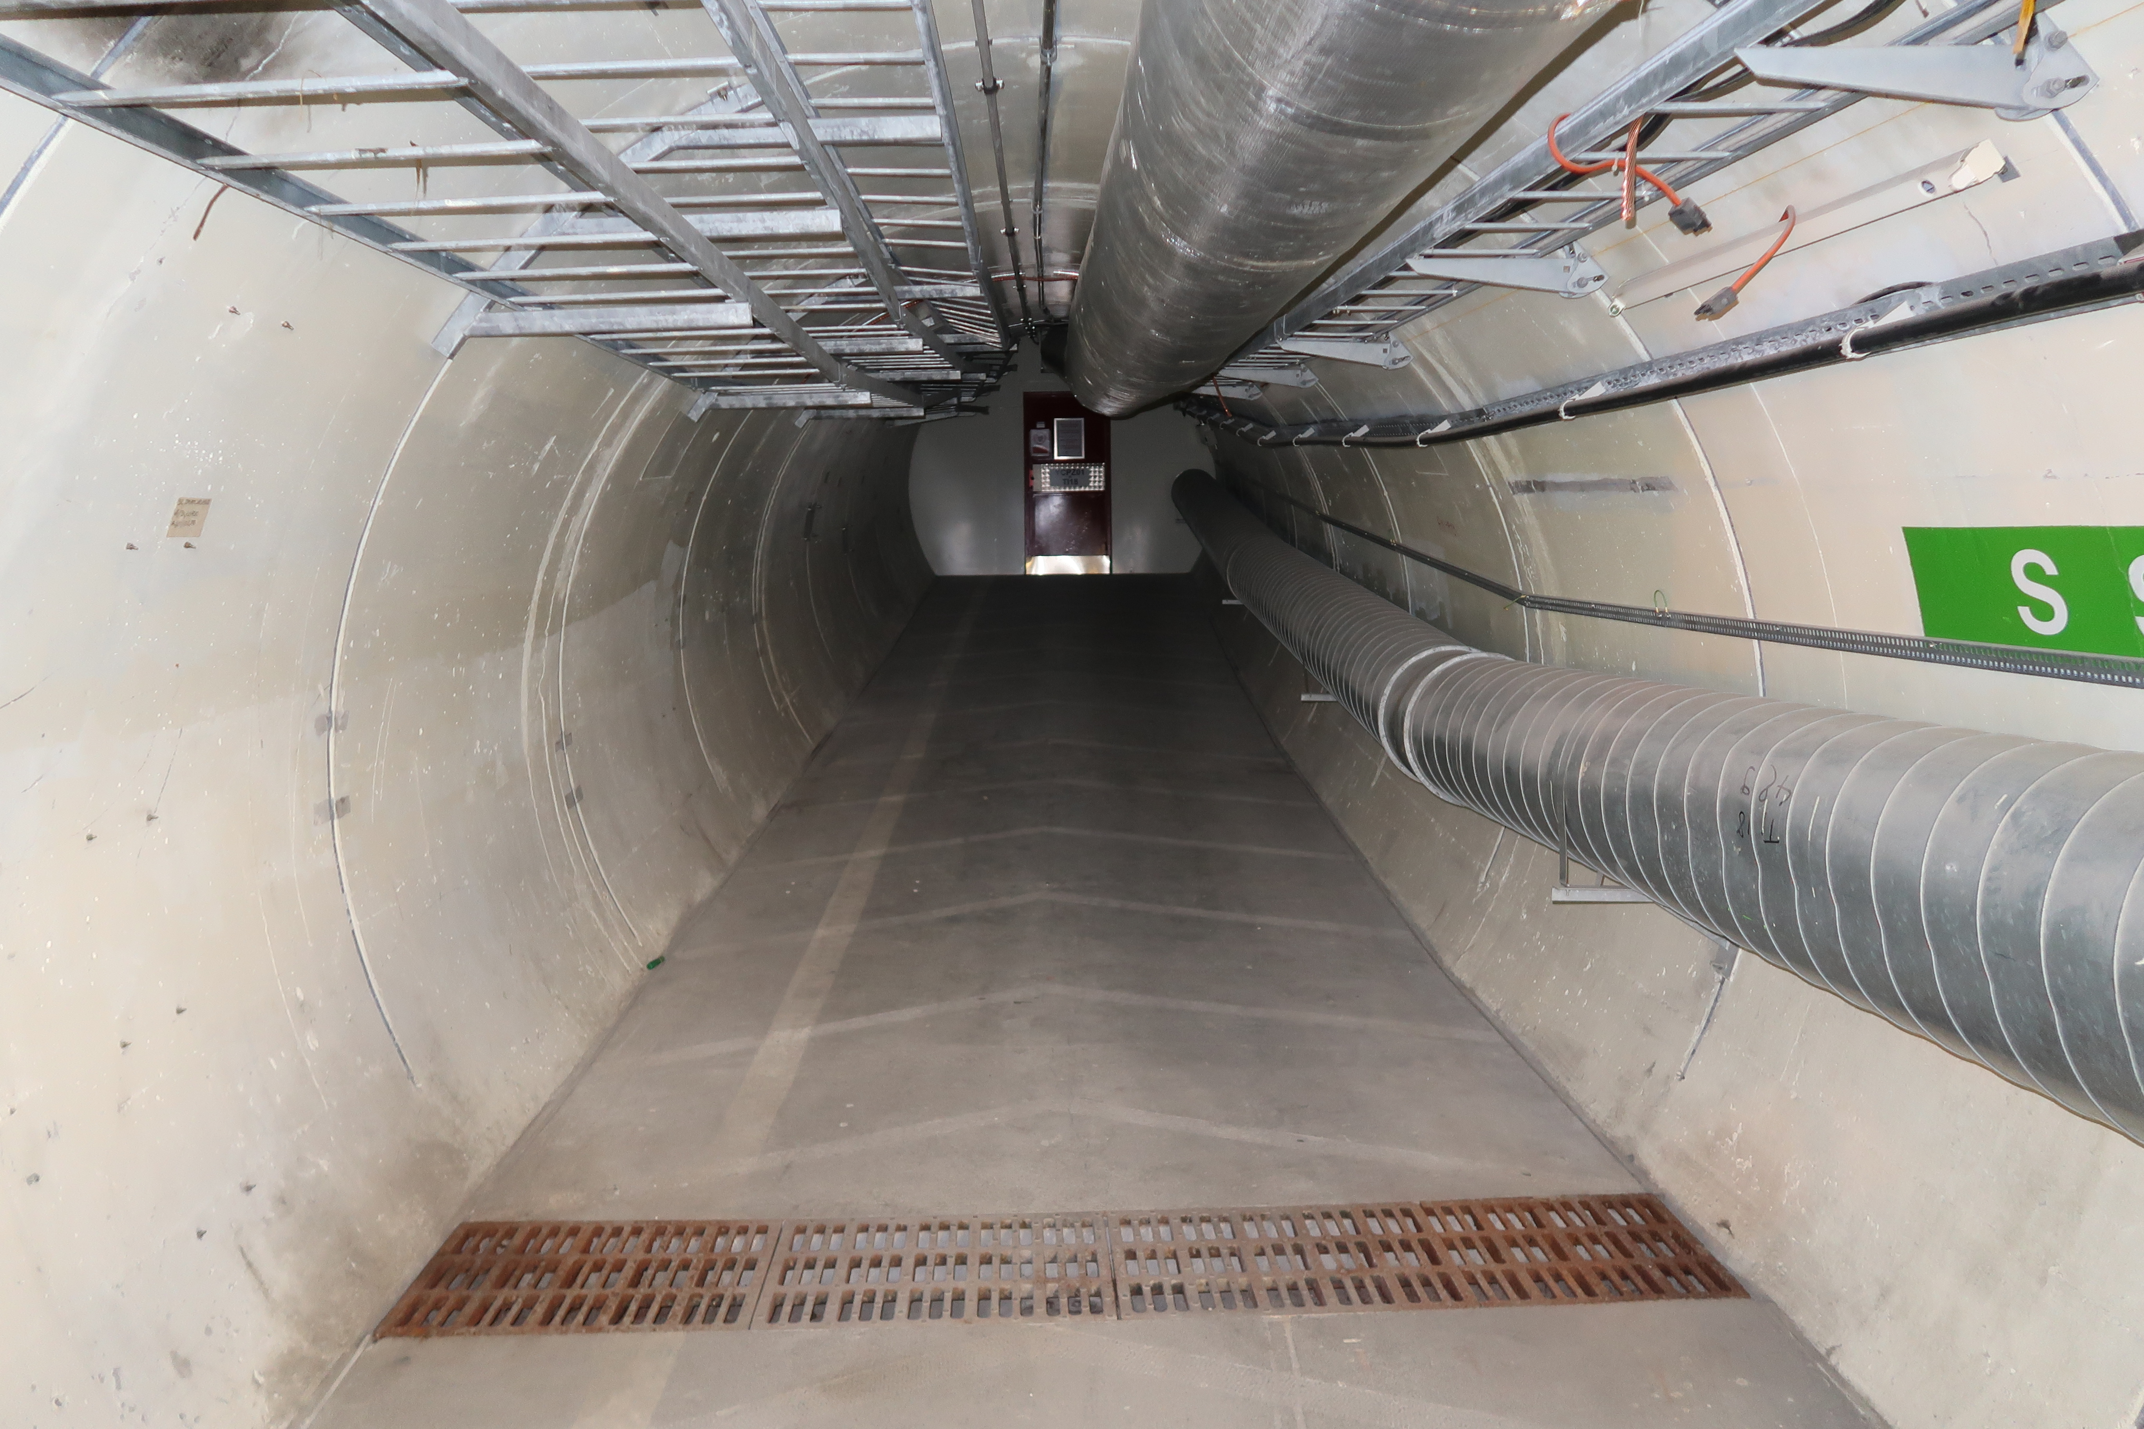
FASER: LOCATION

Slide 30
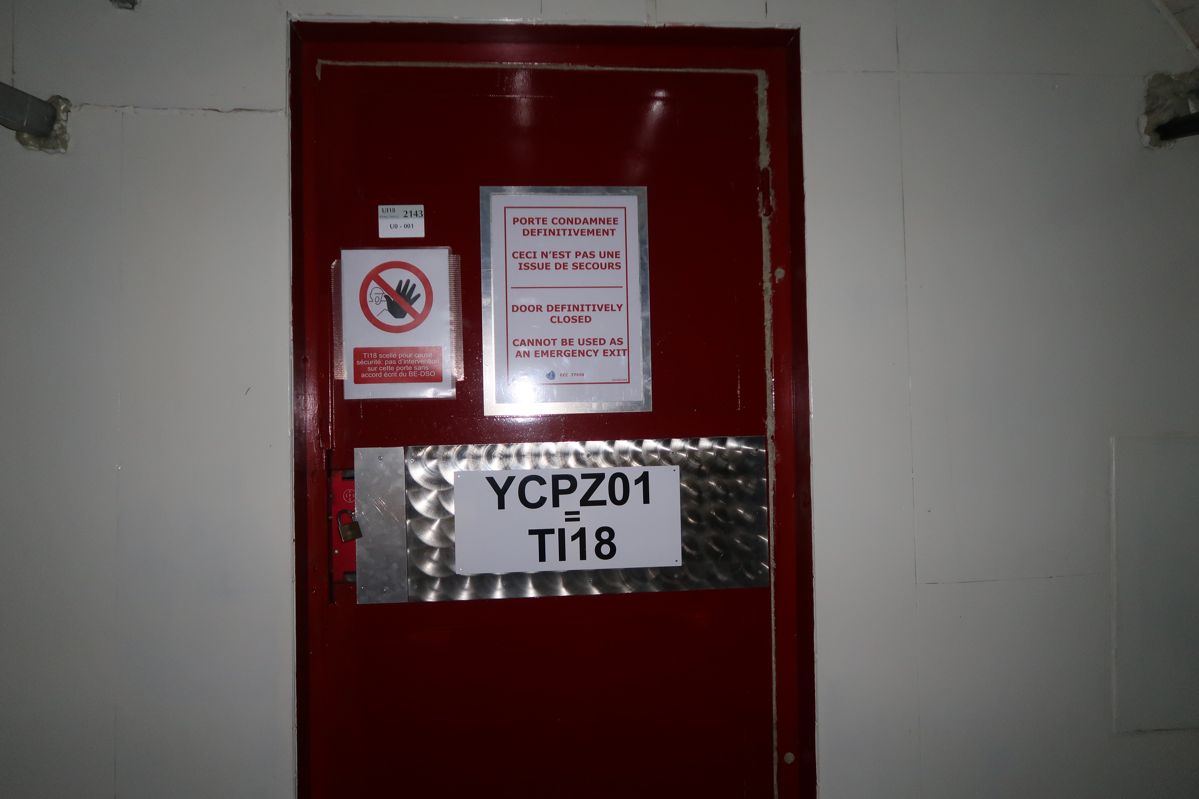
FASER: LOCATION

Slide 31
FASER: LOCATION

Slide 32
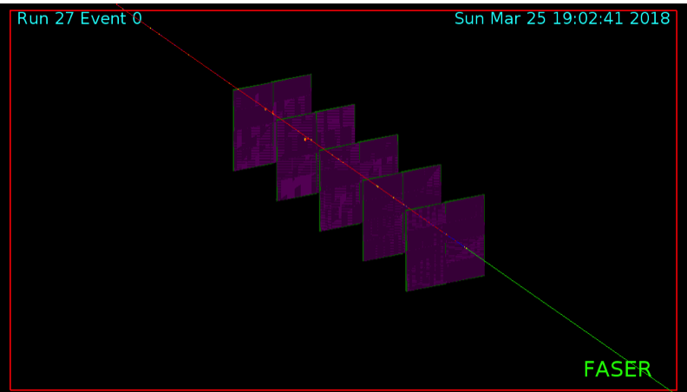
FASER: GEANT STUDY UNDERWAY
Currently have in mind an initial veto layer, followed by ~5 tracking layers and EM calorimeter, with volume largely empty and a magnetic field.

Slide 33
FASER: FLUKA STUDY UNDERWAY

Slide 34
SUMMARY AND OUTLOOK
The LHC has seen no new physics. Adding supplementary detectors to improve discovery prospects is a good idea, and there are many proposals targeting the lifetime frontier.
FASER targets light, weakly-coupled new particles at low p_{T}, runs simultaneously with ATLAS/CMS, is small, fast, and cheap.
FASER has significant discovery potential for dark photons dark Higgs bosons, heavy neutral leptons (sterile neutrinos), ALPs, other gauge bosons, and many other new particles.
Possible timeline: install prototype in LS2 (2019-20) for Run 3 (150-300 fb⁻¹), install full detector in LS3 (2023-25) for HL-LHC (3 ab⁻¹).

