Slide 1
MSSM4G: MOTIVATIONS AND ALLOWED REGIONS
ATLAS SUSY WG Meeting
CERN
Jonathan Feng, University of California, Irvine
31 January 2018
Based on 1510.06089, 1608.00283 with Mohammad Abdullah (Texas A&M), Sho Iwamoto (Padua), Ben Lillard (UC Irvine)

Slide 2
OUTLINE
Motivations
QUE and QDEE Models
Allowed Masses
Neutralino Dark Matter Implications
[ Collider Implications (Sho Iwamoto, next talk) ]

Slide 3

MOTIVATIONS
For decades, the case for weak-scale SUSY has rested on 3 leading motivations.
Recent results from the LHC motivate thinking about new SUSY theories beyond the MSSM that are consistent with these results, but also, ideally, preserve these motivations.
SUSY
Force Unification
Naturalness
Neutralino DM

Slide 4
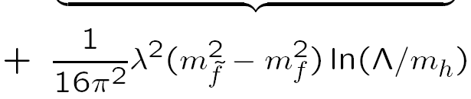
THE HIGGS BOSON MASS
At tree-level, the Higgs boson mass is maximally m_{Z} .
To make it 125 GeV, need large radiative corrections. In the MSSM, this requires multi-TeV stops or large left-right stop mixing. Both options may be unnatural, and the first is certainly disappointing.
f ̃ λ²
λ
+
f f
λ
An obvious solution: introduce more matter, e.g., extra top-like quarks and squarks, that gives additional radiative corrections. These can raise the Higgs mass without extremely heavy or highly mixed superpartners. _{Moroi, Okada (1991)}

Slide 5
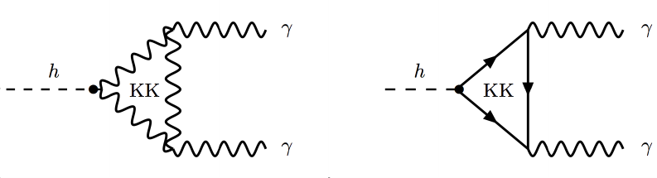
VECTOR-LIKE MATTER
Unfortunately, extra chiral matter is essentially excluded.
E.g., such matter contributes to h→ γγ, which is famously non-decoupling.
The problem: for chiral matter, Q’_{L} is an SU(2) doublet, t’_{R} is an SU(2) singlet, so all mass comes from λhQ’_{L}t’_{R} , .
A solution: introduce vector-like matter, fields come in left-right pairs. E.g., Q’_{L}, t’_{R} and Q’_{R}, t’_{L}, so then also have vector-like masses M_{V}Q’_{L}Q’_{R} and M_{V}t’_{L}t’_{R} without coupling to Higgs field.
We need to keep large Yukawa couplings to give large radiative corrections to the Higgs mass, but we can simultaneously take M_{V} large enough to satisfy all constraints (Higgs properties, electroweak precision, etc.).

Slide 6
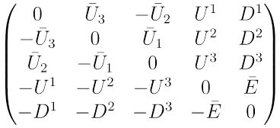
QUE and QDEE MODELS
Vector-like fermions are anomaly-free, so we don’t need complete generations. Too many possibilities?
But we want to keep gauge coupling unification. This suggests complete SU(5) multiplets: 5s or 10s. Requiring couplings perturbative to GUT scale:
  5s do not give sufficient m_{Higgs} corrections.
  at most one vector-like 10 is allowed.
This is the QUE model.
U
Q
There is also a “flipped SU(5) possibility”: the QDEE model.
_{Martin (2010)}
E

Slide 7
QUE AND QDEE MODELS
Summary so far: remarkably, there are only two models that give (1) large Higgs mass corrections and (2) preserve gauge coupling unification. E.g., the QUE model:
[upper case: SU(2) doublet, lower case: SU(2) singlet]
Simple, but not that simple! Assume unified 4th generation squark, slepton, quark, and lepton masses:

Slide 8
ALLOWED MASSES
As with the top Yukawa in the MSSM, the 4th generation quark Yukawa couplings have quasi-fixed points.
Given the quasi-fixed point value, what masses give the desired Higgs mass? ~1-2 TeV squarks are sufficient. Current lower bound ~1.3 TeV (ATLAS, 1707.03347)
m_{q4} = 1 TeV,
m_{h} = f(m_{sq4}/m_{q4})
Martin (2010)
MSSM stop mass →
Abdullah, Feng (2015)

Slide 9
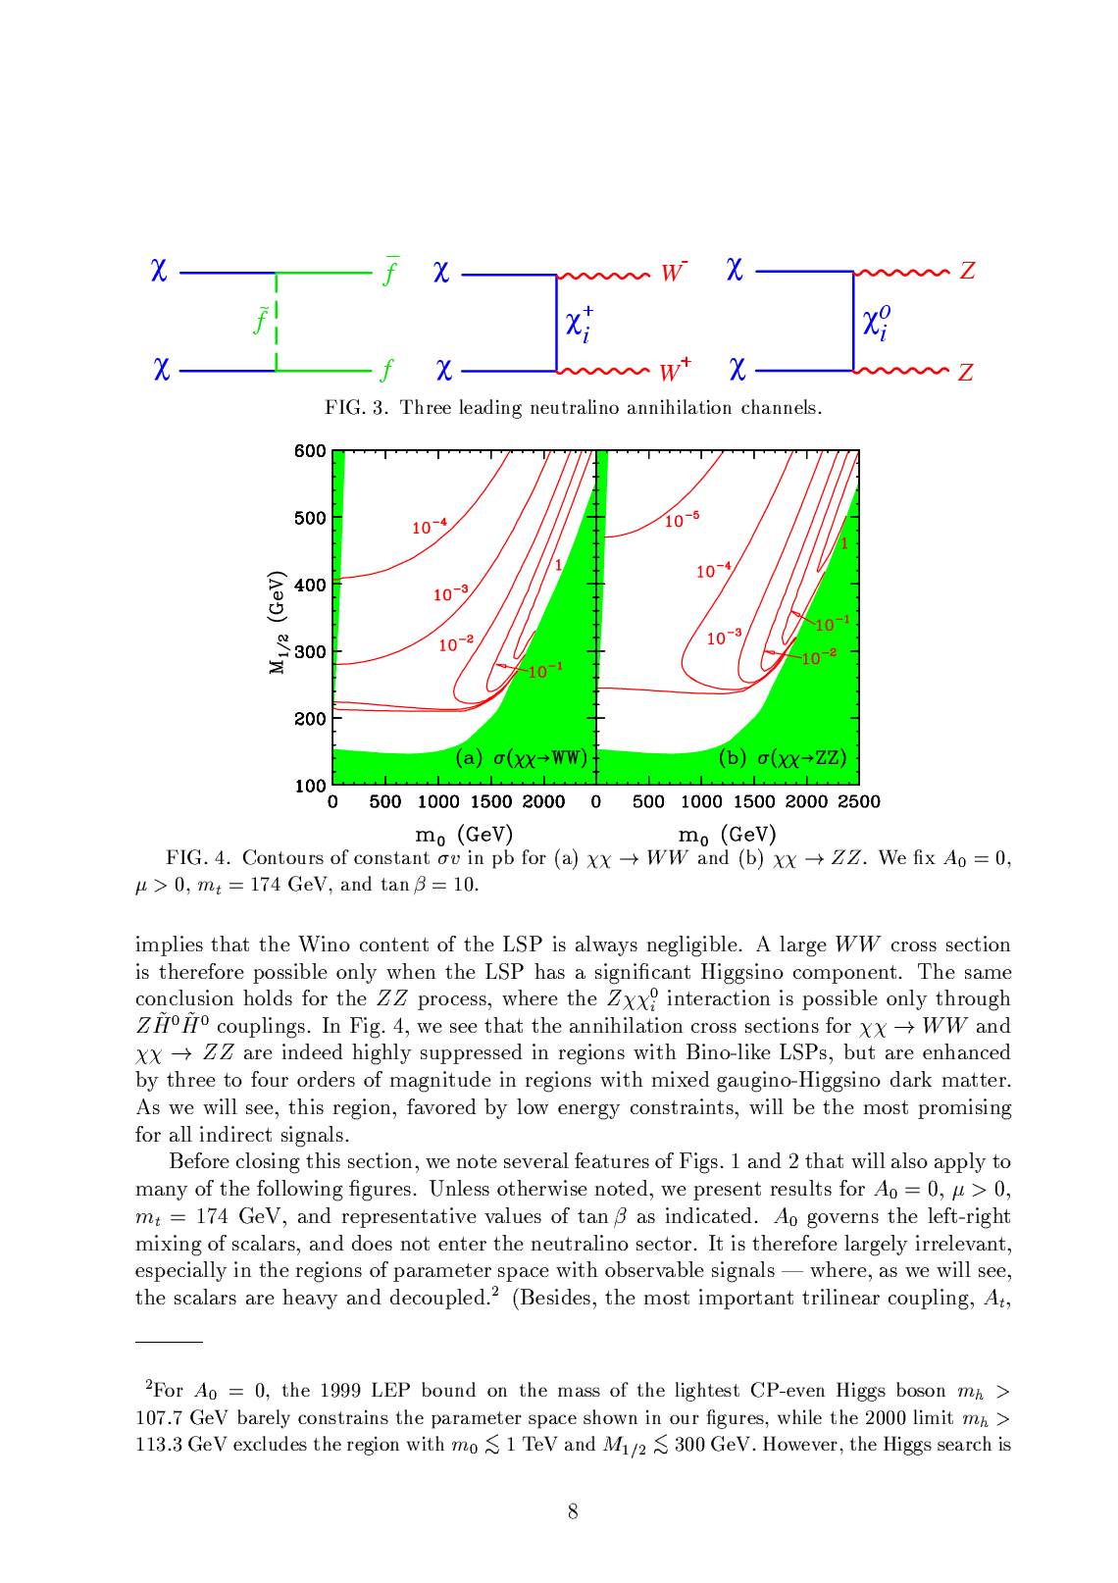
NEUTRALINO DARK MATTER
3rd SUSY motivation: requiring correct thermal relic density prefers certain masses, often provides upper limits:
In the MSSM, Bino DM annihilation is highly suppressed, typically get too much DM:
Need to either raise the couplings (Higgsino/Wino mixing) or lower the mass (light Binos < 200 GeV, gluinos < 1.4 TeV)
~ m_{f}
chiral suppression
0 for Bino

Slide 10
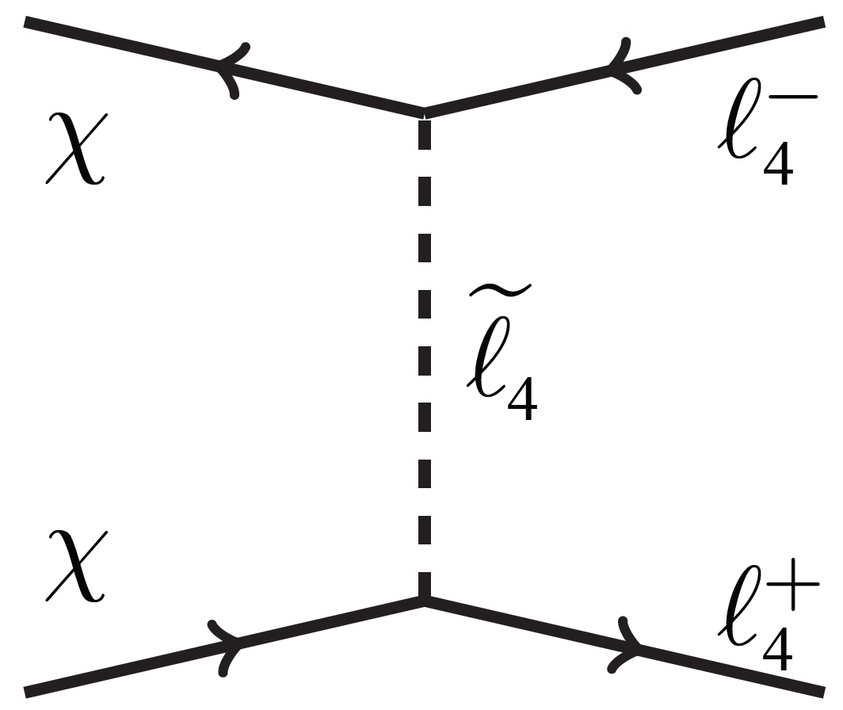
MSSM4G DARK MATTER
For MSSM4G, the situation is completely different. Assume neutralino LSP, annihilates to 4th generation leptons:
Annihilation to 4th generation leptons is unsuppressed, completely dominates all O(100) SM diagrams, opens up new Bino DM parameter space.
Note: No charged DM, so 4th generation leptons must mix with and decay to e/μ/τ, neutrinos; large range of lifetime.

Slide 11
COSMOLOGICALLY PREFERRED MASSES
To get the correct thermal relic density, need
Bino: 200–550 GeV
Slepton: 350–550 GeV
Lepton: 200–450 GeV
[Gluino: 1.4-3.8 TeV]
The masses cannot be higher, or there is too much DM
Abdullah, Feng (2015)

Slide 12
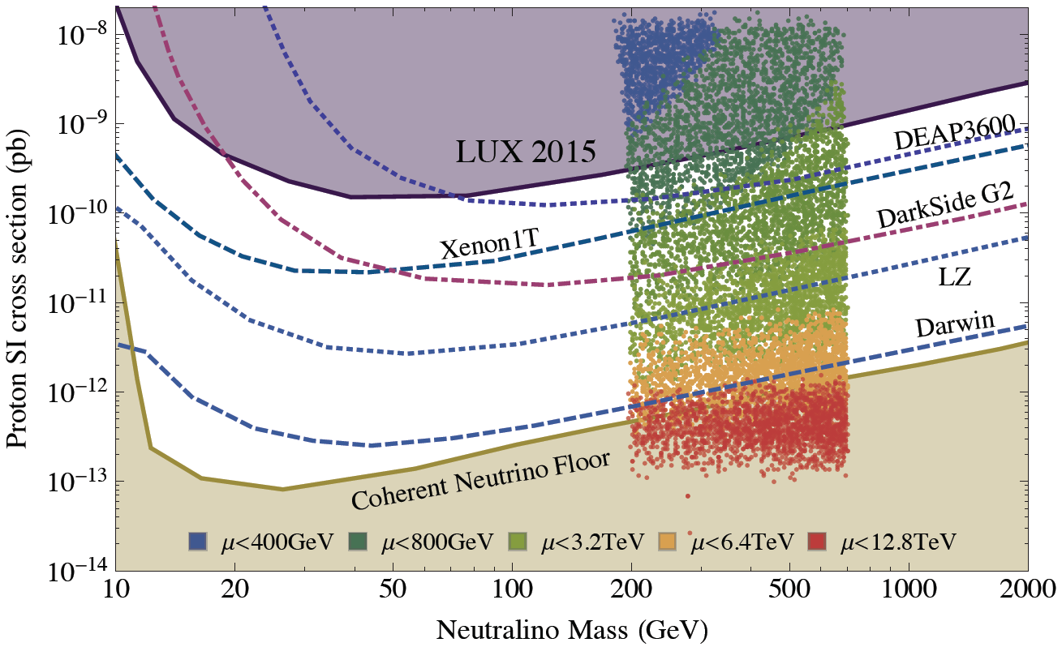
MSSM4G DARK MATTER DIRECT DETECTION
MSSM4G DM direct detection cross sections naturally fall between current bounds and the neutrino floor
QUE
QDEE
Abdullah, Feng, Iwamoto, Lillard (2016)

Slide 13
MSSM4G DARK MATTER INDIRECT DETECTION
Halo DM annihilates to τ₄ pairs, which then decay to e/μ/τ, produce gamma rays. Decays to τ may be seen at CTA in the next few years. Decays to e and μ are harder for CTA, but better for the LHC.
Abdullah, Feng, Iwamoto, Lillard (2016)

Slide 14
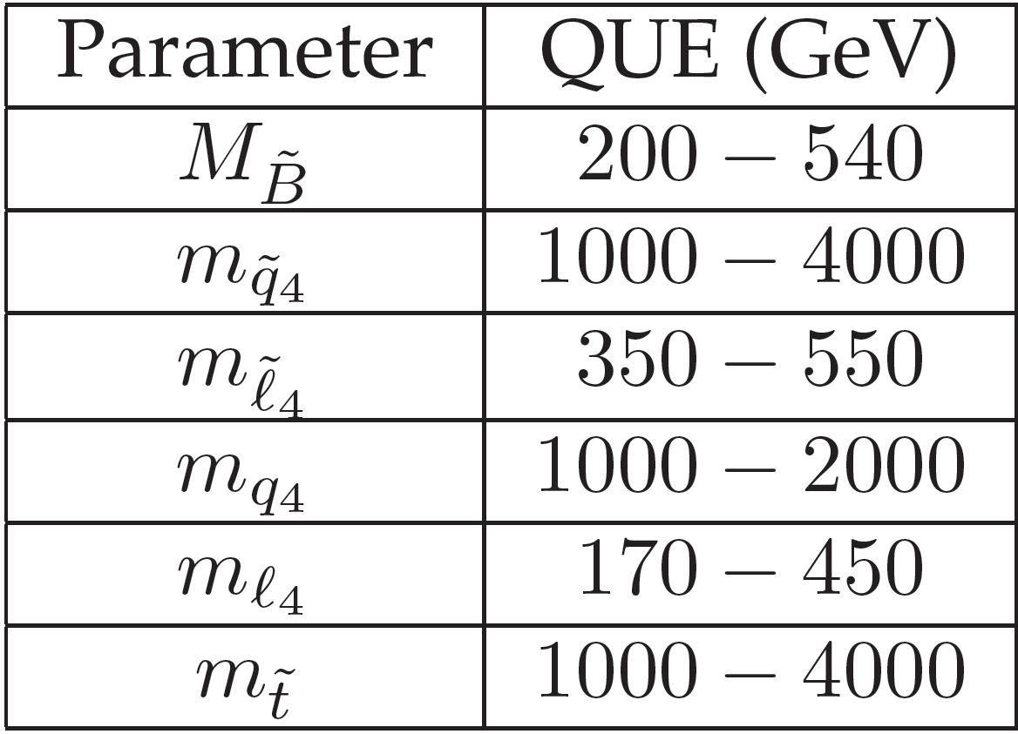
MSSM4G AT THE LHC
MSSM4G models imply a wealth of signals at the LHC (see next talk).
4th generation particles must decay, but can decay to any of the 1st three generations with a variety of lifetimes. Possible signals:
  Quarks, squarks, gluinos in the 1-3 TeV range, cascading down to MET signatures
  τ₄ τ₄ Drell-Yan production, followed by decays τ₄ → τ Z, ν W, τ h, etc.
  τ̃₄ τ̃₄ Drell-Yan production, followed by decays τ̃₄ → e χ, μ χ, τ χ
  τ̃₄ τ̃₄ Drell-Yan production, leading to long-lived charged particles, displaced vertices
Kumar, Martin (2015); Abdullah, Feng, Iwamoto, Lillard ( 2016)

Slide 15
CONCLUSIONS
MSSM4G: extension of the MSSM to include 4th generation vector-like particles.
Higgs mass and gauge coupling unification → only two models to consider: QUE and QDEE.
~1-2 TeV stops and 4th generation squarks raise Higgs mass to 125 GeV.
Dark matter: 350–550 GeV sleptons, 200–550 GeV Binos, 170–450 GeV leptons give correct thermal relic density.
Promising signals for direct detection, indirect detection, and LHC.

