Slide 1
FASER
FORWARD SEARCH EXPERIMENT AT THE LHC
Carleton University
Jonathan Feng, UC Irvine
Based on 1708.09389 and 1710.09387
with Iftah Galon, Felix Kling, Sebastian Trojanowski
9 November 2017

Slide 2
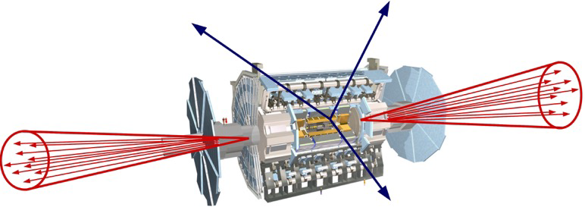
SUMMARY
New physics searches at the LHC focus on high p_{T}. This is appropriate for heavy, strongly coupled particles
  σ ~ fb to pb → N ~ 10³ – 10⁶, produced ~isotropically
However, if new particles are light and weakly coupled, this may be completely misguided. Instead should exploit
  σ_{inel} ~ 100 mb → N ~ 10¹⁷, θ ~ Λ_{QCD} / E ~ 250 MeV / TeV ~ mrad
We propose a small, inexpensive experiment, FASER, to be placed in the very forward region of ATLAS/CMS, a few 100m downstream of the IP, and analyze its discovery potential

Slide 3
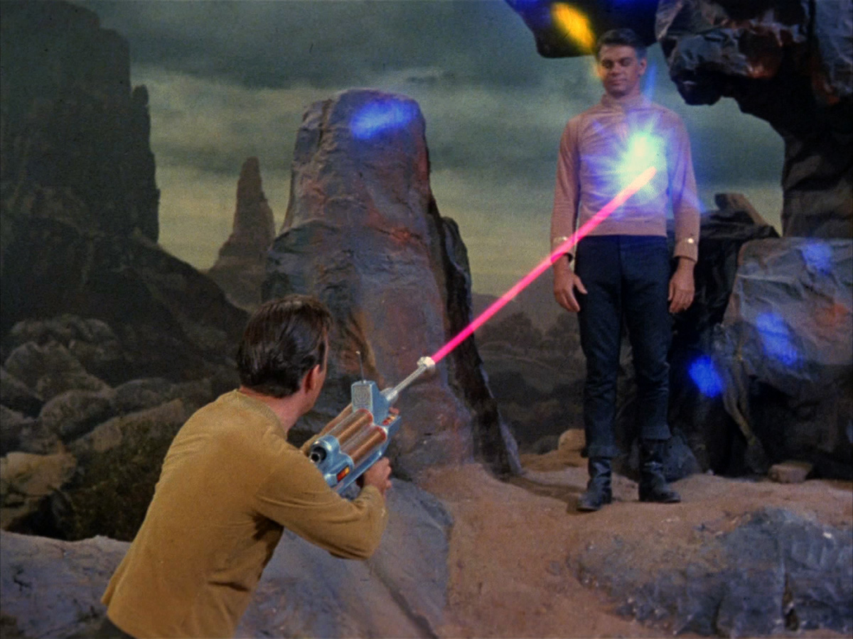
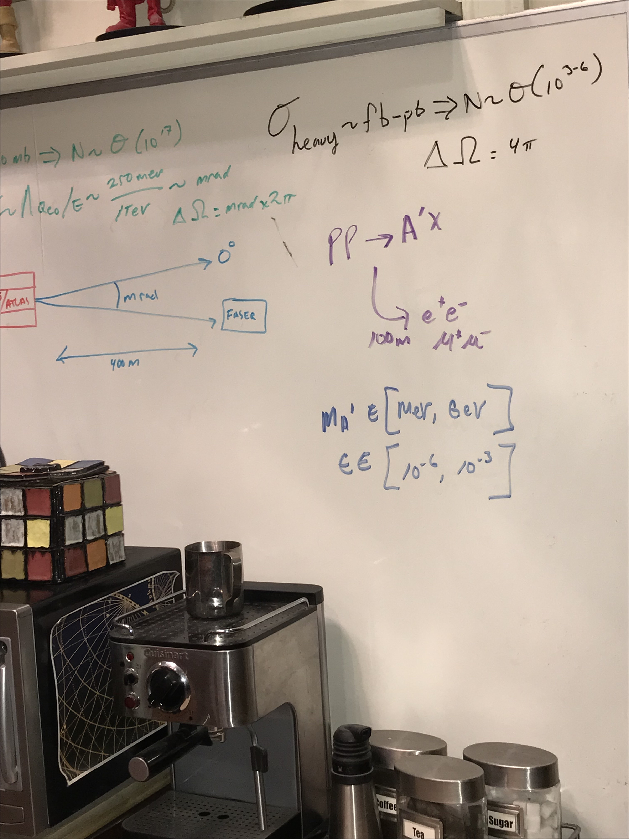


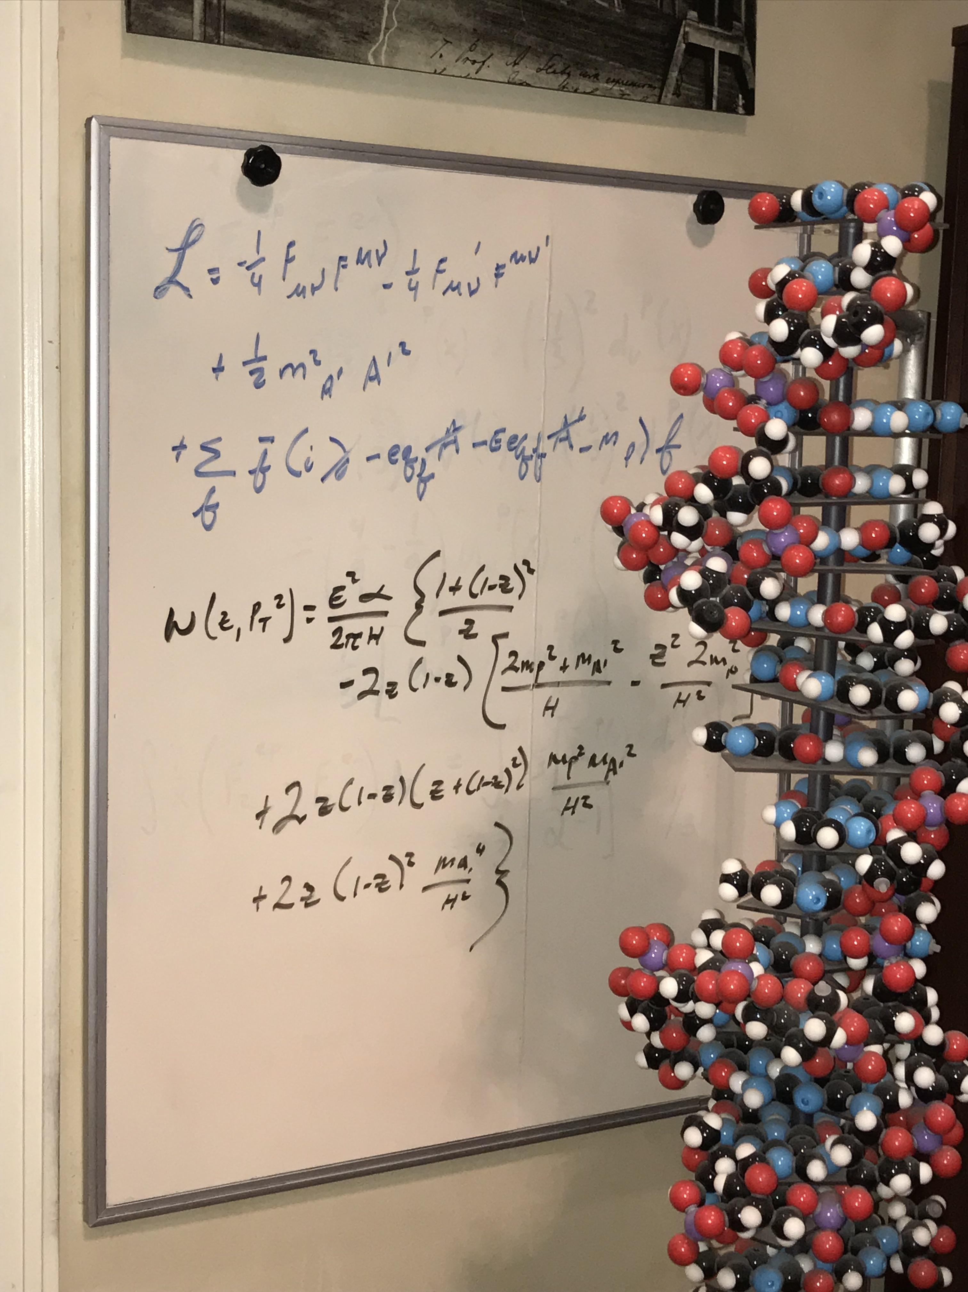
THE LIFETIME FRONTIER
This field is generating worldwide interest. At CERN: LHCb, NA62, SHiP, MATHUSLA, MilliQan, Codex-b, ...
FASER: “The acronym recalls another marvelous instrument that harnessed highly collimated particles and was used to explore strange new worlds.”

Slide 4
OUTLINE
Very Forward Region Infrastructure
New Physics Example: Dark Photons
Signal
Backgrounds
Results
New Physics Example: Dark Higgs Bosons
Summary and Outlook

Slide 5
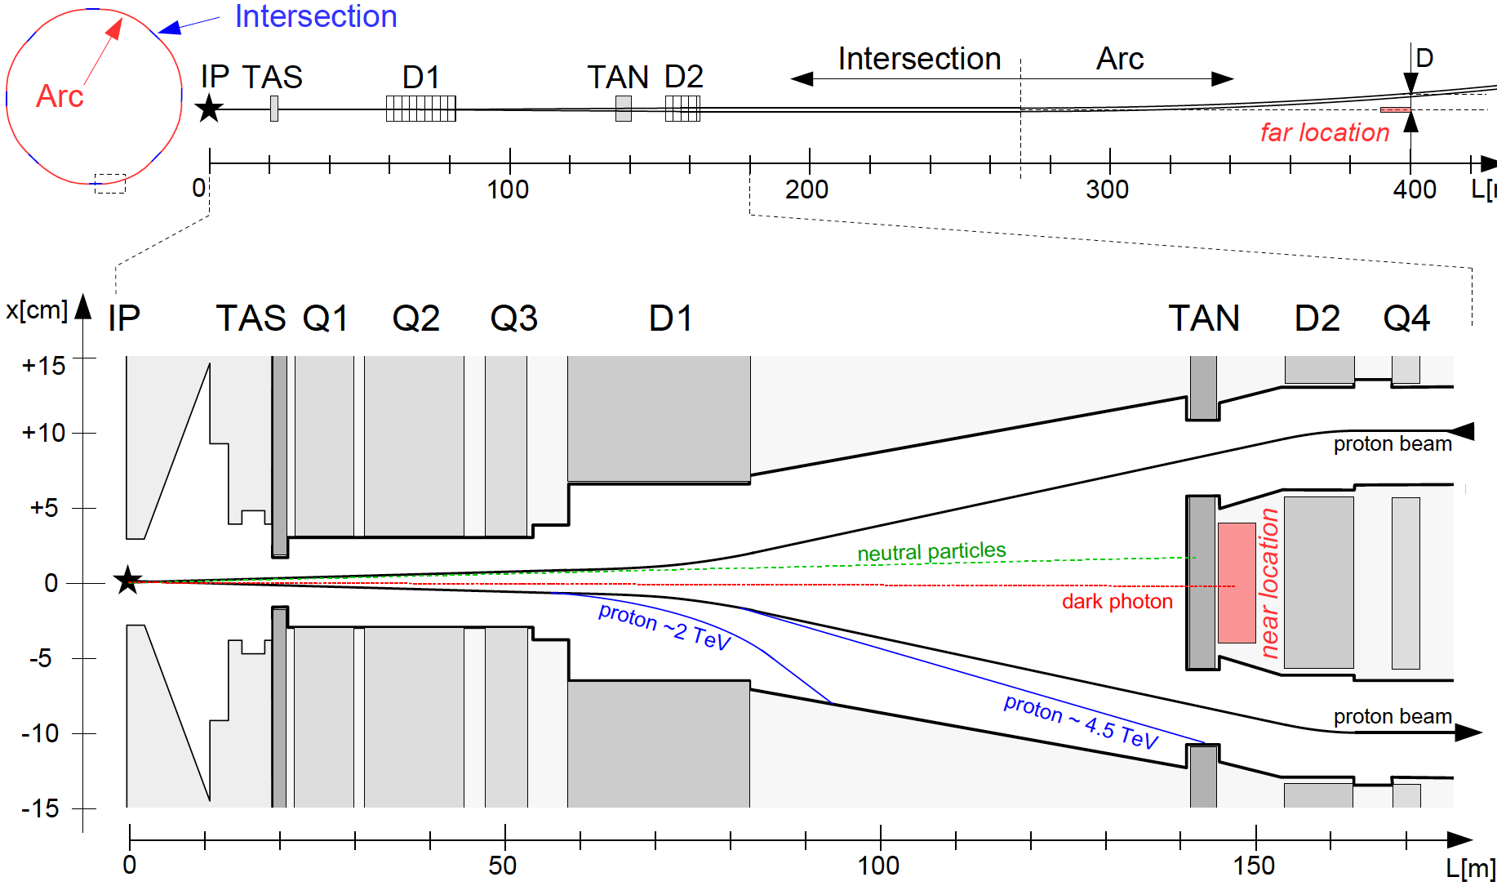
VERY FORWARD REGION INFRASTRUCTURE
LHC ring consists of 8 straight 545 m intersections and 8 curved arcs. The infrastructure common to IP1 and IP5 (also have ALFA, CASTOR, LHCf, TOTEM, etc.):
TAS: front quadrupole
absorbers (θ > 0.85 mrad)
D1: dipole magnet, splits
beams, deflects μ, p, ...
TAN: neutral target
absorbers (n, γ)
Feng, Galon, Kling, Trojanowski (2017)
Note the extreme difference in longitudinal and transverse scales

Slide 6
FASER LOCATIONS
We want to place FASER along the beam collision axis
  Far location: 400 m from IP, after beams curve, 2.6 m from the beams
  Near location: 150 m, after TAN, between the beams
ATLAS/CMS beams cross at 285 μrad in vertical/horizontal plane → shifts far (near) location by 5.7 (2.1) cm
HL-LHC: 285→590 μrad, TAN→TAXN moves forward 10 m,... We assume current parameters, FASER is exactly on-axis

Slide 7
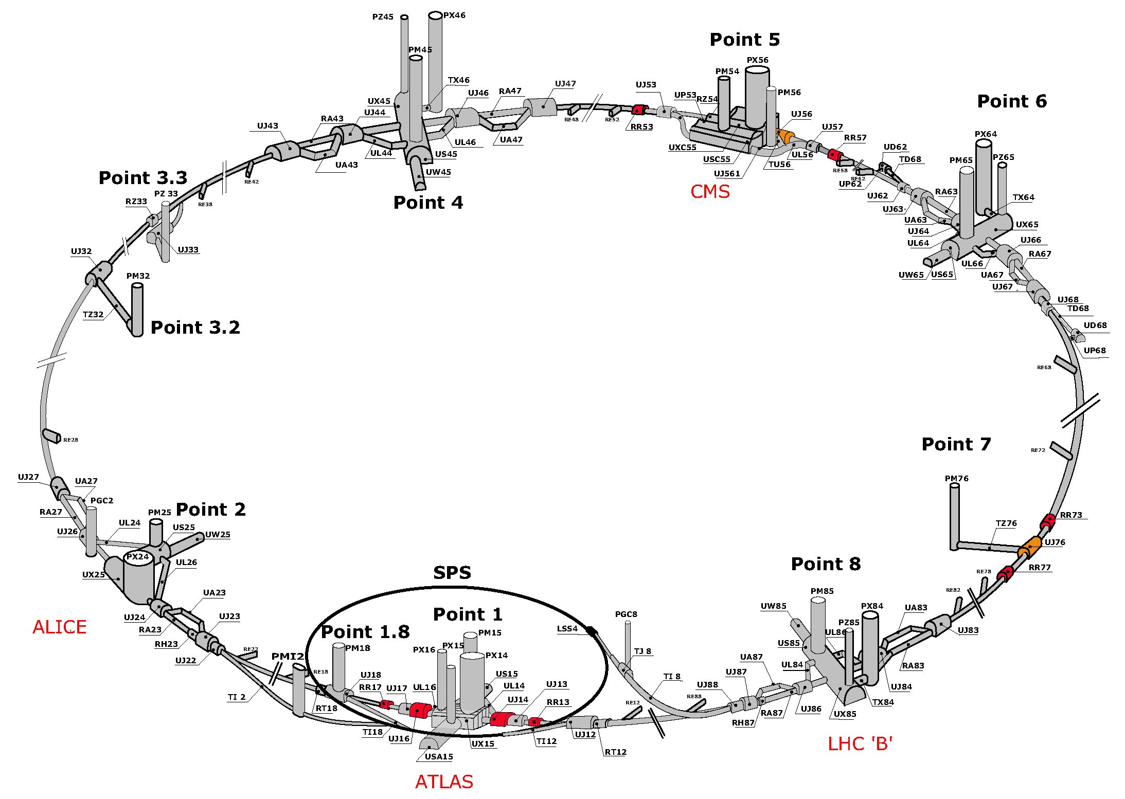
LHC RING

Slide 8
SERVICE TUNNEL TI18
TI18
TI18

Slide 9

DARK PHOTONS
Dark matter is our most solid evidence for new particles. In recent years, the idea of dark matter has been generalized to dark sectors
Dark sectors motivate light, weakly coupled particles (WIMPless miracle, SIMP miracle, small-scale structure, ..)
A prominent example: vector portal, leading to dark photons
The resulting theory contains a new gauge boson A’ with mass m_{A’} and εQ_{f} couplings to SM fermions f
SM
Hidden
U(1)

Slide 10
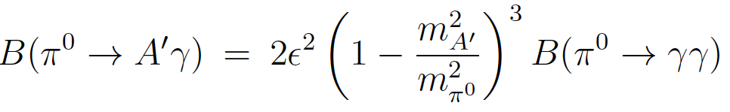
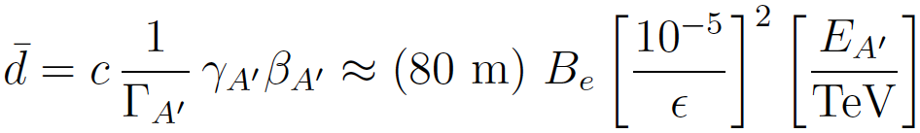

DARK PHOTON PROPERTIES
Produced in meson decays, e.g.,
                , ,
and also through dark bremsstrahlung pp → p A’ X and direct QCD processes qq → A’ X (requires pdfs at low Q², x)
Travels long distances through matter without interacting, decays mainly to e⁺e⁻ (and μ⁺μ⁻ for m_{A’} > 2 m_{μ} )
The essential tension: low ε → low event rate, high ε → decays too fast. Is there a happy middle ground?

Slide 11
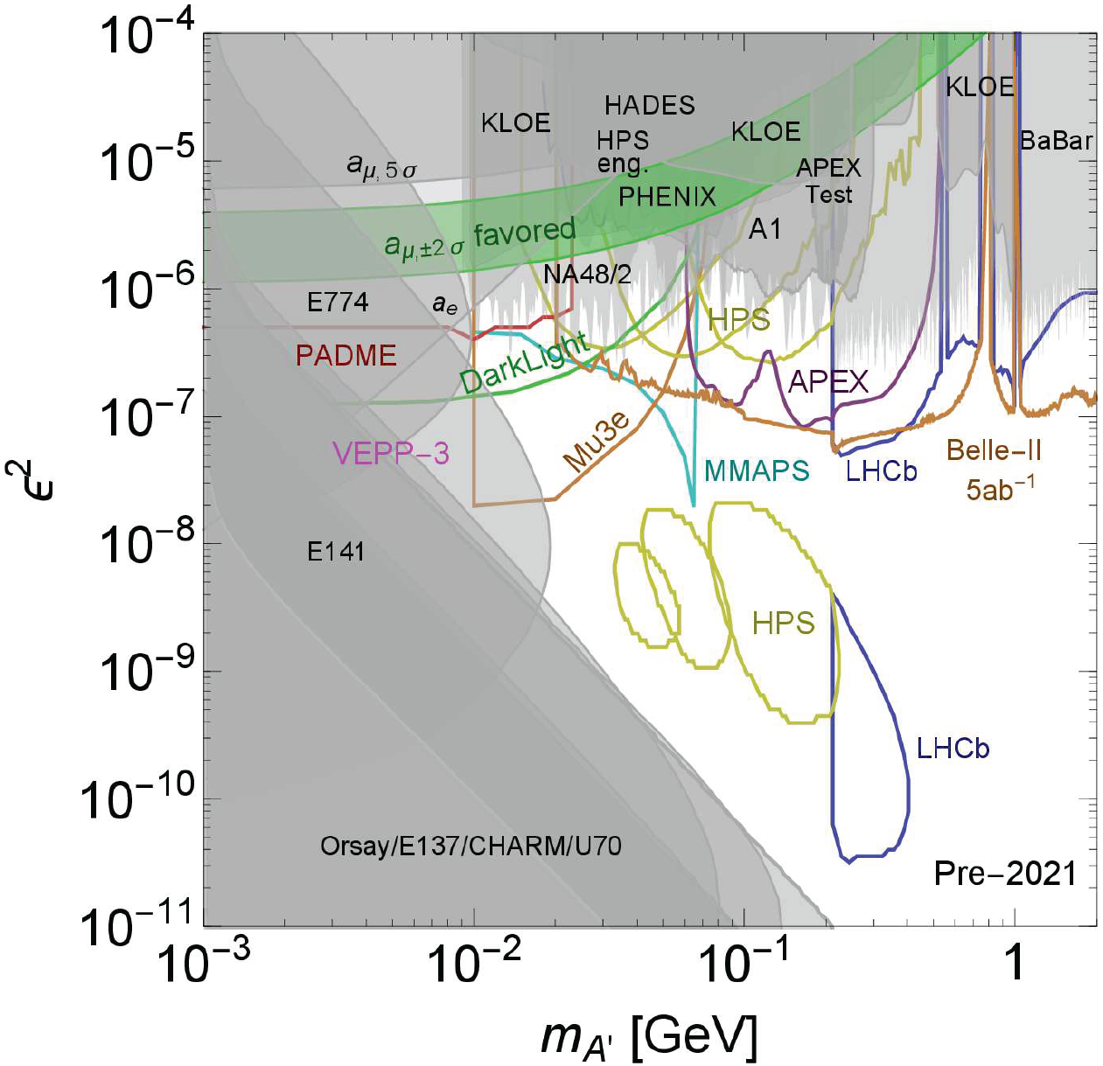
DARK PHOTON STATUS
Lots of unconstrained parameter space with
m_{A’} > 10 MeV
~ 10⁻⁶ – 10⁻³
2 representative model points: (m_{A’}, ε) =
(20 MeV, 10⁻⁴)
(100 MeV, 10⁻⁵)
Cosmic Visions White Paper (2017)

Slide 12
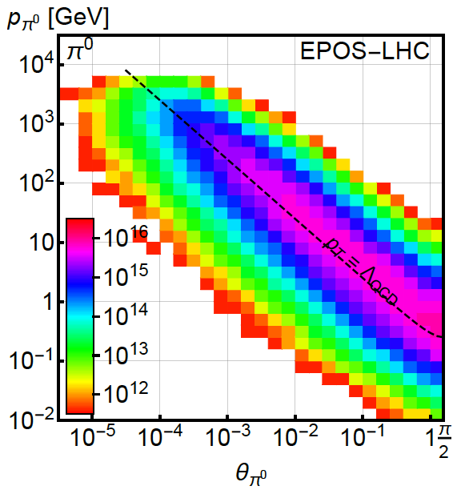
PION PRODUCTION AT THE LHC
Forward particle production simulations and models have been greatly constrained by LHC data
EPOS-LHC, SIBYLL 2.3, QGSJETII-04 agree very well
Enormous event rates (σ_{inel}~70 mb, N_{inel}~10¹⁷), production is peaked at p_{T} ~ Λ_{QCD} , but with significant width
300 fb⁻¹

Slide 13
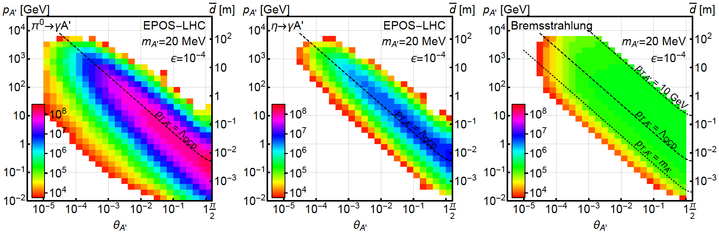
DARK PHOTON PRODUCTION
Consider π⁰ decay, η decay, dark bremsstrahlung
Results for 1st model point: (m_{A’}, ε) = (20 MeV, 10⁻⁴)
From π⁰ → γ A’, E_{A’} ~ E_{π} / 2 ( no surprise)
But note rates: even after ε² suppression, N_{A’} ~ 10⁸: LHC is a dark photon factory!

Slide 14
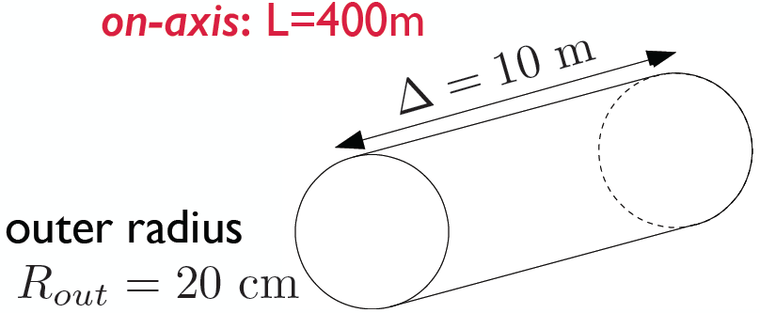
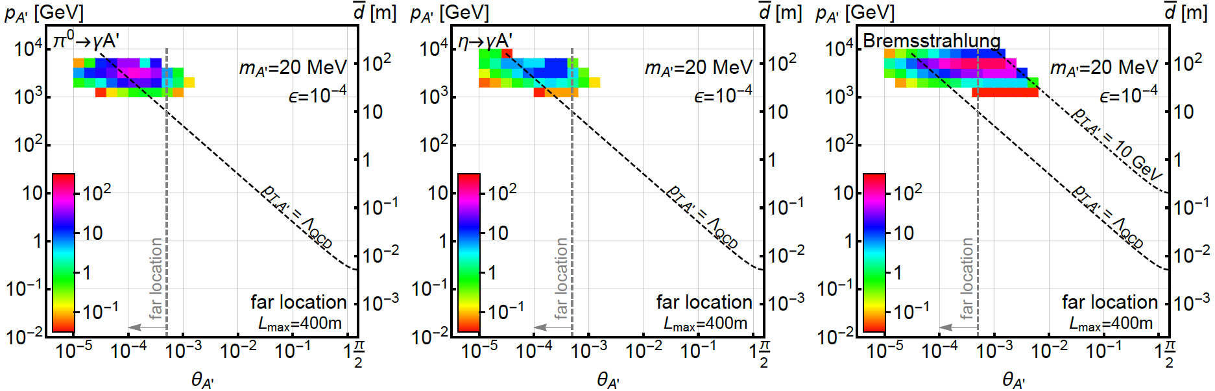
DARK PHOTONS IN THE FAR DETECTOR
Now require dark photons to decay in the far detector: consider cylindrical detector with volume ~1 m²
Only the highest energy A’s survive, but there are still many of them, and they are highly collimated

Slide 15
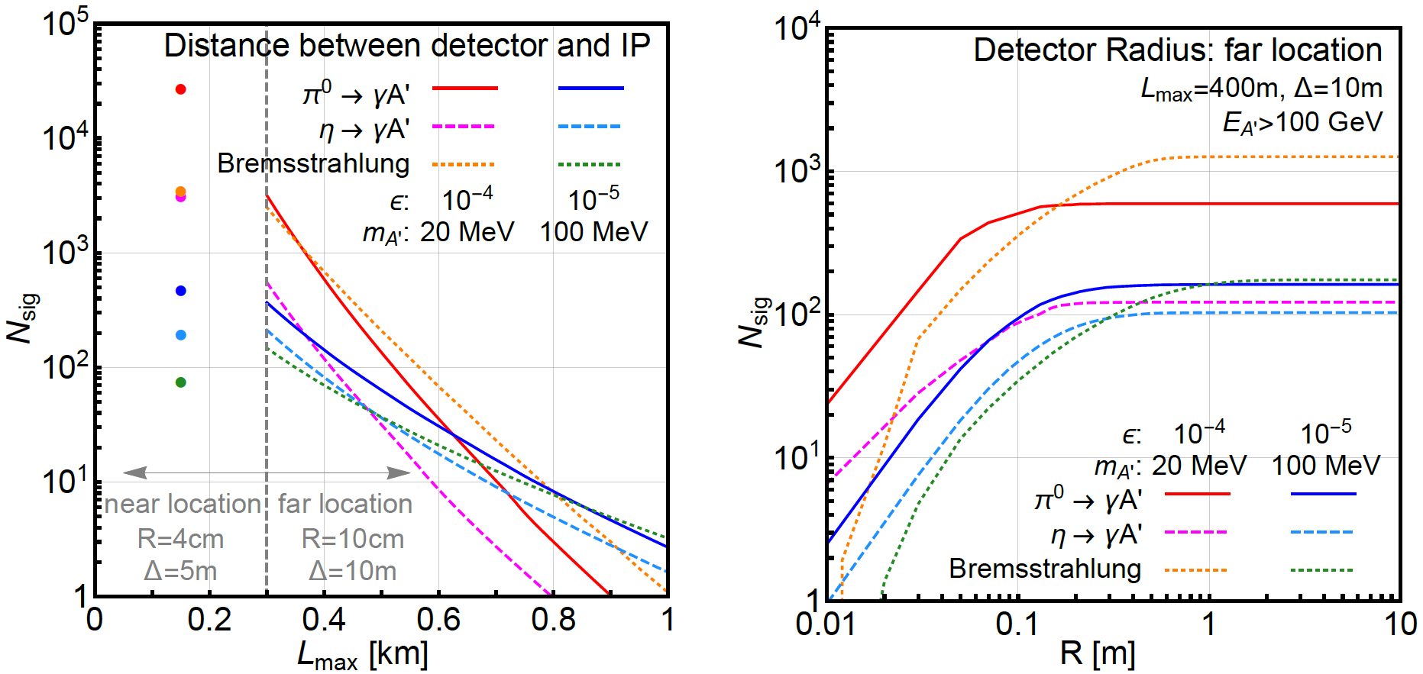
SIGNAL DEPENDENCE ON DETECTOR SPECS
For dark photons, moving the detector closer helps
At the far location, R = 20 cm captures almost all the A’

Slide 16
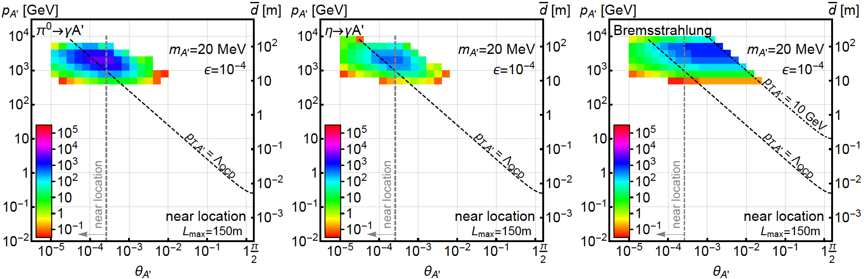
DARK PHOTONS IN THE NEAR DETECTOR
Now require dark photons to decay in the near detector: detector volume only ~0.1 m² !
150m
5 m
4 cm
Moving the detector closer → more dark photons decay in the detector, even though the after-TAN location is crowded

Slide 17
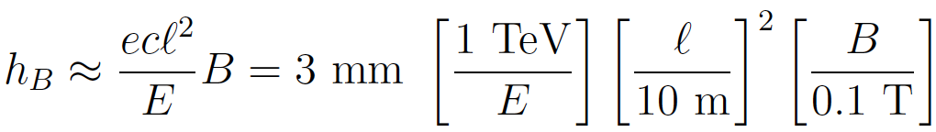
BACKGROUNDS
The signal is two simultaneous, opposite-sign, highly-energetic (E > 500 GeV) charged particles that start in the detector at a vertex and point back to IP → a tracker-based technology
The opening angle is θ_{ee} ~ m_{A’} / E ~ 10 μrad. After traveling ~1 m, this leads to 10 μm separation, too small to resolve, so we need a small magnetic field
Many backgrounds are eliminated simply by virtue of FASER’s location. Cosmic ray background is negligible, charged particles from IP are bent away by D1 magnet
Leading backgrounds originate at the IP: neutrino-induced and beam-induced backgrounds

Slide 18


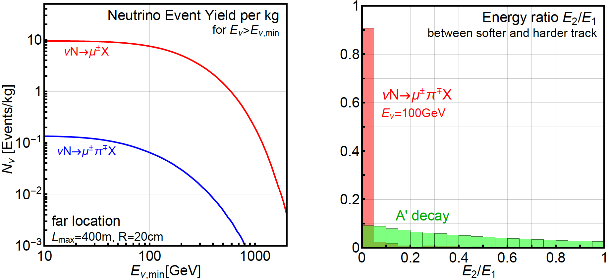
NEUTRINO-INDUCED BACKGROUNDS
If π⁺ → μν before D1 magnet, resulting neutrinos can propagate into FASER, interact through
Coincident single tracks that fake double tracks: negligible
Second process eliminated by requiring no other activity, tracks start in the detector and have high and symmetric energies
ν → K_{S,L} → 2 charged tracks also negligible with same cuts
GENIE

Slide 19

BEAM-INDUCED BACKGROUNDS: FAR LOCATION
Particles from IP must pass through ~ 50 m of matter. Hadrons, electrons are stopped, only muons are relevant
Muon background from 2011 ATLAS study can be used to determine muon background at far location. Requiring E_{μ} > 100 GeV, the flux is
The muon arrival times correspond to bunch crossings. Accounting for the bunch structure and assuming a timing resolution of 100 (10) ps, get ~0.1 (~0.01) coincident μ⁺μ⁻ pairs in 1 LHC year
No significant backgrounds identified for far location

Slide 20
BEAM-INDUCED BACKGROUNDS: NEAR LOCATION
Far more challenging environment
Dedicated simulation using MARS/FLUKA/etc. should be used, but we can use published results to get an estimate
Mokhov, Rakhno, Kerby, Strait (2003)
Hadrons and electrons absorbed in the TAN
Coincident muon background ~10⁸ per LHC year. Can be greatly suppressed by requiring tracks to start in the detector and reconstruct a vertex, and requiring high and symmetric energies
Electron background greatly reduced if electrons can be distinguished from muons

Slide 21
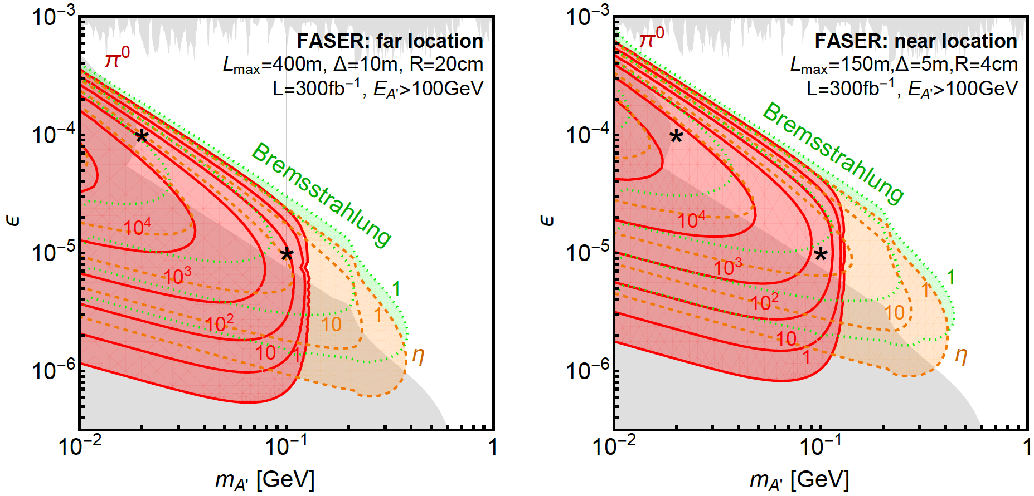
DARK PHOTON EVENT RATES
Up to 10⁵ dark photons arrive in FASER in 300 fb⁻¹ in currently unconstrained regions of dark photon parameter space

Slide 22
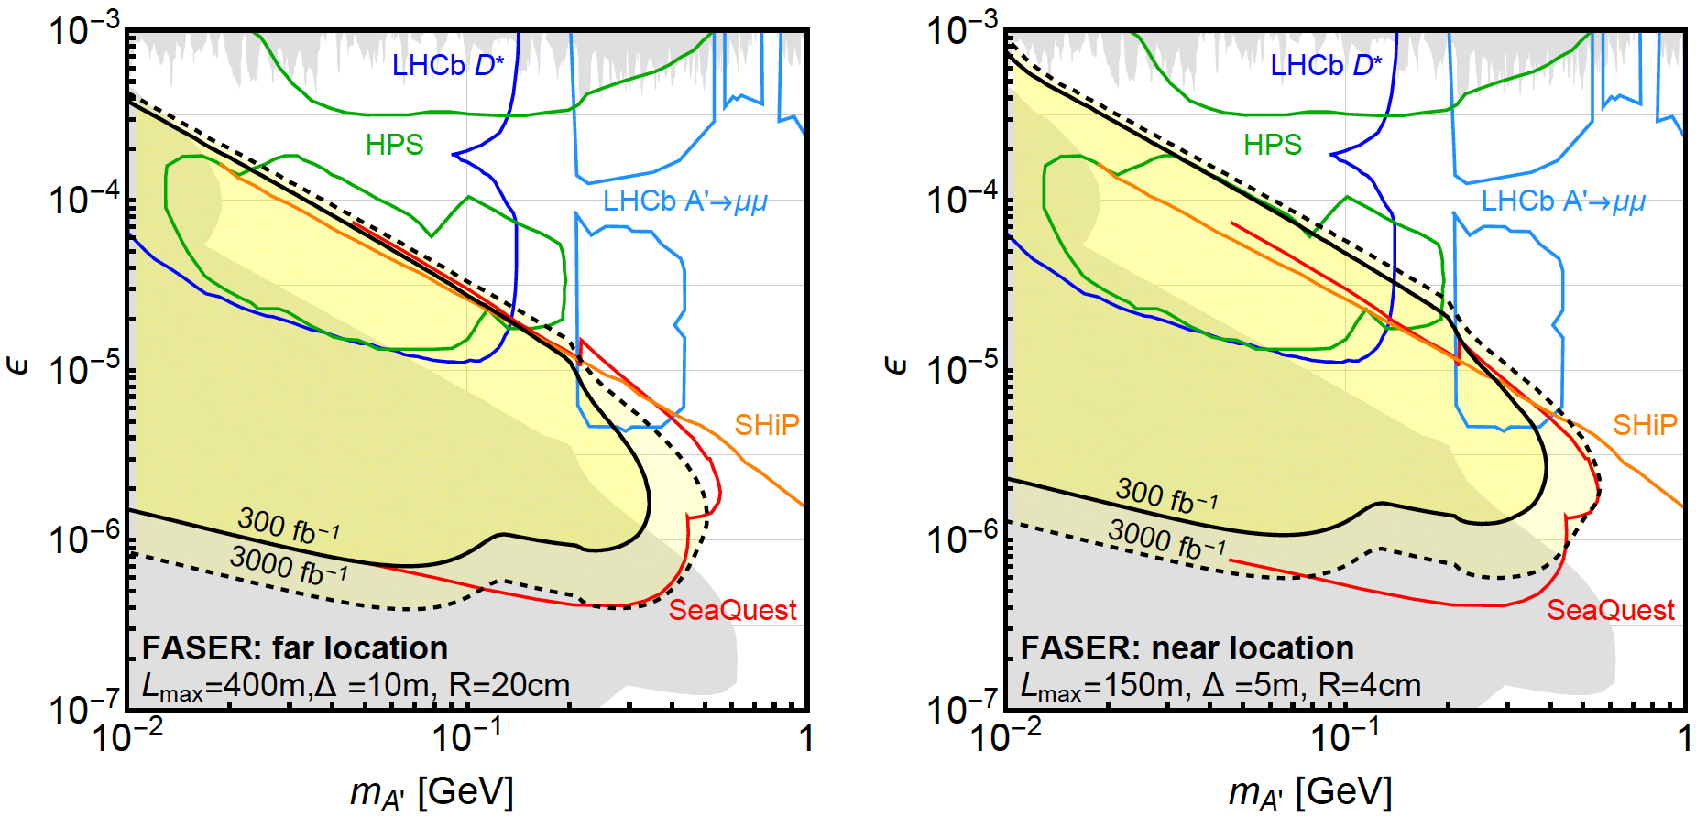
DARK PHOTON REACH
Assuming negligible background, FASER may probe parameter space with m_{A’} ~ 10 - 500 MeV, ε ~ 10⁻⁶ – 10⁻³
SHiP much more sensitive at very low ε, but much of this is excluded already. SHiP reach at high m_{A’} is from direct QCD production, which we have neglected
N=3 contours

Slide 23

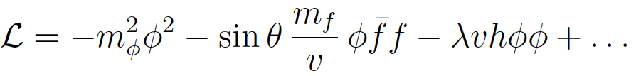
DARK HIGGS BOSONS
Another renormalizable coupling: Higgs portal
The resulting theory contains a new scalar boson φ with mass m_{φ} , Higgs-like couplings suppressed by sin θ, and a trilinear coupling λ
SM
Hidden
Higgs

Slide 24
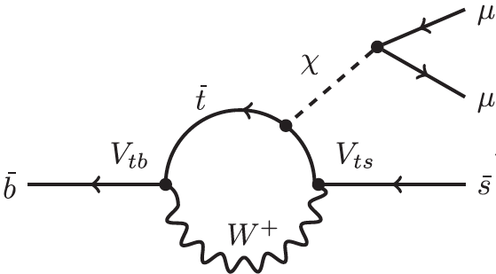

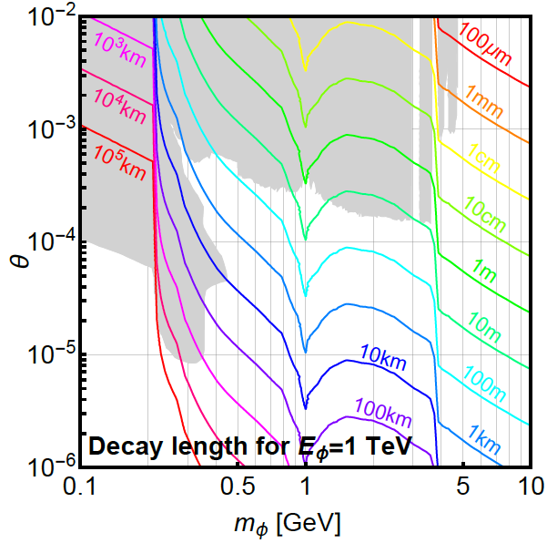
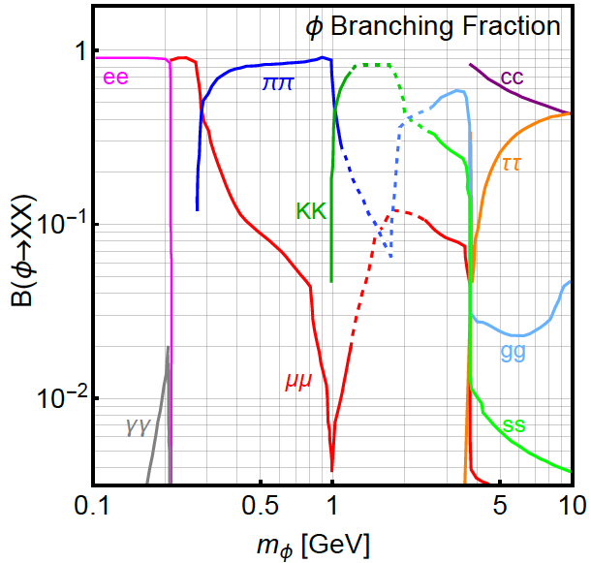
DARK HIGGS PROPERTIES
N_{B} << N_{K} ~ N_{π ,} but dark Higgs couples to mass, so
Turns out B and K are similar and the dominant sources of dark Higgses
Decays to heaviest possible states
φ

Slide 25
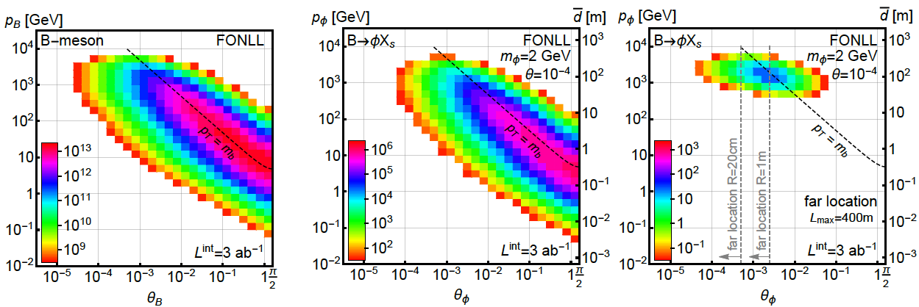
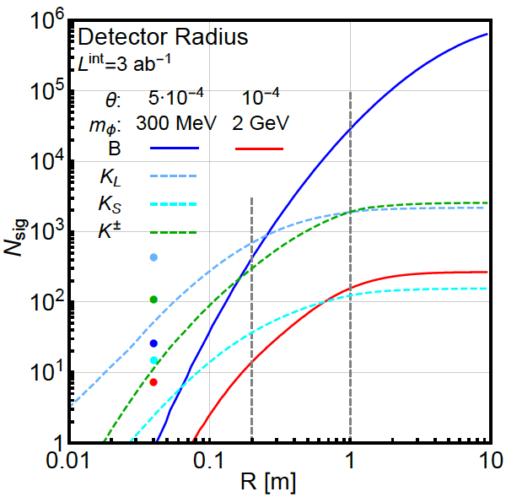
B MESON AND DARK HIGGS PRODUCTION
In B decays, p_{T} ~ m_{B}, dark Higgs bosons are less collimated than dark photons

Slide 26
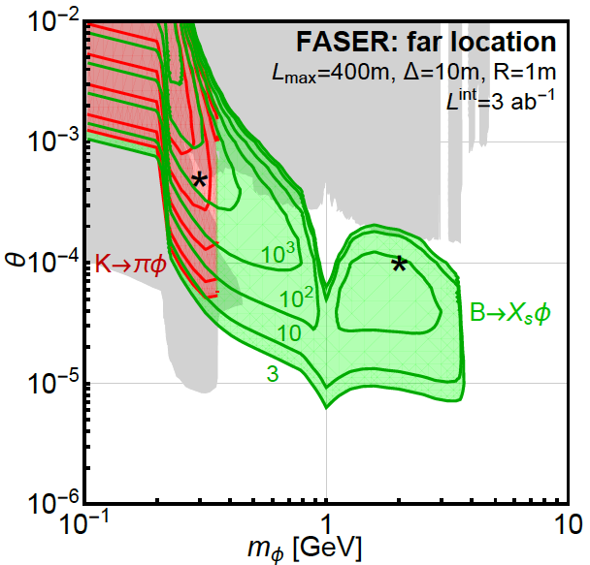
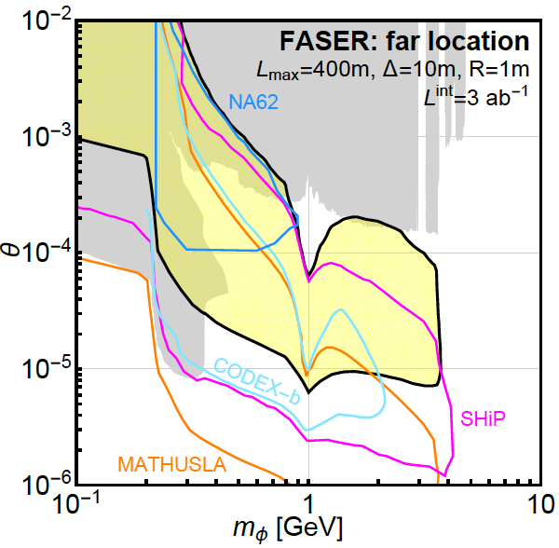
DARK HIGGS EVENT RATES AND REACH
LHCb
FASER probes a large swath of new parameter space and is complementary to other current and proposed experiments

Slide 27
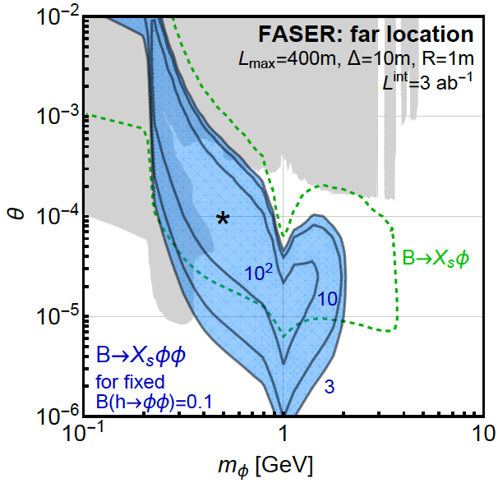
TRILINEAR COUPLINGS REACH
FASER can also probe the trilinear couplings through
φ
h
φ
This competes with
h → φφ (invisible)
Can get 100s of events from “double dark Higgs” production

Slide 28
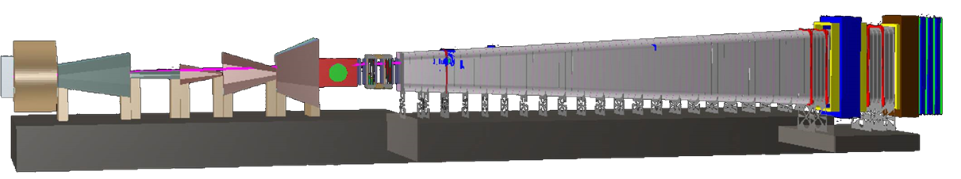
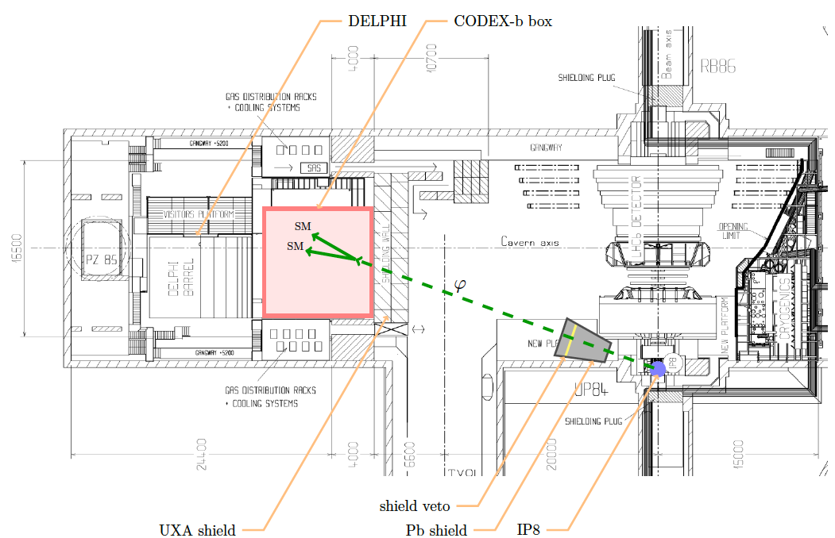
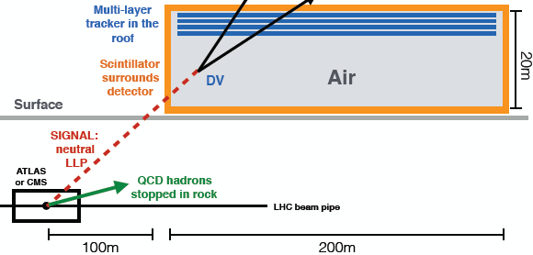
COMPLEMENTARY PROPOSED EXPERIMENTS
SHiP
CODEX-b
~1000 m³, ~100M CHF
Alekhin et al. (2015)
~1000 m³
Gligorov, Knapen, Papucci, Robinson (2017)
FASER
MATHUSLA
~1 m³ ~ 5 μIKEAs
~2 10⁵ m³ ~ 1 IKEA, ~$50M
Feng, Galon, Kling, Trojanowski (2017)
Chou, Curtin, Lubatti (2016)

Slide 29
SUMMARY AND OUTLOOK
The LHC has seen no new physics. Adding inexpensive, small detectors to improve discovery prospects is a good idea
FASER: targets light, weakly-coupled new particles at low p_{T} , runs simultaneously with the LHC program, and is small and inexpensive
No significant backgrounds identified for the far location; near location requires much more study
FASER will probe significant new regions of dark photon and dark Higgs parameter space. Other models?
Much work to do. Hope to install prototype in LS2, install full detector in LS3 in time for the HL-LHC era

