Slide 1
FASER
FORWARD SEARCH EXPERIMENT AT THE LHC
International Workshop on WIMP Dark Matter and Beyond
Shanghai Jiao Tong University
Jonathan Feng, UC Irvine
[based on 1708.09389 with Iftah Galon, Felix Kling, Sebastian Trojanowski]
17 September 2017

Slide 2
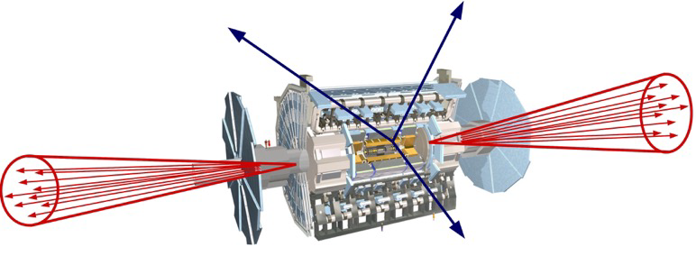
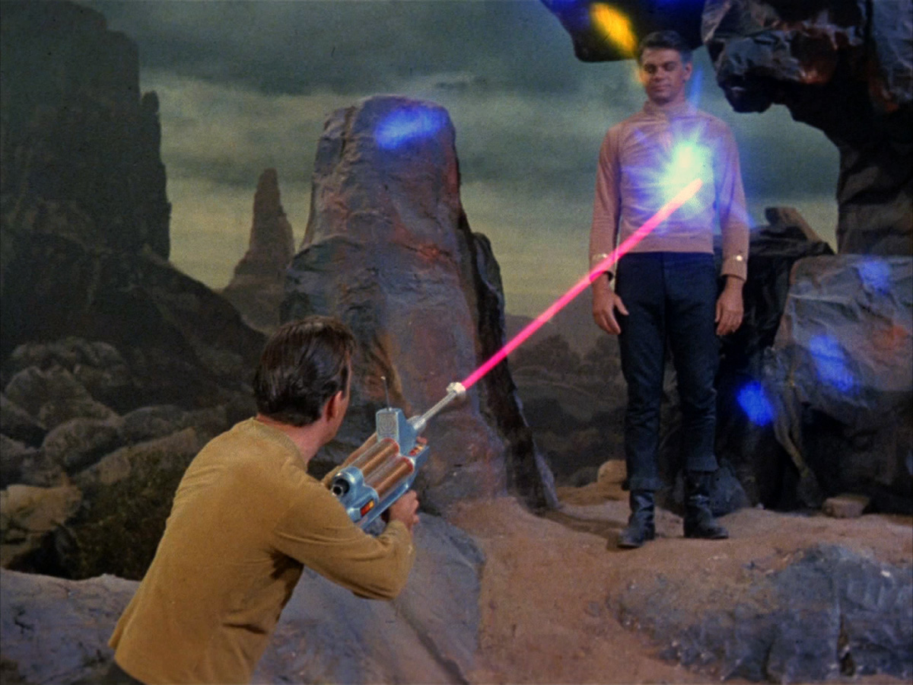
SUMMARY
New physics searches at the LHC focus on high p_{T}. This is appropriate for heavy, strongly coupled particles
  σ ~ fb to pb → N ~ 10³ – 10⁶, produced isotropically
However, if new particles are light and weakly coupled, this may be completely misguided. Instead should exploit
  σ_{inel} ~ 100 mb → N ~ 10¹⁷, θ ~ Λ_{QCD} / E ~ 250 MeV / TeV ~ mrad
We propose a small, inexpensive experiment, FASER, to be placed in the very forward region of ATLAS/CMS, ~150-400 m downstream of the IP, and analyze its discovery potential

Slide 3
OUTLINE
Very Forward Region Infrastructure
New Physics Example: Dark Photons
Signal
Backgrounds
Results
Summary and Outlook

Slide 4
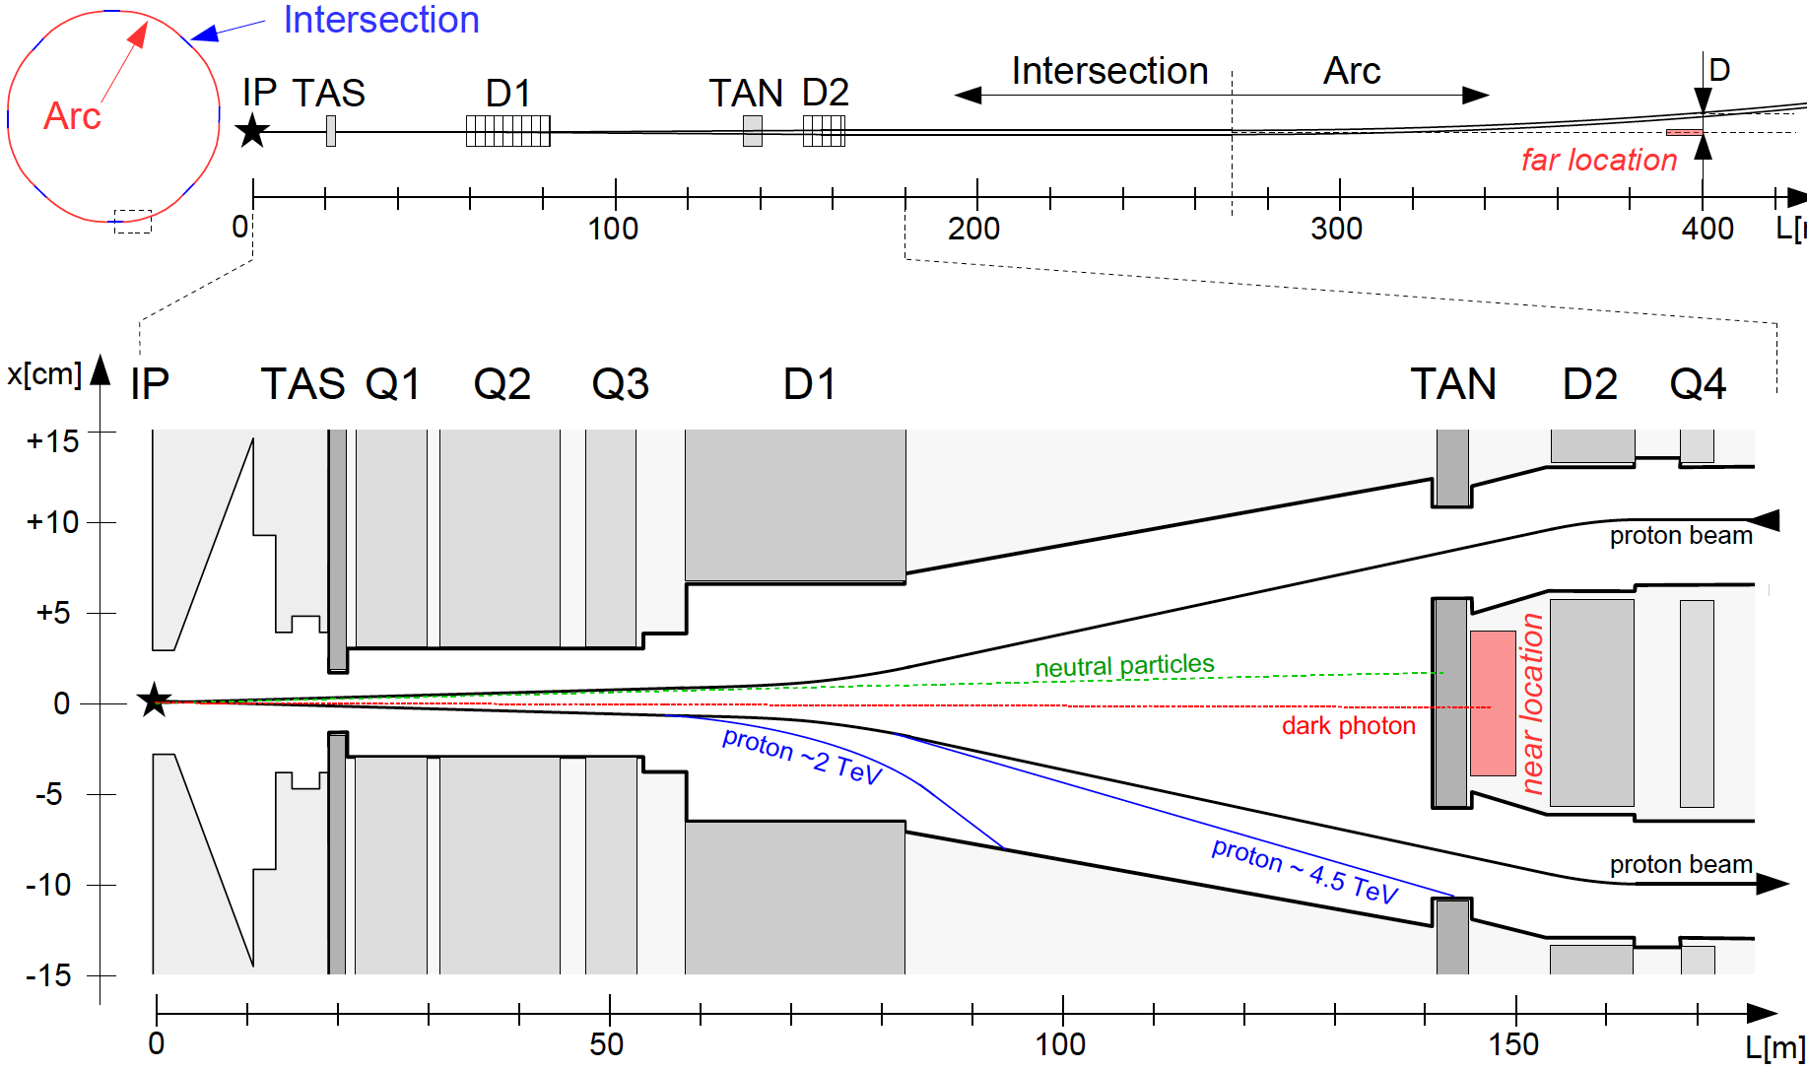
VERY FORWARD REGION INFRASTRUCTURE
LHC ring consists of 8 straight 545 m intersections and 8 curved arcs. The infrastructure common to IP1 and IP4 (also have ALFA, CASTOR, LHCf, TOTEM, etc.):
TAS: front quadrupole
absorbers (θ > 0.85 mrad)
D1: dipole magnet, splits
beams, deflects μ, p, ...
TAN: neutral target
absorbers (n, γ)
Feng, Galon, Kling, Trojanowski (2017)
Note the extreme difference in longitudinal and transverse scales

Slide 5
ON-AXIS LOCATIONS
We want to place FASER along the beam collision axis
  Far location: 400 m from IP, after beams curve, 2.6 m from the beams
  Near location: 150 m, after TAN, between the beams
ATLAS/CMS beams cross at 285 μrad in vertical/horizontal plane → shifts far (near) location by 5.7 (2.1) cm
HL-LHC: 285→590 μrad, TAN→TAXN moves forward 10 m,... We assume current parameters, FASER is exactly on-axis

Slide 6

DARK PHOTONS
Dark matter is our most solid evidence for new particles. In recent years, the idea of dark matter has been generalized to dark sectors
Dark sectors motivate light, weakly coupled particles (WIMPless miracle, SIMP miracle, small-scale structure, ..)
A prominent example: dark photons
The resulting theory contains a new gauge boson A’ with mass m_{A’} and εQ_{f} couplings to SM fermions f
SM
Hidden
U(1)

Slide 7
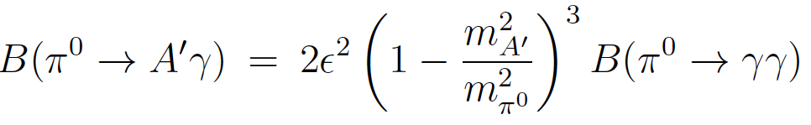
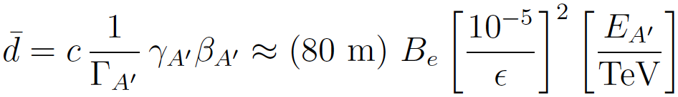

DARK PHOTON PROPERTIES
Produced in meson decays
and also through dark bremsstrahlung pp → p A’ X and direct QCD processes qq → A’ X (requires pdfs at low Q², x)
Travels long distances through matter without interacting, decay mainly to e⁺e⁻ (and μ⁺μ⁻ for m_{A’} > 2 m_{μ} )
The essential tension: low ε → low event rate, high ε → decays too fast. Is there a happy middle ground?

Slide 8
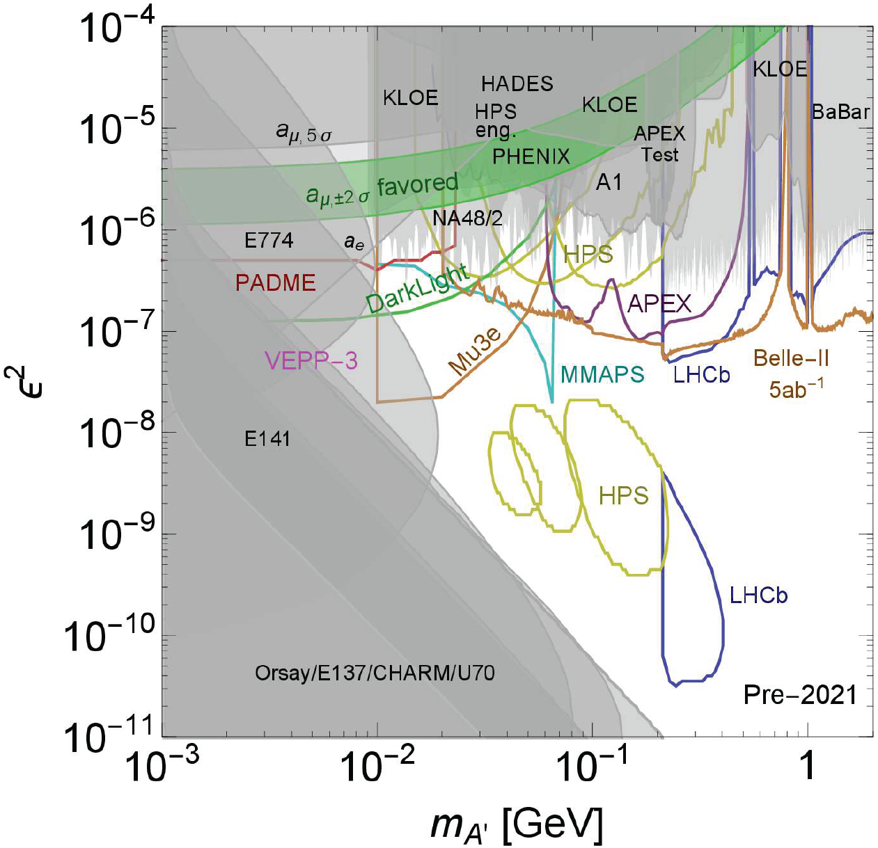
DARK PHOTON STATUS
Lots of unconstrained parameter space with
m_{A’} > 10 MeV
~ 10⁻⁶ – 10⁻³
We will present results for 2 representative model points: (m_{A’}, ε) = =
(20 MeV, 10⁻⁴)
(100 MeV, 10⁻⁵)
Cosmic Visions White Paper (2017)

Slide 9
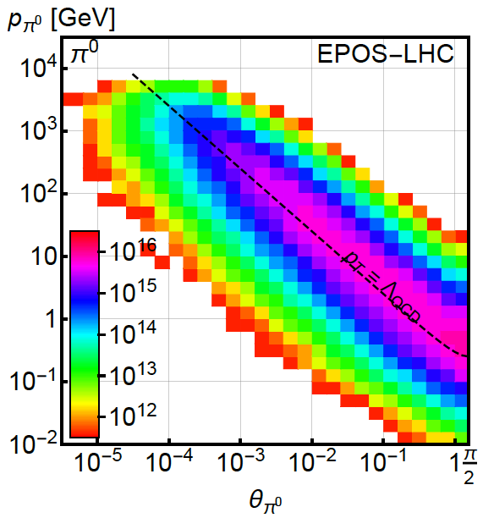
PION PRODUCTION AT THE LHC
Forward particle production simulations and models have been greatly informed by LHC data
EPOS-LHC, SIBYLL 2.3, QGSJETII-04 agree very well
Enormous event rates (σ_{inel}~70 mb, N_{inel} ~ 10¹⁷), production is peaked at p_{T} ~ Λ_{QCD} , but with significant width
300 fb⁻¹

Slide 10
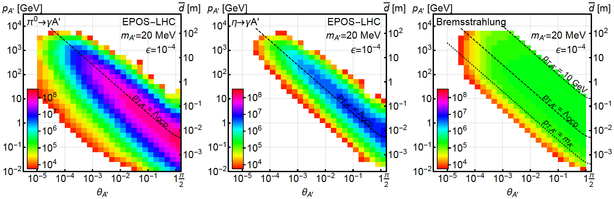
DARK PHOTON PRODUCTION
Consider π⁰ decay, η decay, dark bremsstrahlung
Results for 1st representative model point:
(m_{A’}, ε) = (20 MeV, 10⁻⁴)
Nothing surprising: in π⁰ → A’ γ, relative to pion distributions, rates suppressed by ε², energies reduced by factor of ~2

Slide 11
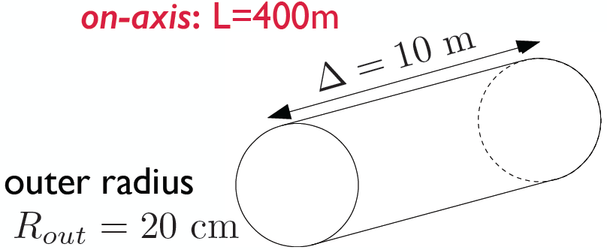
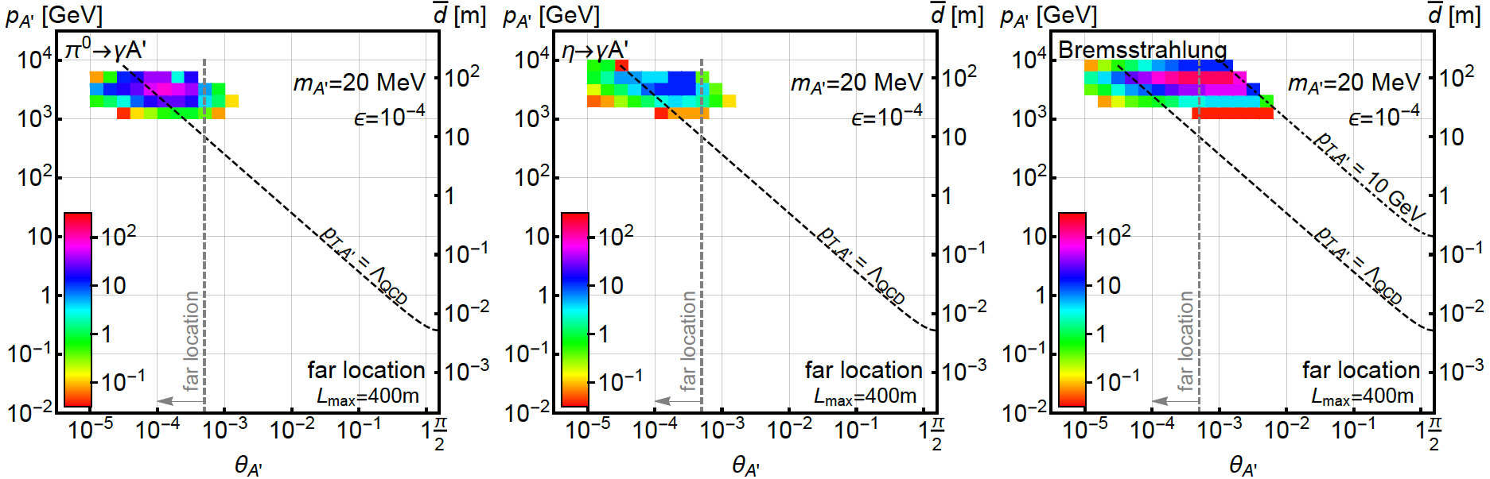
DARK PHOTONS IN THE FAR DETECTOR
Now require dark photons to decay in the far detector: consider cylindrical detector with volume ~1 m²
Only the highest energy A’s survive, but there are still many of them, and they are highly collimated

Slide 12
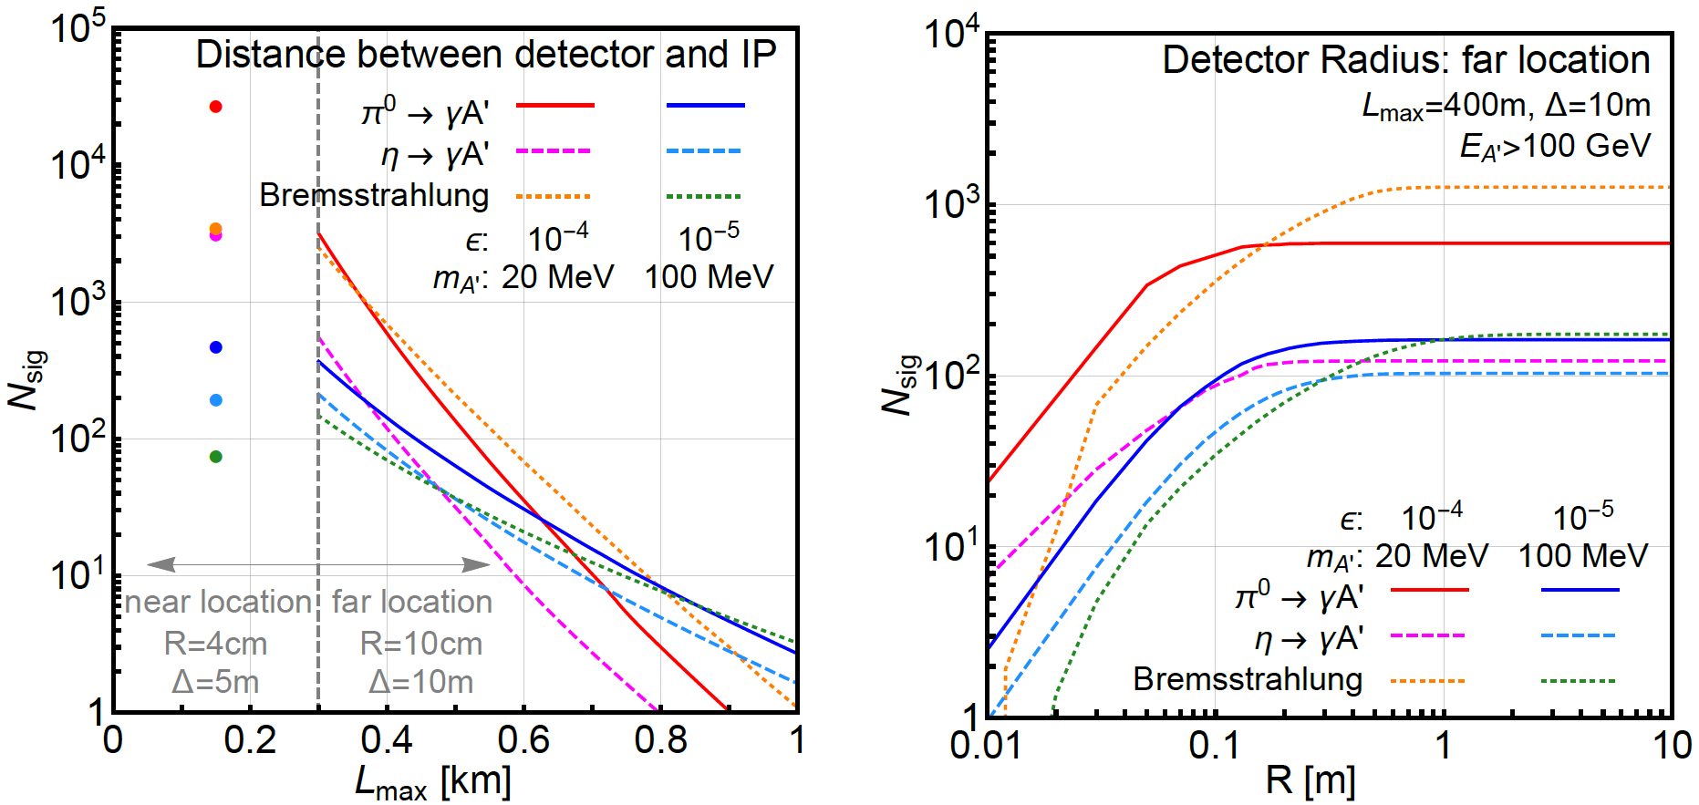
SIGNAL DEPENDENCE ON DETECTOR SPECS
Moving the detector closer helps
At the far location, R = 20 cm captures almost all the A’

Slide 13
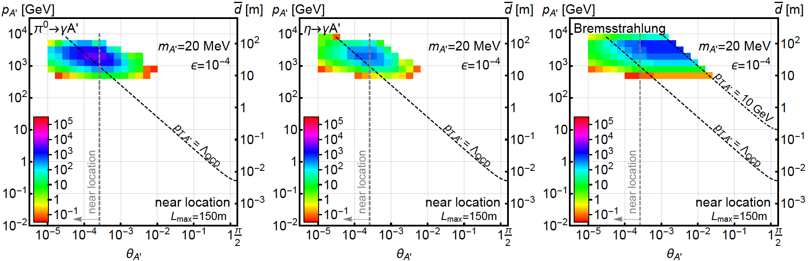
DARK PHOTONS IN THE NEAR DETECTOR
Now require dark photons to decay in the near detector: detector volume only ~0.1 m² !
150m
5 m
4 cm
Moving the detector closer → more dark photons decay in the detector, even though the after-TAN location is crowded

Slide 14
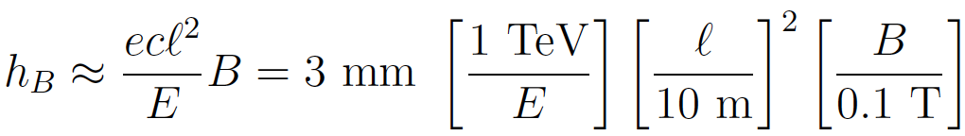
BACKGROUNDS
The signal is two simultaneous, opposite-sign, highly-energetic (E > 500 GeV) charged particles that start in the detector at a vertex and point back to IP → a tracker-based technology
The opening angle is θ_{ee} ~ m_{A’} / E ~ 10 μrad. After traveling ~ 1 m, this leads to 10 μm separation, too small to resolve → a small magnetic field
Many backgrounds are eliminated simply by virtue of FASER’s location. Cosmic ray background is negligible, charged particles from IP are bent away by D1 magnet
Leading backgrounds are neutrino-induced and beam-induced backgrounds

Slide 15


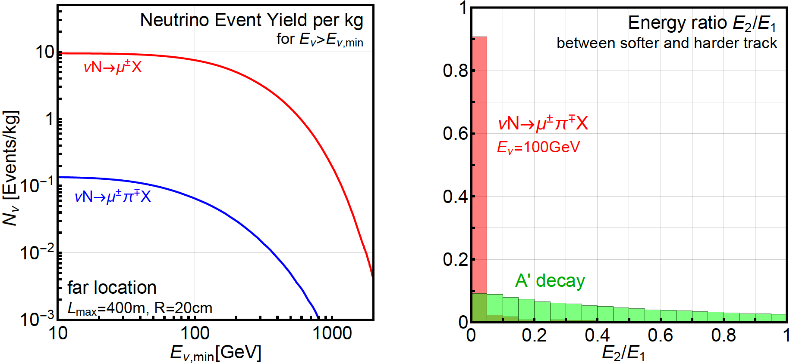
NEUTRINO-INDUCED BACKGROUNDS
If π⁺ → μν before D1 magnet, resulting neutrinos can propagate into FASER, interact through
Second process eliminated by requiring no other activity, tracks start in the detector and have high and symmetric energies
ν → K_{S,L} → 2 charged tracks also negligible with same cuts
GENIE

Slide 16

BEAM-INDUCED BACKGROUNDS: FAR LOCATION
Particles from IP must pass through ~ 50 m of matter. Hadrons, electrons are stopped, only muons are relevant
Muon background from 2011 ATLAS study can be used to determine muon background at far location. Requiring E_{μ} > 100 GeV, the flux is
The muon arrival times correspond to bunch crossings. Accounting for the bunch structure and assuming a timing resolution of 100 (10) ps, get ~0.1 (~0.01) coincident μ⁺μ⁻ pairs in 1 LHC year
Far location appears to be background-free

Slide 17
BEAM-INDUCED BACKGROUNDS: NEAR LOCATION
Far more challenging environment
Dedicated simulation using MARS/FLUKA/etc. should be used, but we can use published results to get an estimate
Mokhov, Rakhno, Kerby, Strait (2003)
Hadrons and electrons absorbed in the TAN
Coincident muon background ~10⁸ per LHC year. Can be greatly suppressed by requiring tracks to start in the detector and reconstruct a vertex, and requiring high and symmetric energies
Electron signal is clean if electrons can be distinguished from muons

Slide 18
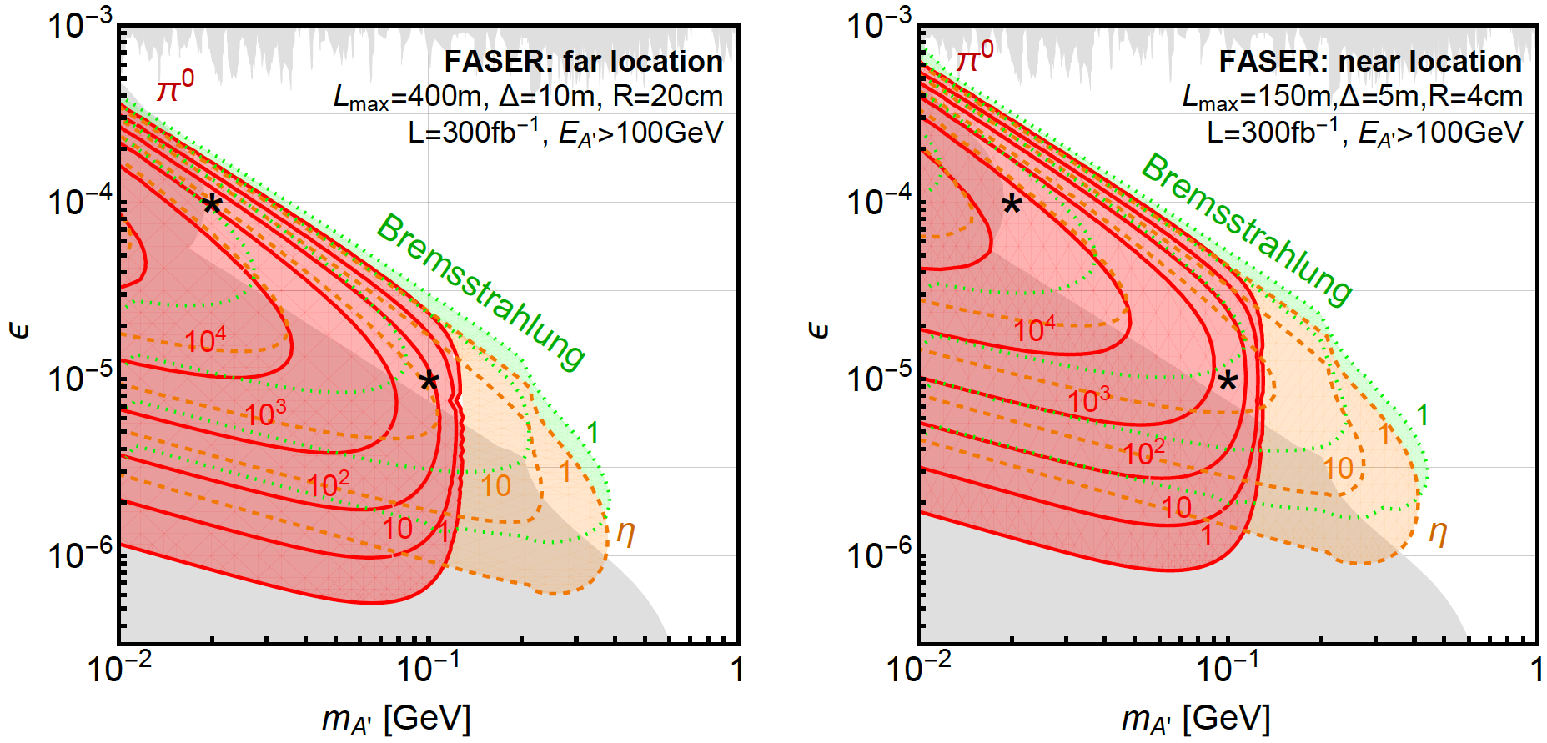
RESULTS: EVENT RATES
Up to 10⁴ dark photons arrive in FASER in 300 fb⁻¹ in currently unconstrained regions of dark photon parameter space

Slide 19
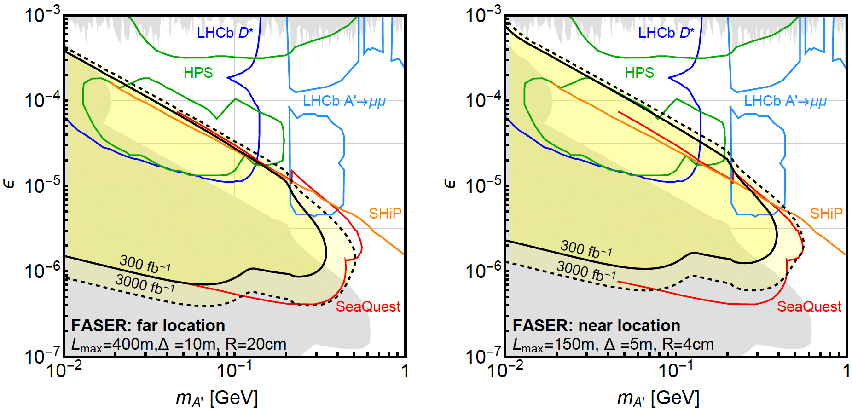
RESULTS: REACH
Assuming negligible background, FASER may probe parameter space with m_{A’} ~ 10 - 500 MeV, ε ~ 10⁻⁶ – 10⁻³
SHiP probes much greater region at low ε, but this is mostly excluded already. SHiP reach at high m_{A’} is from direct QCD production, which we have neglected
N=3 contours

Slide 20
SUMMARY AND OUTLOOK
The LHC has seen nothing yet. Adding a small, inexpensive detector to improve LHC’s discovery prospects seems like a good idea
Related ideas: old proposals for long-lived particles; new ideas, like MATHUSLA and MilliQan; beam dump experiments, like SeaQuest and SHiP; very forward experiments, like CT-PPS
FASER is unique in that it and targets light, weakly-coupled new particles at low p_{T} , runs simultaneously with the LHC program, and should be very small and inexpensive
Feng, Smith (2004); Hamaguchi, Kun, Makaya, Nojiri (2004); De Roeck, Ellis, Gianotti, Moortgat, Olive, Pape (2004); Chou, Curtin, Lubatti (2016); Ball et al. (2016); Alekhin et al. (2016); Aidala et al. (2017); Albrow (2015)

Slide 21
SUMMARY AND OUTLOOK
Far location: appears to be background free. A small 20cm x 20cm x 10m detector ~400m from the IP would provide world-leading sensitivity to dark photons
Near location: a far more challenging environment, but if backgrounds can be controlled, a tiny 4cm x 4cm x 5m detector can do even better
Work to do: We’ve considered dark photons. A multitude of other new physics ideas are also worth considering
Work to do: simulate near detector beam-induced backgrounds, specify detector design, integrate into LHC beam infrastructure, ...

