Slide 1
DARK MATTER AND THE
SEARCH FOR A FIFTH FORCE
University of Kentucky Colloquium
Jonathan Feng, UC Irvine
14 April 2017

Slide 2

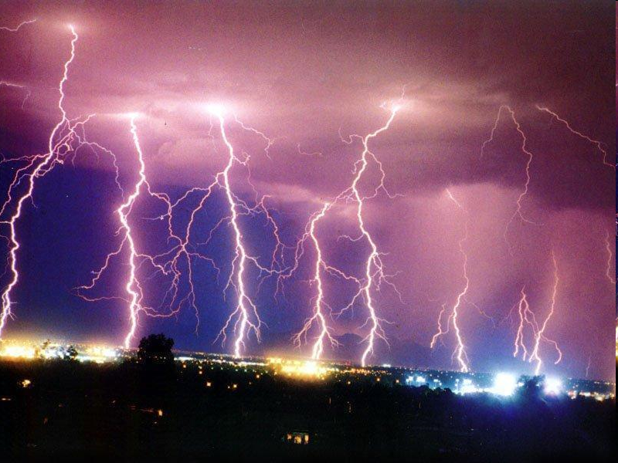
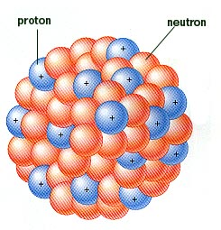
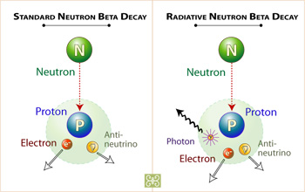
FUNDAMENTAL FORCES
We know of four fundamental forces
Are there more? Is there a fifth fundamental force?
Gravity
Electromagnetism
Strong
Weak

Slide 3
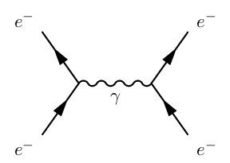
WHAT IS A FUNDAMENTAL FORCE?
There are many kinds of forces: gravitational forces, contact forces, friction forces, tension forces, Coulomb forces, magnetic forces...
How do we decide which of these are fundamental?
At the most basic level, forces are mediated by the exchange of particles
Fundamental forces are, then, those mediated by the exchange of fundamental particles

Slide 4
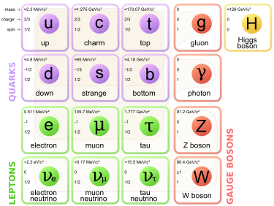
FORCES AND PARTICLES
The known particles can be divided into 2 groups
  Bosons (integer spin)
  Fermions (half-integer spin)
Lorentz invariance implies that all interactions involve an even number of fermions
Particles can therefore emit a boson, but not a fermion
We therefore identify
  Bosons = force-mediating particles
  Fermions = matter particles

Slide 5


FORCES AND BOSONS
At present the known fundamental bosons are
  Photons (electromagnetism) Gluons (strong force)
  Gravitons (gravity) W and Z bosons (weak force)
  and probably the Higgs boson (Higgs force)
  Discovering a 5th (or 6th) fundamental force means discovering a new fundamental boson. Many proposed: dilatons, radions, Z’ gauge bosons, A’ dark photons, Kaluza-Klein gravitons, ...
The particle’s mass determines the force’s range and potential:
“Force” language is most natural when m is small, λ is large
  If m ~ TeV, λ ~ 2 x 10⁻¹⁹ m, this looks like a new particle
  If m ~ MeV, λ ~ 200 fm, this looks like a new force

Slide 6
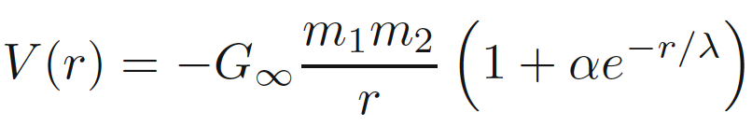
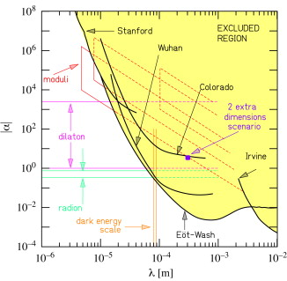
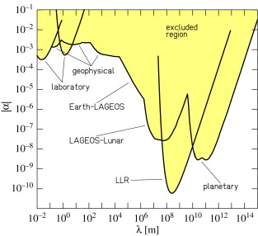
PAST 5TH FORCE SEARCHES
There have been many searches for 5th forces; for example, deviations from gravity:
So far, no such deviations have been found, but the history of 5th force searches is fascinating
See, e.g., Fischbach, “The 5th Force: A Personal History” (2015)
Adelberger,Gundlach, Heckel,
Hoedl, Schlamminger (2009)

Slide 7
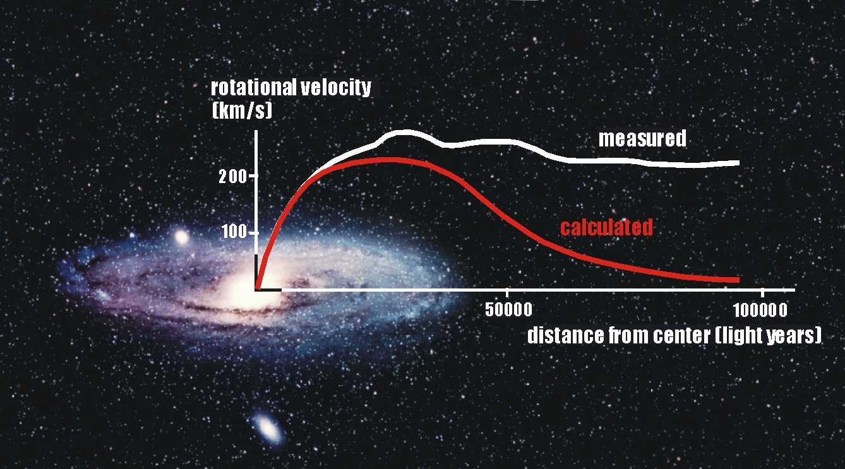

DARK MATTER
There is now every indication that the universe includes 6 times as much dark matter as ordinary matter
Classic evidence: rotation curves
This evidence has now been supplemented by many other observations, all pointing to the same amount of dark matter
Vera Rubin
1928-2016

Slide 8
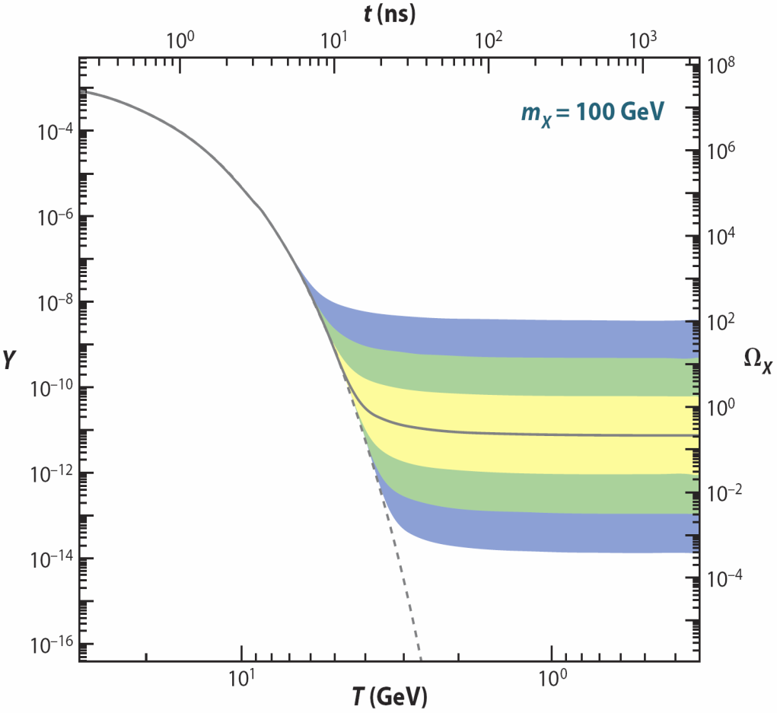
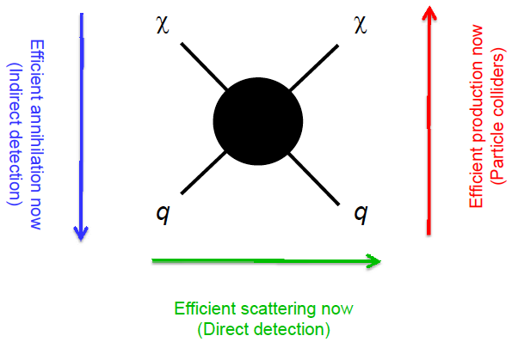
CLASSIC DARK MATTER CANDIDATES
There are classic, well-motivated candidates: axions, sterile neutrinos, and weakly-interacting massive particles (WIMPs)
E.g., WIMPs, particles interacting through the weak force, naturally have the right relic density, can be discovered at colliders and through direct and indirect detection
So far none of them has been found
Zeldovich (1965); Scherrer, Turner (1985); ...
Feng (2008)

Slide 9
DARK SECTORS
All evidence for dark matter is gravitational. Let’s choose a different startig point: perhaps it is in a hidden sector, with no electromagnetic, strong, or weak interactions
A hidden sector with dark matter in it is a “dark sector,” and it may have a rich structure with matter and forces of its own
Visible
Sector
Hidden
Sector
Lee, Yang (1956); Kobsarev, Okun, Pomeranchuk (1966); Blinnikov, Khlopov (1982);
Foot, Lew, Volkas (1991); Hodges (1993); Berezhiani, Dolgov, Mohapatra (1995);
Pospelov, Ritz, Voloshin (2007); Feng, Kumar (2008);...

Slide 10
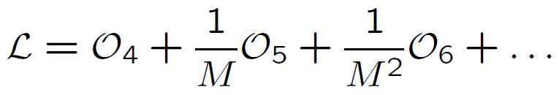



DARK MATTER PORTALS
But if we are to detect it non-gravitationally, it must have some (very weak) interactions with us. What are they?
Seemingly a Pandora’s box of possibilities, but effective operators provide an organizing principle:
where the operators are grouped by their mass dimension, with [scalar] = 1, [fermion] = 3/2, [F_{μν}] = 2
M is a (presumably) large “mediator mass,” so start with dimension 4 operators. Some of the few possibilities:
Neutrino portal Higgs portal Vector portal

Slide 11

VECTOR PORTAL
Holdom (1986)
Suppose there are mediator particles with both hidden sector and visible sector charges. These will induce a coupling between the visible and hidden gauge fields:
One might expect this effect to become very small for heavy mediator particles, but it doesn’t
Instead, one gets a vector portal term , with
ε ~ 10⁻³ e e_{h}, where the 10⁻³ comes from it being a 1-loop effect, and e and e_{h} are the visible and hidden sector charges
A
mediator
particles
A_{h}

Slide 12
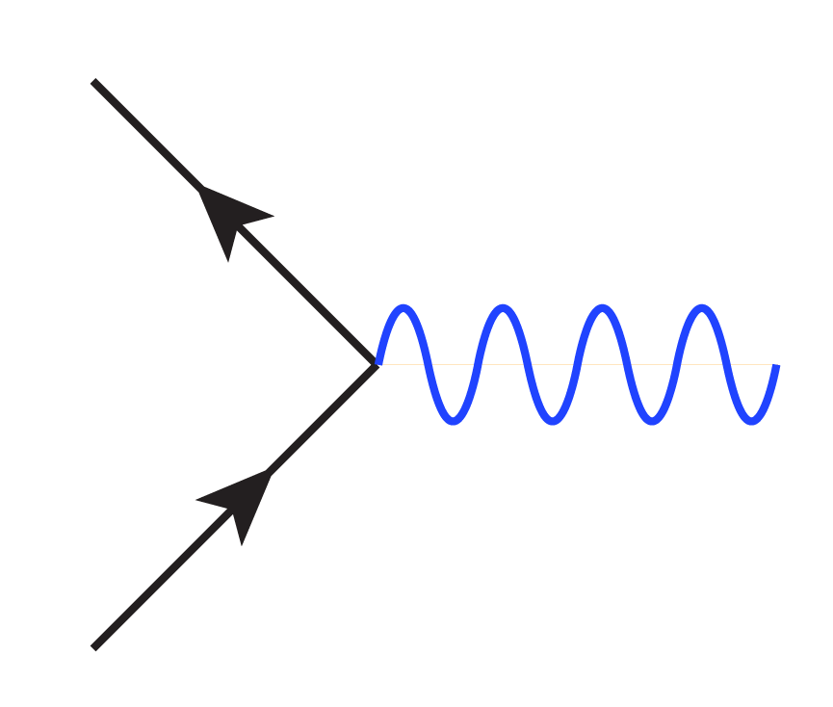
DARK PHOTONS
Holdom (1986)
The operator mixes the visible and hidden force carriers. Diagonalizing to eliminate this mixing term, one finds that the physical states are
  a massless force carrier: the SM photon γ
  a massive force carrier: the “dark photon” A’
The SM photon doesn’t couple to hidden sector particles, but the dark photon couples with charge εeQ_{f} to visible sector particles: it mediates a 5th force!
f_{h}
f
εeQ_{f}
γ
  A’
f_{h}
f

Slide 13
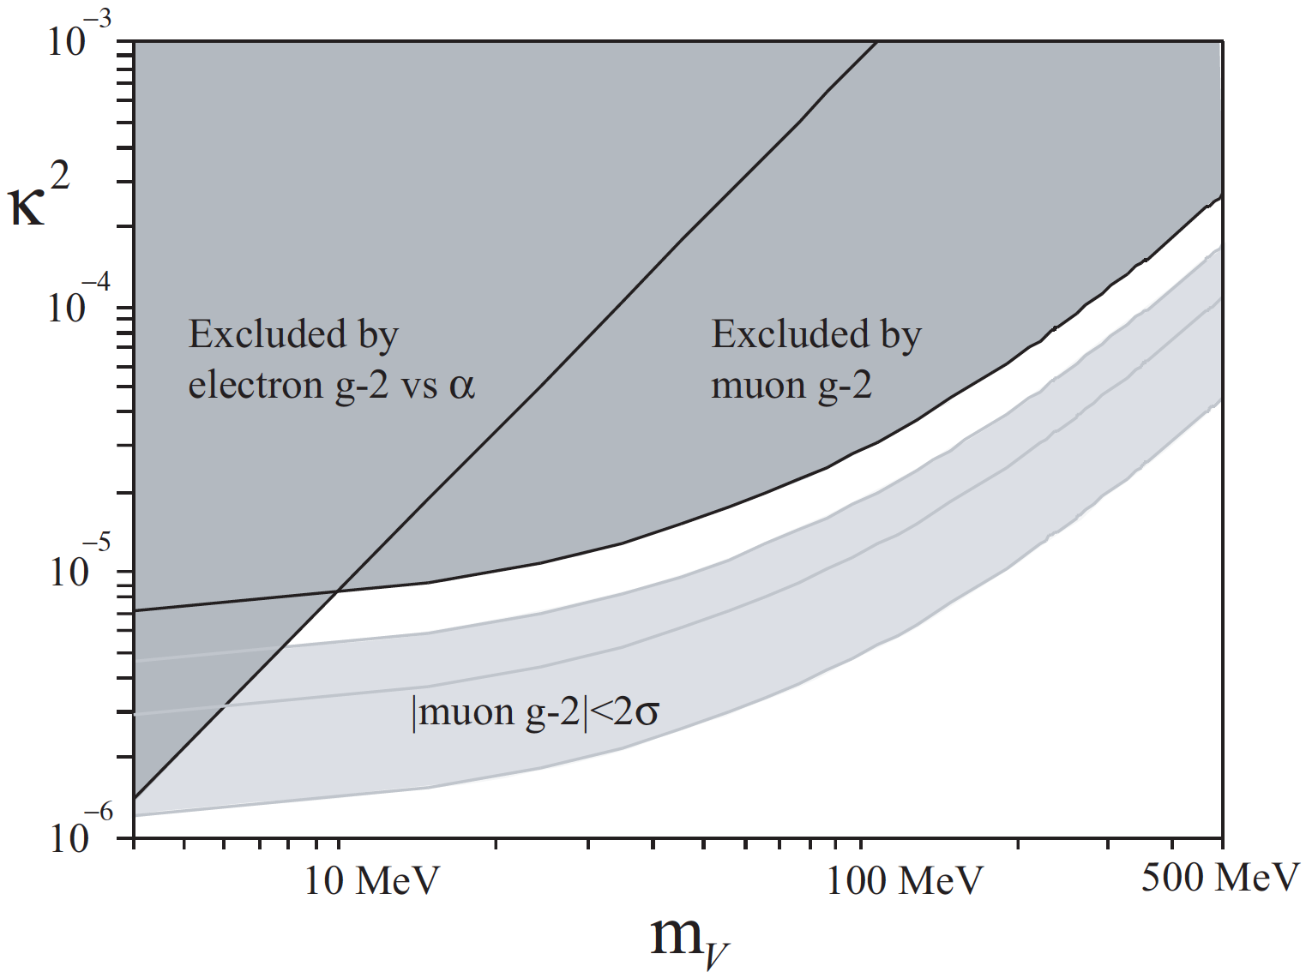
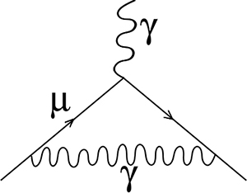
DARK PHOTON SEARCHES
This has motivated a world-wide hunt for dark photons throughout the (mass, coupling) parameter space
What parameters are interesting?
  ε ~ 10⁻³
  Anomalies: muon g-2, currently a 3.5σ discrepancy
  Lamppost: whatever is not excluded and within reach
γ, A’
Pospelov (2008)

Slide 14
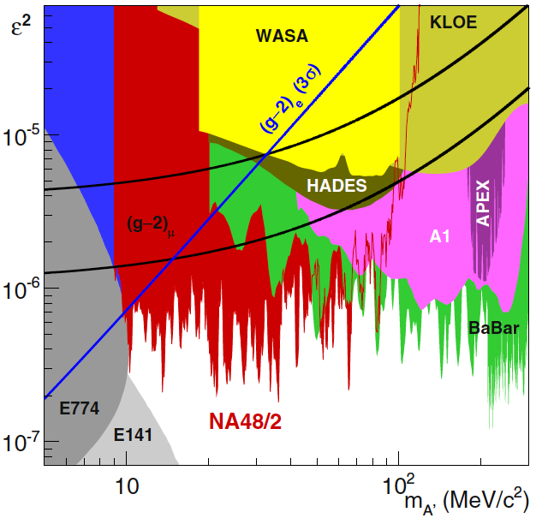
CURRENT CONSTRAINTS
In just 8 years, a large number of analyses have started constraining the parameter space by analyzing archived and current data and by doing new experiments
The dark photon resolution to the muon g-2 anomaly is now excluded, but there is still a lot of parameter space to explore and many proposed experiments

Slide 15
FIFTH FORCE IN NUCLEAR PHYSICS
The interest in dark matter and 5th forces at low energy scales opens up new connections to other branches of physics
In particular, for the MeV scale, nuclear physics becomes a relevant probe of new particles
_{Treiman, Wilczek (1978)}
Donnelly, Freedman, Lytel, Peccei, Schwartz (1978)
Savage, McKeown, Filippone, Mitchell (1986)
A recent 6.8σ experimental anomaly might indicate the production of new particles in excited ⁸Be decays
A. J. Krasznahorkay et al., PRL, 1504.01527 [nucl-ex]
Could these be 5th force gauge bosons?
Feng, Fornal, Galon, Gardner, Smolinsky, Tait, Tanedo,
PRL, 1604.07411 [hep-ph]; PRD, 1608.03591 [hep-ph]

Slide 16
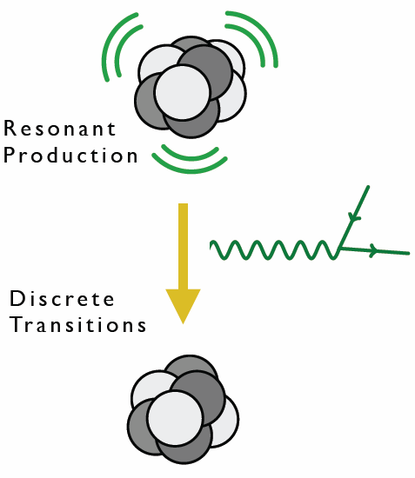
⁸BE AS A NEW PHYSICS LAB
⁸Be is composed of 4 protons and 4 neutrons
Excited states can be produced in large numbers through p + ⁷Li → high statistics “intensity” frontier
Excited states decay to ground state with relatively large energies (~20 MeV)
⁸Be nuclear transitions then provide interesting probes of light, weakly-coupled particles

Slide 17
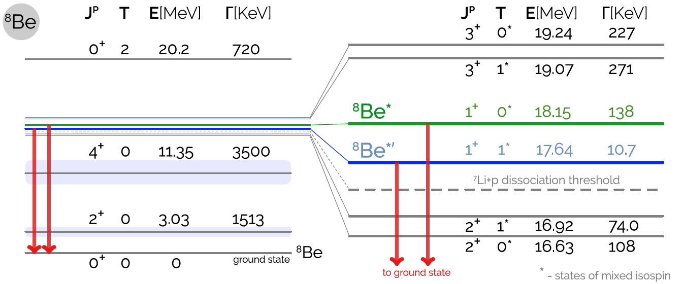
⁸BE SPECTRUM
Many excited states with different spins and isospins
Of special interest: the ⁸Be* (18.15) and ⁸Be*’ (17.64) states
1608.03591; based on Tilley et al. (2004), http://www.nndc.bnl.gov/nudat2, Wiringa et al. (2013)

Slide 18
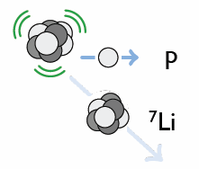
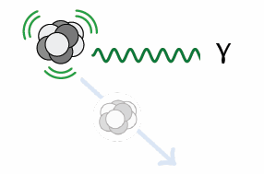
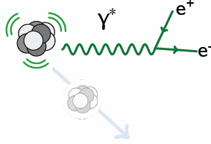
⁸BE* DECAY
Hadronic
B(p ⁷Li) ≈ 100%
Electromagnetic
B(⁸Be γ) ≈ 1.5 x 10⁻⁵
Internal Pair Creation
B(⁸Be e⁺ e⁻) ≈ 5.5 x 10⁻⁸

Slide 19
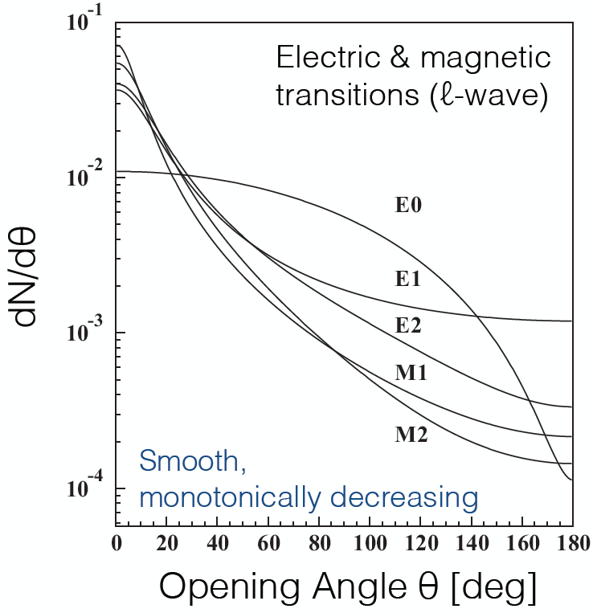
INTERNAL PAIR CREATION KINEMATICS
Internal Pair Creation
B(⁸Be e⁺ e⁻) ≈ 5.5 x 10⁻⁸
For e⁺e⁻ produced by a virtual photon, dN/dθ is sharply peaked at low opening angle θ and is expected to be a monotonically decreasing function of θ
θ
Gulyas et al. (2015); Rose (1949)

Slide 20
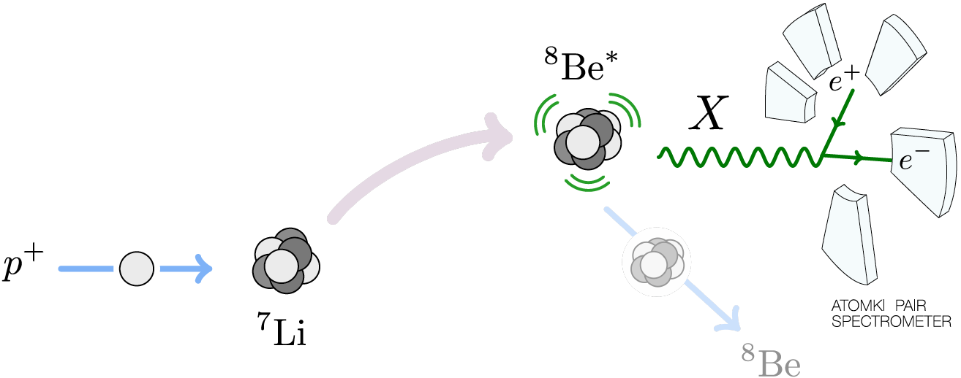
THE ATOMKI ⁸BE EXPERIMENT
A 1 μA p beam with ΔE_{p} ~ 10 keV strikes a thin ⁷Li foil target. The beam energy can be adjusted to select various ⁸Be excited state resonances.

Slide 21
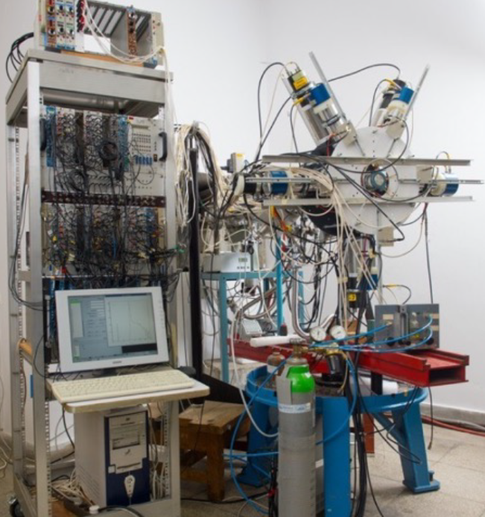
THE ATOMKI ⁸BE EXPERIMENT

Slide 22
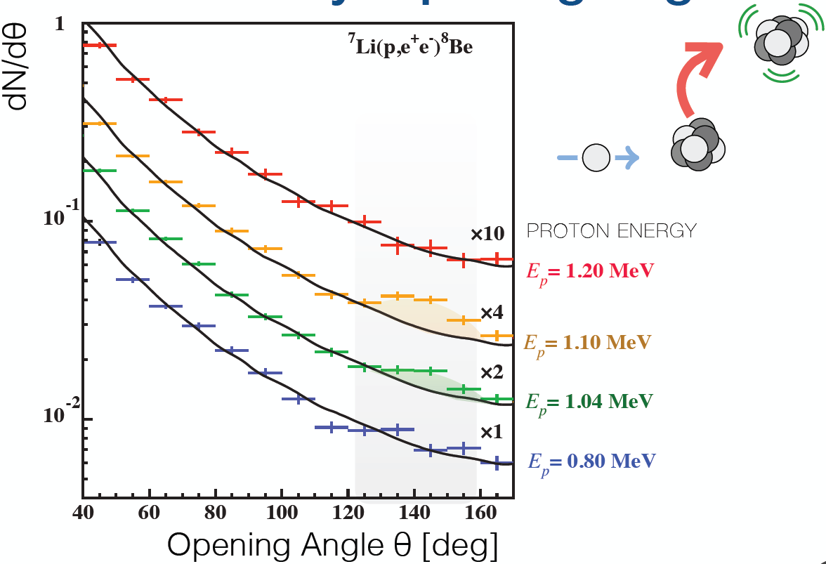
THE ATOMKI ANOMALY
A bump at ~140 degrees is observed as one passes through the ⁸Be* resonance
Background fluctuation probability: 5.6 x 10⁻¹² (6.8σ)
Krasznahorkay et al. (2015)

Slide 23
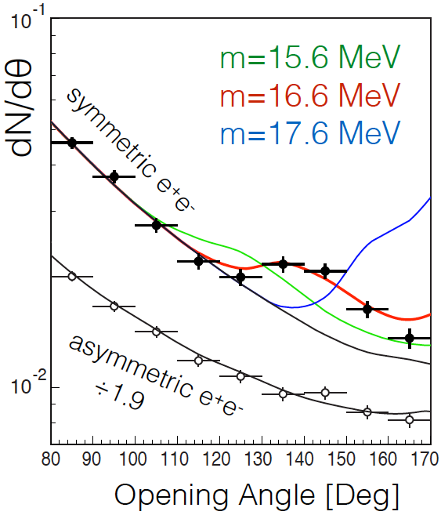
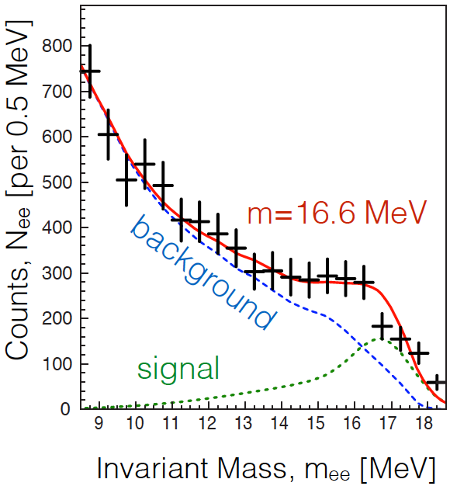
THE ATOMKI ANOMALY
The θ (and m_{ee}) distributions can be explained by postulating a new particle and 2-step decay: ⁸Be* → ⁸Be X, X → e⁺e⁻
The best fit parameters: m = 16.7 ± 0.35 (stat) ± 0.5 (sys) MeV
  B(⁸Be* → ⁸Be X) / B(⁸Be* → ⁸Be γ) = 5.6 x 10⁻⁶
χ²/dof = 1.07
Krasznahorkay et al. (2015)

Slide 24
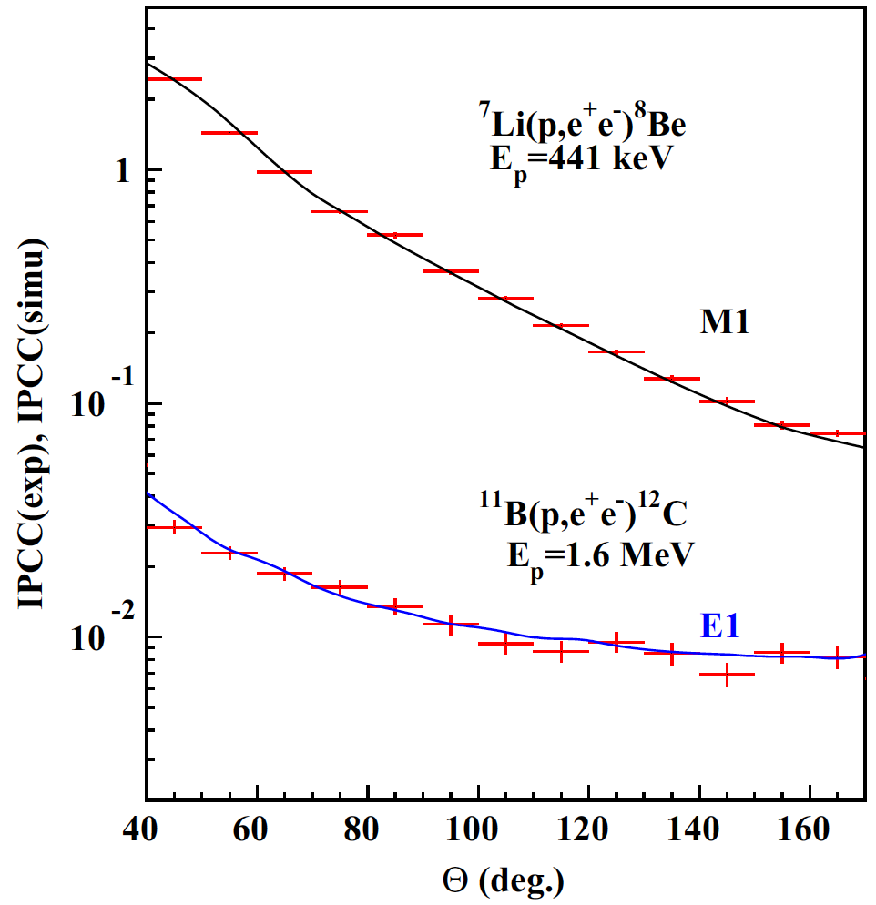
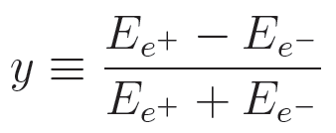
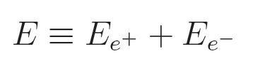
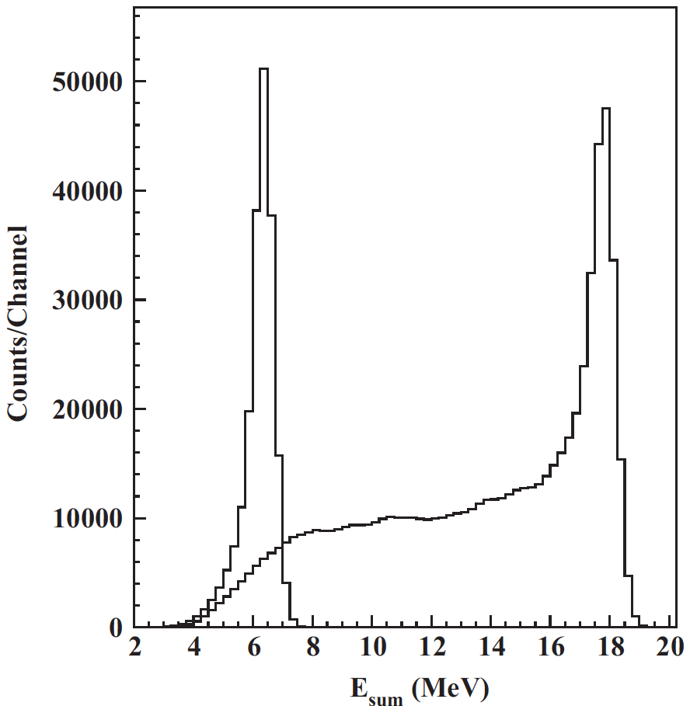
CROSS CHECKS
For example: other decays (all with lower energy), fit theoretical expectations well
The excess is confined to events with symmetric energies, |y| < 0.5 and large summed energies E > 18 MeV, as expected for a new particle interpretation
⁸Be*’
Gulyas et al. NIM (2015)

Slide 25
POSSIBLE EXPLANATIONS
Three possibilities:
  (1) an as-yet-unidentified nuclear experiment problem
  (2) an as-yet-unidentified nuclear theory effect
  (3) new particle physics
(1) Nuclear Experiment
  The excess consists of hundreds of events in each bin and is comparable to the background; not likely to disappear with more data
  The excess is not a “last bin” effect: bump, not smooth excess
  If a nuclear experimental problem, why does it only affect the decay with the largest energy? (Easily explained if we are producing a 17 MeV particle)
  If a nuclear experimental problem, the excellent fit to a new particle interpretation is purely coincidental
  Hungarian group is now collecting data with an improved detector, continues to see bump
  Followup experiments by others are being proposed (see below)

Slide 26
POSSIBLE EXPLANATIONS
(2) Nuclear Theory
  Must explain bump in 18.15 data and no (similarly-sized) bump in 17.64 data
  If a nuclear theory explanation, the excellent fit to a new particle interpretation is purely coincidental
  A detailed analysis of nuclear theory effects finds no reasonable explanation for the bump _{Zhang, Miller (2017)}
(3) Particle Physics
  If it’s new physics, what kind of new particle can it be?
  Is it consistent with all other experiments?
  Are there complete particle physics models that can incorporate this new particle?
  What other experiments can confirm or exclude this?
Feng, Fornal, Galon Gardner, Smolinsky, Tait, Tanedo (2016); Gu, He (2016);
Chen, Liang, Qiao (2016); Jia, Li (2016); Kitahara, Yamamoto (2016);
Ellwanger, Moretti (2016) ; Kozaczuk, Morrissey, Stroberg (2016); ...

Slide 27
WHAT KIND OF NEW PARTICLE CAN IT BE?
Some Quick Observations
Must couple to both quarks and electrons
Must be neutral
Must be a boson – a 5th force
Not everything works
For example: a spin 0 boson (“dark Higgs boson”)
J^{P} Assignments: 1⁺ → 0⁺ 0⁺
L Conservation: L = 1
Parity Cons.: P = (-1)^{L} = 1
Forbidden in parity-conserving theories
X

Slide 28
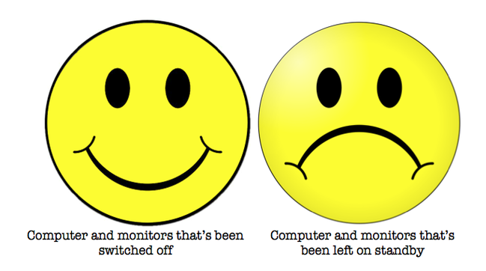

DARK PHOTON?
Consider the case of a spin 1 gauge boson with general couplings ε_{f} e to particle f
To get the right signal strength, need
For the special case of a dark photon with ε_{f} = εQ_{f}, this implies kinetic mixing parameter ε ~ 0.01, which is excluded
This is not a dark photon

Slide 29
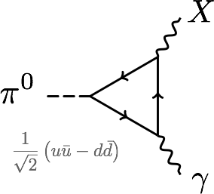
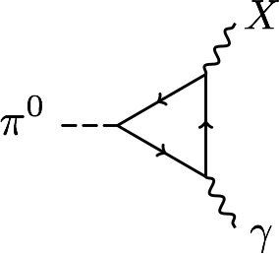
PROTOPHOBIA
The dominant constraints are null results from searches for exotic pion decays π⁰ → X γ → e⁺ e⁻ γ
Eliminated if Q_{u}X_{u}– Q_{d}X_{d} ≈ 0 or 2X_{u} + X_{d} ≈ 0 or X_{p} ≈ 0
A protophobic gauge boson with couplings to neutrons, but suppressed couplings to protons, can explain the ⁸Be signal without violating other constraints
u, d
p, n

Slide 30
PROTOPHOBIC GAUGE BOSON
For a protophobic gauge boson, the NA48/2 “quark” constraints are weakened
One can, then, take electron and muon couplings around 10⁻³. Such couplings are allowed by all constraints
A protophobic gauge boson can resolve both the ⁸Be and muon g-2 anomalies
Implies a milli-charged 5th force with range ~ 11 fm

Slide 31
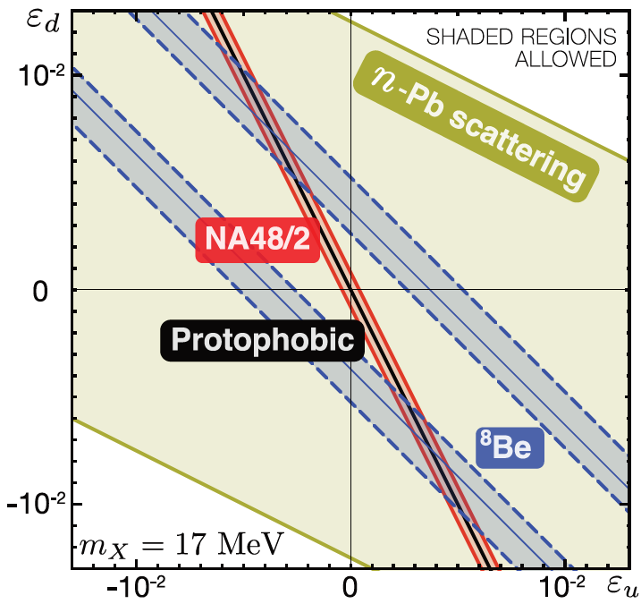
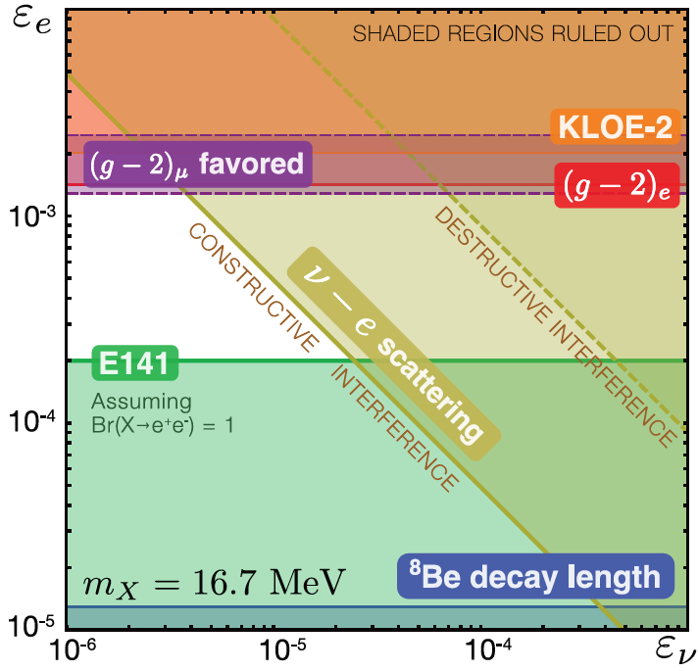
COUPLING CONSTRAINTS
Considering all constraints, require ε_{u}, ε_{d} ~ few 10⁻³ with cancelation to ~10% for protophobia, 10⁻⁴ < ε_{e} < 10⁻³,
and |ε_{e}ε_{ν}|^{1/2} < 3 x 10⁻⁴
Feng, Fornal, Galon, Gardner, Smolinsky, Tait, Tanedo (2016)

Slide 32
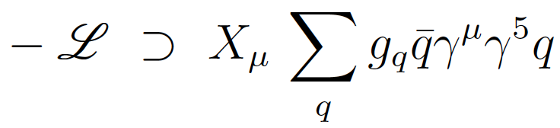
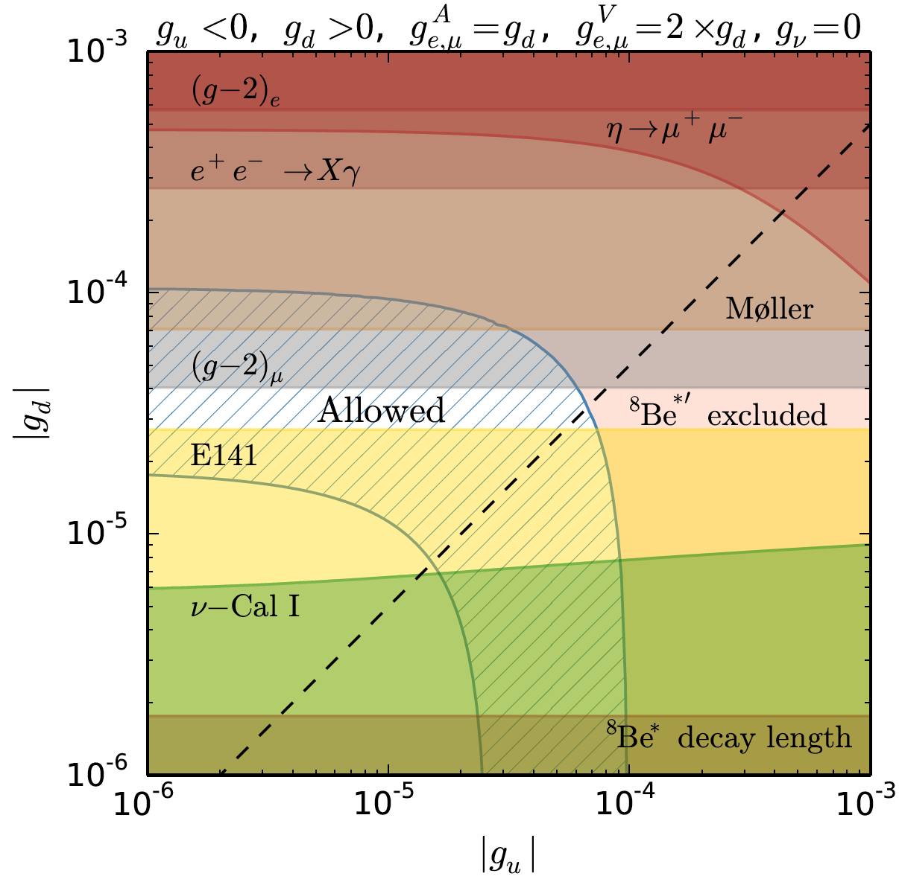
PARTICLE MODELS
How strange is protophobia? The Z boson is protophobic at low energies, as is any gauge boson coupling to B-Q or B-L-Q
Particle | Q | B | L | B-Q | B-L-Q
e | -1 | 0 | 1 | 1 | 0
p | 1 | 1 | 0 | 0 | 0
n | 0 | 1 | 0 | 1 | 1
Feng, Fornal, Galon Gardner, Smolinsky, Tait, Tanedo (2016)
Pseudoscalars have also been explored and are also possible
Axial vectors, which automatically decouple from pion decays, have been analyzed and are also possible
Ellwanger, Moretti (2016)
Kozaczuk, Morrissey, Stroberg (2016)

Slide 33
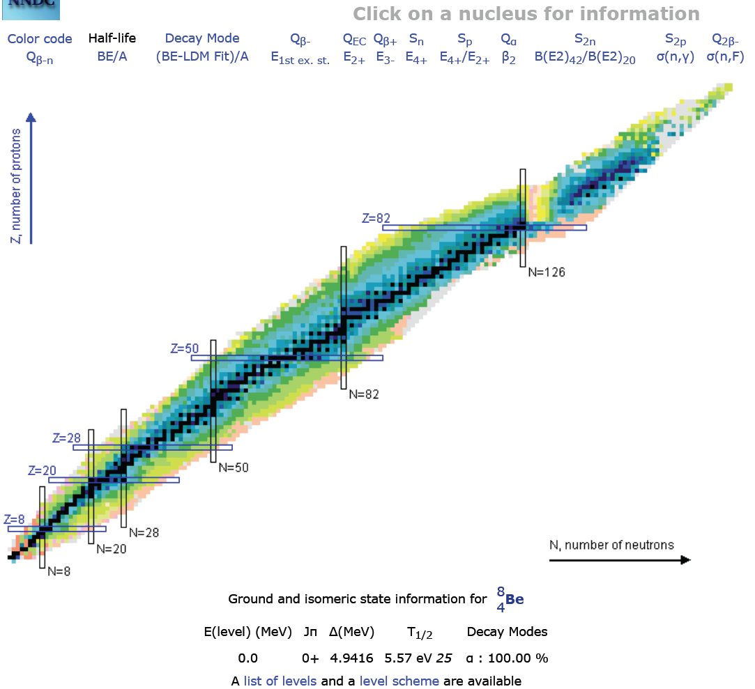
FUTURE TESTS: NUCLEAR PHYSICS
The most direct follow-up tests are to look again at nuclear IPC transitions
The ATOMKI group has new preliminary results with improved detectors for the 18.15 and 17.64 transitions
Other groups may be able to duplicate this in nuclear labs or at particle experiments where ⁸Be transitions are used as a calibration source of high-energy photons
Are other transitions possible? E.g., ⁴He (21.0), ¹⁰Be (17.8)

Slide 34
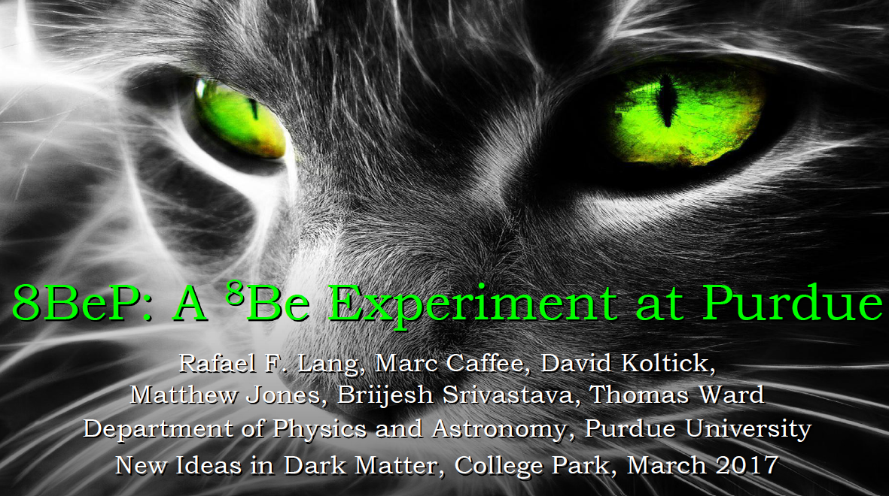
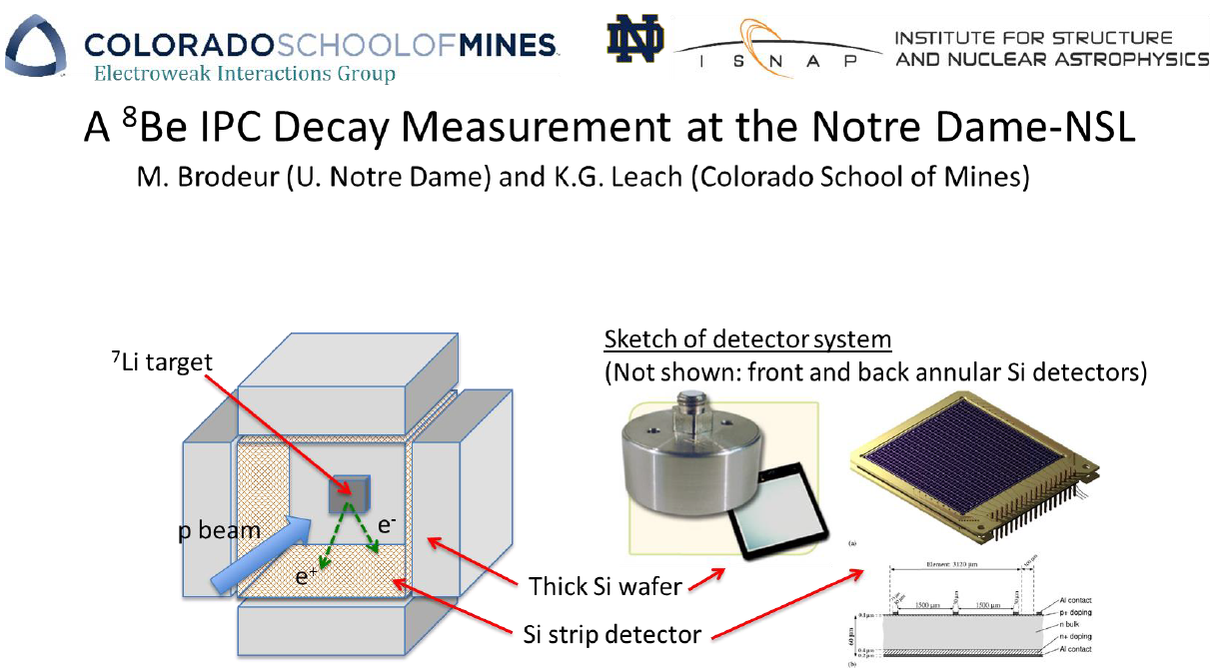
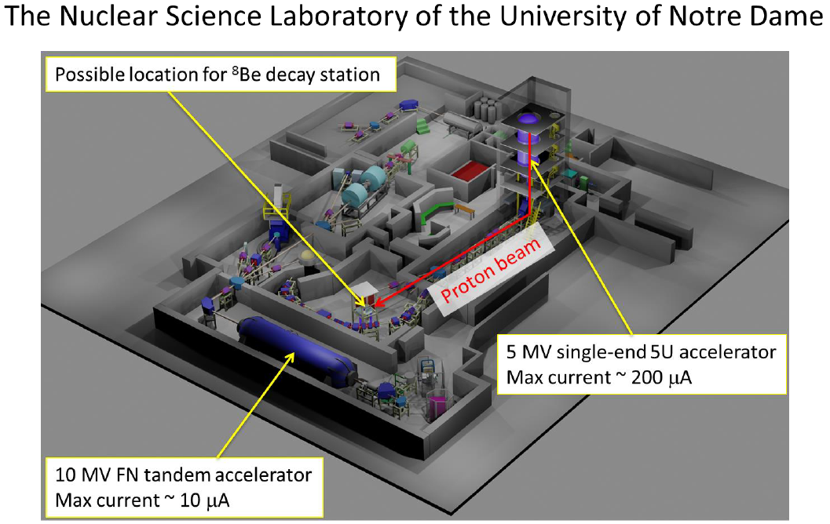
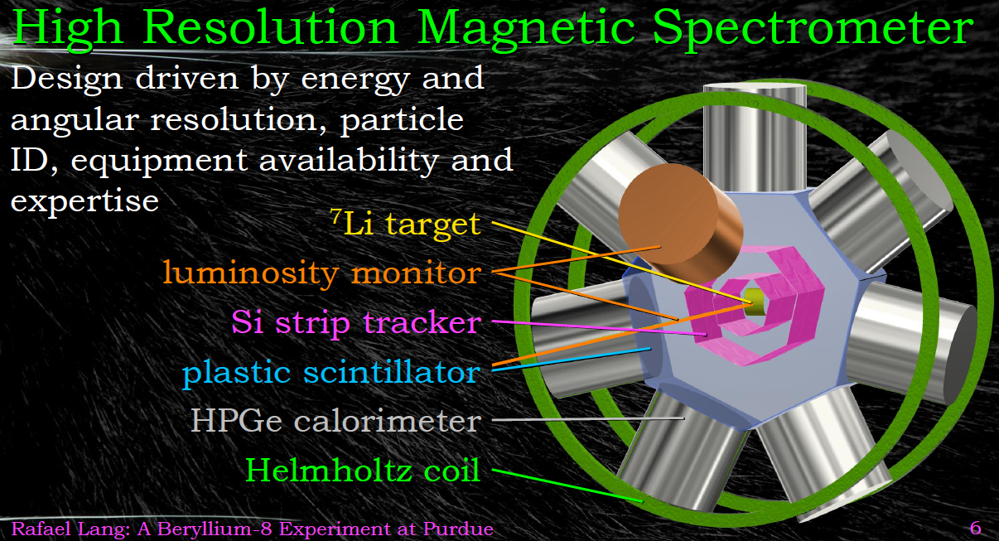
PROPOSED ⁸BE EXPERIMENTS
Purdue
Notre Dame
Timescale: 1-2 years, Total cost: ~ $750K

Slide 35
FUTURE TESTS: PARTICLE PHYSICS
There are a host of accelerator experiments that have been planned for dark photon searches, and may also be sensitive to a17 MeV X boson
Generally they look for e⁺e⁻ → γ A’, posibly followed by A’ → e⁺e⁻
The ⁸Be results provide an interesting target for new accelerator searches for light, weakly-coupled particles
1604.07411

Slide 36
CONCLUSIONS
A 5th force is an open and exciting possibility
Dark matter provides new motivation to look for light, weakly-coupled particles that may mediate a 5th force
There is currently a 6.8σ anomaly in ⁸Be* nuclear decays
The data are consistent with new particle explanations, including a protophobic gauge boson that mediates a 5th force and simultaneously explains the muon g-2 anomaly
The result, if true, has spectacular implications for all of basic science, but particular for particle physics and astrophysics (dark matter, force unification, etc.)
Much work remains, but relatively quick and inexpensive follow-up experiments are in the works

