Slide 1
WG4: New Candidates, Targets, and Complementarity
U.S. Cosmic Visions: New Ideas in Dark Matter Workshop
Conveners: Jonathan Feng and Patrick Fox
(UC Irvine)
(FNAL)

Slide 2

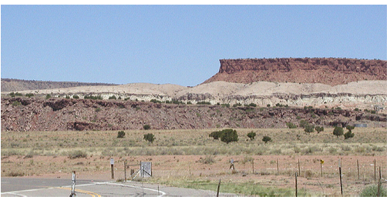
INTRODUCTION
Working Group 4 was charged with exploring
  New Candidates: new dark matter models and frameworks
  Targets: motivated regions of parameter space
  Complementarity: of proposed (small-scale) experiments with existing (large-scale) DM experiments, of proposed experiments with each other, of different classes of DM probes, in potential for discovery, in potential for studying DM after discovery, etc.
This led to an extraordinarily diverse and exciting workshop program, full of innovative ideas in both theory and experiment, and very lively discussions: thanks to all participants!
Hard to summarize in a pithy way, but the talks and topics may be divided into 4 broad and overlapping areas
  Anomalies as Targets
  Astrophysics and Cosmology Constraints and Targets
  New Candidates and Relic Abundance as Targets
  Complementarity

Slide 3
The talks
Anomalies as Targets
Astrophysics as Targets
/Constraints
Non-accelerator probes of light bosons: the 8Be anomaly and a photophobic 5th force, Iftah Galon
8Be and axial vectors, Jonathan Kozaczuk
8Be nuclear theory predictions, Xilin Zhang
Proton radius, Richard Hill
Future 8Be Experiments, Rafael Lang
Future 8Be Experiments, Kyle Leach
Isotope Shift Spectroscopy, Claudia Frugiuele
Small scale structure, Annika Peter
Self-interacting DM, Manoj Kaplinghat
Supernovae constraints on dark mediators, Sam McDermott
CMB, Tracy Slatyer

Slide 4
The talks
Complementarity
Relic abundance/Theory
as Targets
Accelerator Complementarity, Philip Schuster
HPS First results, Omar Moreno
Sensitivity of neutrino facilities to Z’ and DM, Claudia Frugiuele
LAr DM searches: Darkside-20k and beyond, Mark Boulay
ATLAS/CMS and light DM, Marco Trovato
LHCb and light DM, Philip Ilten
CTA, Brian Humensky
Laser-trapped atom search for sterile neutrino DM, Jeff Martoff
N-mirrorN oscillations, Leah Broussard/Ben Rybolt
Search for 10-100 Msolar mass MACHOs, Will Dawson
Non-abelian dark sectors, Nikita Blinov
SIMPle DM and Non-abelian Hidden sectors, Kim Boddy
SIMPs and ELDERs, Maxim Perelstein
Dynamical DM, Keith Dienes
Inelastic thermal relics, Gordan Krnjaic
Axions and WIMPs in natural SUSY, Howie Baer

Slide 5


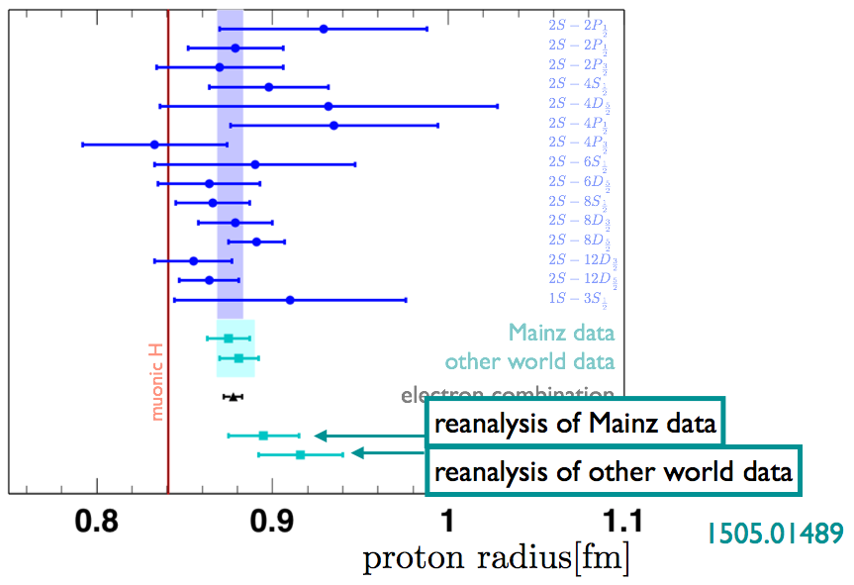

Anomalies and how to test them
Anomalies that may require new light weakly interacting bosons
excess
No explicit talk, but ubiquitous
R. Hill
Light particles ~10 MeV that distinguish mu from e

Slide 6
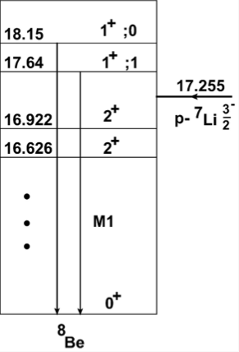
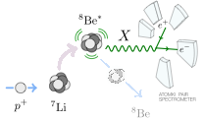
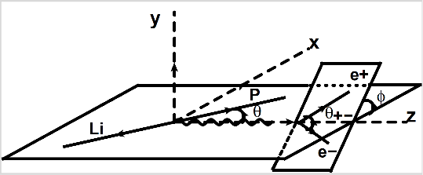
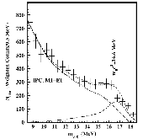

I.Galon
X. Zhang
Model including interference effects now available
Non-trivial angular dependence
Can’t explain it with nuclear theory

Slide 7

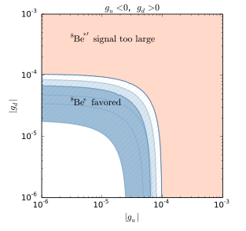
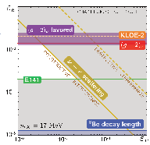

Anomalies and models to explain them
“Never trust an experimental result until it has been confirmed by theory”—Eddington
rp can be explained by light vector or scalar in 1-10 MeV range
    small quark couplings, distinguish e from mu
8Be can be explained by ~17 MeV boson coupling to e
    proto-phobic vector
    Axial-vector
I.Galon
J. Kozaczuk

Slide 8
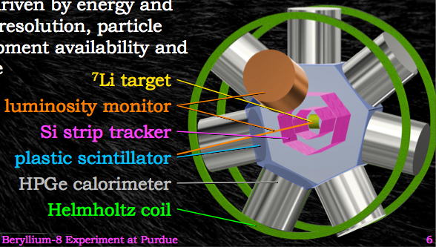
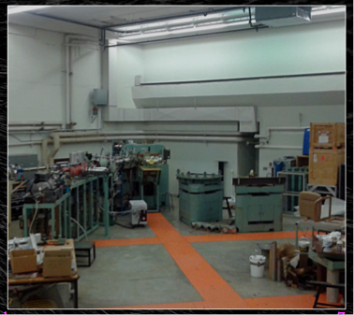

Anomalies and experiments to test them
R.Lang
8Be followup: parts “just lying around”
Quick, cheap cross-check
Hunting bumps requires good energy resolution, <70keV
Improve bounds on <~20 MeV bosons

Slide 9
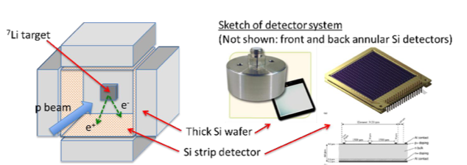

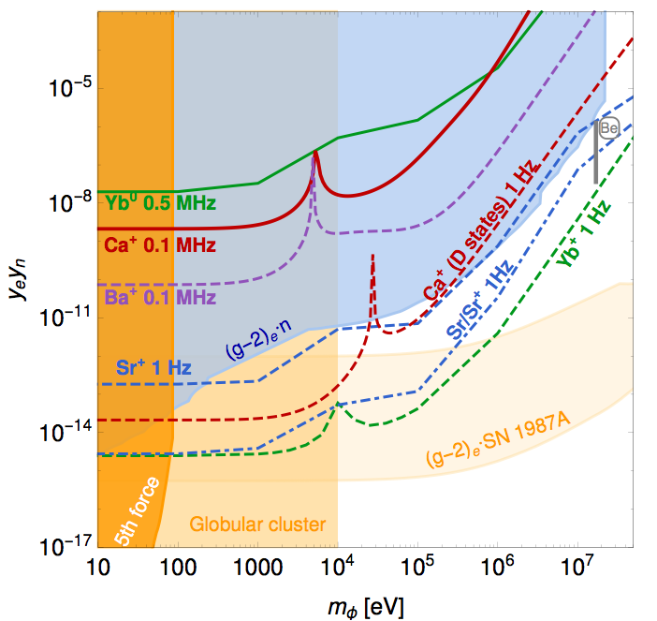
Anomalies and experiments to test them
M. Brodeur and K. Leach
Test Atomki result
~4pi detector
200 microA
Cheap, fast
Move on to other targets
Smaller couplings
Timescale: 1-2 years
Cost: <$1M
C. Frugiuele
Atomic spectroscopy probes new long-range n-e force
“King linearity”

Slide 10
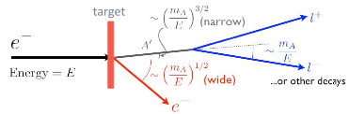
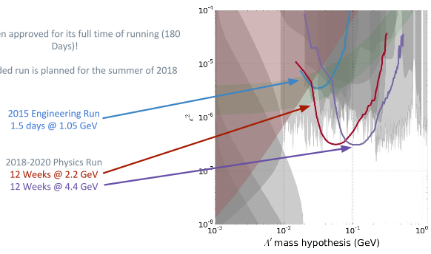
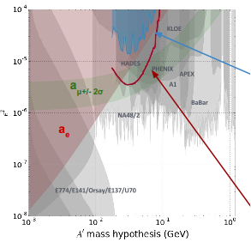
Anomalies and experiments to test them
Omar Moreno
HPS
10% 2015 run
projected 2015 run
Accelerator probes (HPS and many others) and low-energy nuclear and atomic expts. (8Be, isotope spectroscopy) probe complementary mass ranges

Slide 11
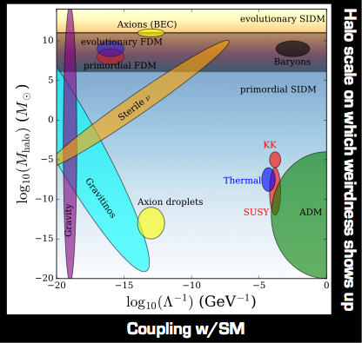

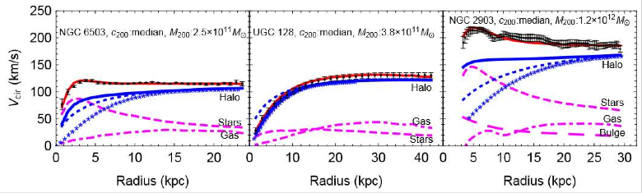
Astrophysics as a target
A. Peter
Microphysics <—> Macrophysics
Lots of data, limited by people and $’s, need better simulations
Puzzling diversity in galaxy rotation curves
      Fixed by SIDM
      Velocity dependent
      Motivates DM interacting through 1-00 MeV mediator
M. Kaplinghat

Slide 12
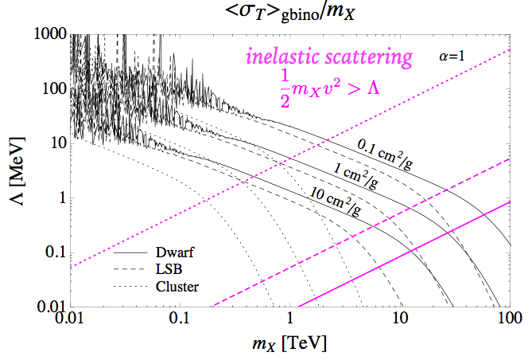
Astrophysics as a complementary probe
DM-DM self interactions can only be probed through astrophysics
New light force carriers in the dark sector would give SIDM, possibly with velocity dependent couplings
Learn something entirely new about the dark sector:
observe
or bound
the size of its self interactions
K. Boddy

Slide 13
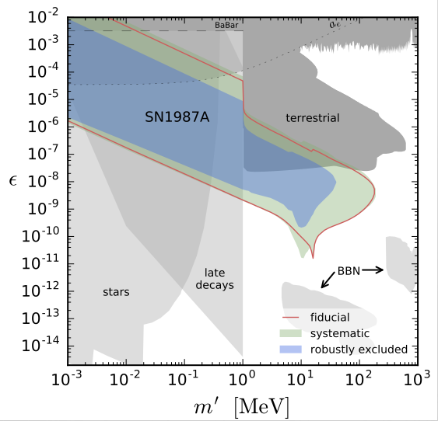
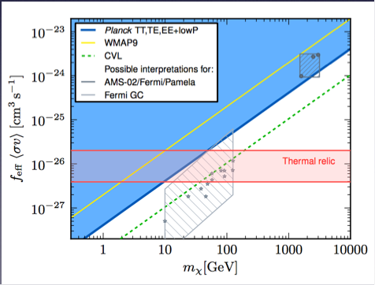
Dark and explosive times
T. Slatyer
S. McDermott
CMB constrains addition of e,
Excludes many DM possibilities, motivates models with e.g. p-wave annihilation
SN constraints on dark photon
Include resonance & F.T. effects
Probes low coupling param. space, completely inaccessible to particle expts.

Slide 14
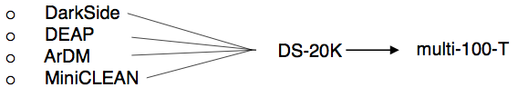
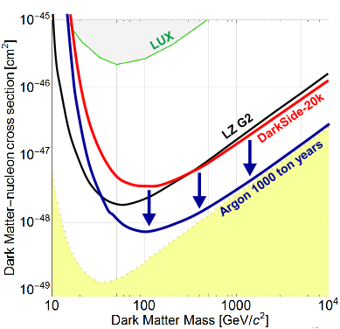
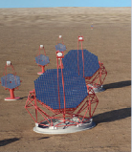
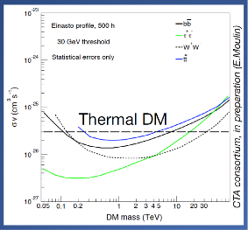
WIMPs
“Keep on keeping on”
Large scale experiments to search for weak scale DM
Worldwide Ar community now unified into single collaboration
Expect DEAP3600 results this year
M Boulay
B. Humensky
CTA
Complementarity: Natural SUSY models with axions and WIMPs
H. Baer

Slide 15




Models of dark sectors
Models of DM have come a long way in 10-20 years
Often a result of dynamic experiment-theory interface
WIMPs
(Coannihilation)
iDM
exDM
….
non-abelian
dark sectors
dynamical DM
G. Krnjaic
K. Boddy
N. Blinov
K. Dienes

Slide 16


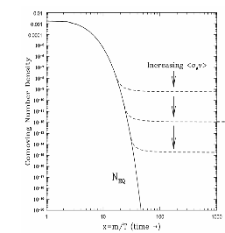
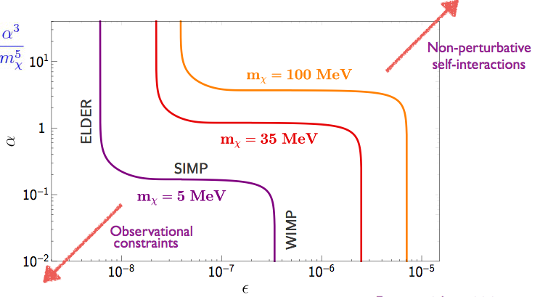
Relics as a target
M. Perelstein
K. Boddy
N. Blinov
Leads to interesting changes in cosmology
cannibalization
WIMPless-miracle (1-100 MeV scale)
SIMP-miracle
ELDER…
all smoothly connected in parameter space
3->2
DM-SM elastic scatter

Slide 17
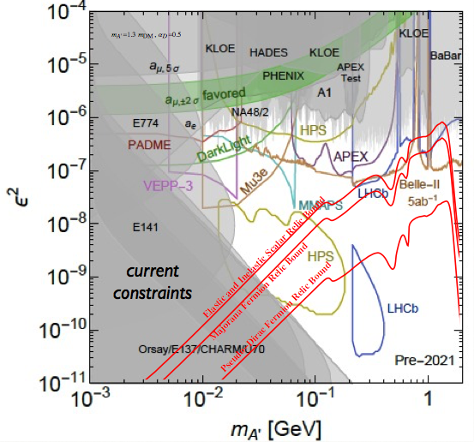
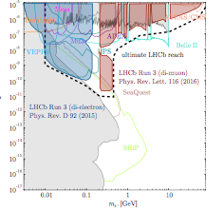
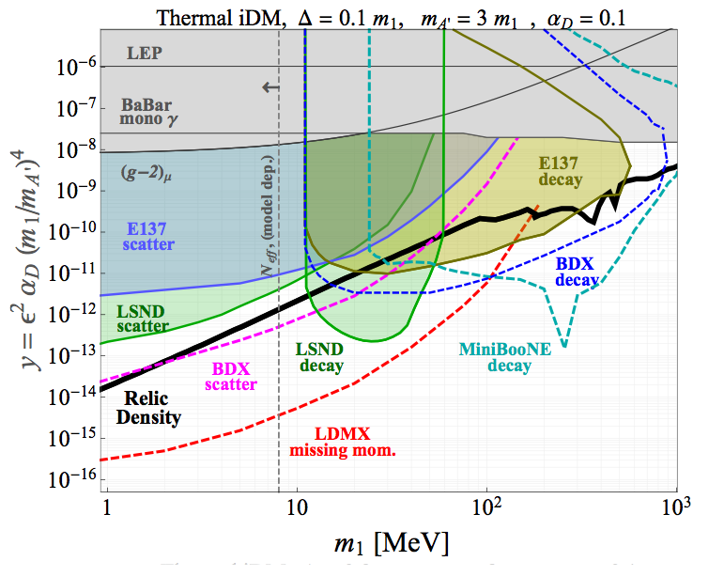
Correct relic abundance requires non-zero couplings of mediator to SM
Complementary probe at accelerators, beam dumps
LHCb has sensitivity through electron scattering, electron-positron annihilation and hadron decays
P. Schuster
G. Krnjaic
P. Ilten

Slide 18
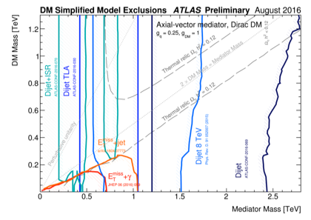
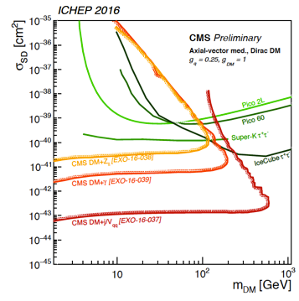
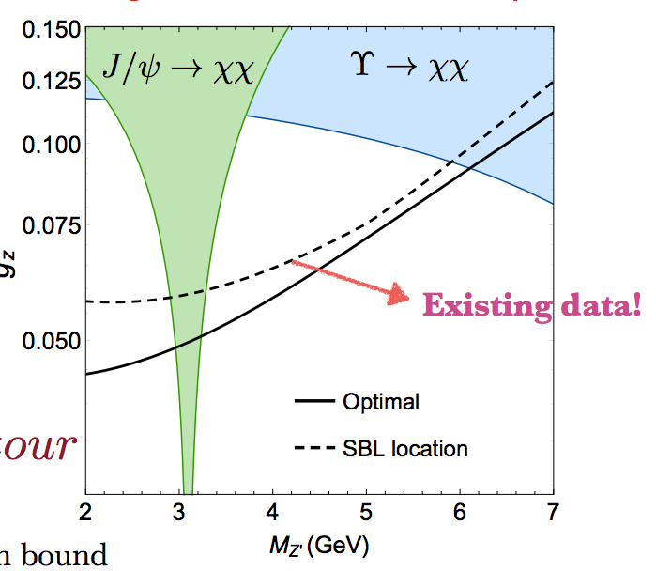
DM-nucleon couplings
M Trovato
ATLAS and CMS have full suite of mono-X searches, and dijet
Use FNAL main injector to make a beam of DM, see recoil in near detector
Optimal placement?
Miniboone
C. Frugiuele

Slide 19
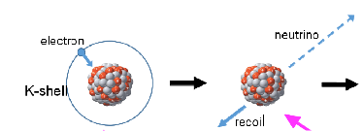
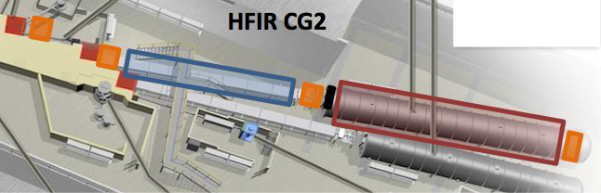
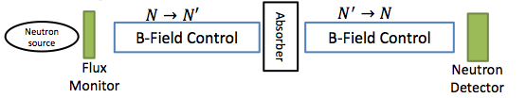
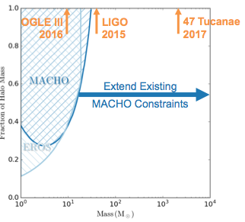
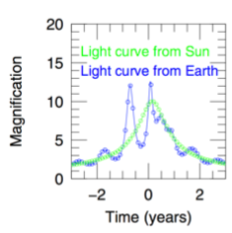

keV sterile neutrinos
HUNTER expt
J. Martoff
N-mirrorN oscillations
B.Rybolt and L. Broussard
W. Dawson
DECam and LSST microlensing search for BH DM
Parallax to the rescue!
Expect ~100 events in 5 years if all of DM
Cheap-leverage existing infrastructure
Heaviest DM
Candidate
GeV

Slide 20
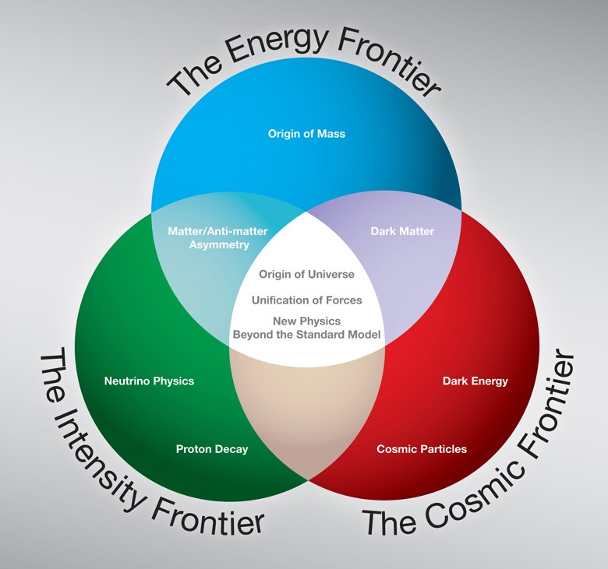
TAKE HOME #1: A NEW ERA IN DARK MATTER
Dark matter has long been one of the leading scientific problems of our time, but it has been transformed in recent years by innovative cross talk across many fields of physics
Previously: an astrophysical problem that leaked into particle physics: the cosmic frontier
!!!
Now: an incredibly fertile field for creative ideas about new particles and forces, spanning the cosmic, energy, and intensity frontiers, and also drawing on nuclear physics, condensed matter physics, and atomic physics

Slide 21
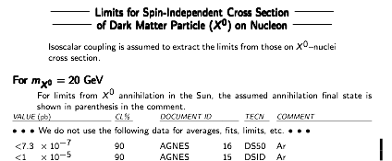


TAKE HOME #2: SYNERGY WITH COSMOLOGY
Precision cosmology now both constrains and motivates new ideas for the microscopic (particle) properties of dark matter
For example: CMB and supernovae constrain regions of parameter space inaccessible to particle experiments; small scale structure motivates new ideas about self-interactions with implications for particle experiments
Investments in simulations and astroparticle theory leverage the enormous amount of cosmological data already being collected and are guaranteed to tell us something interesting about dark matter properties
Self-interaction
PDG 2020
MKAP
SSS inc. cluster data
dwarf halo
HY

Slide 22





TAKE HOME #3: IMPORTANCE OF THEORY
Theory motivates new models and regions of parameter space, suggests new search methods, and draws connections between disparate phenomena.
SIDM
Astrophysics
Cosmology
Relic story
Direct
detection
DM part of a
dark sector
Existing
anomaly?
Dark photons
Probe in low
energy expts.
(In)visibly
decaying mediators
Production of
mediator in lab

Slide 23
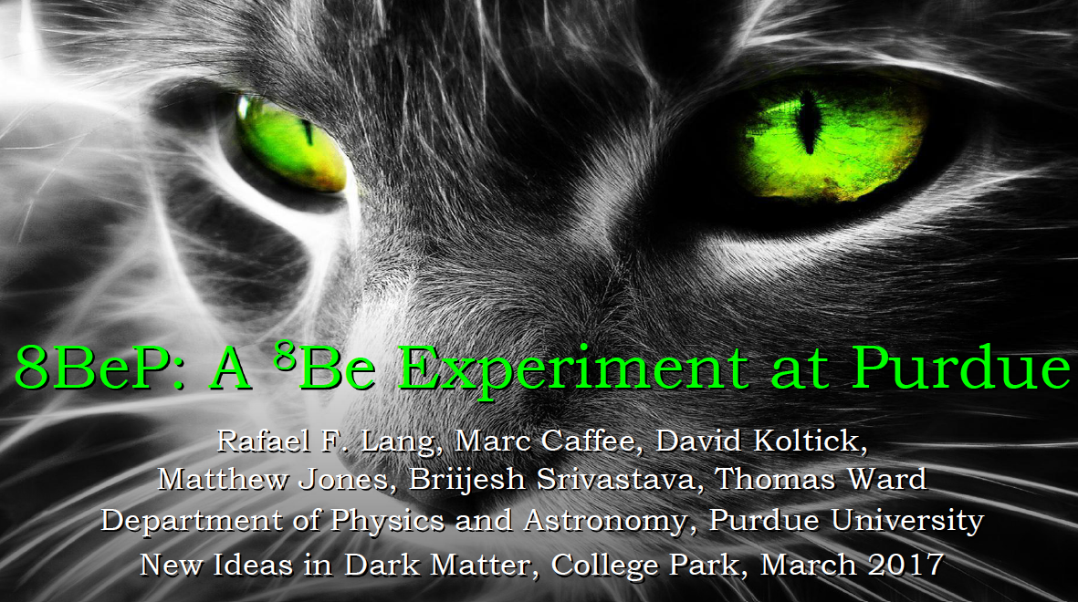
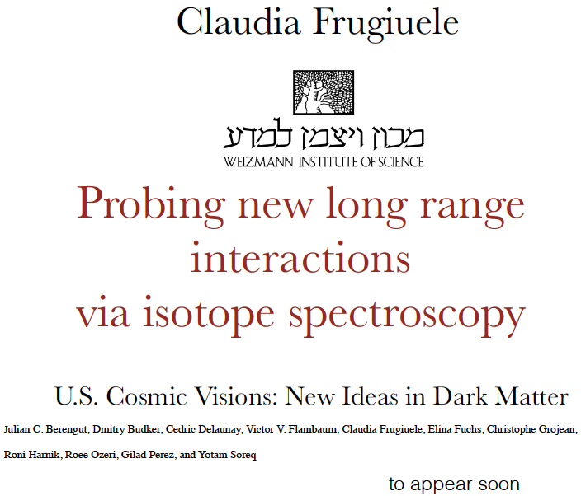
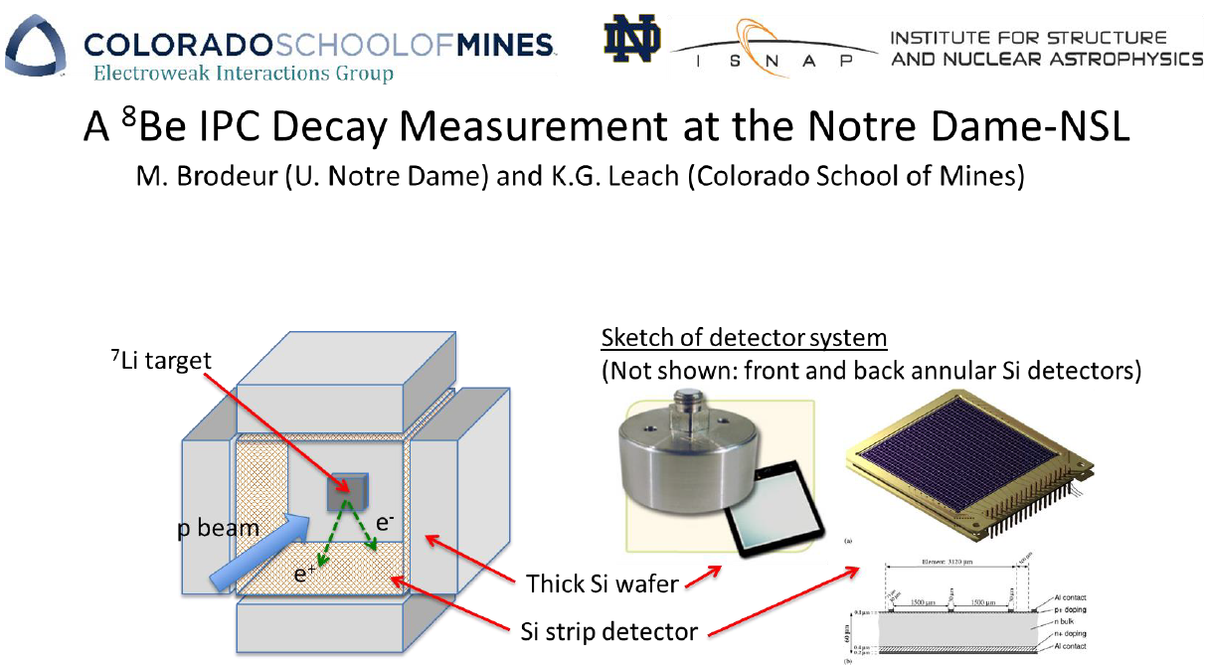
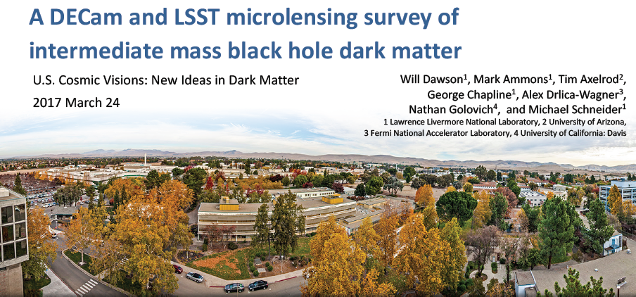
TAKE HOME #4: FAST AND CHEAP EXPERIMENTS
New ideas and anomalies motivate ongoing and planned experiments, but also fast (<2 years) and cheap (~$1M) experiments: there is a rich menu to choose from!

Slide 24
Thank you to all WG4 participants!

