Slide 1
Inputs and Questions from
WG4: New Candidates, Targets, and Complementarity
U.S. Cosmic Visions: New Ideas in Dark Matter
University of Maryland
Jonathan Feng and Paddy Fox, conveners
24 March 2017

Slide 2
INPUTS AND QUESTIONS FROM WG4
1:10pm - 3:40pm WG3-WG4 Joint Parallel
Philip Schuster (SLAC): Accelerator Complementarity
Iftah Galon (UC Irvine): Non-accelerator Probes of Light Bosons: The ⁸Be Anomaly and a Protophobic 5th Force
Omar Moreno (SLAC): HPS First Results
Nikita Blinov (SLAC): Non-Abelian Sectors at Fixed Target
Claudia Frugiuele (Weizmann): Sensitivity of Neutrino Facilities to Leptophobic Z’ and DM
4:00pm - 6:30pm WG4 Parallel
Mark Boulay (Carleton): Argon DM Searches: DarkSide-20K and Beyond
Richard Hill (Perimeter): Proton Radius
Jonathan Kozaczuk (U Mass Amherst): ⁸Be and Axial Vector Bosons
Xilin Zhang (U Washington): ⁸Be Nuclear Theory Predictions
Rafael Lang (Purdue): Future ⁸Be Experiments
Kyle Leach (Colorado School of Mines): Future ⁸Be Experiments
Claudia Frugiuele (Weizmann): Isotope Shift Spectroscopy
Great talks, but not reviewed here: see closeout talk tomorrow

Slide 3
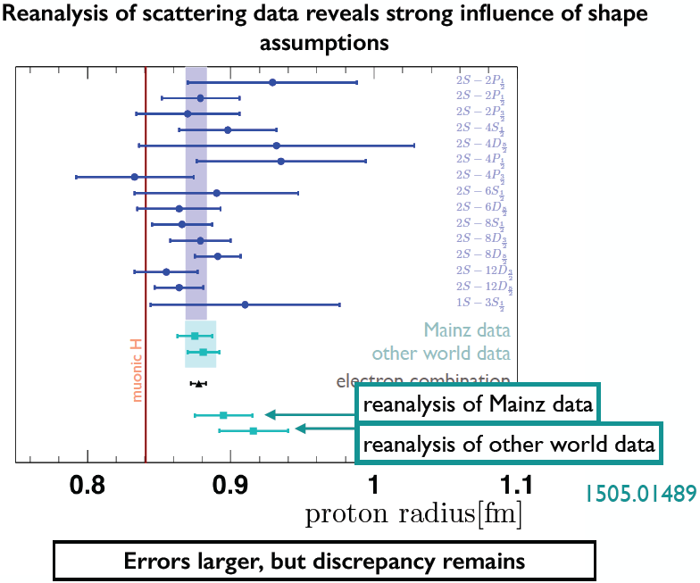
ANOMALIES PROVIDE TARGETS
Proton Radius Anomaly
⁸Be Anomaly
Richard Hill
Iftah Galon, Jonathan Kozaczuk, Xilin Zhang

Slide 4
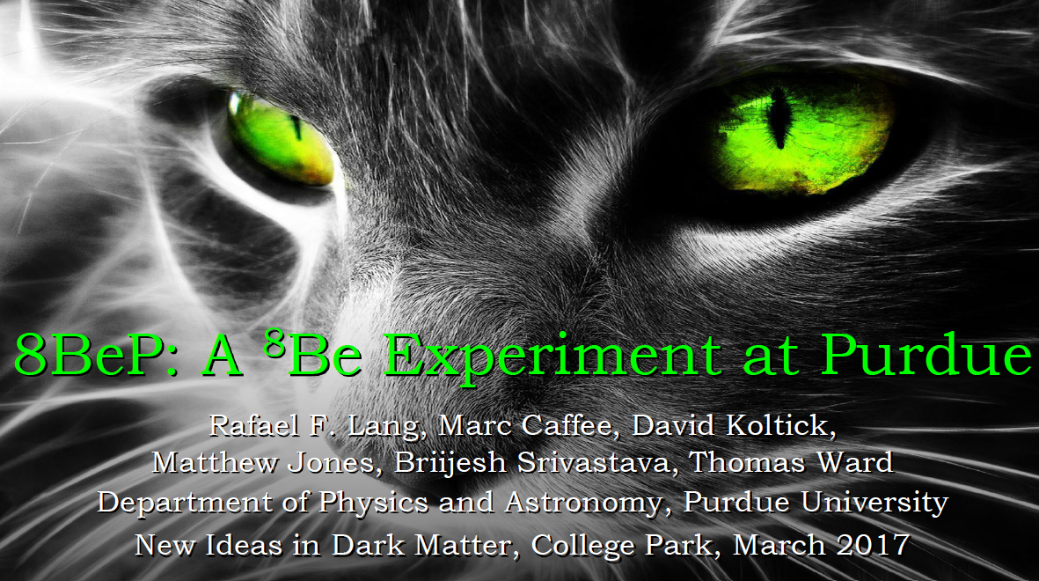
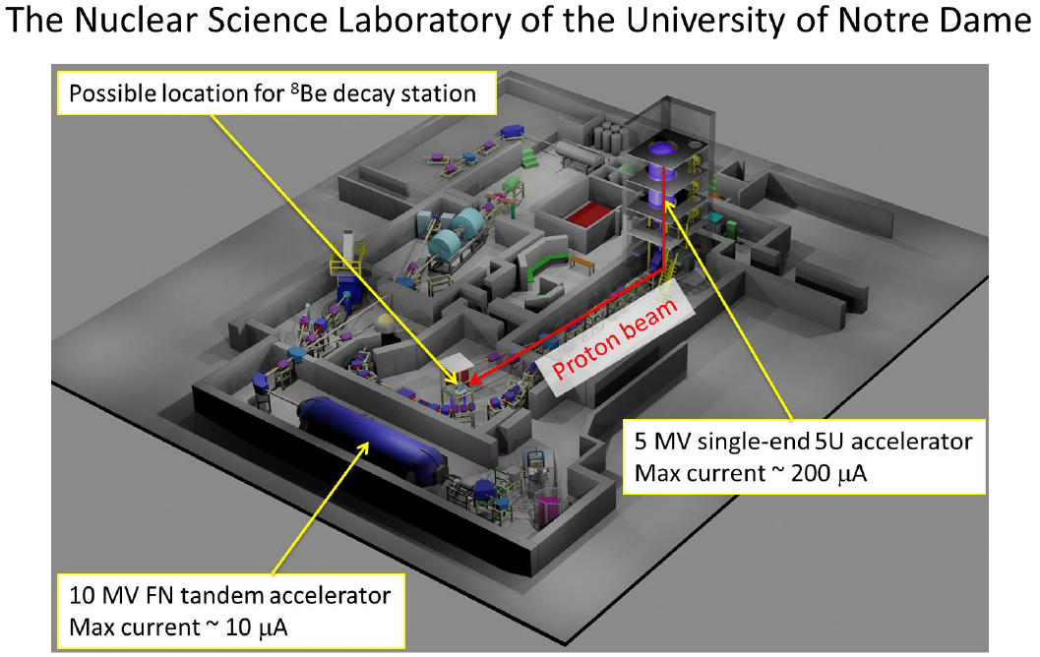
PROPOSED 8BE EXPERIMENTS
Purdue (Lang)
Notre Dame (Leach)
Timescale: <2 years , <$750K
Timescale: 1-2 years, $750K, including manpower

Slide 5
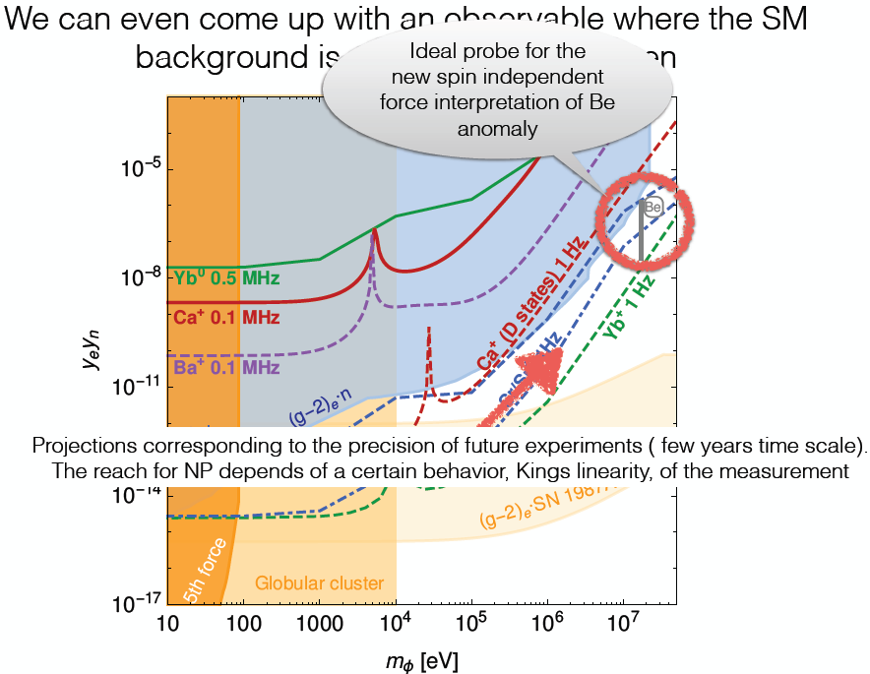
ATOMIC PHYSICS PROBES
Timescale: short, Cost: cheap

Slide 6
INPUTS AND QUESTIONS
Many new ideas in dark matter involve low mass scales, leading naturally to overlap with nuclear physics, condensed matter physics, atomic physics
Proposed experiments certainly fall within the DOE HEP Program Mission to “Discover the elementary constituents of matter and energy [and] probe the interactions between them,” but are in areas traditionally funded by other areas of the DOE Office of Science and the NSF. We are assuming at this point we should be driven by the science. (Cf. supernovae, CMB, etc.)
Many of the proposed experiments are inexpensive, have short timescales, and time is of the essence. Are there ways to get small amounts of funding (~$30K) soon (this summer)?

