Slide 1
DARK MATTER AND THE
SEARCH FOR A FIFTH FORCE
TRIUMF Colloquium
Jonathan Feng, UC Irvine
9 February 2017

Slide 2

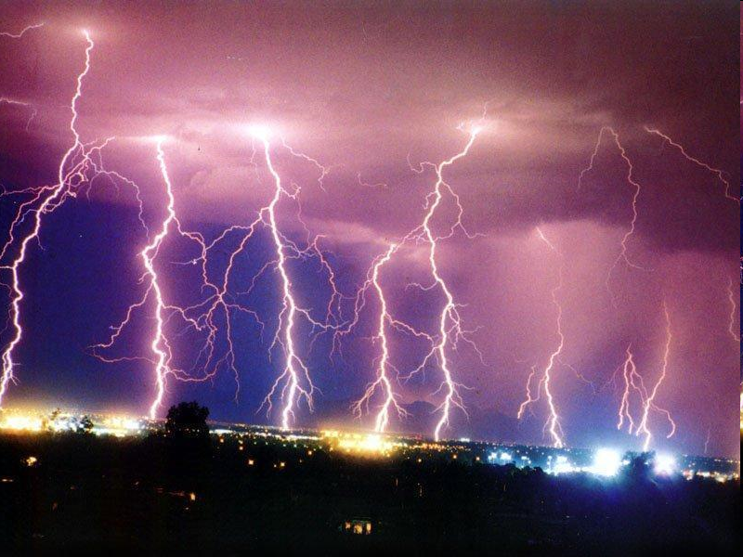
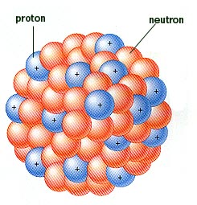
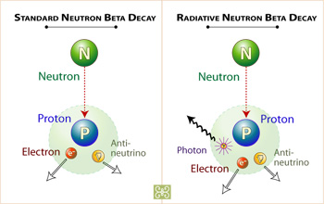
FUNDAMENTAL FORCES
We know of four fundamental forces
Are there more? Is there a fifth fundamental force?
Gravity
Electromagnetism
Strong
Weak

Slide 3
FORCES AND PARTICLES
In this talk, discovering a new fundamental force means discovering a new boson; primarily, I have in mind spin 1 gauge bosons, like the photon, W, Z, and gluon, but other bosons qualify as well
With this definition, 5th forces can be mediated by a host of hypothetical particles: Z’ gauge bosons, A’ dark photons, dilatons, Kaluza-Klein gravitons, ...
The force’s range is inversely proportional to the force-mediating particle’s mass: range λ ~ m⁻¹
The “force” language is perhaps most natural when m is small, λ is large. E.g.,
  m_{Z’} ~ TeV, λ ~ 2 x 10⁻¹⁹ m is a particle
  m_{A’} ~ MeV, λ ~ 200 fm starts to look like a force

Slide 4
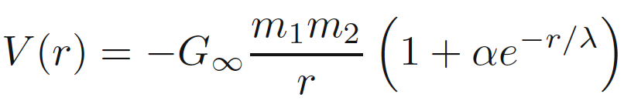
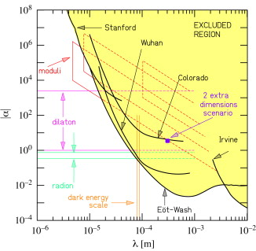
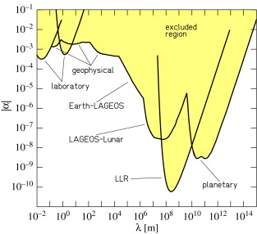
PAST 5TH FORCE SEARCHES
There have been many searches for 5th forces; for example, deviations from gravity:
So far, no such deviations have been found, but the history of 5th force searches is fascinating
See, e.g., Fischbach, “The 5th Force: A Personal History” (2015)
Adelberger,Gundlach, Heckel,
Hoedl, Schlamminger (2009)

Slide 5
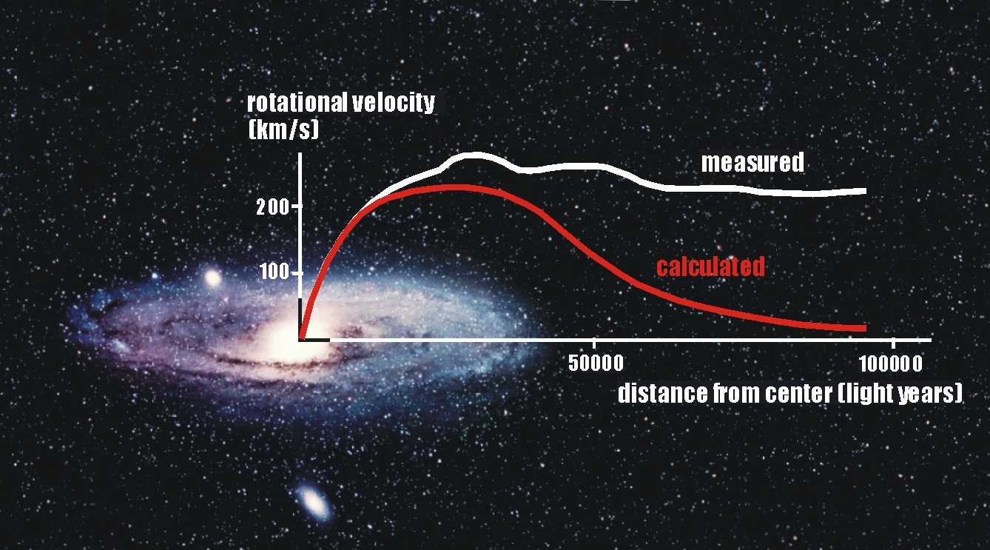

DARK MATTER
There is now every indication that the universe includes 6 times as much dark matter as ordinary matter
Classic evidence: rotation curves
This evidence has now been supplemented by many other observations, all pointing to the same amount of dark matter
Vera Rubin
1928-2016

Slide 6
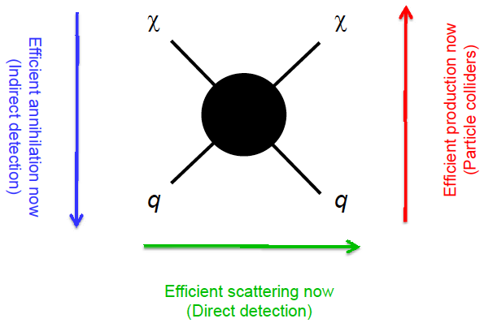
CLASSIC DARK MATTER CANDIDATES
Along with the classic evidence for dark matter, there are classic candidates: axions, sterile neutrinos, and weakly-interacting massive particles (WIMPs)
For many years, we have been exploring how to find these candidates: e.g., WIMPs at colliders, direct/indirect detection
So far none of them has been found
Feng (2008)

Slide 7
DARK SECTORS
All evidence for dark matter is gravitational. Perhaps it’s in a hidden sector, composed of particles with no SM gauge interactions (electromagnetic, weak, strong)
A hidden sector with dark matter in it is a “dark sector,” and it may have a rich structure with matter and forces of its own
Visible
Sector
Hidden
Sector
Lee, Yang (1956); Kobsarev, Okun, Pomeranchuk (1966); Blinnikov, Khlopov (1982);
Foot, Lew, Volkas (1991); Hodges (1993); Berezhiani, Dolgov, Mohapatra (1995);
Pospelov, Ritz, Voloshin (2007); Feng, Kumar (2008);...

Slide 8
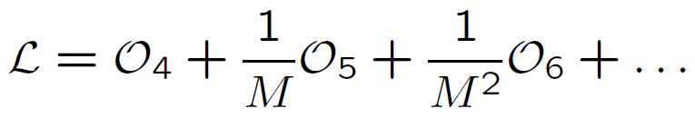



DARK MATTER PORTALS
If we are to detect it, we need to know how the hidden sector interacts with us
Seemingly a Pandora’s box of possibilities, but effective operators provide an organizing principle:
where the operators are grouped by their mass dimension, with [scalar] = 1, [fermion] = 3/2, [F_{μν}] = 2
M is a (presumably) large “mediator mass,” so start with dimension 4 operators. Some of the few possibilities:
Neutrino portal Higgs portal Vector portal

Slide 9

VECTOR PORTAL
Holdom (1986)
Suppose there are mediator particles with both hidden sector and visible sector charges. These will induce a coupling between the visible and hidden gauge fields:
One might expect this effect to become very small for heavy mediator particles, but it doesn’t
Instead, one gets a vector portal term , with
ε ~ 10⁻³ e e_{h}, where the 10⁻³ comes from it being a 1-loop effect, and e and e_{h} are the visible and hidden sector charges
A
mediator
particles
A_{h}

Slide 10
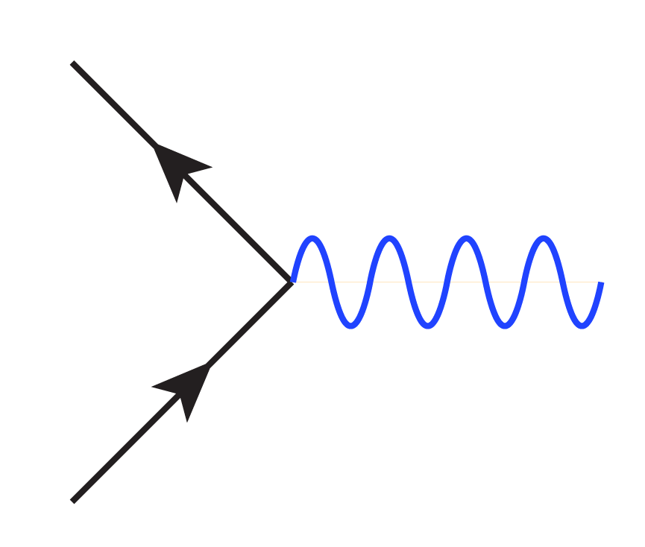
DARK PHOTONS
Holdom (1986)
The operator mixes the visible and hidden force carriers. Diagonalizing to eliminate this mixing term, one finds that the physical states are
  a massless force carrier: the SM photon γ
  a massive force carrier: the “dark photon” A’
The SM photon doesn’t couple to hidden sector particles, but the dark photon couples with charge εeQ_{f} to visible sector particles: it mediates a 5th force!
f_{h}
f
εeQ_{f}
γ
  A’
f_{h}
f

Slide 11
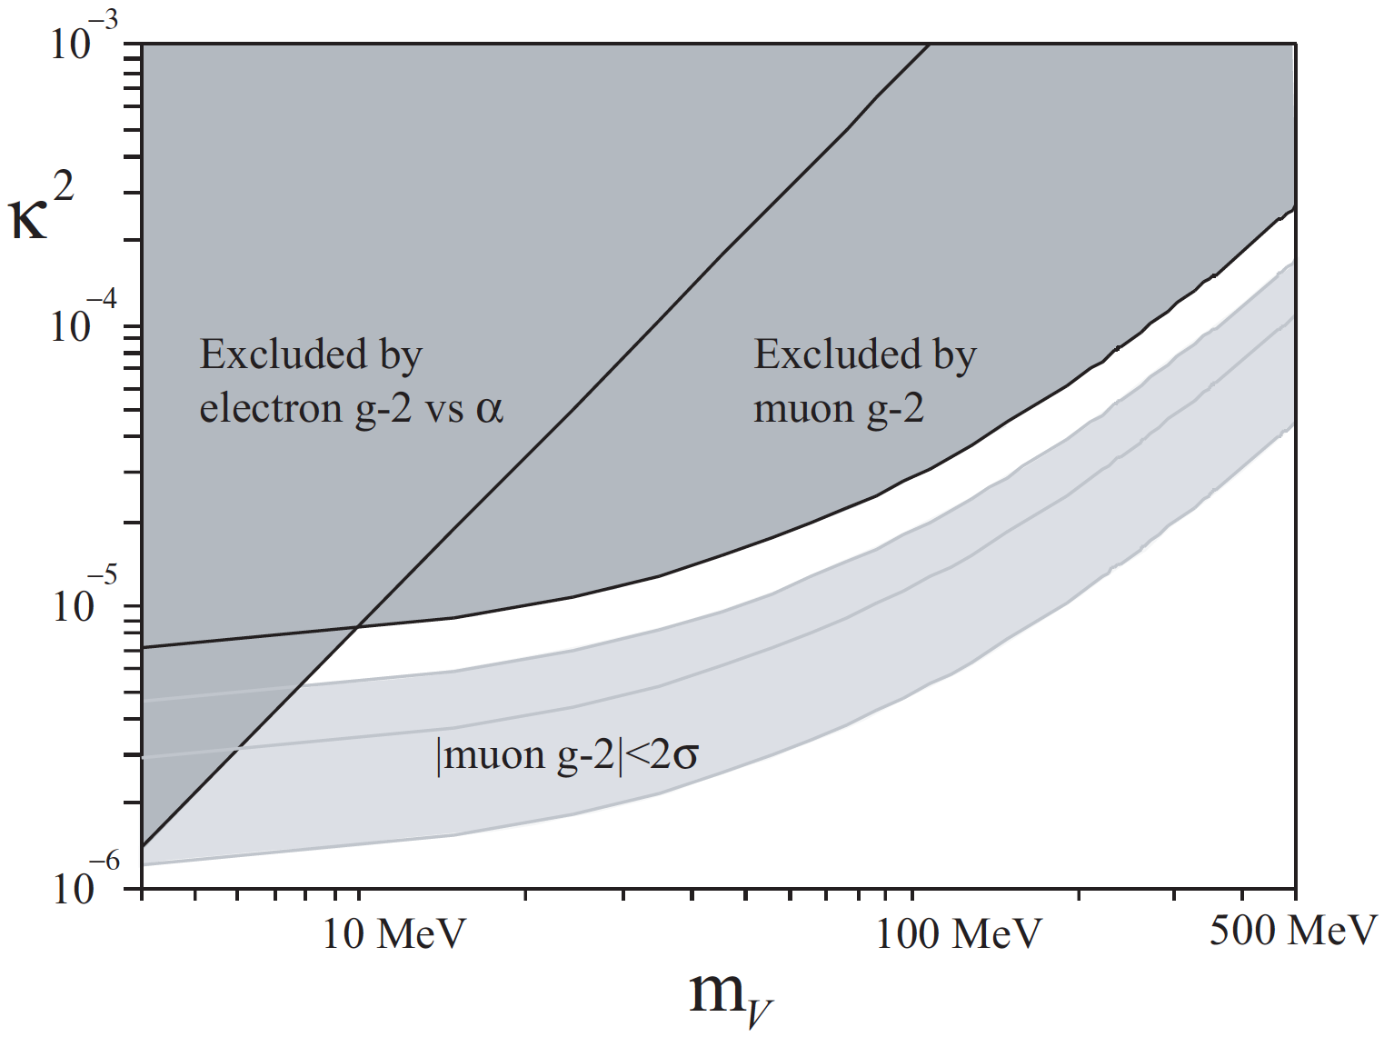
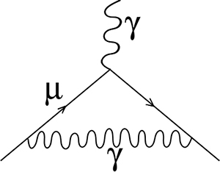
DARK PHOTON SEARCHES
This has motivated a world-wide hunt for dark photons throughout the (mass, coupling) parameter space
What parameters are interesting?
  Lamppost: whatever is not excluded and within reach
  ε ~ 10⁻³
  Anomalies: muon g-2, currently a 3.5σ discrepancy
Pospelov (2008)
γ, A’

Slide 12
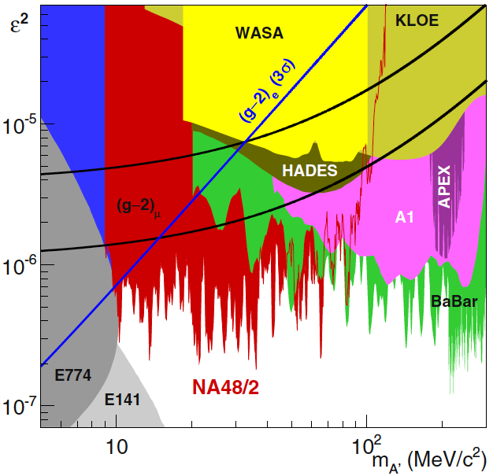
CURRENT CONSTRAINTS
In just 8 years, a large number of analyses have started constraining the parameter space by analyzing archived and current data and by doing new experiments
The dark photon resolution to the muon g-2 anomaly is now disfavored, but there is still a lot of parameter space to explore and many proposed experiments

Slide 13
FIFTH FORCE IN NUCLEAR PHYSICS
The interest in dark matter and 5th forces at low energy scales opens up new connections to other branches of physics
In particular, for the MeV scale, nuclear physics becomes a relevant probe of new particles
_{Treiman, Wilczek (1978)}
Donnelly, Freedman, Lytel, Peccei, Schwartz (1978)
Savage, McKeown, Filippone, Mitchell (1986)
A recent 6.8σ experimental anomaly might indicate the production of new particles in excited ⁸Be decays
A. J. Krasznahorkay et al., PRL, 1504.01527 [nucl-ex]
Could these be 5th force gauge bosons?
Feng, Fornal, Galon, Gardner, Smolinsky, Tait, Tanedo,
PRL, 1604.07411 [hep-ph]; PRD, 1608.03591 [hep-ph]

Slide 14
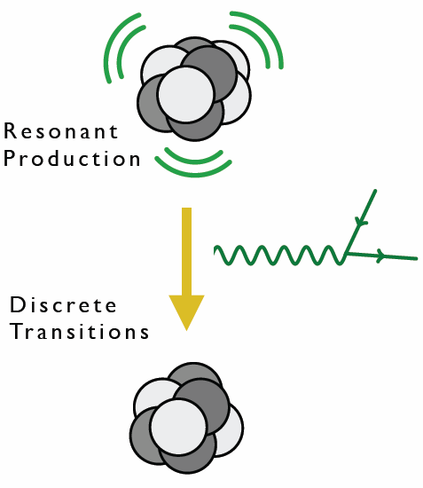
⁸BE AS A NEW PHYSICS LAB
⁸Be is composed of 4 protons and 4 neutrons
Excited states can be produced in large numbers through p + ⁷Li → high statistics “intensity” frontier
Excited states decay to ground state with relatively large energies (~20 MeV)
⁸Be nuclear transitions then provide interesting probes of light, weakly-coupled particles

Slide 15
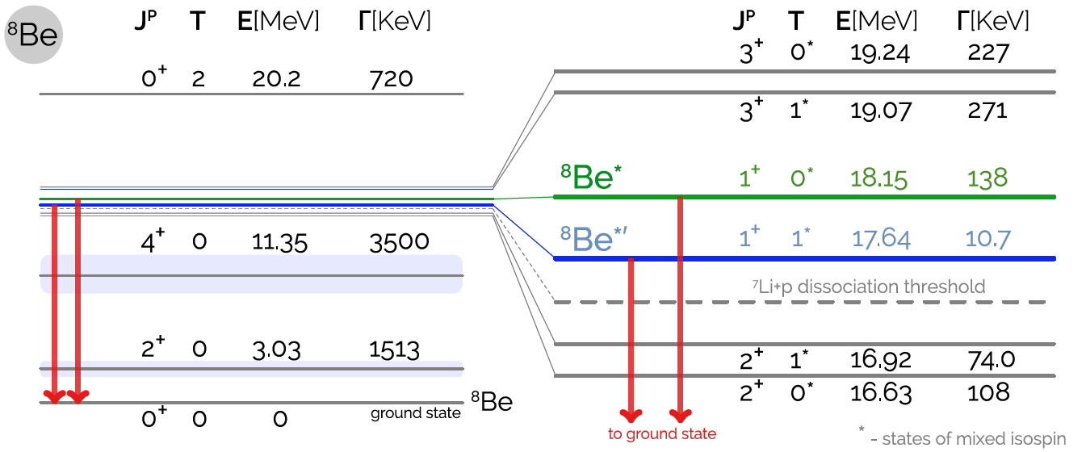
⁸BE SPECTRUM
Many excited states with different spins and isospins
Of special interest: the ⁸Be* (18.15) and ⁸Be*’ (17.64) states
1608.03591; based on Tilley et al. (2004), http://www.nndc.bnl.gov/nudat2, Wiringa et al. (2013)

Slide 16
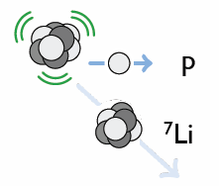
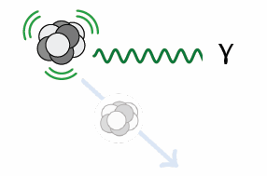
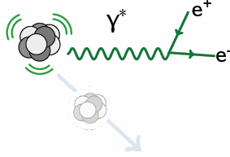
⁸BE* DECAY
Hadronic
B(p ⁷Li) ≈ 100%
Electromagnetic
B(⁸Be γ) ≈ 1.5 x 10⁻⁵
Internal Pair Creation
B(⁸Be e⁺ e⁻) ≈ 5.5 x 10⁻⁸

Slide 17
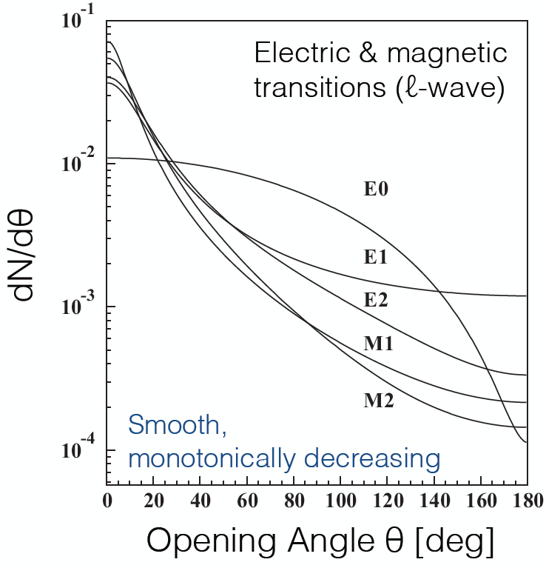
⁸BE* DECAY
Internal Pair Creation
B(⁸Be e⁺ e⁻) ≈ 5.5 x 10⁻⁸
For e⁺e⁻ produced by a virtual photon, dN/dθ is sharply peaked at low opening angle θ and is expected to be a monotonically decreasing function of θ
θ
Gulyas et al. (2015); Rose (1949)

Slide 18
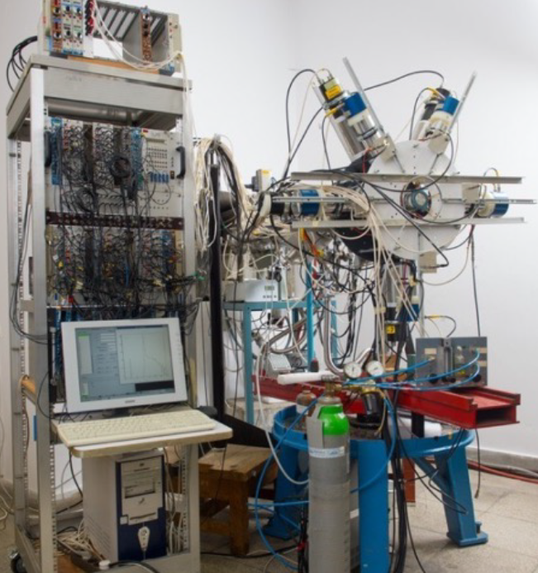
THE ATOMKI ⁸BE EXPERIMENT

Slide 19
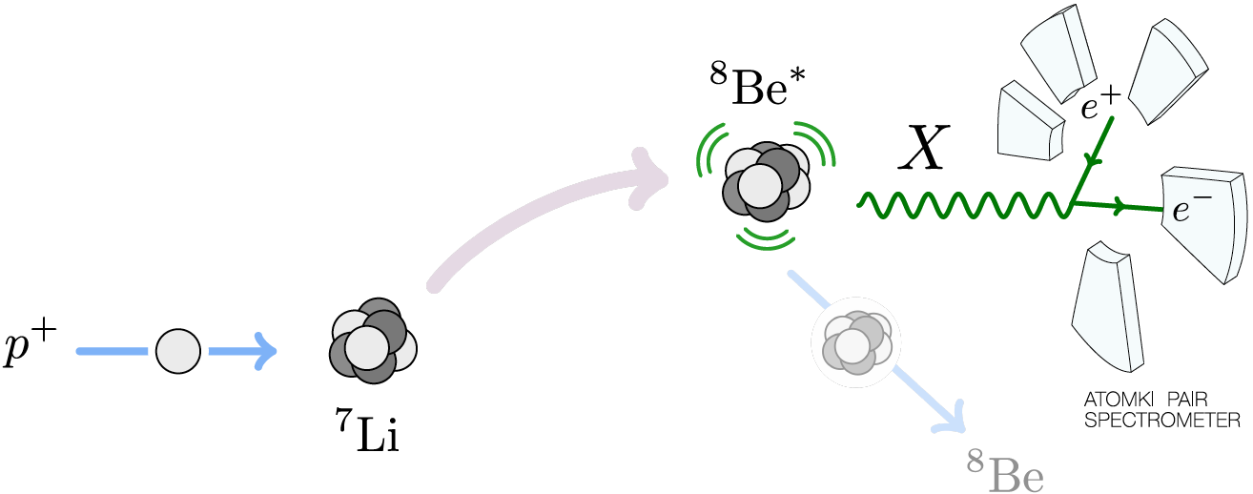
THE ATOMKI ⁸BE EXPERIMENT
A 1 μA p beam with ΔE_{p} ~ 10 keV strikes a thin ⁷Li foil target. The beam energy can be adjusted to select various ⁸Be excited state resonances.

Slide 20
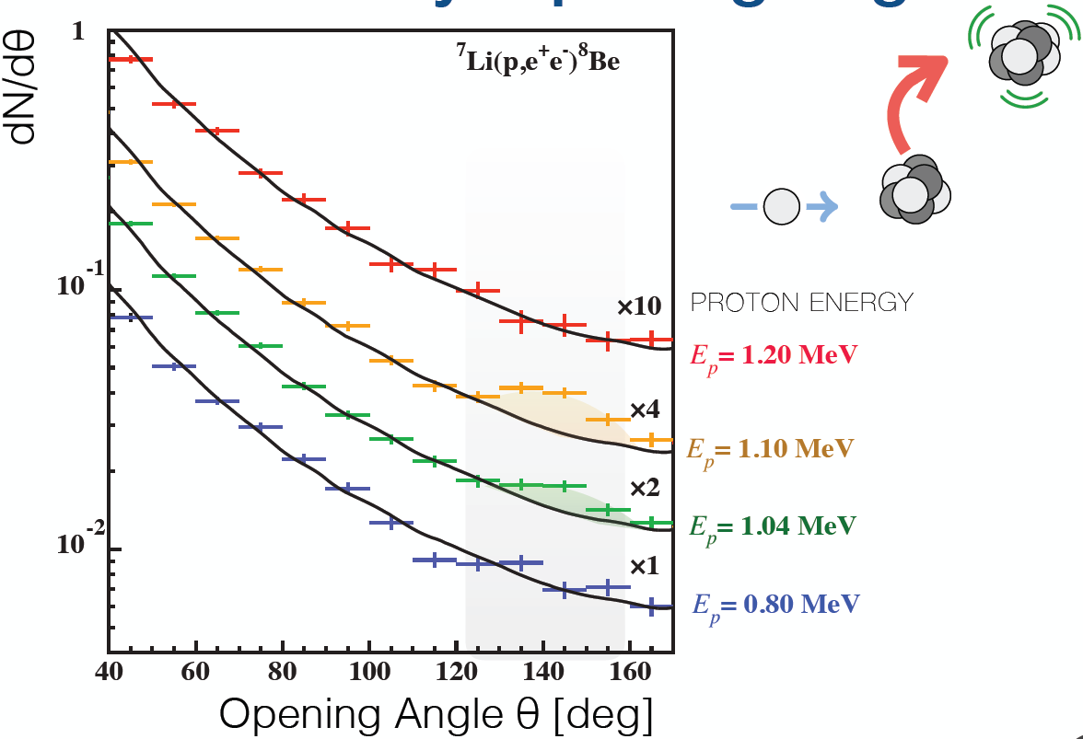
THE ATOMKI ANOMALY
A bump at ~140 degrees is observed as one passes through the ⁸Be* resonance
Background fluctuation probability: 5.6 x 10⁻¹² (6.8σ)
Krasznahorkay et al. (2015)

Slide 21
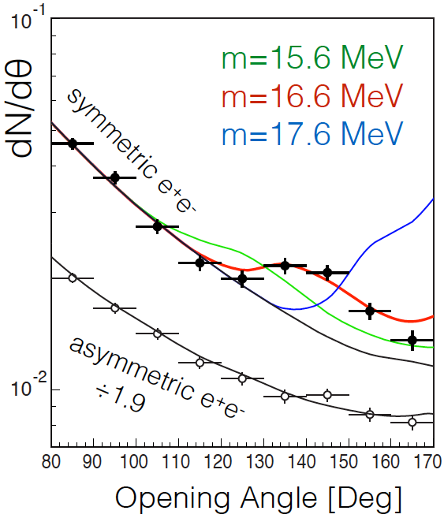
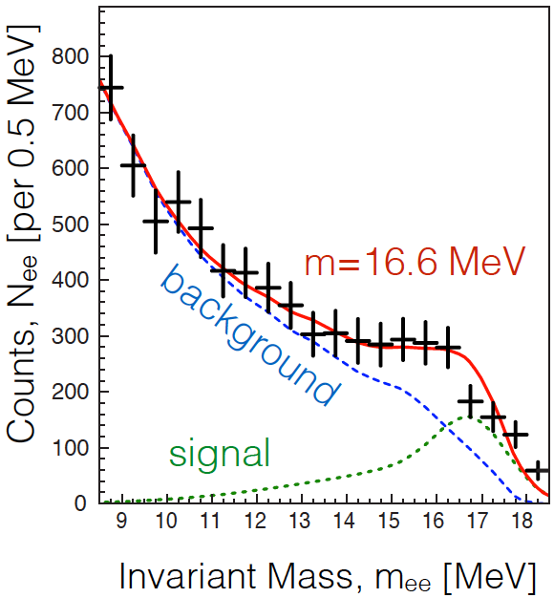
THE ATOMKI ANOMALY
The θ (and m_{ee}) distributions can be explained by postulating a new particle and 2-step decay: ⁸Be* → ⁸Be X, X → e⁺e⁻
The best fit parameters: m = 16.7 ± 0.35 (stat) ± 0.5 (sys) MeV
  B(⁸Be* → ⁸Be X) / B(⁸Be* → ⁸Be γ) = 5.6 x 10⁻⁶
χ²/dof = 1.07
Krasznahorkay et al. (2015)

Slide 22
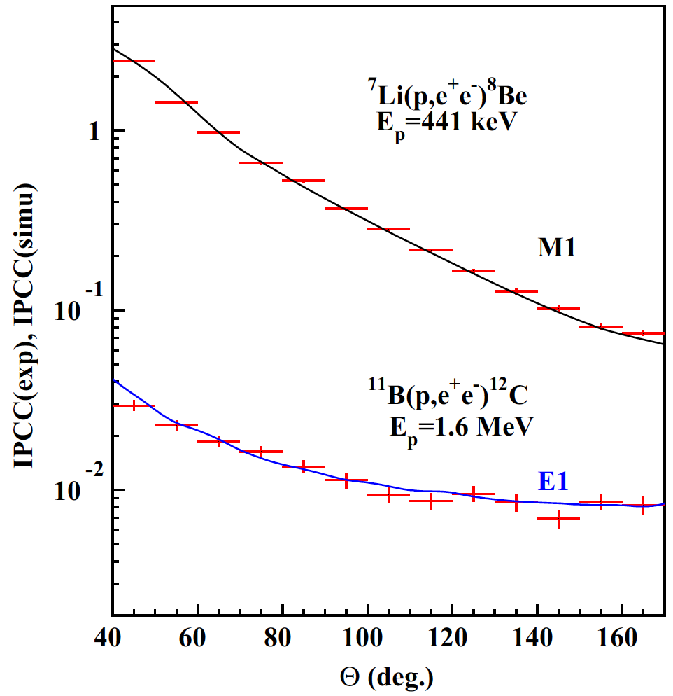
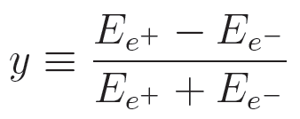
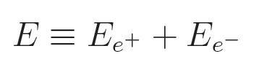
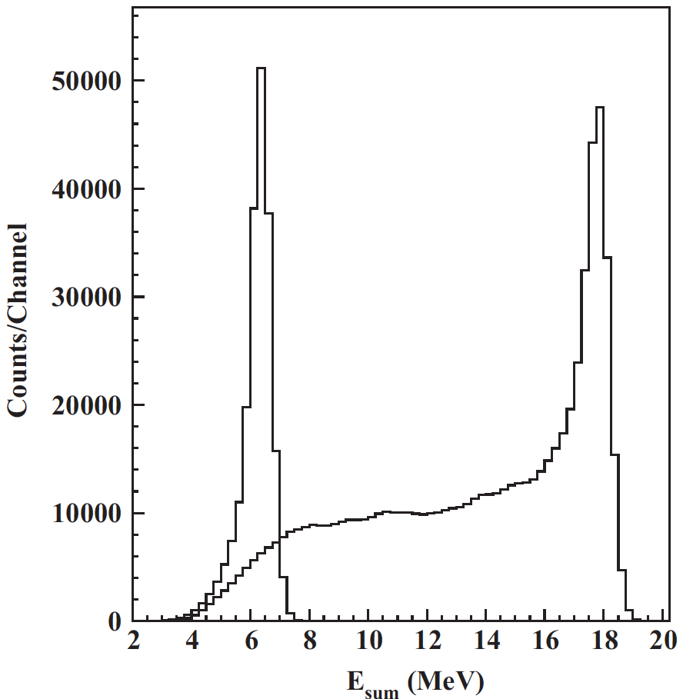
CROSS CHECKS
For example: other (lower energy) decays fit theoretical expectations well
The excess is confined to events with symmetric energies, |y| < 0.5 and large summed energies E > 18 MeV, as expected for a new particle interpretation
⁸Be*’
Gulyas et al. NIM (2015)

Slide 23
POSSIBLE EXPLANATIONS
Three possibilities:
  (1) an as-yet-unidentified experimental problem
  (2) an as-yet-unidentified nuclear theory effect
  (3) new particle physics
(1) Nuclear Experiment
  The excess consists of hundreds of events in each bin and is comparable to the background; this is not a statistical fluctuation
  The excess is not a “last bin” effect: bump, not smooth excess
  Comparable excess not seen for 17.64 MeV states; explainable by phase-space suppression for 17 MeV particle
  Reports of conflicts with previous results of this collaboration are highly misleading / exaggerated
  the excellent fit to a new particle interpretation is purely coincidental
  Hungarian group is now collection data with improved detector, continues to see bump
  Similar experiments by other groups would be of great interest

Slide 24
POSSIBLE EXPLANATIONS
(2) Nuclear Theory
  Must explain bump in 18.15 data
  Must simultaneously explain lack of similarly-sized bump in (isospin-mixed) 17.64 data
  the excellent fit to a new particle interpretation is purely coincidental
  Preliminary results investigating interference effects reported at APS meeting in January by Zhang and Miller
  Further work would be of great interest
(3) Particle Physics
  If it’s new physics, what kind of new particle can it be?
  Is it consistent with all other experiments?
  Are there complete particle physics models that can incorporate this new particle?
  What other experiments can confirm or exclude this?
Feng, Fornal, Galon Gardner, Smolinsky, Tait, Tanedo (2016); Gu, He (2016);
Chen, Liang, Qiao (2016); Jia, Li (2016); Kitahara, Yamamoto (2016);
Ellwanger, Moretti (2016) ; Kozaczuk, Morrissey, Stroberg (2016); ...

Slide 25
WHAT KIND OF NEW PARTICLE CAN IT BE?
Some Quick Observations
Must couple to both quarks and electrons
Must be neutral
Must be a boson – a 5th force
Not everything works
For example: a spin 0 boson (“dark Higgs boson”)
J^{P} Assignments: 1⁺ → 0⁺ 0⁺
L Conservation: L = 1
Parity Cons.: P = (-1)^{L} = 1
Forbidden in parity-conserving theories
X

Slide 26
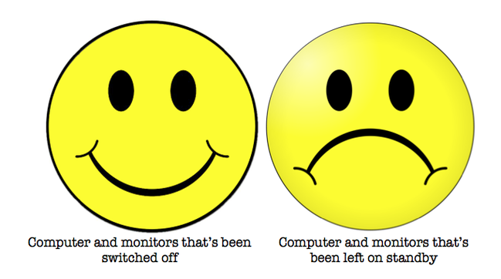

DARK PHOTON?
Consider the general case of a spin 1 gauge boson with couplings ε_{f}e to particle f
To get the right signal strength, need
For the special case of a dark photon with ε_{f} = εQ_{f}, this implies kinetic mixing parameter ε ~ 0.01, which is excluded
This is not a dark photon

Slide 27
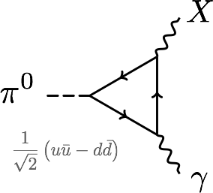
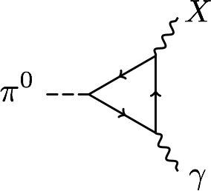
PROTOPHOBIA
The dominant constraints are null results from searches for exotic pion decays π⁰ → X γ → e⁺ e⁻ γ
Eliminated if Q_{u}X_{u}– Q_{d}X_{d} ≈ 0 or 2X_{u} + X_{d} ≈ 0 or X_{p} ≈ 0
A protophobic gauge boson with couplings to neutrons, but suppressed couplings to protons, can explain the ⁸Be signal without violating other constraints
u, d
p, n

Slide 28
PROTOPHOBIC GAUGE BOSON
For a protophobic gauge boson, the NA48/2 “quark” constraints are weakened
One can, then, take electron and muon couplings around 10⁻³. Such couplings are allowed by all constraints
A protophobic gauge boson can resolve both the ⁸Be and muon g-2 anomalies
Implies a milli-charged 5th force with range ~ 12 fm

Slide 29
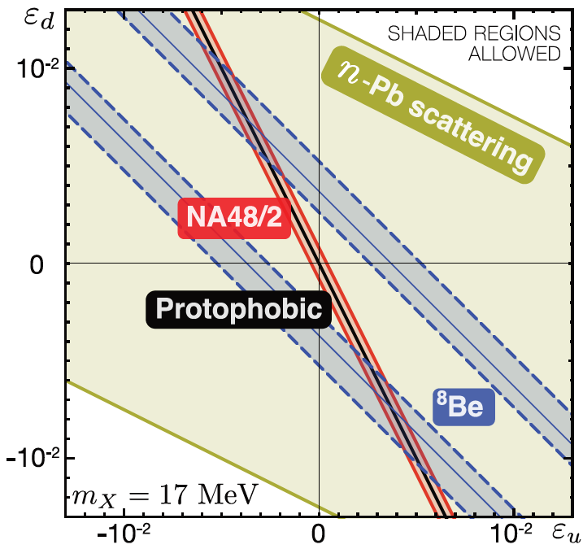
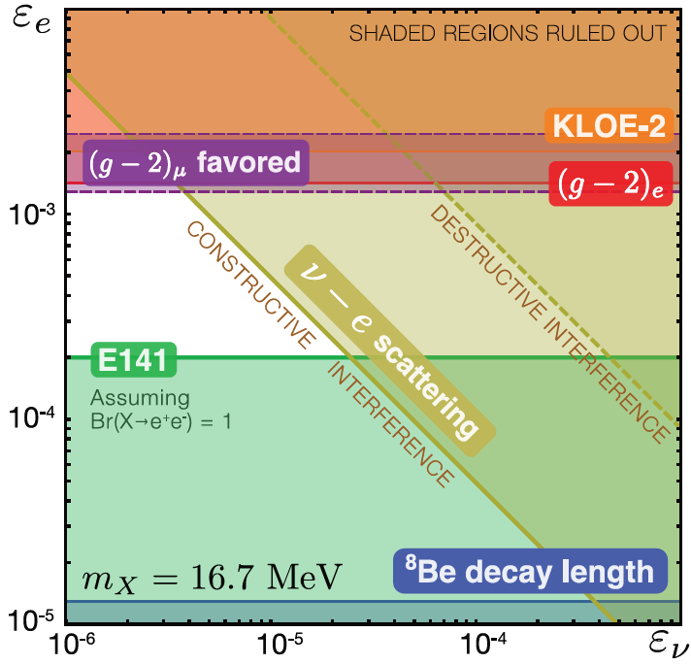
COUPLING CONSTRAINTS
Considering all constraints, require ε_{u}, ε_{d} ~ few 10⁻³ with cancelation to ~10% for protophobia, 10⁻⁴ < ε_{e} < 10⁻³,
and |ε_{e}ε_{ν}|^{1/2} < 3 x 10⁻⁴
Feng, Fornal, Galon, Gardner, Smolinsky, Tait, Tanedo (2016)

Slide 30
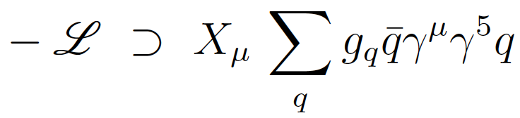
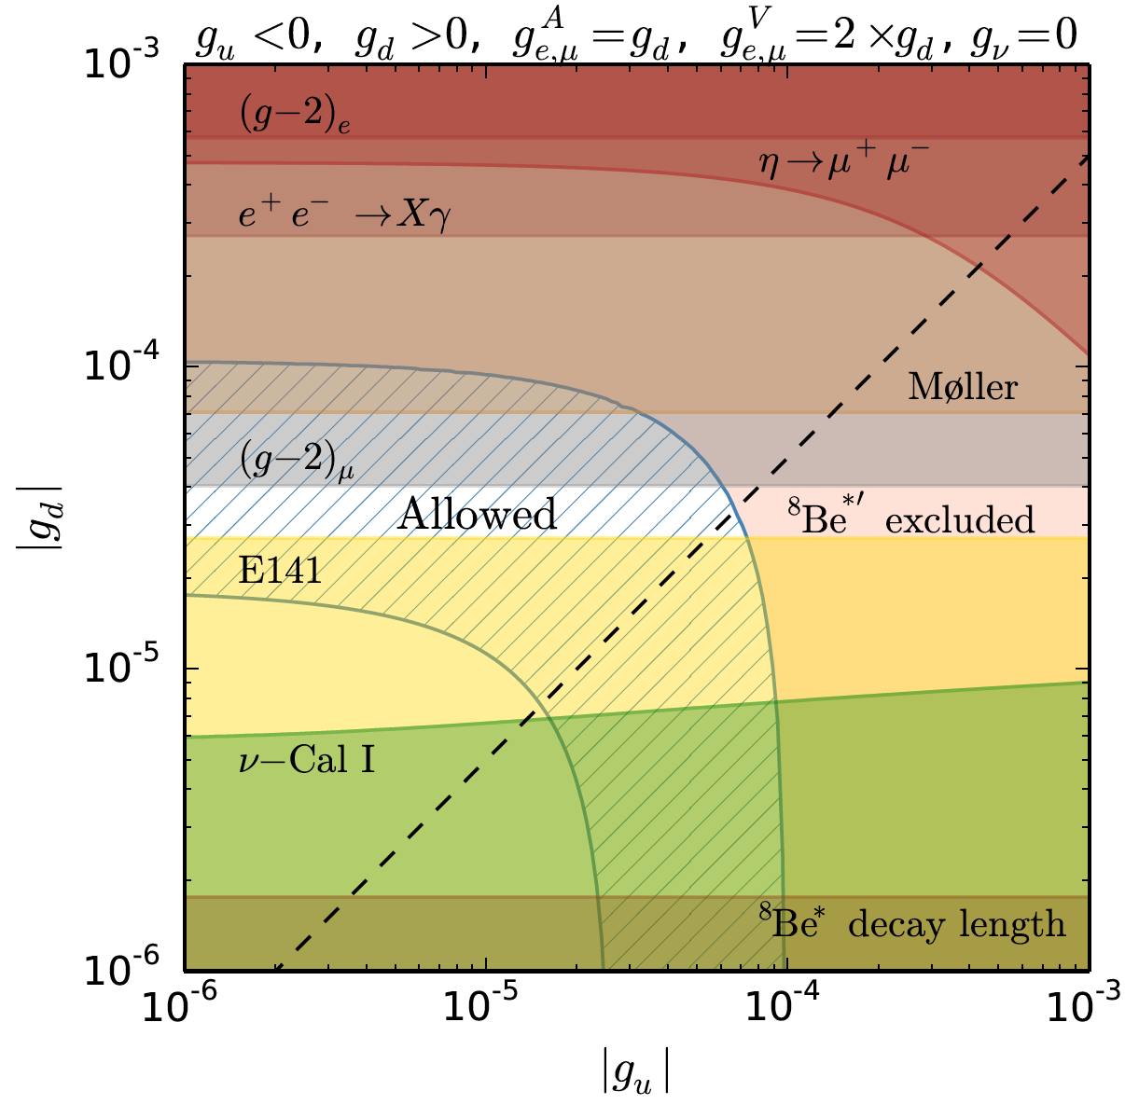
PARTICLE MODELS
How strange is protophobia? The Z boson is protophobic at low energies, as is a gauge boson coupling to B-L-Q or B-Q
The latter observation suggests a model-building strategy: consider a model with a light B-L or B gauge boson. After kinetic mixing with the photon, the new boson’s couplings can be B-L-Q or B-Q.
Feng, Fornal, Galon Gardner, Smolinsky, Tait, Tanedo (2016)
Pseudoscalars have also been explored and are also possible
Axial vectors, which automatically decouple from pion decays, have been analyzed and are also possible
Ellwanger, Moretti (2016)
Kozaczuk, Morrissey, Stroberg (2016)

Slide 31
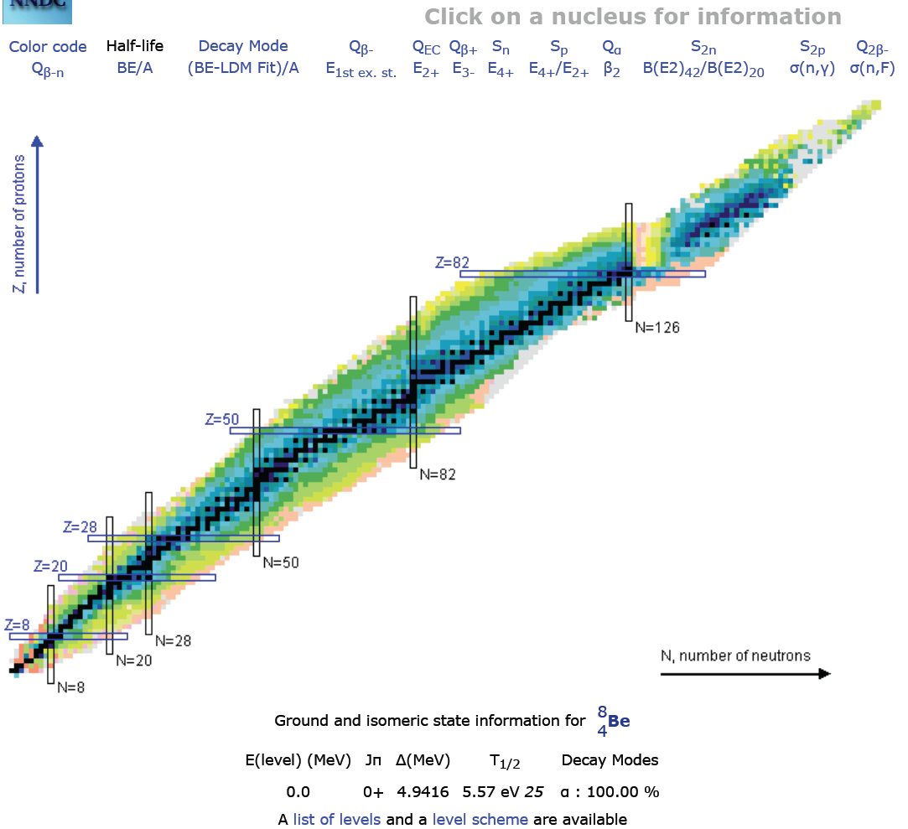
FUTURE TESTS: NUCLEAR PHYSICS
The most direct follow-up tests are to look again at nuclear IPC transitions
The ATOMKI group has new preliminary results with improved detectors for the 18.15 and 17.64 transitions
Other groups may be able to duplicate this in nuclear labs or at particle experiments where ⁸Be transitions are used as a calibration source of high-energy photons
Are other transitions possible? E.g., ¹⁰B (19.3), ¹⁰Be (17.8)

Slide 32
FUTURE TESTS: PARTICLE PHYSICS
There are a host of collider experiments that have been planned for dark photon searches, and may now be sensitive to the 17 MeV range
Generally they look for e⁺e⁻ → γX, posibly followed by X → e⁺e⁻
See “Advances in Dark Matter and Particle Physics 2016,” Messina, Italy, October 2016
1604.07411

Slide 33
CONCLUSIONS
A 5th force is an open and exciting possibility
Dark matter provides new motivation to look for light, weakly-coupled particles that may mediate a 5th force
There is currently a 6.8σ anomaly in ⁸Be* nuclear decays
The data are consistent with new particle explanations, including a protophobic gauge boson that mediates a 5th force and simultaneously explains the muon g-2 anomaly
The result, if true, has spectacular implications for dark matter, force unification, etc.
Further work is needed and there are many interesting upcoming experiments

